Slide 1
My Works Review
Hamed Shaker

Slide 2
Timeline-2011
2011
Jan
Feb
March
April
May
June
July
Aug
Sep
Oct
Nov
Dec
CTF3 TW Buncher
study
Estimation of
Input power
CTF3 SHBs study
First idea to use a backward traveling wave structure for the CLIC SHBs
SHBs design – Comparison between FTW,BTW and SW structures
Finding relation between phase switiching and bandwidth

Slide 3
Powering – CTF3 vs. CLIC DB
15 MW
15 MW
15 MW
Gun
SHB-I
SHB-II
SHB-III
PB
Buncher
Accelerating cavity
PB - II
?
?
?
CTF3 | Field (MV/m) / Normalized | Length (cm) | Voltage (KV) | Input Power
Gun |  |  | 140
SHB - I | 0.128/0.043 | 15.6 | 20 | 40 KW
SHB - II | 0.128/0.043 | 15.6 | 20 | 40 KW
SHB - III | 0.128/0.043 | 15.6 | 20 | 40 KW
PB | 1.375/0.458 | 2 | 27.5 | 100 KW
Buncher | 10.7(ave.) / 3.57 | 53.7 |  | 35 MW
CLIC DB Injector (CDR) | Field (MV/m) | Length (cm) | Voltage (KV) | Input Power (CTF3 rescaling)
Gun |  |  | 140
SHB - I | 0.224 | 15.6 | 35 | 1.1 MW
SHB - II | 0.234 | 15.6 | 36.5 | 1.2 MW
SHB - III | 0.249 | 15.6 | 38.8 | 1.4 MW
PB | 1.2 | 6 | 72 | 686 KW
Buncher | 4.2 | 168.1 |  | 26.7 MW

Slide 4



Fundamental Equation
R : Effective shunt impedance
R’: Effective shunt impedance per length
Q : Unloaded quality factor
P: Source power
V : Gap voltage
W’ : Stored energy per length
L: Structure length
v_{g} : Group velocity
n : Cell numbers
P_{d} : Power disappears on surface.
β : Coupling coefficient
Q_{e} = ωτ : External quality factor
τ : Filling time
P
Standing Wave Structure
Load
…
P/n V/n , τ
P/n V/n , τ
P/n V/n , τ
Travelling Wave Structure
For the known gap voltage and filling time our goal is to increase R/Q to reduce the input power.
P
Load
Load
P
τ=10ns
V=36.5 KV
V , τ
V , τ
Forward Travelling Wave structure
Backward Travelling Wave structure

Slide 5





Pill Box Model – TM₀₁₀ mode
Maximum at 133.5°
Maximum at 77°
g
a

Slide 6
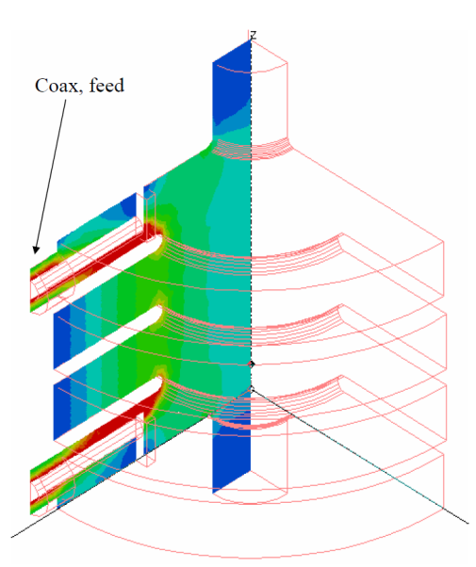
CTF3 case – Forward TW structure
Related to pill-box model and by attention to the disk thickness, the maximum R/Q is at 85° phase advance but 75.5° was chosen for CTF3 SHBs before detuning for beam loading compensation.
Maximum is around 4.8% that was chosen for CTF3 SHBs.
From L. Thorndahl presentation (2) for 4 cells model. Finally 6 cells structure was chosen.
The group velocity is increased by increasing the iris radius. The iris radius is about 10cm for 4.8% group velocity.
It means the minimum input power needs using the fundamental equation is around 1.11MW for CLIC DB injector.
The best thing was done for the CTF3 SHBs with Forward TW structure and it can not be reduced so much then we should look for another structure type.

Slide 7
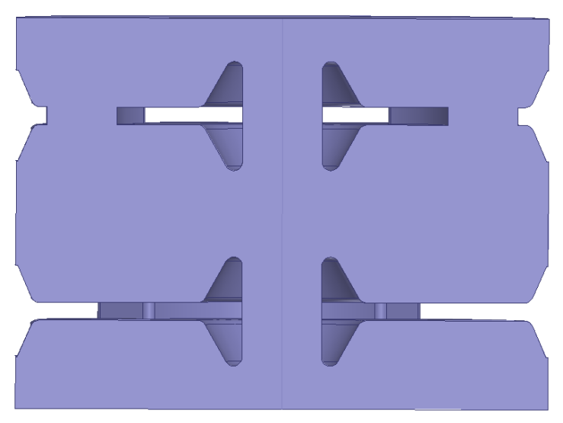
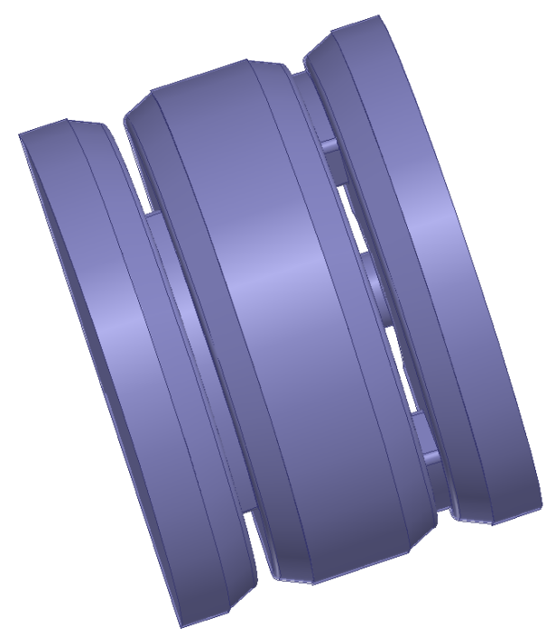

Optimization - II
another HFSS models with a little better R/Q
number of cells | phase(deg) | vg/c(%) | R/Q - cell (Ω) | R'/Q (Ω/m) | R/Q (Ω) | Input power (KW) | r₁(mm) | r₂(mm) | r_{c}(mm) | θ_{c}(deg) | l_{c}(mm) | r_{n}(mm) | t(mm) | g/l | phase velocity/c
3 | 105 | 10.86 | 142.76 | 1337.61 | 428.28 | 100.79 | 169.8 | 186.35 | 164.9 | 75 | 49.04 | 6.13 | 12.26 | 0.45 | 0.61
3 | 120 | 12.2 | 163 | 1336.35 | 489 | 86.81 | 152.9 | 167.8 | 148.49 | 89 | 44.16 | 5.52 | 11.04 | 0.44 | 0.61
4 | 105 | 14.34 | 142.16 | 1331.96 | 568.64 | 75.04 | 159.55 | 175.1 | 154.94 | 87 | 46.08 | 5.76 | 11.52 | 0.46 | 0.61
5 | 105 | 16.14 | 126.89 | 1314.05 | 634.45 | 67.07 | 162.88 | 178.75 | 158.17 | 95 | 47.04 | 5.88 | 11.76 | 0.54 | 0.61
It is possible to reduce the power a little. For example to 75 KW from 80 KW in last slide.
After choosing the structure we can work to optimize cells depend on all parameters affect the design like beam loading, HOMs, minimum wall thickness for cooling water pipe holes and ...
It is the definition of drain time as was introduce by L. Thorndahl et al.(2) . This time is used to find the number of bunches passages during phase switching. For FTW case it is about 8% less (τ’≈9ns) and for BTW case it is about 20 % more than filling time(τ’≈12ns).

Slide 8
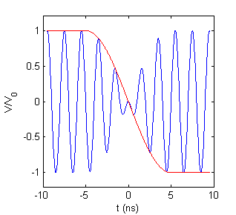

Phase Switching Model and the Power Source Bandwidth
A
B
C
At f₀±f_{s} (499.75 ± 50 MHz) frequencies the amplitude is half of f₀ frequency. By this fact that the bandwidth is measured from the frequencies that power consumption is half , the BW is about 57.7 MHz or 11.5%.
The BW of CTF3 SHBs sources - that are TWT structures -are about 160 MHz (10.7 %) then they have capability of phase switching at less than 4 ns.

Slide 9
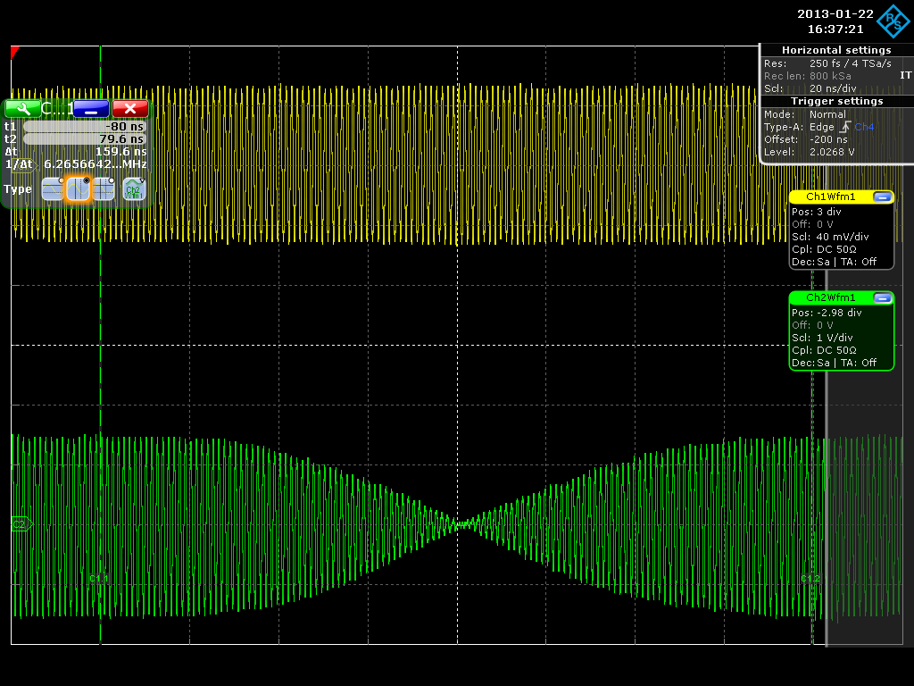
180° Phase flipping test
Done at the end of 2012 that confirmed the analytical result
Borrowed from Steffen
This measurement was done for a 800 MHz IOT with about 6MHz band-width.
About 100ns is needed for switching for 6 MHz band-width then about 60 MHz band-width is needed for 10ns switching as was shown in the previous slide.

Slide 10
Timeline-2012
2012
Jan
Feb
March
April
May
June
July
Aug
Sep
Oct
Nov
Dec
SHBs Design ; Coupler design and comfirmation of phase switching by CST particle studio
Shahin joined to the group – Starting of the beam dynamic study
Finding analytical solution for the beam loading compensation
for a TW structure
Mechanic’s group joined- Luca Dassa and Raphael Leuxe
Mohsen joined to the group for the Pre-Buncher Design

Slide 11
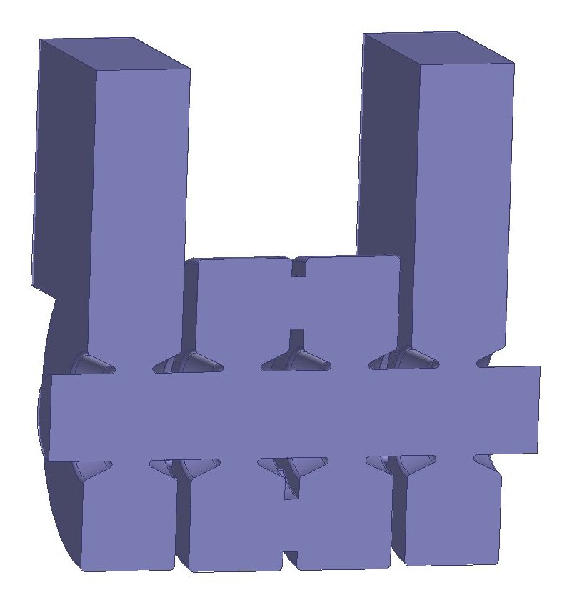
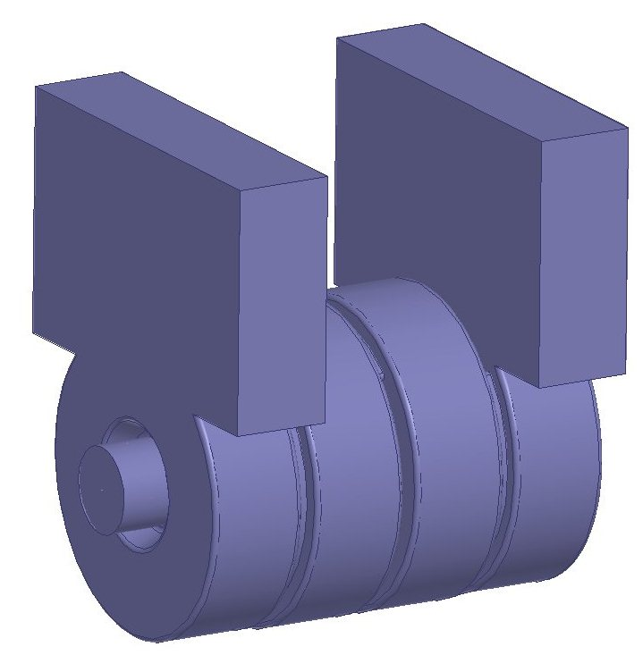
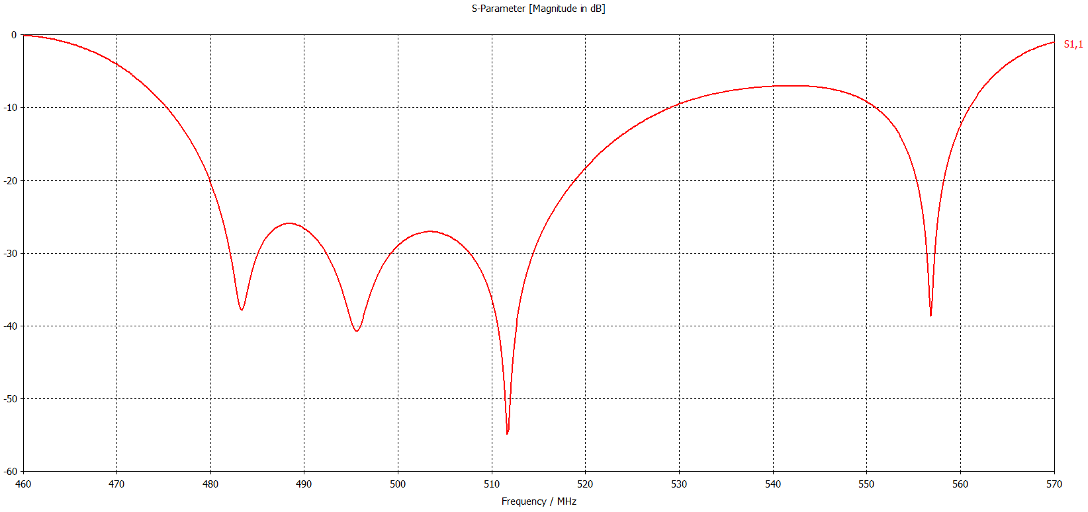
Four cells structure with waveguide couplers
In this design for the first SHB about 73 MW peak power is needed for 10ns filling time and 36.5 KV gap voltage.

Slide 12
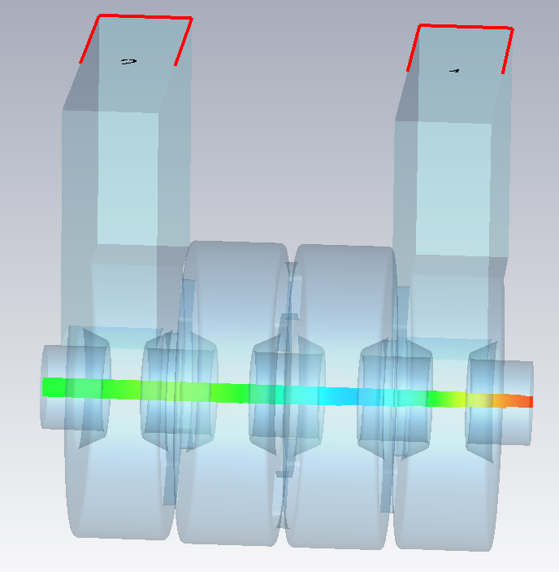
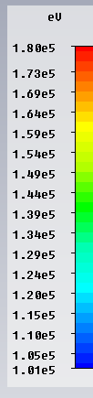
Phase flipping simulation with beam – 10 ns
port 2
port 1
Excitation signal from port 1 with 80 KW peak power.
Beam Entrance
Continues beam with 6A current

Slide 13
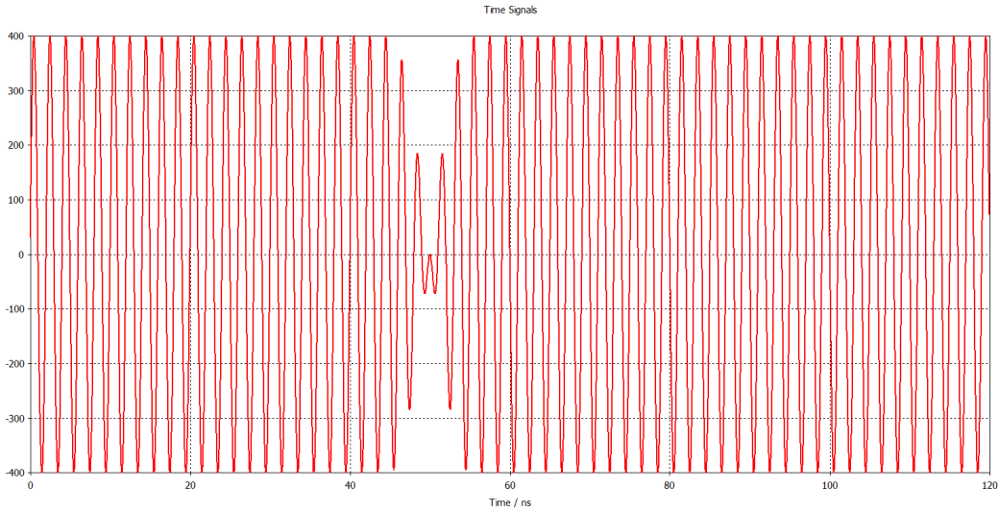
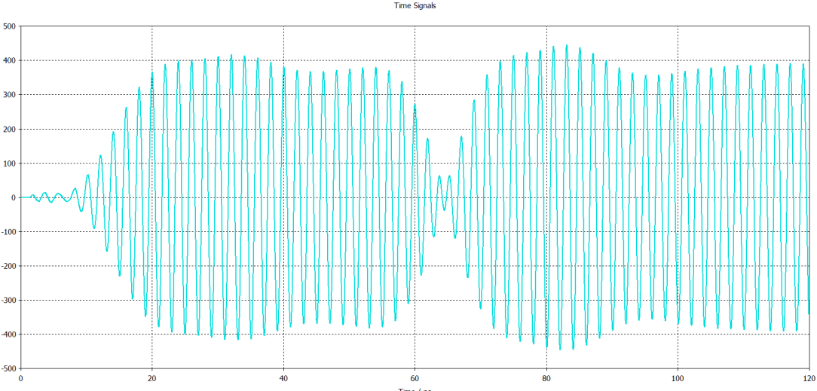
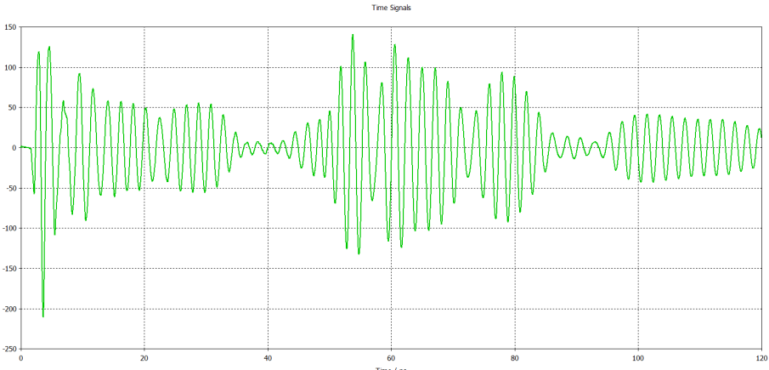
Phase flipping simulation with beam – 10 ns
Excitation signal – port 1
Output signal – port 2
≈ 12 ns
≈ 44 ns
Output signal – port 1

Slide 14
Phase flipping simulation with beam – 10 ns
About 5 bunches will be missed in comparison with about 120 bunches in each sub-pulse.

Slide 15
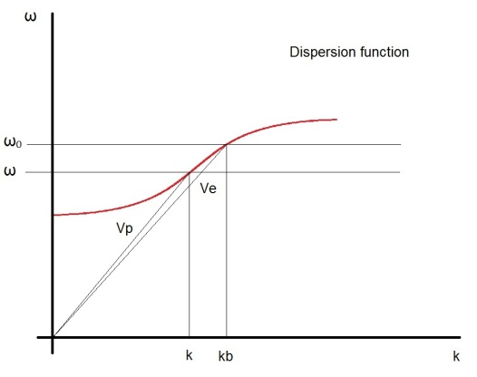
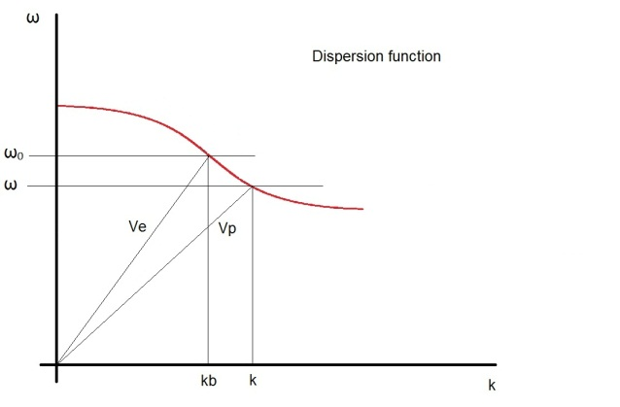
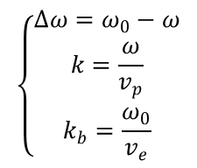
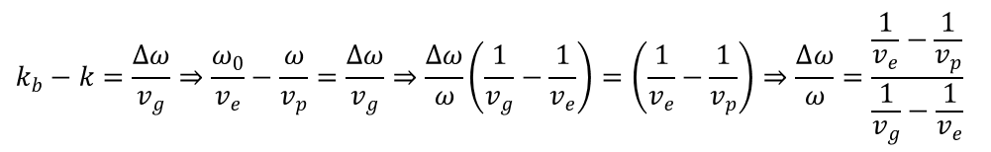
Detuning definition in a TW structure
We can define detuning (Δω) by defining ω₀ as the related angular frequency of bunch velocity (v_{e}) in the TW structure dispersion function. This definition is velocity dependent.
$$k_{b}−k=\frac{∆ω}{v_{g}}⇒\frac{ω_{0}}{v_{e}}−\frac{ω}{v_{p}}=\frac{∆ω}{v_{g}}⇒\frac{∆ω}{ω}\left(\frac{1}{v_{g}}−\frac{1}{v_{e}}\right)=\left(\frac{1}{v_{e}}−\frac{1}{v_{p}}\right)⇒\frac{∆ω}{ω}=\frac{\frac{1}{v_{e}}−\frac{1}{v_{p}}}{\frac{1}{v_{g}}−\frac{1}{v_{e}}}$$
$$\left\{\begin{aligned}∆ω=ω_{0}−ω \\ k=\frac{ω}{v_{p}} \\ k_{b}=\frac{ω_{0}}{v_{e}}\end{aligned}\right.$$
Usually a bunch should sees a fixed amplitude and phase in a TW structure then phase velocity(vp) and bunch velocity(ve) should be equal but as we will see this difference help us to compensate beam loading.

Slide 16
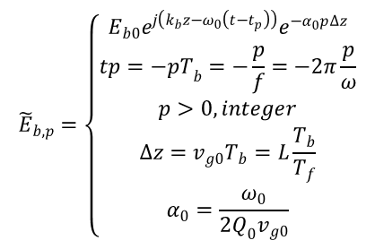
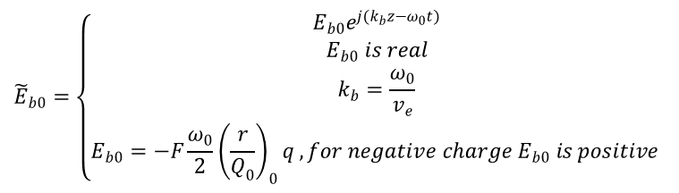
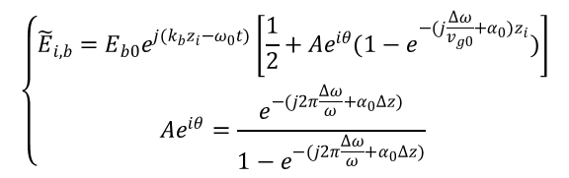
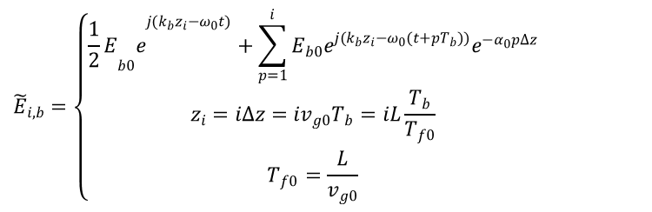
Fundamental mode beam-induced field
$${\tilde{E}}_{b0}=\left\{\begin{aligned}E_{b0}e^{j(k_{b}z−ω_{0}t)} \\ E_{b0} is real \\ k_{b}=\frac{ω_{0}}{v_{e}} \\ E_{b0}=−F\frac{ω_{0}}{2}{\left(\frac{r}{Q_{0}}\right)}_{0}q , for negative charge E_{b0} is positive \end{aligned}\right.$$
L
0
1
2
i
n-1
z
Δz
E_{b0} shows the fundamental mode induced field of a single bunch passages thorough the structure in each point.
We can divide the structure length to n sections that each one is equal to energy transferring length (Δz) between two bunches passage.
$${\tilde{E}}_{b,p}=\left\{\begin{aligned}E_{b0}e^{j\left(k_{b}z−ω_{0}\left(t−t_{p}\right)\right)}e^{−α_{0}p∆z} \\ tp=−{pT}_{b}=−\frac{p}{f}=−2π\frac{p}{ω} \\ p>0,integer \\ ∆z=v_{g0}T_{b}=L\frac{T_{b}}{T_{f}} \\ α_{0}=\frac{ω_{0}}{2Q_{0}v_{g0}}\end{aligned}\right.$$
E_{b,p} represents the previous bunches fundamental mode induced fields and E_{i,b} represents the total fundamental mode electric field seen by the reference bunch from its induced field and previous bunches induced fields.
$${\tilde{E}}_{i,b}=\left\{\begin{aligned}{{\frac{1}{2}E}_{b0}e}^{j(k_{b}z_{i}−ω_{0}t)}+\sum_{p=1}^{i}{{E_{b0}e}^{j(k_{b}z_{i}−ω_{0}(t+pT_{b}))}e^{−α_{0}p∆z}} \\ z_{i}=i∆z=iv_{g0}T_{b}=iL\frac{T_{b}}{T_{f0}} \\ T_{f0}=\frac{L}{v_{g0}}\end{aligned}\right.$$
$$\left\{\begin{aligned}{\tilde{E}}_{i,b}={E_{b0}e}^{j(k_{b}z_{i}−ω_{0}t)}\left[\frac{1}{2}+Ae^{iθ}(1−e^{−(j\frac{∆ω}{v_{g0}}+α_{0})z_{i}})\right] \\ Ae^{iθ}=\frac{e^{−(j2π\frac{∆ω}{ω}+α_{0}∆z)}}{1−e^{−(j2π\frac{∆ω}{ω}+α_{0}∆z)}}\end{aligned}\right.$$

Slide 17
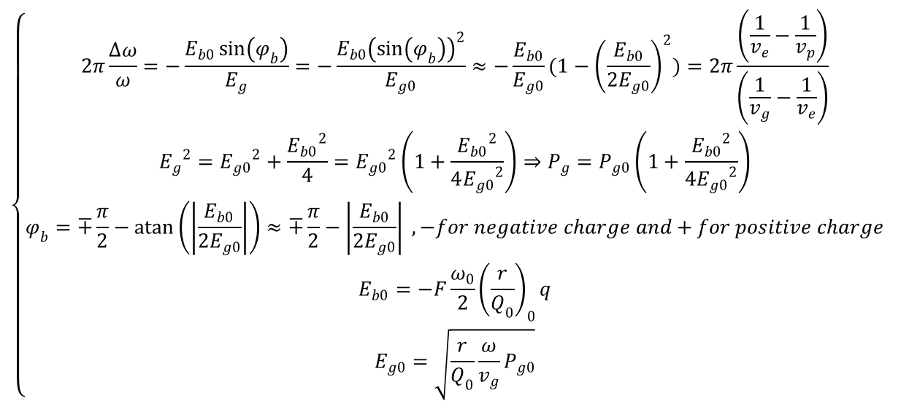
Bunching phase
$$\left\{\begin{aligned}2π\frac{∆ω}{ω}=−\frac{E_{b0}\sin\left(φ_{b}\right)}{E_{g}}=−\frac{E_{b0}{\left(\sin\left(φ_{b}\right)\right)}^{2}}{E_{g0}}≈−\frac{E_{b0}}{E_{g0}}(1−{\left(\frac{E_{b0}}{{2E}_{g0}}\right)}^{2})=2π\frac{\left(\frac{1}{v_{e}}−\frac{1}{v_{p}}\right)}{\left(\frac{1}{v_{g}}−\frac{1}{v_{e}}\right)} \\ {E_{g}}^{2}={E_{g0}}^{2}+\frac{{E_{b0}}^{2}}{4}={E_{g0}}^{2}\left(1+\frac{{E_{b0}}^{2}}{4{E_{g0}}^{2}}\right)⇒P_{g}=P_{g0}\left(1+\frac{{E_{b0}}^{2}}{4{E_{g0}}^{2}}\right) \\ φ_{b}=∓\frac{π}{2}−\operatorname{atan}\left(\left|\frac{E_{b0}}{2E_{g0}}\right|\right)≈∓\frac{π}{2}−\left|\frac{E_{b0}}{2E_{g0}}\right| , −for negative charge and+for positive charge \\ E_{b0}=−F\frac{ω_{0}}{2}{\left(\frac{r}{Q_{0}}\right)}_{0}q \\ E_{g0}=\sqrt{\frac{r}{Q_{0}}\frac{ω}{v_{g}}P_{g0}}\end{aligned}\right.$$
The bunching phase is the best phase for bunching mechanism uses in prebunchers and our sub harmonic bunchers.
As you can see Δω>0. For backward TW it means |v_{e}|>|v_{p}| and for forward TW if vg>ve it means |v_{e}|<|v_{p}|.

Slide 18
Timeline-2013
2013
Jan
Feb
March
April
May
June
July
Aug
Sep
Oct
Nov
Dec
SHB Design; The design of first SHB finished
Second and third SHBs are waiting for the finalized parameters
from the beam dynamic study
Thermal and Structural analysis was done
by the mechanic’s group
Progress in the mechanic’s group
Preliminary TW Buncher Design
Analytical method for the efficinecy for the accelerating structures

Slide 19
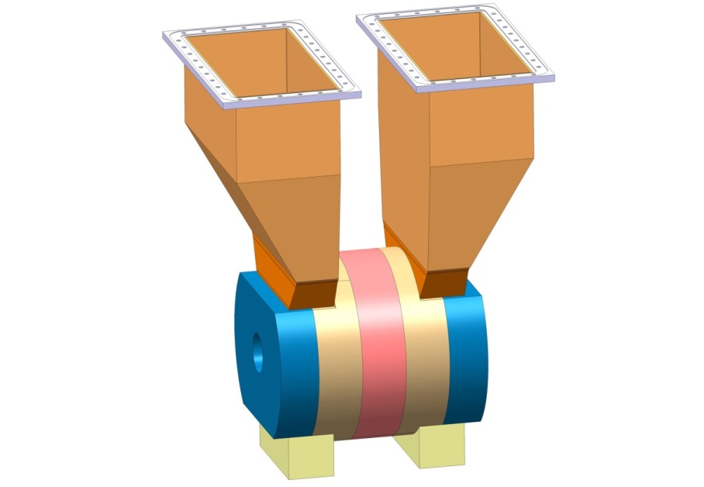
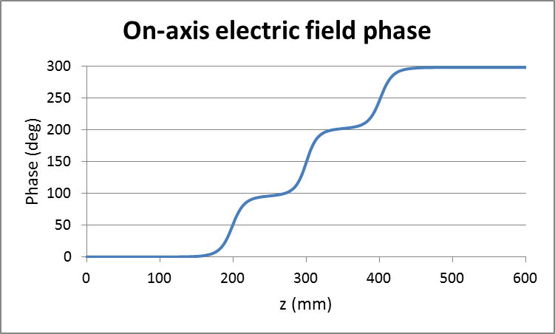
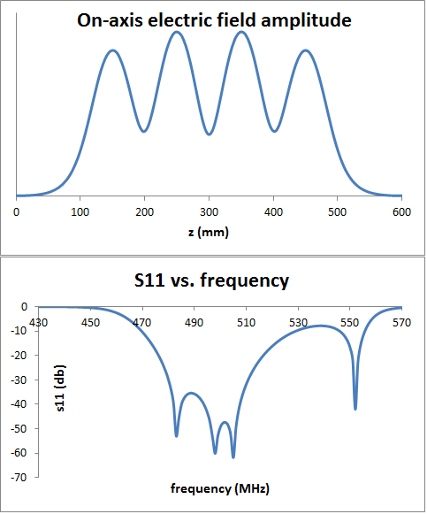
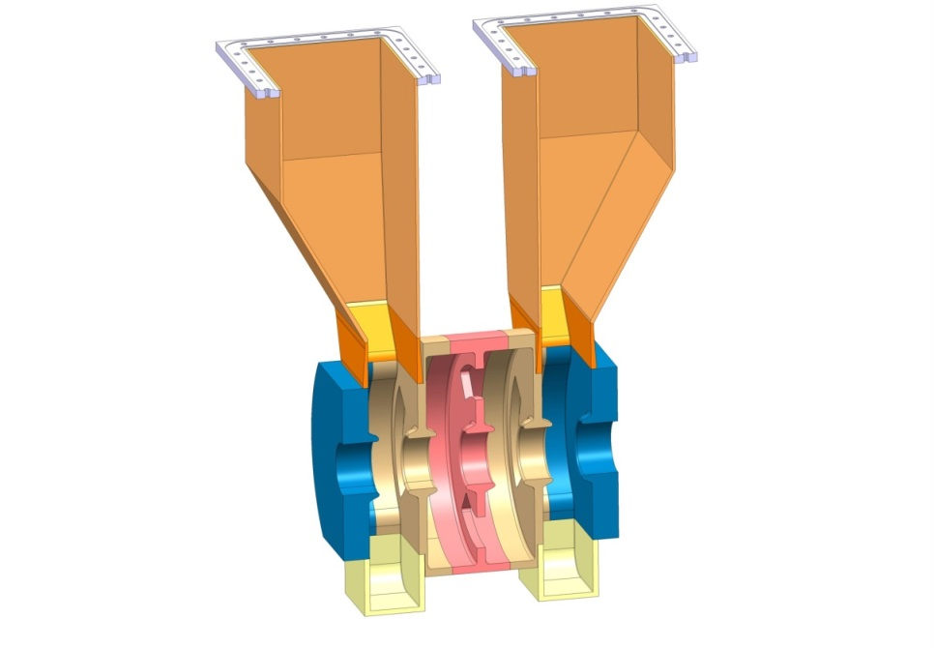
First SHB

Slide 20
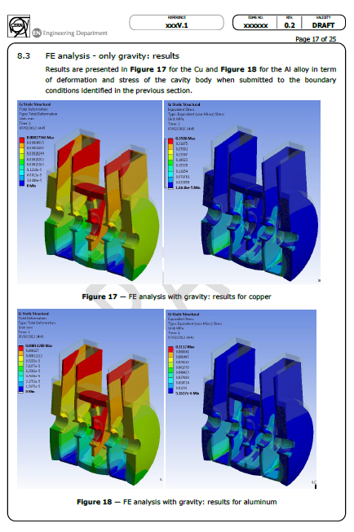
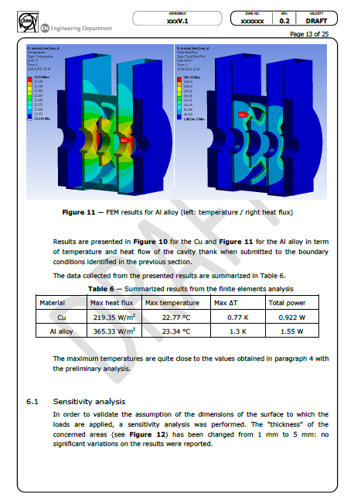

Slide 21
Results from Beam Dynamics study done by Shahin

Slide 22
Normalized field
Power consumption/cell=
Energy gain/cell * Current (5A)
Normalized field= sqrt(P0/P)*non normalized field. P0=19MW

Slide 23
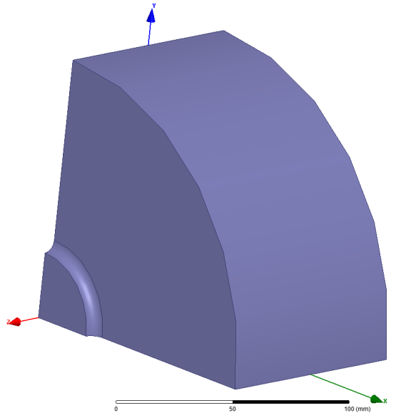
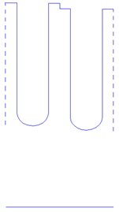
Cells design
dt=10mm
5 cells was designed and the rest was interpolated
b_{i}
a_{i}
b_{i+1}
a_{i+1}
cell no. | beta | norm_field | vg/c(percent) | R/Q (Ohm) | a0 | a-1 | a1 | a-2 | Q | E_field | R(Mohm) | l(cm) | r(Mohm/m) | a(cm) | b(cm) | r/Q(Ohm) | alfa | dP/P(%)
1 | 0.6 | 1.70 | 6.7 | 28.88 | 0.8789 | 0.1298 | 0.00637 | 0.01123 | 16610.44 | 1.69 | 0.47971 | 5.998849 | 7.99669304 | 53 | 129.73 | 481.42572 | 0.009411 | -0.11285
5 | 0.68 | 1.90 | 7.81 | 48.31 | 0.857 | 0.15 | 0.00535 | 0.00876 | 18466.8 | 1.9 | 0.892131 | 6.798695 | 13.12209328 | 52.7 | 128.25 | 710.57754 | 0.007262 | -0.0987
9 | 0.83 | 2.45 | 8.2 | 102.45 | 0.818 | 0.195 | 0.00967 | 0.00378 | 21554.42 | 2.45 | 2.20825 | 8.298407 | 26.61053228 | 49.8 | 124.77 | 1234.5743 | 0.005926 | -0.0983
13 | 0.94 | 3.80 | 4.67 | 158.55 | 0.782 | 0.256 | 0.02466 | 0.014265 | 23409.13 | 3.79 | 3.711518 | 9.398196 | 39.49180796 | 40.9 | 120.24 | 1687.0259 | 0.009581 | -0.17993
17 | 1.03 | 7.33 | 1.48 | 205.23 | 0.767 | 0.328 | 0.0552 | 0.0397 | 24687.44 | 7.31 | 5.066603 | 10.29802 | 49.19976497 | 29.55 | 116.9 | 1992.9067 | 0.028666 | -0.58868
5 cells was designed and the rest was interpolated

Slide 24
Cells design-2

Slide 25
Cells design-3
cell no | beta | l | energy gain(KV) | power consumption | power left | power loss on surface | power left-total | E | norm_E | norm_E_tot | r/Q | Eb0 | F | Eb0/E | dw/w | df(MHz) | vg/c(%) | dv | vp
1 | 0.601335 | 6.0122 | -25.3 | -0.1265 | 19.1265 | -0.021584594 | 19.10491541 | 1.71 | 1.700449 | 1.701408993 | 481.4257 | 6049.769 | 0.8 | 0.003546 | 0.000547 | 0.546649 | 6.7 | 0.003138 | 0.623138
2 | 0.609327 | 6.0921 | 32.2 | 0.161 | 18.9655 | -0.020731838 | 18.94476816 | 1.72 | 1.721964 | 1.722906014 | 538.7137 | 6769.67 | 0.8 | 0.003935 | 0.000596 | 0.595679 | 6.9775 | 0.003283 | 0.623283
3 | 0.62505 | 6.2493 | 58.4 | 0.292 | 18.6735 | -0.01975191 | 18.65374809 | 1.75 | 1.765233 | 1.76616712 | 596.0016 | 7489.571 | 0.8 | 0.00428 | 0.000576 | 0.575608 | 7.255 | 0.003051 | 0.623051
4 | 0.647934 | 6.4781 | 55.5 | 0.2775 | 18.396 | -0.01880747 | 18.37719253 | 1.80 | 1.825449 | 1.826383226 | 653.2896 | 8209.472 | 0.8 | 0.00457 | 0.000639 | 0.639018 | 7.5325 | 0.003263 | 0.623263
5 | 0.67707 | 6.7694 | 41.1 | 0.2055 | 18.1905 | -0.017953731 | 18.17254627 | 1.86 | 1.902162 | 1.903101505 | 710.5775 | 8929.373 | 0.8 | 0.004798 | 0.000722 | 0.721439 | 7.81 | 0.003553 | 0.623553
6 | 0.711156 | 7.1102 | 24.1 | 0.1205 | 18.07 | -0.017816997 | 18.052183 | 1.95 | 1.997397 | 1.998382392 | 841.5767 | 10575.56 | 0.8 | 0.005429 | 0.000851 | 0.850478 | 7.9075 | 0.004136 | 0.624136
7 | 0.748514 | 7.4837 | 11.8 | 0.059 | 18.011 | -0.017741079 | 17.99325892 | 2.06 | 2.115392 | 2.116434191 | 972.5759 | 12221.74 | 0.8 | 0.005934 | 0.000942 | 0.941189 | 8.005 | 0.004522 | 0.624522
8 | 0.787171 | 7.8702 | 11 | 0.055 | 17.956 | -0.017669213 | 17.93833079 | 2.20 | 2.262641 | 2.26375539 | 1103.575 | 13867.92 | 0.8 | 0.006305 | 0.001001 | 1.000904 | 8.1025 | 0.004751 | 0.624751
9 | 0.825038 | 8.2488 | 29 | 0.145 | 17.811 | -0.017508982 | 17.79349102 | 2.37 | 2.449584 | 2.450789282 | 1234.574 | 15514.1 | 0.8 | 0.006541 | 0.00103 | 1.029072 | 8.2 | 0.004827 | 0.624827
10 | 0.860205 | 8.6004 | 60.3 | 0.3015 | 17.5095 | -0.020785464 | 17.48871454 | 2.58 | 2.686319 | 2.687914917 | 1347.687 | 16935.52 | 0.8 | 0.006567 | 0.001006 | 1.00533 | 7.3175 | 0.005284 | 0.625284
11 | 0.891231 | 8.9106 | 96.1 | 0.4805 | 17.029 | -0.023689886 | 17.00531011 | 2.82 | 2.982745 | 2.984822132 | 1460.8 | 18356.94 | 0.8 | 0.006501 | 0.000956 | 0.955722 | 6.435 | 0.005712 | 0.625712
12 | 0.917316 | 9.1714 | 131.9 | 0.6595 | 16.3695 | -0.026112672 | 16.34338733 | 3.11 | 3.348745 | 3.351418728 | 1573.913 | 19778.36 | 0.8 | 0.006363 | 0.000898 | 0.897347 | 5.5525 | 0.006215 | 0.626215
13 | 0.93896 | 9.3878 | 170.1 | 0.8505 | 15.519 | -0.027922653 | 15.49107735 | 3.43 | 3.799554 | 3.802976424 | 1687.026 | 21199.77 | 0.8 | 0.006174 | 0.000835 | 0.834234 | 4.67 | 0.00687 | 0.62687
14 | 0.959834 | 9.5965 | 211.7 | 1.0585 | 14.4605 | -0.040794975 | 14.41970502 | 3.80 | 4.358101 | 4.364261097 | 1763.496 | 22160.73 | 0.8 | 0.005829 | 0.000756 | 0.755167 | 3.8725 | 0.0075 | 0.6275
15 | 0.981168 | 9.8098 | 261.2 | 1.306 | 13.1545 | -0.050552842 | 13.10394716 | 4.22 | 5.065674 | 5.075435498 | 1839.966 | 23121.68 | 0.8 | 0.005486 | 0.000677 | 0.676461 | 3.075 | 0.008461 | 0.628461
16 | 1.002972 | 10.0278 | 324.8 | 1.624 | 11.5305 | -0.056094536 | 11.47440546 | 4.68 | 6.00179 | 6.016442434 | 1916.437 | 24082.63 | 0.8 | 0.005151 | 0.000591 | 0.590903 | 2.2775 | 0.009978 | 0.629978
17 | 1.025267 | 10.2507 | 403.9 | 2.0195 | 9.511 | -0.055988965 | 9.455011035 | 5.19 | 7.330293 | 7.351964736 | 1992.907 | 25043.58 | 0.8 | 0.004829 | 0.0005 | 0.499471 | 1.48 | 0.012979 | 0.632979
18 | 1.048061 | 10.4786 | 501.4 | 2.507 | 7.004 | -0.048388078 | 6.955611922 | 5.75 | 9.470965 | 9.503851283 | 2069.377 | 26004.54 | 0.8 | 0.004522 | 0.000399 | 0.398959 | 0.6825 | 0.022482 | 0.642482
Total power loss on the surface is about 0.52 MW (≈ 2.7%)
By interpolation

Slide 26
optimisations
Borrowed from Rolf
η_{RF} ≥ 97.5 %
|t_{fill} – 245 ns| ≤ 5 ns
P_{in} = 15 MW
Beam dynamic (Avni Aksoy):
RB = 49 mm,
N = 19 cells

Slide 27
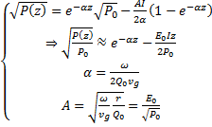


Accelerating structure efficiency
It shows that for higher efficiency we need increase “r*Q0*vg”. For the electric coupling when you increase r, the vg will decrease. But with the magnetic coupling we can increase both together. Alexej reached the same equation and his structure efficiency is about 1% more than Rolf’s structure.
For constant-impedance structure

Slide 28
Full beam loading in Constant impedance TWS
Borrowed from Alexej
Efficiency in steady-state:
Full beam loading condition:
In order to maximum efficiency means maximum relative beam loading parameter at the full beam loading condition: => Maximum R’*vg*Q0

Slide 29
Future plans
Construction of the first SHB
Finishing the beam dynamic study
Design and construction of the second and third SHBs
Design and construction of the TW Buncher
Finishing the design of accelerating structures like HOM dampers and a prototype construction.
Prebuncher : Shahin showed the prebuncher decreases the satellite population.
RF photocathode gun : Next subject by Mohsen

Slide 30
RF Source for SHBs
L3 Electronics: IOT
PSI: Solid-state amplifier
India : Solid-state amplifier

