Slide 1
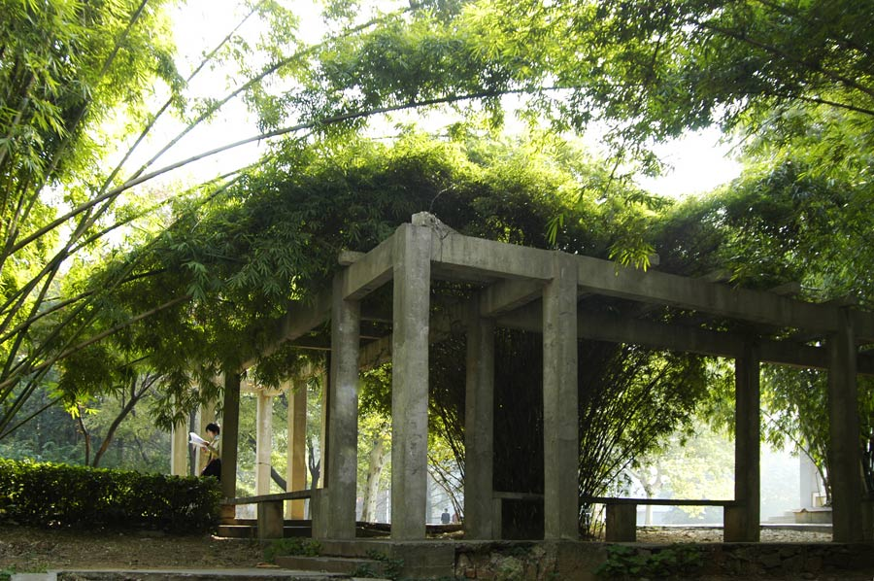

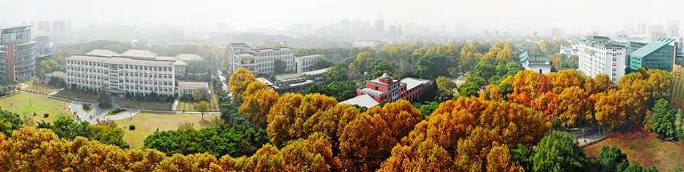
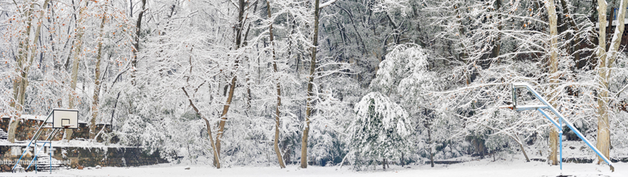
Heavy Ion Physics
at CCNU
Spring
Summer
Autumn
CAI, Xu
Winter

Slide 2
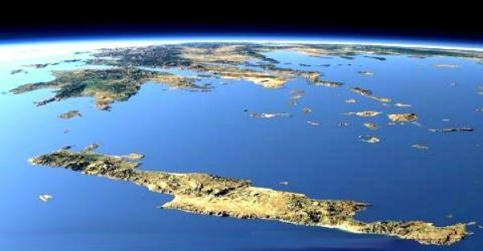
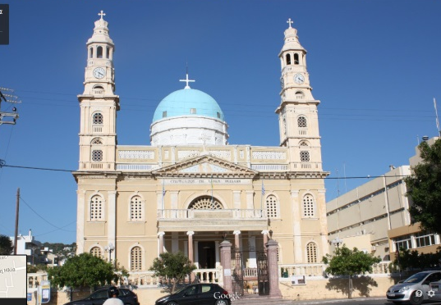
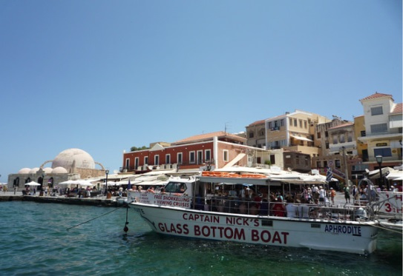
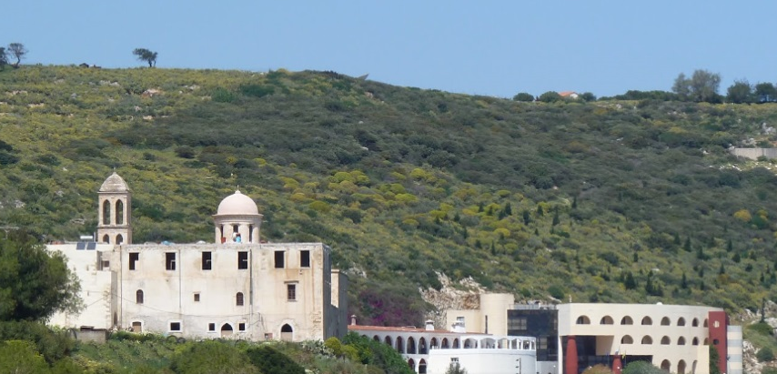
Kolymbari Beach
科林巴里 ΚΟΛΥΜΒΆΡΙ
Chania
干尼亚 Χανιά

Slide 3
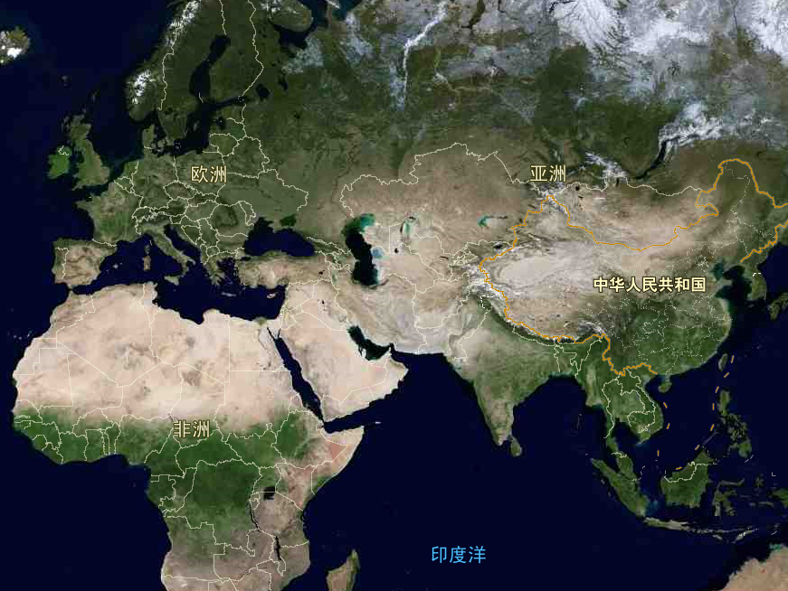
Crete, Greece
CCNU
Wuhan, China

Slide 4
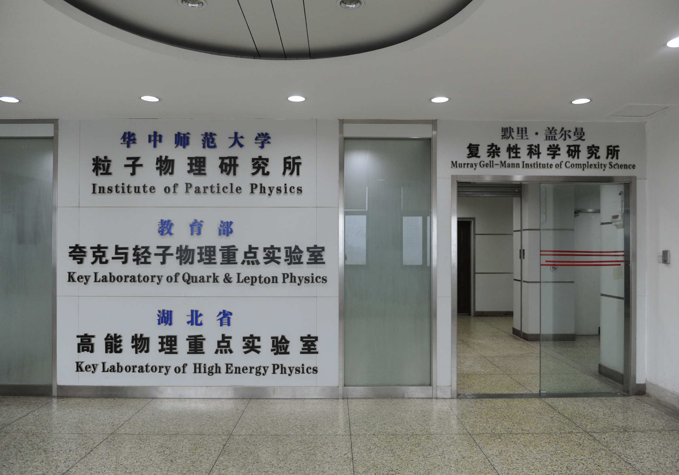
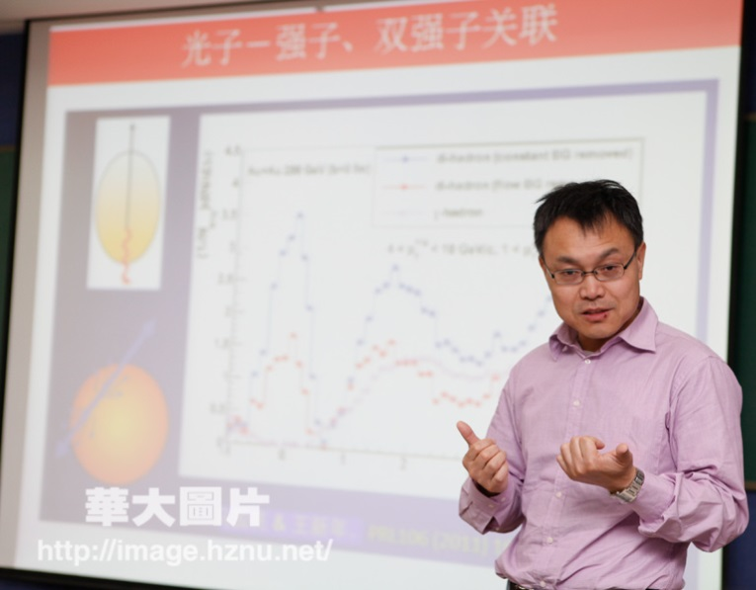
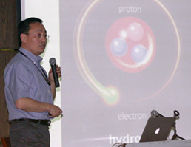


WANG, Xin-nian
Director of IOPP
XU, Nu
Director of Key Lab
LIU, Feng
Deputy Director of IOPP
ZHOU, Dai-cui
Deputy Director of Key Lab

Slide 5

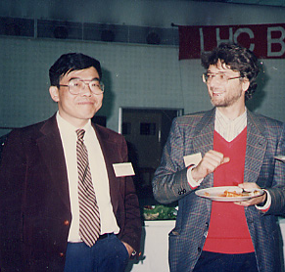
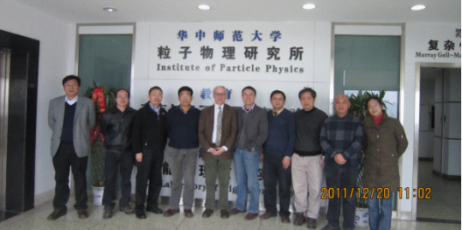
杨亚东，张本威，许怒，蔡勖，James Symons，王新年，王恩科，刘峰，周代翠，刘复明
2011年12月17日-20日,美国劳伦斯-伯克利国家实验室（Lawrence Berkeley National Laboratory, LBNL）副主任、核科学部主任詹姆斯•西蒙斯(James Symons)访问我校物理科学与技术学院（教育部夸克与轻子物理重点实验室）。

Slide 6
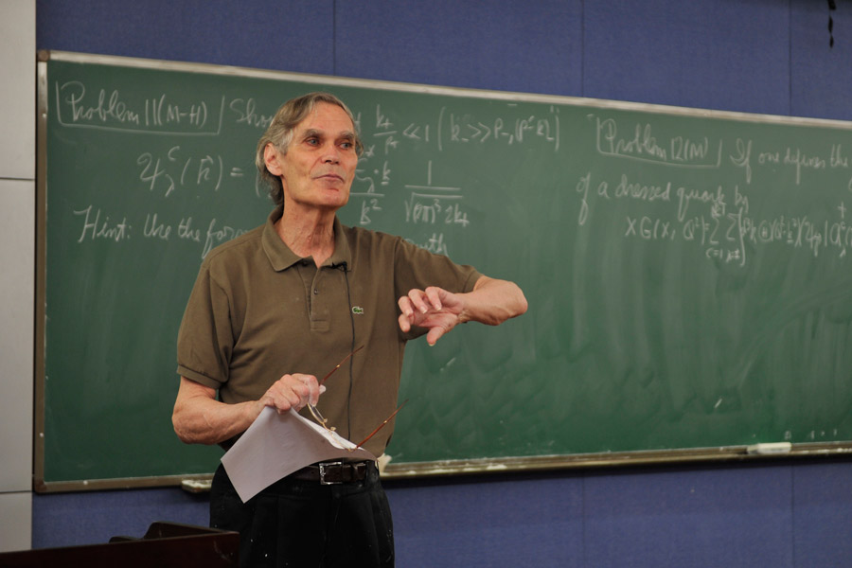
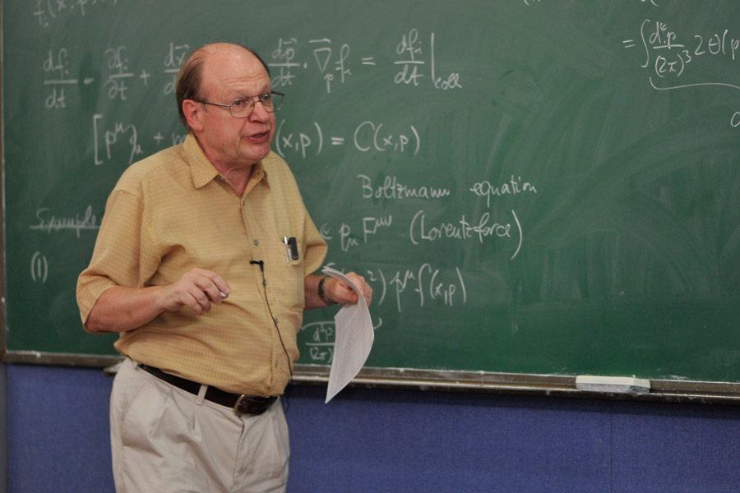
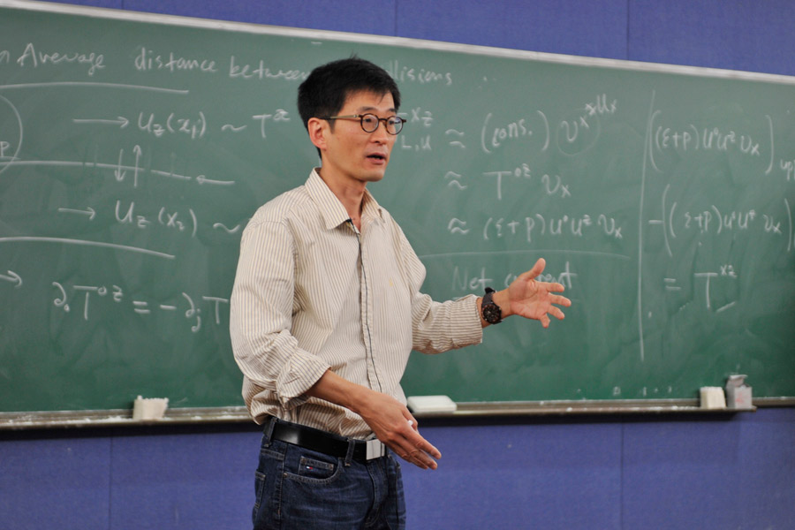
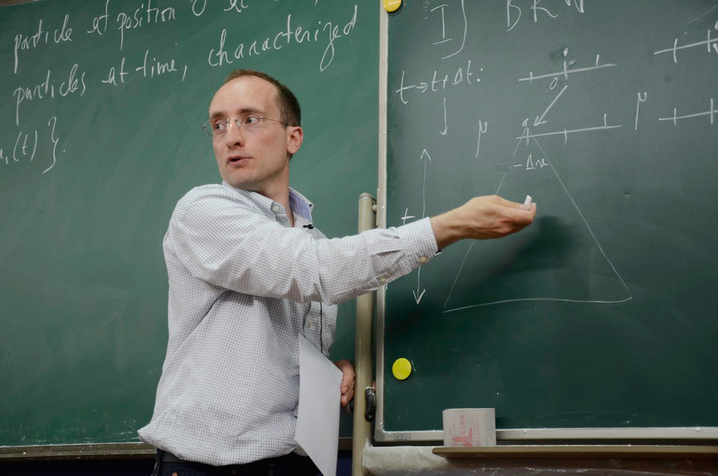
2014 Summer School on QCD at CCNU
2014年华大QCD讲习班
Al Mueller
Columbia University
Ulrich Heinz
The Ohio State University
Sangyong Jeon
McGill University
Stephane Munier
École Polytechnique

Slide 7
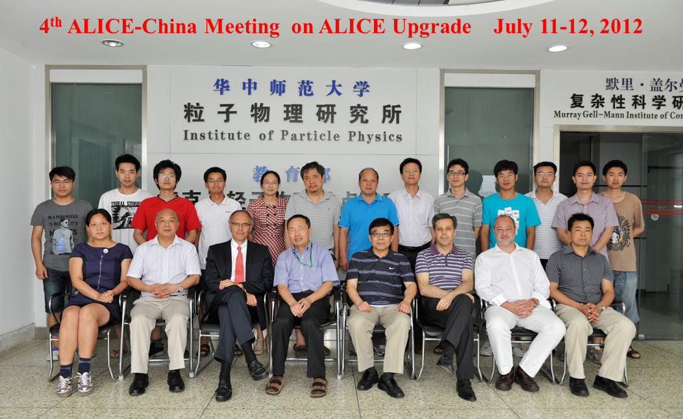
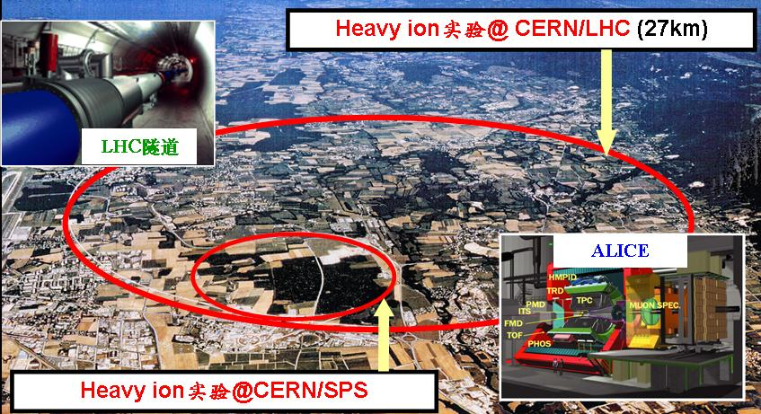
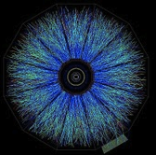
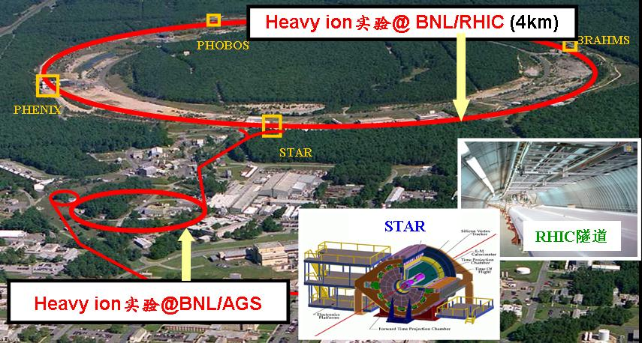
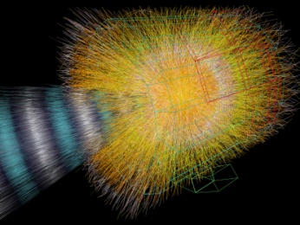
欧洲CERN/ALICE国际合作组发言人
Paolo Giubellino 保罗•朱比里诺
美国BNL/STAR国际合作组原发言人
Nu Xu 许 怒

Slide 8


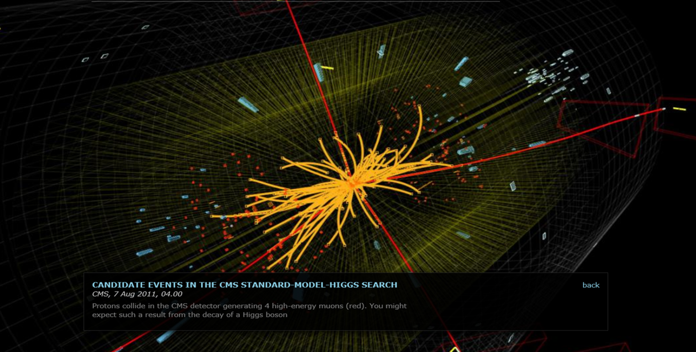

60 years of CERN

Slide 9

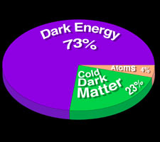
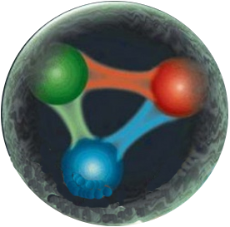
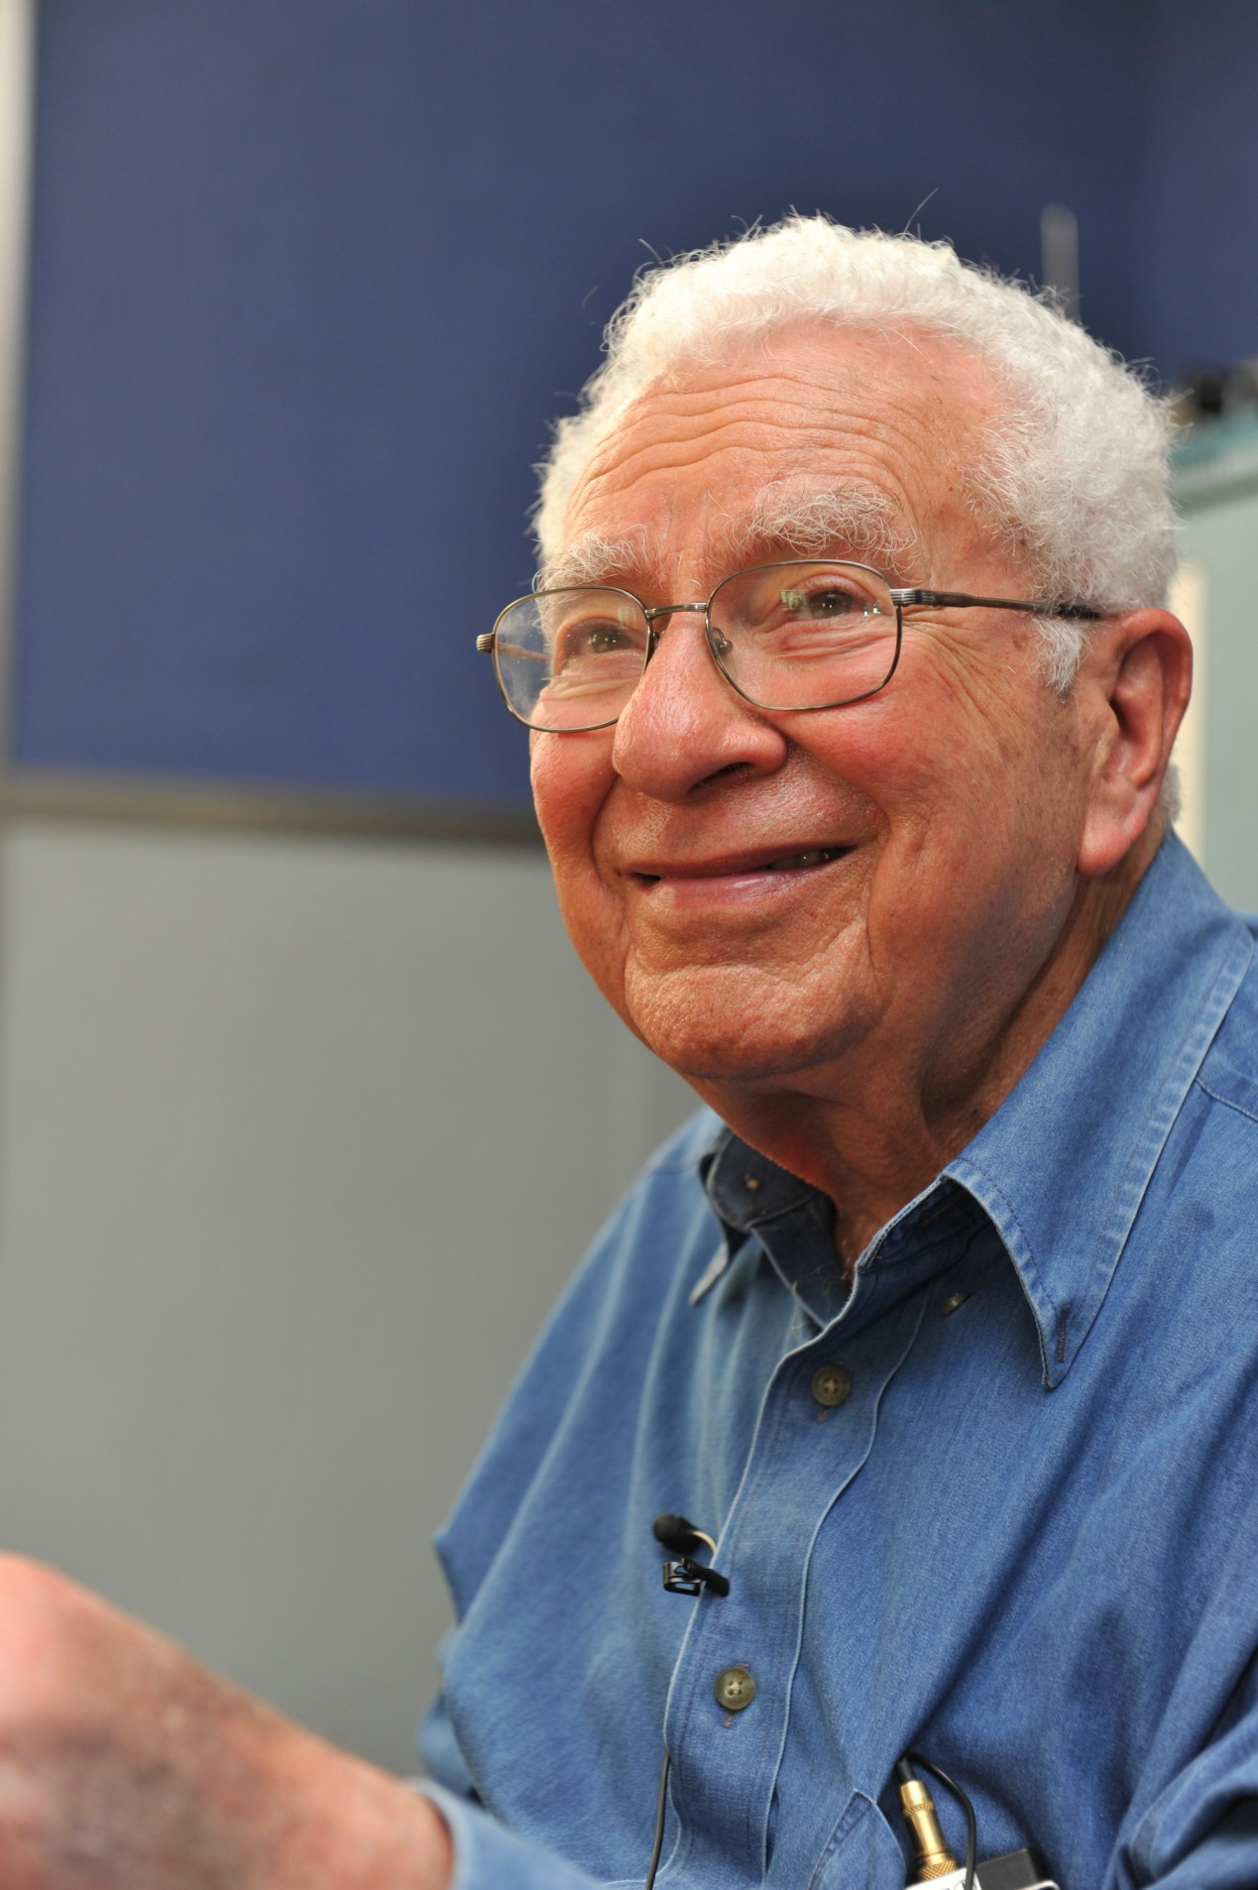

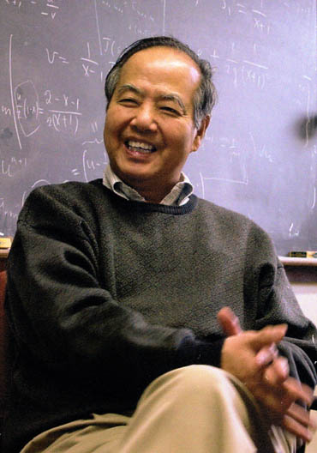
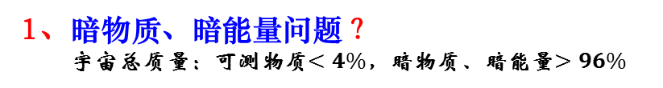

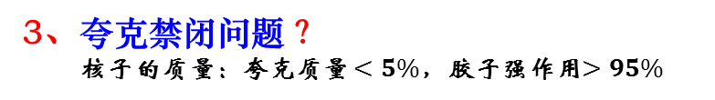
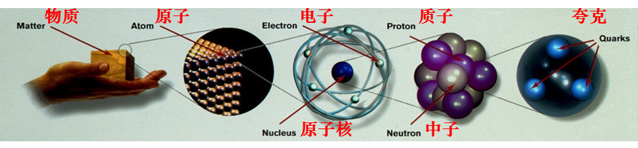
基础性研究、物质深层次结构物理
创立“夸克时代” 的科学大师
盖尔曼（M. Gell-Mann）
1964年提出夸克概念
夸克
胶子
50 years ago
on quark concept
李政道（T. D. Lee ）
1974年提出夸克物质概念
Dark matter, Dark energy
Higgs
Quark confinement
40 years ago
on quark matter
1984年开始实验寻找夸克物质
30 years ago
for searching quark matter
夸克物质

Slide 10
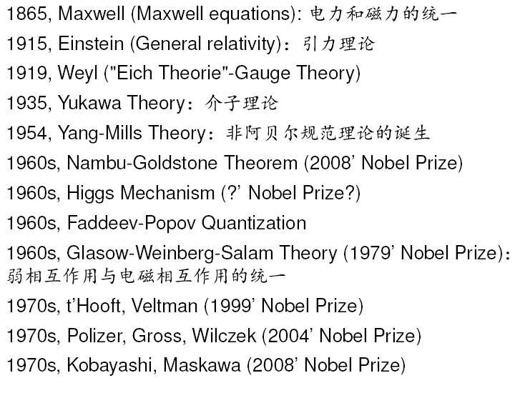
History of gauge theory

Slide 11

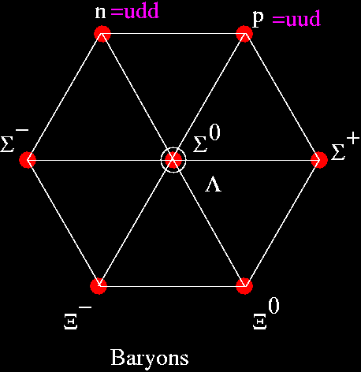
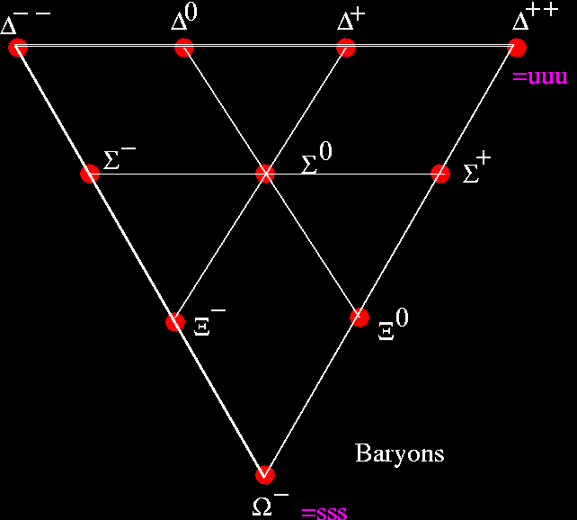
The Eightfold Way
by Murray Gell-Mann
盖尔曼的研究，发现强子有“周期律”，即“八重法”的点阵模型。
八重法预示：强子有更深层次的结构。
盖尔曼发现：强子由1/3或2/3基本电荷的三种带电基础粒子构成。
他给这三种基础粒子取名“夸克 quark ”。
夸克被永久地禁闭在强子内部（夸克禁闭 confinement）。
Quark and its confinement

Slide 12
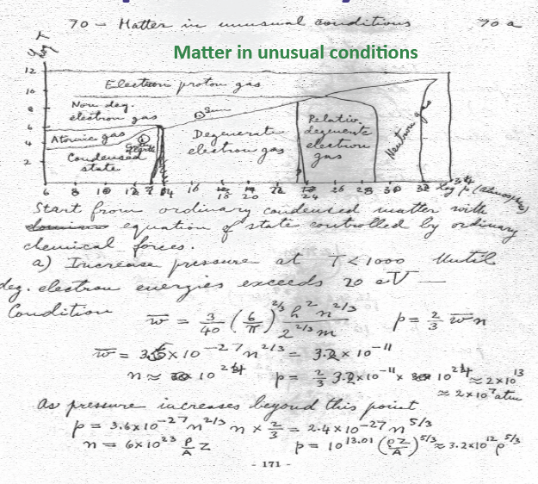

History of QGP
E. Fermi (1953)
Notes on Thermodynamics and Statistics
Hagedorn (1965)
TD Lee（李政道）-Wick matter (1974)
Collins-Perry/Cabibbo-Parisi (1975)
Shuryak (1978)
Quark-Gluon Plasma (QGP)

Slide 13
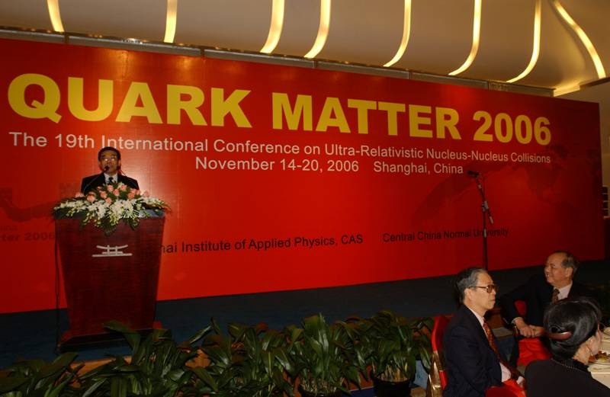
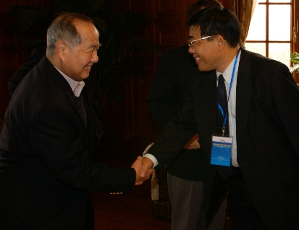
大会联合主席蔡勖主持
《庆贺李政道80寿诞暨夸克物质2006国际大会招待会》
李政道：完美的液态sQGP
宇宙兮，
倚胶子八重以建规范；
人类兮，
取夸克六种欲揭帷幔。
汤浓浓其混沌兮，
斡维焉系；
能闇闇其朦胧兮，
猝灭焉急。
遂古之初，上下未形 ；
天何所沓，列星安行。
中文译者：蔡勖
《物理》，2009年38卷1期，18页
“在大型强子对撞机上探测物质本源的大型重离子实验”
T.D. Lee: PERFECT LIQUID - sQGP
Eight Gluons for the Universe,
To set her gauge.
Six Quarks for the Humankind,
Searching for the truth.
One Plasma with superstrength,
One Plasma to bind them.
Through Dark Energy,
One Plasma to quench them.
And from the Big Bang,
One Plasma to shape them all.
摘自大会名誉主席李政道
在夸克物质2006国际大会上的开幕式报告
8 years
on sQGP concept

Slide 14
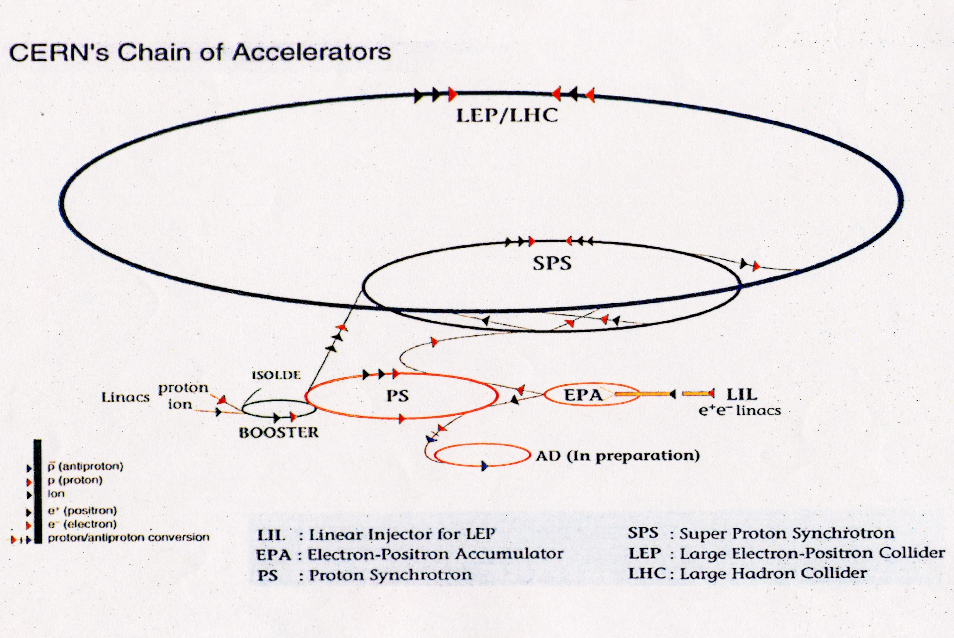
SPS and LHC at CERN

Slide 15

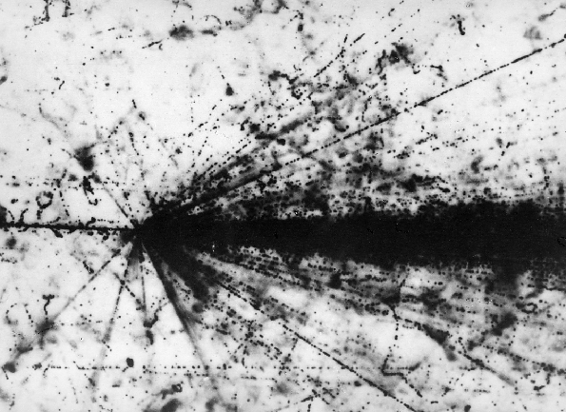
CCNU China
began the heavy-ion experiments
with SPS/CERN in 1984
In 1986 CERN began to accelerate heavy ions in the Super Proton Synchrotron (SPS) to study the possibility on the quark gluon-plasma

Slide 16
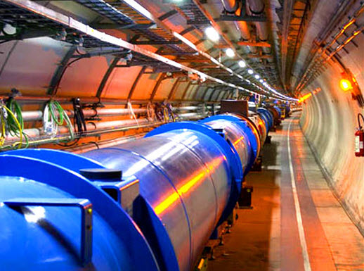

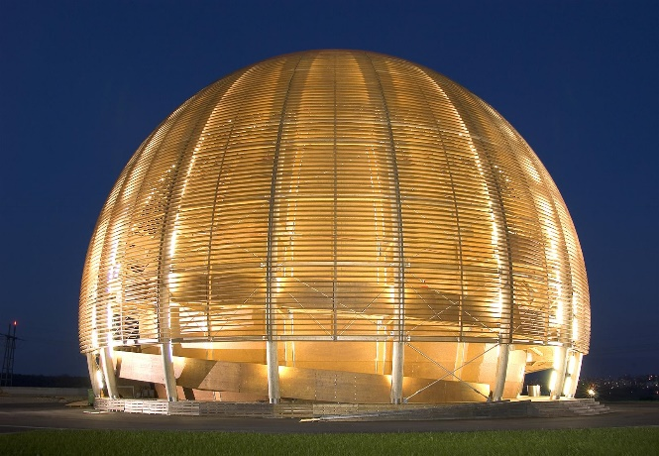
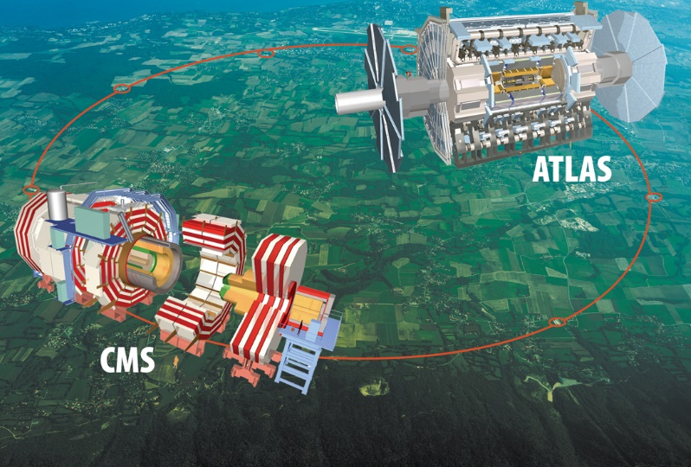
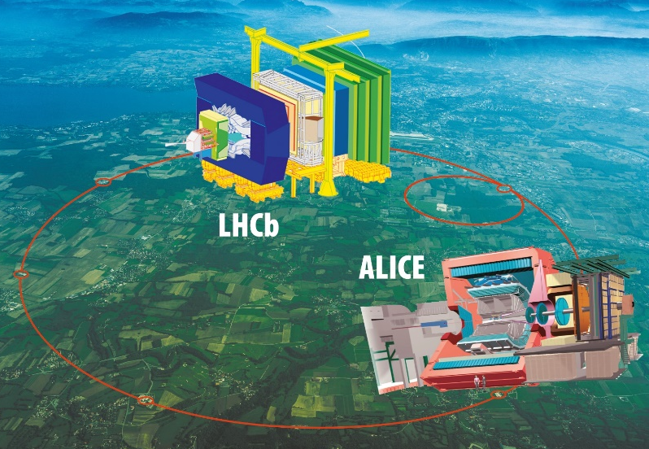
LHC
CERN

Slide 17
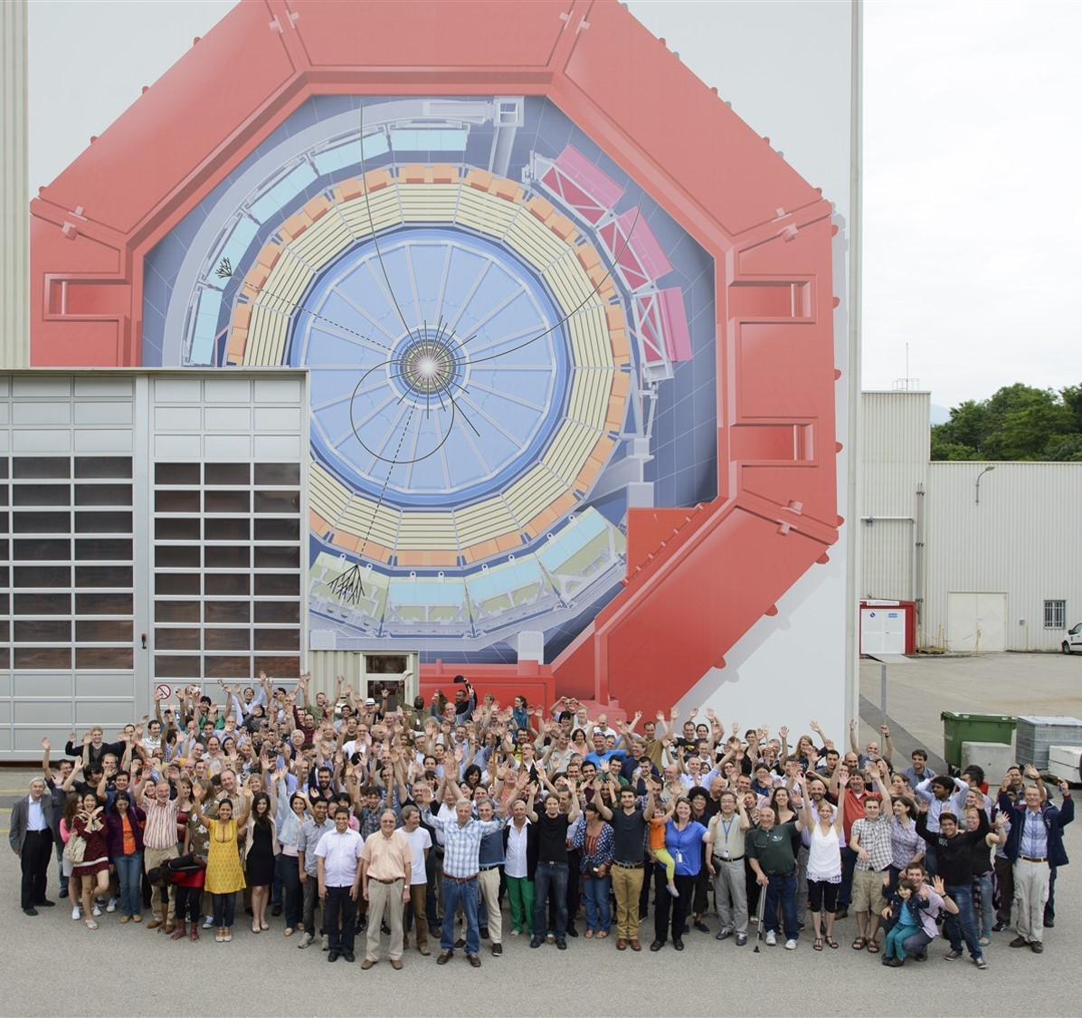
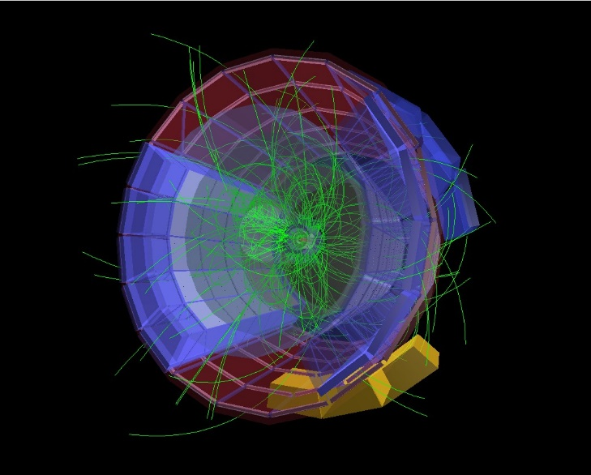
CCNU China
began the heavy-ion experiments
with ALICE/CERN in 1993
ALICE

Slide 18
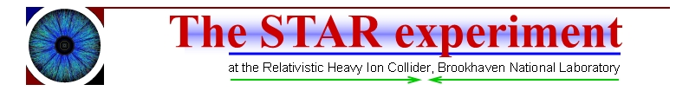
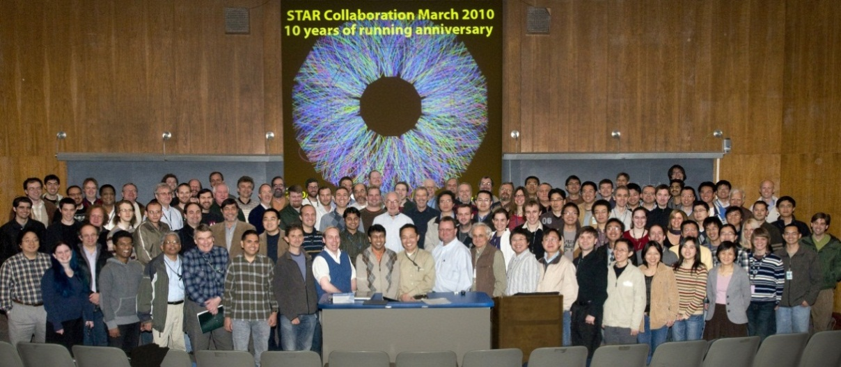
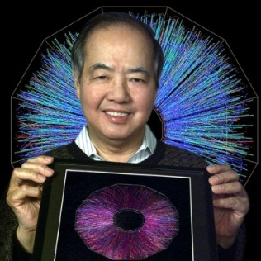
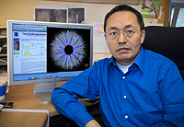

Slide 19
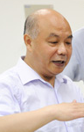
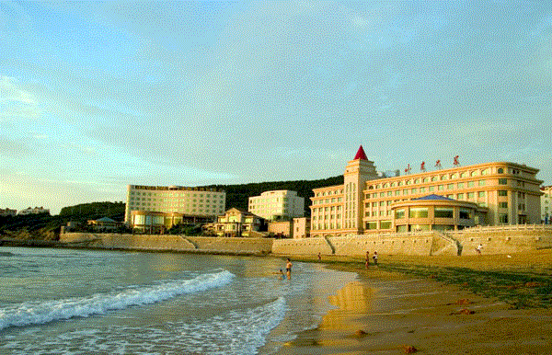

Results on Heavy-Flavour Production
Measured with ALICE at the LHC
ZHOU, Daicui for the ALICE Collaboration
Institute of Particle Physics, CCNU, Wuhan, China
Key Laboratory of Quark & Lepton Physics, MoE, China
STAR regional meeting and workshop
on high temperature and high density nuclear matter study
08/19-22, 2014 , Weihai, China

Slide 20

Outline
O physics motivation
O heavy-flavour measurements with ALICE
O results in pp collisions at $\sqrt{s}=$2.76 and 7 TeV
O results in Pb-Pb collisions at $\sqrt{sNN}$=2.76 TeV
O results in p-Pb/Pb-p collisions at $\sqrt{sNN}$=5.02 TeV
O summary and outlook
Thanks to
Nicole Bastid, Philippe Chrochet, Grazia Luparello, Xiaoming Zhang,
Zhuang Li,
Ralf Averbeck, Francesco Prino, Zuman Zhang,
and ALICE PWG-HF and DQ colleagues

Slide 21

Motivations-1: why heavy flavours?
■ Heavy flavours in pp collisions: produced in hard partonic collisions
● Test of pQCD-based predictions for production cross sections
● Study of effect of multi-parton interactions on heavy-flavour production
● Reference for the study of p-A and A-A collisions
■ Heavy flavours in p-A collisions: sensitive to CNM eff.
● Control experiment for A-A collisions
● Cold nuclear matter effects
→ Nuclear modification of Parton Distribution
Functions (PDF): shadowing or saturation;
→ Energy loss in cold nuclear matter;
→ k_{T} broadening, multiple interactions;
→ Nuclear absorption of quarkonia
■ Heavy Flavours in A-A Collisions: sensitive to medium
● Large mass (m_{c} ~ 1.5 GeV, m_{b} ~ 5 GeV) heavy quarks are produced in initial hard
scatterings with a short formation time τ_{f} ~ 1/2m_{c/b} ~ 0.1 fm/c << τ_{QGP} ~ 5-10 fm/c
● Experience the full collision history, allow us to explore HF interactions with the medium
K. J. Eskola et al., JHEP 0904 (2009) 65
D.E. Kharzeev et al., arXiv:1205.1554
F.Dominguez, et ql. arXiv:1109.1250
R. Vogt, Phys. Rev C81 (2010) 044903
F. Arleo et al., arXiv:1204.4609
C.Lourenco et al.,JHEP 0902(2009)014)
Notes:
21

Slide 22







Motivations-2: heavy flavours in A-A collisions
● In medium parton energy loss
Depend on: colour charge, quark mass, medium density
(ΔE_{gluon} >ΔE_{light} > ΔE_{charm} >ΔE_{beauty})
Caveats: different shapes of parton p_{T} distributions,
different fragmentation functions, soft production
mechanism of low p_{T} 𝜋.
● HF azimuthal anisotropy
→ Initial spatial anisotropy → particle momentum anisotropy
→ Low p_{T}: HF collectivity and therm. of heavy quarks in QGP
→ High p_{T} : path-length dependence of energy loss
● Quarkonia ($c\overline{c, }$ b$\overline{b}$) suppression and regeneration
→ Suppression by colour screening
→ Regeneration via recombination of heavy quarks
mostly for charm
$${E\frac{d^{3}N}{d^{3}\vec{p}}}_{}=\frac{1}{2π}\frac{d^{2}N}{p_{T}dp_{T}dy}(1+2\sum_{n=1}^{∞}{v_{n} cos[n\left(φ−Ψ_{RP}\right)]\text{)} }$$
$$v_{2}\left(p_{T},y\right)=<cos2(φ−Ψ_{RP})>$$
Phys.Lett.B178 (1986) 416 ;
Phys. Lett. B 490 (2000) 196;
Phys. Rev. C (2001) 054905

Slide 23

HF decay-electron measurements with ALICE
EMCAL
TRD
TOF
TPC
ITS
B → e + X, B.R. ~ 11%
D → e + X, B.R. ~ 10%
|η| < 0.9
ITS: tracking, vertexing, PID
TPC: tracking, PID
TOF, EMCAL, TRD: e-ID
VZERO*: trigger and centrality determination
ZDC*: event activity determination in p-Pb collisions
*common for all the channels

Slide 24


D meson measurements with ALICE
EMCAL
TRD
ITS
TPC
TOF
Displaced decay vertices (|η| < 0.8):
D⁰ → K⁻ π⁺, BR = 3.88 ± 0.05%
D⁺ → K⁻ π⁺ π⁺, BR = 9.13 ± 0.19%
D*⁺→ D⁰ π⁺, BR = 67.7 ± 0.5%
D_{s} → Φπ⁺
→ K⁻K⁺π⁺, BR = 2.28 ± 0.12%
K
π
ITS: tracking, vertexing
TPC: tracking, PID
TOF: PID

Slide 25


HF decay-muon measurements with ALICE
Tracking chambers
B → μ + X, B.R. ~ 11%
D → μ + X, B.R. ~ 10%
Muon spectrometer:
μ-ID via tracks matched with
the trigger system
-4 < η < -2.5
Dipole Magnet
Trigger Chambers

Slide 26



pp : $√$s = 7 TeV
open HF p_{T} spectra
HF decay electrons
D mesons (D⁺⁾
JHEP 1201 (2012) 128
Phys. Lett. B 718 (2012) 279 for D⁺_{S}
HF decay muons
Phys. Lett. B 708 (2012) 265
PLB 708(2012)2659
p_{T}-differential cross-section in all channels measured
pQCD-based calculations (FONLL, GM-VFNS, k_{T} -factorization) compatible with data
FONLL: JHEP 1210 (2012) 137
GM-VFNS: Eur. Phys. J. C 72 (2012) 2082
k_{T} factorization: arXiv:1301.3033

Slide 27




pp : $√$s = 2.76TeV
open HF p_{T} spectra
charmed hadrons: D⁰
JHEP 1207 (2012) 191
HF decay electrons
Phys. Lett. B 721 (2013) 13
HF decay muons
Phys. Rev. Lett. 109 (2012) 112301
pQCD-based calculations compatible with data;
FONLL: JHEP 1210 (2012) 137], [GM-VFNS: Eur. Phys. J. C 72(2012) 2082
HF decay-muon data used as reference for Pb-Pb collisions at 2.76 TeV;
For other channels (and p-Pb at 5.02 TeV), an extrapolation based on pQCD calculations is performed due to the limited statistics in pp collisions at 2.76 TeV.
data at 2.76 TeV used to test the scaling

Slide 28



Pb-Pb: $√$s_{NN} = 2.76 TeV
D mesons: R_{AA} vs p_{T} and centrality
Non-prompt J/Ψ from B
D mesons
Strong suppression at high p_{T} in central Pb-Pb collisions relative to the binary scaled pp reference (a factor of about 4 at p_{T} = 5 GeV/c in 0-7.5%);
Measured suppression is a final-state effect (R_{pPb} close to unity);
Non-prompt J/Ψ (from B decays) measured by CMS less suppressed than D mesons in central collisions: Indication of R_{AA}(D) < R _{AA}(J/ψ ← B), consistent with the expectation ΔE_{c} > Δ E_{b} (due to the dead cone effect, Phys. Lett. B 519 (2001) 1999)
[Similar <p_{T} > (~10 GeV/c) for D and B → J/Ψ, rapidity range slightly different]

Slide 29


Pb-Pb: $√$s_{NN} = 2.76 TeV
HF decay leptons: R_{AA} vs p_{T}
c,b → e±; c,b→ μ ±
b(→c) → e
Strong suppression measured at high p_{T} in the most central Pb-Pb collisions (a factor 3-4 in 4 < p_{T} < 10 GeV/c) for both heavy-flavour decay electrons (|y| < 0.6) and muons (2.5 < y < 4)
Measured suppression is a final-state effect (R_{pPb} close to unity)
Suppression of electrons from beauty-hadron decays observed in Pb-Pb: R_{AA} < 1 for p_{T} > 3 GeV/c
Beauty decay electrons are separated exploiting their wider impact parameter distr. and the high precision measurem. of the track impact parameter provided by the ITS

Slide 30





Pb-Pb: $√$s_{NN} = 2.76 TeV
R_{AA} mass dependence:
comparing D, B with π mesons
Test: ΔE_{light} > ΔE_{charm} >ΔE_{beauty} $→$ R_{AA}($π$) < R_{AA}(D) < R_{AA}(B)
D⁰ , D^{+ ,} D*⁺ with $π$ and charged
D⁰ with $π±$
D-meson and $π$meson R_{AA} compatible within uncertainties
➢ Measurement not yet conclusive
➢ In agreement with models including ΔE_{gluons} >ΔE_{light} > ΔE_{charm}
$∎$different shapes of the parton p_{T} distributions;
$∎$different fragmentation functions;
$∎$Soft production mechanism for low p_{T} $π$
M.Djordjevic, arXiv:1307.4098;
Wicks, Horowitz, Djordjevic Nucl. Phys. A
872 (2011) 265

Slide 31




Pb-Pb: $√$s_{NN} = 2.76 TeV
HF decay leptons: $v$₂ in Pb-Pb collisions
c,b → e±; c,b→ μ ±
$$v_{2}\left(p_{T},y\right)=<cos2(φ−Ψ_{RP})>$$
Positive heavy-flavour lepton $v_{2}$ measured (> 3σ effect) in semi-central collisions and at inter mediate p_{T}
  Significant interaction of heavy quarks with the medium
  Suggest collective motion of low p_{T} heavy quarks (mainly charm) in the expanding fireball
Positive $v_{2}$ also measured for D mesons

Slide 32






Pb-Pb: $√$s_{NN} = 2.76 TeV
Model comparisons: R_{AA} and $v$₂
c,b → e±
BAMPS: Phys. Lett. B 717 (2012) 430,
arXiv: 1401.3817
POWLANG, Eur. Phys. J. C 71 (2011)1666,
J. Phys. G 38 (2011) 124144
TAMU: arXiv:1401.3817
MC@ Shq+EPOS: Phys. Rev. C 89(2014) 014905
BAMPS: Phys. Lett. B 717 (2012) 430,
arXiv: 1401.3817
POWLANG, Eur. Phys. J. C 71 (2011)
1666, J. Phys. G 38 (2011) 124144
TAMU: arXiv:1401.3817
MC@ Shq+EPOS: Phys. Rev. C 89
(2014) 014905
c,b→ μ ±
Reasonable agreement with models including in-medium energy loss.
Simultaneous measurement of R_{AA} and $v_{2}$ allows one to constrain models.
D-meson mesurements lead to the same conclusion

Slide 33


Pb-Pb: $√$s_{NN} = 2.76 TeV
J/Ψ : R_{AA} vs centrality and p_{T}
J/Ψ→e$±$ , |y| <0.8; J/Ψ → μ±, 2.5 < y < 4; PHENIX: J/Ψ→μ±, 1.2<|y| < 2.2
Clear suppression at forward rapidity, slightly larger than measured at mid-rapidity in central collisions
Suppression measured at the LHC increases with increasing p_{T} and is smaller than that observed at RHIC
Results consistent with a significant fraction of J/Ψ from recombination at low p_{T}

Slide 34


Pb-Pb: $√$s_{NN} = 2.76 TeV
J/Ψ elliptic flow
ALICE, Phys. Rev. Lett. 111 (2014) 162301
Positive $v_{2}$ in semi-central collisions (20-40% centrality)
at intermediate p_{T} (2.7σ effect)
Consistent with a significant fraction of J/Ψ from the recombination of charm quarks in a flowing medium

Slide 35




p-Pb $: √$s_{NN} = 5.02 TeV
Rapidity shift : 0.465 in the p-beam direction (positively)
Two configurations:
p-Pb , muon spectrometer in p-going direction
Pb-p, muon spectrometer in Pb-going direction
Pb
p
μ
p
Pb
μ

Slide 36


p-Pb $: √$s_{NN} = 5.02 TeV
D mesons: RpPb vs p_{T}
minimum bias collisions
mid-rapidity
ALICE: arXiv:1405.3452
CGC: H.Fujii and K. Watanable, arXiv: 1308.1258
pQCD NLO (MNR): Nucl. Phys. B 373 (1992) 295, EPS09:
K. J. Eskola et al., JHEP 04 (2009) 065
Vitev: Phys. Rev. C 80461 (2009) 054901
Nuclear modification factor (R_{pPb}) consistent with unity within uncertainties in the region p_{T} > 2 GeV/c
D-meson R_{pPb} in agreement with:
Perturbative QCD calculations including EPS09 parameterization of shadowing
Color Glass Condensate (CDG) predictions
Model including energy loss, shadowing and k_{T} broadening 

Slide 37

p-Pb $: √$s_{NN} = 5.02 TeV
HF decay electrons: R_{pPb} vs p_{T}
b,c → e±, TPC+ITS; b,c →e±, EMCal
b → e±, TPC+ITS
Mid-rapidity
R_{pPb} consistent with unity within uncertainties for electrons from
heavy-flavour hadron decays and beauty-hadron decays
R_{pPb} in agreement with perturbative QCD calculations including EPS09 parameterization of shadowing
(separation of beauty decay-electron is based on impact parameter of electron)
FONLL: M. Cacciari et al., JHEP 007 (1998) 9805, JHEP 006 (2001) 0103
pQCD NLO (MNR): Nucl. Phys. B 373 (1992) 295, EPS09: K. J. Eskola et al., JHEP 04 (2009) 065

Slide 38



p-Pb $: √$s_{NN} =5.02 TeV
HF decay muons: R_{pPb} vs p_{T}
Pb
p
p
Pb
μ
μ
Forward
Backward
R_{pPb} at forward rapidity consistent with unity within uncertainties over the whole measured p_{T} region
R_{pPb} at backward rapidity slightly larger than unity in 2 < p_{T} < 4 GeV/c and close to unity at higher p_{T}
R_{pPb} in agreement with perturbative QCD calculations including EPS09
parameterization
pQCD NLO (MNR): Nucl. Phys. B 373 (1992) 295, EPS09: K. J. Eskola et al., JHEP 04 (2009) 065

Slide 39




p-Pb $: √$s_{NN} =5.02 TeV
J/Ψ(→μ⁺μ⁻ , e⁺e⁻): R_{pPb} vs rapidity
Backward
Forward
Data in reasonable agreement with NLO calculations including EPS09 shadowing
Coherent energy loss model
overestimates the suppression at
forward rapidity and low p_{T}
CGC model overestimates suppression at forward rapidity
Mid-rapidity
JMP E22 (2013) 1330007; K.Eskola et al., JHEP 04467 (2009) 065;
F. Arleo et al., JHEP 1303 (2013) 122; H. Fujii et al., Nucl. Phys. A 915 (2013) 1

Slide 40

p-Pb $: √$s_{NN} =5.02 TeV
Ψ(2S) R_{pPb} :
comparisons to J/Ψ results and models
p-Pb: backward rapidity
p-Pb: forward rapidity
blue: J/Ψ; red: Ψ(2s)
ALICE, arXiv: 1405.3796
Ψ(2S) more suppressed than J/Ψ at forward and backward rapidity
Ψ(2S) suppression not described by model predictions including initial-state effects only
Indication for sizeable final-state effects on Ψ(2S) production

Slide 41


p-Pb $: √$s_{NN} =5.02 TeV
Υ: R_{pPb} and R_{AA} vs rapidity
p-Pb
Pb-Pb
ALICE, arXiv:1405.4493
Backward
Forward
p-Pb: indication of a suppression at forward rapidity and consistent with
no suppression at backward rapidity
Pb-Pb: strong suppression at forward rapidity that cannot be ascribed to
only cold nuclear matter effects
  Larger at forward rapidity than at mid-rapidity
Pb-Pb: transport model does not reproduce the R_{AA} rapidity dependence and underestimates the measured suppression

Slide 42

Summary and Outlook
Open heavy-flavour measurements
● HF suppression observed at high p_{T} in central Pb-Pb collisions is a strong indication that the suppression is due to in-medium parton energy loss
● Measured positive $v$₂ suggests that charm quarks participate in the collective expansion of the system.
● CNM effects are small and are reasonably well reproduced by pQCD + shadowing models.
Quarkonium measurements
● J/Ψ suppression observed in Pb-Pb collisions consistent with a significant fraction of J/Ψ from regeneration (low-p_{T})
● The$Υ$ suppression in Pb-Pb collisions is not reproduced by models
● J/Ψ suppression in p-Pb collisions is in reasonable agreement with shadowing and coherent energy loss models
● Final-state effects on the Ψ(2S) production in p-Pb collisions
More precise measurements to come with the LHC run II and ALICE upgrades

Slide 43



Slide 44



Slide 45



Slide 46





doğum günün kutlu olsun
všechno nejlepší k narozeninám
Gratulerer med dagen
joyeux anniversaire
buon compleanno
Happy Birthday
С Днем Рождения
Všechno nejlepší k narozeninám
Plurimos annos
Χρόνια Πολλά
La mulți ani
생일 축하
生日快乐
Alles Gute zum Geburtstag
boldog születésnapot
誕生日おめでとう
С Днем Рождения

