Slide 1
Uncertainty quantification in generic Monte Carlo Simulation: a mathematical framework
How to do it?
Abstract:
Uncertainty Quantification (UQ) is the capability of predicting the uncertainty of experimental observables produced by Monte Carlo particle transport, deriving from uncertainties in the physics modeling components (such as cross sections, atomic and nuclear parameters, geometrical description of the experimental apparatus and so on) used in the simulation.
We establish a general mathematical framework for UQ: in the case of a single input uncertainty the problem is analytically soluble, while the case of many uncertainties requires the additional hypothesis of statistical independence and involves some predictable approximations.

Slide 2

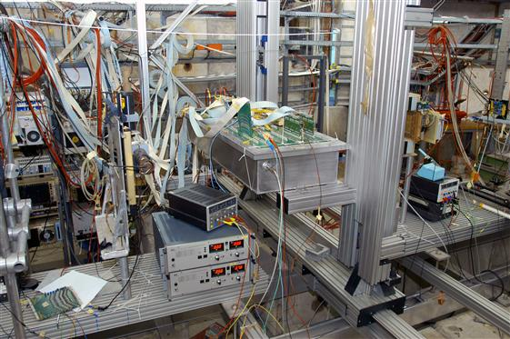
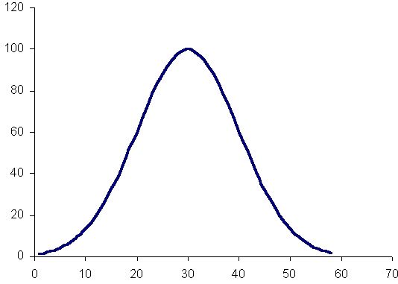

A simulation engine is needed when a given physical model
is too much complicated to be analytically solved
SOLVER Simulation Engine (MC)
Physical model
User’s data
Physical data
Transport equation
…
Geometry
Composition
…
Cross sections
Models
…
Output for some observable + solver errors (statistical for MC)

Slide 3

… but in a non idealized situation there are many sources of uncertainties
Physical data
uncertainties
Model
uncertainties
User’s data
uncertainties
Solver (statistical)
uncertainties
Result of the simulation are affected by a complex mix of various sources of uncertainties

Slide 4
… but in a non idealized situation there are many sources of uncertainties
Physical data
uncertainties
Model
uncertainties
User’s data
uncertainties
Neglect model uncertainties: transport equation is the “true world” and there are no other approximations (like condensed path approximation) in its solution other than those induced by MC sampling
1st step to UQ
Solver (statistical)
uncertainties
Result of the simulation are affected by a complex mix of various sources of uncertainties

Slide 5
… but in a non idealized situation there are many sources of uncertainties
Physical data
uncertainties
Model
uncertainties
User’s data
uncertainties
Validation of physical data needed for simulation: MC users should have accurate infos about confidence intervals (better PDFs) for each of the physical parameters used by the code (cross sections, models employed, …) AND the possibility to make variations
2nd step to UQ
Solver (statistical)
uncertainties
Because depending on the experimental configuration small variations in some parameter may result in large variations of the output or large variations in some other parameter may have no practical effect at all

Slide 6
… but in a non idealized situation there are many sources of uncertainties
Physical data
uncertainties
Model
uncertainties
User’s data
uncertainties
Accurate study of the experimental configuration: MC users should select a proper restricted set of parameters (physical and/or user controlled) on which perform an UQ attempt
3rd step to UQ
Solver (statistical)
uncertainties
Because as we shall see it is out of human possibilities (and probably meaningless) to perform UQ over possibly hundreds of different parameters

Slide 7
Sensitivity analysis
Computational cost
(thousands of MC runs needed)
To reduce computational costs, one can transform a full sensitivity analysis into the search for the most probable output
➔ this means giving up a full statistical characterization of the output
Mathematical methods
Software toolkits (DAKOTA, PSUADE..)

Slide 8
Then (4rd step to UQ) we assume to have N independent source of uncertainty x₁,…,x_{N} with their associate known and fixed PDFs (may be flat, normal or …) and we want to derive the PDF for an observable Y in the range (y,y+dy) from a MC simulation encompassing N_{E} events:
from the Central Limit Theorem.
This result derives from probability composition rules.
If the number of events is very large this distributions approaches
A not trivial assumption, by the way
To do the job we need a consistent way
to easily handle this expression

Slide 9

How it works (1 – dimension)
We must know (and invert) the “susceptivity” x₀(SS)!!!
We can use MC to study this (see later).
Lower computational cost
EXAMPLE: a (very) simplified “transport code”, a random path generator ruled by two constant parameters describing the relative probability of absorption (Σ_{A}) and scattering processes (Σ_{S}), sampling an observable – track-length in this case.
(by the way, this simulates the propagation of neutral particles in an uniform medium with constant scattering and absorption cross-sections and isotropic scattering)
If Σ_{S} is affected by some uncertainty, say Σ_{S, min}< Σ_{S} < Σ_{S, max} we run many simulations varying its value with some known probability (for instance flat)

Slide 10
Disentangling uncertainties
Algorithmic (statistical) and parameter uncertainties
Results for a track length observable scored in a volume near the source
15000 simulations
10⁵ events
5 10⁵ events
10⁶ events
10⁸ events
linear susceptivity (?)
As statistical errors decrease, the distribution of the observable is dominated by parameter uncertainties only

Slide 11
How all it works (II) : verification
(when all is under control …)
analytical result
Example: evaluate the
area of the circle
with some flat uncertainty on the measure of its radius
f(R)=θ(R-R_{min})θ(R_{max}-R)/(R_{max}-R_{min})
A(R) = π R²
Metropolis simulation,
50K samples
the exact solution (susceptivity) is known
analytical result
Metropolis simulation,
1M samples

Slide 12

A direct sampling G_{MC}(y) requires thousands of MC simulations
Knowledge of G(x) is
the ultimate goal of UQ
Knowledge of y₀(x₁,…,x_{N}) required
USE MC to sample y₀(x₁,…,x_{N})
Reduced number of simulations needed
Caution: statistical errors un y₀(x₁,…,x_{N})
Fixed values of
x₁,…,x_{N}
…with high statistics
on y₀(x₁,…,x_{N})

Slide 13
The task of UQ
The feasibility of UQ requires:
To know input uncertainties and their probability distributions - Validation of MC modeling ingredients needed
To be able to solve explicitly for G(x):
An exact mathematical context needed
To use MC simulations to determine parameters in G(x):
(in the previous example, to find A_{max/min} from simulation and to determine the proper behavior A^{-1/2})
Possible with few simulations with predetermined accuracy
2) is independent from the features of the specific problem and can be solved within the scope of wide assumptions
this is an exact mathematical frame for UQ

Slide 14
Many parameters problem
In the generic case we have many input parameter unknowns:
We make two “reasonable” assumptions:
The x_{k} are independent: f(x₁,…,x_{N})=f₁(x₁)…f_{N}(x_{N})
is linear (if necessary subdivide the domain of variability of the unknowns in such a way to fulfill the condition)
Under these hypothesis the evaluation of G(x) reduces to a well known problem in probability theory: the determination of the weighted sum of a certain number of independent stochastic variables.
Unfortunately even this problem is not soluble in general
Can we approximately solve it?

Slide 15
Some remarks
Under these assumptions with σ_{k}² the variances of the individual input unknowns.
For M input unknowns we need a priori M+1 simulations to
determine the values , a task that can be pursued reasonably
if the number of input unknowns is not so large.
So detailed physical knowledge of the problem at hand is required to select a proper set of physical parameters on which is meaningful to attempt a full Uncertainty Quantification.
We then emphasize that a full UQ is PROBLEM SPECIFIC

Slide 16
BUT we are not sure that σ_{x}² is a proper measure of the output uncertainty, since we do not know the exact form of G(x).
In some useful selected cases the form of G(x) is known:
all the input unknowns are normally distributed: in such case G(x) is normal with the quoted variance
all the input unknown are uniformly distributed: in such case a generalization of the Irwine-Hall distribution holds
all the input unknowns have α-stable distributions with the same α value: in such case G(x) is again a stable distribution with the same α value (e.g. the Lorentz distribution)
We recently proved that a general (polynomial) form exists for the weighted sum of generic polynomial distributions over different intervals: this result can be used directly to find an approximate form of G(x) with arbitrary predetermined accuracy in the general case.
Choose the appropriate norm…
A specific software tool is needed
to reliably perform this step

Slide 17
Current scope of applicability
Single parameter uncertainty (see [1]):
- complete analysis of uncertainty propagation available
- simulation is used solely to determine the values of the parameters defining the output probability density function
confidence intervals for the output are known with a statistical error that can be predetermined
Many parameter uncertainty (see also [2]):
a complete UQ is possible only for independent input uncertainties.
calculability issues may exist, in practice, if the number of parameters considered is high and/or if linearity of x₀(Σ_{k}) is questionable
confidence interval for the output are affected by the statistical errors in the determination of the required parameters AND by errors in the polynomial approximations required
in principle a predefined accuracy can be obtained
calculation issues must be studied
[1] - P. Saracco, M. Batic, G. Hoff, M.G. Pia – “Theoretical ground for the propagation ofuncertainties in Monte Carlo particle transport”, submitted to IEEE Trans. Nucl. Phys., 2013.
[2] – P. Saracco, M.G. Pia – “Uncertainty Quantification and the problem of determining the distribution of the sum of N independent stochastic variables: an exact solution for arbitrary polynomial distributions on different intervals”, submitted to Journ. Math. Phys., 2013.

Slide 18

Conclusion and outlook
We have established:
A novel conceptual approach
A mathematical framework
Calculation methods for single and many parameter uncertainties
to determine the intrinsic uncertainty
of the results of Monte Carlo simulation
(beyond statistical uncertainty)
These developments are applicable to Monte Carlo simulation in general
Particle transport
Event generators
Outlook
Verification in a realistic experimental scenarios
Application software system
Enlargement of dynamical models and solution methods (other than MC)
Collaboration with HEP experiments is welcome!

