Slide 1
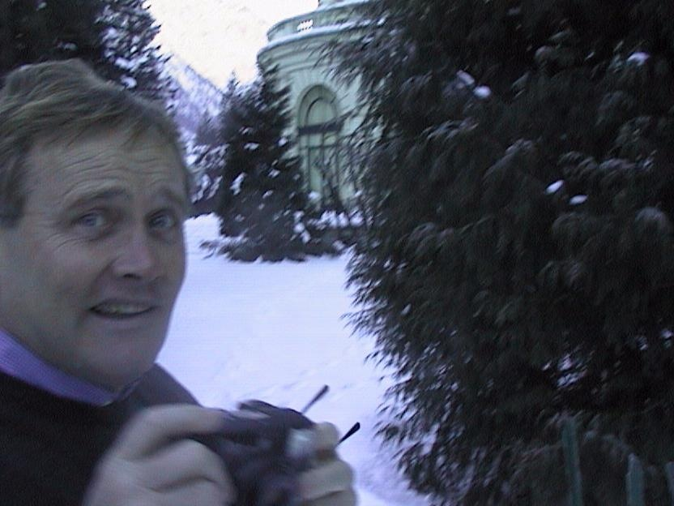
Steve Myers
The 1980s and 1990s
LEP and LEP2
THE TRUE STORY

Slide 2
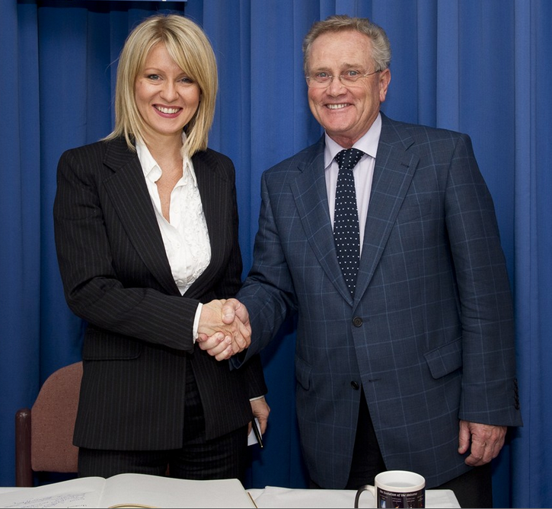
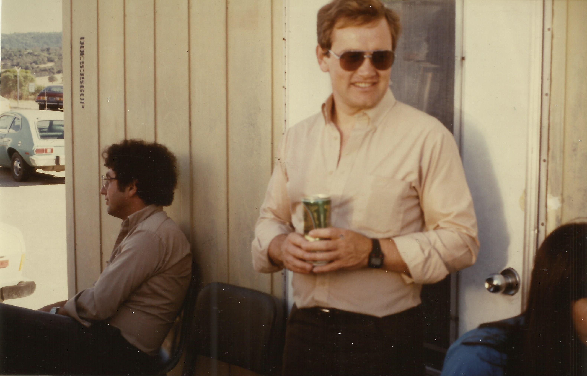
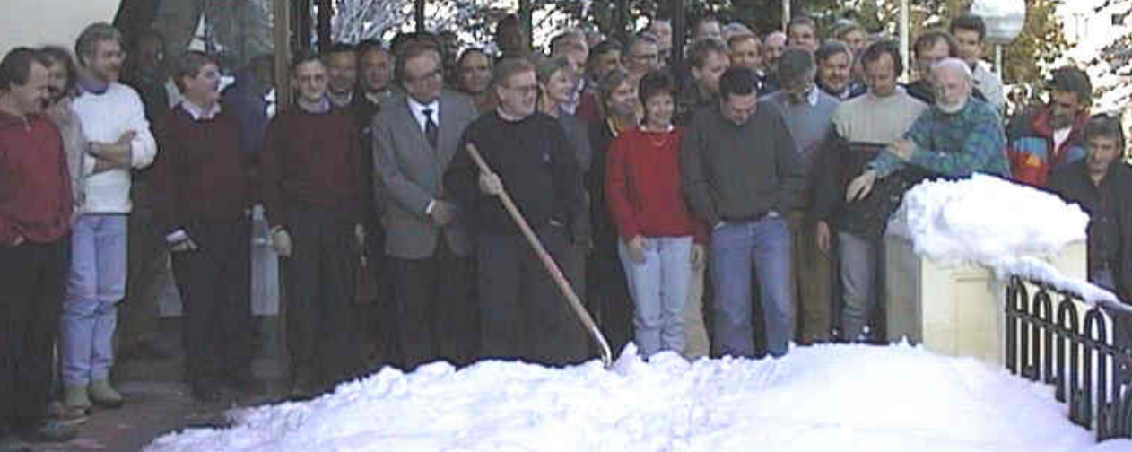
DRUNKENESS
WOMENIZING
Substance abuse

Slide 3
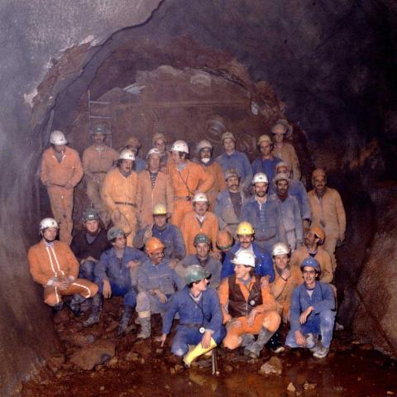
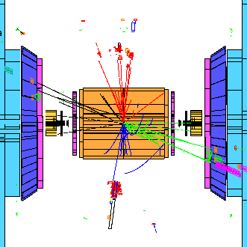
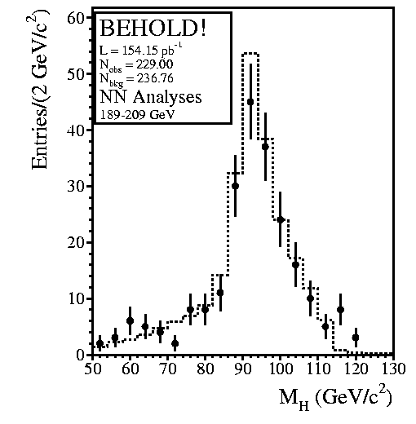
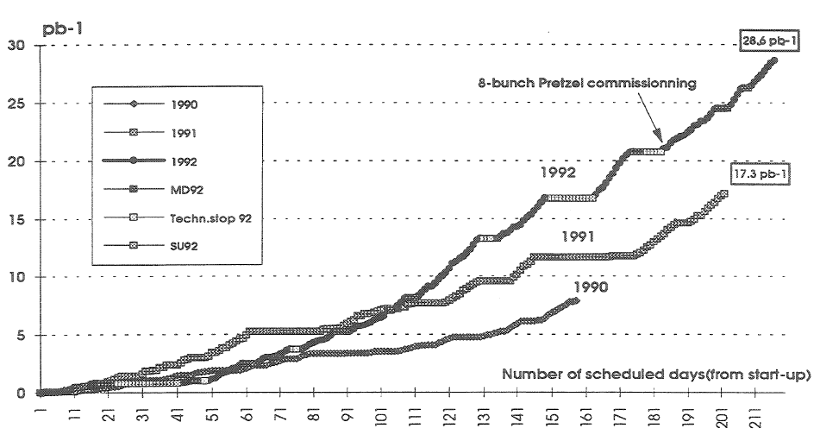
September 13, 1983
Civil engineering started
03:13 9th July 1996
February 8, 1988
LEP tunnel finished
July 12, 1988
Injection test
1996
First Ws
80.5 to 86 GeV
July 14, 1989
First injection
2000
102 – 104.4 GeV
Discovery mode
1995
LEP1.5
65, 68, 70 GeV
August 13, 1989
First collisions
1998
94.5 GeV
10³² cm⁻²s⁻¹
1983
≈
1988
1989
1990
1991
1992
1993
1994
1995
1996
1997
1998
1999
2000
Responsible for Injection test (with Albert Hoffman)
1991
First Chamonix
1996
LEP2 Project Leader
2000
SPS-LEP (SL)
Division Leader
Responsible for LEP commissioning and HW testing (with Albert Hoffman)
1990
SPS-LEP (SL) Deputy Division Leader

Slide 4
Emilio Picasso (1980): “After being appointed as LEP Project Leader my first task was to set up a LEP Management Board, in agreement with the DG (Prof. Schopper) with the best people available”
Deputy Project Leader | Günther Plass
Head of the CERN accelerators | Giorgio Brianti
Head of the magnet systems | Lorenzo Resegotti
Head of the radio-frequency (RF) Systems | Wolfgang Schnell
Head of the vacuum system | Hans Peter Reinhard
Super Proton Synchrotron (SPS) | Bas de Raad
PS, LIL, EPA | Roy Billinge
LEP operation | Steve Myers
Installation | Gèrard Bachy
Machine parameters | Andrew Hutton
Civil engineering | Henri Laporte
Experimental halls | Franco Bonaudi
Steve also acted as Scientific Secretary for the LEP Advisory Committee which included Burt Richter (SLAC) and Maury Tigner (Cornell).

Slide 5
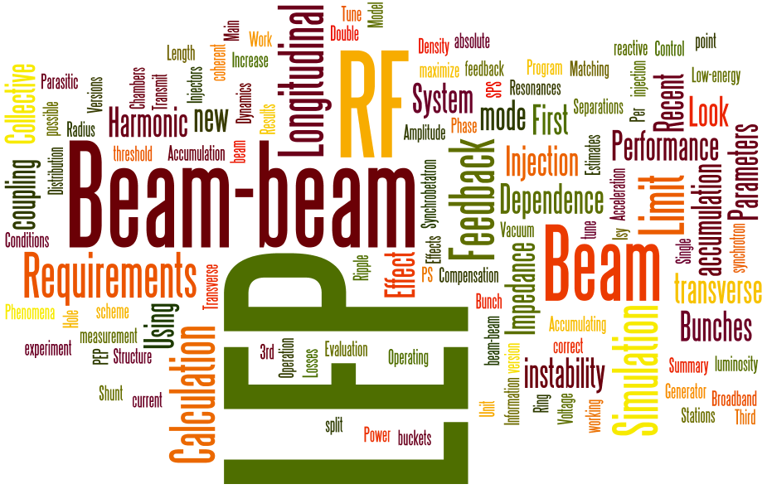
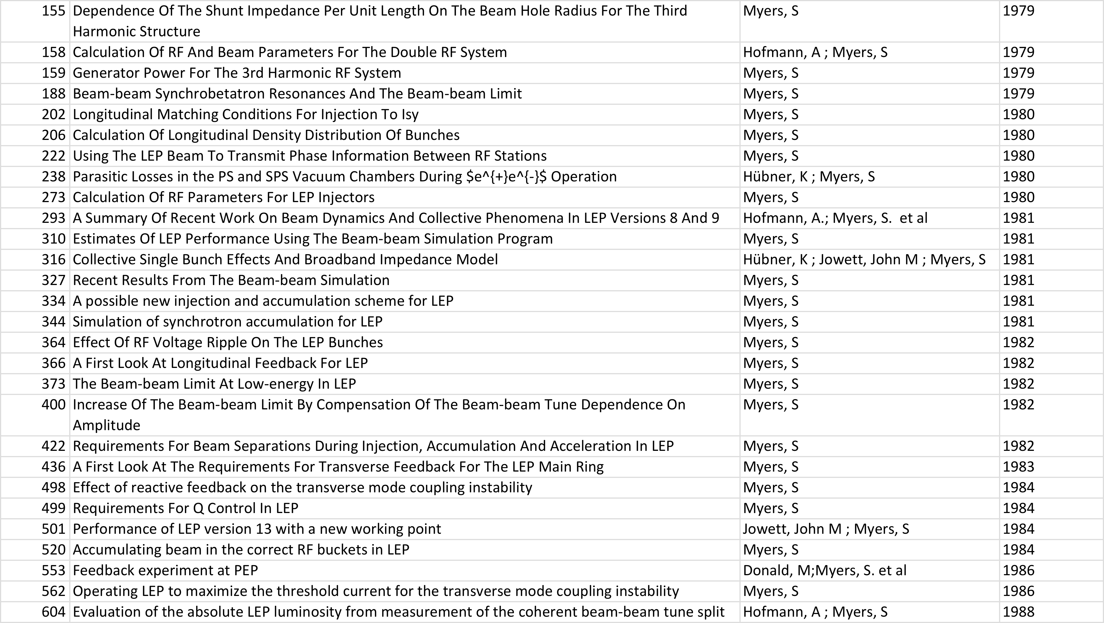
LEP project notes

Slide 6
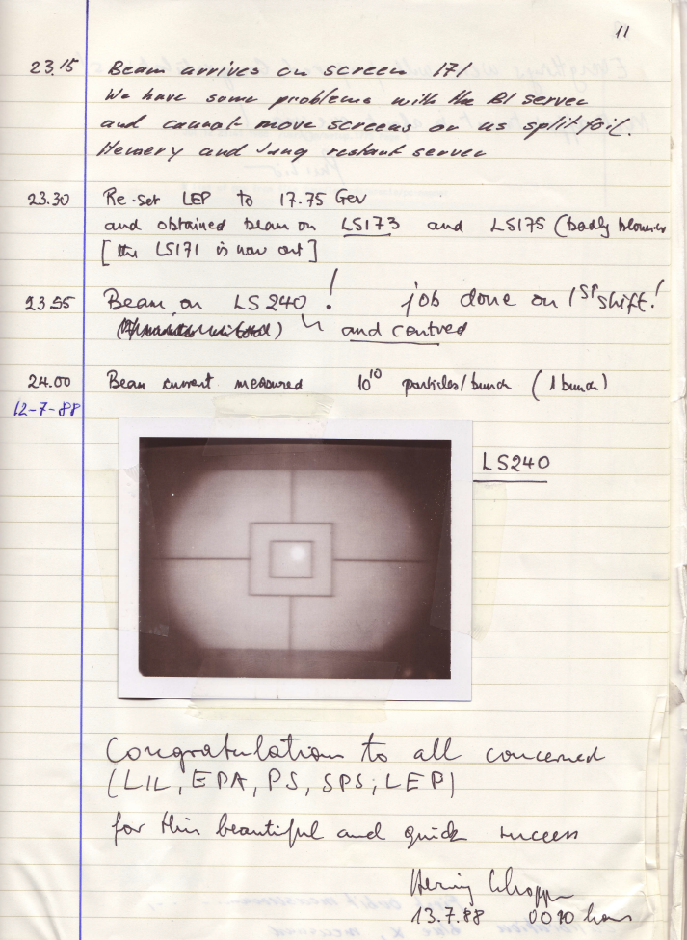
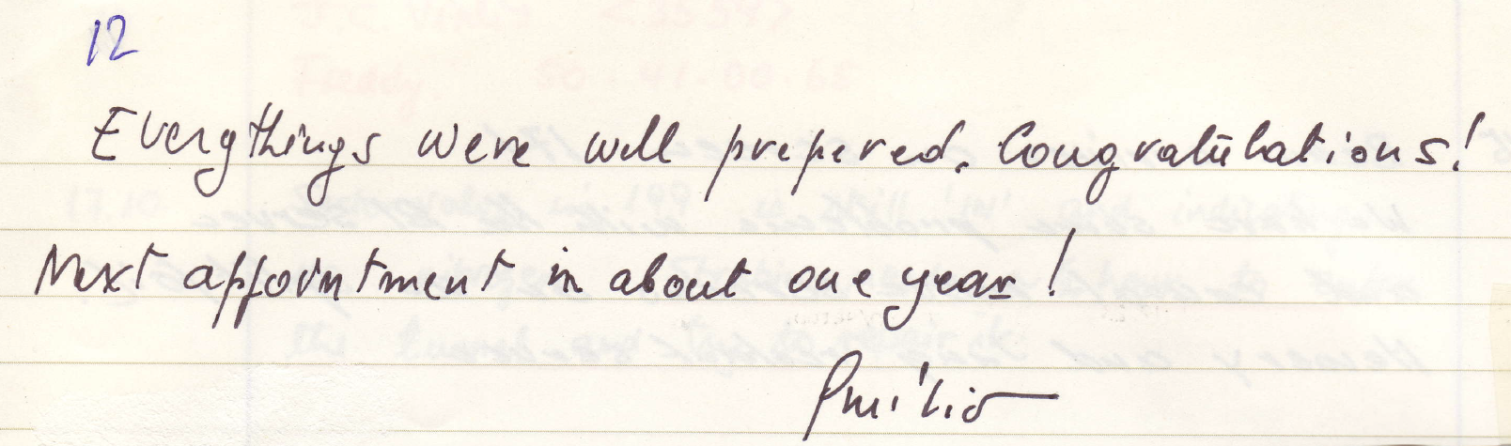
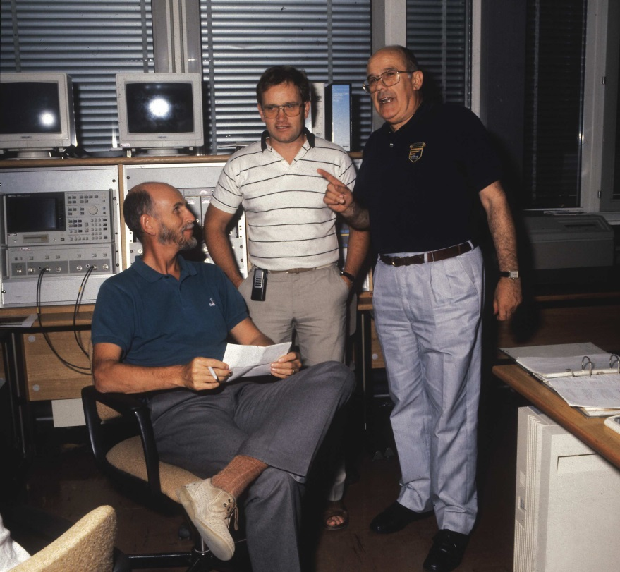
1988: Injection test
Steve Myers led the first commissioning test and a week later he reported to the LEP Management Board, making the following conclusions: "It worked! We learnt a lot. It was an extremely useful (essential) exercise – exciting and fun to do. The octant behaved as predicted theoretically."

Slide 7
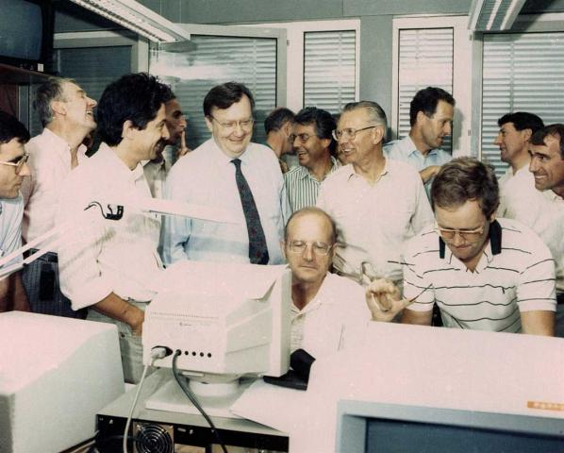
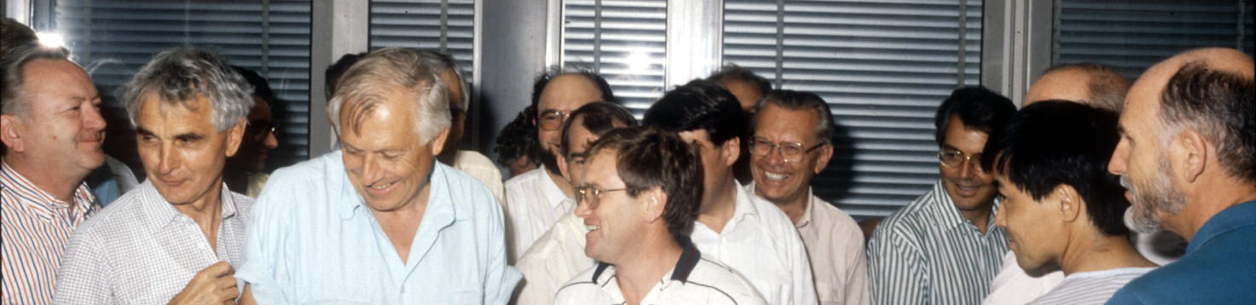
1989 - commissioning
14th July: First beam
23rd July: Circulating beam
4th August: 45 GeV
13th August: Colliding beams

Slide 9
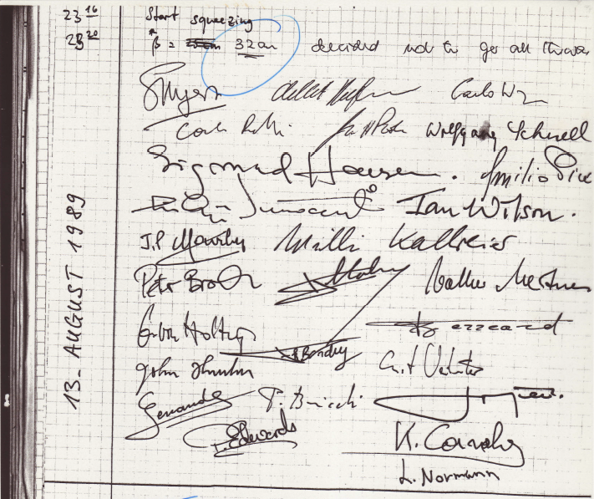
"For a long 10 minutes, Steve Myers and I didn't know whether the beams were colliding or not," Picasso recalls, "and then Aldo Michelini called: 'We have the first Z⁰.' It was a beautiful moment. Steve had done an excellent job – and I thought, OK, I've finished my job now."

Slide 10
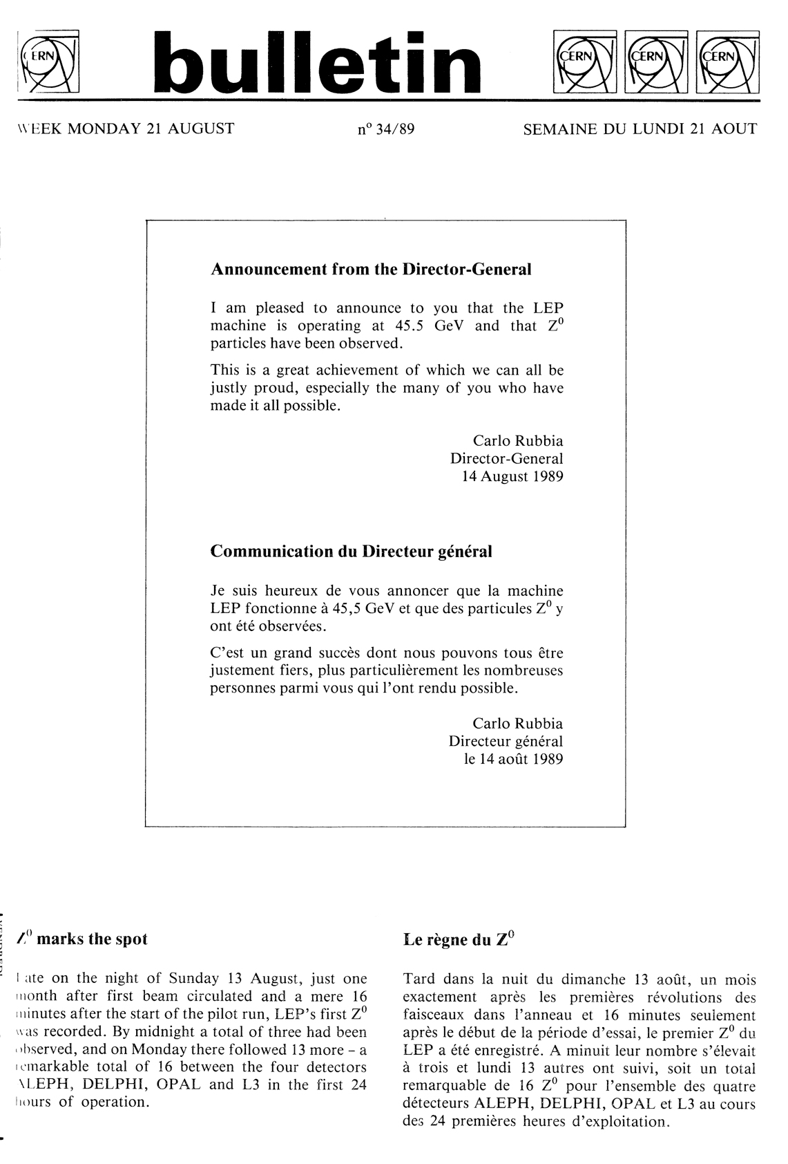
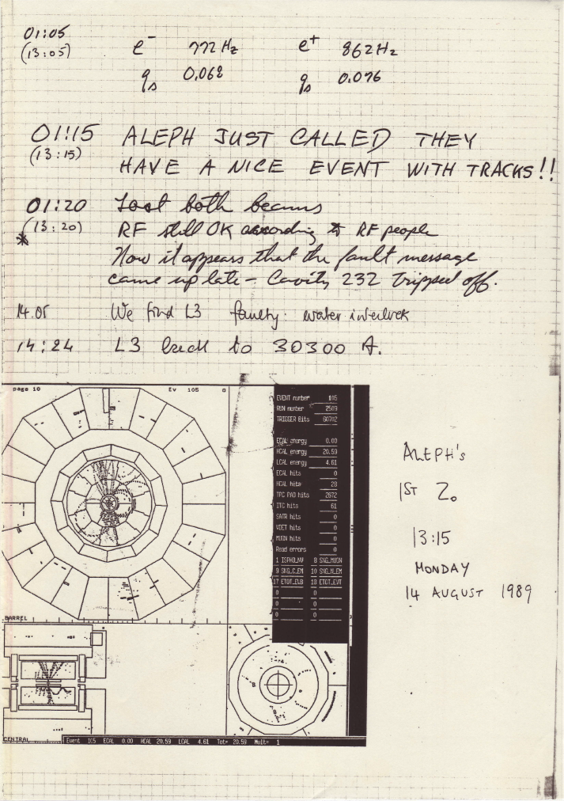

Slide 11
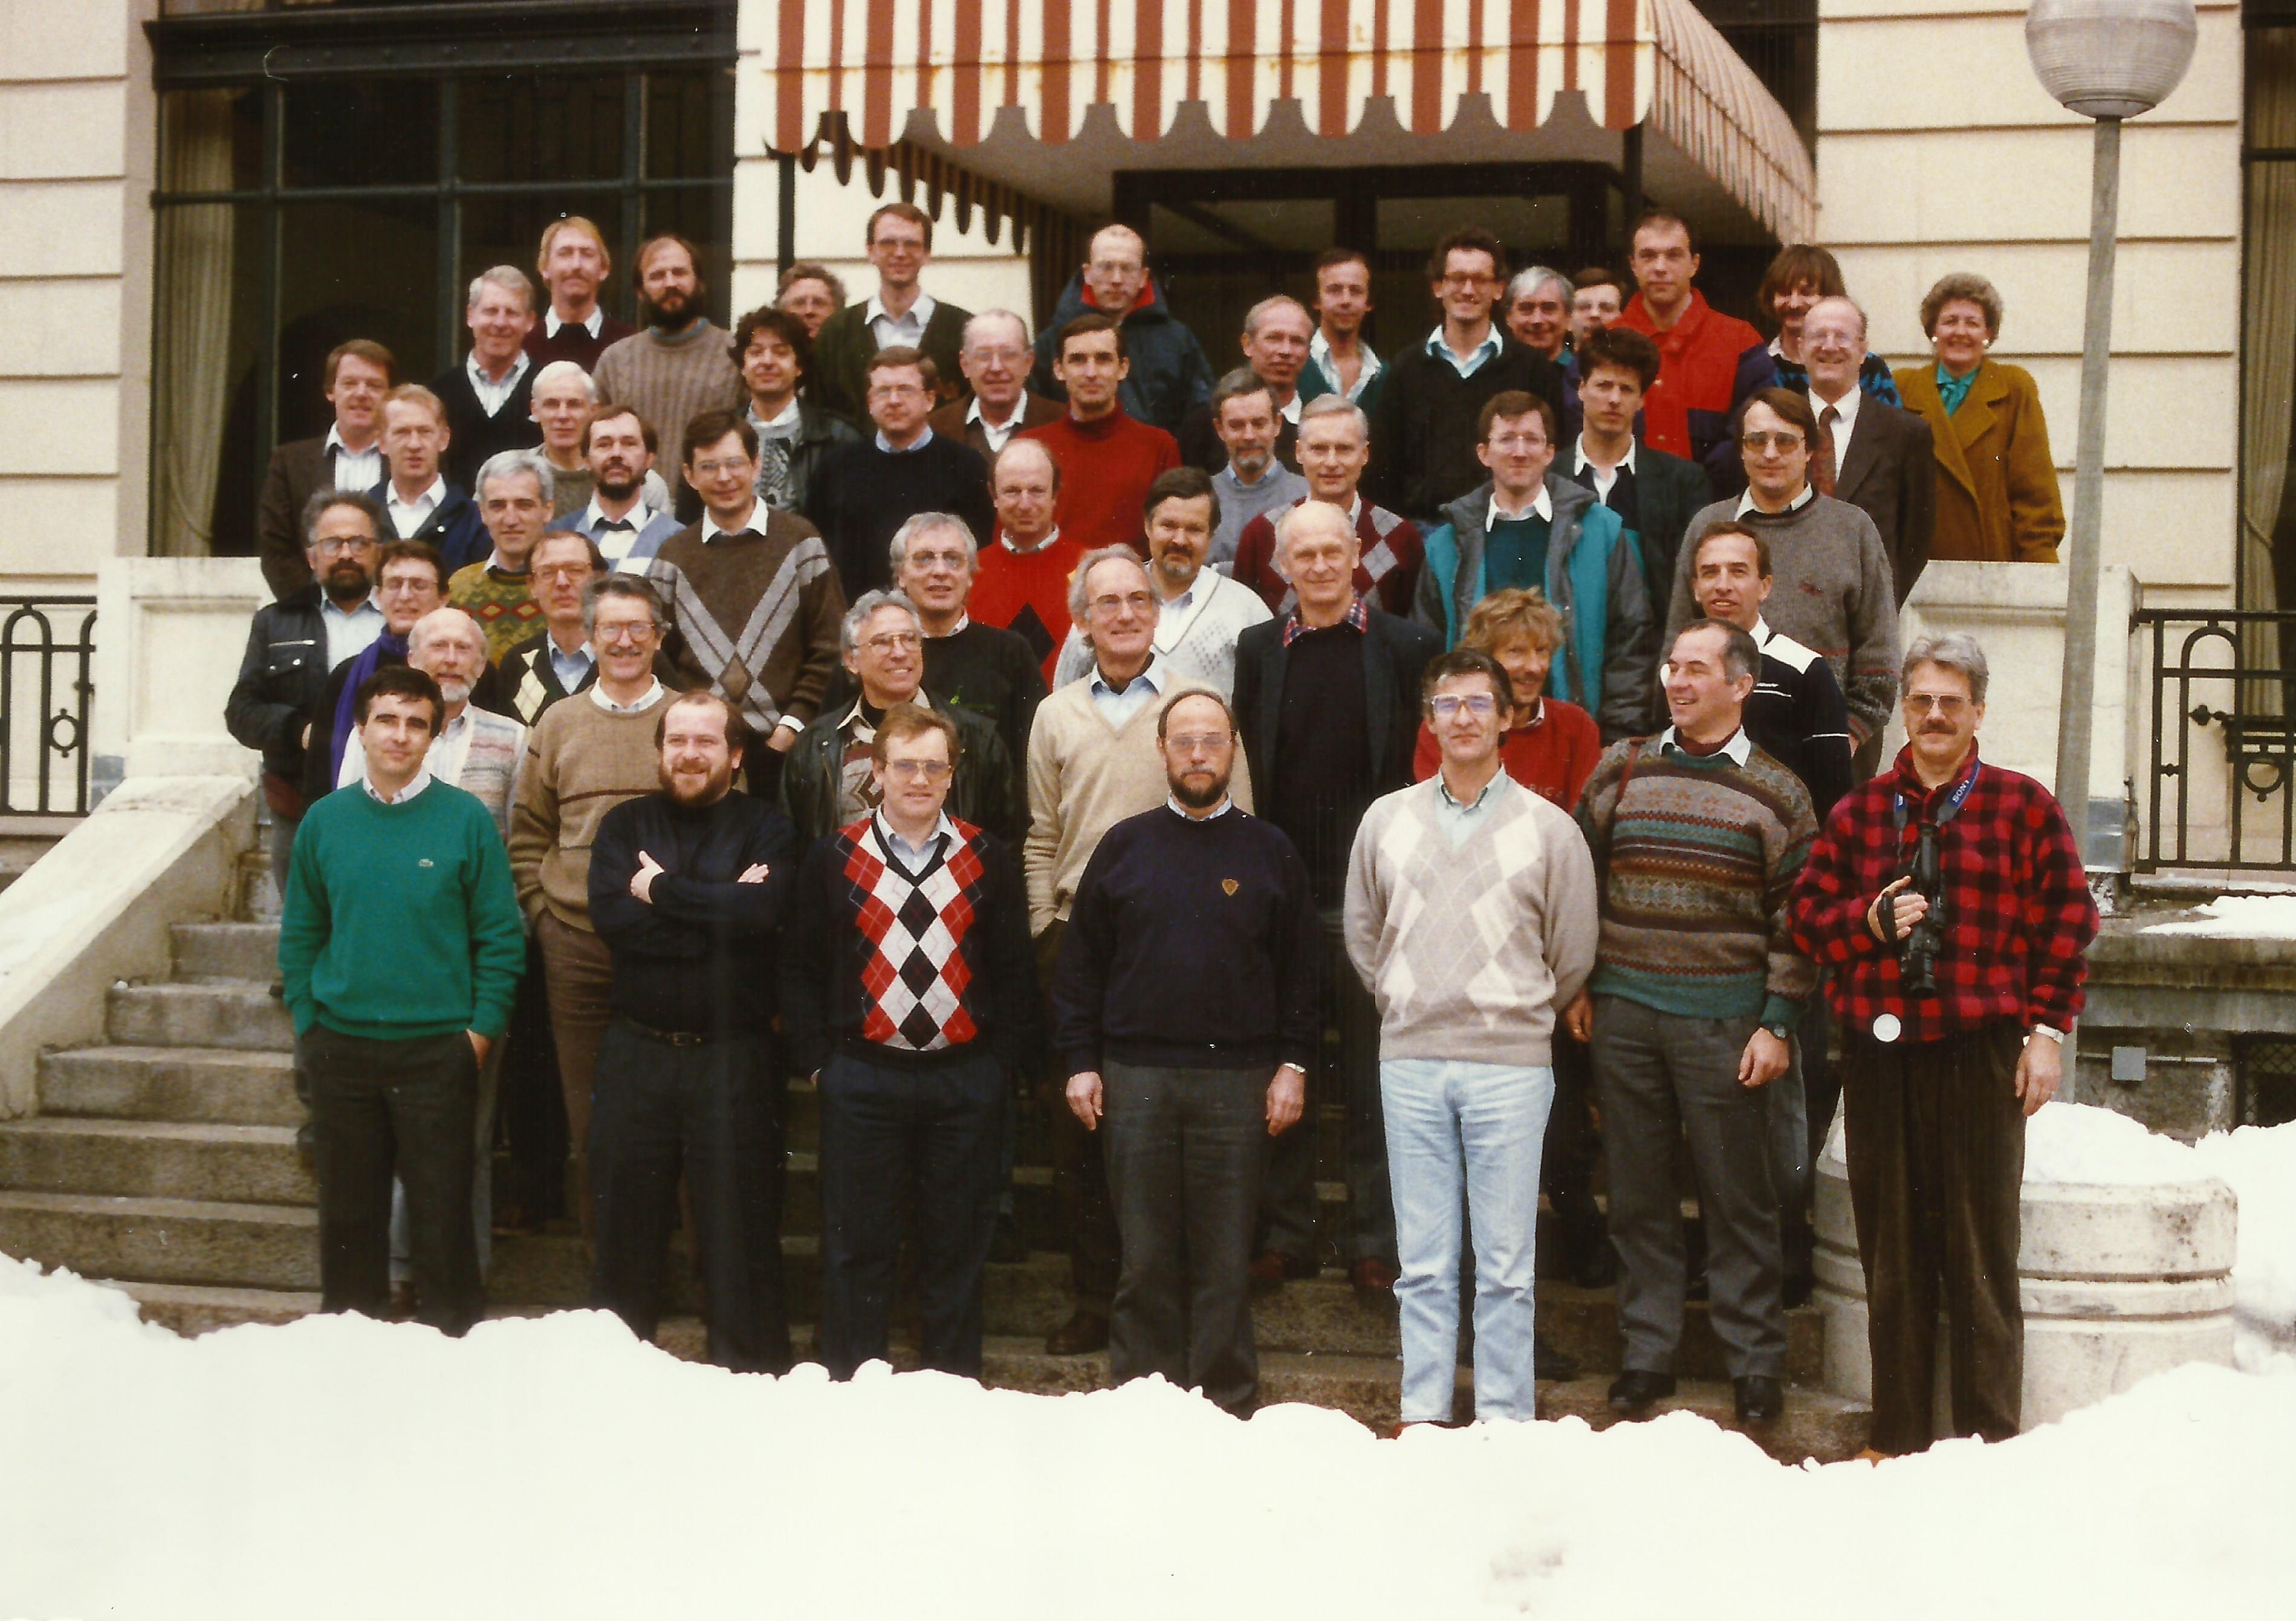
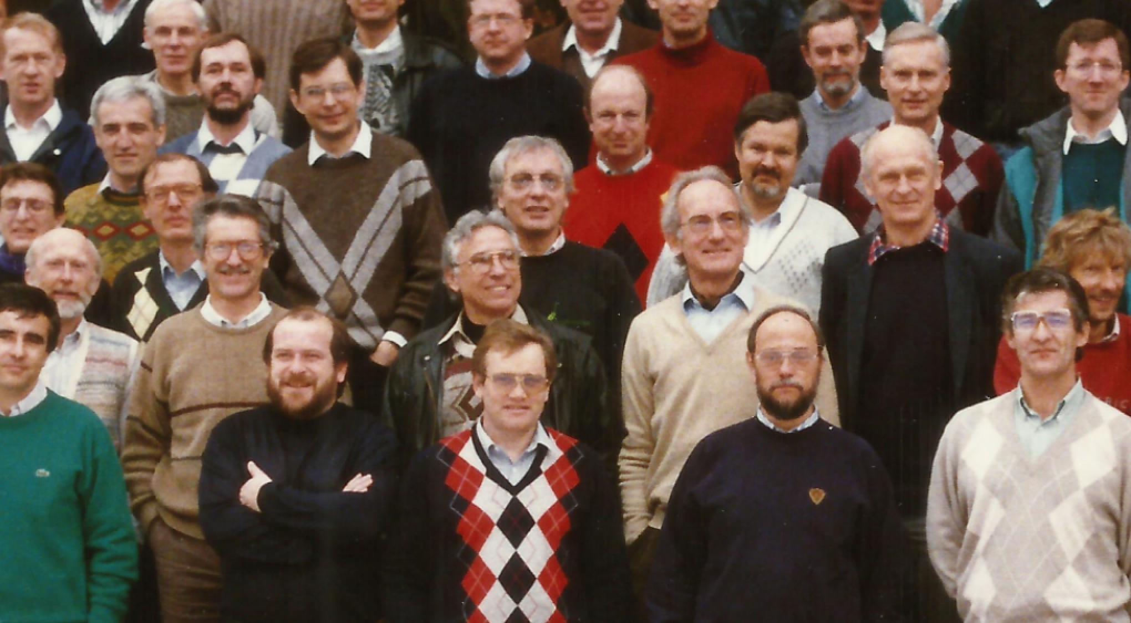
First Chamonix 1991

Slide 12
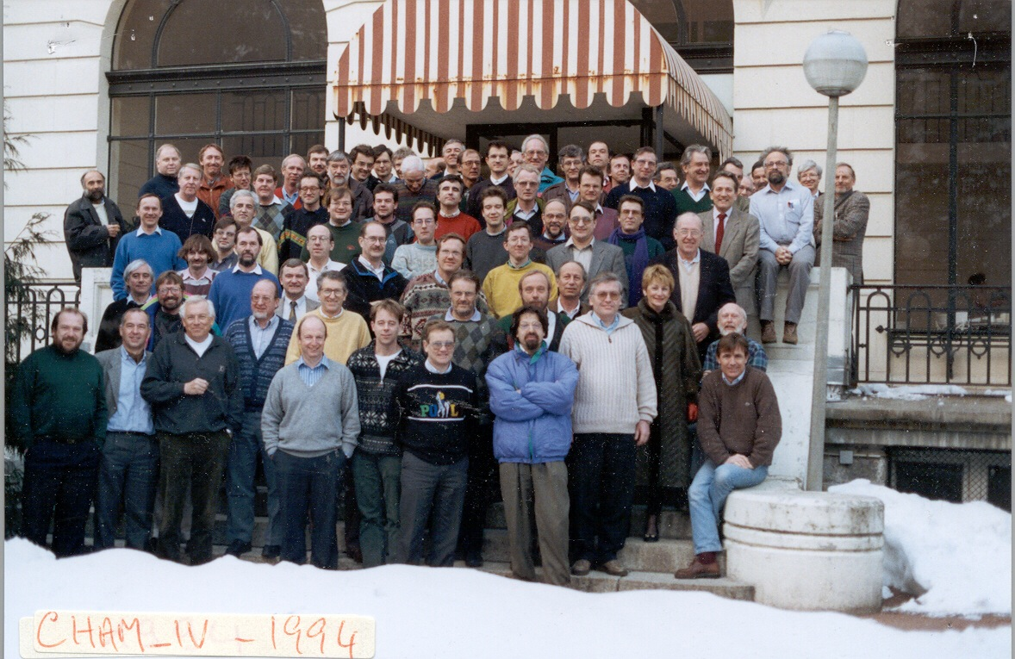

Slide 13
1992
In typical robust style Steve had pushed for the so-called super optics at Chamonix…
  90⁰/90⁰ phase advance
We also tried combined ramp and squeeze
And the release of a completely new high level software system…
It was a rather difficult start-up…

Slide 14
Pretzel commissioned
Steve – project leader of the “crash pretzel scheme”

Slide 15
1993:
  Pretzel
  90/60
  Design luminosity
  Energy scans
40 pb⁻¹
Z⁰ production
1994:
  Pretzel
  Tune shift ~ 0.047
  Bunch trains MD
  108/60 MD
  Synchrotron injection
64.5 pb⁻¹
Things were starting to look good, so the obvious thing was to…
1995:
  22 GeV injection
  Bunch trains of 2, of 3, of 4, of 3
  108/60 and 108/90 tests
  Oct/Nov: Physics at 65, 68 and 70 GeV
46.1 pb⁻¹
...was to switch to bunch trains

Slide 16
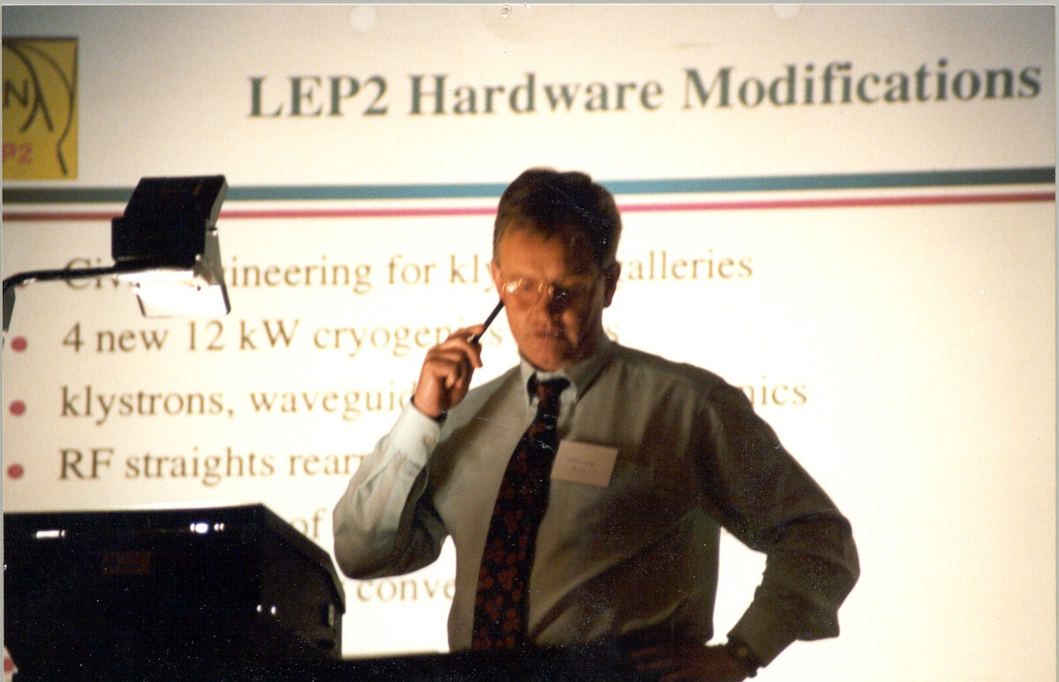
Steve took over project leadership in 1996
Key driver was the superconducting RF system…

Slide 17
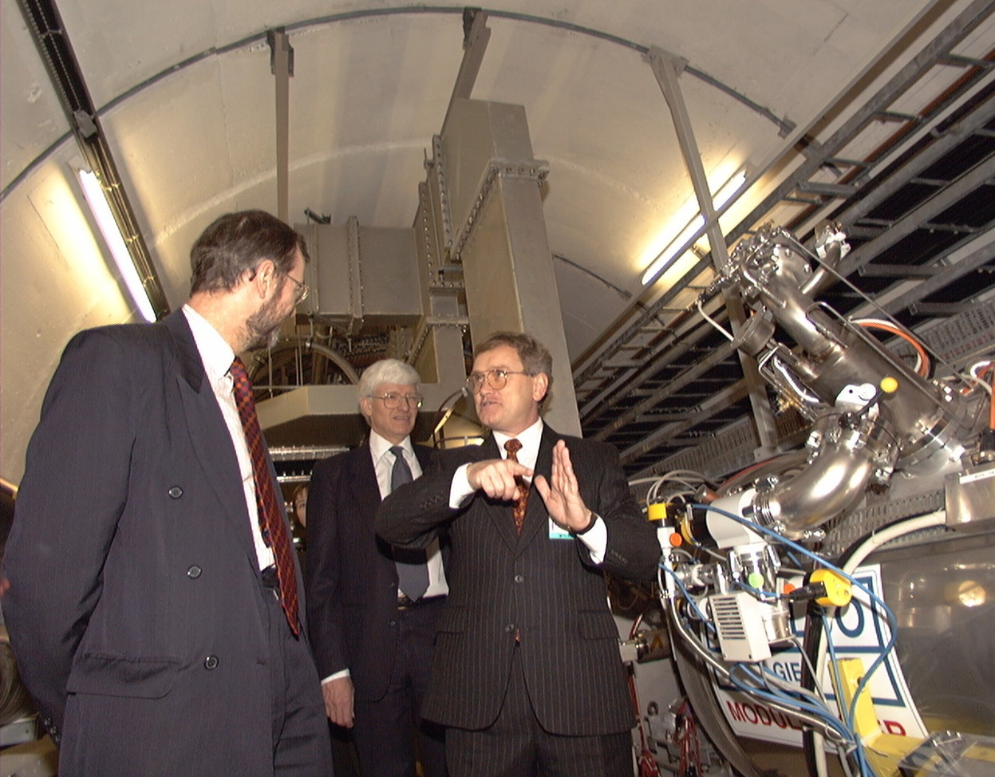
LEP 2
Going above the W pair threshold was always foreseen
Development of superconducting RF technology
Industrial production & numerous technical problems overcome
Money, politics and a supportive Director General
Chris Llewellyn Smith in 1995:
LEP extension in 1999 and 2000;
more SC cavities to reach 192 GeV;
to maximize the S.M. Higgs discovery reach.

Slide 18
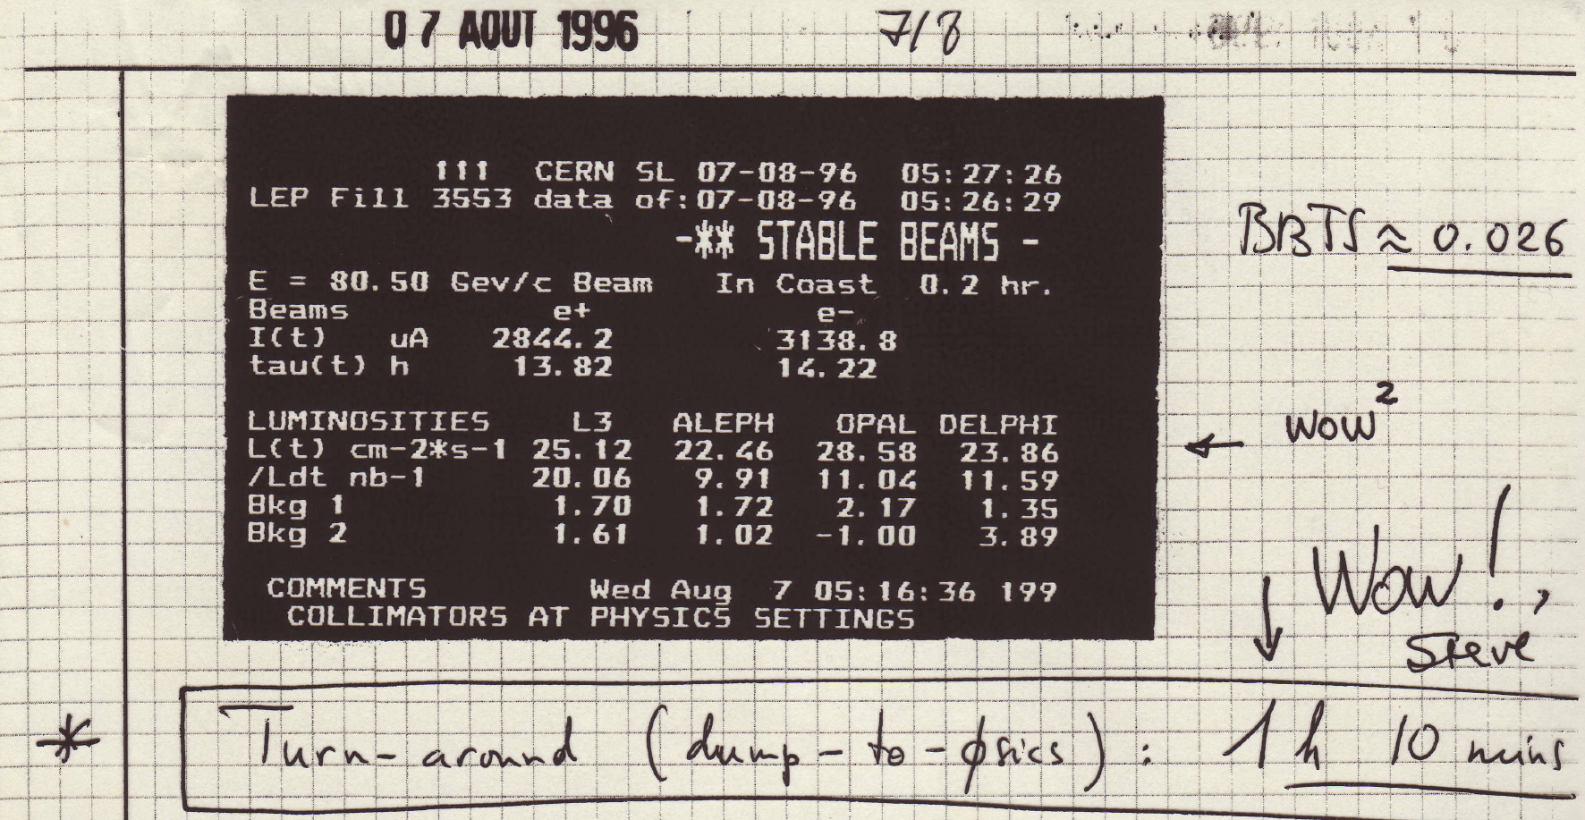
1996
Establish RF system
Deliver luminosity above the WW threshold
Come up with a low emittance optics
2 out 3
ain’t bad

Slide 19
Refreshing the particles that other beers cannot reach
x2
“Unsociable sabotage: both bottles were empty!!”

Slide 20
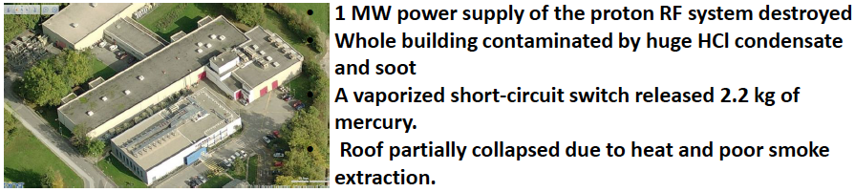
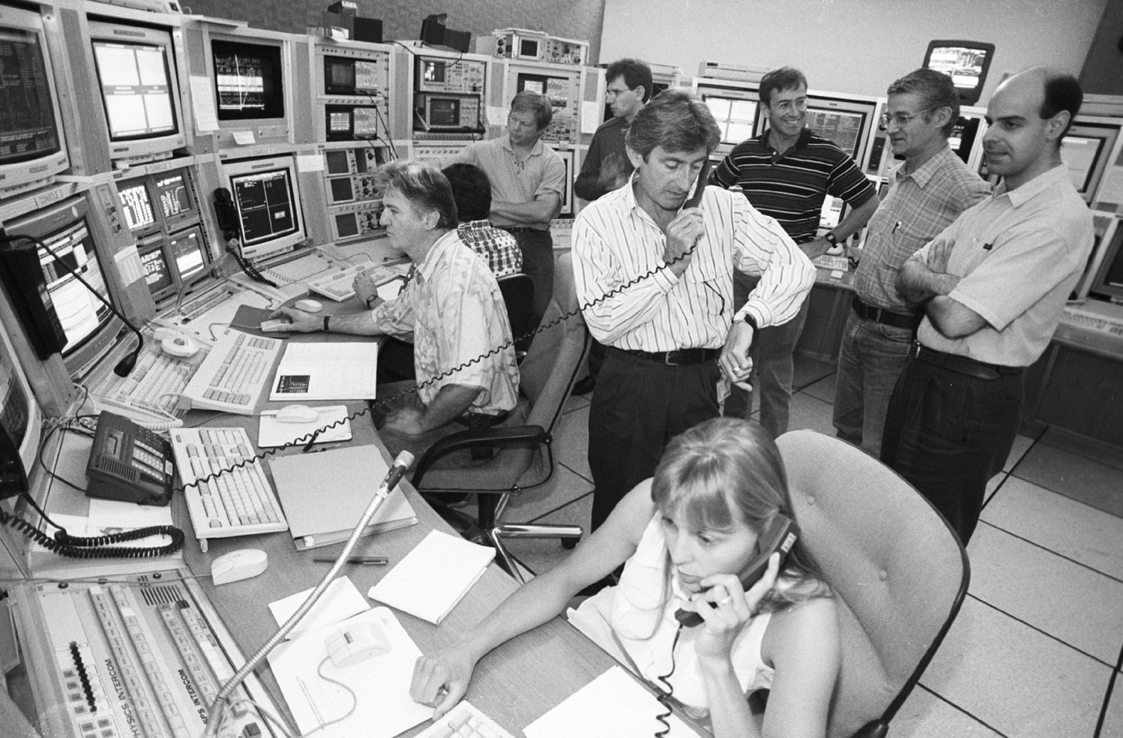
1997
13th May FIRE in BA3 – recovery coordinated by SM
13th July first beam
91.5 GeV
October: 102/90 tests
ξ_{y} ~ 0.053 & we have
a high energy optics

Slide 21
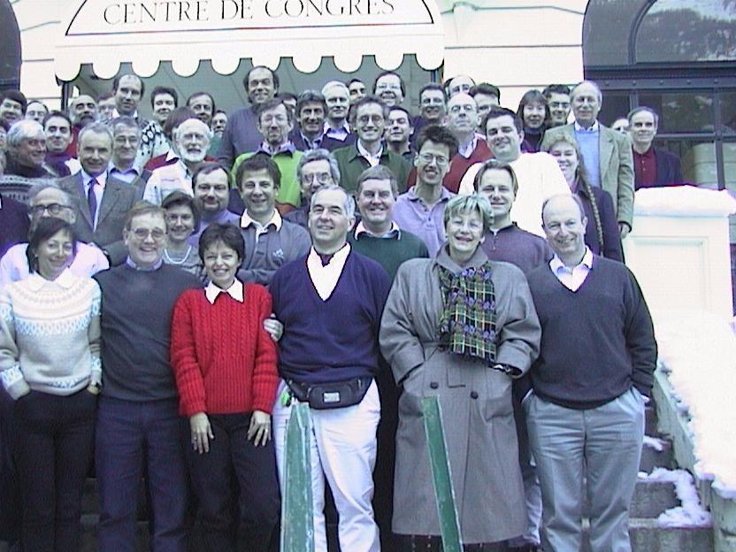
Chamonix 1998
MORE WOMENIZING

Slide 22
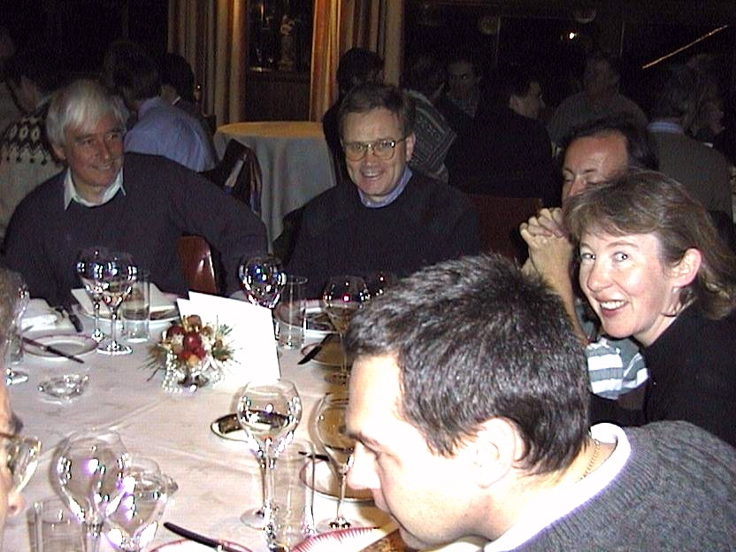

Slide 23
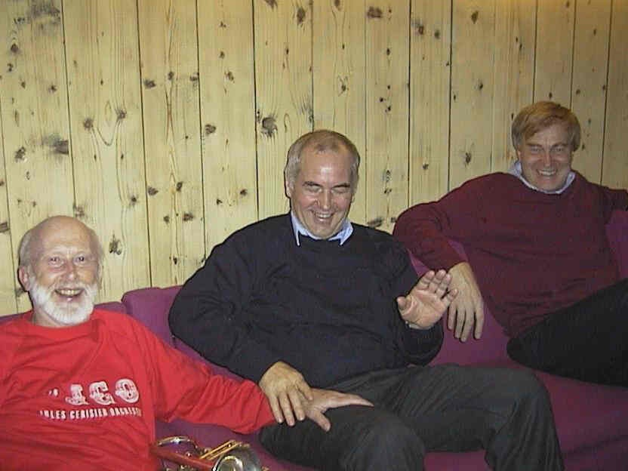

Slide 24
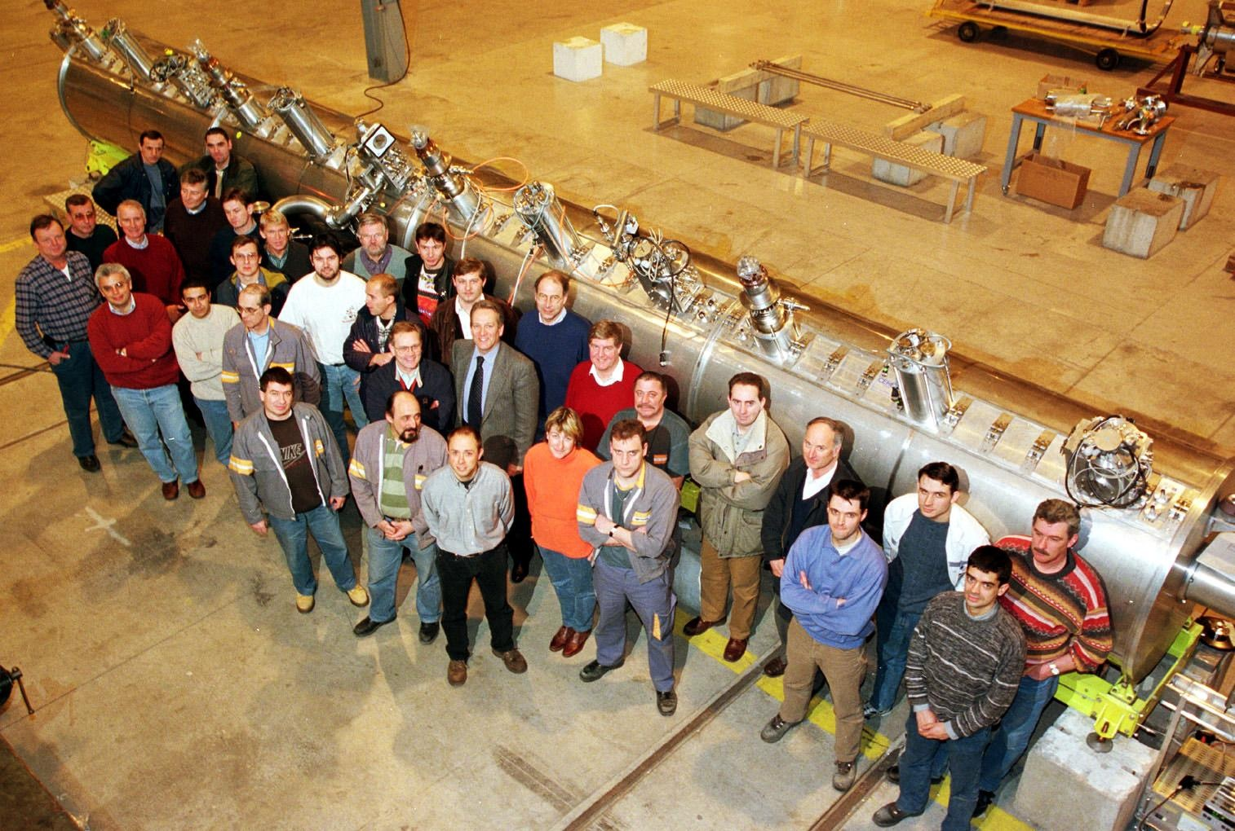
1999
A four year project to boost LEP's energy to 100 GeV per beam entered its final phase at the end of February when the accelerator's last superconducting cavities were installed. At a short ceremony held in SM18, Enrico Chiaveri, Head of the Cavity Technology Group, congratulated his team on a difficult job well done.

Slide 25
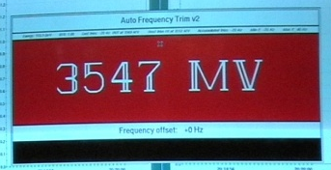
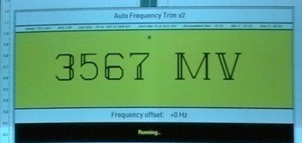
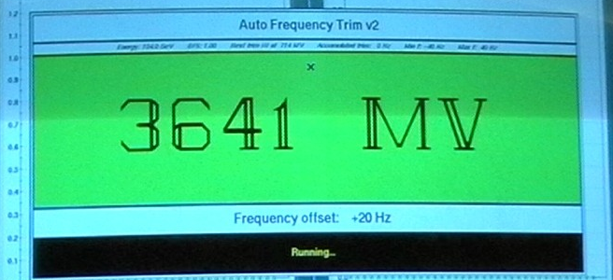
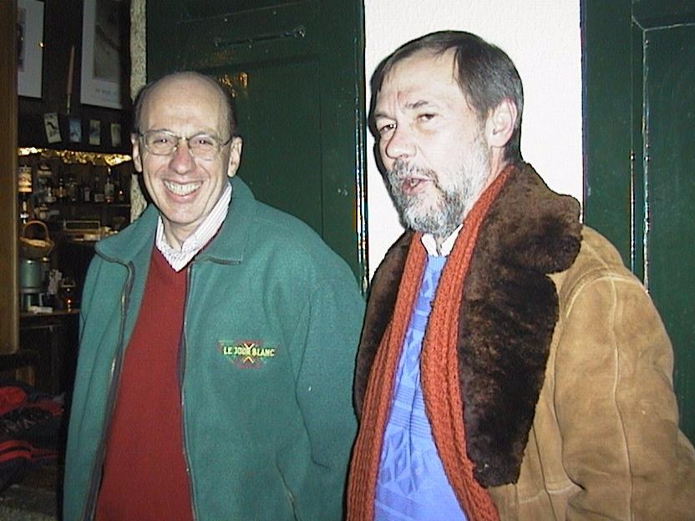
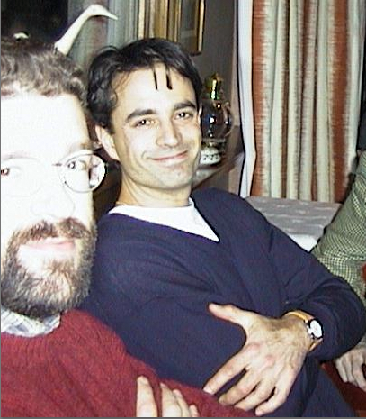
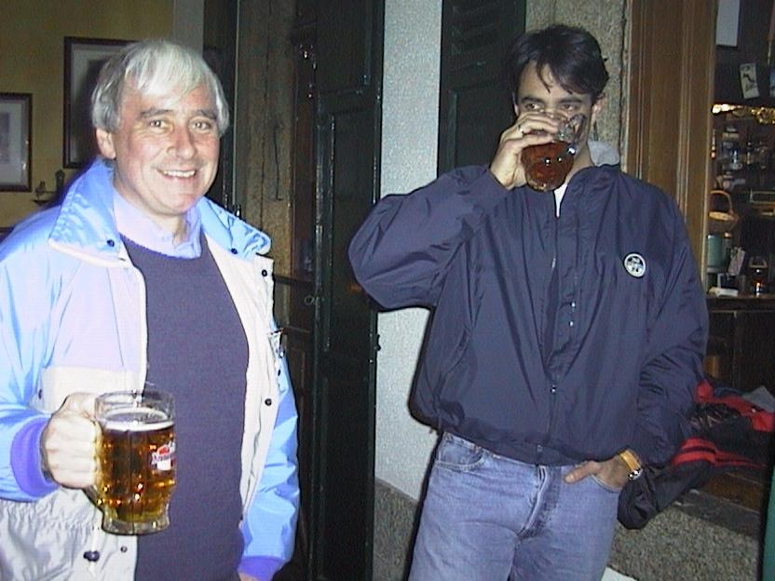
“The … RF system is now almost nearly fully operational”
In the final year of operation LEP had 288 SC cavities (272 niobium sputtered on copper; 16 solid niobium) and 56 copper cavities.
Average accelerating field was 7.5 MV/m (design: 6 MV/m)
Some operational tricks helped gain another ~2.3 GeV.

Slide 26
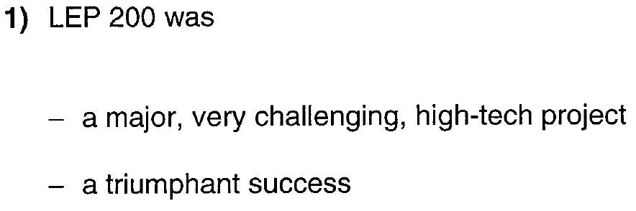
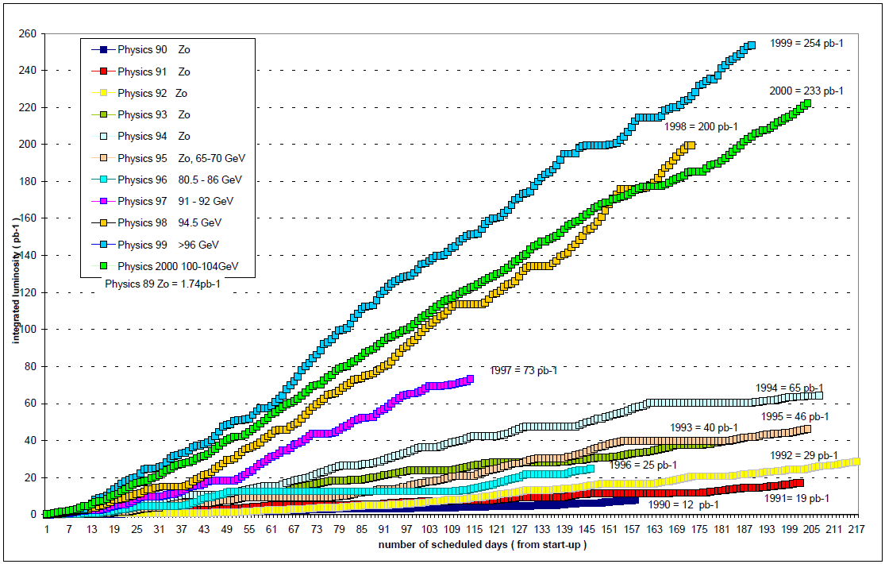

Chris Llewellyn Smith
70% of total delivered luminosity above 94 GeV
and in the last three years

Slide 27
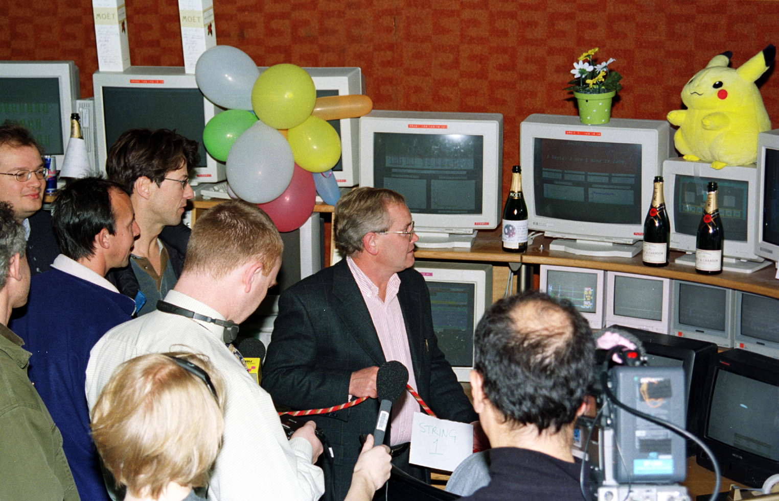
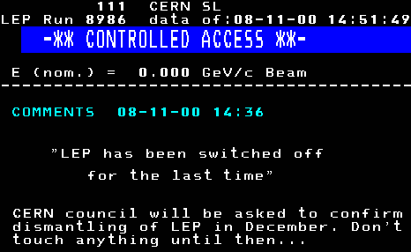
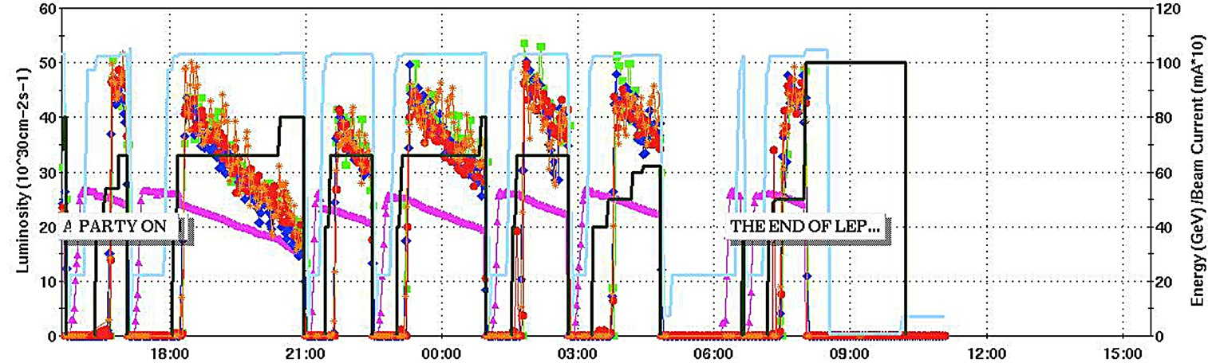
The
end…
November 2nd 2000, 7 a.m.

Slide 28
The legacy of LEP
The physics data (luminosity, energy, energy calibration)
“It should be stressed that the whole body of knowledge accumulated by the study of LEP and SLD data is simply enormous”
The experience in running large accelerators.
- Technical infrastructure
- Operational control (Orbit, tunes, ramp, squeeze…)
- Alignment, ground motion in deep tunnels
- Designing and running a large SC RF system.
- Impedance and beam dynamics in big machines
- Optics designs from 60/60 to 102/90 and 102/45
Operation in unique regime of ultra-strong damping:
- Vertical emittance with small solenoid effects (dispersion-dominated).
- Beam-beam limit with strong damping.
- First confirmation of theory of transverse spin polarization.
Numerous papers (e.g. 554 papers in Chamonix proceedings from 118 authors).
LEP will be the reference for any future e⁺e⁻ ring collider design.

Slide 29
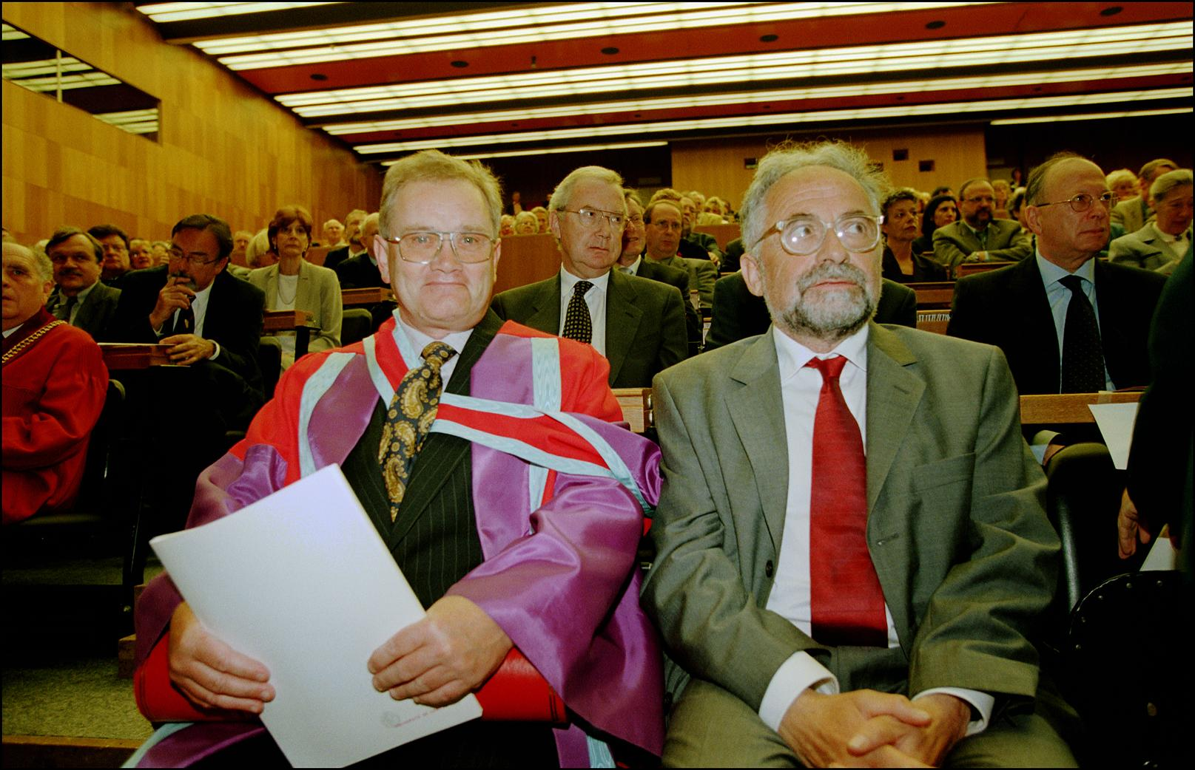
Steve Myers and Albert Hofmann awarded the title of Doctor Honoris Causa by the University of Geneva in recognition of their services to accelerator physics and their essential contributions to the success of CERN's LEP electron-positron collider…
June 2001

Slide 30
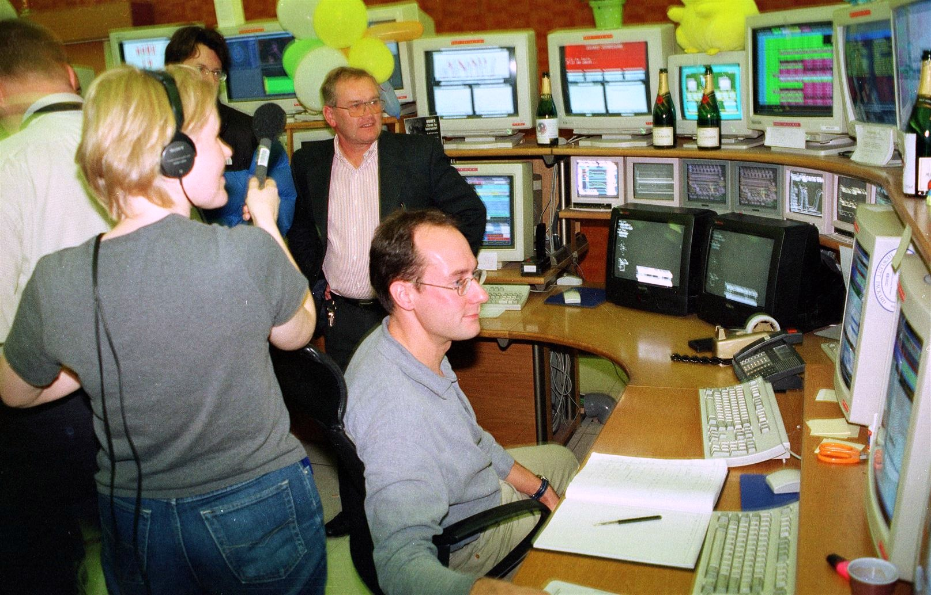

Slide 31
