Slide 1
Alice overview
New detector and chamber
ALICE TC

Slide 2
The ALICE smaller diameter beampipe
ALICE wants to install a new beampipe in LS2. The reason is to build a new silicon tracker with greatly improved features in terms of determination of the distance of closest approach to the primary vertex, tracking efficiency at low transverse momenta, and read-out rate capabilities.
First request in LEB meeting 16.9.2010. Several options evaluated since then: outer diameter 3.4cm to 4cm, and wall thickness down to 500um.
The TDR for new ITS has recently been submitted to LHCC, and presented at the LHCC week the 2nd of December. Another detector, the MFT, has in the meantime been approved.
New beampipe ready for final LEB submission:
Outer diameter: 3.6cm (6cm now) and wall thickness of 0.8mm
Length: 550cm (+68cm wrt present pipe)
Bellows and flanges in Al (instead of SS)
Remote bakeout

Slide 3
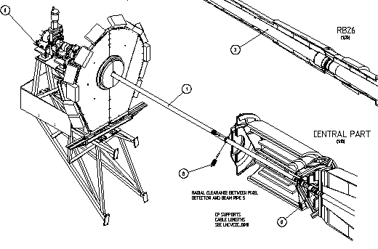
Present central beampipe
Fixation Points
ALICE can align the beampipe – this was already done in 2008 to compensate a sag of support structures due to detector installation.
IP

Slide 4
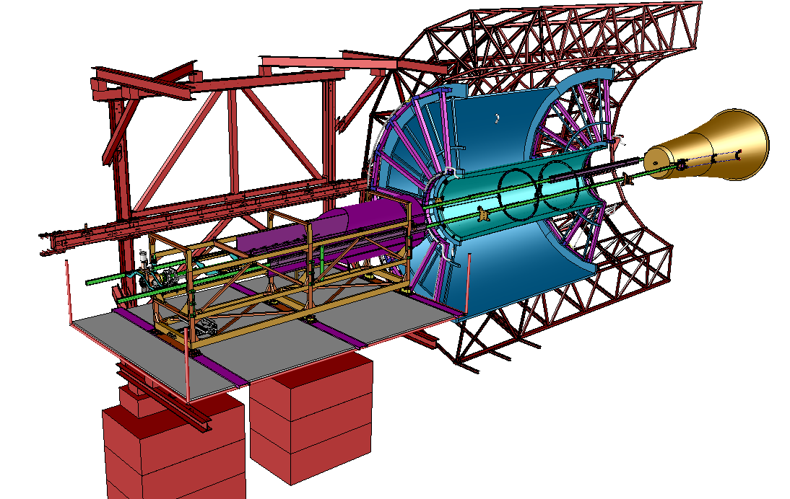
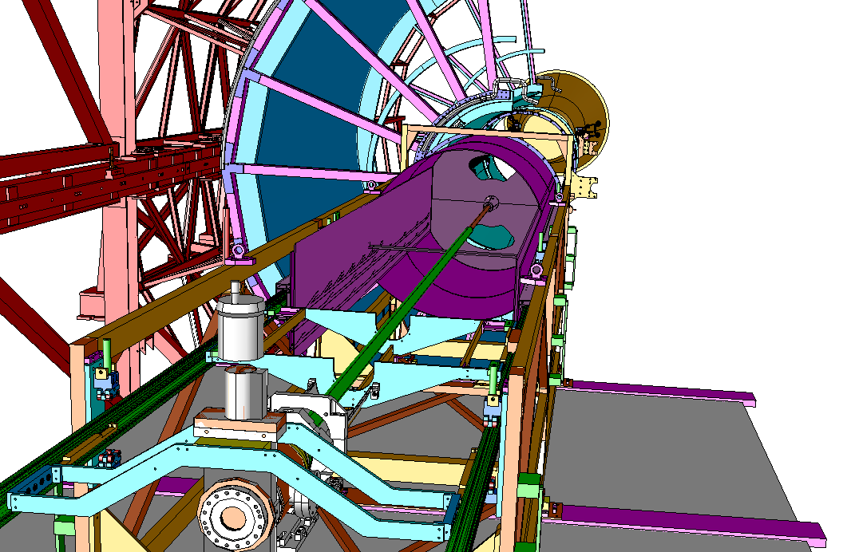
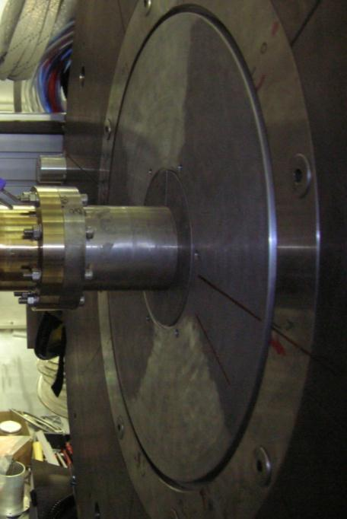
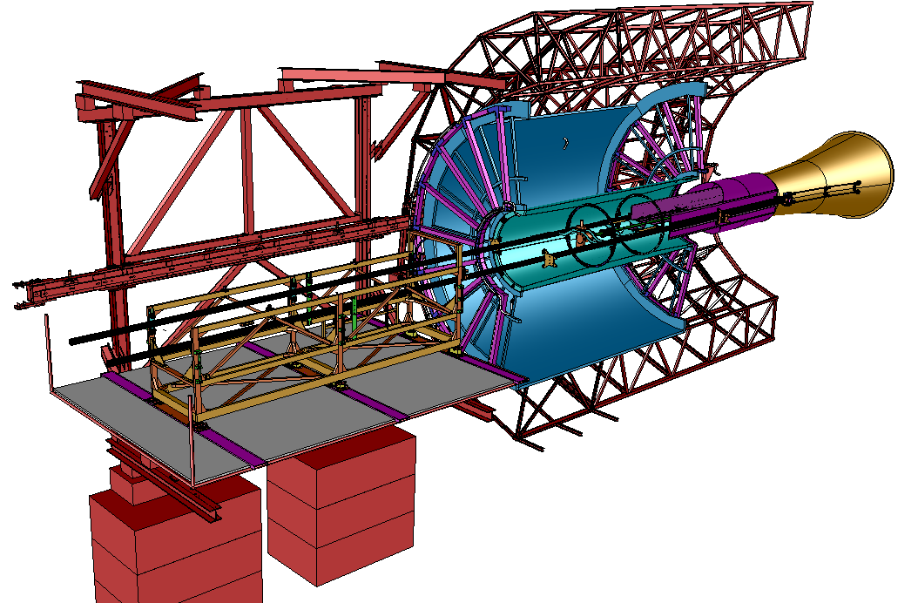
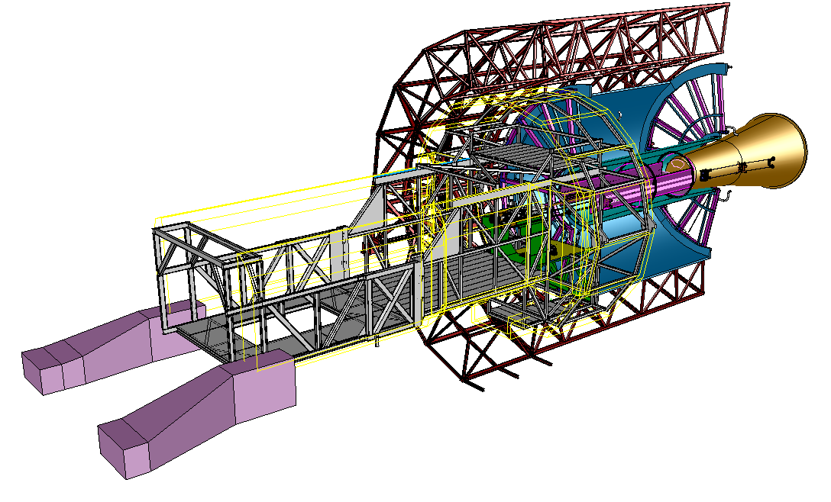
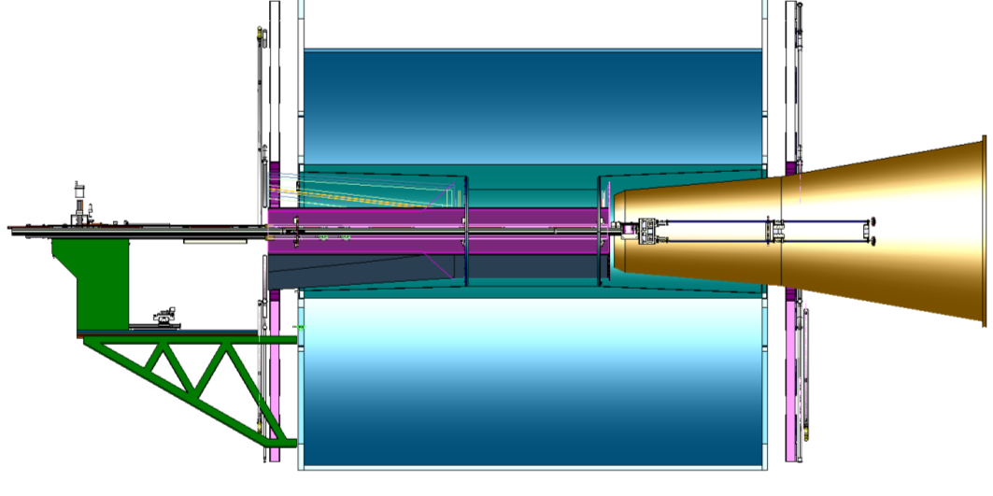
DELPHI FRAME
Beam pipe in the Cage
Beam pipe connection
1)
TPC
CAGE OUT
2)
CAGE IN
Beam pipe external support
3)
MINI FRAME

Slide 5
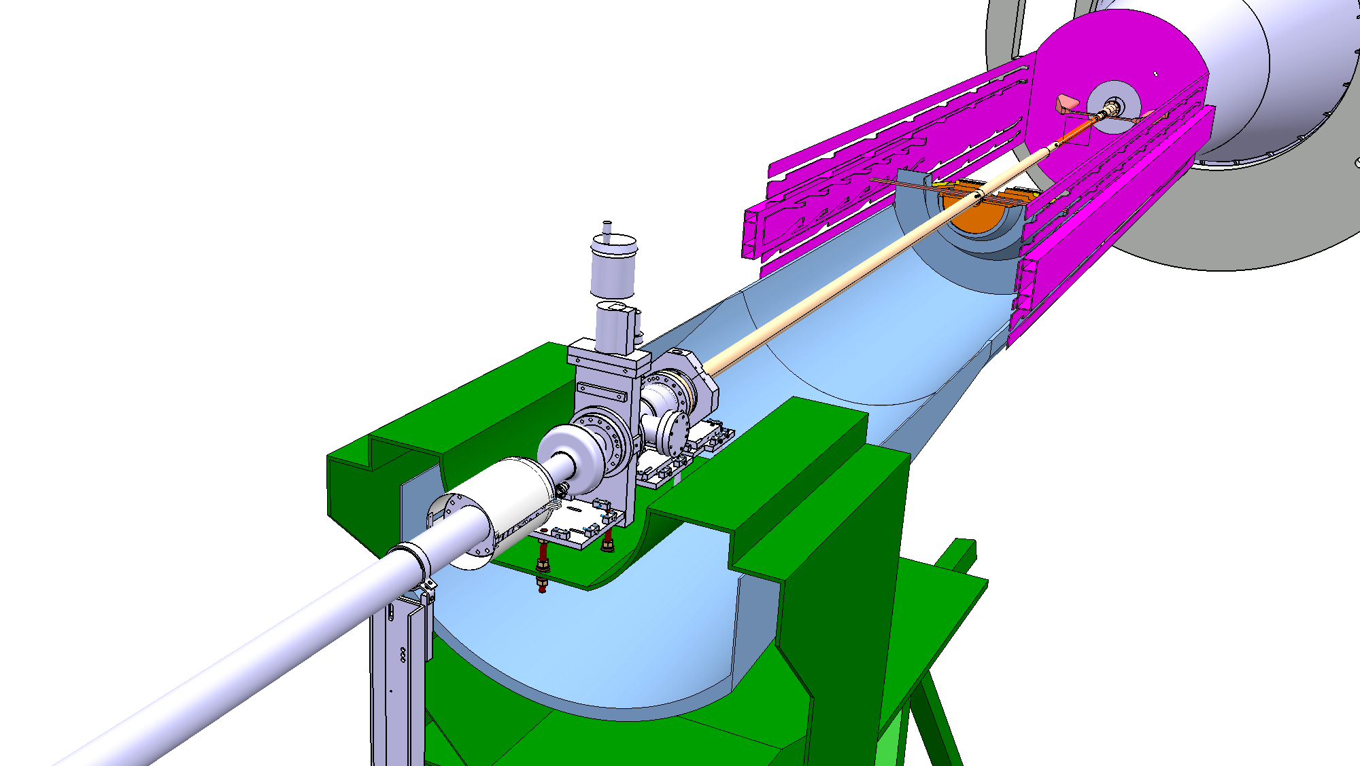
New layout
Cage
Detector/Service Barrel
Beampipe new support

Slide 6
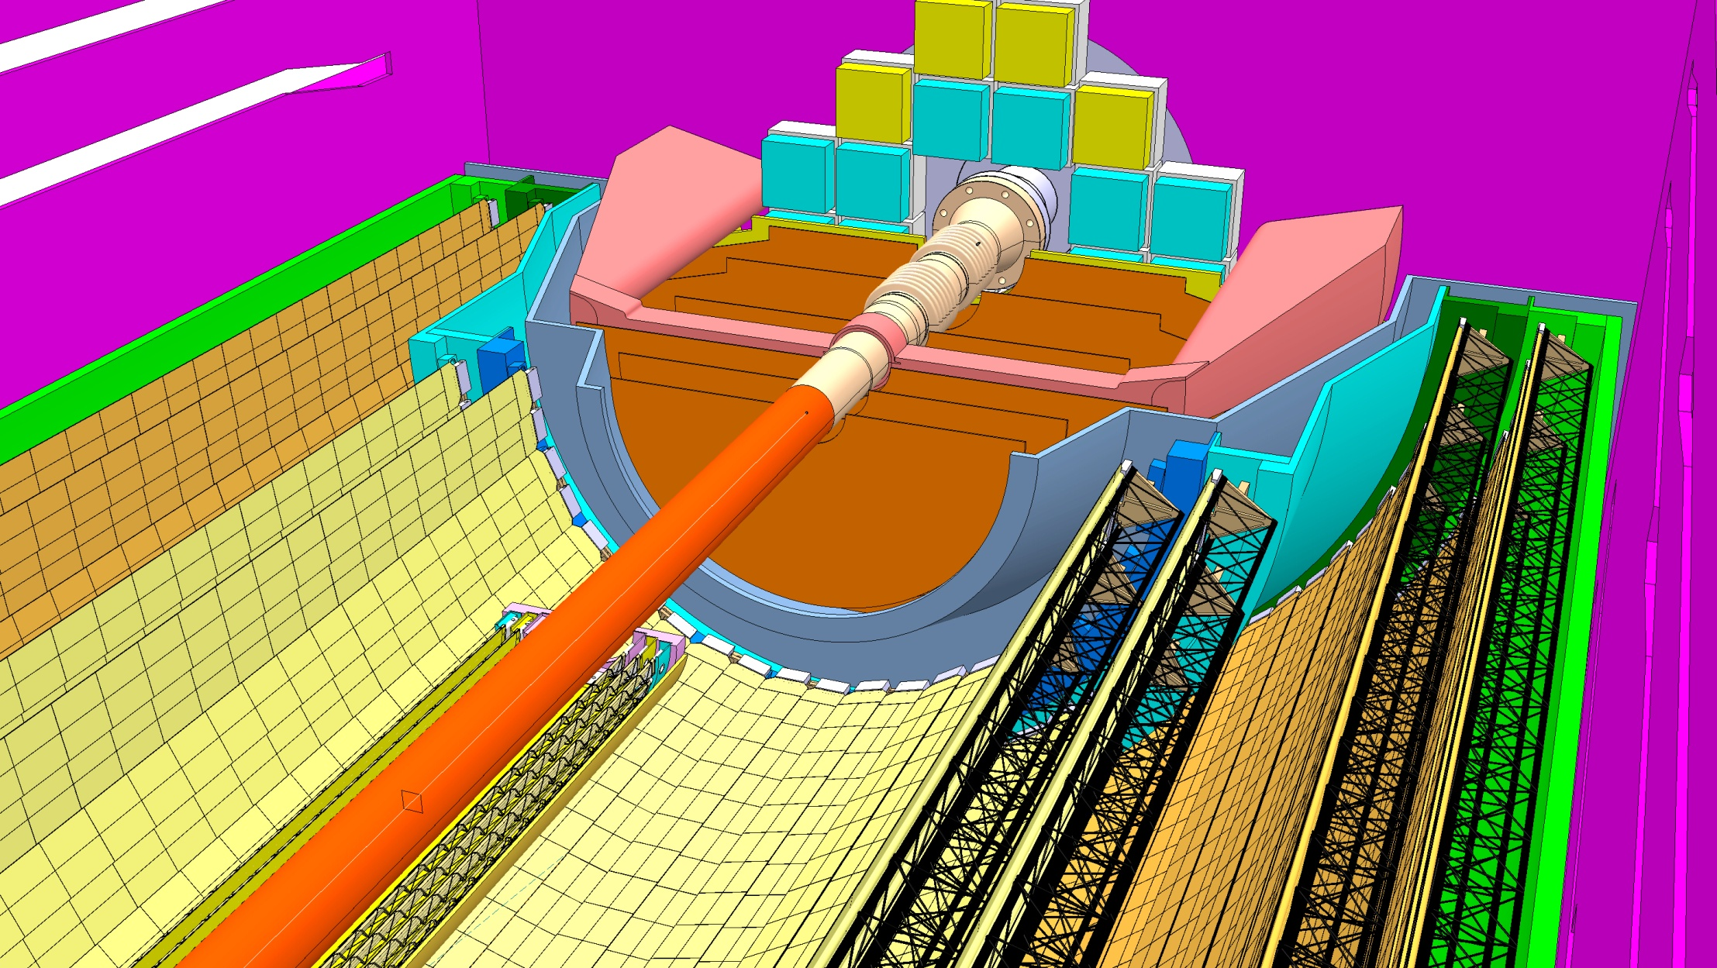
ALICE beam pipe central section, C-side
cage
FIT
MFT
ITS

Slide 7
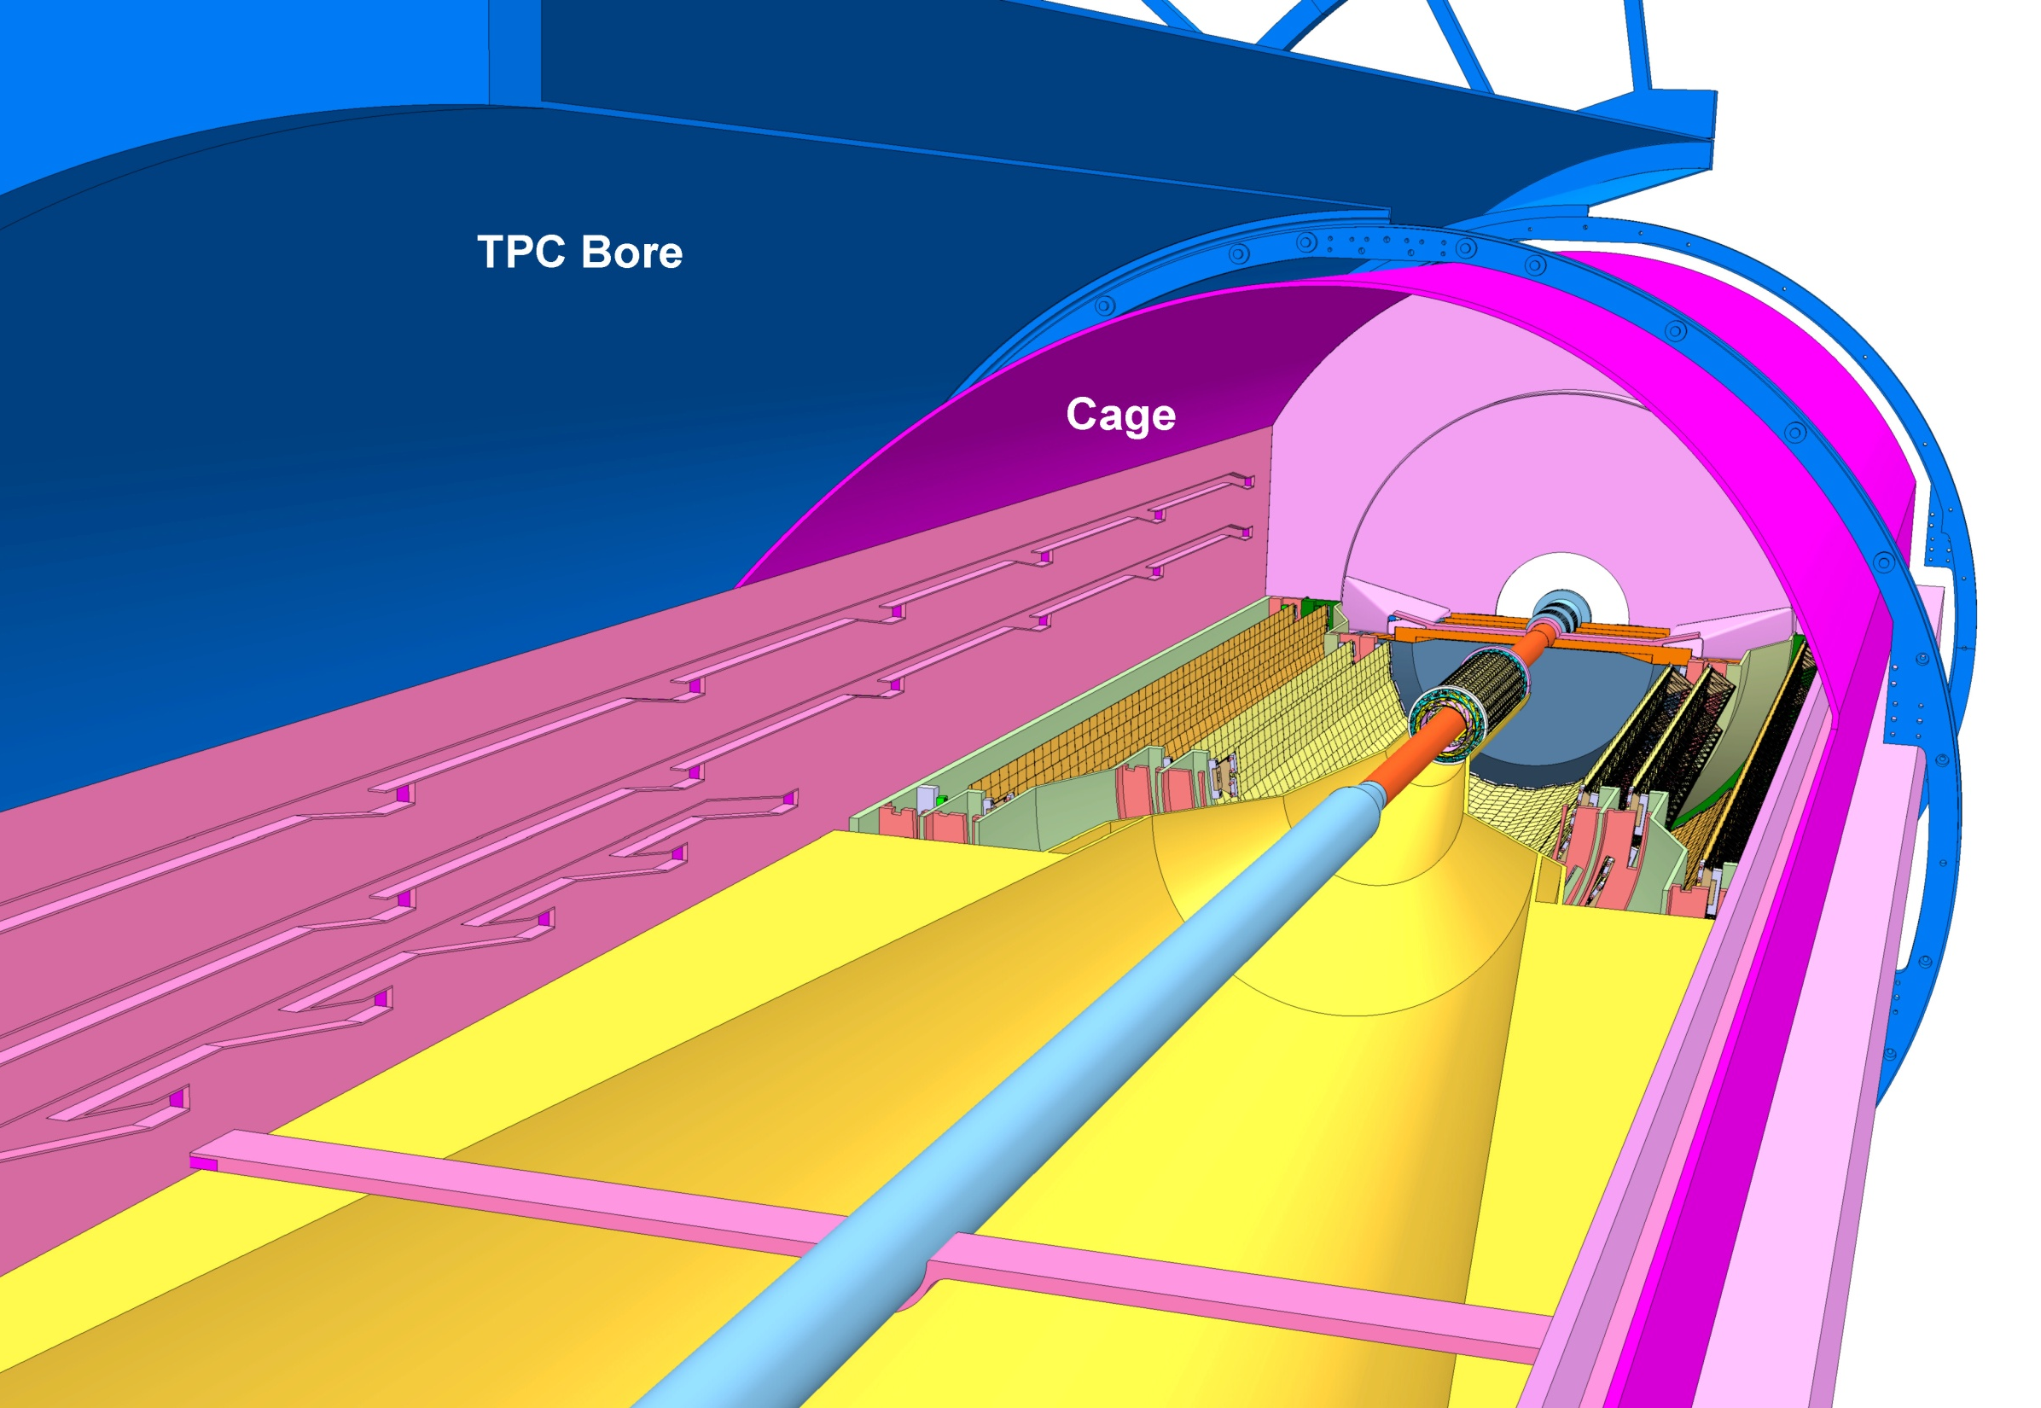
ALICE beam pipe central section

Slide 8
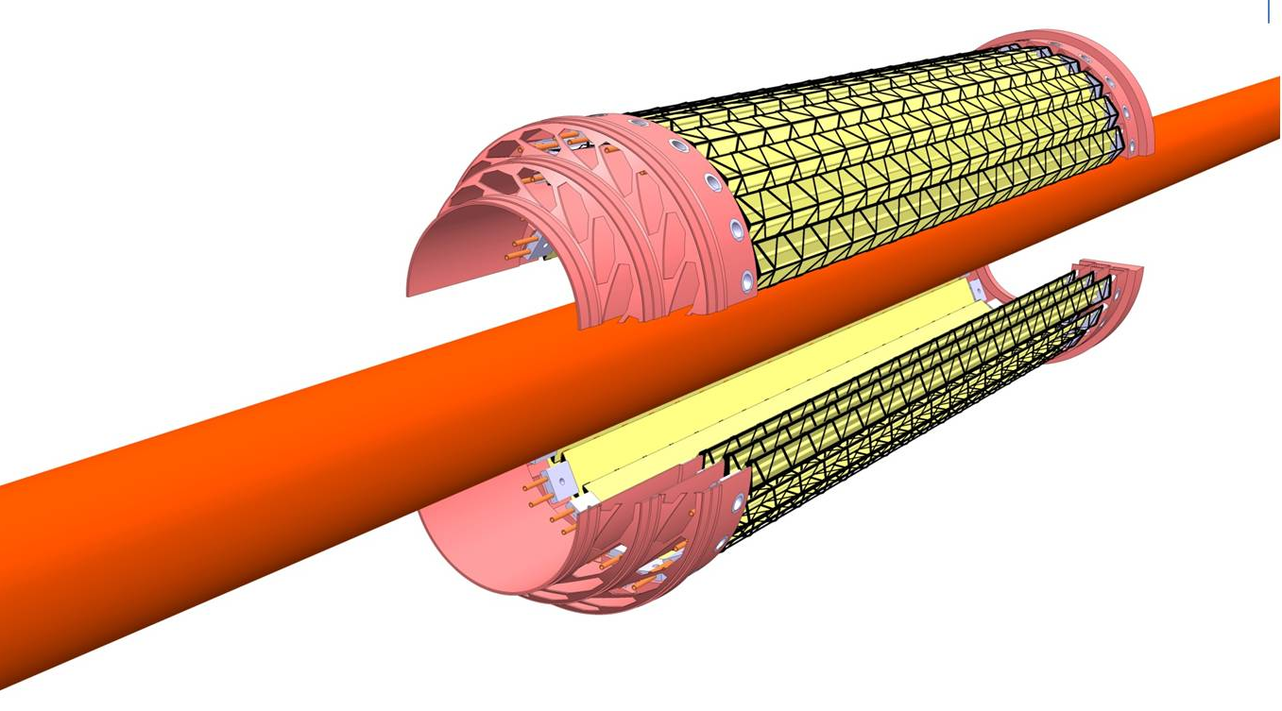
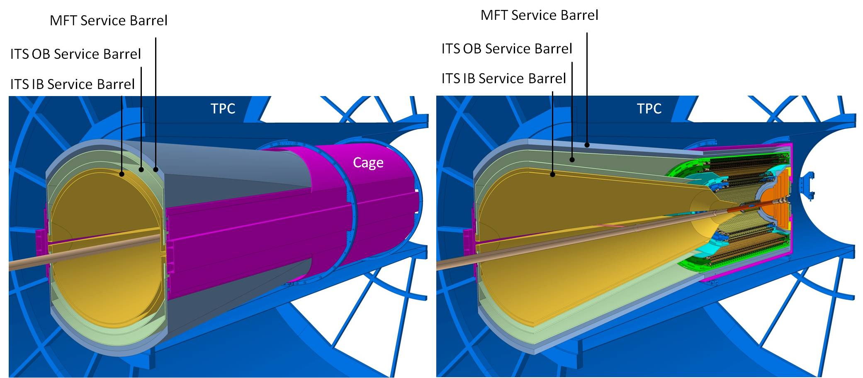
ALICE beam pipe central section

Slide 9
Layout new ALICE central beampipe (LS2) V6
Central part
C-side section
A-side section
IP
4236
444
444
376
4680
820
5500
A-side Al section
Central Be part
C-side Al section
IP
63.8
68.3
15.4
58.9
30
58.9
η=3.9
15
20
α=15°
α=15°
α=15°
Bellow OD56
Bellow OD56
α=15°
OD 60
OD 50
OD 36
OD 43
OD 43
OD 60
Support#1
Support#2
Support#3
21.4
9.4
18.7
3956.1
26.1
204.3
330.3
31.7
14
4236
888
376
All dimensions in mm. Wall thickness 800μm everywhere (bellow thickness 300μm)

Slide 10
Tolerances
Quantity | Central part (A) | C-side part (B)
Construction and deflection | 0.6mm ⁽¹ | 0.5mm
Mechanical adjustment precision | 1.5mm ⁽² | 0.5mm
Survey to beamline uncertainty | 1.5mm ⁽³
Quad fiducial to beamline uncertainty | 0.5mm ⁽³
L3 movement | <0.5mm ⁽⁴
B field movement | <0.5mm | <5mm
Linear sum | 5.1mm | 8.5mm
LEB 21.3.12
LEB 4.11.10
LEB 22.2.12
LEB 23.3.12
A
B

Slide 11
ALICE
Injection energy

Slide 12
ALICE
min 13.1
Injection energy

Slide 13
Conclusions
ALICE wants to install a new beampipe in LS2, with central section, 3.6cm OD and 88.8cm long, in Be
The tolerances are 5.1mm (central part) and 8.5mm (C-side part)
With these tolerances the n1 min (at injection) is around 13.1 sigma, and is located at the C-side of the pipe → to be confirmed by Massimo

