Slide 1

Water detectors?
Nobody ever called me divine,
so I will stick to Hyper Kamiokande

Slide 2
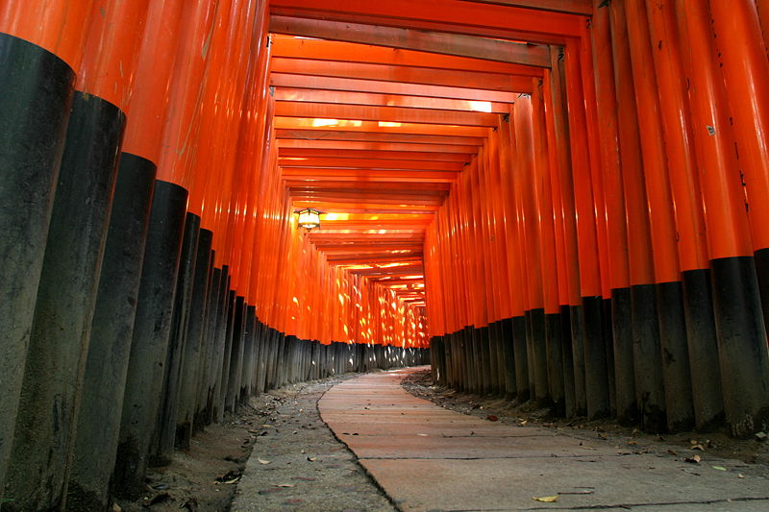
Hyper-Kamiokande and Europe
CERN Neutrino Meeting
CERN
November 26, 2013
Dave Wark
Oxford University/RAL

Slide 3
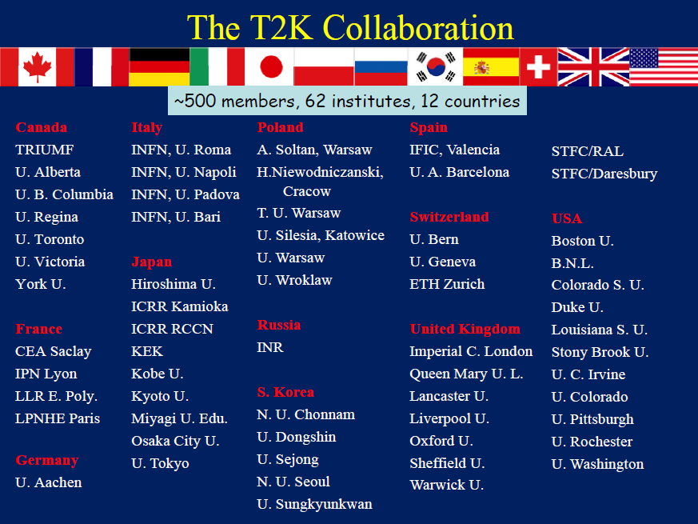
>50% of members are from Europe.
Largest (by numbers) neutrino exp. in Europe

Slide 4
Overview
Super-Kamiokande
p
π
μ-mon
ν
off-axis
on-axis
2.5º
Near detectors
0m
120m
280m
295 km
30GeV proton beam from J-PARC MR to produce neutrino beam
Beam is 2.5 deg off-axis from far detector direction
  Peak ~0.6GeV @ osc. max
  Small high energy tail
  Dominated by CCQE
  ➔ Low background
Muon monitors @ ~120m
Near detector @280m
  On-axis detector “INGRID”
  Off-axis (toward SK direction)
Far detector Super-Kamiokande @ 295km
w/o osc.

Slide 5
CERN Contributions to T2K
Donation of the magnet.
Technical support for the magnet refurbishment.
Technical support for magnet services.
Administrative and technical support for the magnet shipment.
Procurement of the magnet cooling system.
Maintenance contract for the magnet cooling system.
Technical support for magnet field mapping system.
Technical support for the Micromegas design, construction of the MM, support for their testing.
Testing of other TPC components.
Test beam access for TPC and ECAL.
Enormous support for the NA61 experiment, which is a key part of T2K.

Slide 6
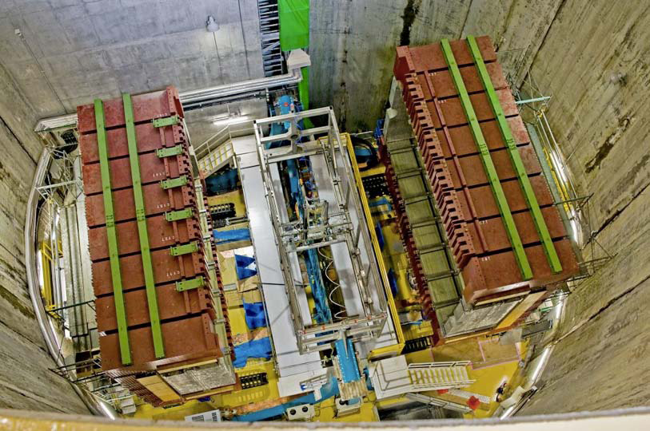

Slide 8
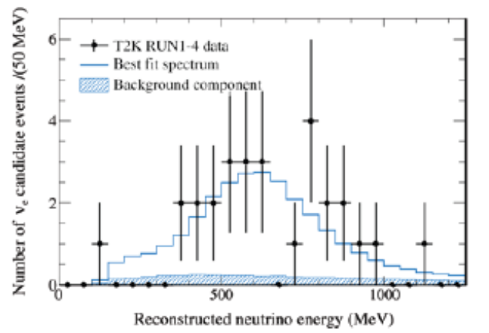
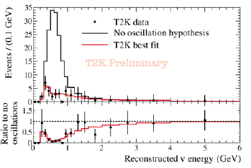
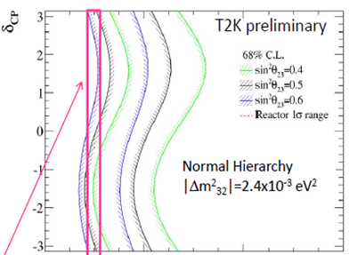
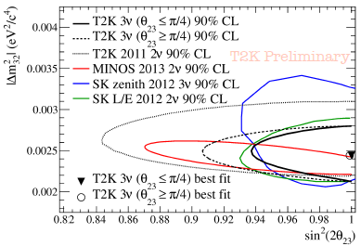
T2K Results
T2K Appearance
PDG Reactor
constraint

Slide 9
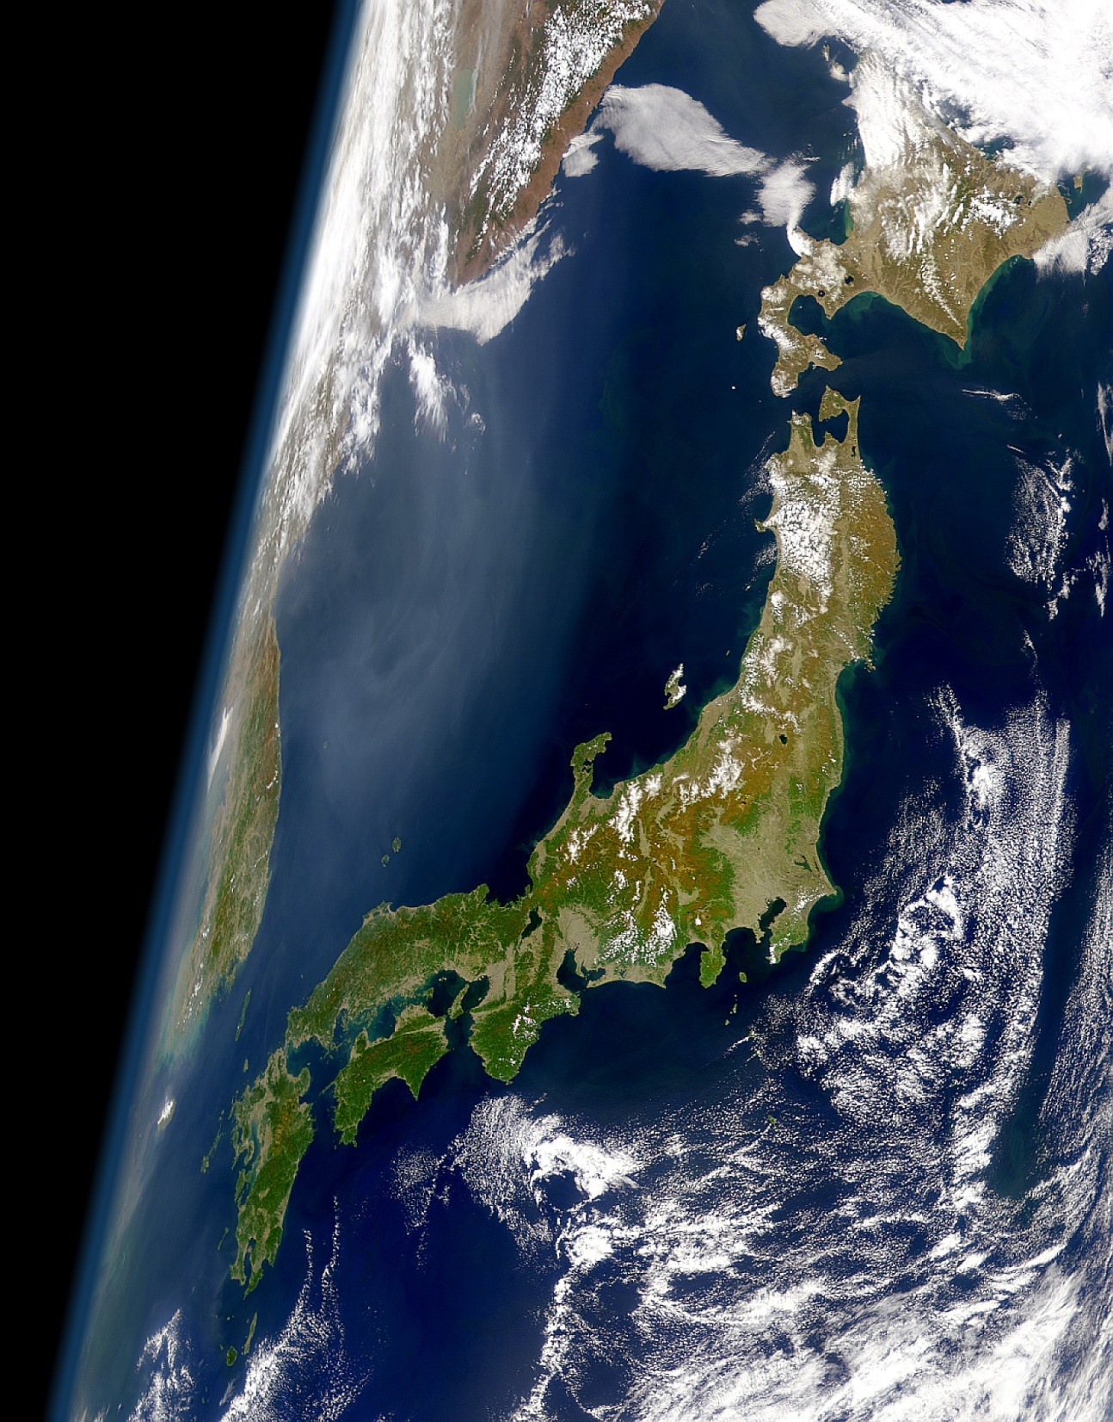
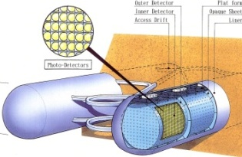
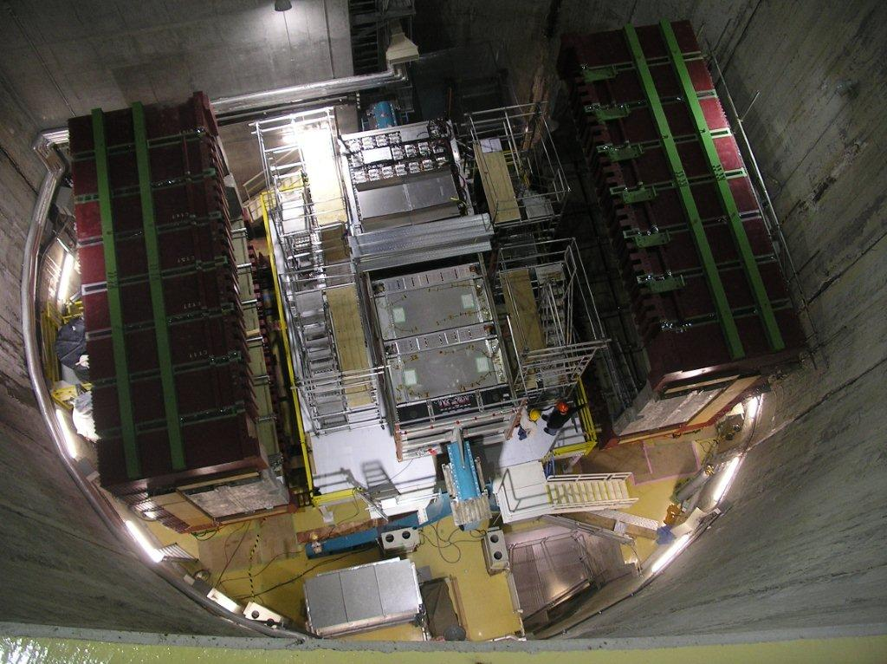

The Next Step in Japan
Hyper Kamiokande L=295km OA=2.5deg
J-PARC MR
→~>1.0MW
Water Cerenkov optimal on this baseline.
T2K 280m near detectors, will be re-used,
but upgraded (?) and maybe enhanced
with new near detector(s) at 2km.
Interference with ILC in Japan?

Slide 10
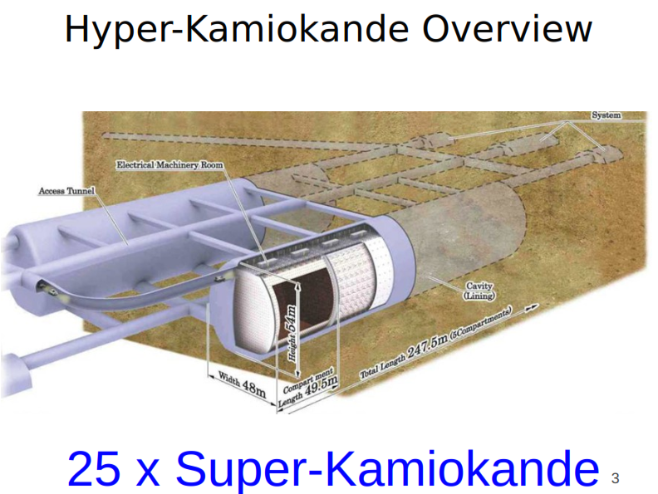
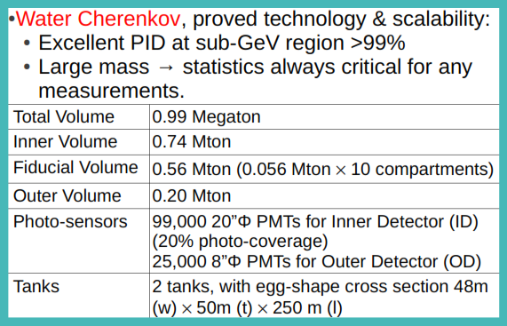
Most HK slides stolen from Di Lodovico’s talk at NNN 13

Slide 11
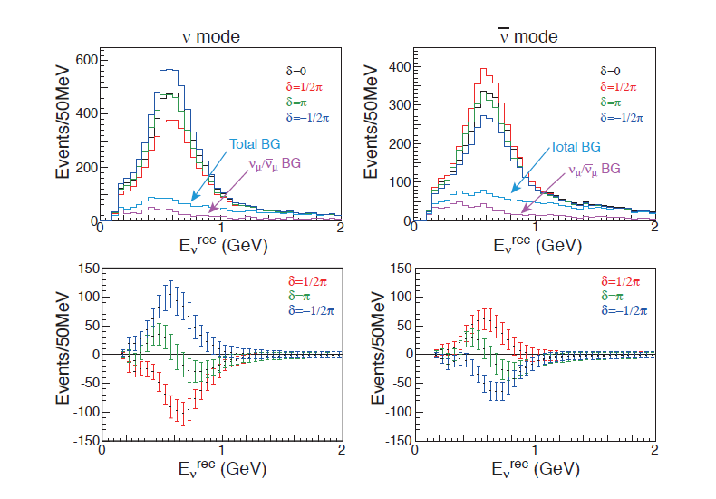
Hyper Kamiokande Appearance Spectra
NB: Normal Hierarchy Assumed!
Difference from
δ = 0.
10 yrs running (3 ν, 7 anti-ν) @ 750 kW assumed…

Slide 12
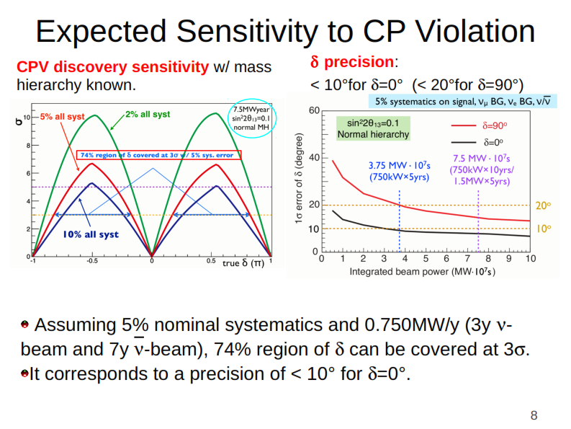

Slide 13
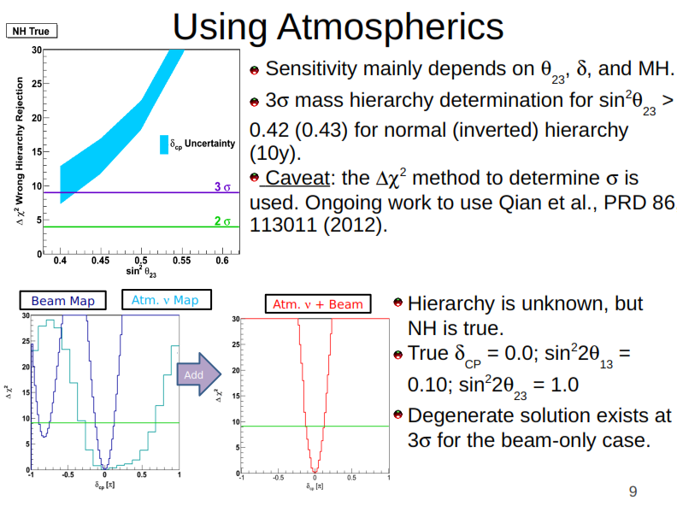

Slide 14
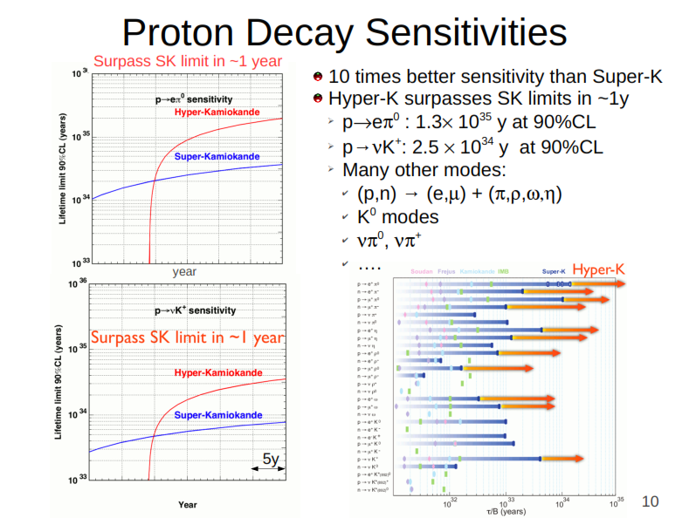

Slide 15
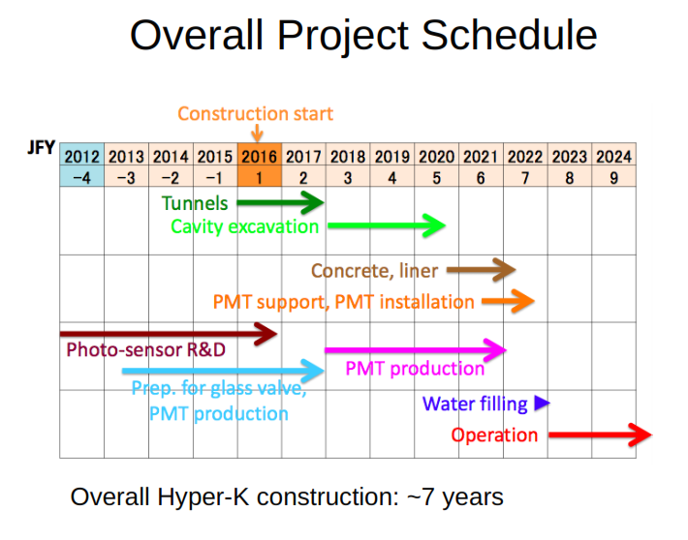

Slide 16
European Involvement in HK
An ongoing involvment in HK will be a natural outgrowth of the large European involvement in T2K, and is warmly welcomed by our Japanese collaborators.
Europeans are being involved in Hyper Kamiokande from the start, meaning that the separation between T2K and Super Kamiokande will not happen in the new project.
We are still exploring many different possibilities for our involvement, mostly centred on the near detectors(s). We are likely to build at least one, and perhaps 3, new ones.
A meeting is scheduled at Queen Mary in London on Dec. 18th to begin planning coordinated European involvement, and ~30 people have signed up so far (that is similar to the number that showed up at the first Euro-JHFnu meeting at CERN, which grew into the ~250 on T2K).
I think significant European involvement in HK is certain (assuming it is built, of course!).

Slide 17
CERN Involvement in HK?
European collaborators in Hyper Kamiokande will no doubt wish to request help from CERN on many different things, however I don’t currently know of anything on the scale of the UA1/NOMAD magnet.
The most critical thing, in my view, will be NA61 – which will be critical as we move into systematics limited experiments.
CERN should think carefully about how it can support NA61 or its successors on the time scale of decades.
A precision measurement of electron (anti-)neutrino cross sections would be extremely useful in establishing the reality of any effect.
The UK and the US were heavily involved in the neutrino beamline for T2K. CERN involvement in upgrades to the entire accelerator complex could well be extremely useful.
We are speculating about a beam at the 2nd maximum…
Does all this compete with other LBNx’s? No.

Slide 18
Why do we need multiple experiments?
The history of our field is littered with wrong results – my first exposure to ν physics was Reines et al. “discovering” neutrino oscillations in the mid-70’s, as did Bugey, and about a dozen other experiments, and there was Lubimov’s ν mass and the 17 keV neutrino and many, many others – superluminal neutrinos come from a proud tradition of ν anomalies.
ν experiments are hard – so why do we believe the current measurements of 3ν oscillations?

Slide 19
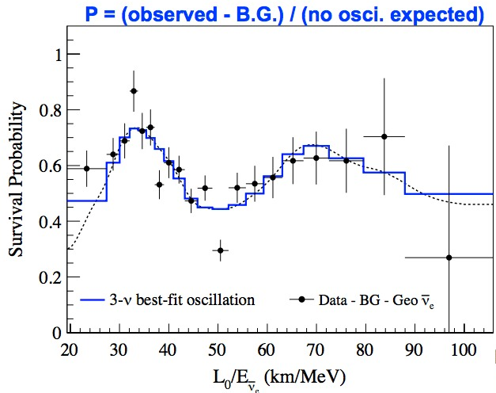
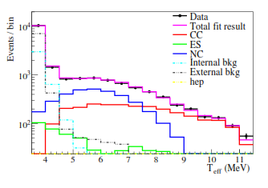
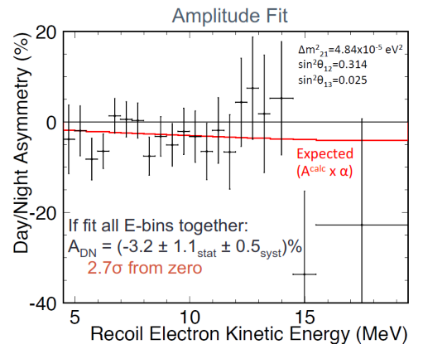
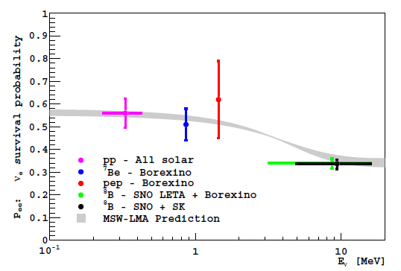

How do we know θ_{12,} Δm₁₂?
SNO LETA and 3-Phase
KamLAND
Ishidoshiro, this conference.
Clearly seen with reactor ν!
MSW effect
Raaf, this conference.
Clearly seen with solar ν!
Super Kamiokande D/N

Slide 20
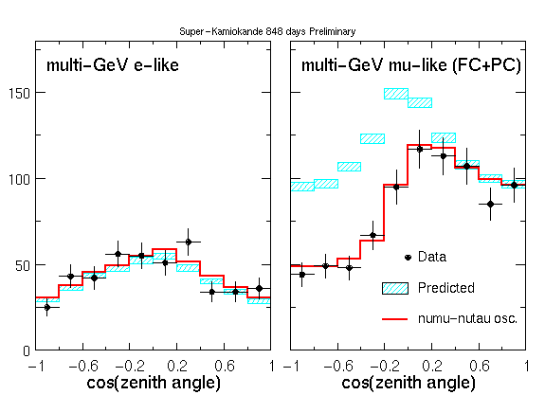
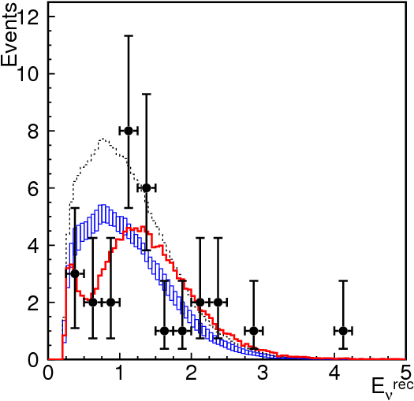
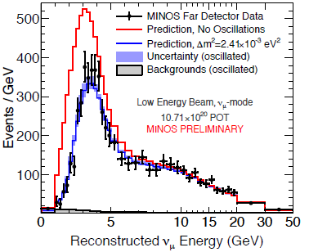
How do we know θ_{23,} Δm₂₃?
Super Kamiokande
K2K
Clearly seen with atmospheric ν!
Now seen by Icecube/ANTARES as well.
MINOS Beam and Atm.
T2K Disappearance
Clearly seen with accelerator ν!
Also seen by OPERA in appearance.

Slide 21
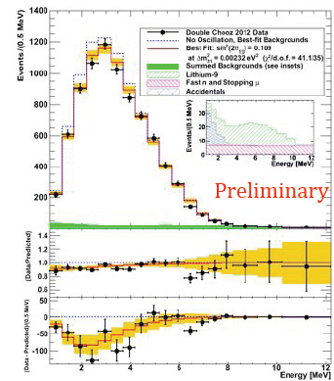
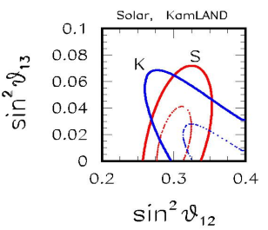
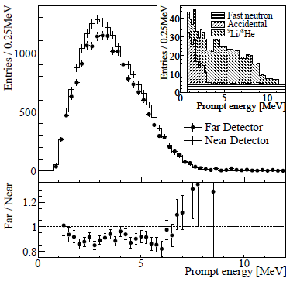
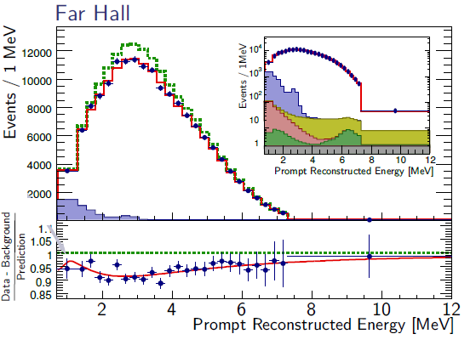
How do we know θ_{13,} Δm₁₃?
Double Chooz
RENO
Clearly seen with reactor ν!
T2K
Appearance
Clearly seen with accelerator ν!
Daya Bay rate plus shape

Slide 22
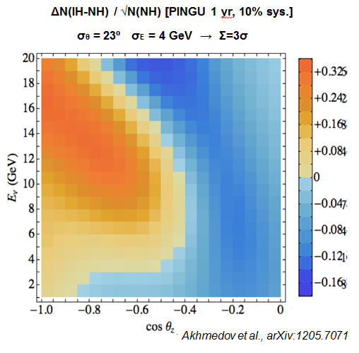
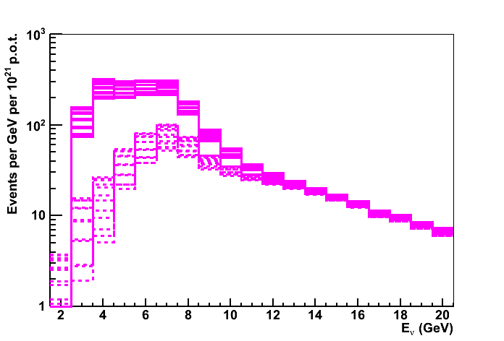
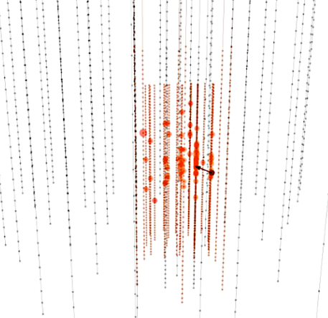
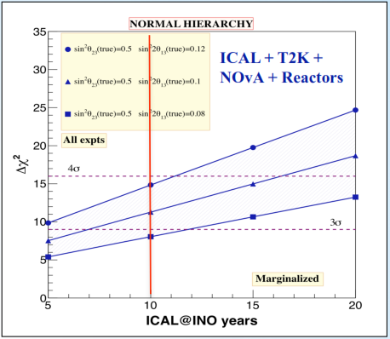
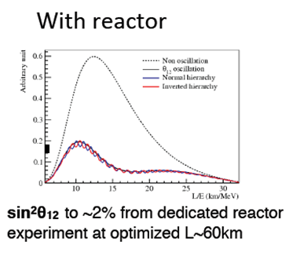
Many are called to measure the MH…
P2O
Measuring CP violation, on the other hand, can only currently be done with long-baseline. We therefore need more than one long-baseline experiment (as in the case of colliders)….
PINGU
JUNO
INO

Slide 23
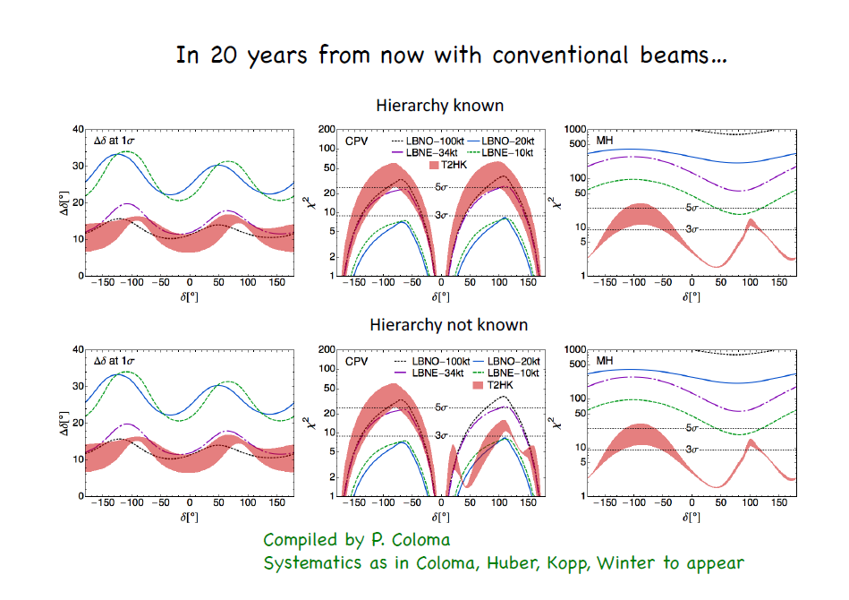
From Pilar Hernandez’s talk in Kracow…
Europe and CERN should make sure that another Long Baseline project is done with similar CP sensitivity to HK, while we also contribute to achieving the goals of Hyper Kamiokande.

