Slide 1
TLEP study news

Slide 2
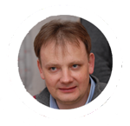
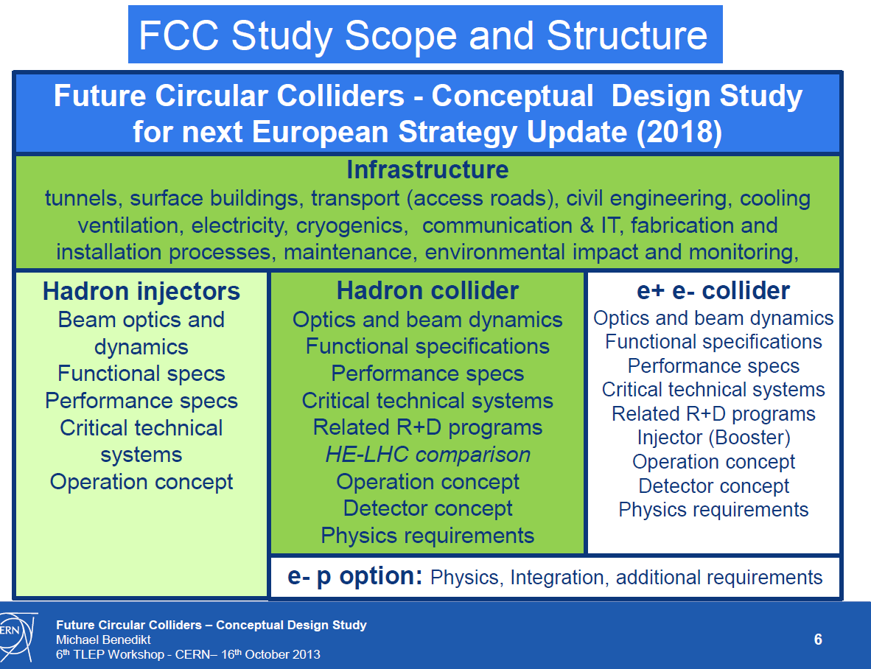
Michael
Benedikt
The two pillars: pp and e+e-
mandate is to deliver full CDR for both machines
with an extended cost review

Slide 3
The combination of TLEP and the VHE-LHC offers, for a great cost effectiveness, the best precision and the best search reach of all options presently on the market.
First look at The Physics Case of TLEP
arXiv:1308.6176v2 [hep-ex] 22 Sep 2013

Slide 4
Team for kick-off and study preparation
Future Circular Colliders - Conceptual Design Study
Study coordination, host state relations, global cost estimate
Benedikt, Zimmermann
Hadron injectors
B. Goddard
VL Hadron collider
D. Schulte
Infrastructure, cost estimates
P. Lebrun
e+ e- collider
J. Wenninger
High Field Magnets
L. Bottura
Supercon-ducting RF
E. Jensen
Cryogenics
L. Tavian
Specific Technologies
(MP, Coll, Vac, BI, BT, PO)
JM. Jimenez
Physics and experiments
Hadron physic Experiments, infrastructure
A. Ball, F. Gianotti,
M. Mangano
e+ e- exper., physics
A. Blondel J.Ellis, P.Janot
e- p physics +
M. Klein
e- p option
Integration aspects O. Brüning
Operation aspects,
energy efficiency, OP & mainten., safety, environment.
P. Collier
Planning (Implementation roadmap, financial planning, reporting)
F. Sonnemann

Slide 5
General TLEP VIDYO meetings
Time-slot:
Monday 15:00-17:00 CERN time; (6-8) am on Pacific time; 23:00-1:00 in Japan
Every two weeks, VIDYO, material on TLEP indico
Standing items: TLEP news, short reports from conveners, agenda for next time
+ a few feature items for information, discussion
Emphasis in alternance Accelerator / Physics
There will be a single room at CERN
First meeting 18 November with accelerator emphasis
for that date: aim at a first set of WP conveners so that work can begin in earnest
Comments suggestions and requests to the steering committee
tlep3-steering-group@cern.ch

Slide 6
Project baselining
We will need new parameter list for accelerator
and consistent running scenarios for physics studies
with version number and explanatory notes
Aim at doing this by mid January 2014 in view of FCC Kick-off meeting

Slide 7
Calendar (to my knowledge)
2013 Oct 23 Frascati Higgs Workshop
2013 Oct 28 UK IOP meeting on TLEP (UCL)
2013 Nov 18 TLEP general VIDYO Meeting accelerator
2013 Dec 2 TLEP general VIDYO Meeting Physics
2013 Dec 9 TLEP general VIDYO Meeting Accelerator
2013 Dec 16-17 FHECC meeting in Beijing
2013 Dec 23 no meeting.
2014 Jan 6, 20 , 3 Feb etc... TLEP VIDYO (TBC)
2014 Feb 12-15 FCC Kick-off meeting
Next TLEP workshops TBD (Candidates to host?)

Slide 8
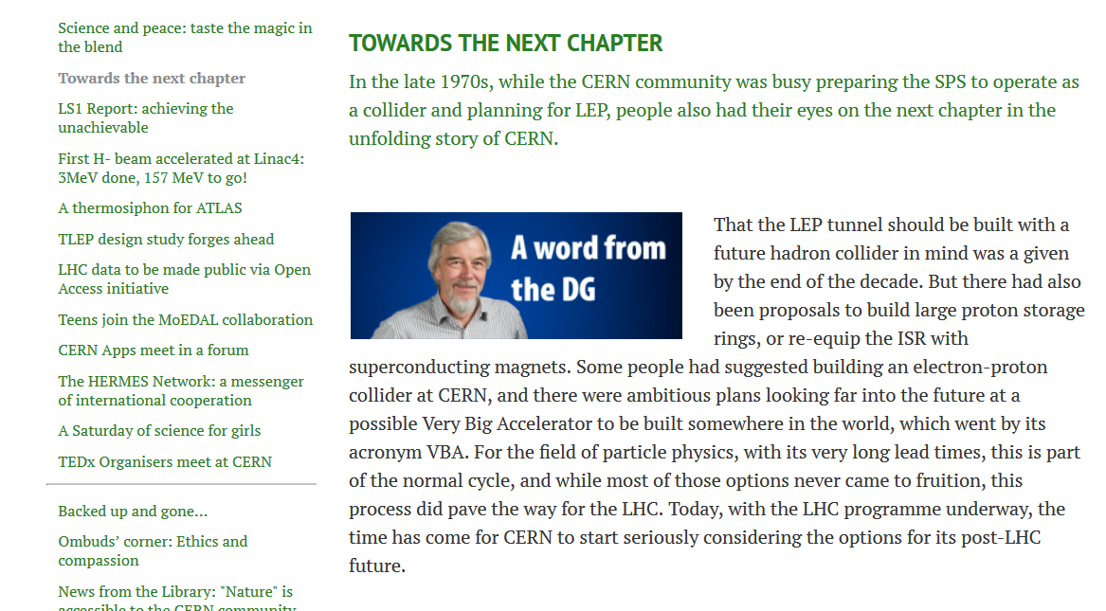
http://cds.cern.ch/journal/CERNBulletin/2013/48/News%20Articles/1630234?ln=en

Slide 9
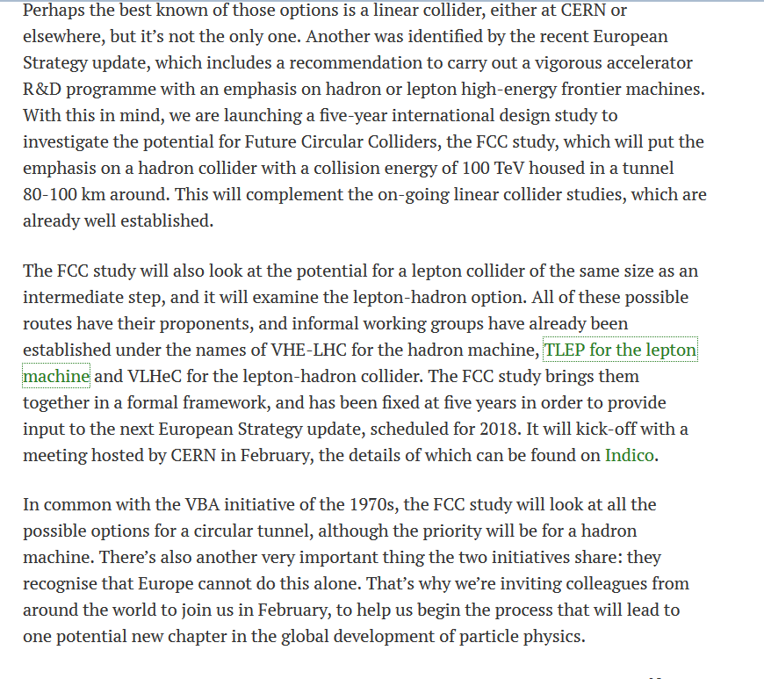
CLIC

Slide 10
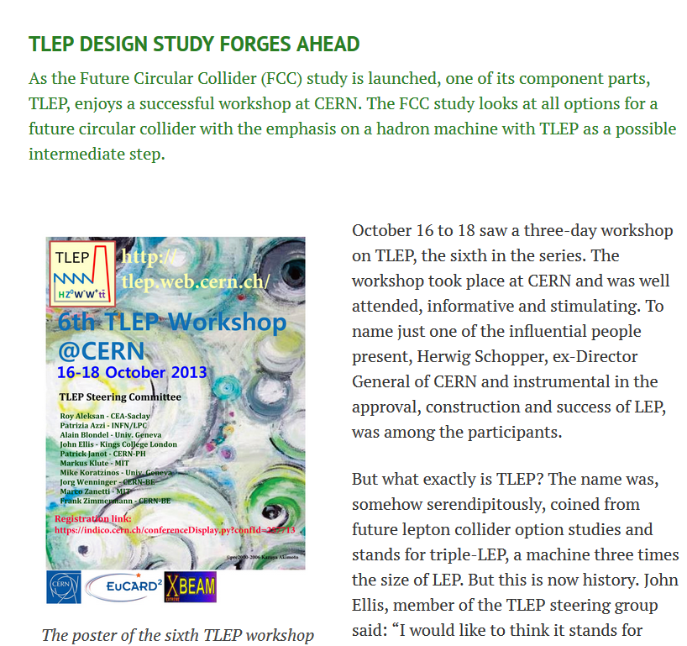

Slide 11
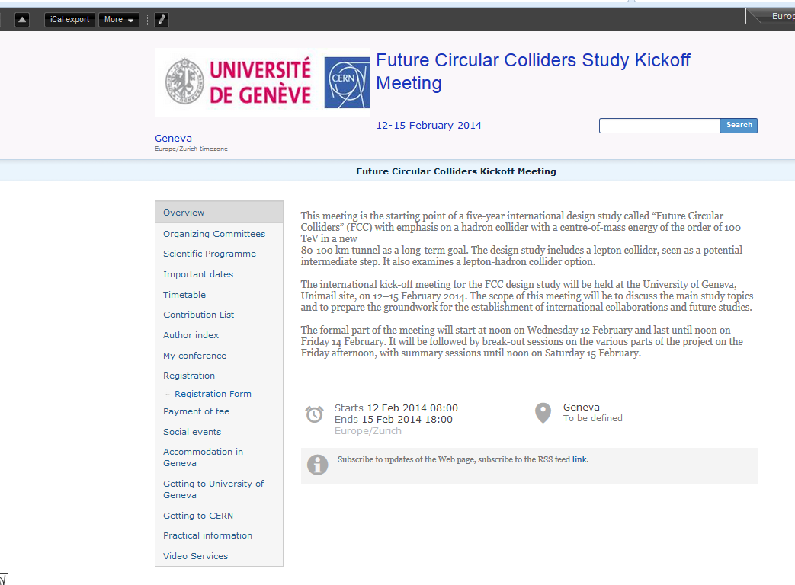
https://indico.cern.ch/conferenceDisplay.py?confId=282344
Important that e+e- community is well represented

Slide 12
Kick-off meeting Agenda
Wednesday 12 February | Thursday 13 February | Friday 14 February | Saturday 15 February
At University of Geneva
 | 8:30 begin VLHC session | 8:30 begin infrastructure session | 9:00 at CERN
 |  |  | Summary sessions
 | 10:30 coffee | 10:30 coffee | 10:30 coffee
 |  |  | summary sessions
12:00 registration opens | 12:30 end of plenary | 13:00 end of plenary | 13:00 end of meeting
 | Lunch | lunch
13:45 welcome address | 14:00 TLEP session | 14:00 breakout sessions
14:00 DG introduction and session
15:30 coffee | 16:00 coffee | 16:00 coffee
18:00 Welcome drink | 18:00 end of session | 18:00 end of break-out session
20:00 Public Lecture | 19:30 collaboration dinner
21:30 Vin de l'amitié

Slide 13
Working group conveners nominations
Nominations have started in the Accelerator group and in the Physics groups
e.g.
WG1. EW physics at the Z pole : Roberto Tenchini
WG5. Flavour physics : Stéphane Monteil
WG10. Online software/computing : Christos Leonidopoulos
WG11. Detector Designs : Gigi Rolandi
YES, but needs to be formalized/finalized
WG4. Top Physics : Patrizia Azzi
WG6. QCD and gamma gamma : David d'Enterria
WG9. Offline software : Colin Bernet
need WG2 WW, WG3 Higgs, ... and a few more.

Slide 14
kick-off meeting 12-14(15) February ‘14
location: University of Geneva
draft agenda, Wednesday 12 February
Session 1a – opening
13:45 | Welcome | Rector U. Geneva
14:00 | Opening & introduction | Rolf Heuer
14:30 | Energy Frontier after the Higgs discovery | Nima Arkani-Hamed
15:00 | Precision Frontier at High Energies | Christophe Grojean
15:30 | coffee break
Session 1b – opening
16:00 | CERN Roadmap | Frederick Bordry
16:30 | FCC Study | Michael Benedikt
17:00 | Gotthard Tunnel Project | Felix Amberg

Slide 15
draft agenda, Thursday 13 February morning
Session 2a – hadron machine
08:30 | Hadron Collider Overview | Daniel Schulte
09:00 | Synchrotron Radiation & Vacuum Concepts | TBC
09:30 | Hadron Injector Options | TBC
10:00 | R&D roadmap towards 16 T Nb3Sn dipole magnets ready for industrial production by 2025 | TBC
10:30 | coffee break
Session 1b – hadron physics
11:00 | FCC Hadron Physics & experiments I | TBC
11:30 | FCC Hadron Physics & experiments II | TBC
12:00 | FCC Hadron Physics & experiments III | TBC

Slide 16
draft agenda, Thursday 13 February afternoon
Session 3a – lepton machine
14:00 | Lepton Collider Overview | Jorg Wenninger
14:30 | Optics challenges | Bernhard Holzer
15:00 | Lepton Injector Options | TBC
15:30 | 100-MW RF System at different Beam Energies and Intensities | Erk Jensen
16:00 | coffee break
Session 3b – lepton physics
16:30 | Lepton Physics | TBC
17:00 | Lepton Experiments & Detectors | Gigi Rolandi
17:30 | Future e-p physics | Monica d’Onofrio

Slide 17
draft agenda, Friday 14 February morning
Session 4a – infrastructure & operation
08:30 | Unconventional issues in conventional facilities | Philippe Lebrun
09:00 | Geodesy and civil engineering | John Osborne
09:30 | Cryogenics | TBC
10:00 | Health, safety and environment | TBC
10:30 | Availability, energy, operation | Paul Collier
11:00 | coffee break
Session 4b – closing
11:30 | Cultural, economical and societal impact of big science projects | TBC
12:15 | Closing Remarks & Outlook | Rolf Heuer
12:30 | End of formal meeting

Slide 18
Fri afternoon
14:00 break out sessions (coffee break at 16:00)
-- Technical infrastructure and civil engineering
-- Hadron collider design (+ SC magnet technology, + injectors)
-- Lepton collider design (+ SC RF technology + injectors)
-- Hadron Physics, Experiments, Detectors
-- Lepton Physics, Experiments, Detectors
-- e-p Option
-- FCC Overall physics and phenomenology
Saturday morning 9:00 (coffee break at 11:00)
-- reports by conveners
-- Warp-up and next steps (Michael Benedikt)

