Slide 1
Proposal of crab cavities and fringe fields models in HL-LHC optics
R. De Maria

Slide 2
Optics Version
SLHCV3.1b: tracking studies well advanced.
HL-LHCV1.0:
  No linear optics changes.
  Tracking tools in preparations for field quality studies.
HL-LHCV??:
  Next version with many layout and linear optics changes.

Slide 3
Strategy for crab cavities [any optics]
Temporarely:
  In madx optics files use rfmultipole(dipole) instead of tkicker
    Supported in Twiss (voltage matching) and Track (short term simulations)
    Dynamic effects in track managed by the update options (no need of the special options in the crab cavity element)
    Update Madx conversion to Sixtrack to use existing elements (to be reviewed anyway since it is not consistent at the moment).
  Sixtrack: no change
In the long-run:
  Sixtrack
    Implement generic rf-multipole (with different phase conventions to match sixtrack defaults)
    Extend time dependent effect module (already in preparation for other studies).
  Update madx conversion to Sixtrack to use new rf-multipole implementation.
Alternative: if step 2.1 is quick enough one can go directly to last step.

Slide 4
Strategy for fringe fields
[existing optics]
Since no linear optics changes are foreseen, only non linear fringe field effect could be included.
In lattice files:
  add marker (or new mad element) for end of fringe field kick location (useful in thin lattices);
  in SixTrack:
    add hard edge fringe field kick (in preparation by Dave)
    use tune matching in SixTrack to absorb the small feed-down effects (done properly with ATS optics using different powering, therefore element name, of the weak arc quadrupoles).
Rely on manual editing to test new tracking maps in SixTrack.

Slide 5
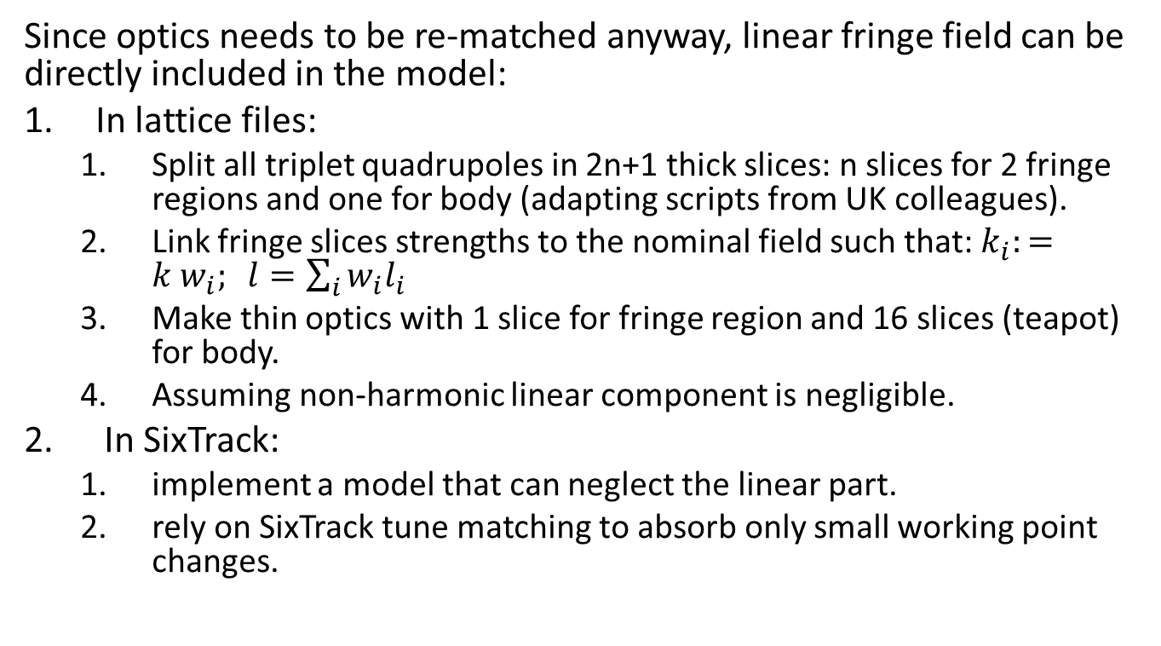
Strategy for fringe fields
[new optics versions]
Since optics needs to be re-matched anyway, linear fringe field can be directly included in the model:
In lattice files:
  Split all triplet quadrupoles in 2n+1 thick slices: n slices for 2 fringe regions and one for body (adapting scripts from UK colleagues).
  Link fringe slices strengths to the nominal field such that: $k_{i}:={k w}_{i}; l=\sum_{i}{w_{i}l_{i}}$
  Make thin optics with 1 slice for fringe region and 16 slices (teapot) for body.
  Assuming non-harmonic linear component is negligible.
In SixTrack:
  implement a model that can neglect the linear part.
  rely on SixTrack tune matching to absorb only small working point changes.

Slide 6
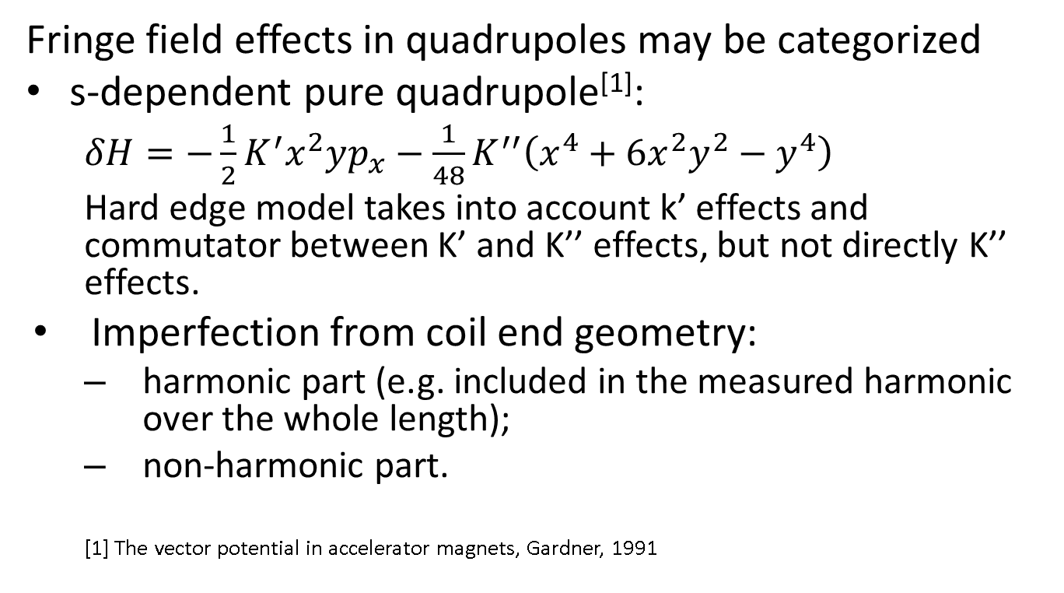
Fringe Field Effects
Fringe field effects in quadrupoles may be categorized
s-dependent pure quadrupole^{[1]}:
  $δH=−\frac{1}{2}K^{′}x^{2}yp_{x}−$ $\frac{1}{48}K^{′′}\left(x^{4}+6x^{2}y^{2}−y^{4}\right)$
  Hard edge model takes into account k’ effects and commutator between K’ and K’’ effects, but not directly K’’ effects.
Imperfection from coil end geometry:
  harmonic part (e.g. included in the measured harmonic over the whole length);
  non-harmonic part.
  [1] The vector potential in accelerator magnets, Gardner, 1991

