Slide 1
Kick-off Meeting
PSB Half-Sector and Stripping Foil Test in L4T
B. Mikulec
28/11/2013

Slide 2
History
Complexity and related risk of the future PSB H⁻ charge-exchange injection section has been exposed at several occasions
  Idea of a test installation of PSB injection equipment in Linac4 first pronounced by P. Collier at the IEFC workshop March 2012.
EDMS note 1224575 (June 2012) with the first concept
Installation of a stripping foil unit and of half of the PSB H⁻ injection section of one ring in L4T approved by Linac4 BCC #43: https://indico.cern.ch/conferenceDisplay.py?confId=246360

Slide 3
Mandate
Installation of PSB injection equipment in the Linac4 transfer line supported by sector department heads and LIU management. Email from P. Collier from 08/10/2013 proposing a new project.
  Project plan to be presented at the IEFC beginning of 2014.

Slide 4
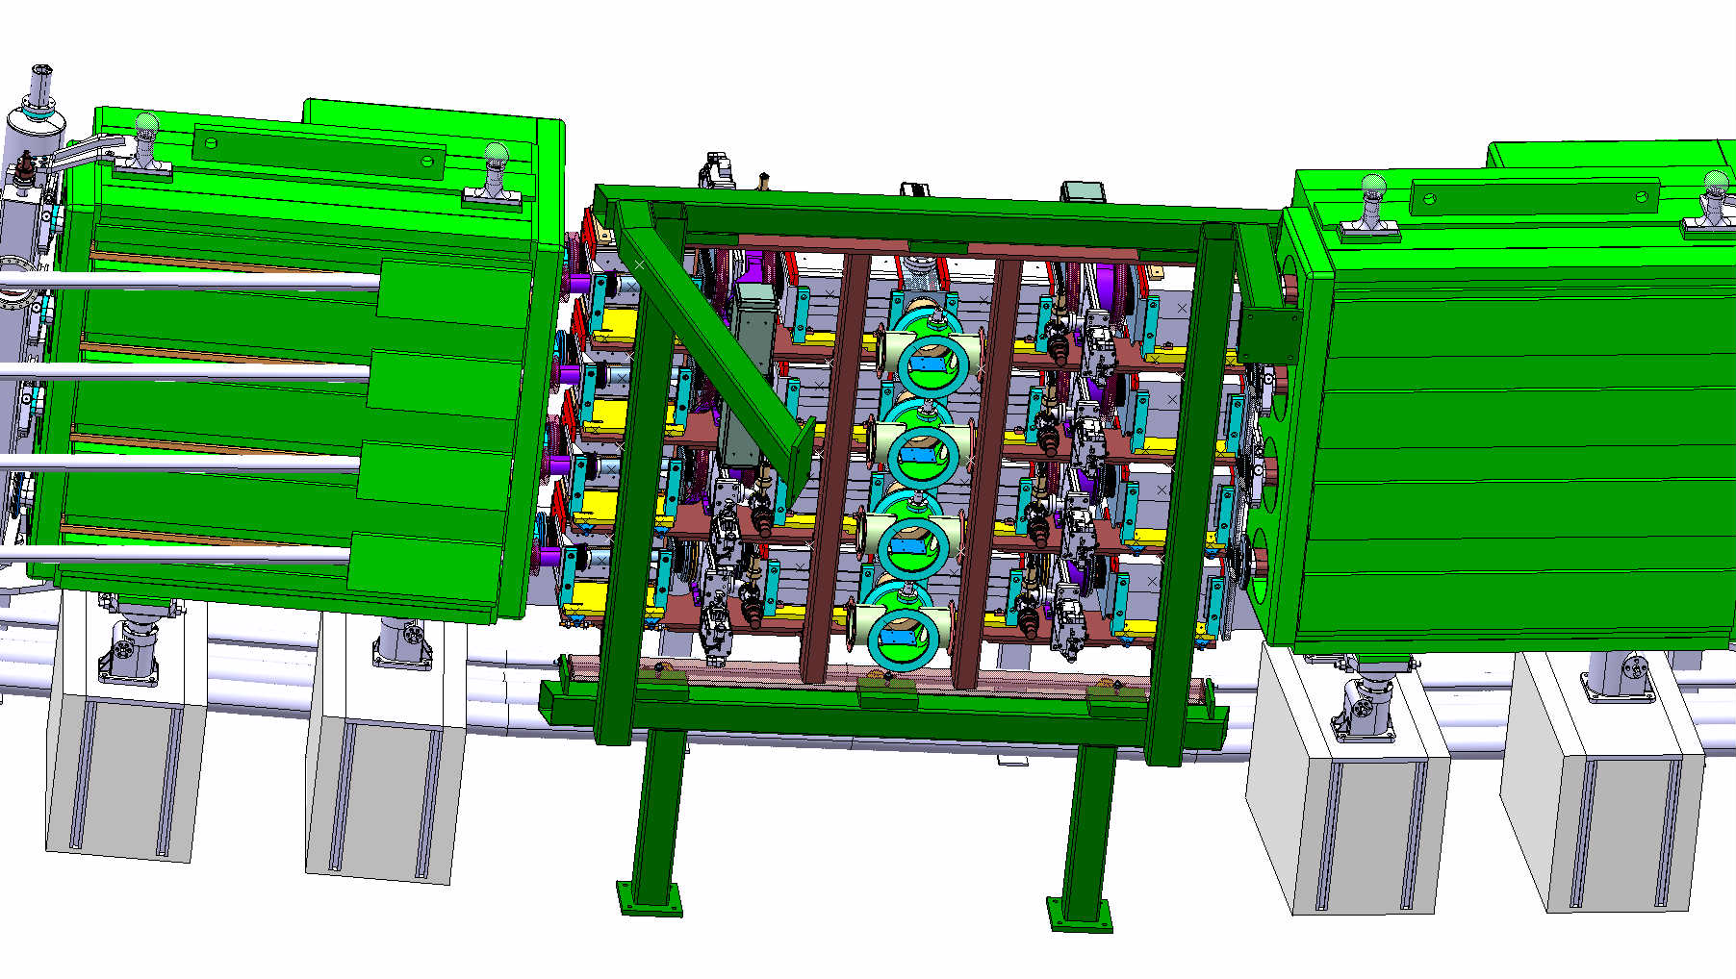
Future PSB H- Injection Section
No experience at CERN with H⁻ charge-exchange injection
Extremely compact and complex section (4 rings and very limited space); combining equipment from TE/ABT, EN/STI, BE/BI, TE/EPC, TE/VSC, TE/MPE + services
Long installation and commissioning times; critical for LS2 duration
~2.65 m
Courtesy of
L. Zuccalli

Slide 5
Top View of Future PSB Injection Section
Courtesy of L. Zuccalli, R. Noulibos, C. Baud, S. Burger and J. Borburgh

Slide 6
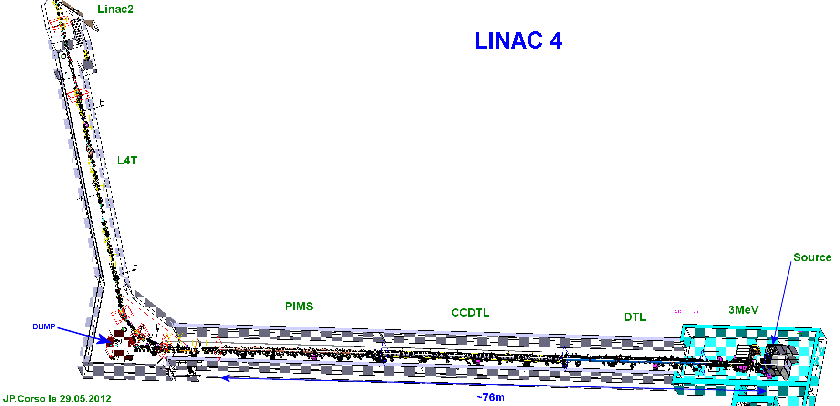
Location of the Test Installations
L4T: new Linac4 to Linac2 transfer line
PSB half-sector test installation
H⁻ stripping foil+BTV unit

Slide 7
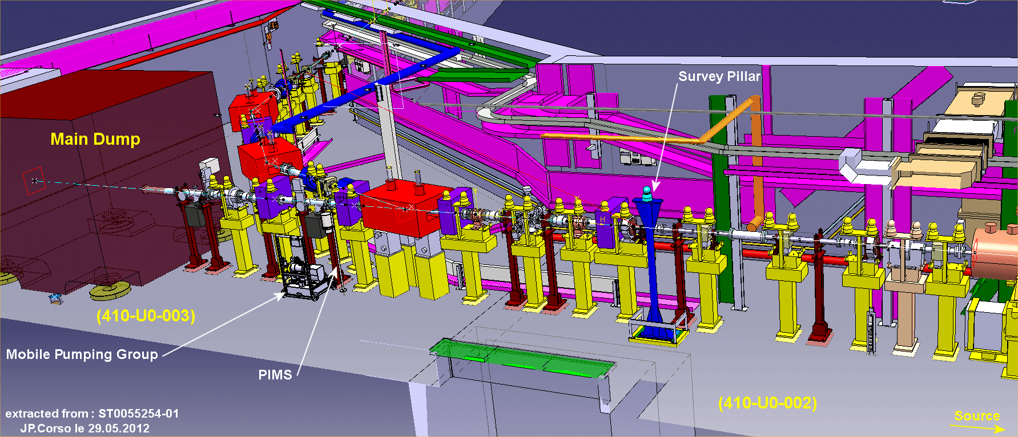
Scope of the Project – Part 1
Part 1: Permanent installation of H⁻ stripping foil+BTV unit
Potential location for
BI laser stripping installation
(not part of this project)
Potential location for
H⁻ stripping foil unit

Slide 8
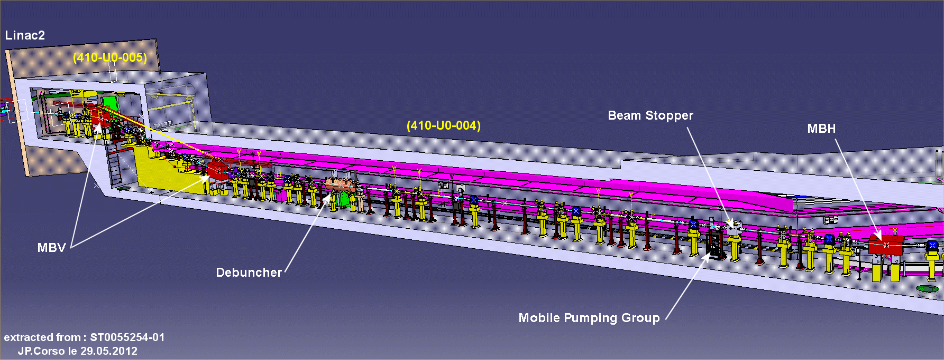
Scope of the Project – Part 2
Part 2: Temporary installation of half of the future PSB H⁻ injection chicane
  At place of debuncher
  Install L4T only up to this point (plus 2 vertical bends)

Slide 9
Outside the Project Scope
Mechanical assembly of the PSB injection section to check integration issues, optimise intervention steps and reduce risk in terms of installation delays → W. Weterings
Installation of laser stripping + emittance measurement system in L4T → BI

Slide 10
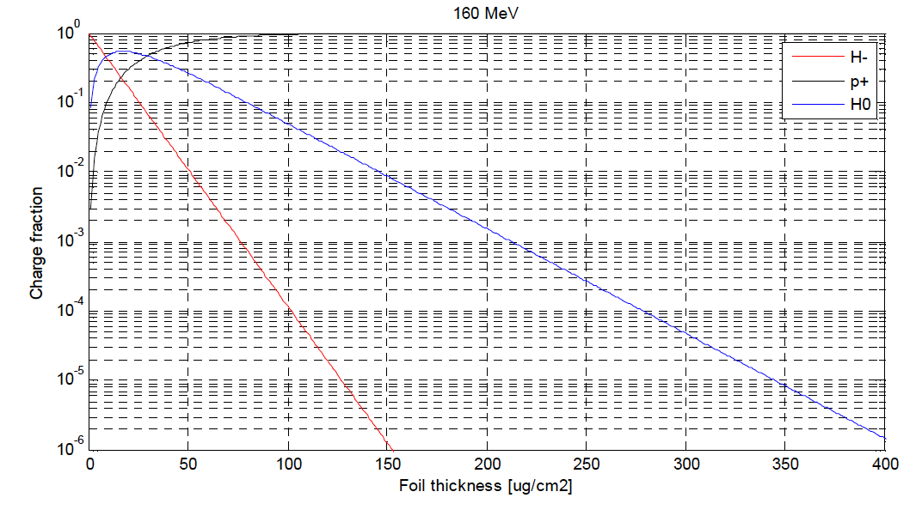
Installation of a Stripping Foil+BTV Unit (1)
See BCC #38: https://indico.cern.ch/conferenceDisplay.py?confId=212409
  Need to dump safely H⁰, H⁻ and protons
H⁰: 2%
H⁻: negligible
sLHC Project Note 0005

Slide 11
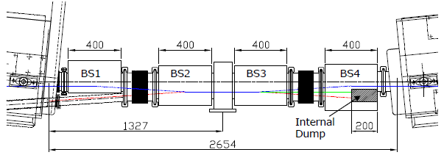
Installation of a Stripping Foil+BTV Unit (2)
See presentation V. Dimov, BCC #38:
p, H⁰ and H⁻ beam can be safely dumped on the main Linac4 dump (in L4Z) by switching off the quadrupole L4T.MQF.0210
Beam size on dump can be adapted by varying strength of quadrupole L4T.MQD.0110
To be cross-checked by the beam dynamics team with the new location!

Slide 12
Installation of a Stripping Foil+BTV Unit (3)
What can be tested?
  Lifetime of different foils and foil holders
  Controls of foil changer
  Commissioning and optimisation of the instrumentation at the stripping foil (screen + mirrors + camera)
  Rough estimate of stripping efficiency of different foil types and thicknesses
    Need 2 well cross-calibrated BCTs; H⁰ will not be detected and H⁻ will cancel with p (but H⁻ signal negligible)!
  Hope to be able to obtain a rough estimate of emittance growth through the foil
    Use grids in L4Z line
Beam size on foil will be similar to situation at PSB injection
Detection of foil breakage (foil current)
Tests can be performed in parallel to Linac4 beam tests (except for emittance measurements at end of the line)

Slide 13
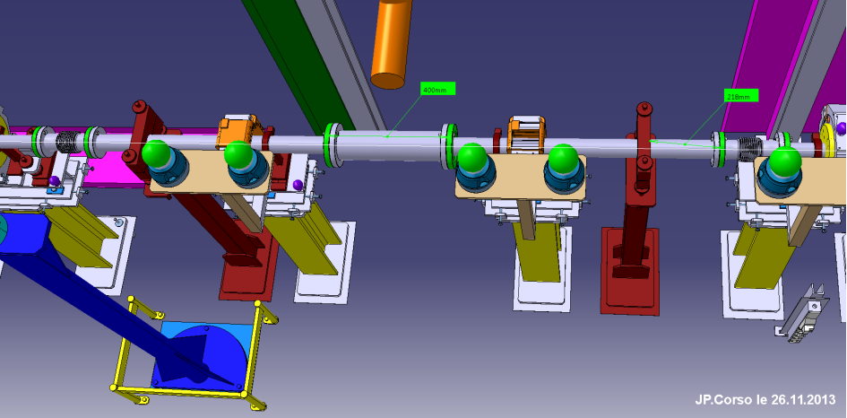
Installation of a Stripping Foil+BTV Unit (4)
Proposed (new) location between L4T.MQD.0110 and L4T.MCHV.0115 to allow for BI laser stripping test just upstream of L4T.MCHV.0115
  Sufficient longitudinal space available (>200 mm)
  Lateral space to be checked
  Beam dynamics confirmation! (otherwise need to go back to original location)
Modifications needed (red support + vacuum chamber) → ECR (permanent installation)

Slide 14
Installation of the Half Sector Test (1)
Install stripping foil+BTV unit, half of the injection chicane (BSW3+BSW4) including the H⁰/H⁻ dump and the H⁰/H⁻ current monitor
In addition: 1 standard + 1 diamond BLM, 1 BCT (stripping efficiency cross-check) + external beam dump+shielding (including vacuum valve)
Maybe add another sector valve just upstream in case of foil exchange
Use where possible prototypes or not yet installed Linac4 equipment and cabling (standard BLM and BCT)
L4-T-EP-0002 rev 1.0
Notes:
Requires ~1.3 m space (half-sector with stripping foil unit).

Slide 15
Installation of the Half Sector Test (2)
Installation details:
Half-sector assembly will arrive on support plate
Assembly has to be offset towards left (seen in beam direction) by 80 mm corresponding to the height of the painting and chicane bump (special adaptation flange will be provided)
Dump core should be offset wrt half-sector test center by 45 mm towards left (height of chicane bump)
L4-T-EP-0002 rev 1.0
Notes:
Requires ~1.3 m space (half-sector with stripping foil unit).

Slide 16
Installation of the Half Sector Test (2)
What can be tested in addition to stripping foil test?
  BSW3+4
    Powering and control of half of the chicane magnets
    Current stability and interlocking
  Stripping foil
    More precise stripping efficiency measurement of H⁰ and H⁻
    Interlocking of foil position
  H⁰/H⁻ dump
    Aperture check
    Temperature cross-check with simulated values → refine cooling requirements
    Analysis of SiC material after removal (micro-cracks etc.; novel material!)
    Interlocking (temperature and pressure drop – define operational thresholds)

Slide 17
Installation of the Half Sector Test (3)
What can be tested in addition to stripping foil test?
  Special BLM
    Diamond BLM to measure secondaries close to H⁰/H⁻ dump; evaluate operational conditions for foil degradation measurement and fast losses
  H⁰/H⁻ current monitor: new development!
    General operational check incl. for example secondary emission suppression
    Sensitivity check for H⁰ and H⁻; comparison to theory
    Aperture check
    Influence on measurement if beam passes besides the monitor (simulate circulating beam)?
    Interlocking – essential for dump protection
  Interlock system test for part of PSB injection (BIS + SIS)
  Specific applications

Slide 18
Proposed Operation
Plan to run only during daytime and week days in 2 shifts (7am – 7pm)
Operating Scenario | Phase 1 (1 month) | Phase 2 (1 month) | Phase 3 (1 month)
Max. pulse current | 40 mA | 40 mA | 40 mA
Max. pulse length | 0.5-1 μs | 20 μs | 100 μs
Avg. pulse length | 0.5-1 μs | 10 μs | 100 μs
Max. repetition rate | 0.833 Hz | 0.833 Hz | 0.833 Hz
Pulse period | 1.2 s | 1.2 s | 1.2 s
Particle type | proton | proton | proton
Max. number of particles/pulse | 2.5E11 | 5E12 | 2.5E13
Particle energy | 160 MeV | 160 MeV | 160 MeV
Energy/particle | 2.563E-11 J | 2.563E-11 J | 2.563E-11 J
Max. energy/pulse | 6.4 J | 128 J | 640 J
Mean power/pulse | 5.33 W | 107 W | 533 W
Beam designation | Pencil beam | Nominal beam | Nominal beam
1σ beam size | 1.9 x 2.4 mm² | 2.2 x 3.3 mm² | 2.2 x 3.3 mm²

Slide 19
External Dump (1)
Planned to use a spare 160 MeV dump core (or LBE line dump), reuse trolley and shielding from 100 MeV commissioning dump and add additionally required shielding.
  Cooling? → STI
Add internal dump for complete picture
I. Leitao

Slide 20
External Dump (2)
Issue with prompt radiation in Linac2 supervised area
  Refine shielding according to available space and redo calculations
  Refine geometry of Linac2 area and maybe classify temporarily as ‘limited stay area’; < 2 mSv/h)
J. Blaha

Slide 21
Draft Linac4 Masterplan
Installation window;
Racks, services etc.
Remaining installation
Beam tests

Slide 22
Work Breakdown Structure – tbc!

Slide 23
To be sorted out…
Confirmation of locations from beam dynamics
Location of control/powering equipment etc.
Cabling and water-cooling (requirements and solutions)
Support structures, special beam pipe connections…
Temporary dump
  Installation, cooling and required shielding → transport and RP + STI
Required budget and manpower
Planning
  Provide in time equipment, services, controls, applications

Slide 24
Organisation
Indico site available
Twiki website created: https://twiki.cern.ch/twiki/bin/view/PSBHalfSectorTest/WebHome
Use LIU-PSB EDMS structure
Mailing list to be created
Plan to integrate bi-weekly or monthly meetings in J. Coupard’s meeting slot of the Linac4 installation coordination meetings
  Monday 15h30 in 376/1-016
  Next meeting in January

Slide 25
Next Steps
Need the following information until end of the year:
  Cooling requirements (flow, pressure, flow rate)
  Rack requirements and cabling details
  Identify equipment to be specifically constructed/ordered for the test installations
  Identify equipment that has to be reused for final installation in PSB
  Budget and manpower estimate
In parallel work on technical issues (dump shielding, transport, integration…)

Slide 26
Conclusions
Stripping foil and PSB half-sector test will be extremely beneficial
  From technical point of view for each sub-system
  For risk reduction
  For reduction of commissioning time for Linac4-to-PSB connection
Installation April-June 2015 + November 2015, beam tests from December 2015
Notes:
EC: OR of 4 timing signals (needs to be synchronised)

Slide 27
I’m looking forwards to a great collaboration with you!

