Slide 1
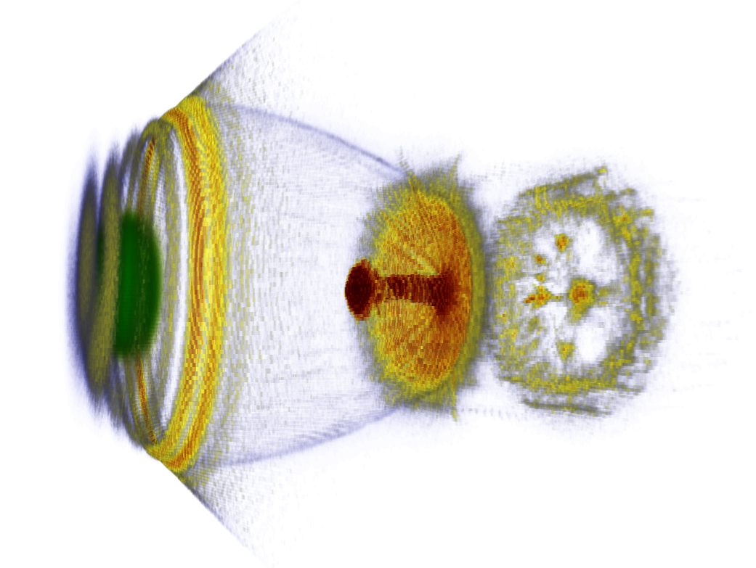



Laser-plasma based electron acceleration
Arie Irman
Laser Particle Acceleration Division, Institute of Radiation Physics
LA³NET Advanced School on Laser Applications at Accelerators,
28.9 - 3.10.2014, Salamanca, Spain

Slide 2
Outline
Characteristic of plasmas
Plasma wave excitation
Electron acceleration in plasma wave
Different electron injection scheme
Recent progress in LWFA

Slide 3
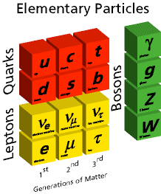
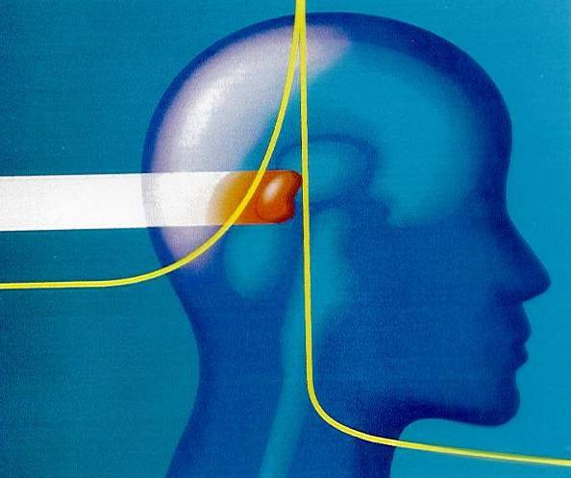
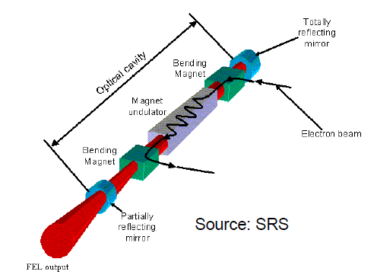
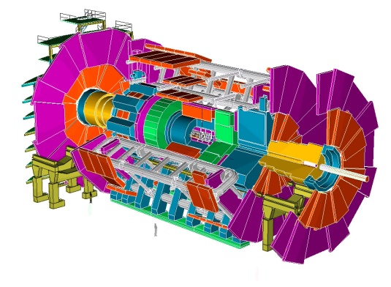
High energy charged particles
High energy physics:
fundamental structure of matter and energy
Material science: semiconductor, phase transition
Medical physics: cancer therapy
Coherent radiation and X-ray sources:
synchrotron and FEL
State of the art technology:
vacuum technology, detector
CERN

Slide 4
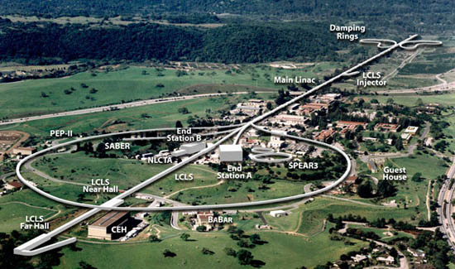
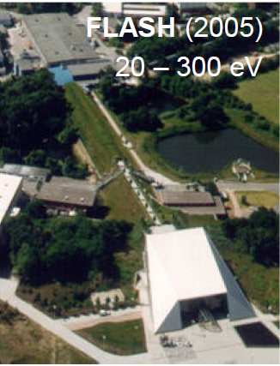
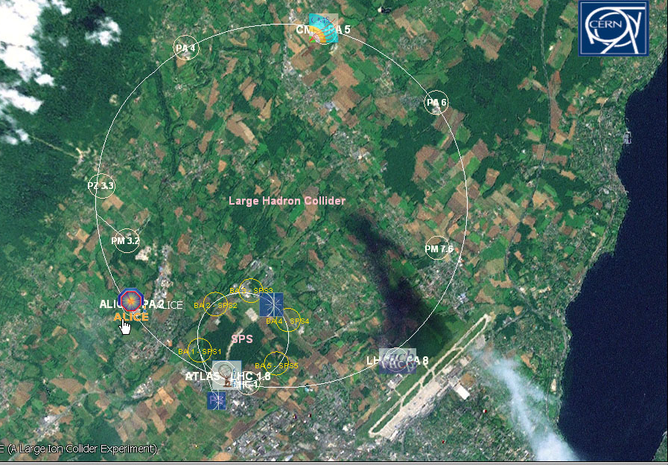
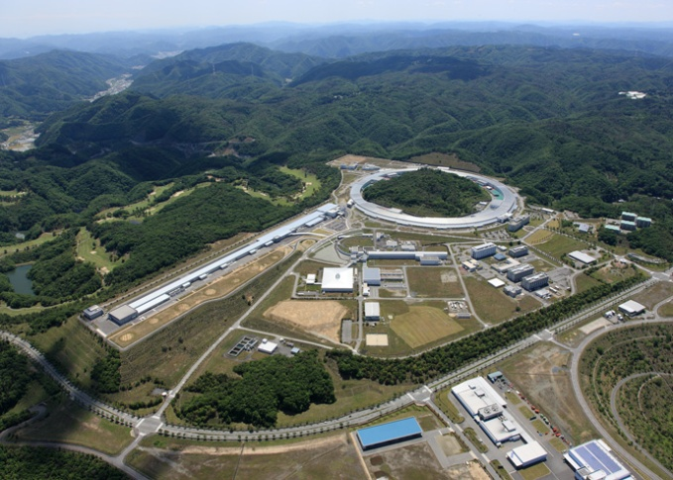
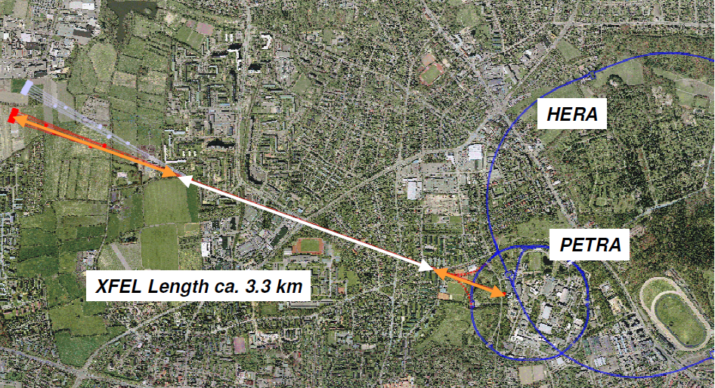
State of the art particle accelerators
3 km
SLAC: 50 GeV electron
27 km
LHC 7 TeV protons
SACLA
European X-ray Free Electron Laser, Hamburg, Germany
Drawbacks:
large infrastructure:
extremely expensive
limitted access
Novel accelerator concepts need to be found !!

Slide 5
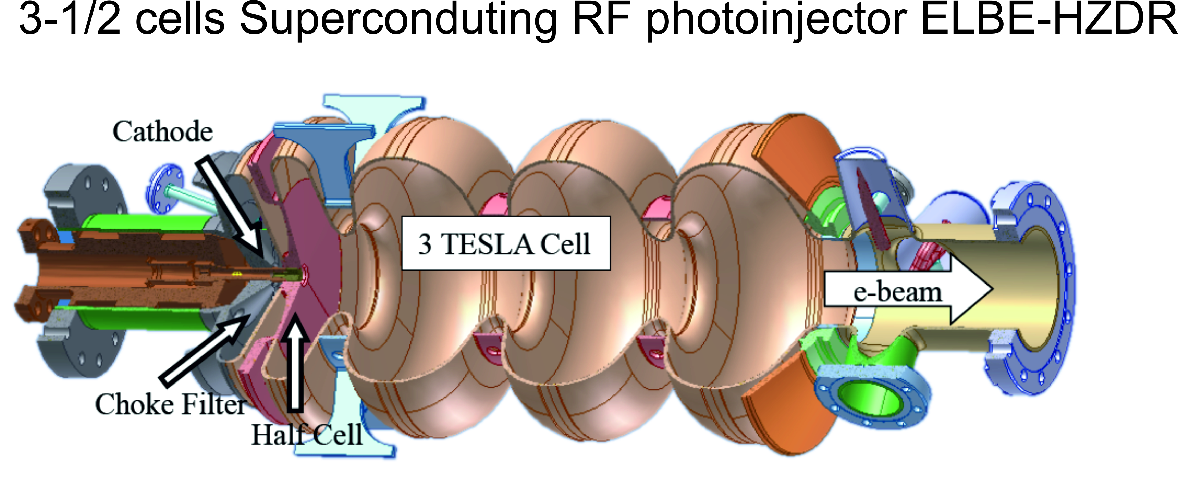
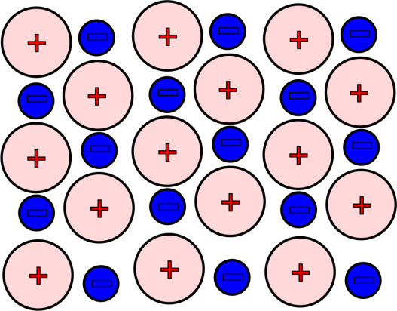
RF cavities versus plasmas
Linac → high power RF technology (λ_{RF} ~ tens of cm)
→ accelerating field ~ a few tens of MV/m (vacuum breakdown)
design value:
E_{peak} = 50 MV/m
(TESLA cavities at DESY)
obtained:
E_{peak} ≈ 20 MV/m
Plasmas → neutral particles, hot ions and electrons
→ space-charge electric fields >> RF electric fields in linac
E_{z} ~ GV/m
λ_{plasma} ~ tens of μm
> 10³ higher than in RF linacs
a compact accelerator

Slide 6
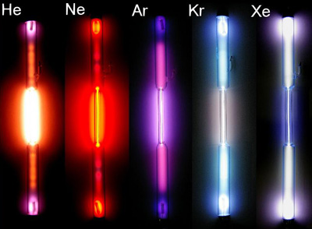
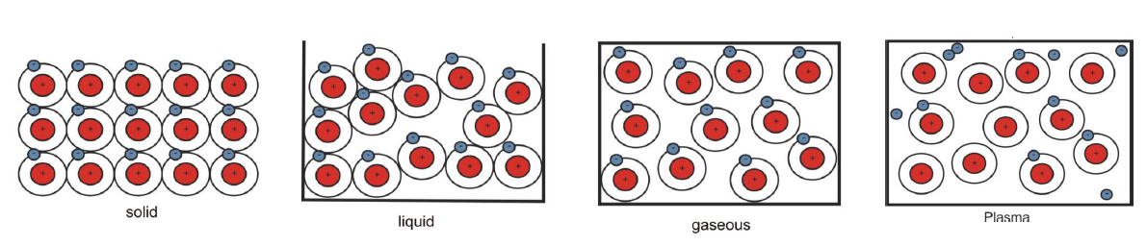
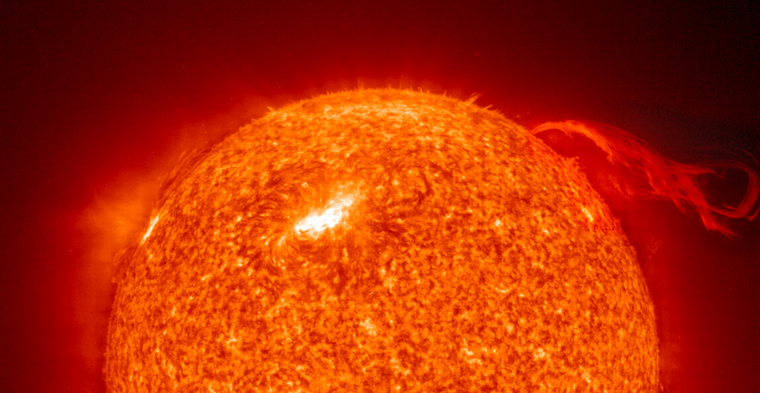
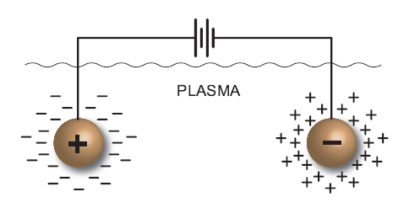
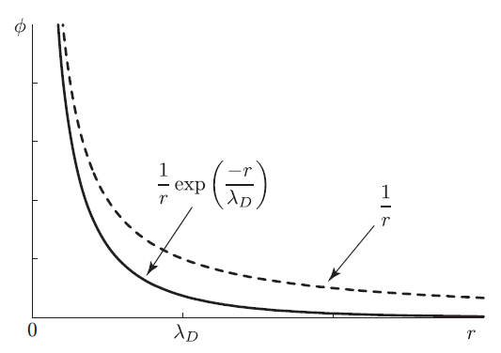
Plasma: the fourth state of matter
A mixture of neutral particles, hot ions and electrons
Characteristics:
→ Collective behavior
→ Debye shielding, Debye length, Debye sphere
→ Response time

Slide 7
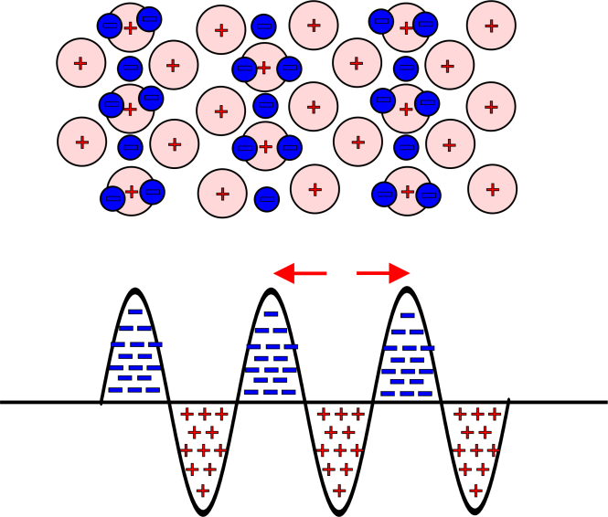
Plasmas as accelerators
If you create a charge separation in plasmas, plasma oscillations will be generated:
plasma oscillations
it propagates with phase velocity ~ speed of the
driver:
laser-driven
frequency
maximum accelerating field strength
E_{z}
n_{e}
n_{i}

Slide 8
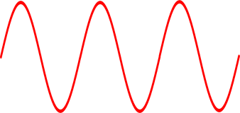
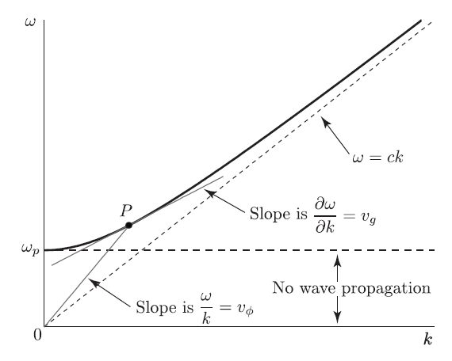
Propagation of light in plasmas
Electrons wiggle in the E-field
(via Lorentz force)
- ions remain immobile in their positions
- fast time ~ laser period
- the net charge separation is zero
E
plasmas
→ dispersion relation
Phase velocity
Group velocity

Slide 9
Propagation of light in plasmas
Plasma refractive index
Plasma refractive index becomes imaginary
Plasma becomes not transparent
Light will reflected by the plasma (like a mirror)
Critical density
→ ~ 35 bar Helium gas
Overdense plasma
Underdense plasma
→ Regime for laser electron acceleration

Slide 10
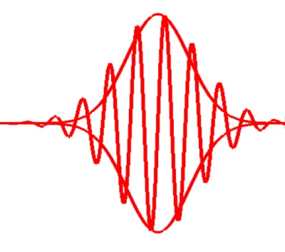
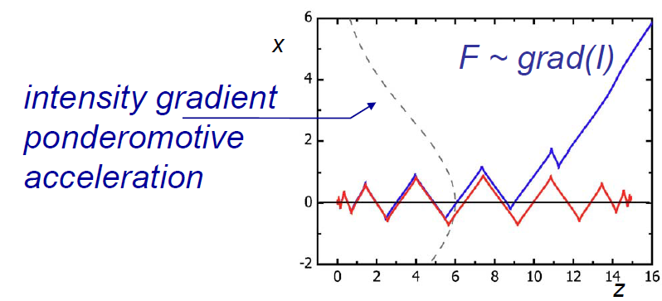
The Ponderomotive force
E
Electrons wiggle in the E-field
(via Lorentz force)
- time-averaged force is not zero
- fast time ~ laser period
- slow time ~ laser envelope
- the net charge separation is not zero
plasmas
The ponderomotive force (“light pressure”) expels electrons from high intensity region

Slide 11
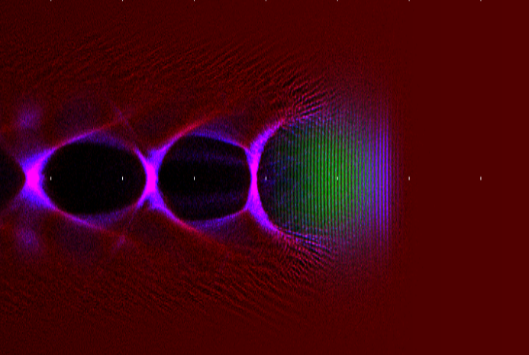
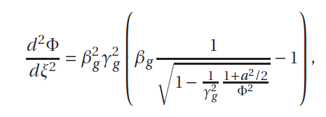

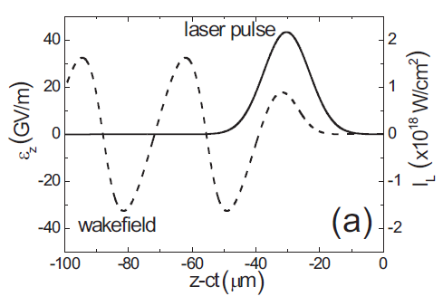
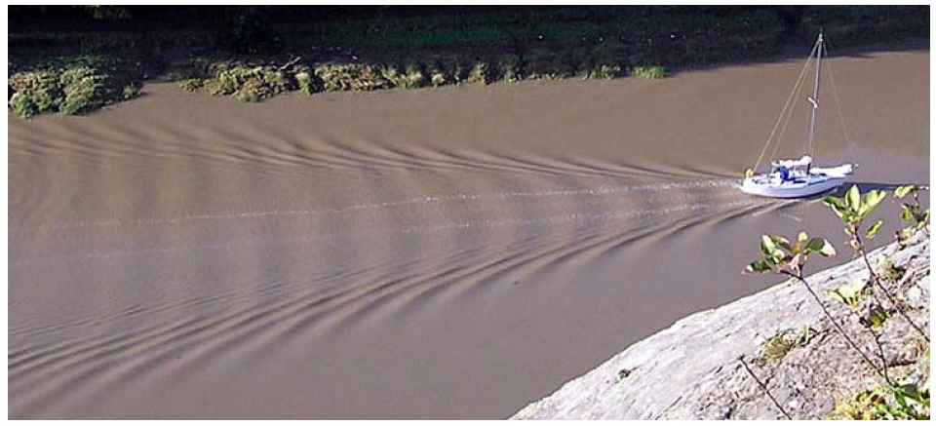

Plasma wave excitation
A high intensity laser pulse can excite plasma waves > 10¹⁷ W/cm²
Driver pulse length << λ_{p}
Ions remains immobile
.
laser pulse
background plasma
1-D Laser wakefield equation
T.Tajima and J.Dawson, PRL 43, 267(1979)
water wave behind a boat

Slide 12
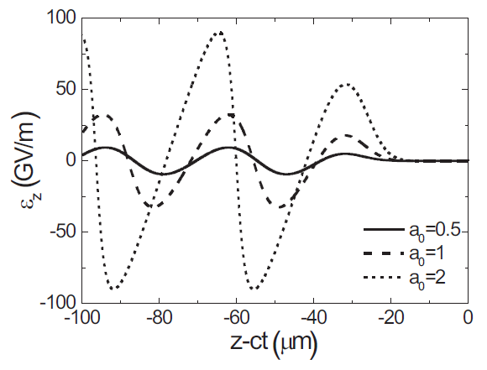
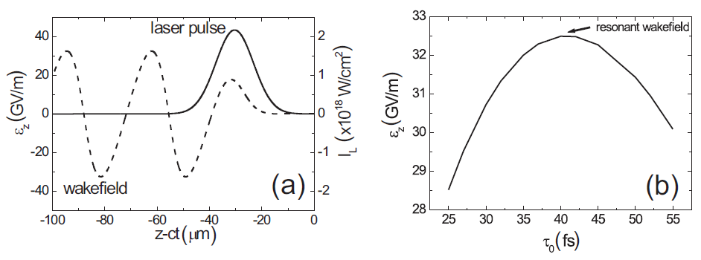
Characteristics of laser wakefield: 1D
The amplitude of wakefield increases with increasing the laser intensity
Linear regime: the wakefield has a sinusoidal shape
Non-linear regime: the wakefield becomes steeper
Plasma wavelength increases with increasing the laser intensity
The resonance occurs when the driver laser length is ~ 0.4 λ_{p}

Slide 13
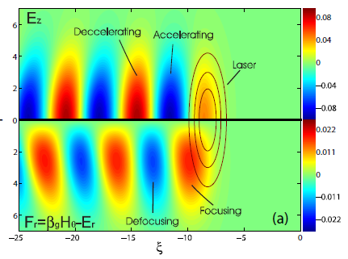
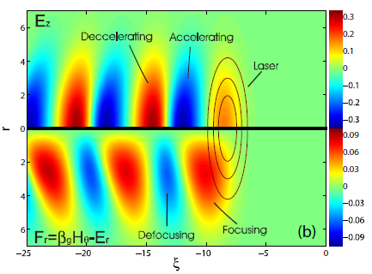
Characteristics of laser wakefield: 3D
a₀ = 0.5
Existence of transverse force fields
Focusing fields bring electrons to the axis.
Defocusing fields scatter electrons out of the axis.
The optimum accelerating region is the overlap region between the accelerating and the focusing region.
The overlap region becomes larger in the non-linear wakefield.
a₀ = 1

Slide 14
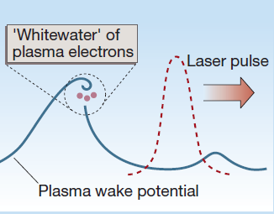
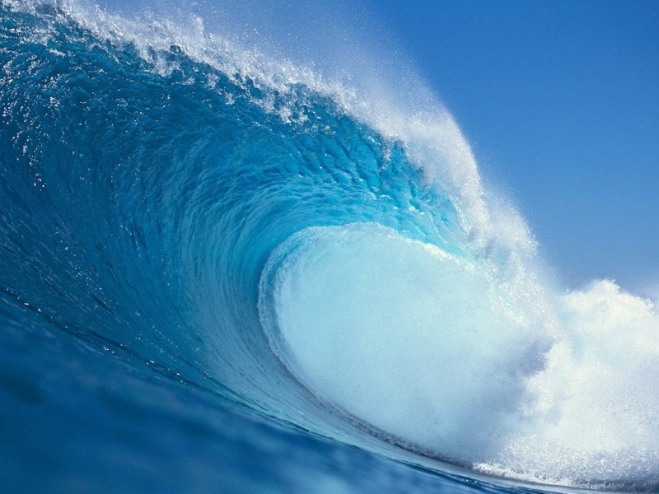

Wave-breaking
Wave-breaking limits the maximum accelerating field strength.
Electron longitudinal velocity > plasma wave phase velocity
When
Wave-breaking

Slide 15
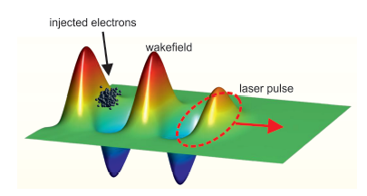
LWFA: a compact electron accelerator
Electron orbit in phase space:
electron trapping mechanism
acceleration
dephasing
Equation of motion of a test electron
in wakefields with amplitude E_{z}
Decelerating
Accelerating
Hamiltonian constant
along a given electron
orbit

Slide 16
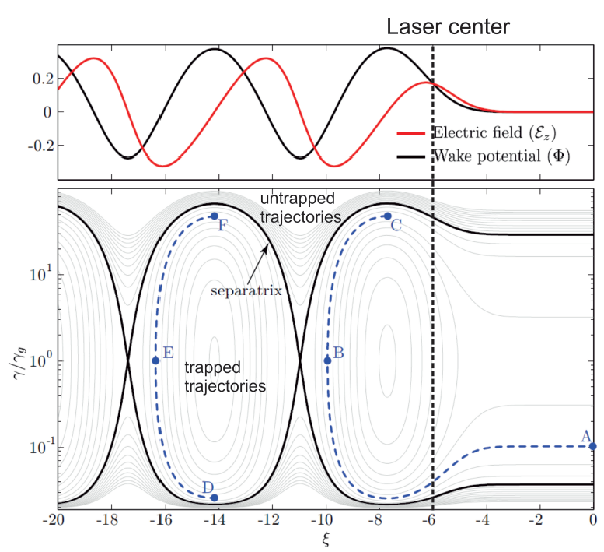
Electron dynamics in 1D plasma wave
The separatrix:
orbit that separates the region of trapped and untrapped electrons in the longitudinal phase space
→ laser center

Slide 17
Maximum energy gain
Dephasing length: distance for electron to gain energy before entering
the decelerating phase
Maximum electron energy:
L_{deph}
to gain more energy: lowering plasma density

Slide 18
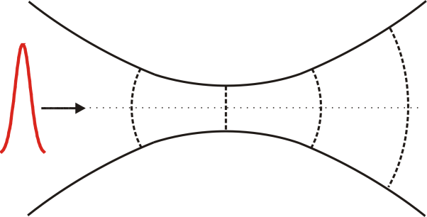
Requirements to produce mono-energetic bunch
1. Long dephasing length ≈ acceleration distance
Z_{R}
High intensity laser over long distance
Optical diffraction limits the acceleration length to the Rayleigh length
Example:
L_{deph}
Z_{R}

Slide 19
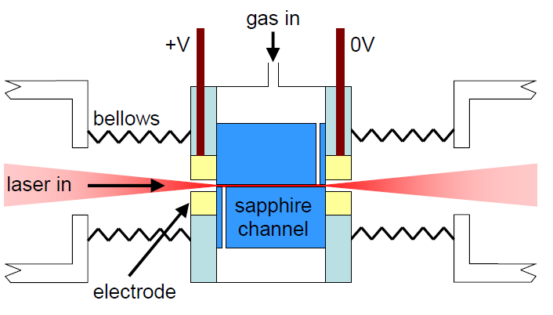
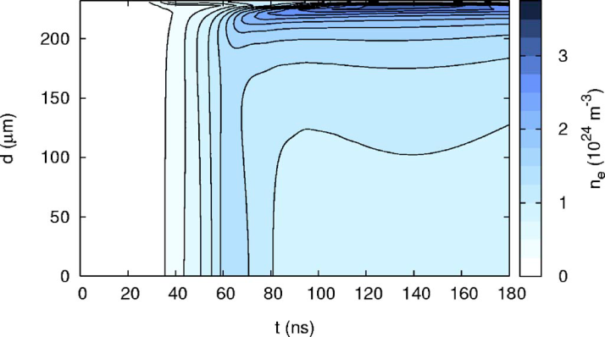
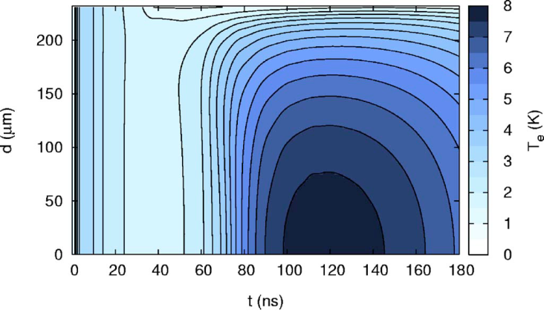
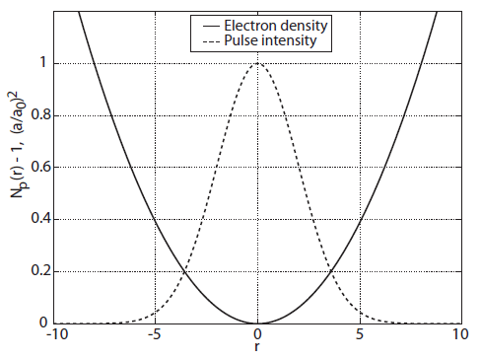
Preformed plasma channel
A.Gosalves, PhD Thesis 2006, Oxford University
slow discharge: Hydrogen gas
electron temperature higher on axis
electron density lower on axis
B. Broks, et.al., physplasmas 14,23501(2007)
Notes:
There are requirements to make laser wakefield acceleration produce a high energy electron bunch with very small energy spread. Firstly, the interaction length between a high intensity laser and a plasma should be extended. When a gaussian laser pulse is focused into a small spot size, naturally after a characteristic distance will diverge. This characteristic distance is called the Rayleigh length. To extend the interaction disctance, a few ways have been proposed. First, by using relativistic self-focusing, second, by using plasma channel, and third using petawatt class laser. The later is done by increasing the focus spot size. Secondly, the dephasing length should be long. The dephasing length is a distance where electrons feel the accelerating field of the wakefield. The dephasing length is proportional with the wakefield wavelength. So, increasing the wakefield wavelength by reducing the electron density, the dephasing length can be increased. The third requirement is that electrons need to be injected in the correct phase of the wakefield. This is in fact a fraction of the plasma wavelength. Furthermore, the synchronization for the injection should be in fs time. This is beyond the state of the art technology. Therefore, injection becomes the central problem in the laser wakefield.

Slide 20
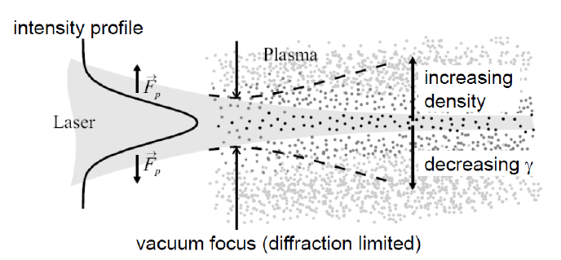
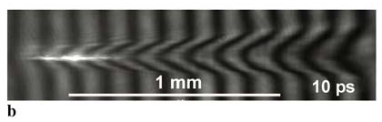
Relativistic self-guiding
Intensity dependent plasma refractive index
Region with higher laser intensity:
electron mass increase
local plasma frequency decrease
electron density decrease
relativistic quiver motion
M.Kaluza lect. Note,Uni Jena
Requirements:
ponderomotive force + relativistic effect
A. Maksimchuk, et.al., APB 89,201(2007)
Notes:
There are requirements to make laser wakefield acceleration produce a high energy electron bunch with very small energy spread. Firstly, the interaction length between a high intensity laser and a plasma should be extended. When a gaussian laser pulse is focused into a small spot size, naturally after a characteristic distance will diverge. This characteristic distance is called the Rayleigh length. To extend the interaction disctance, a few ways have been proposed. First, by using relativistic self-focusing, second, by using plasma channel, and third using petawatt class laser. The later is done by increasing the focus spot size. Secondly, the dephasing length should be long. The dephasing length is a distance where electrons feel the accelerating field of the wakefield. The dephasing length is proportional with the wakefield wavelength. So, increasing the wakefield wavelength by reducing the electron density, the dephasing length can be increased. The third requirement is that electrons need to be injected in the correct phase of the wakefield. This is in fact a fraction of the plasma wavelength. Furthermore, the synchronization for the injection should be in fs time. This is beyond the state of the art technology. Therefore, injection becomes the central problem in the laser wakefield.

Slide 21

Requirements to produce mono-energetic bunch
2. fs bunch and fs time for injection → the central problem !!
    size < laser beam size
    length < plasma wavelength
    synchronization < laser pulse duration
    initial energy > trapping threshold
~ tens of microns
~ tens of microns

Slide 22
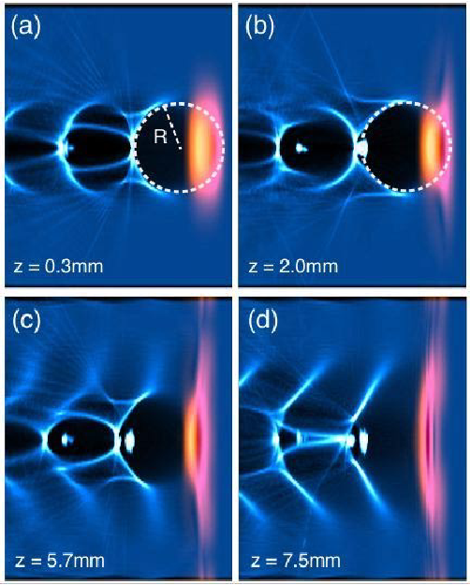
Self-injection in the bubble regime^{1,2,3,many more}
A highly nonlinear mechanism: self focusing + self steepening
Electrons completely blown out by the F_{p}
No spatial and temporal problems with injection
Inherent problem: shot-to-shot stability is very sensitive to the fluctuation of laser’s and plasma’s parameters
Lu, W., et al, PRSTAB 10,061301(2007)
¹Pukhov, A., et al, Appl.Phys.B.,74,355(2002), ²Leemans, W.P., et al, Nature physics2,696(2006),³Mangles, S.P.D., et al, Nature 431,535(2004),⁴ Geddes, C.G.R, et al, Nature 431,538(2004), ⁵Faure, J., et al, Nature 431,541(2004), many more

Slide 23
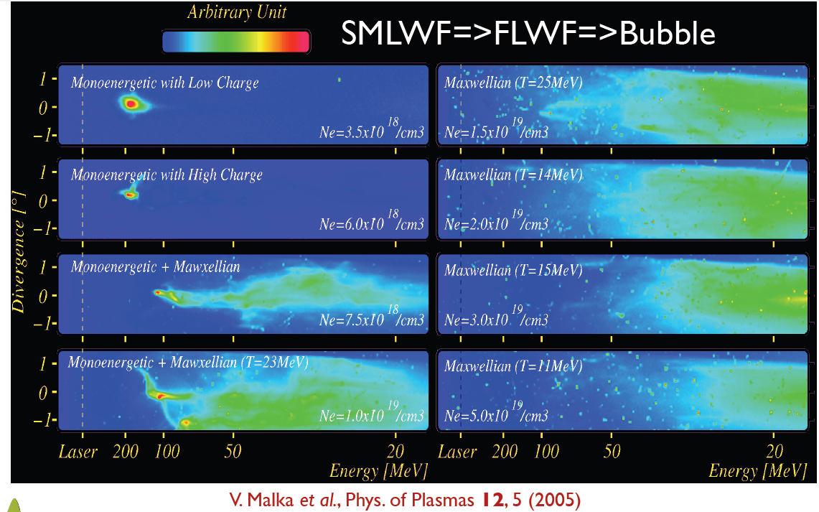
Self-injection in the bubble regime^{1,2,3,many more}

Slide 24
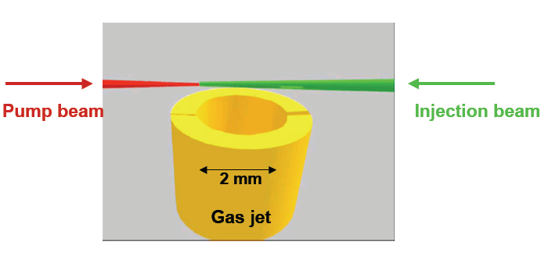
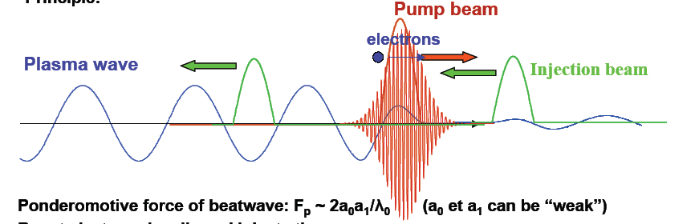
Injection by colliding pulse scheme^{1,2,3}
The pump beam to drive the wakefield, the injection beam to heat up the background electrons
Injection is local
Better shot to shot reproducibility
Better control over electron parameters, energy, total charge,
¹Faure, J., et al, Nature 444,737 (2006), ²Esarey, E., et.al., PRL79,2682(1997), ³Kotaki, H., et.al., PoP 11 (2004)

Slide 25
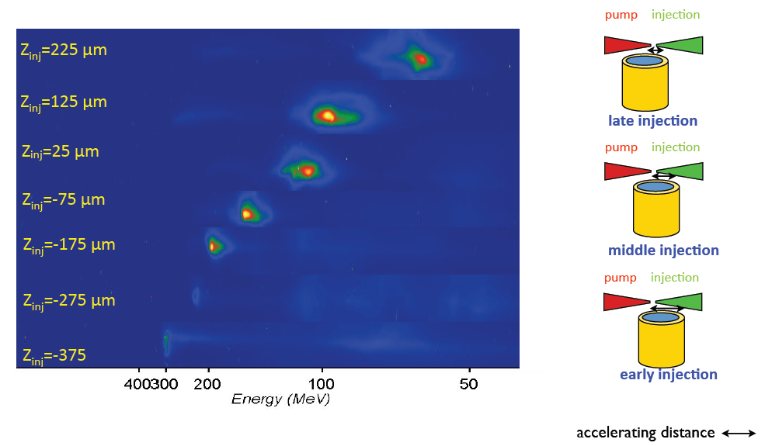
Injection by colliding pulse scheme
Tuneable electron energy
Faure, J., et al, Nature 444,737 (2006)

Slide 26
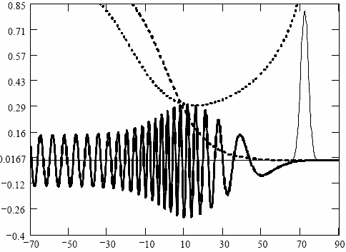
Density down-ramp injection
calculation by A. Khachatryan
v_{p}/c
n_{e}
λ_{p} increase as n_{e} decrease
v_{p} decrease faster, eventhough v_{g} increase
when v_{p} ≈ v_{e} local wavebreaking, injection and acceleration
a²
v_{e}/c
z
Does not require non-linear laser pulse dynamics
better stability can be expected

Slide 27
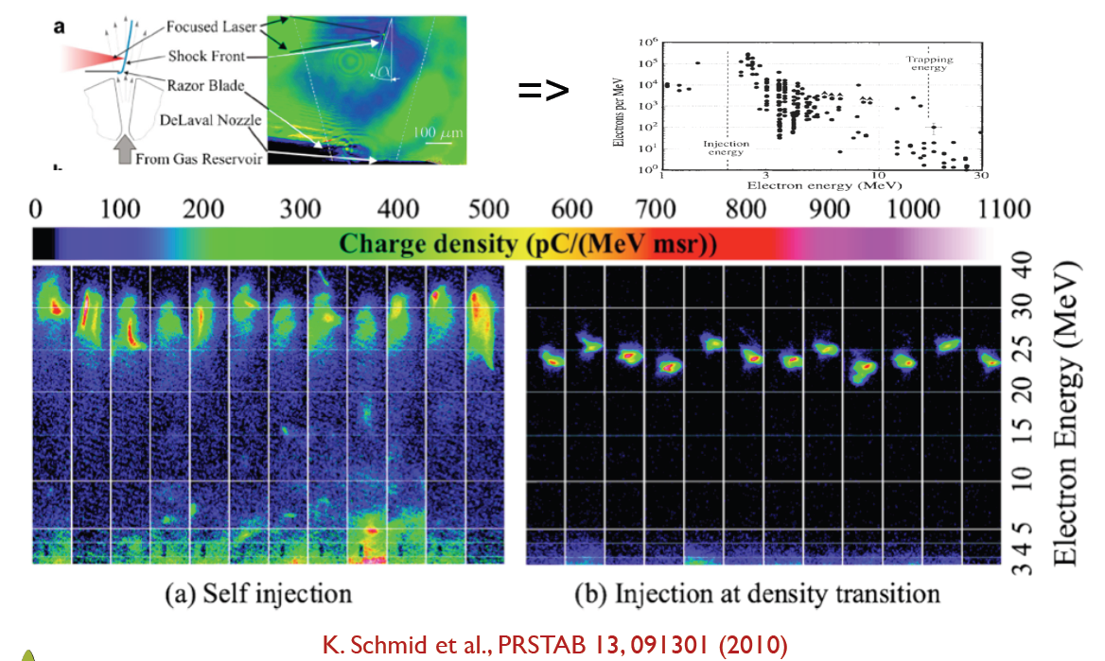
Density down-ramp injection

Slide 28
External electron injection
Idea:
separate the production and injection of electrons from the acceleration process
similar as in conventional RF accelerators
injector
booster
Injector:
full control over electron generation
well-characterized electron beam parameters:
charge, emittance, energy and energy spread
spatial and temporal control over injection
RF photoinjector
Booster:
linear to weakly nonlinear laser
wakefield
optical guiding for high intensity
laser pulse
operate at lower plasma density
capillary discharge plasma channel
How to inject external electrons into the right phase of laser wakefield inside a booster stage ?

Slide 29
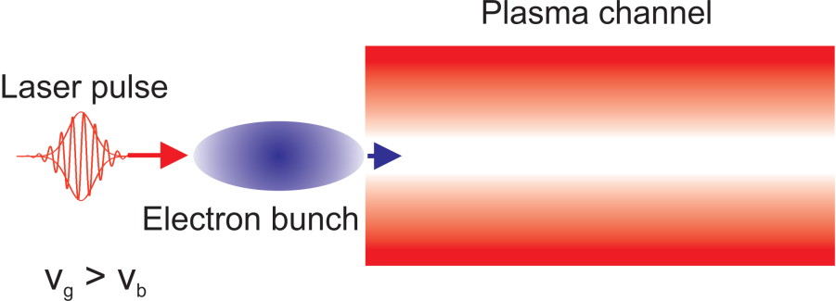
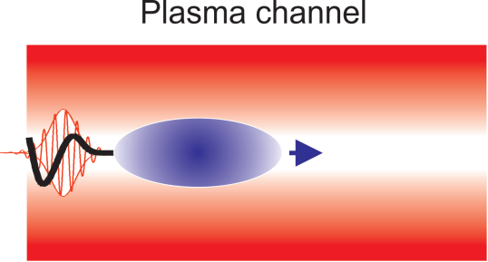

External electron injection
Linear to weakly nonlinear wakefield
No need ultra-short injected electron bunch
No need fs synchronization
No need precise transverse positioning
Easy control over the injection time
Scaleable to higher energies
Promising candidate for a controlled acceleration
¹A. G. Khachatryan et. al Nucl.Instrum.Methods Phys. Res.A, 566, 244 (2006), A. G. Khachatryan et. al., Phys. Rev. ST Accel. Beams 7, 121301 (2004), A. G. Khachatryan, Phys. Rev. E 65, 046504(2002), A. G. Khachatryan, JETP Lett. 74, 371 (2001).

Slide 30



Recent progress in LWFA experiment
40 TW laser pulse, plasma density n_{p} = 4.3 x 10¹⁸ cm⁻³, 30 pC at 1 GeV with 2.5 % rms energy spread
Acceleration distance < 3 cm, E_{z} > 33 GV/m

Slide 31


Energy scaling with laser power
τ_{pulse} = 150 fs, 1 PW pulse
(Texas PW)
bubble
injected
electron
bubble
τ_{pulse} = 30 fs, 1 PW pulse
(GIST, LBNL and
all those other guys)

Slide 32






Visualization of laser wakefields
Wakefield acceleration with 40-TW JETI-laser @ Jena, Germany: up to 0.8 J in 35 fs, f/13 focusing into H₂ gas jet
Frequency-broadening of synchronized probe pulse in gas-filled hollow fiber + chirped-mirror compression
1.1 µm resolution with optimized imaging system
Snap-shots of non-linear, laser-driven plasma waves
τ_{probe} = (5.9±0.4) fs
M. B. Schwab et al. Appl. Phys. Lett. (2013), A. Sävert et al. submitted (2014)

Slide 33




Compact Xray sources

Slide 34

LWFA: unique bunch properties

Slide 35

Main challenges in LWFA

Slide 36

Laser particle acceleration group
Thank you for your attention!
Sachsen Zeitung

Slide 37
Self-consistent fluid model
The huge number of particles in plasmas
→ impossible to solve Newton’s equation for each particle
→ hydrodynamic approach: study the motion of fluid elements
Main assumptions:
plasma is fully ionized and initially at thermal equilibrium
plasma is underdense: ω₀>> ω_{plasma}
ions are immobile
plasma is cold: plasma electron thermal velocity << plasma wave phase
velocity : v_{th} << v_{ph}

Slide 38

Towards master equations: starting point
Maxwell’s equations
(EM fields)
Continuity equation
(conservation of the number of particles)
→ Closed loop magnetic fields
→ Faraday induction’s law
→ Poisson’s equation
→ Ampere’s law
Sources
Lorentz equation
(motion of particles in an EM field)
→ Charge density
→ Current density

Slide 39




Towards master equations
Fields can be described in term of potentials:
where A satisfies:
In normalized parameters:
1-Dimensional case
Driver laser pulse
→ the strength of laser-plasma interaction
Non-relativistic regime
Relativistic regime(v x B)
λ₀=0.8 μm, a₀=1, I₀= 2.1x10¹⁸ W/cm²

Slide 40
Towards master equations
Laboratory frame → laser frame

Slide 41



Master equations
momentum eq.
continuity eq.
laser propagation
in plasma eq.
Poisson eq.
Quasi-static approximation:
evolution time of the laser envelop >> the plasma response time
this requires

Slide 42

Master equations
With quasi-static approximation:
0
=
momentum eq.
0
=
continuity eq.
laser propagation
in plasma eq.
Poisson eq.
1-D Laser wakefield equation
Try with Runge-Kutta
Normalized to

