Slide 1


Introduction to Tasks 11.2 and 11.3 of WP11:
Status of Materials R&D and Work Proposal
Alessandro Bertarelli (CERN)
EuCARD2 – WP11 Tasks 11.2/11.3 Meeting
CERN, Geneva – 10 December, 2013

Slide 2
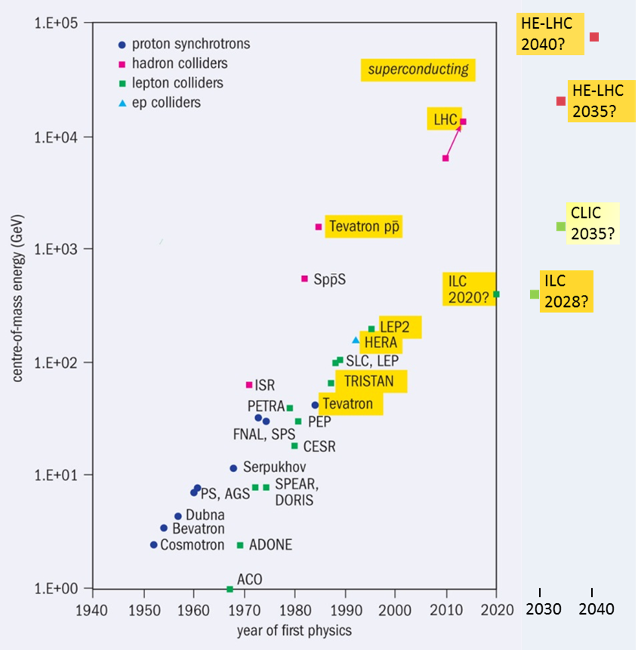
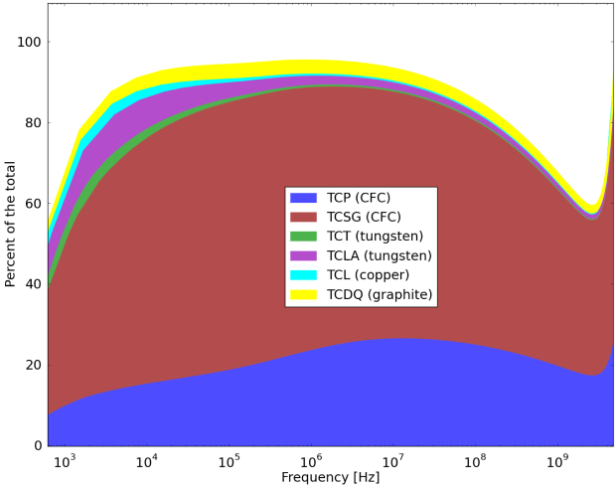
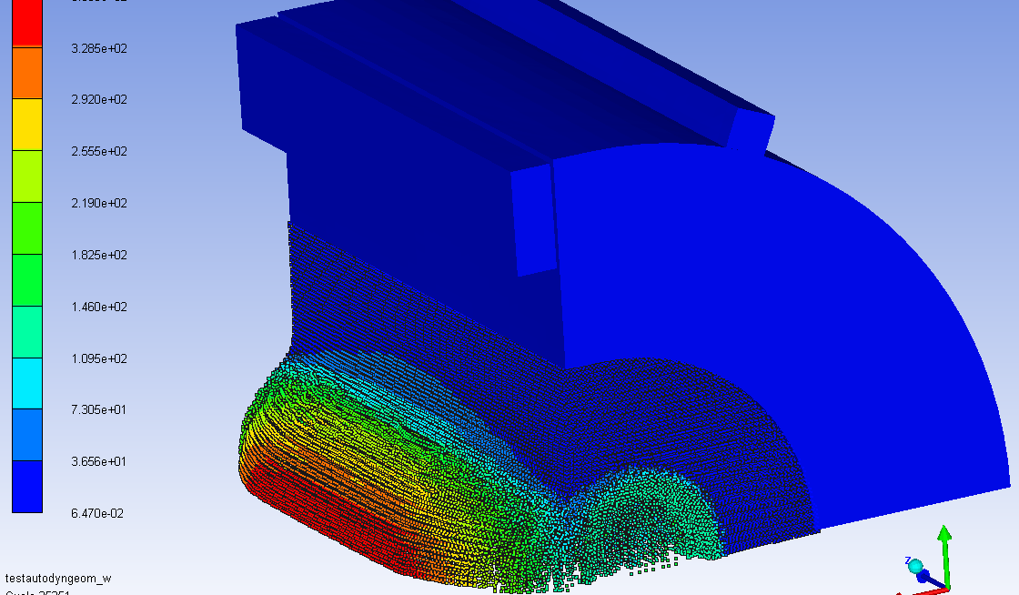
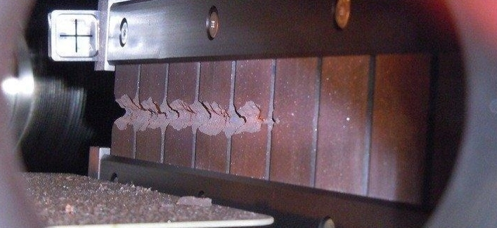
Context
LHC is reaching unprecedented beam brightness and energy leading to extreme energy density (15 GJ/mm²).
At such energy densities Beam-induced accidents are among the most dangerous events for particle accelerators.
Collimators are inherently exposed to such extreme events (β* reach is determined by collimator constraints)
Collimators are, by far, the highest contributors to machine impedance, potentially leading to serious instabilities.
Development of advanced materials,
along with state-of-the-art simulations,
are instrumental in facing these challenges!
Collimators impedance/
LHC Impedance

Slide 3

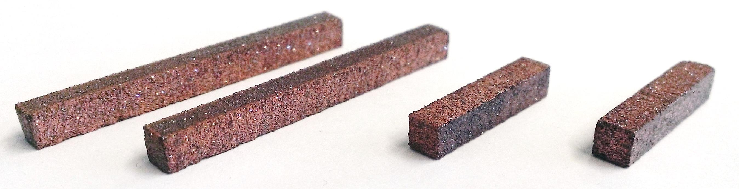
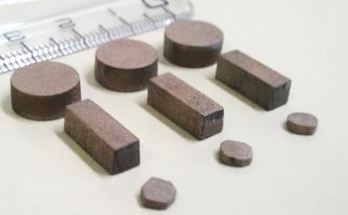
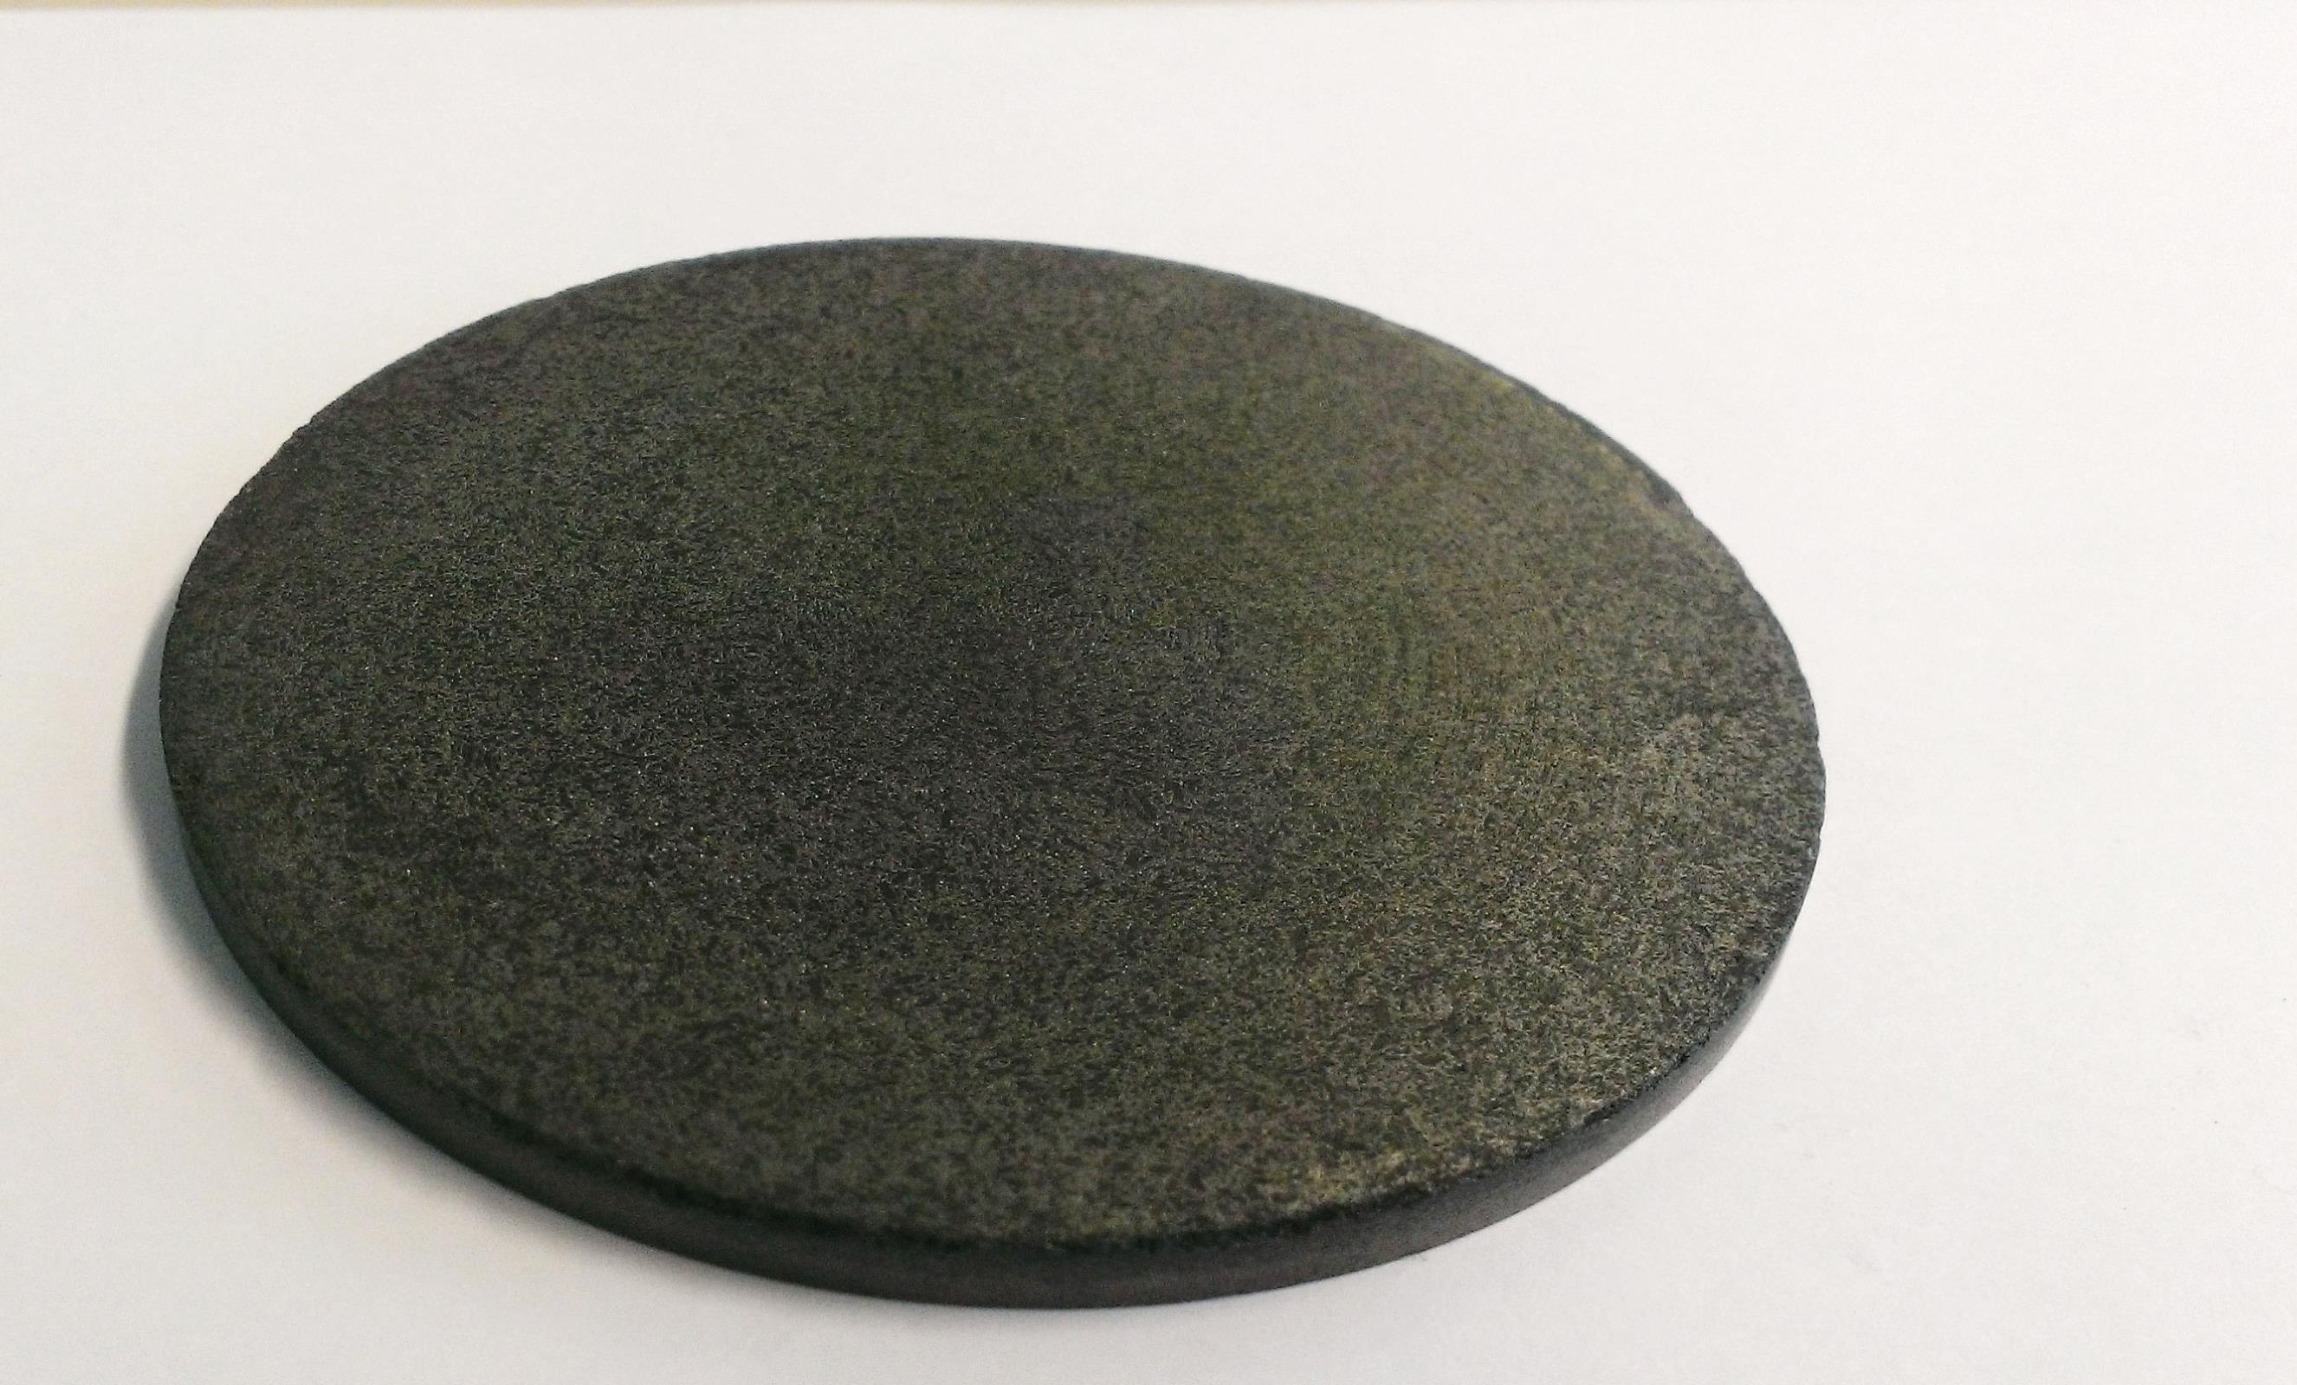

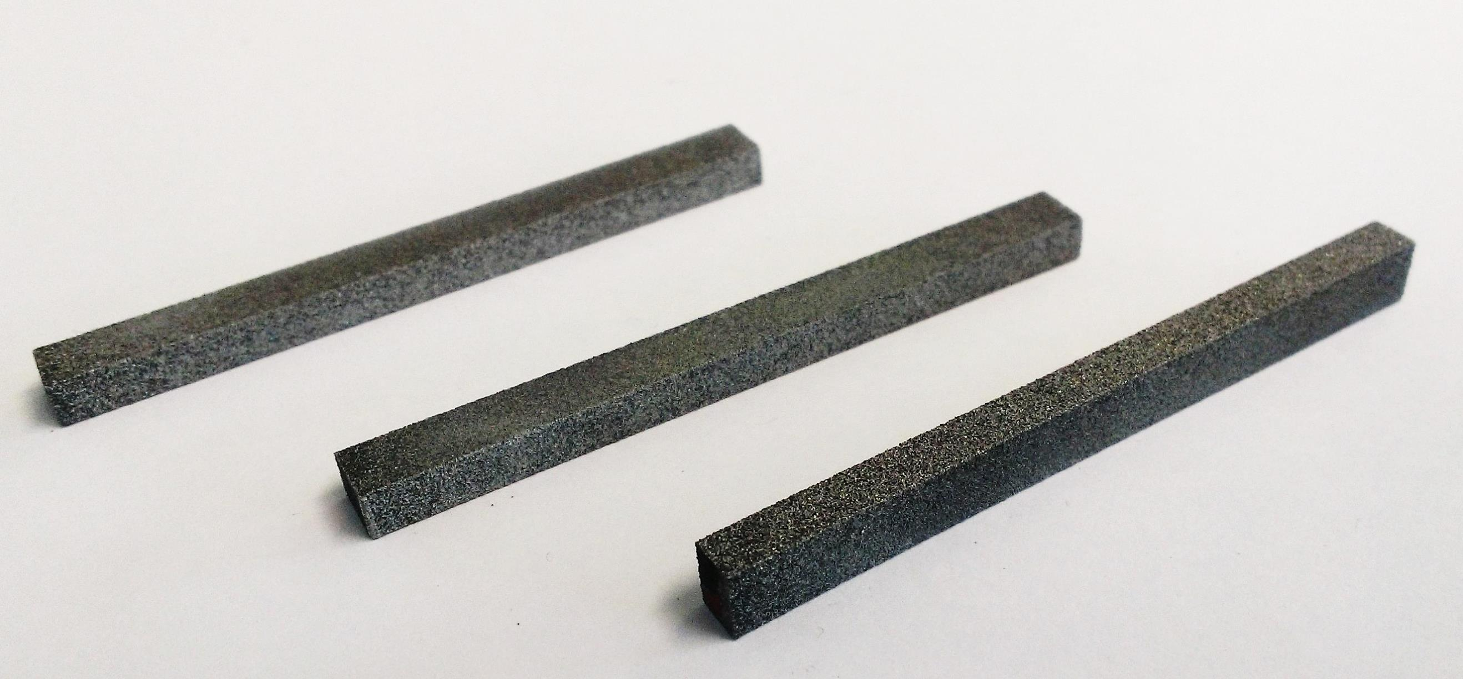

Metal Matrix Composites
Materials investigated are Copper-Diamond (Cu-CD), Molybdenum-Diamond (Mo-CD), Silver-Diamond (Ag-CD), Molybdenum-Graphite (Mo-Gr)
Most promising materials are Cu-CD and Mo-Gr.
Ag-CD and Mo-CD are, by now, sidelined as they are limited by (relatively) low melting temperature (Ag-CD) and insufficient toughness (Mo-CD).
Mo-Gr is particularly appealing as it is easy to machine, is versatile and can be coated with a Mo layer dramatically increasing electrical conductivity …
Cu-CD
Mo-CD
Mo-Gr
Ag-CD

Slide 4
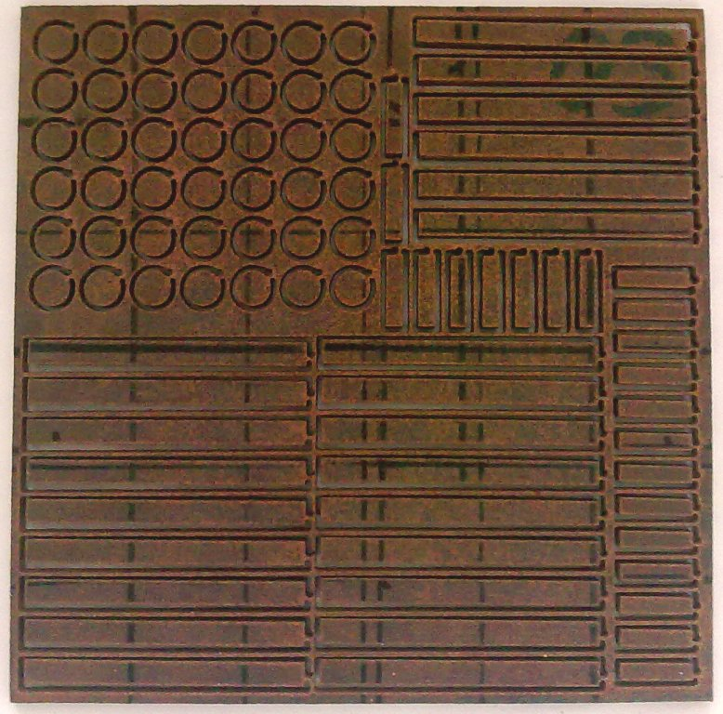
Copper-Diamond Composite
Developed by RHP-Technology (Austria)
No diamond degradation (in reducing atmosphere graphitisation starts at ~ 1300 °C)
Very good thermal (~490 Wm⁻¹K⁻¹) and electrical conductivity (~12.6 MSm⁻¹).
No direct interface between Cu and CD (lack of affinity). Partial bonding bridging assured by Boron Carbides limits mechanical strength (~120 MPa).
Cu low melting point (1083 °C) may limit Cu-CD applications for highly energetic accidents.
CTE increases significantly with T due to high Cu content (from ~6 ppmK⁻¹ at RT up to ~12 ppmK⁻¹ at 900 °C)
150 x 150 x 4mm³
BC “bridge” stuck on CD surface.
No CD graphitization

Slide 5
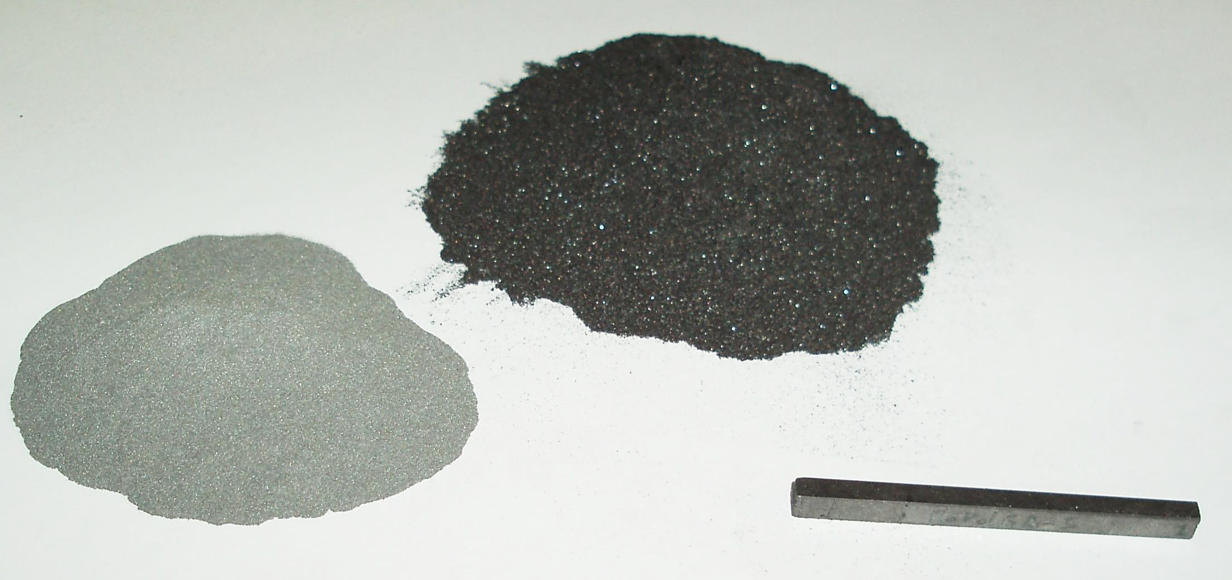
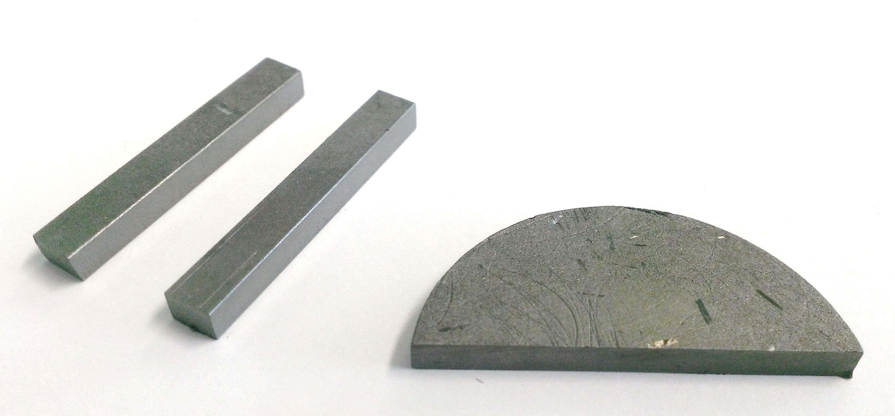
Molybdenum-Graphite Composites
Co-developed by CERN and Brevetti Bizz.
Why Molybdenum?
Refractory metal
High mechanical strength
Density lower than Tungsten
Why Graphite?
Low CTE
Low Density
High Thermal Conductivity (natural graphite flakes)
Very High Service Temperatures (also allowing elevated processing temperatures)
High Shockwave Damping
Composite Features
Very high melting point (2500+°C)
Low Density (can be tailored)
Very high thermal conductivity
Highly stable (forms MoC_{1-x} carbides)
Fair electrical conductivity
Mechanical strength to be improved …

Slide 6
Molybdenum-Graphite Composites
Addition of mesophase pitch-base carbon fibers
Liquid Phase Spark Plasma Sintering (>2500° C)
Advantages of Carbon Fibers addition
Increase mechanical strength
Contribute to high thermal conductivity (mesophase pitch grade)
Along with MoC_{1-x} , catalyze graphitization process

Slide 7
Mo-Gr-CF Microstructures
Homogeneous distribution of graphite, fibers and fine MoC_{1-x} grains
Recrystallization of graphite and CF
Highly Oriented Graphene planes
Strong fiber-matrix bonding
➔ Improved Mechanical Strength
Thermal Conductivity 700+ Wm⁻¹K⁻¹
… almost twice pure Cu !!!
(97% of theoretical value)
Mechanical Strength > 75 MPa.

Slide 8
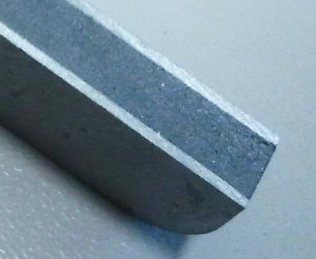
Mo-coated Mo-Gr
Co-developed by CERN and Brevetti Bizz.
Molybdenum – Graphite core with pure Mo cladding.
Sandwich structure drastically increases electrical conductivity.
Excellent adhesion of Mo cladding thanks to carbide interface.
… no surprise a full Collimator prototype is requested in LHC by 2016!
N. Mounet et al., Impedance @ 2013 Collimation Review, May 2013
Core:
1 MS/m
Carbide layer: 1.5 MS/m
Mo Coating:
18 MS/m
Collimator impedance reduced by a factor 10 through Mo-coated Mo-Gr.

Slide 9
Material Tests in HiRadMat
Why HiRadMat Experiments?
With accidental beam impacts, one enters a relatively unknown territory, that of high power explosions and ballistics.
Existing material Constitutive Models at extreme conditions are limited and mostly drawn from military research (classified).
Simulations are sophisticated, but unavoidably affected by uncertainties and approximations.
Consequences on UHV, electronics, bellows cannot be easily anticipated by numerical simulations.
Only dedicated material tests can provide the correct inputs for numerical analyses and validate/benchmark simulation results.
Based on this, two complementary experiments at CERN HiRadMat facility were approved:
  Destructive Test of a complete tertiary collimator for a thorough, integral assessment of beam accident consequences (HRMT09 – A. Rossi, O. Aberle, S. Redaelli, M. Cauchi et al.).
  Controlled test on a multi-material test bench hosting a variety of specimens conveniently instrumented for online and offline measurements (HRMT14 ).

Slide 10
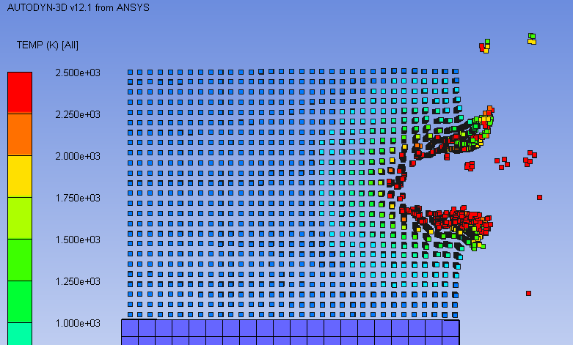
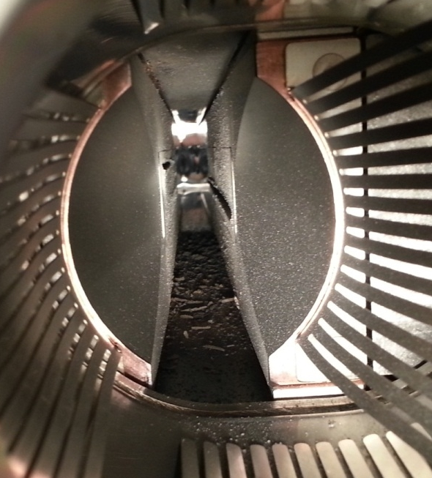
HRMT09: Post-irradiation observation
24 bunches 440 GeV
~8.5 mm
Test 1
(1 LHC bunch @ 7TeV)
  Good matching between tests and simulations (e.g. groove height)
  Impressive quantity of tungsten ejected (partly bonded to the opposite jaw, partly fallen on tank bottom or towards entrance and exit flanges)
  Vacuum degraded
  Tank contaminated
Test 2
(Onset of Damage)
Test 3
(72 SPS bunches)

Slide 11
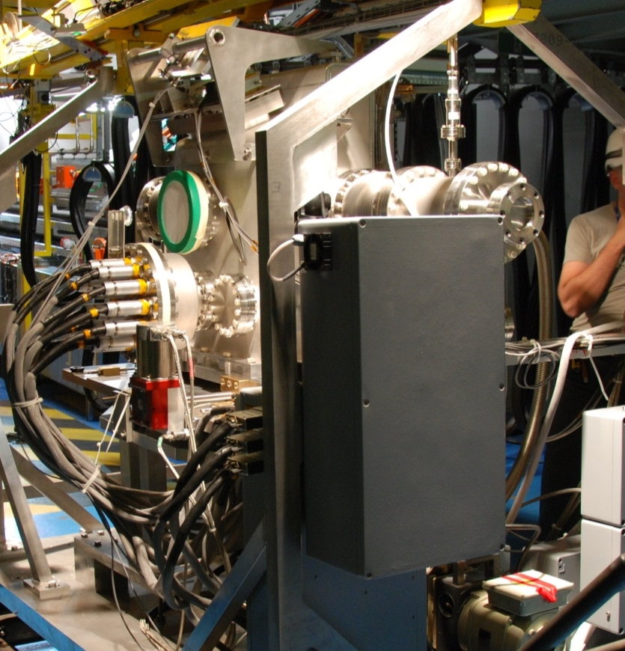
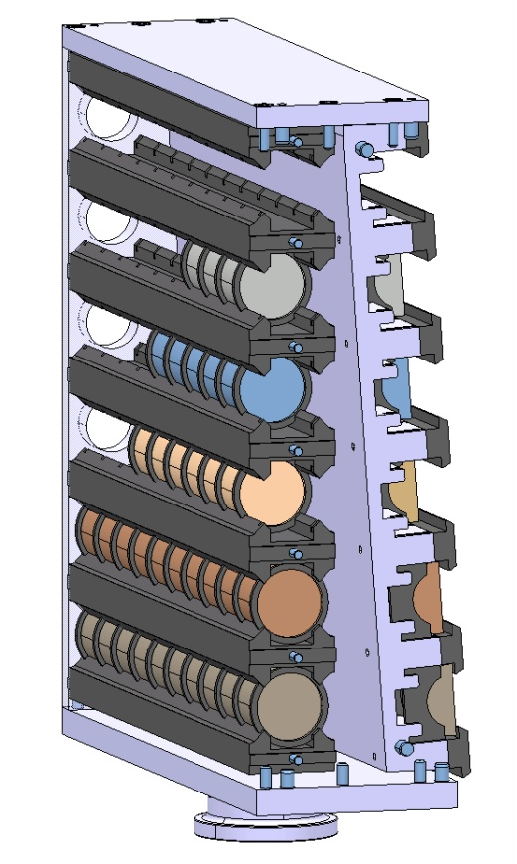
HRMT14 Experiment
Benchmark advanced numerical simulations and material constitutive models through extensive acquisition system.
Characterize in one go six existing and novel materials under development: Inermet180, Molybdenum, Glidcop, Mo-CD, Cu-CD, Mo-Gr. 2 sample types, 12 target stations, 88 samples.
Collect, mostly in real time, experimental data from different acquisition devices (Strain Gauges, Laser Doppler Vibrometer, High Speed video Camera, Temperature and Vacuum probes).
  High Intensity Samples
  (Type 2)
  Strain measurements on sample outer surface;
  Fast speed camera to capture fragment front formation and propagation;
  Temperature measurements;
  Sound measurements.
  Medium Intensity Samples
  (Type 1)
  Strain measurements on sample outer surface;
  Radial velocity measurements (LDV);
  Temperature measurements;
  Sound measurements.
Beam

Slide 12
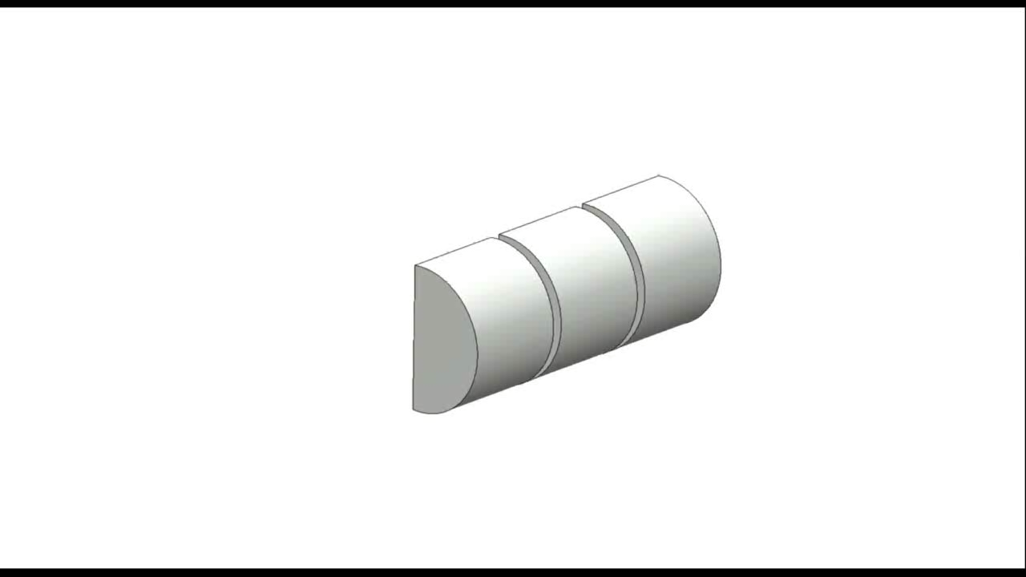
HRTM14: High Intensity Tests
  Inermet samples as seen from viewport and camera

Slide 13
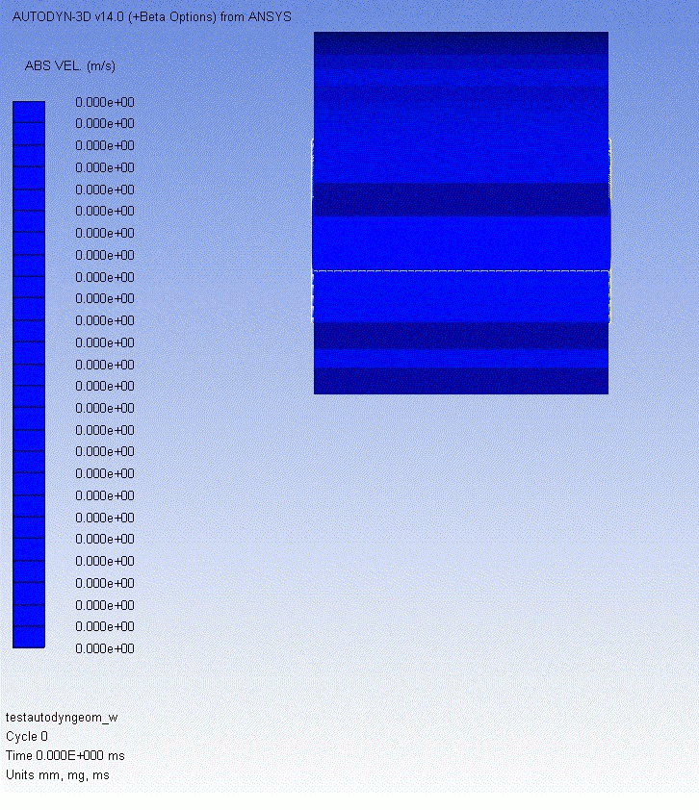
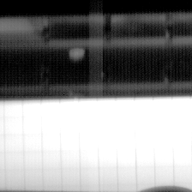
HRMT14: High Intensity Tests
  Inermet : comparison Autodyn (SPH) between simulation and experiment
Beam
Case | Bunches | p/bunch | Total Intensity | Beam Sigma | Specimen Slot | Velocity
Simulation | 60 | 1.5e11 | 9.0e12 p | 2.5 mm | 9 | 316 m/s
Experiment | 72 | 1.26e11 | 9.0e12 p | 1.9 mm | 8 (partly 9) | ~275 m/s

Slide 14
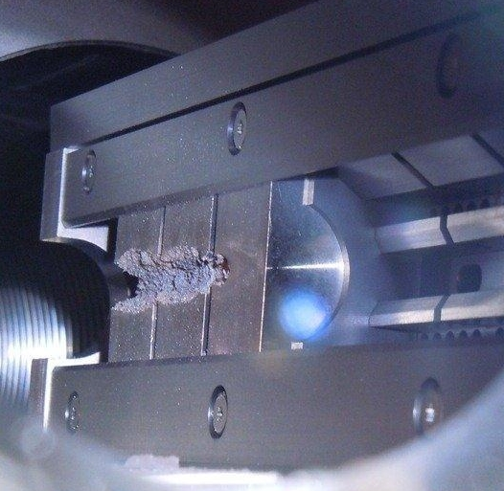
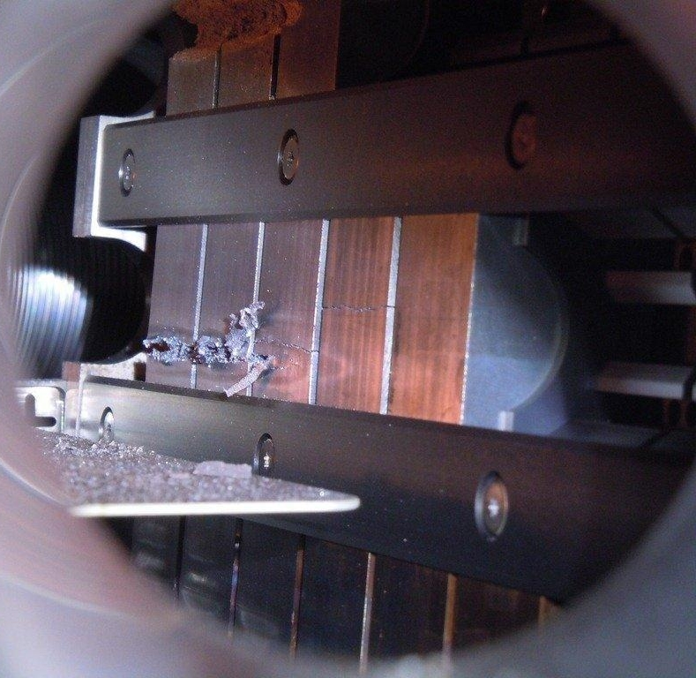
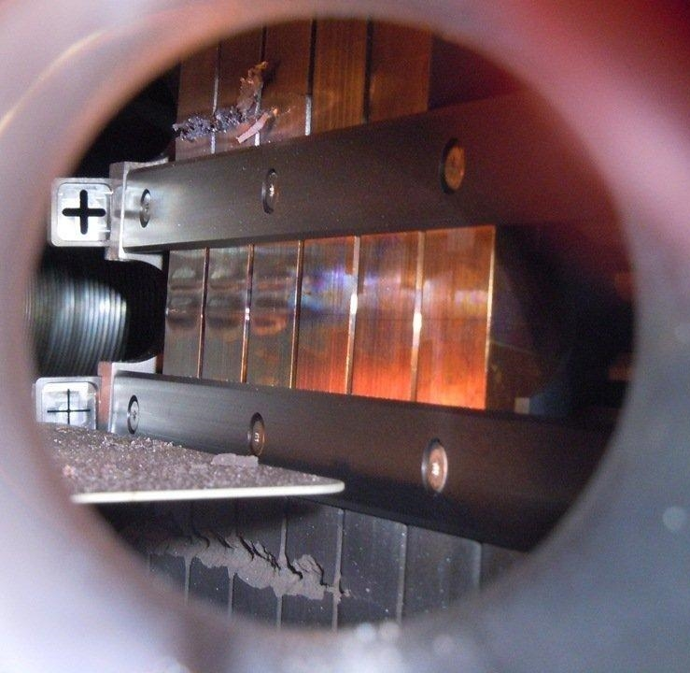
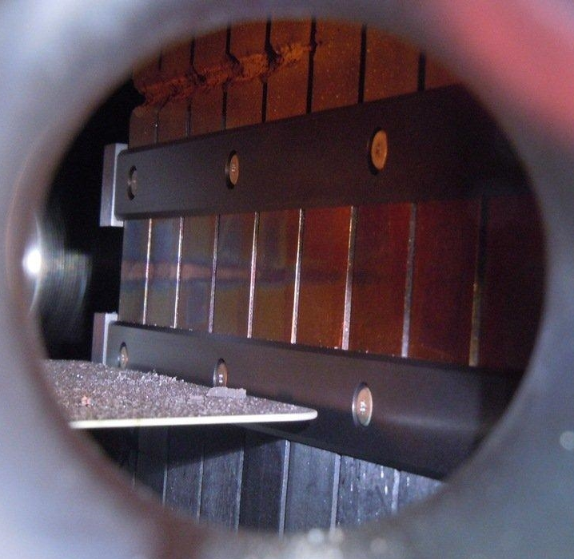
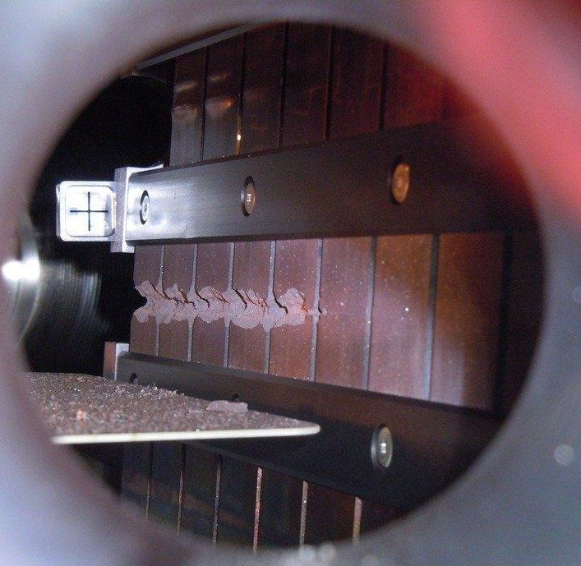
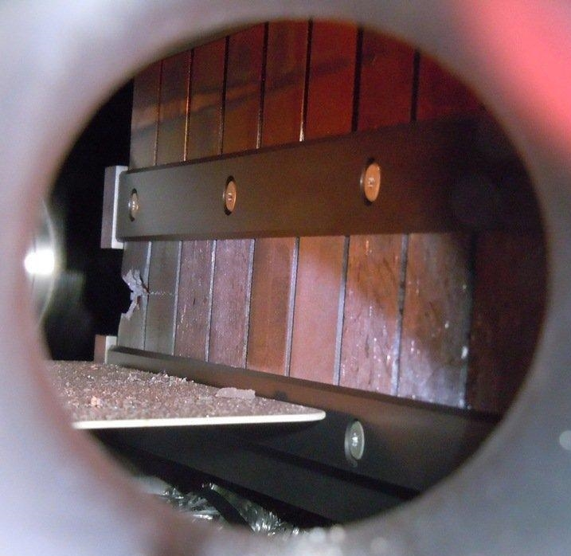
HRMT14: High Intensity Tests
    Inermet 180, 72 bunches
  Molybdenum, 72 & 144 bunches
  Glidcop, 72 bunches (2 x)
  Copper-Diamond
  144 bunches
  Molybdenum-Copper-Diamond 144 bunches
  Molybdenum-Graphite (3 grades)
  144 bunches

Slide 15


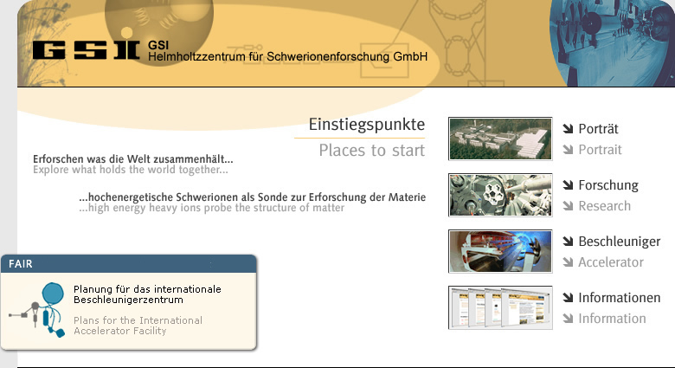







Tasks 11.2 and 11.3 Framework
“Global” Collimation Objectives (relevant to Tasks 11.2 and 11.3) and (aggressive) Timing
  Choose a novel, robust (low-Z) material for HL-LHC Primary and Secondary Collimators (TCSx) – Mid 2014
  Design, build and install a test bench for one or more HL-LHC Collimator full jaws in HiRadMat² – Early 2015
  Investigate alternative, more robust materials for Tertiary Collimators and Absorbers – Mid 2014
  Design, build and install a test bench to assess and qualify a palette of materials samples in HiRadMat² – Mid 2015
  Design, build and install in the LHC a prototype of HL-LHC Secondary Collimator embarking novel advanced materials – Early 2016
Notes:
Make a distinction of what does who, why it is complementary to have different sources.

Slide 16
Activities within Task 11.2 (I)
Research and Development of Novel Materials
  Low-Z materials for HL-LHC Primary and Secondary Collimators
    Continue development of Mo-Gr particularly in view of improving mechanical strength
    Optimize methods to coat or clad Mo-Gr with pure Molybdenum (hot cladding, sputtered coating etc.)
    Explore alternatives for high-Z materials, with high thermal conductivity and good electrical conductivity (Molybdenum, high strength refractory carbides or ceramics, SiC, C-SiC …)
    Continue investigations on existing “traditional” materials (particularly Carbon-based).
Notes:
Make a distinction of what does who, why it is complementary to have different sources.

Slide 17
Activities within Task 11.2 (II)
Characterization and physio-mechanical testing of Collimator Materials (novel and existing)
  Microscopic Analyses
    SEM, TEM, Spectroscopy, Metallograpies etc.
  Thermo-physical characterization up to 2000° C
    Density, Thermal Diffusivity, Specific Heat, CTE etc.
  Mechanical Testing
    Strength tests at different temperatures, strains and strain rates
    Static and dynamic (spall) fracture tests.
  Irradiation and radiation damage characterization in situ and off-line
    On-line and in-situ SEM monitoring of (heavy) ions radiation-induced damage on material structure (with particular reference to carbon-based composite materials)
    On-line thermal camera studies of thermal conductivity degradation induced in irradiated materials (with particular reference to carbon-based composite materials)
    Off-line RAMAN spectroscopy on irradiated materials
    Laser induced spall studies on pristine and irradiated materials
Notes:
Make a distinction of what does who, why it is complementary to have different sources.

Slide 18
Activities within Task 11.2 (III)
Experimental tests at HiRadMat²
  Although very successful, a number of intrinsic limitations exist for HRMT-14 (and HRM-09) experiments:
  Intrinsically low signal to noise ratio for resistive strain gauges.
  Low signal for low-Z materials (those which better survived the impact …).
  Relatively low resolution / acquisition rate for high speed camera.
  Lighting with limited reliability.
  Pollution by molten material of viewports.
  LDV acquisition on one single specimen per target station.
  Non-optimized specimen aspect ratio (length to radius).
  Signal attenuation on cables.
  And most notably:
  A number of novel materials yet to test …
Notes:
Make a distinction of what does who, why it is complementary to have different sources.

Slide 19

Proposed Types of Experiments
Integrally test under full SPS beam (288 b) jaws and collimators of latest generation (TCSx, TCTPx, BBLRC, SLAC Phase II …)
Acquire online data on response to impact of full jaws.
Experiment 1: Integral Test of Fully Assembled Jaws
Include in one tank (at least) two superposed jaws.
Equip the jaws with set of strain gauges, displacement monitors, temperature sensors, PVDF etc. for online acquisition.
Equip test bench with advanced microphonic sensors.
Design a special, mobile tank equipped with viewports for optical acquisition, LDV, electric connections etc.
Assess the test-bench compatibility with 288 bunch pulses …

Slide 20
Proposed Types of Experiments
Test samples of novel materials for collimators and other (future) BIDs (TDI, TCDI, TCDQ, …)
Acquire online exploitable data for low-Z materials
Benchmark not-yet-explored effects such as code coupling
Experiment 2: Multi-material sample holder (v2)
Evolve sample holder v1 (up to 288 SPS bunches)
Optimize dimensions of material specimens (specific to each material ?)
Use faster camera. Improve lighting system.
Optimize strain gauges.
Complement LDV with VISAR (?) for higher sample velocity acquisition.
Equip test bench with advanced microphonic sensors.

Slide 21
Activities within Task 11.2 (IV)
Long-term irradiation tests and assessment of material property changes
  Continuation of Irradiation studies at KI-RRC and reports
    Cu-CD
    MoCuCD
    SiC
  Continuation of Irradiation studies at BNL and reports
    Cu-CD
    Mo-Gr
    Molybdenum
    Glidcop
Notes:
Make a distinction of what does who, why it is complementary to have different sources.

Slide 22
Tasks 11.3
Activities to pursue
  Theoretical modelling of materials and novel composites (Equations of State, Strength models, Failure models).
  Energy deposition calculations (FLUKA) and coupling with hydrocodes.
  Modelling of dynamic phenomena (stress and shock waves, spall, melting, fragmentation, tunnelling …) induced by fast abnormal beam loss events.
  Modelling of long-term radiation damage. Equivalence between high fluence, low energy and lower fluence, high energy irradiation with various species.
  Benchmark numerical results with experimental data.
Notes:
CERN, GSI, POLITO, RHP, RRC KI, UM

Slide 23

Summary and Perspectives

Slide 24
Thank you for your attention!

