Slide 1

Politecnico di Torino: Possible Contributions to WP11 and Work Proposals
Lorenzo Peroni, Martina Scapin
EuCARD2 WP11 (Materials for Collimation) kick-off and tasks meeting
Dipartimento di Ingegneria Meccanica e Aerospaziale

Slide 2
Outline
Development of strength and failure models for relevant materials
Fracture analysis of novel composites materials
Contributions to the development of Equations of State for relevant materials
Contribution to multi-material tests in HiRadMat2

Slide 3
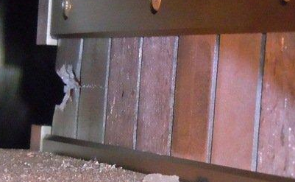
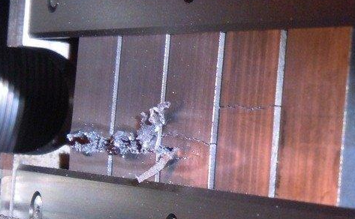
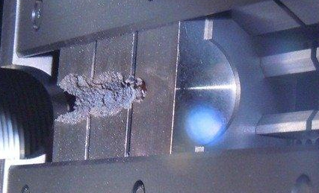
What do we want to investigate?
Reflected shockwaves
Fracture analysis of novel composites materials
Mo-GR
Spall
fracture
Molten zone/plasma
p
Development of strength and failure models for relevant materials
Mechanical shock
BEAM
Mo
ρ₀
Equation Of State
r
depth
Cylindrical shockwaves
Vapour
Gas
SPLASH
Energy deposition shock
isodensity
Contributions to the development of Equations of State for relevant materials
attenuation
IT180
Solids

Slide 4
Constitutive material models
Pressure gradients produce plasticity (in ductile material)!
These models have typically been tested and calibrated with experiments on Hopkinson bars, Taylor cylinders and with high-explosive (HE)–driven shock or compression waves at pressures up to a few tens of GPa and strain rates of 10³ to 10⁵ s⁻¹
Johnson-Cook
Steinberg-Guinan
P_{expected} ~ E_{deposited} >100 GPa!
For the future, improvement in the material strength model is a fundamental aspect!
Pure metals data avaliable
When the temperature reaches the value of the melting temperature the shear strength of the material model becomes zero and the material starts to be considered like a fluid (pure hydrodynamic behaviour)

Slide 5
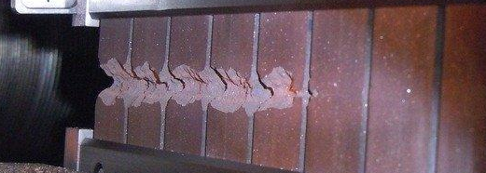
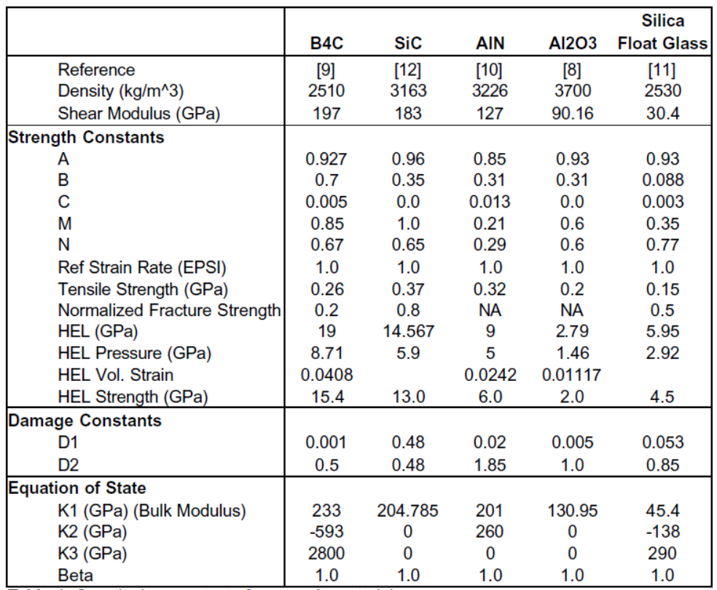
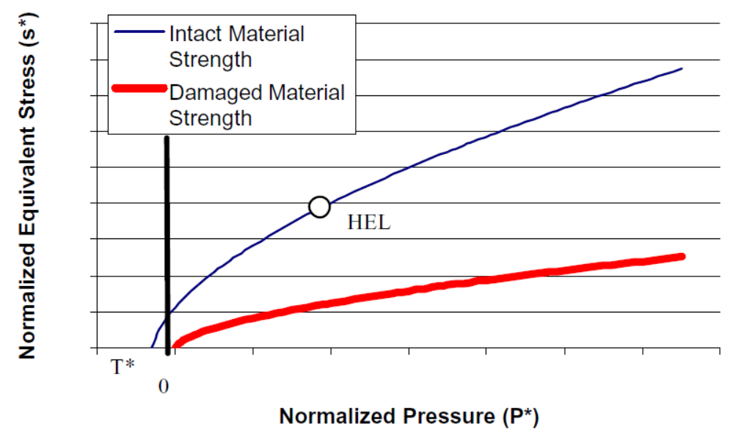


Constitutive material models
Pressure values (spall) and gradients produce fracture (in brittle material)!
The Johnson-Holmquist material model, with damage, is useful to model brittle materials, such as ceramics, subjected to large pressures, shear strain and high strain-rates.
The model simulates the increase in strength shown by ceramics subjected to hydrostatic pressure as well as the reduction in strength shown by damaged ceramics.

Slide 6
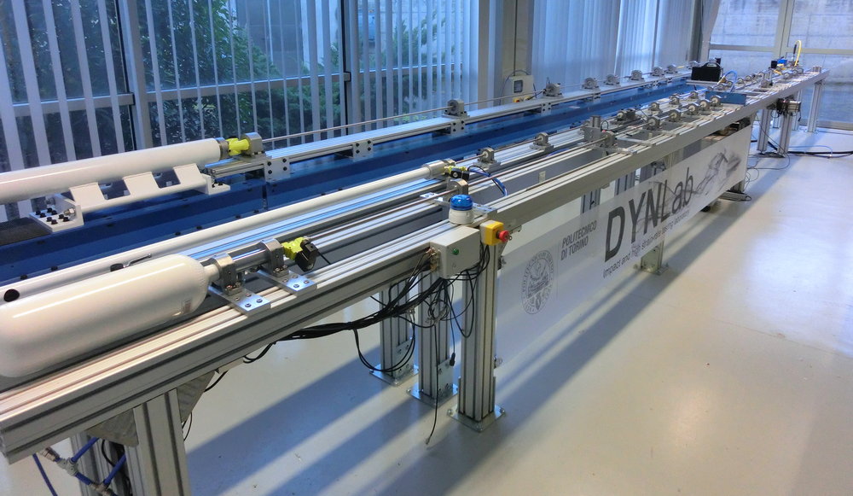
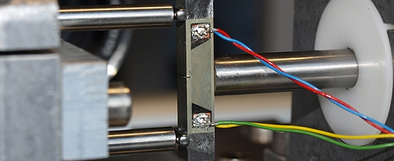
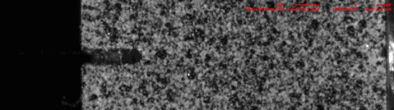
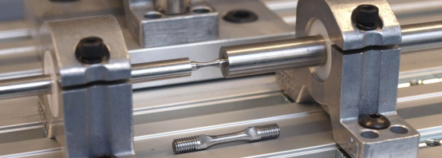
Strength and failure models – SHPB
Gasgun
Mini
Trazione
Compressione/flessione
4 Hopkinson bar systems (tension, compression/bending, miniaturized) with semiconductor straingages and fast data acquisition system (up to 100 MHz)
Standard test (tensile, compression), miniaturized tensile, Brazilian and Spalling test (brittle), triaxiality effects (notched specimens), fracture toughness …
2 high speed video cameras (max 1 Mfps) and a VISAR

Slide 7
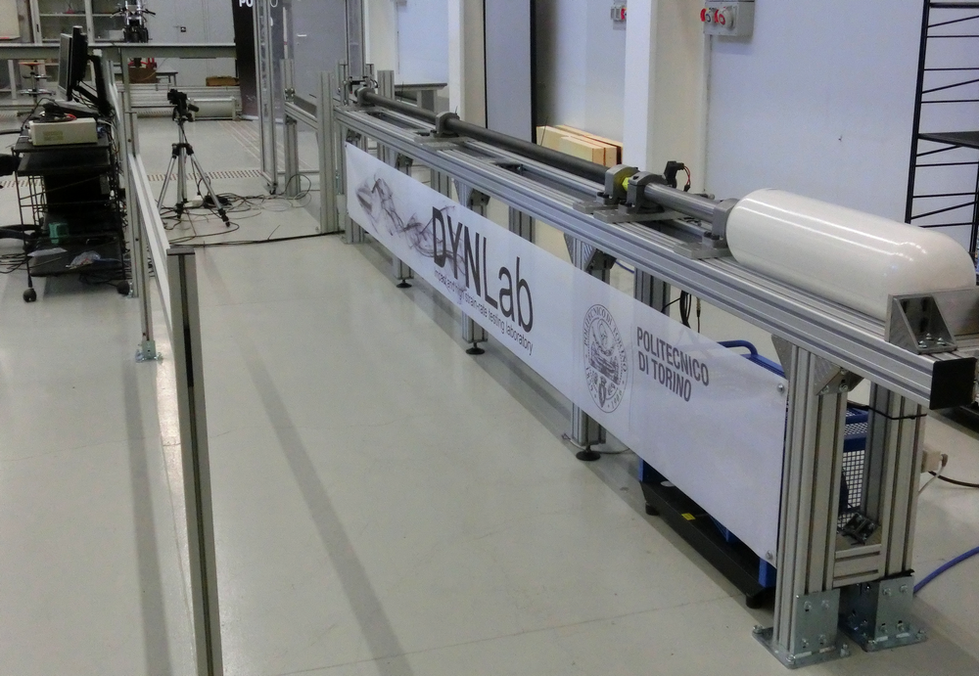
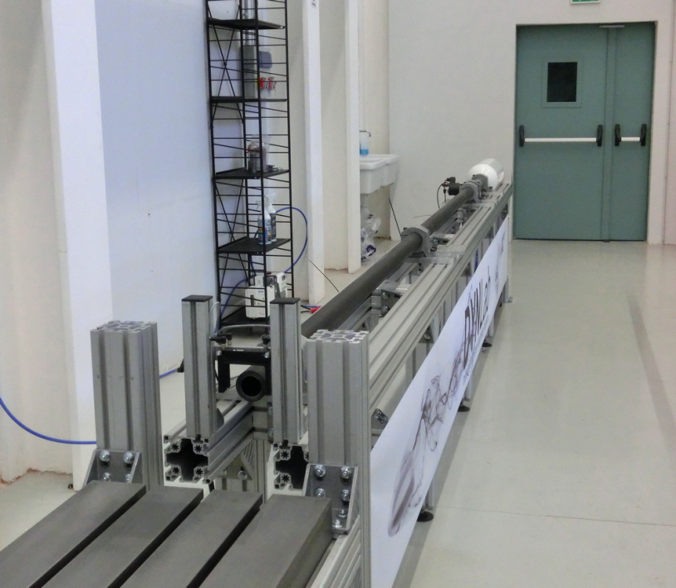
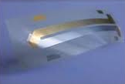
Strength and failure models - Gasgun
Light Gasgun forTaylor, flyer-plate and ballistic impacts tests
Max Bore size 40 mm, accelerating length 4 m
2 high speed video cameras (max 1 Mfps) and 1 VISAR (Velocity Interferometer System for Any Reflector), PVDF sensors

Slide 8
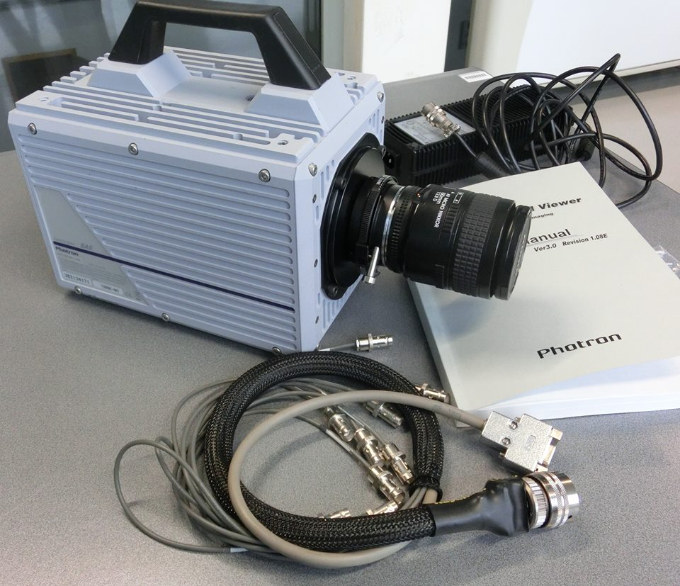
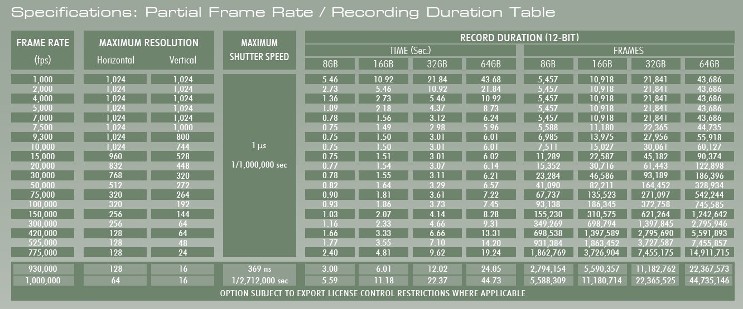
High speed camera (I)
Maxima performances: full resolution 1024 x1024 (7000 fps); maximum frame rate 1000000 f/s (64 x 16 pixels);
Shutter: global electronic shutter up to 369 ns, frame rate independent
Variable Region of Interest (ROI)
Capture 12-bit uncompressed data
20μm pixels ensure best light sensitivity for demanding high-speed or low light applications
8GB memory (standard: 5457 frames or 0.780 s @ maximum resolution)
Gigabit Ethernet interface
Triggering and trigger delay options programmable and selectable
According to EUCARD2 improvement process of all testing facilities a new high speed camera was acquired

Slide 9
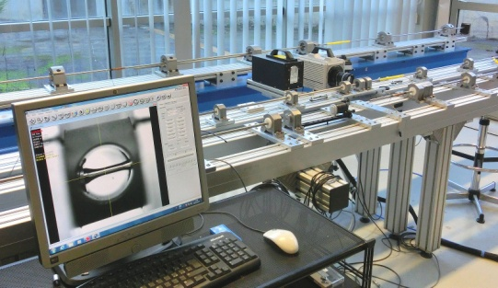
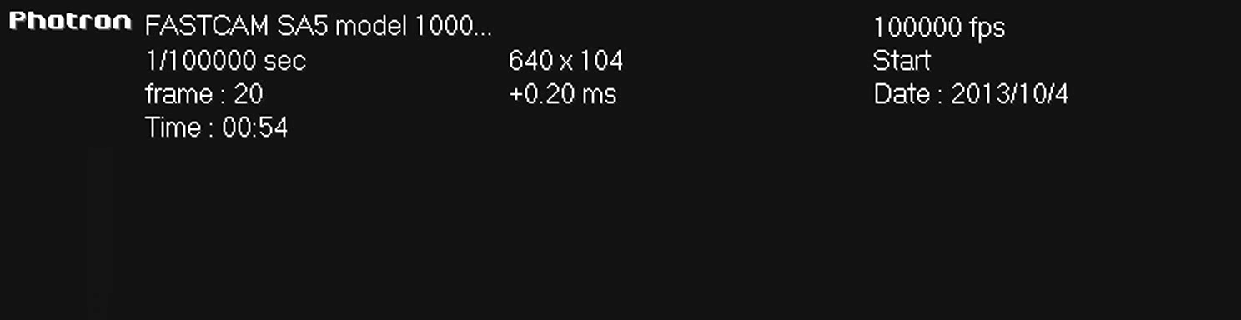
High speed camera (II)
Video acquisition could be synchronized with data acquisition systems (which generates trigger) and lightening system (flash).
The time between trigger and full light illumination is about 20 μs (using MOF-SET transistors).

Slide 10
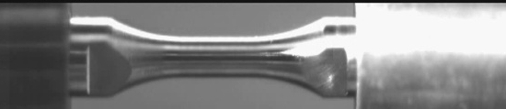


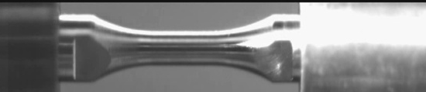

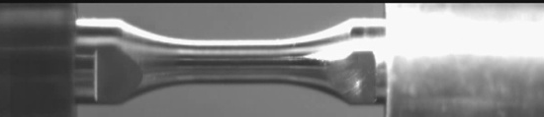
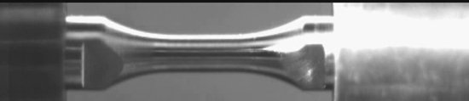




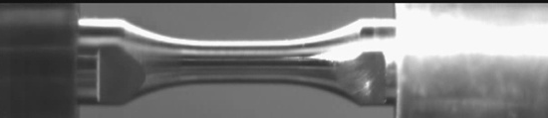

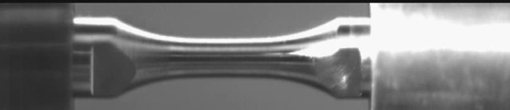











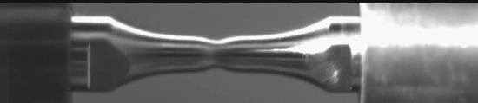





High speed camera (III)
Tensile test at 10³ s⁻¹ - duration 300 μs
A great number of high resolution images are available for FEM comparison and image analysis

Slide 11
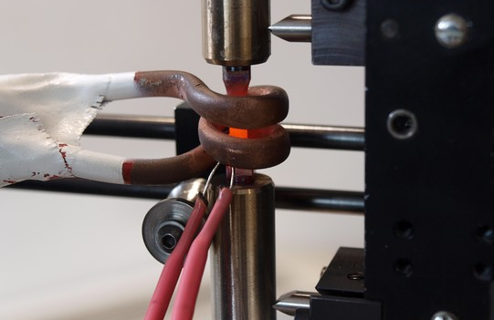
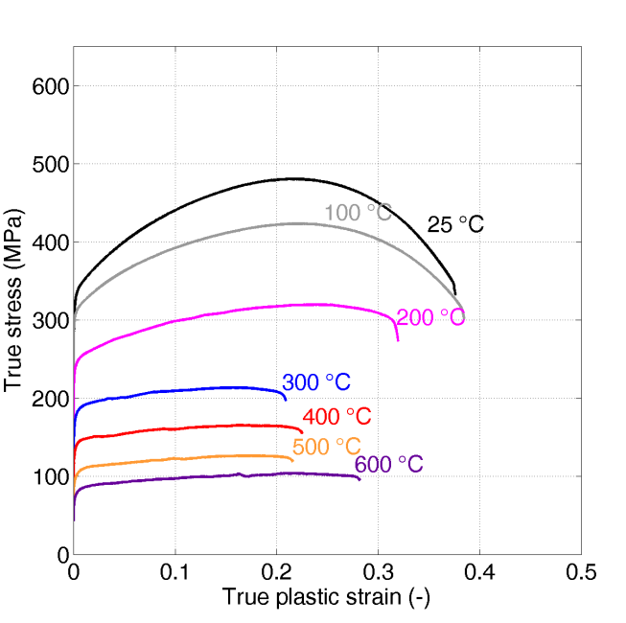
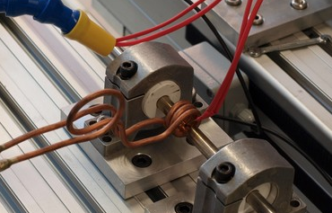
Strain-rate & temperature (I)
Quasi-static test
varying temperature
High strain-rates varying temperature

Slide 12
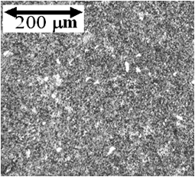
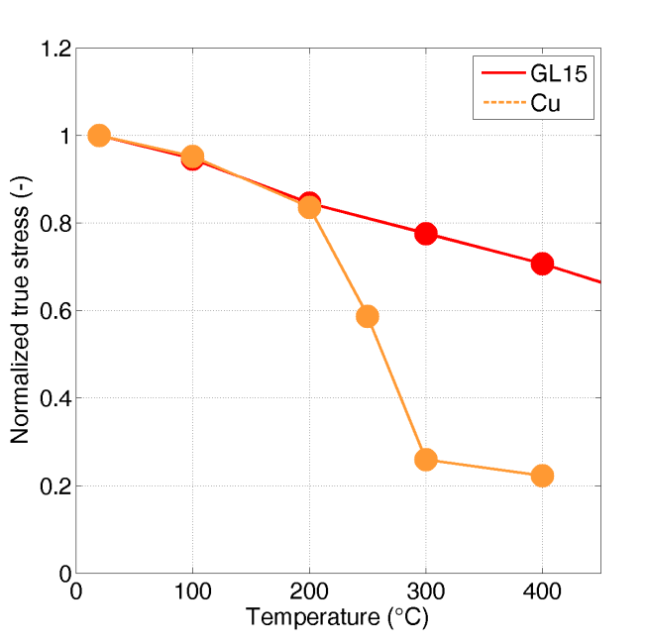
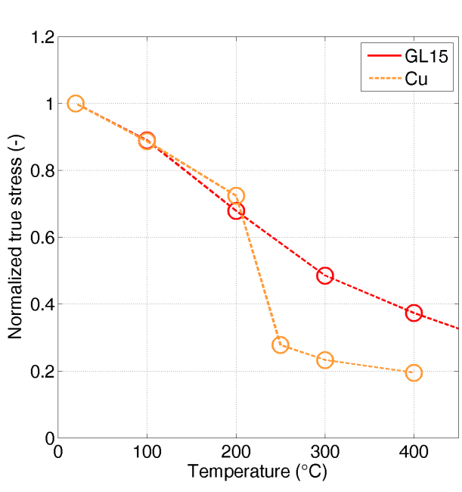
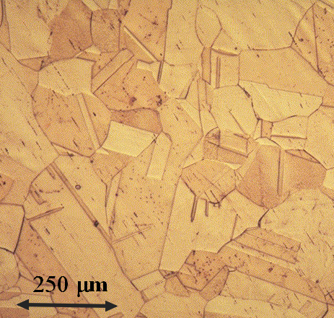
Strain-rate & temperature (II)
Copper
Glidcop
dynamic
dynamic
static
static
ε =10%
ε =10%
Static
Dynamic
Glidcop
Glidcop
Copper
Copper
ε =10%
ε =10%

Slide 13
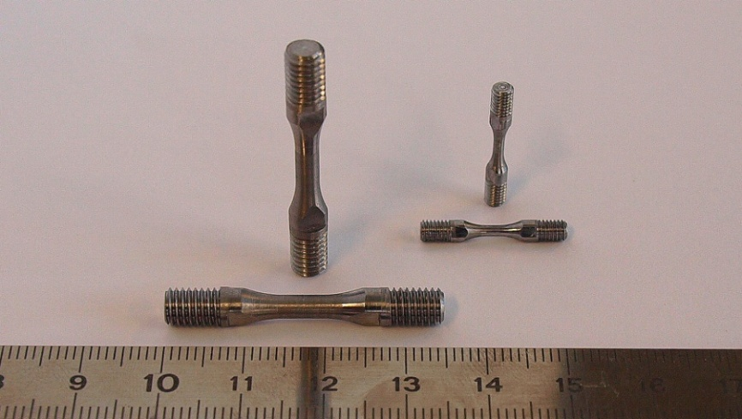
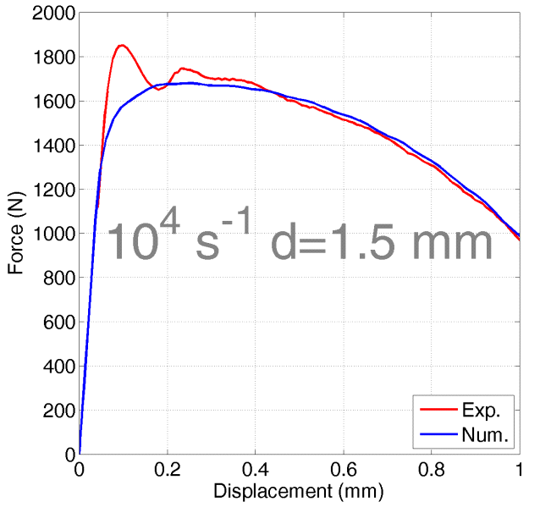
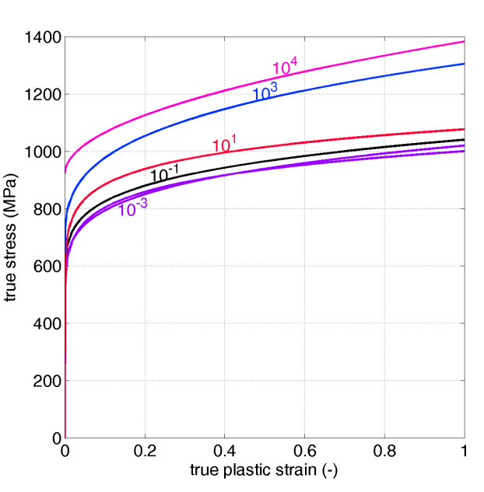

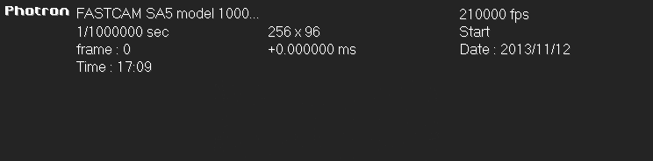
Ultra high strain-rate (10⁴ s⁻¹)
Experimental test
Numerical model

Slide 14
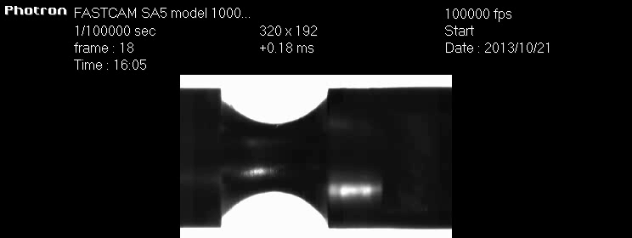
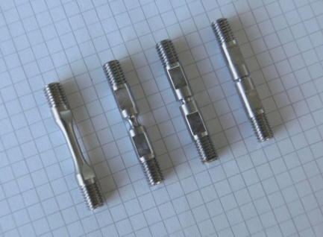
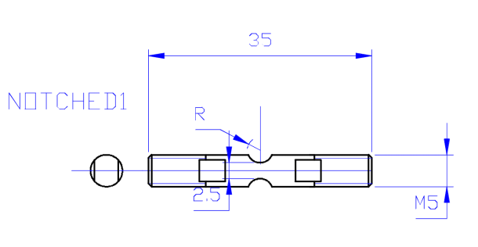
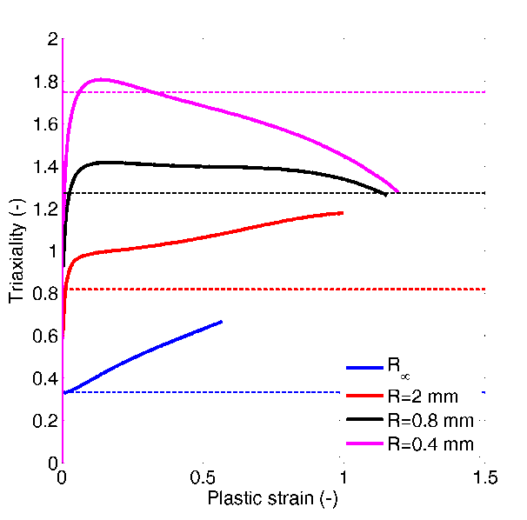
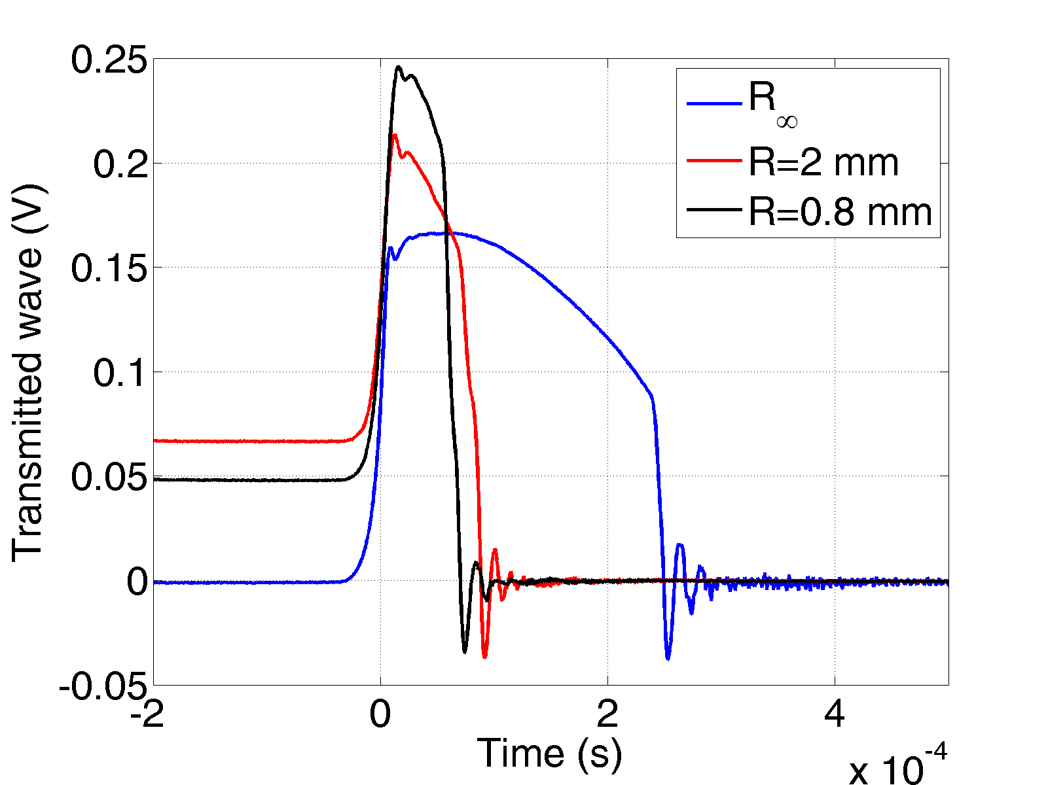
Failure locus: triaxiality effects
R∞
R=0.4
R=0.8
R=2
FEM analysis
For ductile materials, the fracture strain is strongly triaxiality dependent. High strain-rate tests on notched specimens are needed.

Slide 15

Material models identification
Measured and computed quantities
Numerical model
Experimental test

Slide 16
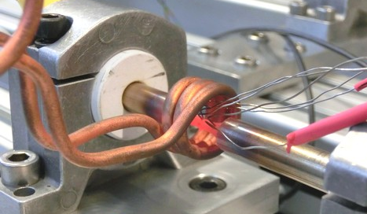
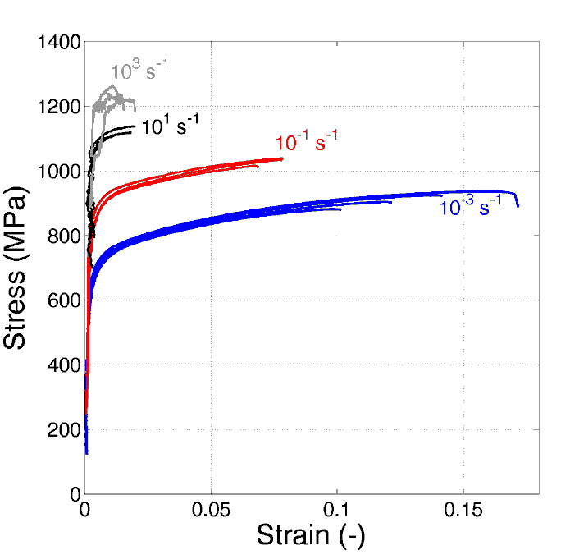
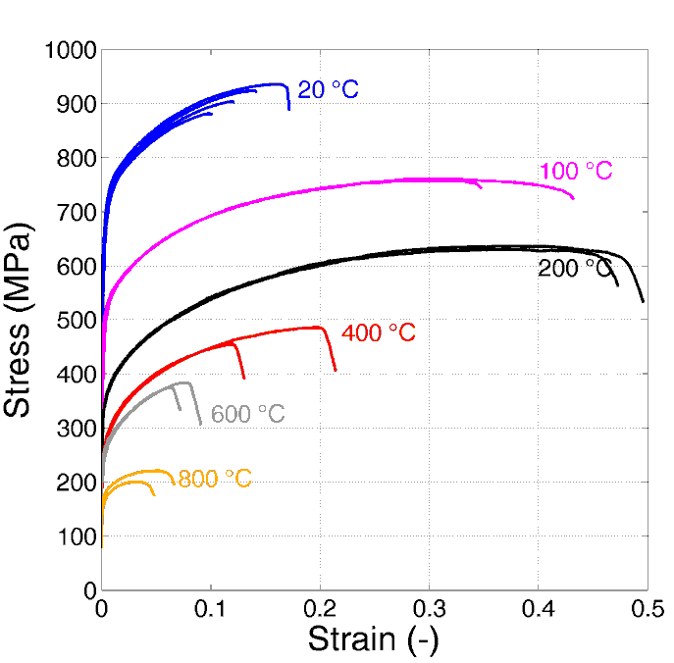
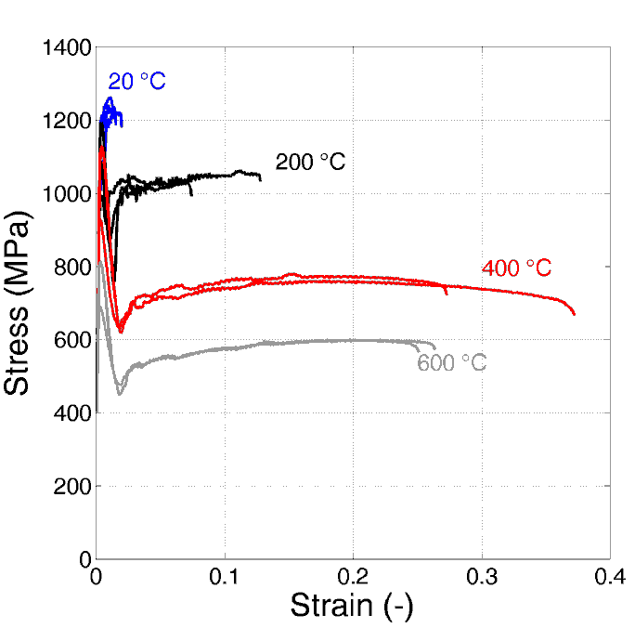
Inermet - IT180 (I)
High strain-rate test
Room temperature varying strain-rates
Quasi-static varying temperature
High strain-rates varying temperature

Slide 17
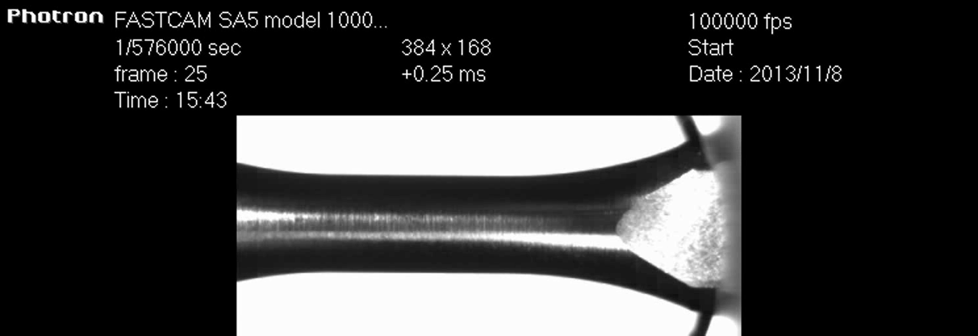
Inermet - IT180 (II)
Metals produced via powder technology could exhibit brittle behaviour especially at high strain-rates (during the test many waves could travel inside the specimen, with many reflections).
In this condition, even for ductile material, techniques similar to those used for brittle materials could/should be adopted.

Slide 18
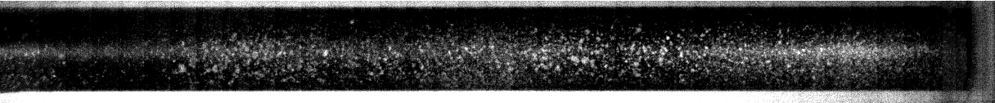
SHPB Spalling test (I)
The SHPB setup is modified in order to allow dynamic tensile tests on brittle material (graphite), to evaluate the failure strain at high strain rates.
The compressive wave reflects on the free surface and turns into a tensile wave.
Specimen motion
Tensile wave

Slide 19

SHPB Spalling test (II)
Measuring point on the specimen
C
t₁
The compressive wave (C) of length L is transmitted into the specimen and travels until reaching the free surface
t₂
C
At the free surface the compressive wave is reflected back as tensile wave (T), which grows in amplitude: when T = C, the resultant R = 0 and the specimen is completely unloaded.
R
T
t₃
C
When the resultant R = T – C reaches the ultimate stress of the material, it generates a fracture surface.
R
T
The wave travelling inside the left main fragment is limited in amplitude by the ultimate stress of the material, and cannot generate other fractures (unless inhomogeneities are present). Further fracture could occur in the right fragment.
t₄
???

Slide 20
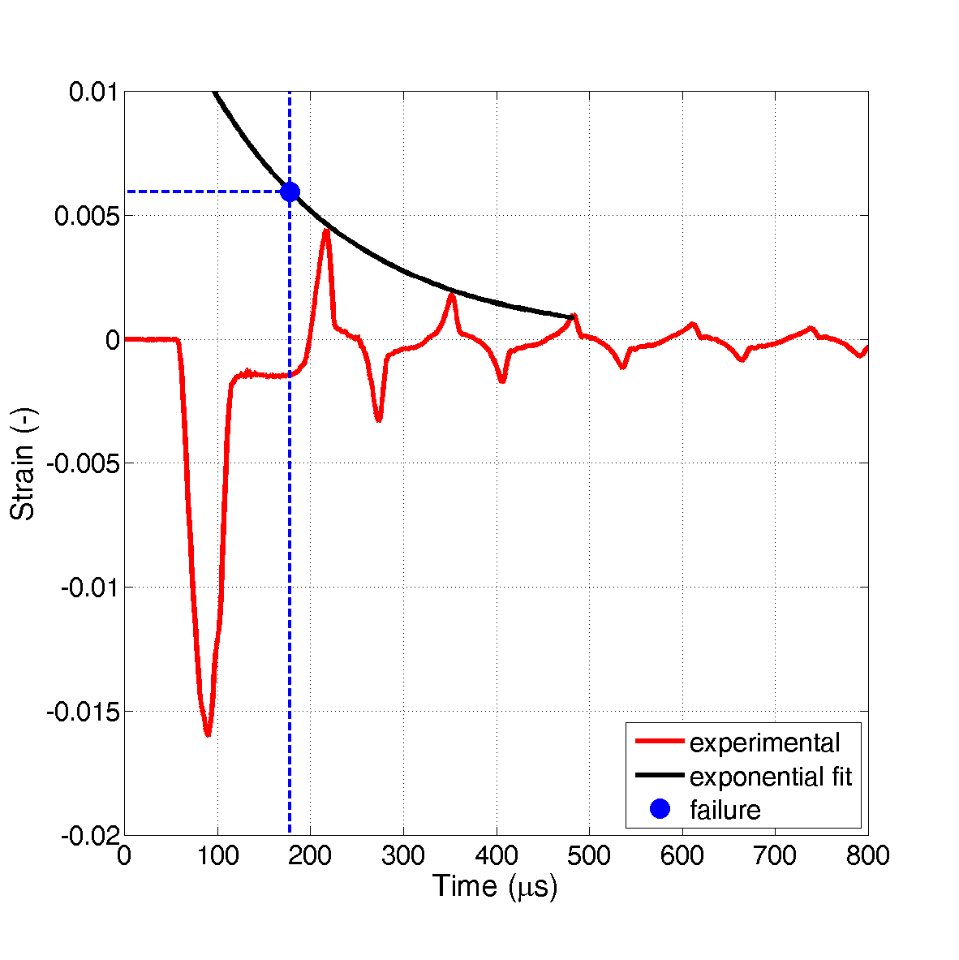

SHPB Spalling test (III)
Evaluation of the failure strain
  Strain gauge is reached by the tensile wave only after fracture has already occurred: given to material damping, the failure strain is therefore higher than what registered by the gauge!
  Failure strain estimated with an exponential model (ε = Ae^{-Bt})
TENSION
Damping
COMPRESSION
Residual strain (plasticity, compaction, damping…)
Measuring point
Fracture
surface
correspondent
to
the
recorded
signal
First compressive wave
Main
fragment
Fracture
surfaces

Slide 21
Brazilian test (I)
Experimental technique, alternative to the classic tensile and compression tests, used for the evaluation of tensile strength of brittle and hard materials (like rocks, glass and ceramics).
Tension
F
Compression
The stress distribution along the diameter in which load is applied is known in case of elastic material behaviour. The stress field is triaxial but the only positive stress (fracture) is the transversal one.
σ₁
σ₁/σ₀
σ₂
σ₂/σ₀
D
τ
τ/σ₀
+1 0 20
F
Test execution:
Diametric compression of a cylinder (diameter D, thickness t) which generates a maximum tensile stress in the middle of the specimen, perpendicular to the applied load.
The standard test is valid only if the fracture happens/starts in the middle of the specimen

Slide 22
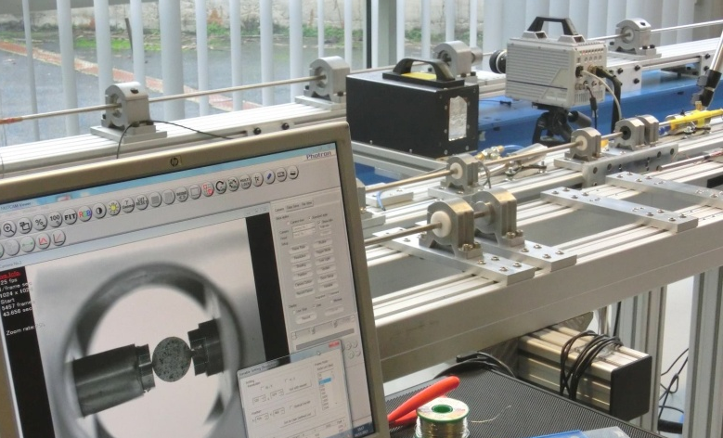
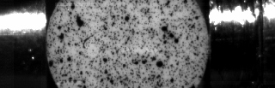
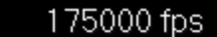
Brazilian test (II)
SHPB Brazilian test
Input bar
Output bar
Release valve
Striker
Pulse shaper
Straingage
Straingage
Reservoir
Accelerating gun
Specimen
High speed camera
Lightening system
DAQ System

Slide 23


Spall fracture
FREE
SURFACE
When an high intensity compression shockwave reaches a free surface it is reflected has a tensile wave: if the material is still solid, a spall fracture could occur. It is of great interest to determine the spall strength of novel materials.
spall
Typical spall fracture induced by a reflection of waves generated by impact
FREE SURFACE
The typical technique for spall strength evaluation is the measurement of the free surface velocity (stress related)

Slide 24

VISAR
A VISAR (Velocity Interferometer System for Any Reflector) measures the velocity of a moving surface by measuring the Doppler shift of laser light reflected off the surface.
Changes in the velocity of the surface produce changes in the wavelength of the reflected light due to the Doppler effect. The interferometer is sensitive to wavelength and converts these wavelength changes to changes in the intensity of several output light signals. These intensities are then recorded by fast photodiodes in a DAQ.
Velocities can be determined with accuracy of ±1% or better, in the range from a fraction of a m/s up to thousands of km/s and with sub-nanosecond time resolution.
The surface observed does not need to be mirror polished and changes in it's reflectivity or in background light have no effect on the velocity. The system requires no calibration and can be considered to be absolute.

Slide 25




Development of new Equations of State
Due to the mechanical engineering competencies in this field, POLITO could not develop a whole EOS for new materials
Our main actions could be:
Benchmarking and checking of available tables (hydrocodes requirements)
Combining existing EOS to obtain EOS for mixture and composite materials (for example molybdenum-graphite)
Molybdenum
Carbon

Slide 26

HiRadMat 2
HRMT14 were a successful and novel series of experiment but some improvements could be considered in the second generation of experiments on materials hit by particle beam:
Optimization of the geometry and boundary condition of the specimens (reduction of the dimensions?)
Evaluation of the mechanical quantities to acquire (stress, strain, pressure, velocity , displacements, acceleration…)
Optimization of the beam parameters (number of bunches) in function of the type of material and of the required scenario: high number of bunches on cylinder specimen for tunneling evaluation
Evaluation of thermodynamics variable (temperature)
Electromagnetic disturbs reduction
2

Slide 27

HiRadMat 2
A great interest from POLITO is the experimental verification of high number of bunches ...

Slide 28
Next steps (I)
Development of strength and failure models for relevant ductile materials (mechanical tests at different temperatures, strains and strain-rates)
Inermet: improvement of the characterization (compression tests) and extension to ultra high strain-rates in tension
Molybdenum: complete characterization of two alloys (varying temperature and strain-rates) in tension and compression. Failure model definition
Spall strength experiments setup

Slide 29


Next steps (II)
Fracture analysis of composites materials
Improvement of Hopkinson Bar spalling test for brittle material analysis: test on square section graphite specimens in the next months (specimens ready) with high speed image analysis
Development of a spalling test setup at high temperature
Comparison of results obtained with Brazilian test
Improvement of Brazilian test for very hard materials
Improvement of FE models for advanced results analysis of Spalling and Brazilian tests.

Slide 30
Politecnico di Torino: Possible Contributions to WP11 and Work Proposals
Thank you for your attention
EuCARD2 WP11 (Materials for Collimation) kick-off and tasks meeting
Dipartimento di Ingegneria Meccanica e Aerospaziale

Slide 31

Politecnico di Torino: introduction, overview of WP8 work and possible contributions to WP11
Backup slides
EuCARD2 WP11 (Materials for Collimation) kick-off and tasks meeting
Dipartimento di Ingegneria Meccanica e Aerospaziale

Slide 32




WP11 Work - Scenario
In the material part closest to the beam, the pressure and temperature increase and the materials could melt or vaporize, depending on the loading condition: shockwaves are generated.
The remaining part of the material, which remains solid, is characterized by high values of plastic strain, strain-rate and temperature.
EXPERIMENTAL
METHODS
2
MATERIAL ans FAILURE MODELS
EQUATIONS OF STATE
MULTI-PHYSICS SOLUTIONS

Slide 33





Background: numerical simulations
2004: Target rod hit off-axis by a fast extracted beam of 3.5×10¹³ p at 400 GeV over an extraction time of 10 μs
2005: Collimator jaw hit by a beam of 3.2×10¹³ p at 450 GeV over an extraction time of 7.5 μs
Ansys/Analytical
Ansys
A. Bertarelli
A. Dallocchio
2009: Bar (20 mm radius, 1 m long) facially irradiated with 8 bunches of 7 TeV protons (each bunch comprises 1.15x10¹¹ protons)
Density -10 bunches
2012: 3D structure, 7 TeV beam impact, soft-coupled simulations (FLUKA-LSDYNA) with deposition upgrade
LS-DYNA
Density - 60 bunches

Slide 34


Background: Experimental tests
1998
2003
2013
1 Low energy system
Total length 6 m
Resistive straingages
Straingages amplifier homemade
Data Acquisition system 8bit, 100 MS/s
1 High energy systems (pneumatic, 9 bar)
Total length 8 m
Bars diameter up to 30 mm
Straingages amplifier with high bandwidth (>3 MHz)
Data acquisition systems :
16 bit, 800 kS/s
8 bit, 100 MS/s
5 High energy systems (Gasgun 20-200 bar)
Length 10 m
Semiconductor straingages
2 Fast cameras
Data acquisition systems:
14 bit, 3 MS/s
12 bit 20 MS/s
16 bit 100 MS/s

