Slide 1
EUCARD II - RHP presentation
10/12/2013
RHP-Technology GmbH & Co KG
A-2444 Seibersdorf, Austria

Slide 2
Overview
Updated of processing technologies available at RHP
Overview on possible geometries and size of parts which can be realized by our available sintering and hot pressing facilities
Overview on possibilities to develop ceramics with customized composition
Possible contribution of RHP

Slide 3
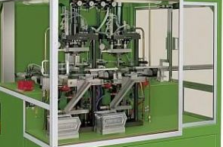
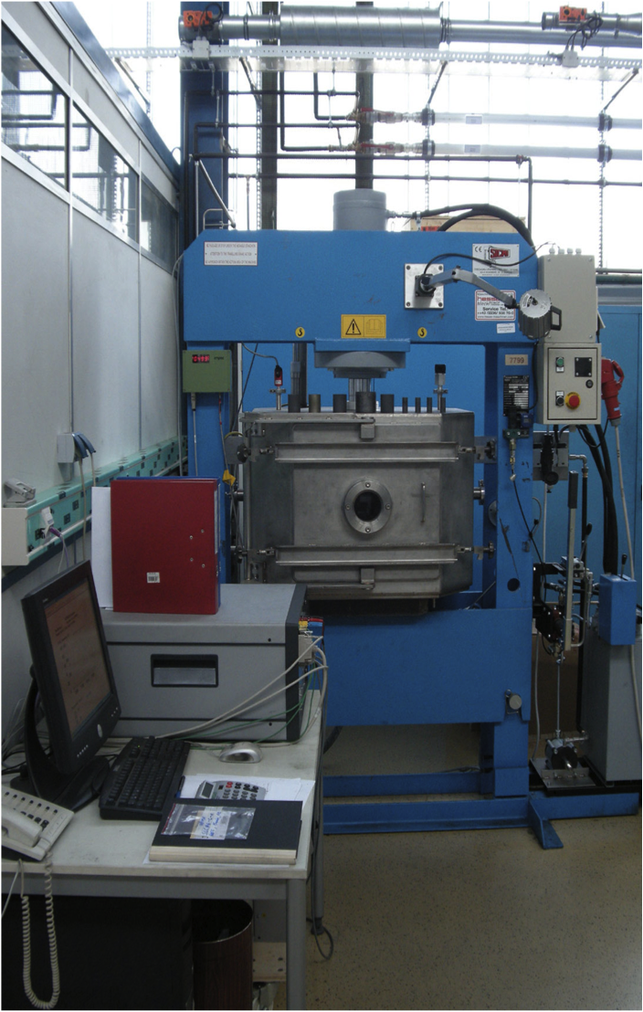
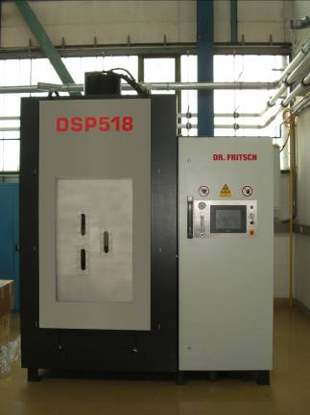
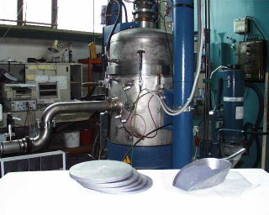
Hot Pressing Technologies at RHP:
2012: Installation einer Einzelsegment Sinterpresse
fast
2009 Installation der direkten Heißpresse Dr. Fritsch
2009 Installation der induktiven Heißpresse (Eigenbau)
Process Cycle Time
slow
small
Sample Size
large
1996 Installation der konventionellen Heißpresse (FCT)

Slide 4

Overview: hot pressing technologies
Punch
Heating Element
Punch
Heating Elements
Graphit e
Electrode
Steel die
Atmosphere
Graphite Die
Graphite
Matrize
Power Supply
AC/DC/pulsed
Green part
Vacuum Chamber
Powder
Vacuum chamber
Powder
Punch
Punch
Graphite
Punch
Hydraulic Pressure
Hydraulic Pressure
Hydraulic pressure
Coventional Hot Pressing
Direct heated hot pressing/
Spark Plasma Sintering
Rapid Sinter Pressing
3 different pressure assisted Sintering Techniques:
Conventional Hot Pressing: Heating of graphite die using a heating element (indirect)
Direct Hot Pressing or Spark Plasma Sintering (pulsed): Heating of graphite die via current
Rapid Sinter Pressing: Placing of a pre-compacted green part in a permanently heated pressing die
Notes:
Dez-13
4

Slide 5
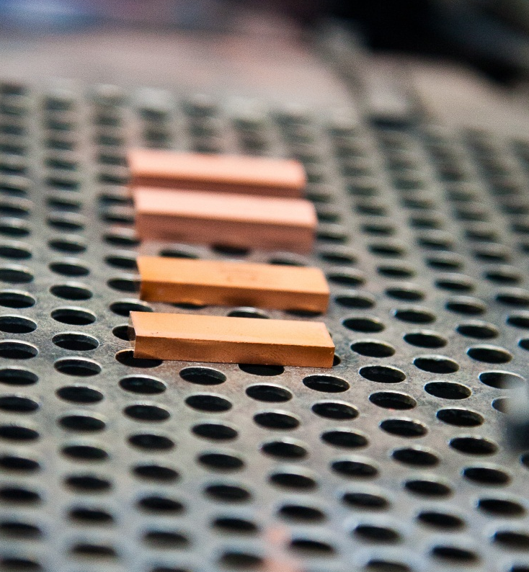
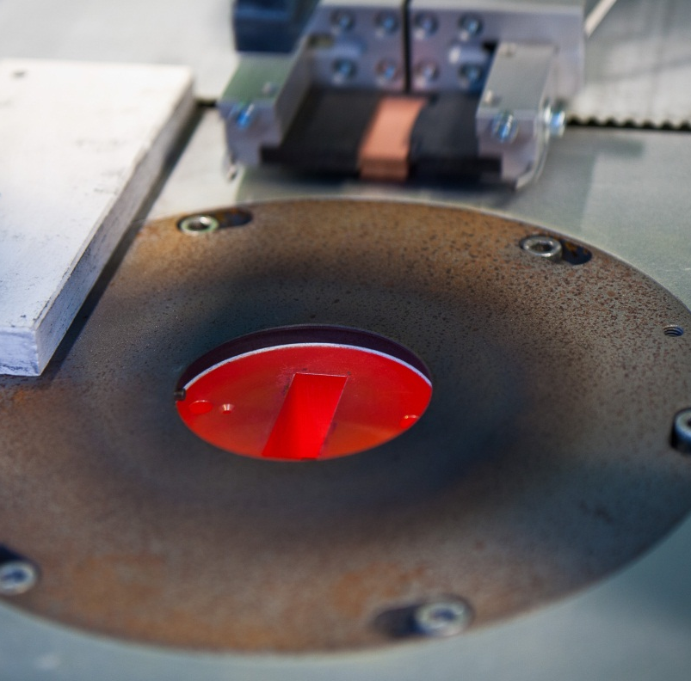
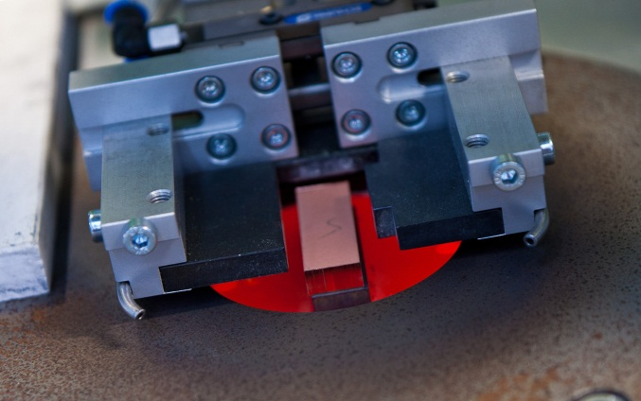
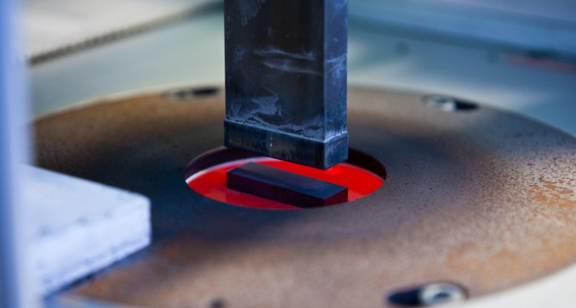
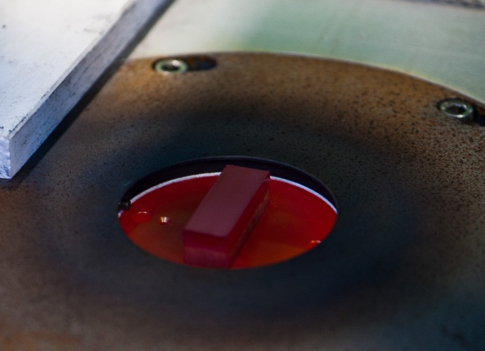
Processing steps of Rapid Sinter Pressing
RSP-Technology allows the densification of powders in seconds
RSP uses a permanently heated cavity (e.g. up to 950°C) in which a compacted green part is inserted and densified by pressure (up to 150 MPa)
RSP is a method which is suitable for the manufacturing of parts in large volume
Figure 1: Left image shows the green part and in the right image the automatic handling system is bringing the green part to the permanent heated hot pressing die
Figure 2: The sequence of images shows a) insertion of the green part in the pressing die b) consolidation of the green part and c) ejection of the part after hot pressing

Slide 6
Parameter Studies: Densification of Copper (I)
By using significant higher pressures compared to conventional hot pressing it is possible to obtain a densification in copper within 10 seconds or less

Slide 7
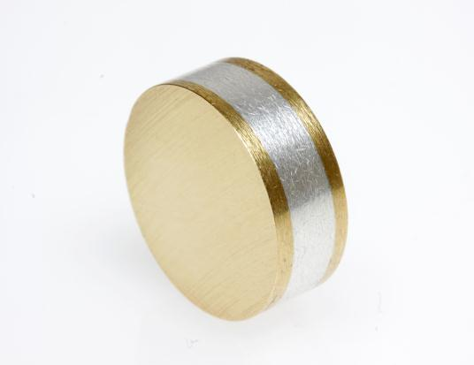
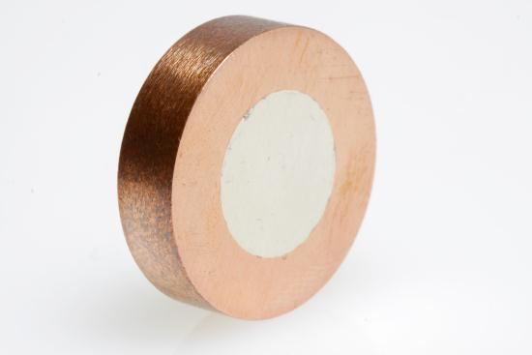
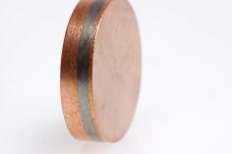
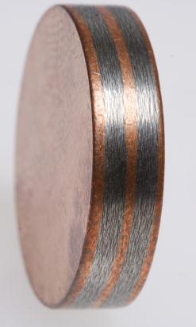
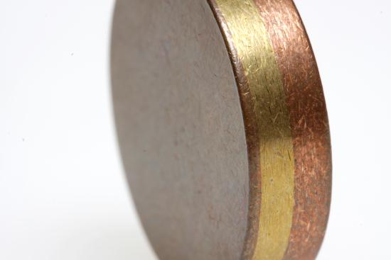
„Design“ Possibilities using RSP Technology (I)

Slide 8
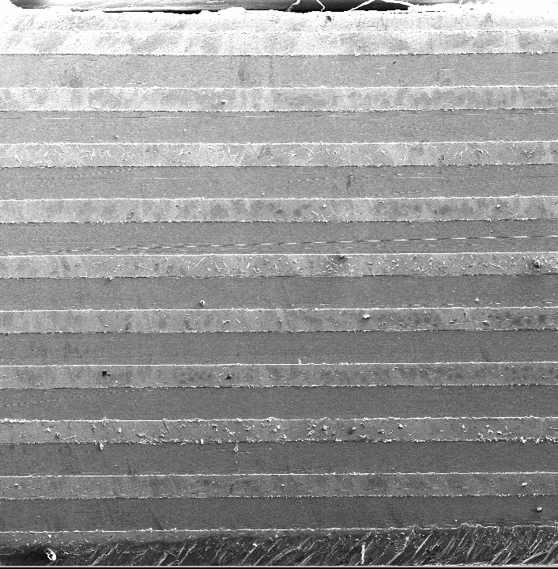
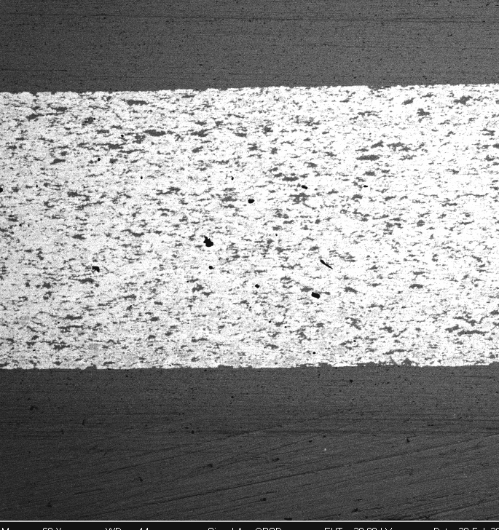
„Design“ Possibilities with RSP Technology (II)
Copper
Molybdenum
Cu-Mo 30:70 wt%)
Copper
Copper
Sandwich Structure
Multilayer Structure
Functionally Graded Structures are also possible

Slide 9
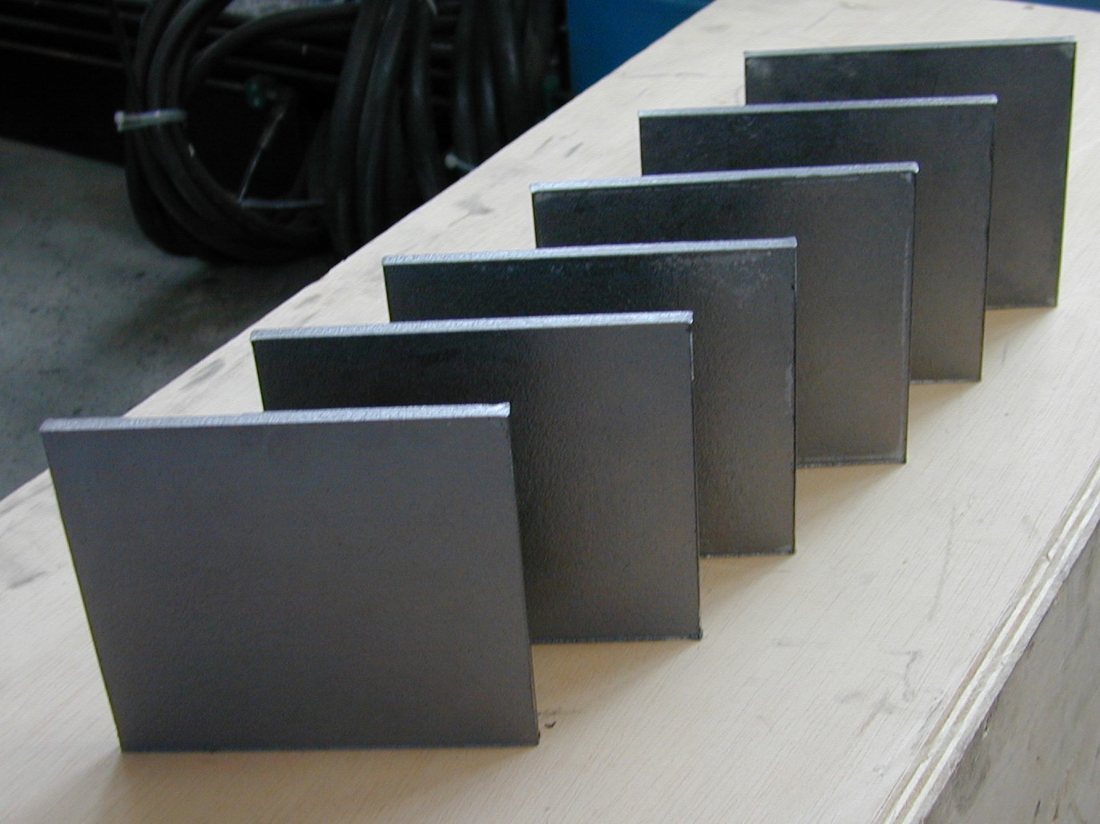
Typical geometries of hot pressed plates
Target/Plate size (examples) for hot pressing and direct hot pressing:
Plates with diameter: 53 mm, 65mm, 76mm, 102mm, 153mm, 175mm, 205mm, 240mm, (for some materials 300 and 350 mm)
Squares mit 40mmx40mm, 62mmx62mm, 140mmx140mm, 150mmx150mm
Rectangular e.g. 171mmx76mm, 182 mm x 91 mm, 320mmx80mm (for materials up to 1.200°C hot pressing temperature)
Rectangular targets

Slide 10

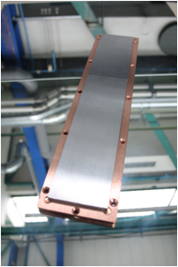
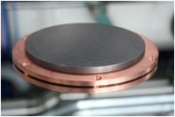
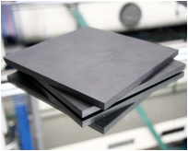
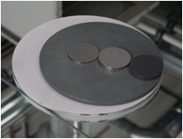
TARGETS ON DEMAND
CUSTOMIZED TARGET MATERIALS
Individual Material Compositions
Single Samples, Prototypes
Small Series
Ceramics, Metals and Composites
Fine-tuned Microstructure
Magnetron Sputtering, Arc-Deposition,
Pulsed Laser Deposition, ...
Hard metals, ultrahard coatings, magnetic layers, photovoltaic applications,
solid lubricants, advanced ceramics
WC without binder
W, Mo, Nb andTa-Oxide
Ti Carbide, Boride or Nitride
Cr or Ti Silicide
ZnS/SiO₂
Sulfides such as MoS₂, WS₂
Various alloys or metal/ceramic combinations

Slide 11
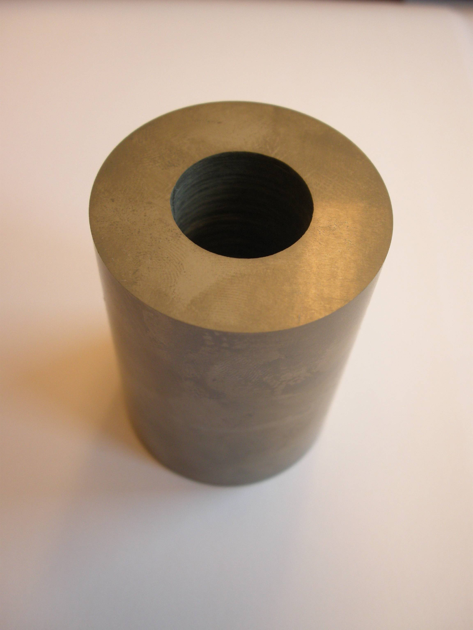
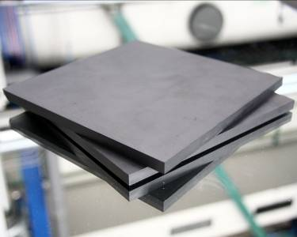
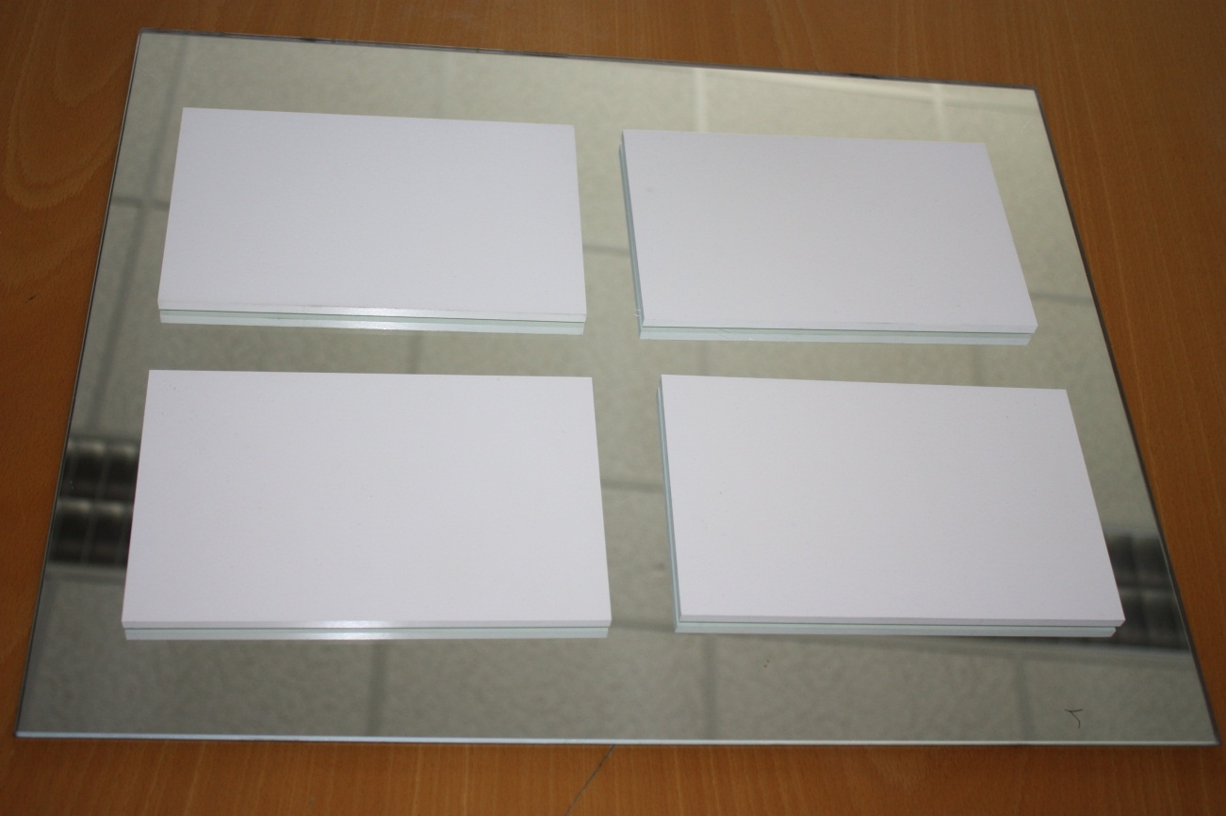
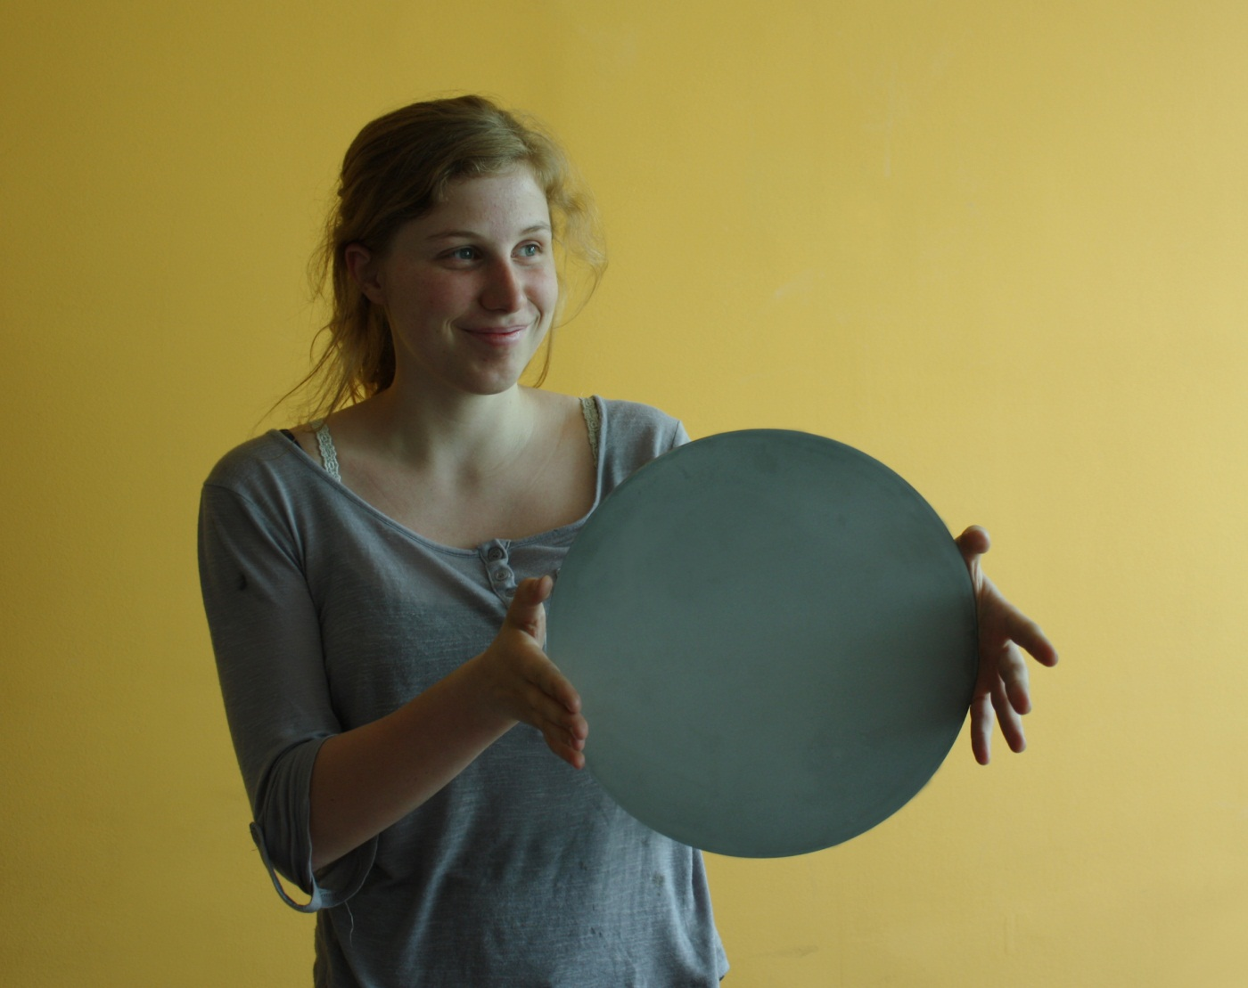
Advanced Ceramics – Customized products
HfO2 target segments with size of 200 mm x125 mm
TiB2 tube
B4C plates
Materials:
Various Oxide, Nitride, Carbide ceramics in customized shape and size
High temperature borides such as TiB2, ZrB2, HfB2, HfC etc.
Size of up to 300 mm possible
AlN compound target with size of 300 mm

Slide 12
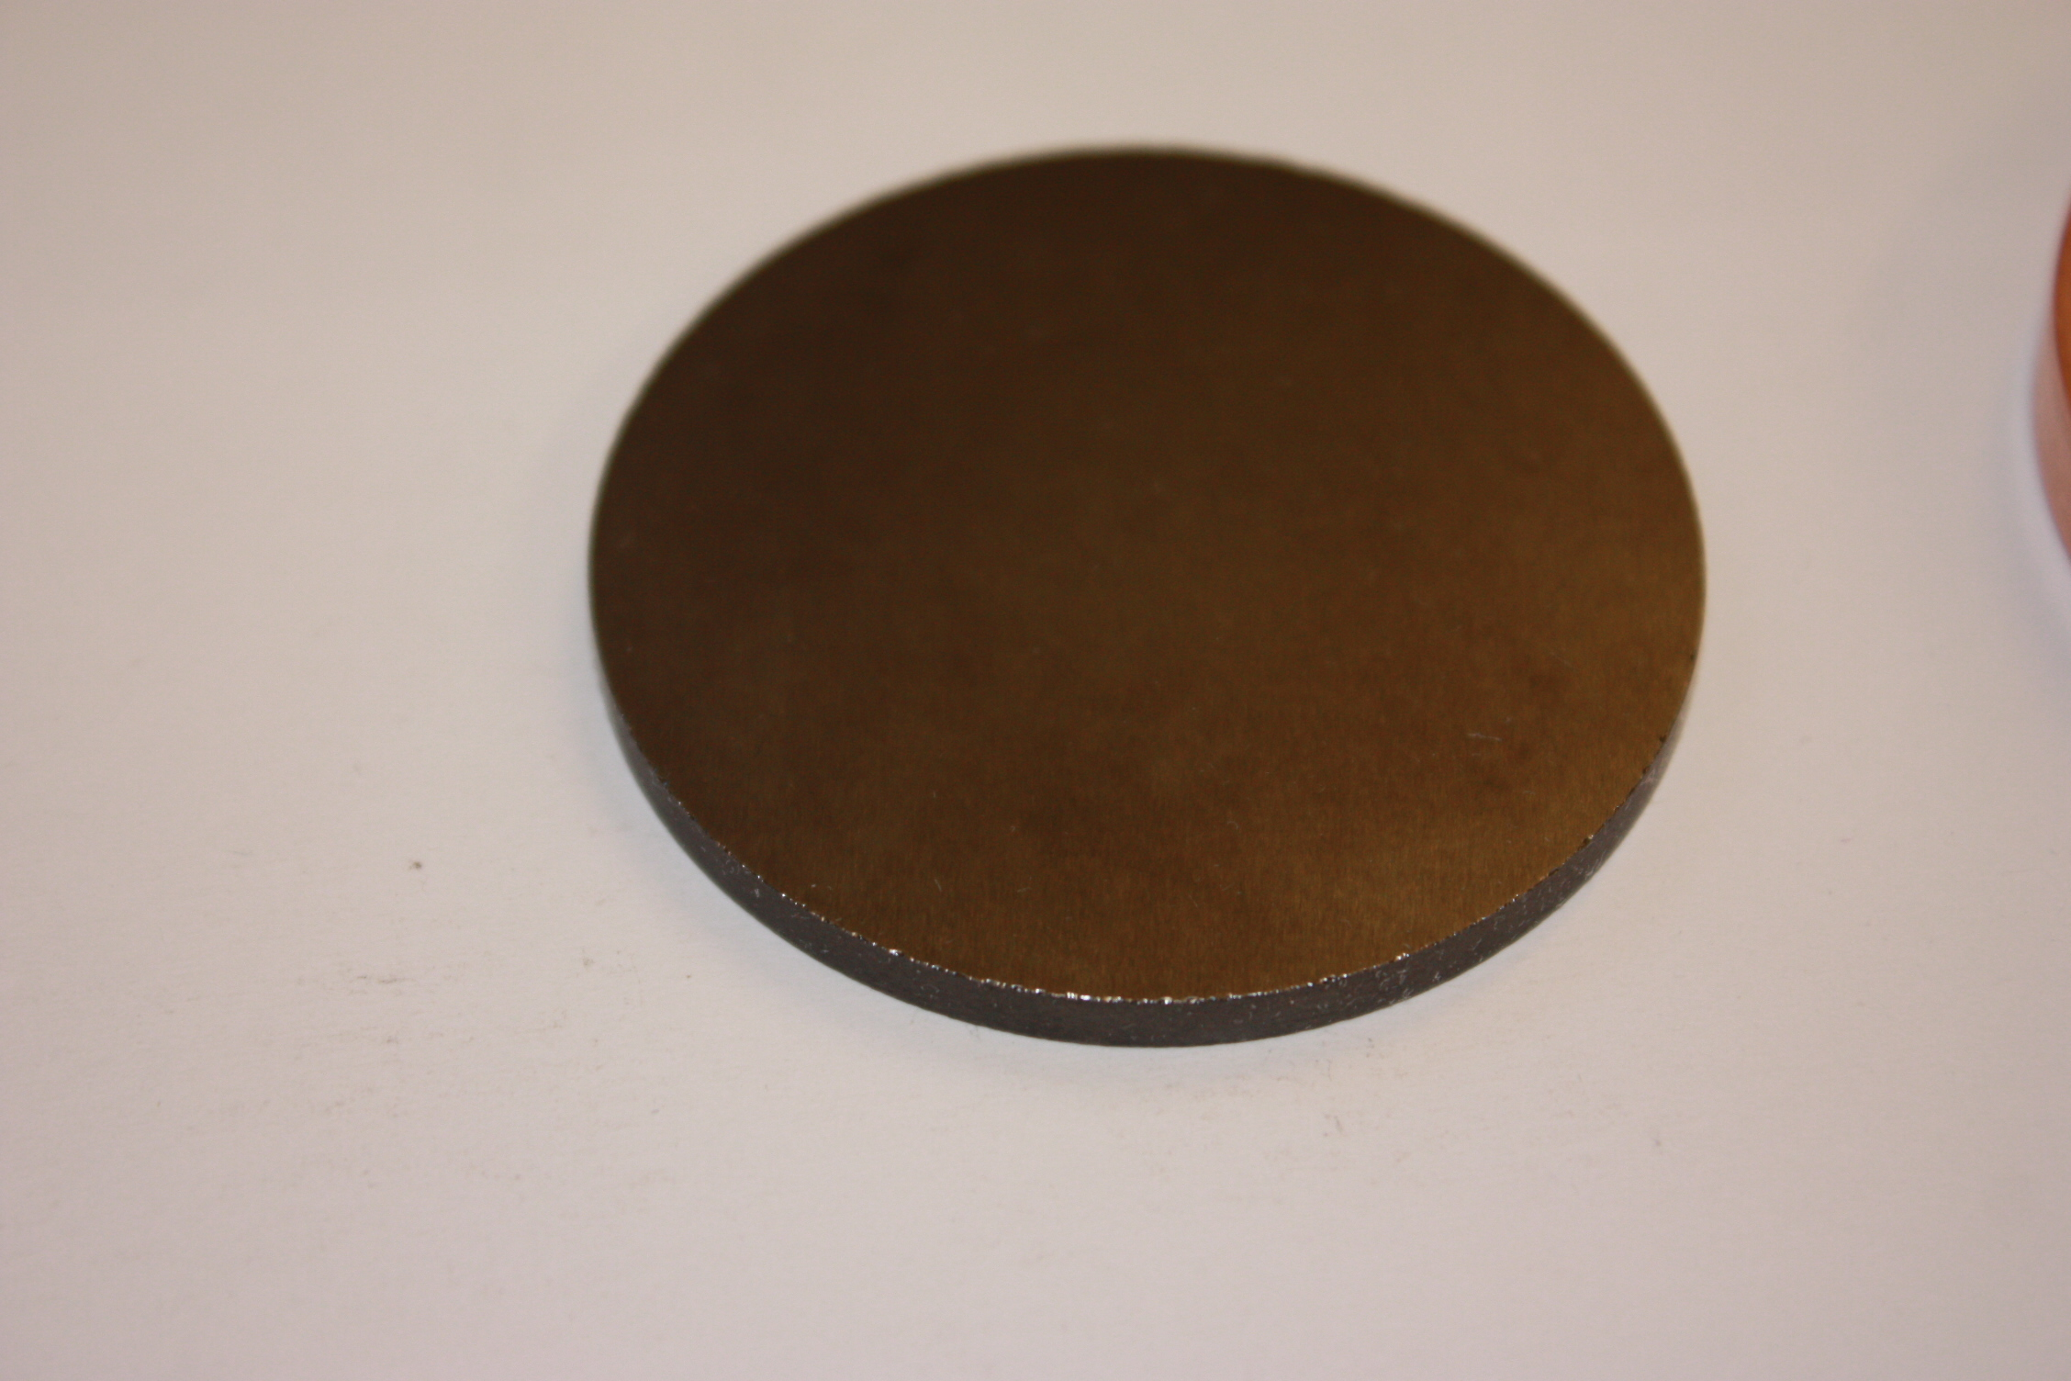
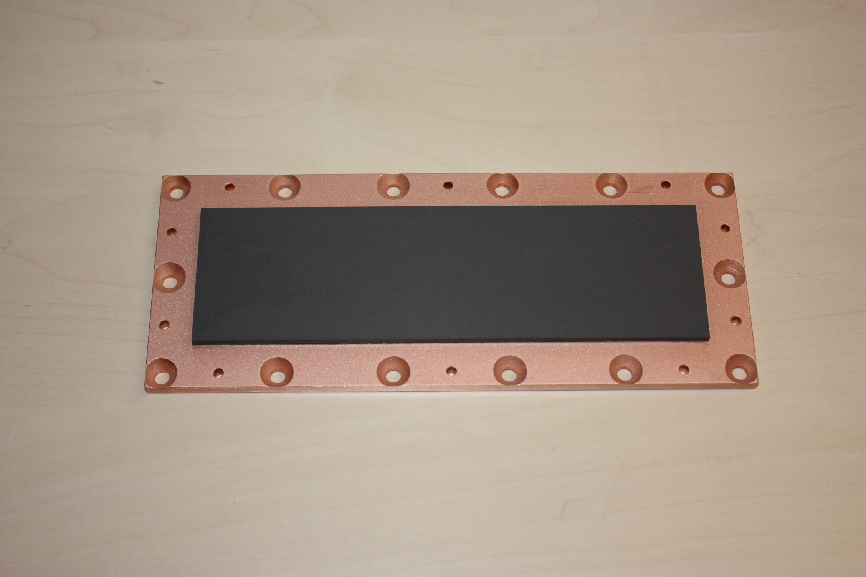
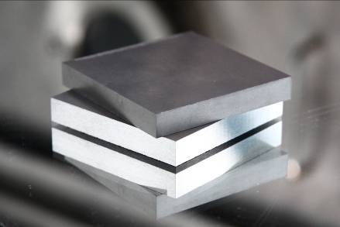
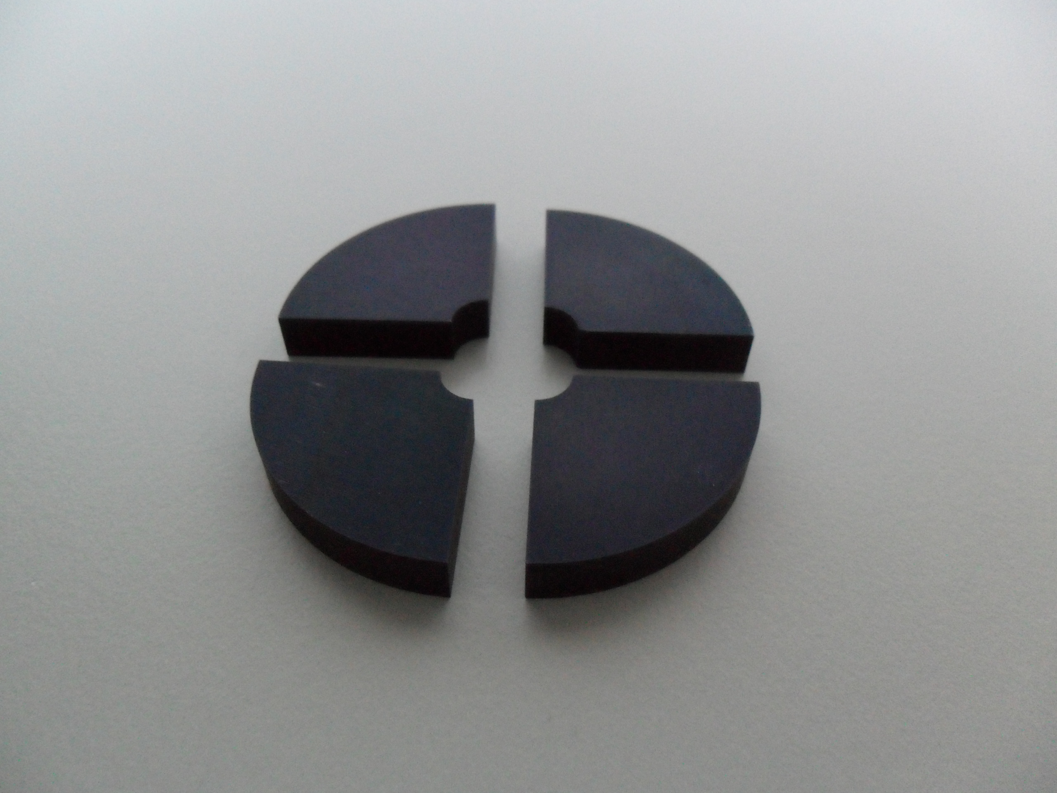
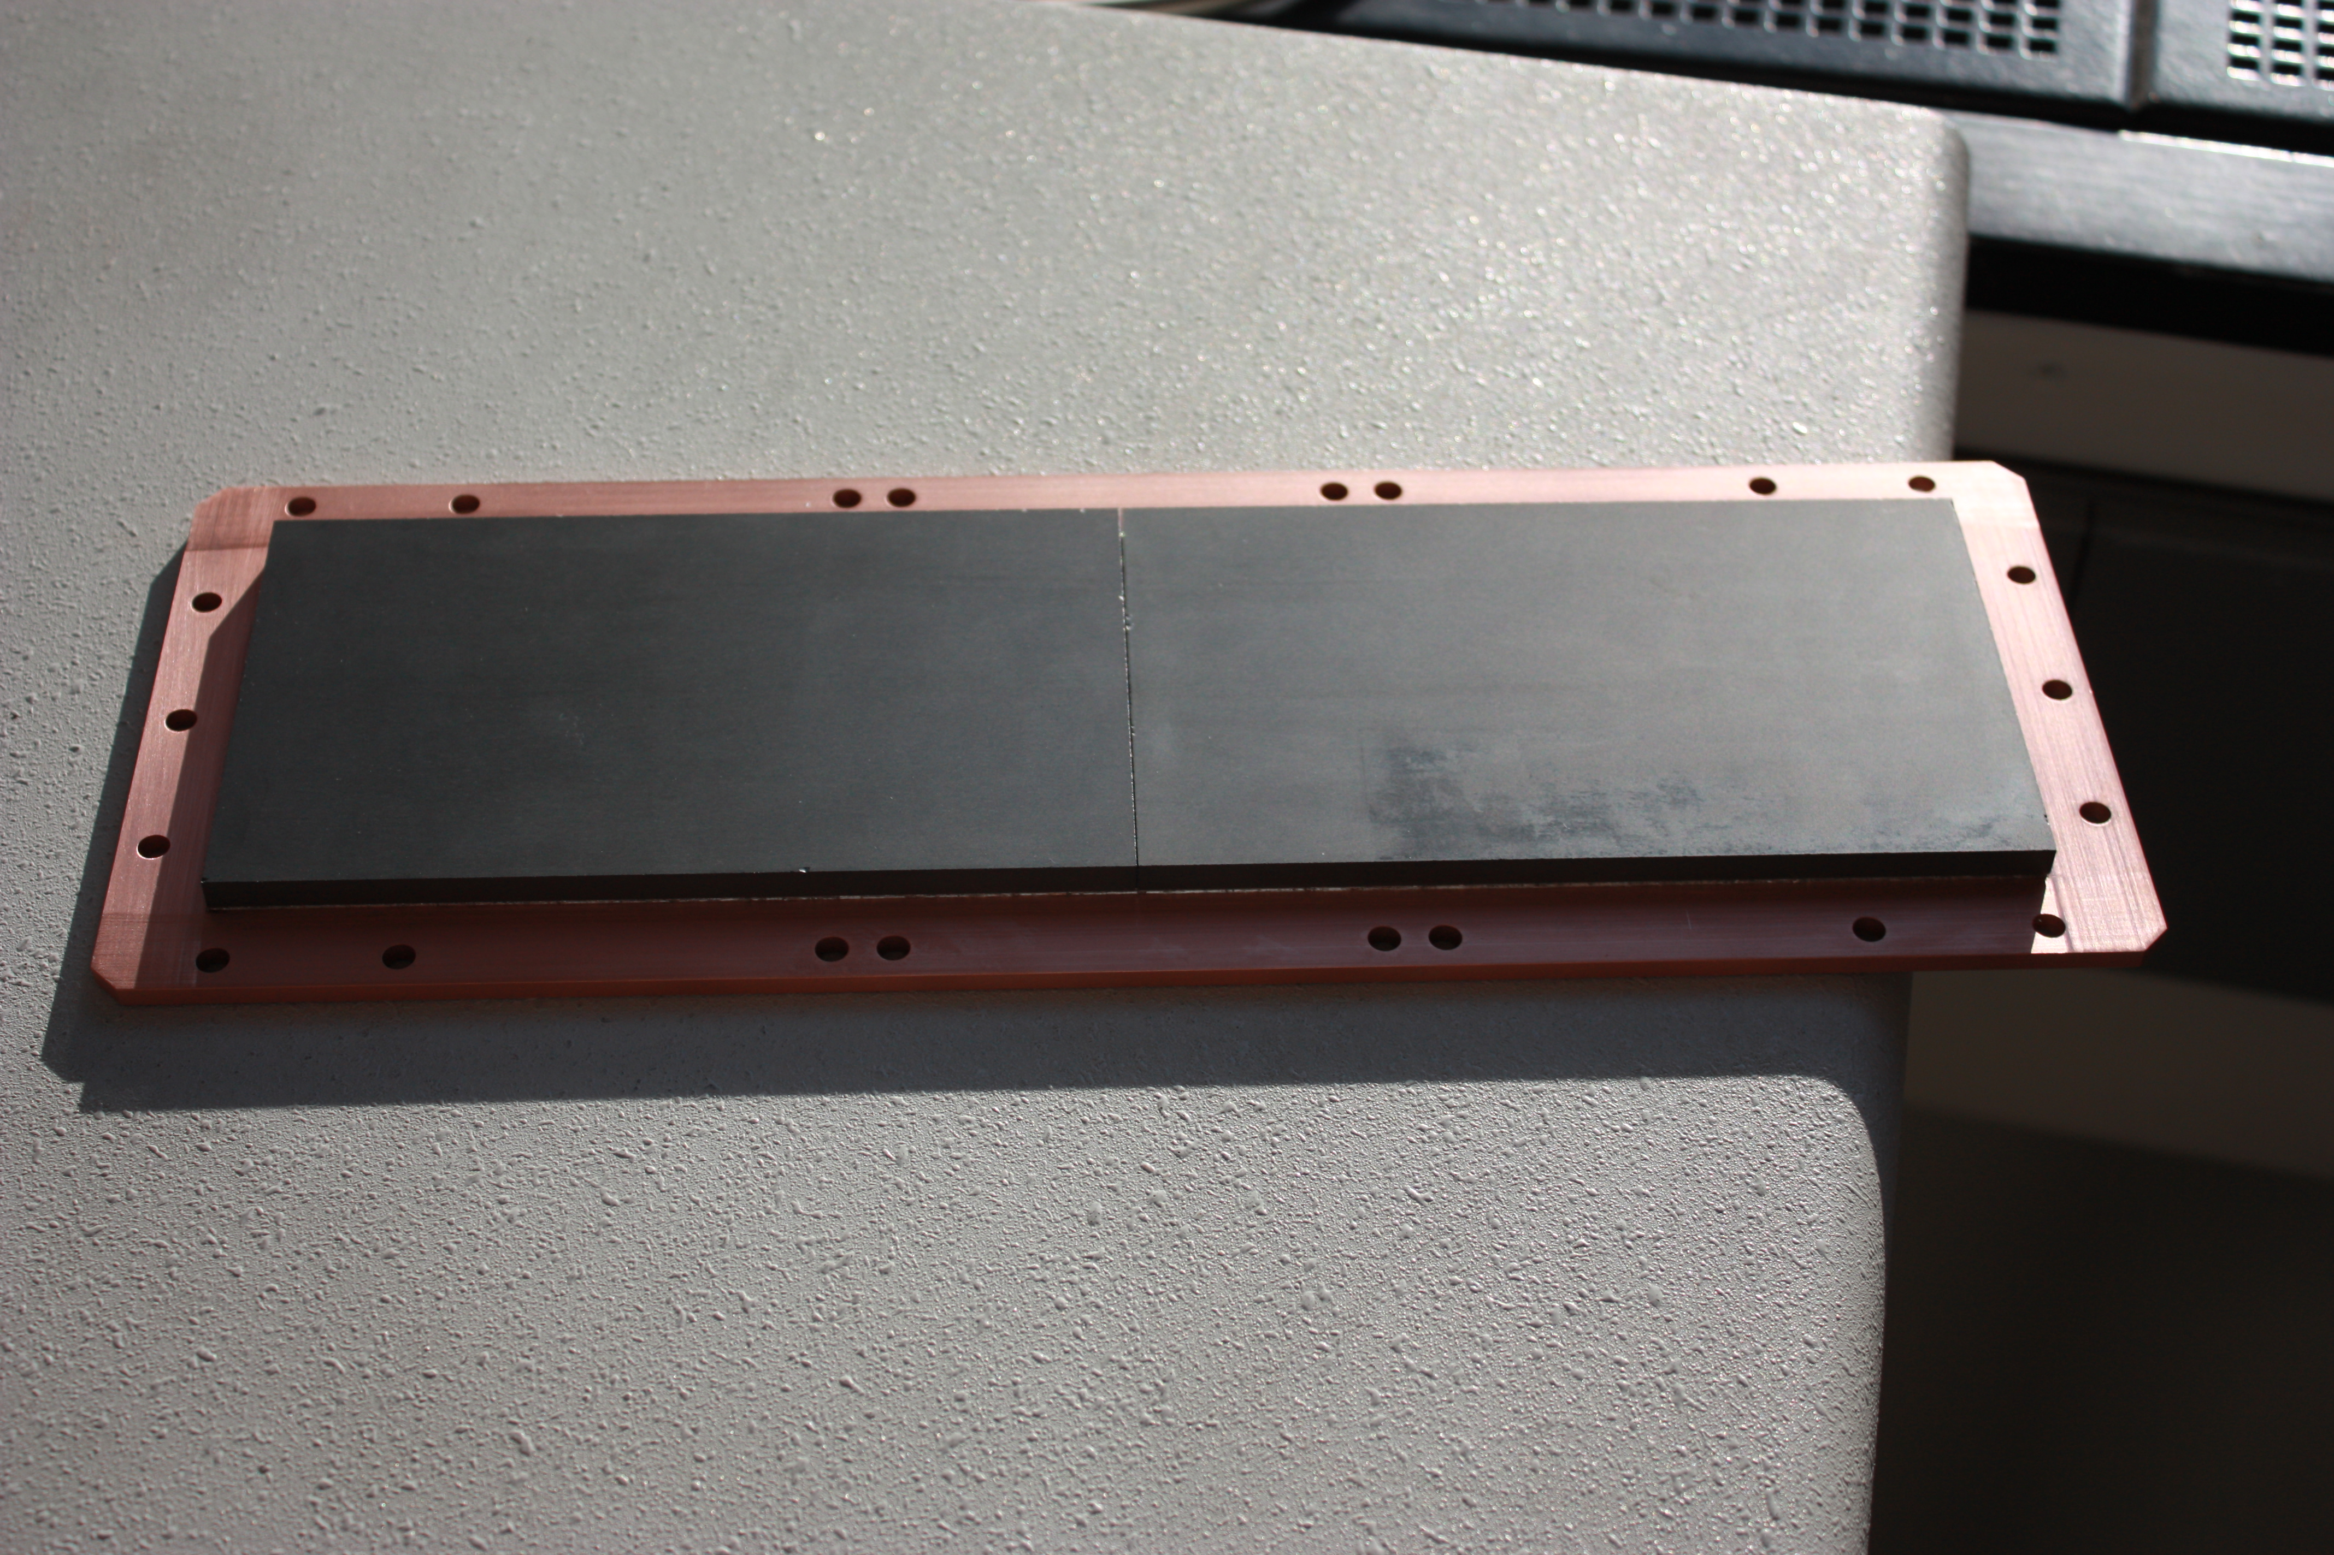
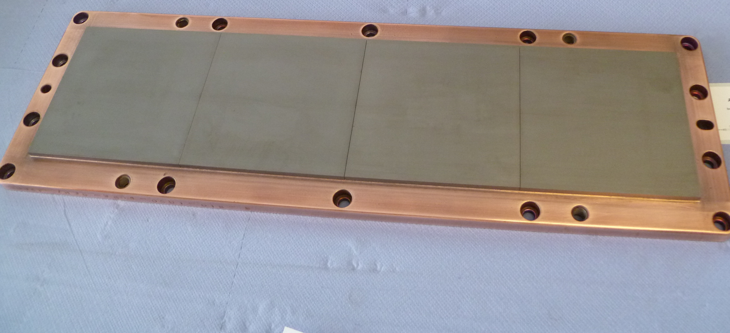
Target materials for PVD processes
Hot pressed Boron Target
Hot pressed SiC-C Target on Cu backing plate
Tungsten Carbide without binder
Lanthanum Hexaboride
B4C (enriched B10) Target on Cu back plate
AlMgB14 Target

Slide 13
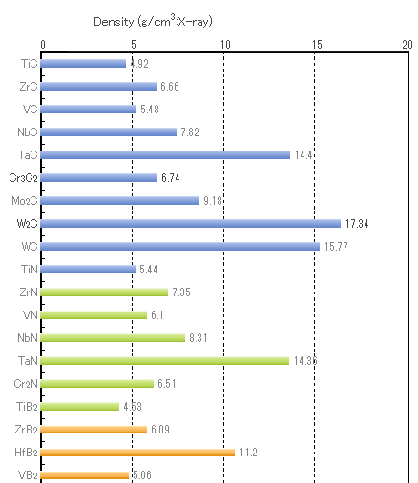
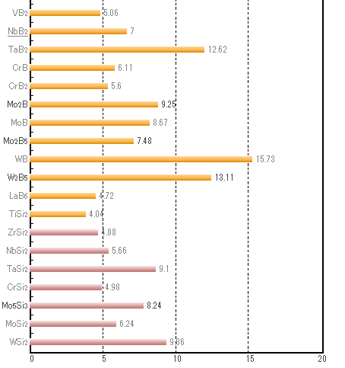
Density of Borides, Nitrides, carbides

Slide 14
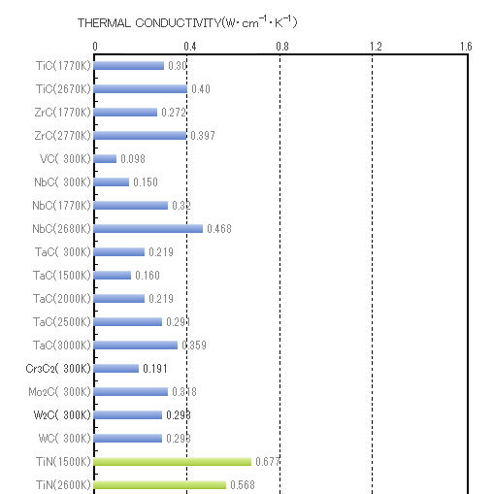
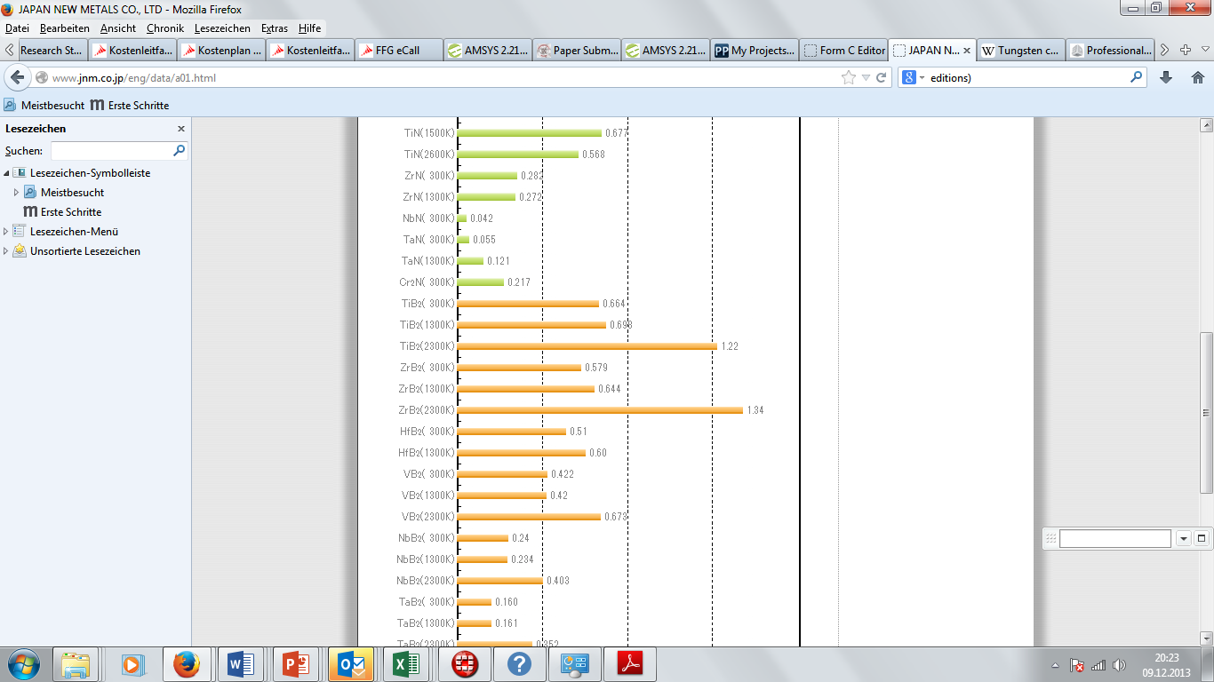
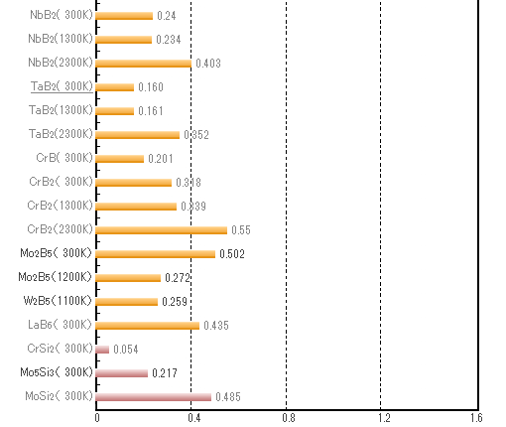
Thermal Conductivities of Borides, Carbides, Nitrides

Slide 15
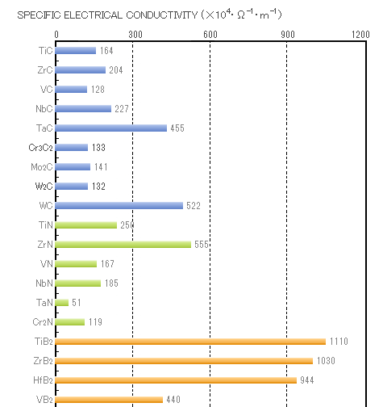
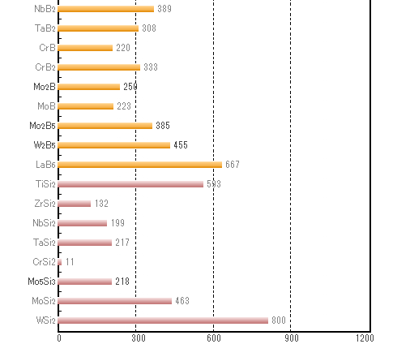
Electrical properties

Slide 16
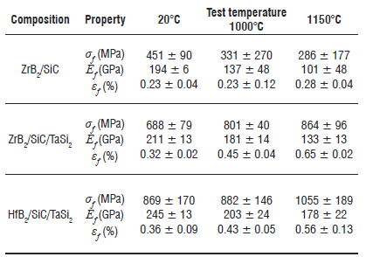
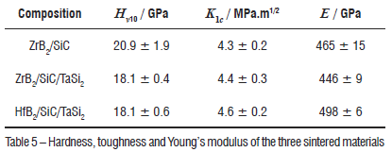
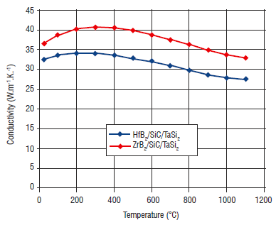
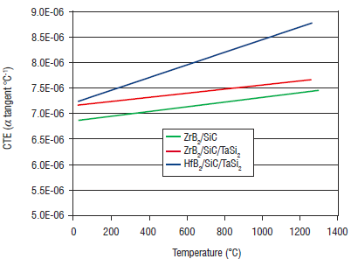
Material Combinations : e.g. ZrB2/SiC & HfB2/SiC

Slide 17
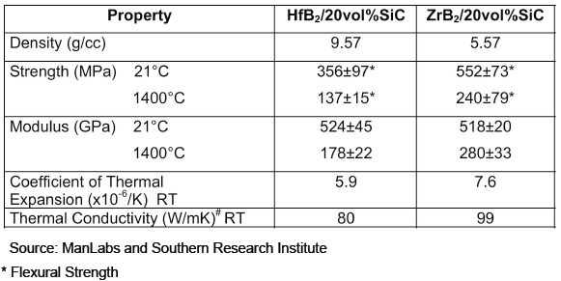
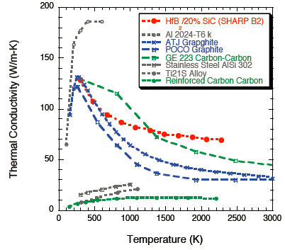

ZrB2/SiC & HfB2/SiC

Slide 18
Topics
1. Presentation of advanced ceramics produced at RHP Technology (WC, MoC, SiC, TiC, ecc) with specific focus on highly conductive materials
2. Proposals for new heavy and conductive refractory materials (e.g. WC- or Mo2C- based) as an alternative to present tungsten heavy alloys
3. Proposals for other SiC- based materials and their bonding to metallic substrates
4. Type and number of material samples to be produced.

Slide 19
Possible contributions of RHP
1. Continue Work on Copper-Diamond composites (sandwich structure; include a Mo oder W cladding layer by direct bonding)
2. Prepare ceramic materials/customized composition for screening tests and further characterization
3. Screening of SiC – Metal bonding technology
=> to discuss: type and number of material samples to be produced.
Copper-diamond composites
Cu-Mo-Cu-Mo-Cu Multilayer

Slide 20
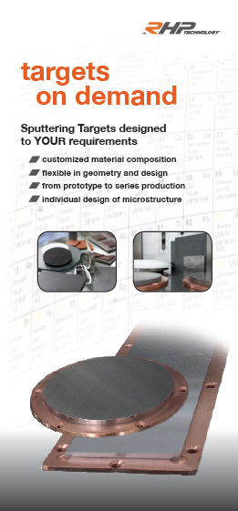
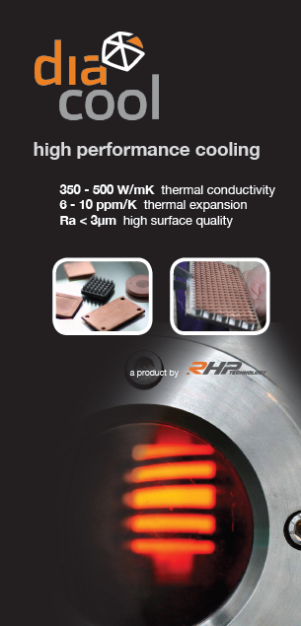
Thank you for your attention!
Further information:
www.rhp-technology.com
DI Dr. Erich Neubauer
RHP-Technology GmbH & Co. KG
Forschungs- & Technologiezentrum, Gebäude CA
A-2444 Seibersdorf
Tel.: 0043-650-9151074
Email: erich.neubauer@rhp-technology.com

Slide 21
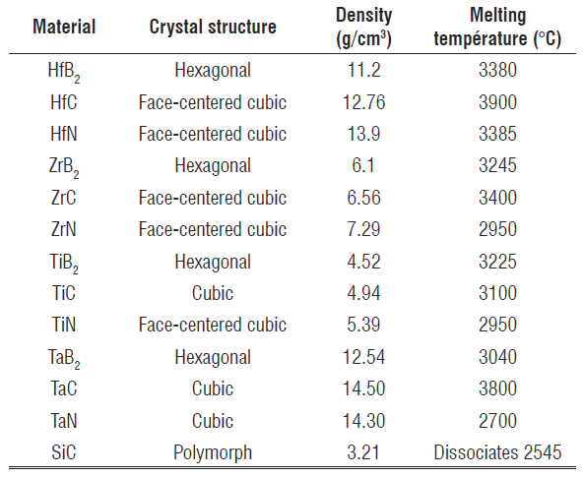
Properties of some UHTCs

Slide 22
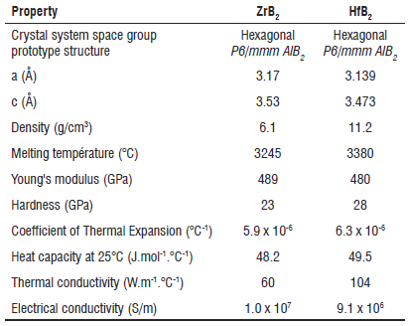
ZrB2 & HfB2

