Slide 1
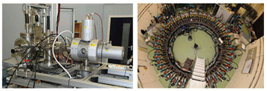


University of Huddersfield
International Institute for Accelerator Applications
Target simulation and opportunities of accelerator physics in other applications
Professor Rob Edgecock
Professor Roger Barlow

Slide 2
University of Huddersfield
Centre for Precision Technologies
CERN collaboration
Dr Simon Fletcher – Senior Research Fellow
Dr Andrew Longstaff – Senior Enterprise Fellow
Professor Alan Myers – Group Leader

Slide 3
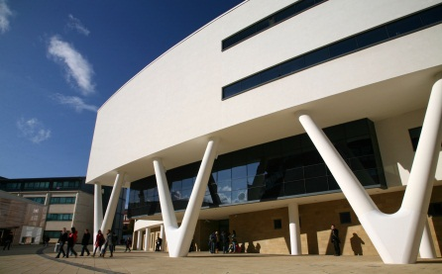
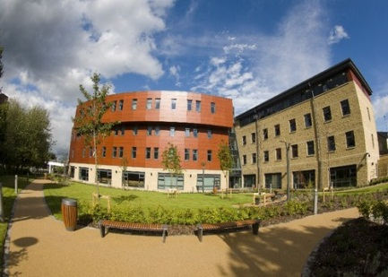
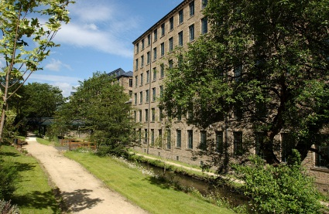
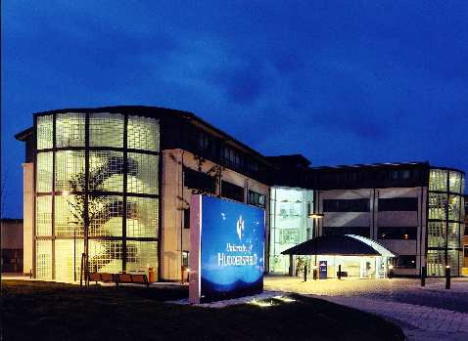
University of Huddersfield
Founded in 1825
A history of education, innovation and
industrial collaboration
£140m turnover
£300m benefit to the local economy
Over 2,800 staff on payroll
24,000 students studying more than 400 degrees
An international University
  Students from over 130 countries
  Delivering courses in China, Hong Kong, India and Singapore
Notes:
3

Slide 4

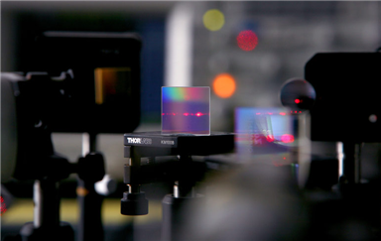
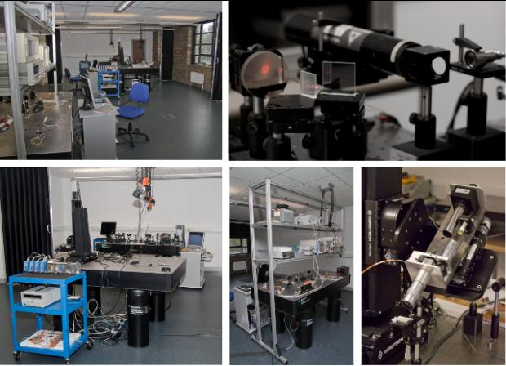
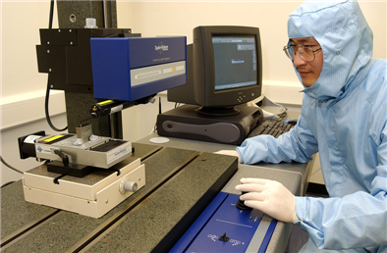
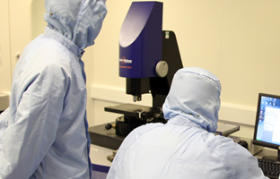
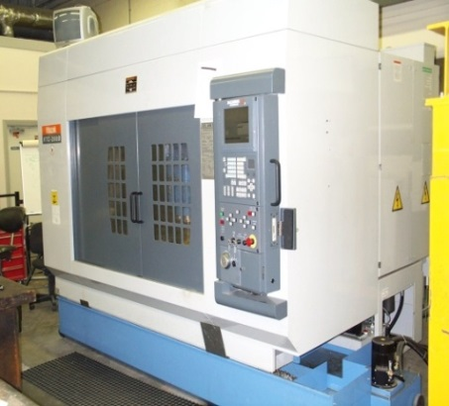
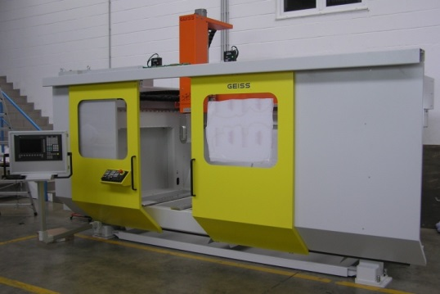
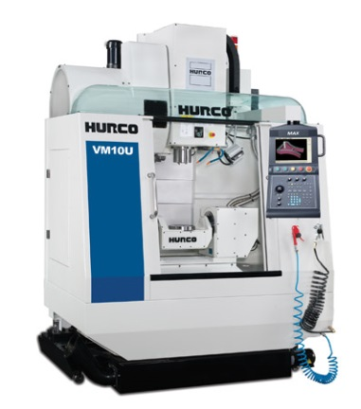
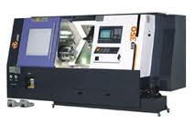
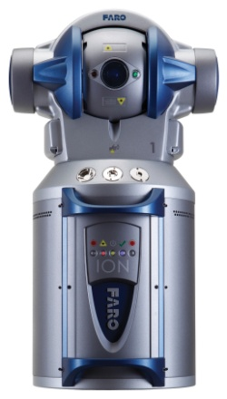
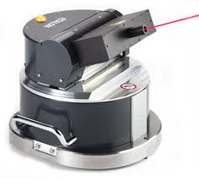
CPT Research Areas
Centre for Precision Technologies (CPT)
  Specialist engineers in the areas of
    Machine tool performance
    3D Surface metrology and material properties
    Precision grinding
    Condition monitoring
  CPT is the EPSRC National Centre for Innovative Manufacturing in Advanced Metrology
Facilities within the centre
  Class 10000 lab for measurement with vibration isolated SEM, AF, Stylus instruments
  Advanced optical laboratory with four air damped interferometry grade optical tables
  Machine shop with a variety of 3- and 5-axis machines and full suite of associated metrology equipment
  Precision control laboratory

Slide 5
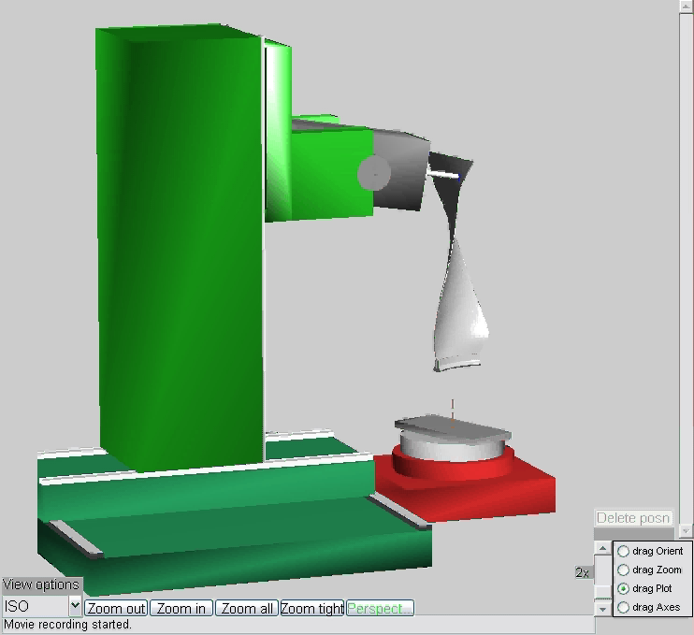
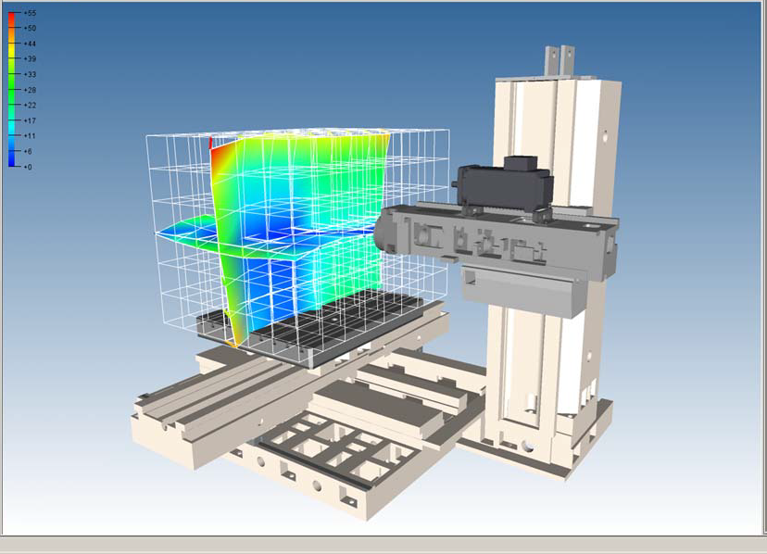
Machine tool performance - ECMPG
Engineering Control and Machine Performance research group
Currently 20 people in the group
  14 PhD students
  6 senior staff
All aspects of machine tool technology
Metrology
  Rapid calibration
  Machine capability and error simulation
  Sensor development
  Software
  Training
Compensation
  Geometric, thermal and non-rigid
    Integrated (Siemens 840D, Osai S10)
    Retrofit system
  Dynamic modelling

Slide 6
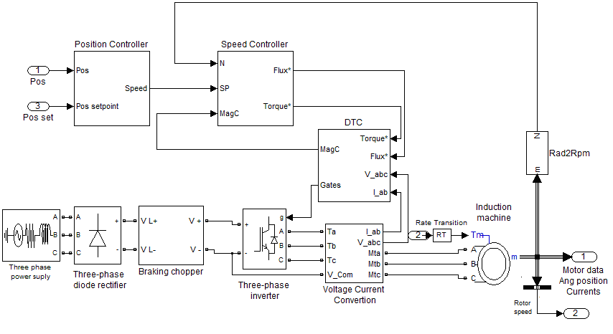
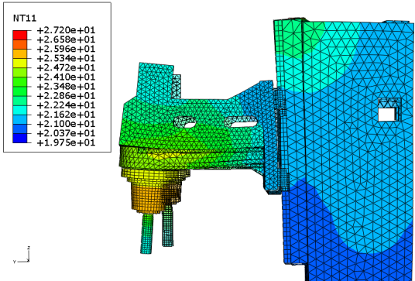
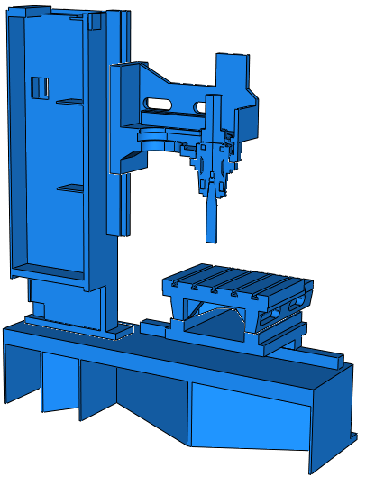
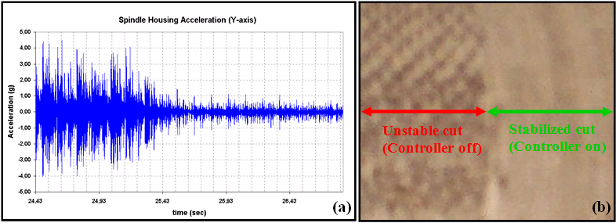
Machine modelling
Simulation of mechanical and thermal effects (FEA)
Servo-drive modelling and adaptive control
  Simulink and dSPACE

Slide 7
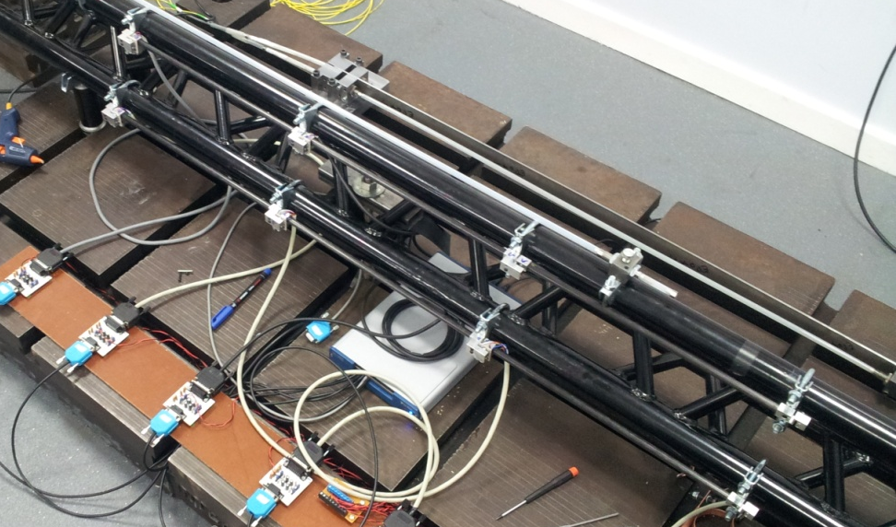
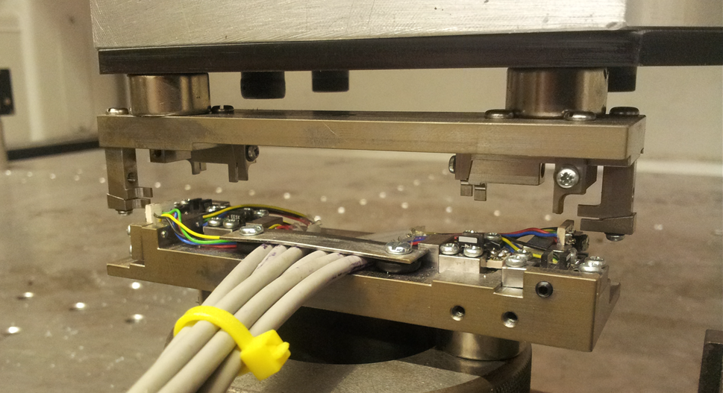
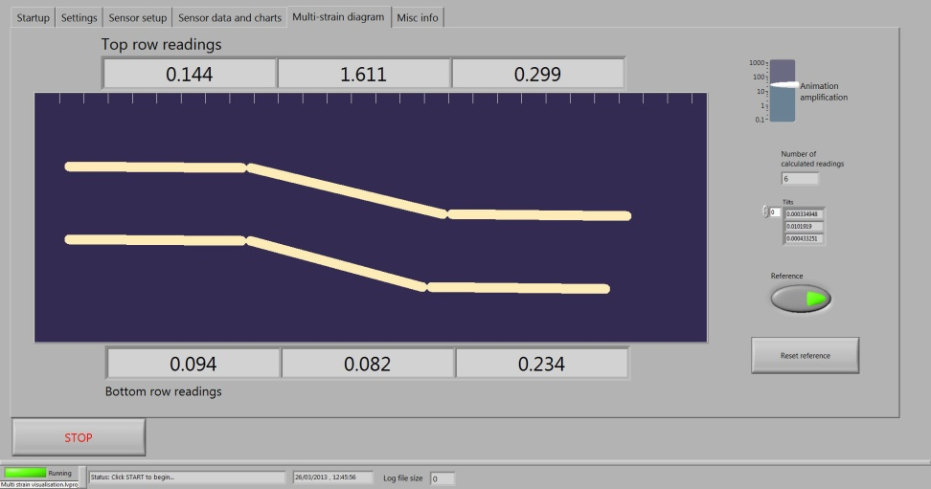
Structural monitoring
Phototransistor based prototypes
up to 6 DoF
  Non-contact
  0.01µm and 0.1µrad sensitivity
  Ultra low cost
Multistrain

Slide 8
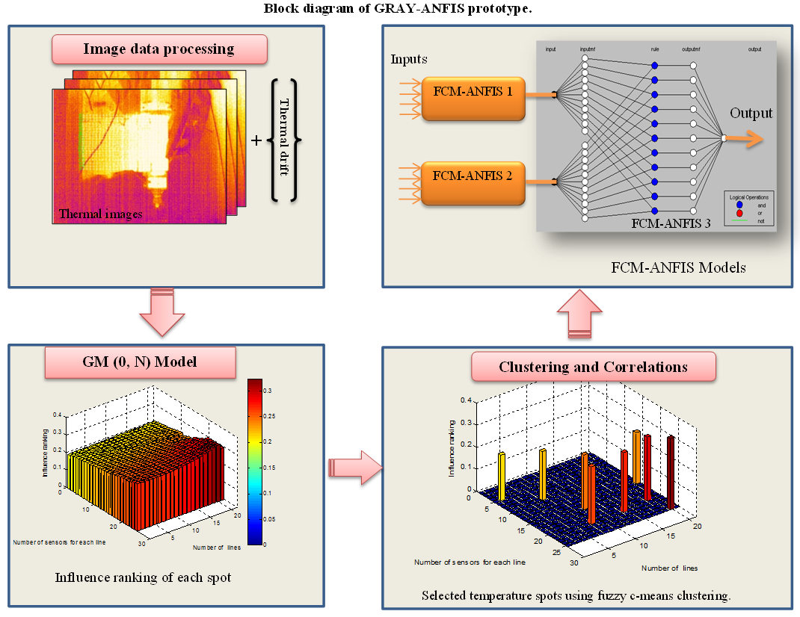
AI modelling for active compensation
ANFIS Modelling and compensation of thermal effects
  Current inputs include temperature and strain

Slide 9
CERN potential collaboration
Collimator straightness
  Simulation of the effect of temperature variations due to different running conditions
  Active compensation to preserve collimator straightness
    On-line monitoring
    AI modelling for active compensation and actuator methods
Collimator positioning
  Servo controlled collimator positioning system
    Targeting improved resolution and precision
    Adapting to mechanical variability due to limited/no lubrication
  Alternative drive mechanism (possibly adapt from machine tools)
    E.g. ceramic bearings in roller screw.
    Linear motors
    Other (squiggle, PZT,…)
Due consideration of radiation effects, cabling distances, …

Slide 10
Thank you
Dr Simon Fletcher – s.fletcher@hud.ac.uk
Dr Andrew Longstaff – a.longstaff@hud.ac.uk
Professor Alan Myers – a.myers@hud.ac.uk

