Slide 1

DHBT method to detect rotation in heavy ion collisions
Dujuan Wang
Supervisor: Prof. Laszlo P. Csernai
University of Bergen, Norway
Budapest, 02/12/2013

Slide 2
Outline
Short Introduction
Two particle correlation calculation
The DHBT method
Results in our FD model
Summary

Slide 3
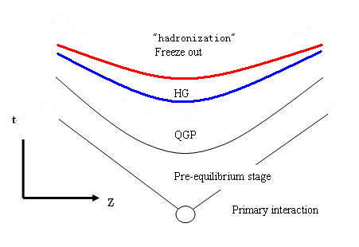
Short Introduction
Pre-equilibrium stage → Initial state (Yang-Mills flux tube)
Quark Gluon Plasma → FD/hydrodynamics → Particle In Cell (PIC) code
Freeze out, and simultaneously “hadronization” →
Phase transition on hyper-surface → Partons/hadrons

Slide 4
1. Relativistic Fluid dynamics model
Relativistic fluid dynamics (FD) is based on the conservation laws and the assumption of local equilibrium (→ EoS)
4-flow:
energy-momentum tensor:
For perfect fluid:
In Local Rest (LR) frame = (e, P, P, P);

Slide 5
2. Results in our FD model
Low viscosity , turbulence,
Kelvin Helmholtz Instability, Vorticity
The expanding system do rotates
How to detect the rotation seems interesting
and necessary. Ǝ three suggestions:
→v1 directed flow weak at High energy HIC
→Diffrential HBT
→Polarization
(Laszlo Csernai ‘ talk)
[F. Becattini, L.P. Csernai, D.J. Wang, PRC 88, 034905 (2013)]

Slide 6
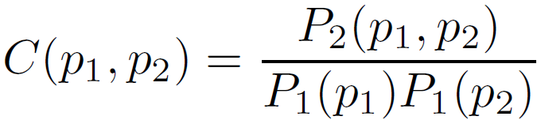
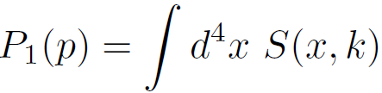
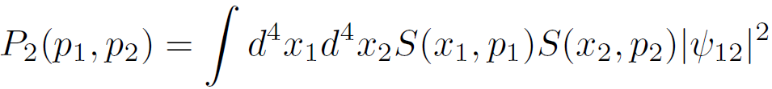
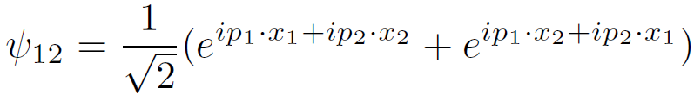
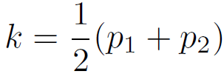

Two Particle Correlation Calculation
Center of mass momentum
Relative momentum

Slide 7
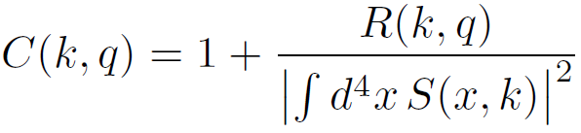





The source function:
and
are invariant scalars
n_{s} is the average density of Gaussian source
Details in [L.P. Csernai, S. Velle, arXiv:1305.0385]

Slide 8

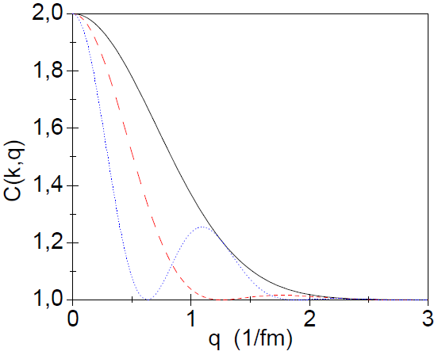
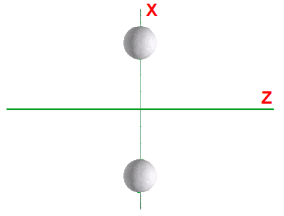
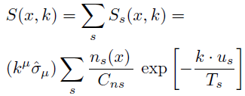
1. Two steady sources
[T. Csorgo, Heavy Ion Phys. 15,1-80 (2002)]
, R is the source size
X1 = d
X2 = - d
d=0
d=1.25
d=2.5

Slide 9


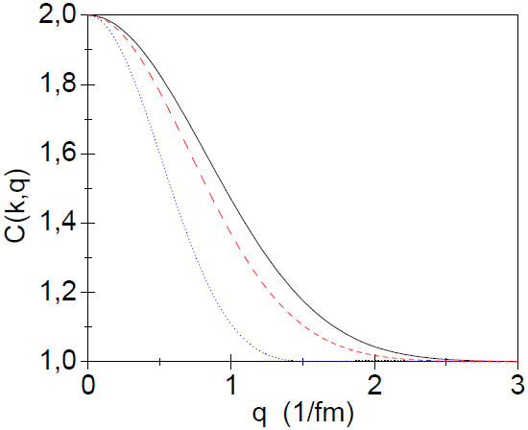
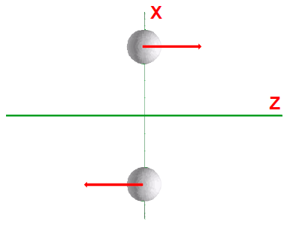
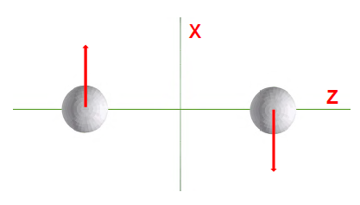
[L.P. Csernai & S. Velle, arXiv:1305.0385]
2. Two moving sources
q_{z}
q_{y}
q_{x}
Flow is mainly in x direction!
Detectable

Slide 10
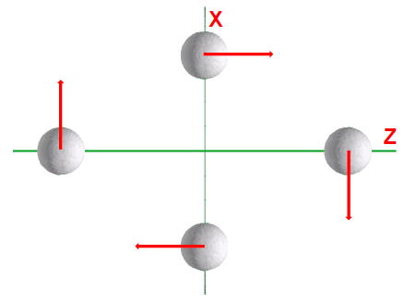
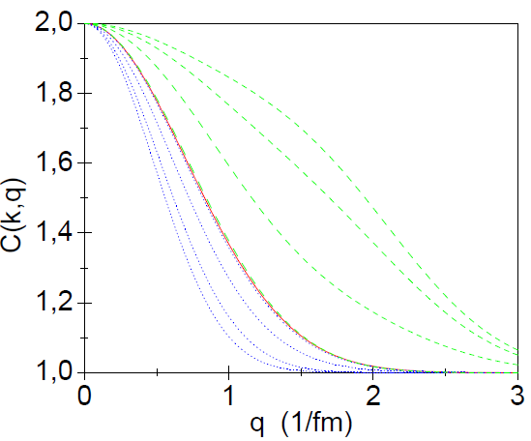
3. Four moving sources
Increase the flow v
The sources are symmetric ➔
Not sensitive to direction of rotation!
Increase in d

Slide 11
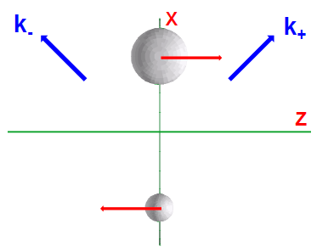
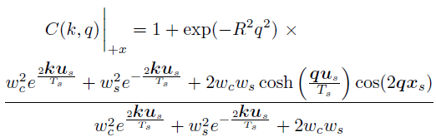


4. Inclusion of emission weights
w_{c}
w_{s}
w_{c}>w_{s}
Introduce ( < 1 ), then w_{c}=1 + , w_{s}=1 -

Slide 12


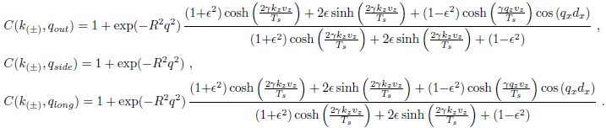
DHBT method

Slide 13
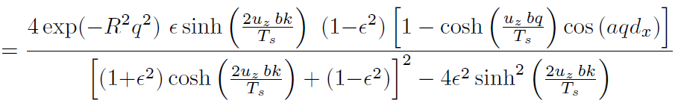
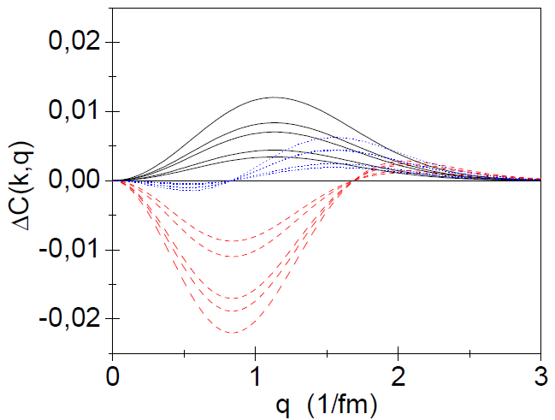
Differential Correlation Function (DCF) (DHBT)
Vz=0.5c
Smaller k values
Sensitive to the
speed and direction
of the rotation !
0.6 c
0.7 c

Slide 14
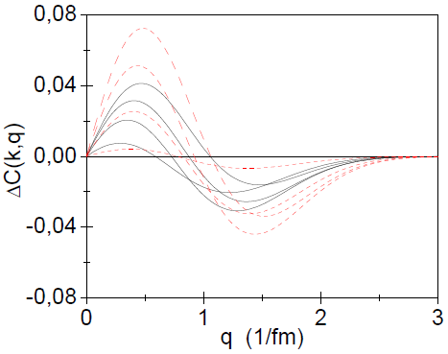
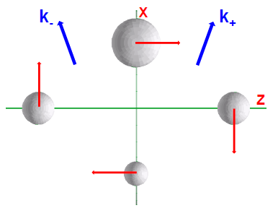
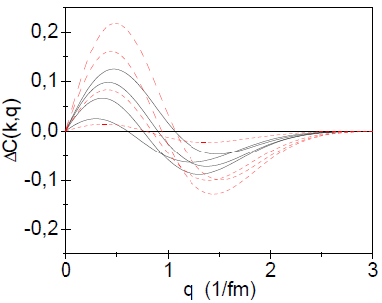
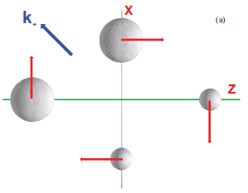
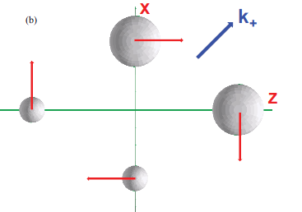
Vz=0.7c
d
c
Vz=0.5c
Sources c and d lead to bigger amplitude

Slide 15
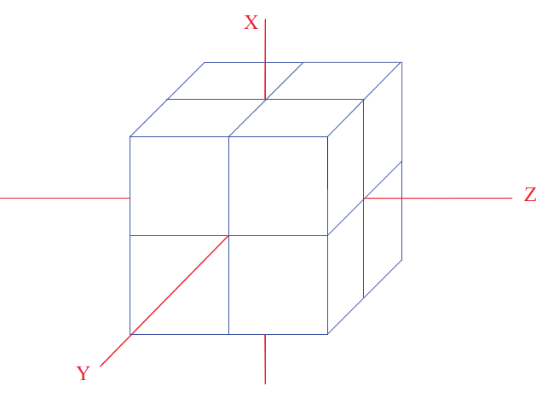
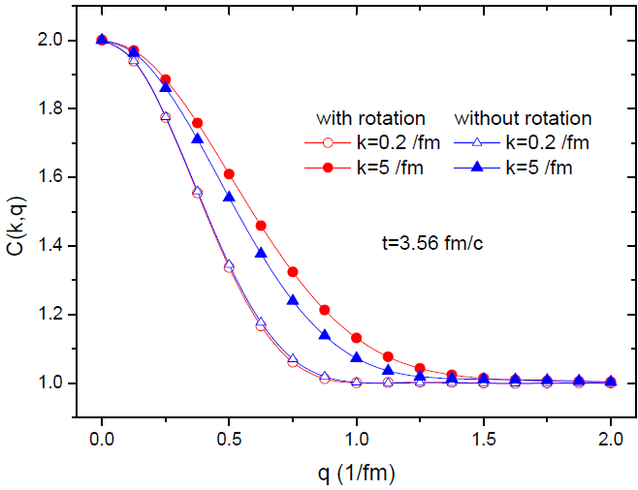
Results in our FD model
[L.P. Csernai, S. Velle, D.J. Wang, arXiv:1305.0396]
Bjorken type of flow → weights [Csorgo]:
~ 10000 fluid cells → numerical,
& not symmetric source!
Two direction are chosen:
50 degrees
130 degrees
For pseudorapidity +/- 0.76

Slide 16
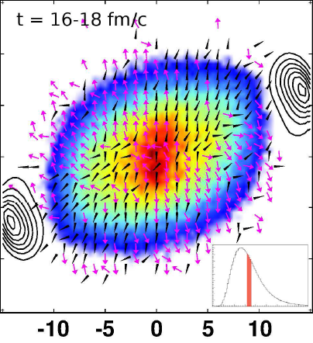



Separation of shape & rotation
X’
Still both rotation and
shape influence the DCF
so rotation alone is
not easy to identify
➔
We can use the work
[G. Graef et al.,
arXive 1302.3408 ]
To reflect an event
CF’ := (CF + R[CF])/2
will have no rotation
➔
Rotation and shape
effects can be separated
[G. Graef et al., arXiv: 1302.3408]

Slide 17




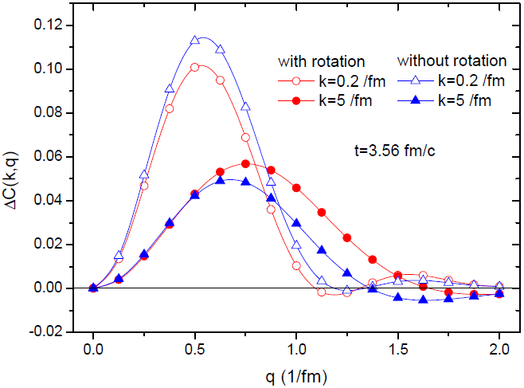
Rotation-less flow from our FD
Oringinal
Reversed
Radial component:
Rotational component:
DCF with and without rotation:
For smaller k the
sensitivity on the
rotation is smaller
k=5 /fm, relative
difference due to
rotation is larger

Slide 18
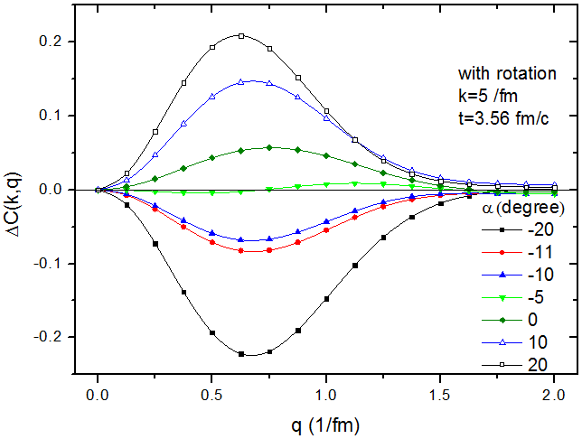

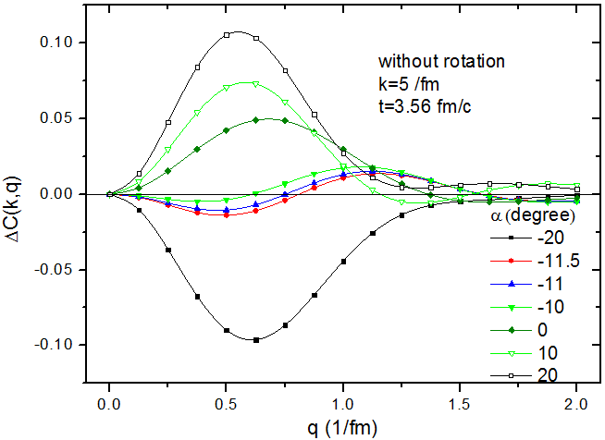


To determine proper axes of
emission ellipsoid:
x,z axes remain in RP,
but tilted by an angle α.
Pb+Pb @2.76 TeV
In K frame, a vector k :
In K’ frame, a vector k’:
If shape is symmetric &
no rotational flow→
For rotation-less flow:
Has minimal DCF at α=-11

Slide 19
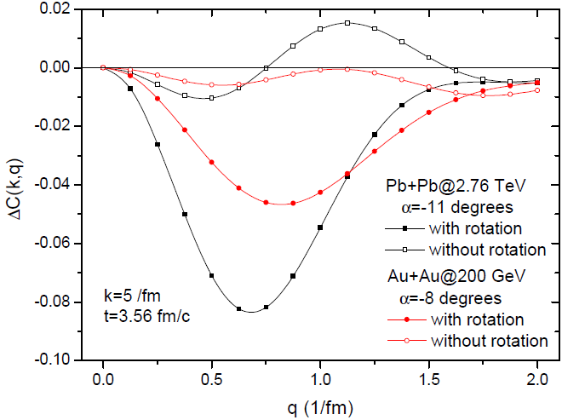
Compare different energies:
(dependence on angular momentum)
Deflection angle for
RHIC energy is smaller
DCF is two times bigger for LHC energy at their angle
of symmetry axes
b =0.7 b_{max}

Slide 20
Summary
Correlation for different source configurations are considered and discussed
DHBT method can detect the rotation and its direction, and sensitive to beam energy
The rotation has a big effect on the correlation function and it is necessary to separate rotations and shape
Thank you for your attention!

