Slide 1
WW Data Excess in the H->WW->lvlv Channel
Nicholas Luongo
Advisors:
Jianming Qian
Magda Chelstowska

Slide 2
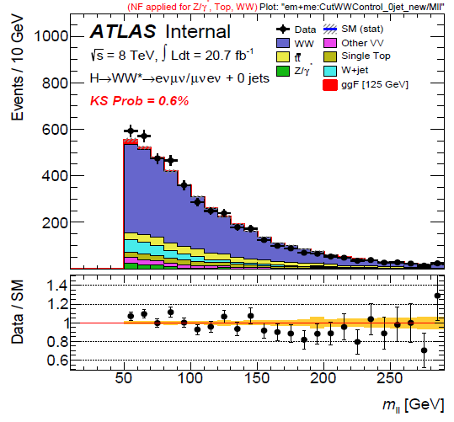
Introduction
H->WW->lvlv results show an excess of data in the WW control regions that suggest a more in-depth study
SM WW group also notes similar differences which are not easily explained
Possible reasons for this are new physics or insufficient modeling
Objective is to look for explanations by comparing different potential WW control groups as well as reproduce results using different MC generators

Slide 3
Background Method
In order to have a clear understanding of our signal, we must account for background processes
Major backgrounds involved:
  WW
  Ttbar
  Z+jets
  W+jets
  Single Top
We want to construct a region that is relatively pure in each background in order to determine how well data and MC agree and correct for any offset

Slide 4
WW Background Summary
SM WW is an irreducible background of the H->WW->lvlv process, both produce the same final state that is seen by the detector
The final-state leptons produced by H->WW->lvlv will have small differences in direction, resulting in low DPhill and Mll values
Final state of SM WW will include leptons moving opposite or near-opposite one another
Cuts can be applied exploiting these differences in order to separate the background from signal

Slide 5
Constructing WW Signal Region
First apply cuts in order to minimize the effects of other backgrounds and isolate signal
Initial cuts applied:
  Jet veto - Choose 0-jet region
  DphillMET > 1.57 - Remove Z+jets
  pTll > 30 GeV - Remove Z+jets
  Dphill < 1.8 - Restrict to region with signal
  Mll < 50 GeV - Restrict to region with signal
Different-flavor channels are preferred because same-flavor channels show significantly higher Z contamination and so give a less pure control region
Notes:
Relate Dphill and Mll cuts back to beginning explaining difference between HWW and SMWW

Slide 6
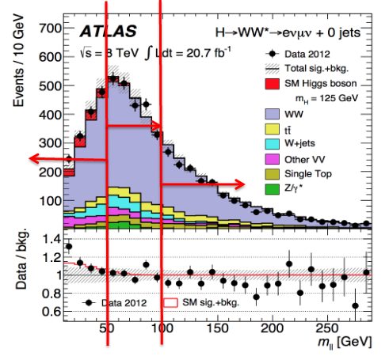
Control Region Candidates
Control region will be identical to signal except for different Mll cut
A desirable CR is one which is accurately modeled and has reasonable extrapolation uncertainties
Regions to investigate:
  80+ GeV
  50-100 GeV
  50+ GeV
  100+ GeV
Notes:
Explain Extrapolation Uncertainties
Explain Validation Region – Not present in all CR

Slide 7
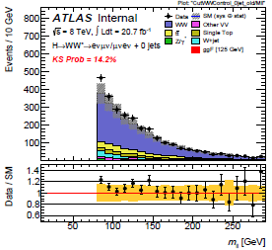
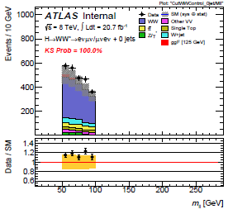
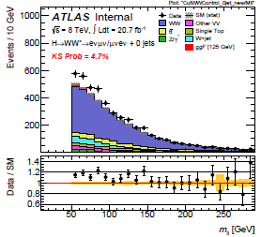
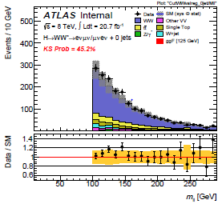
Graphs of Each Control Region
80+ GeV
50-100 GeV
50+ GeV
100+ GeV
Notes:
Explain all of these are without NFs applied
Mention of other plots for all other variables

Slide 8
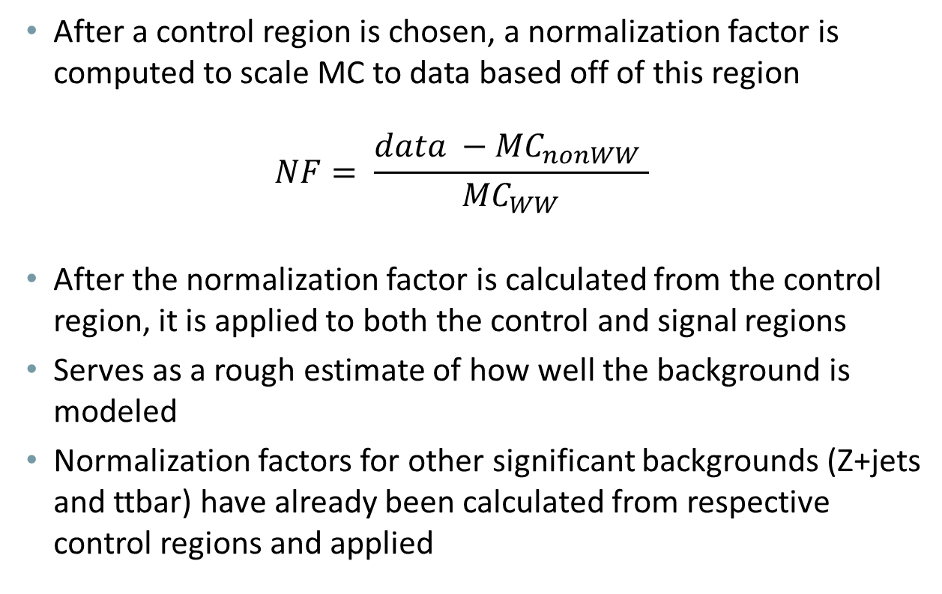
Normalization Factors
After a control region is chosen, a normalization factor is computed to scale MC to data based off of this region
$$NF= \frac{data −{MC}_{nonWW} }{{MC}_{WW}}$$
After the normalization factor is calculated from the control region, it is applied to both the control and signal regions
Serves as a rough estimate of how well the background is modeled
Normalization factors for other significant backgrounds (Z+jets and ttbar) have already been calculated from respective control regions and applied
Notes:
Formula: Total number of data events - total etc.
Normalizing other backgrounds affects the WW background through MCnonWW

Slide 9
Normalization Factors
Powheg+Pythia6
Normalization Factors
 |  | All Channels |  | ee/uu |  | eu/ue
CutWWControl_0jet (50-100 GeV) |  | 1.189 +/- 0.031 |  | 1.079 +/- 0.063 |  | 1.223 +/- 0.036
CutWWControl_0jet_new (50+ GeV) |  | 1.128 +/- 0.021 |  | 1.097 +/- 0.042 |  | 1.139 +/- 0.025
CutWWControl_0jet_old (80+ GeV) |  | 1.102 +/- 0.027 |  | 1.112 +/- 0.057 |  | 1.099 +/- 0.030
CutWWvalreg_0jet (100+ GeV) |  | 1.067 +/- 0.030 |  | 1.112 +/- 0.057 |  | 1.047 +/- 0.035
CutWWAoI_0jet (120-180 GeV) |  | 1.138 +/- 0.045 |  | 1.166 +/- 0.083 |  | 1.124 +/- 0.054
CutWWAoI1_0jet (120-150 GeV) |  | 1.228 +/- 0.058 |  | 1.301 +/- 0.107 |  | 1.192 +/- 0.070
CutWWAoI2_0jet (150-180 GeV) |  | 0.988 +/- 0.071 |  | 0.947 +/- 0.131 |  | 1.008 +/- 0.085
CutWWControl_1jet_new (80+ GeV) |  | 1.026 +/- 0.045 |  | 0.996 +/- 0.095 |  | 1.035 +/- 0.052
CutWWControl_1jet_old (50+ GeV) |  | 0.957 +/- 0.053 |  | 0.772 +/- 0.123 |  | 1.001 +/- 0.058
CutWWvalreg_1jet (100+ GeV) |  | 0.949 +/- 0.060 |  | 0.772 +/- 0.123 |  | 1.007 +/- 0.068
Notes:
Smaller NFs do not guarantee a better control region, extrapolation uncertainties also a factor

Slide 10

Alternate Generators
Baseline generator was Powheg+Pythia6
Wanted to compare with other generators Powheg+Pythia6(P2011C) and Powheg+Pythia8
Also produced extrapolation parameters for each generator and uncertainties between pairs
eu/ue |  | Powheg+Pythia6 |  | Powheg+Pythia6 (P2011C) |  | Powheg+Pythia8
CutWWControl_0jet (50-100 GeV) |  | 1.223 +/- 0.036 |  | 1.230 +/- 0.035 |  | 1.231 +/- 0.036
CutWWControl_0jet_new (50+ GeV) |  | 1.139 +/- 0.025 |  | 1.141 +/- 0.025 |  | 1.137 +/- 0.025
CutWWControl_0jet_old (80+ GeV) |  | 1.099 +/- 0.030 |  | 1.102 +/- 0.030 |  | 1.091 +/- 0.030
CutWWvalreg_0jet (100+ GeV) |  | 1.047 +/- 0.035 |  | 1.045 +/- 0.034 |  | 1.036 +/- 0.034
CutWWAoI_0jet (120-180 GeV) |  | 1.124 +/- 0.054 |  | 1.122 +/- 0.053 |  | 1.106 +/- 0.053
CutWWAoI1_0jet (120-150 GeV) |  | 1.192 +/- 0.070 |  | 1.192 +/- 0.069 |  | 1.182 +/- 0.069
CutWWAoI2_0jet (150-180 GeV) |  | 1.008 +/- 0.085 |  | 1.002 +/- 0.083 |  | 0.980 +/- 0.082
$$\frac{N_{SR}}{N_{CR}}$$
Notes:
Differences between generators, how they treat pileup
Note how there is very little range to the values, ~.01 for each of the potential control regions
Mention that extrapolation factors are in backup but they have a similarly low range

Slide 11
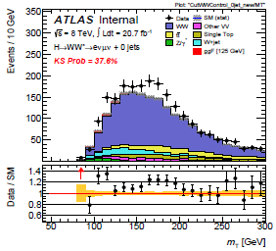
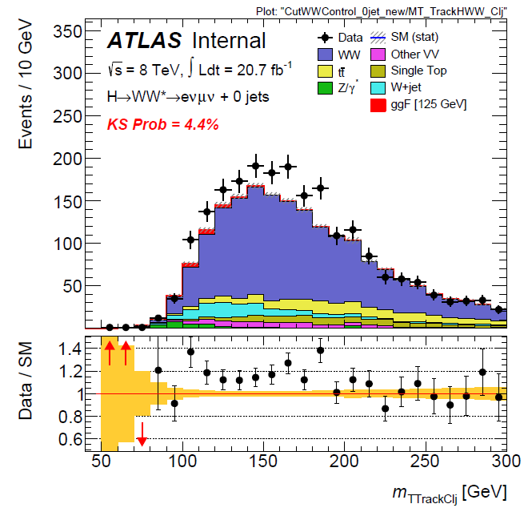
MT in 50-100 GeV Mll region
Calorimeter-Based MET
Track-Based MET
Notes:
Excess of data between mT of 150-200 GeV
Different methods of detecting

Slide 12
Conclusion/Moving Forward
Results do not show obvious causes for the excess that we are seeing
Could point to problems with SM WW theoretical cross section, consistent with SM WW group
More precise cuts can be made to study particular areas of interest which could shed light on the cause of particular excesses instead of properties of an entire control region
Repeat analysis with a greater variety of MC generators than is currently present (plans to add MC@NLO)
Notes:
Time constraints
Note that you did a small amount of the more precise analysis
MC@NLO is very different from Powheg+Pythia, more likely to show noticeable differences

Slide 13
Questions?

Slide 14
Extrapolation Factors
Opposite Flavor | 80+ GeV | 50-100 GeV | 50+ GeV | 100+ GeV
Alpha Powheg+Pythia6 | 0.554 +/- 0.00531 (0.959%) | 0.697 +/- 0.00698 (1%) | 0.364 +/- 0.00327 (0.897%) | 0.762 +/- 0.00779 (1.02%)
Alpha Powheg+Pythia6P | 0.556 +/- 0.00318 (0.572%) | 0.701 +/- 0.00419 (0.598%) | 0.365 +/- 0.00195 (0.535%) | 0.76 +/- 0.00463 (0.609%)
Alpha Powheg+Pythia8 | 0.551 +/- 0.00521 (0.946%) | 0.703 +/- 0.00696 (0.99%) | 0.364 +/- 0.00322 (0.885%) | 0.755 +/- 0.00761 (1.01%)
Extrap. Unc. PowPyth6/PowPyth6P | (-)0.334% +/- 1.12% | (-)0.589% +/- 1.17% | (-)0.211% +/- 1.05% | 0.199% +/- 1.19%
Extrap. Unc. PowPyth6/PowPyth8 | 0.562% +/- 1.34% | (-)0.796% +/- 1.42% | 0.0237% +/- 1.26% | 0.905% +/-1.42%

Slide 15
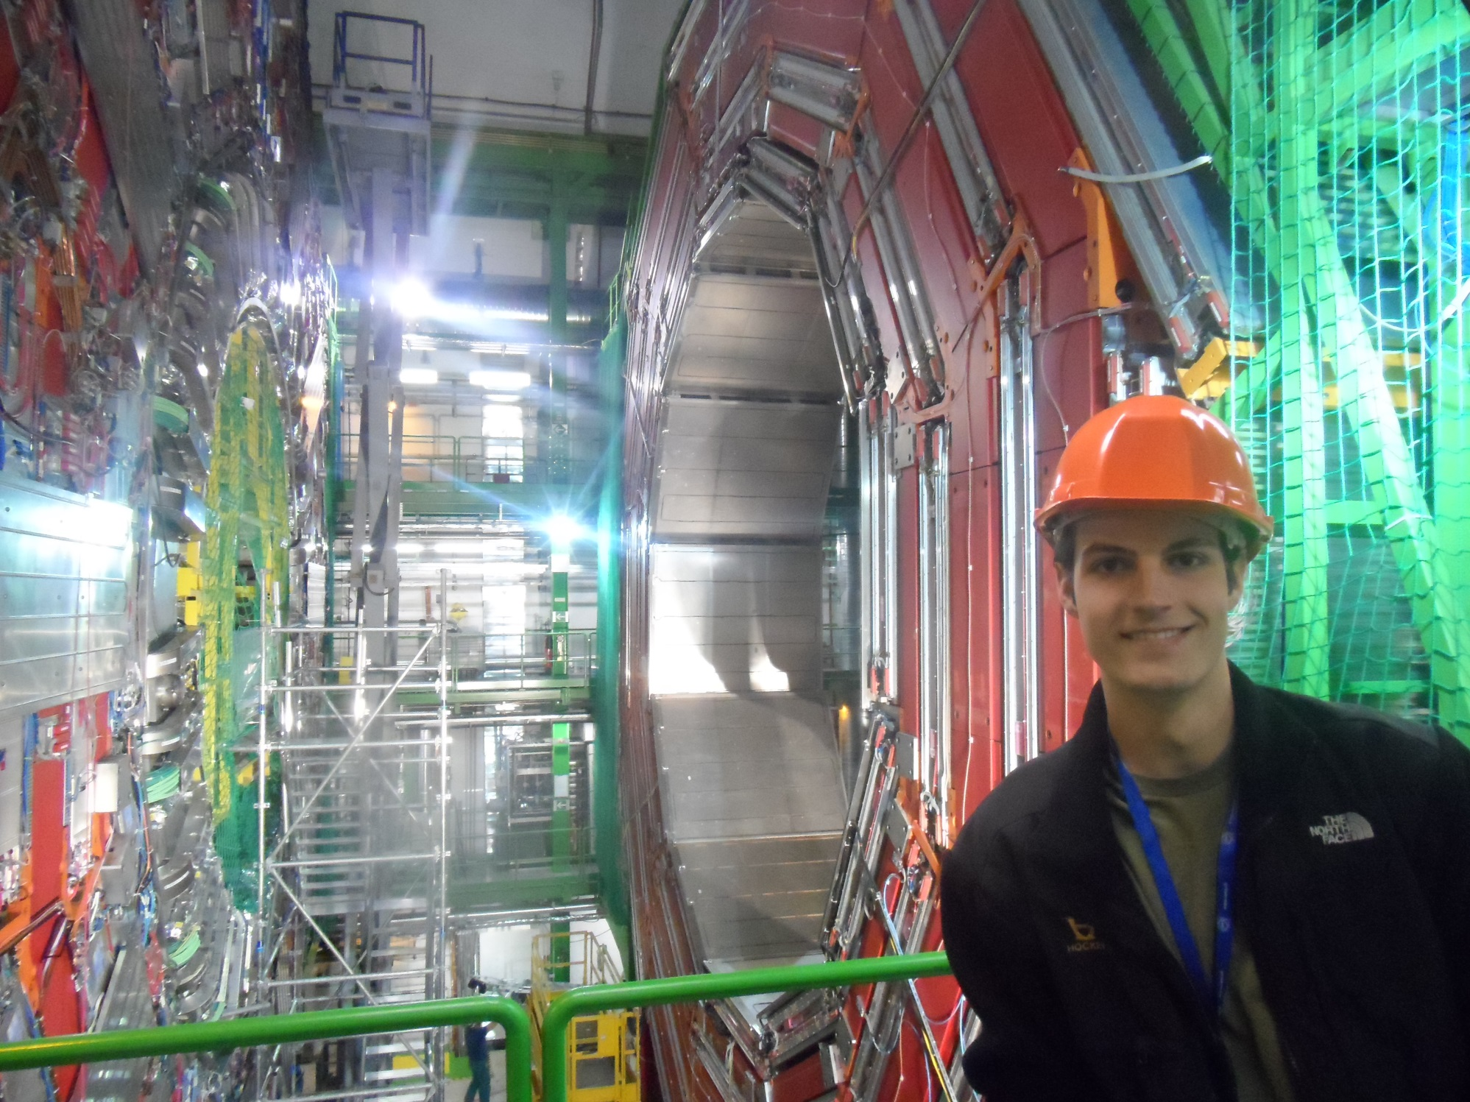
CMS

