Slide 1

PART II:
Cyclotrons for radioisotope production
MID 42329
1

Slide 2
Why cyclotrons for isotope production?
Cost-effective machines for achieving:
  required energies (<100 MeV) and
  high currents (< 1000 μA)
  Constant particle revolution frequency in a uniform magnetic field => same accelerating structure used multiple times
Compact =>
  magnet and RF integrated into one system
  Single stage => no injector accelerator needed
Moderate magnetic fields up to 1 to 2 Tesla
Simple RF system:
  Constant RF-frequency (10-100 MHz) => CW operation
  Moderate voltages (10-100 kVolt)
Relative easy injection (internal ion source or axial injection)
Simple extraction (stripping for H⁻⁻ ions)

Slide 3
Major milestones in cyclotron development (1)
Classical cyclotron (Lawrence)
  Uniform magnetic field => loss of isochronism due to relativistic mass increase => energy limited
  CW but weak focusing => low currents
Synchro-cyclotron (McMillan-Veksler)
  B-uniform but time varying RF frequency => high energies achievable
  Pulsed operation and weak focusing => very low currents
The isochronous AVF cyclotron (Thomas focusing)
  Azimuthally varying magnetic fields with hills and valleys
  Allows both isochronism and vertical stability
  CW-operation, high energies and high currents
  Radial sectors => edge-focusing
  Spiral sectors => alternating focusing

Slide 4
Major milestones in cyclotron developoment (2)
The separate sector cyclotron (Willax)
  No more valleys=> hills constructed from separate magnets
  More space for accelerating cavities and injection elements
  Example PSI-cyclotron at Villingen-Switserland
  Very high energy (590 MeV) and very high current (2 mA) => 1 MWatt
H– cyclotron (Triumf)
  Easy extraction of H⁻⁻ by stripping
  Low magnetic (center 3 kG) field because of electromagnetic stripping
  Triumf is largest cyclotron in the world (17 m pole diameter)
Superconducting cyclotron: Fraser/Chalk River/Blosser/MSU
  High magnetic field (up to 5 Tesla) => high energies at compact design
Superconducting synchrocyclotrons (Antaya-Wu-Blosser)
  Very high magnetic fields (9 Tesla)
  Very compact => cost reduction => future proton therapy machines?

Slide 5
Market and suppliers of 30 MeV cyclotrons

Slide 6
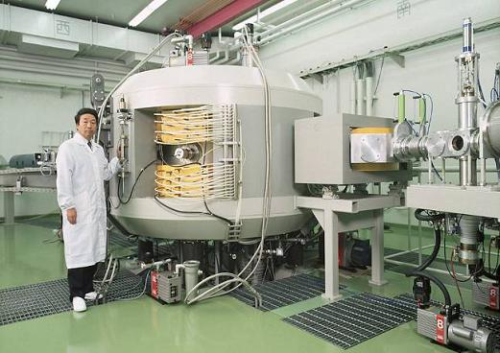
IBA Cyclone-30 for production of SPECT isotopes
First IBA machine
30 MeV - 500 µA
1986
Used by many (all) radiopharmaceutical producers

Slide 7
IBA medical cyclotrons: some general features
Deep-valley magnetic structure
  Strong azimuthal variation of B ⇒ Strong focussing
  Small gap requiring low power dissipation
  Yoke completely closed ⇒ providing some shielding
4-fold symmetry
  Two accelerating structures (dees) in two valleys ⇒
  Very compact; two other valleys for pumping, ESD….
Acceleration of negative ions (H⁻ or D⁻) ⇒
  Beam extraction by stripping
  Very easy using thin carbon foil
  100% extraction efficiency
Injection from internal PIG-source (PET-isotopes) or with a spiral inflector (SPECT => cyclone 30)

Slide 8
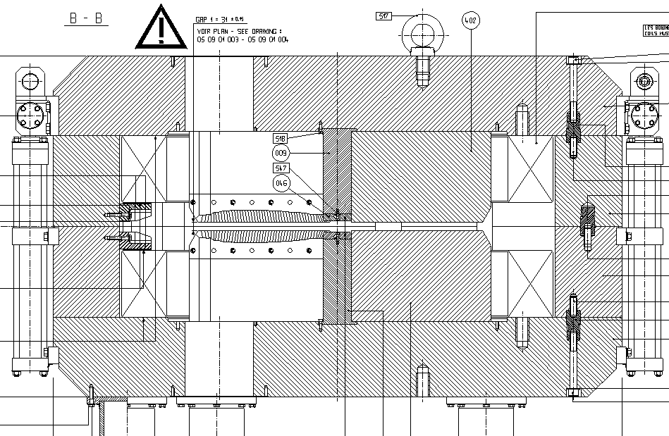
Deep-valley Cyclotron Magnet Design
Yoke
Coil
B
Valley :
120 cm
Hill :
3 cm

Slide 9
Extraction of the beam from the cyclotron
Extraction is always a major concern in cyclotrons => how to get the beam out of the magnetic field
No extraction at all => place an internal target
Stripping extraction (H⁻ cyclotrons)
Extraction with an electrostatic deflector (ESD)
  Proton therapy cyclotrons
Self-extraction => suitable shaping of the magnetic field
Regenerative extraction => synchrocyclotron
Some examples will be shown later

Slide 10
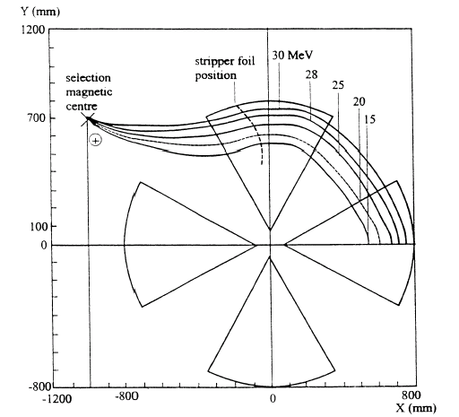
Extraction by stripping (Cyclone 30)
Stripper foil removes the two electrons of the H⁻ ion
Orbit curvature changes sign after stripping foil
Simple =>high extraction yield and little internal activation
Energy variation by moving stripper position
All energies go to one crossover point by proper foil azimuthal position
Place combination magnet at crossover
Ideal solution for industrial cyclotrons
Cross-over
Stripper foil

Slide 11
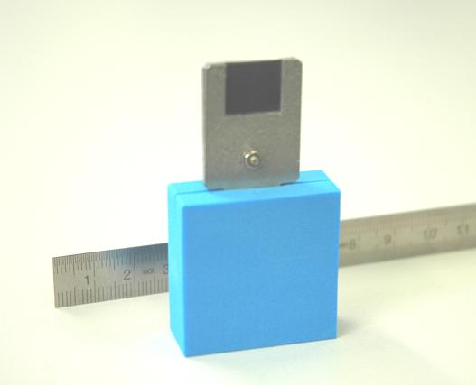
Extraction by stripping: carbon stripping foil
Simpler than this is not possible

Slide 12
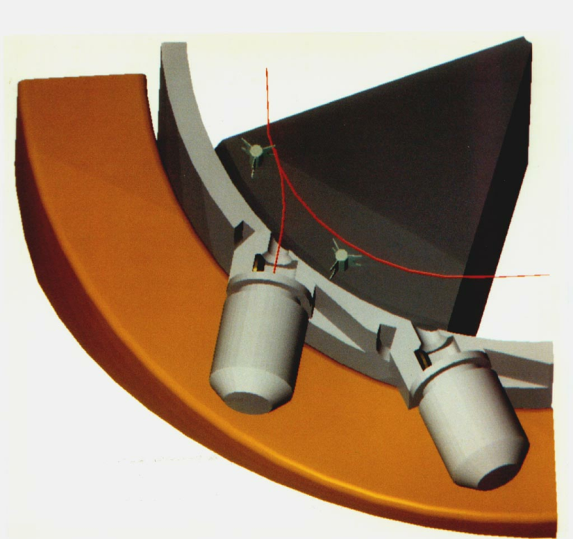
Extraction by stripping (Cyclone-18/9)
Fixed foil position => constant energy but
Multiple extraction ports around the machine
Dual beam capability

Slide 13
An Internal Ion Source
Some advantages
  Simple and cheap: No injection line needed
  Compact: two ion sources can be placed simultaneously
  Cost considerations are essential in this market
Some limitations
  Moderate beam intensities
  Simple ion species (H⁺,H⁻,deuterons,He-3, He-4)
  Gas-leak directly into the cyclotron (stripping of negative ions)
  Carefull CR design is needed in order to obtain good centering and focusing

Slide 14
Cold Cathode PIG Ion Source => how does it work
Electron emission due to high initial electrical potential on the cathodes
Electron confinement due to the magnetic field along the anode axis
Electrons produced by thermionic emission and ionic bombardment
  Start-up: 3 kV to strike an arc
  Operating point 100V
cathodes heated by the plasma (100 V is enough to pull an outer e- off the gas atoms)
Cathode
H₂
B
H⁻
PLASMA

Slide 15
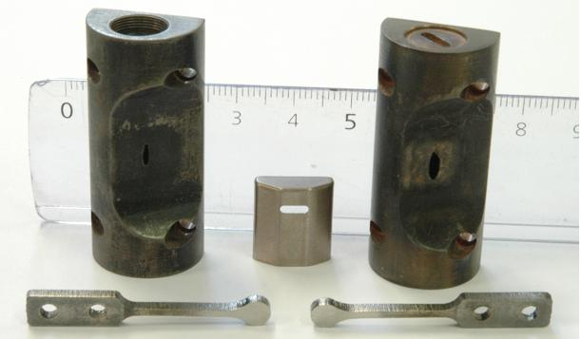
Chimney cathodes and puller
Chimney: copper-tungsten ⇒ good heat properies; machinable
Cathodes: tantallum ⇒ high electron emission (low workfunction)

Slide 16
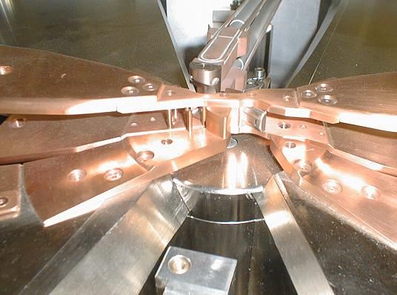
The cyclotron central region with an internal source
PIG-source
Dee
Puller
Dummy-Dee
Two ion sources can be placed symmetrically

Slide 17
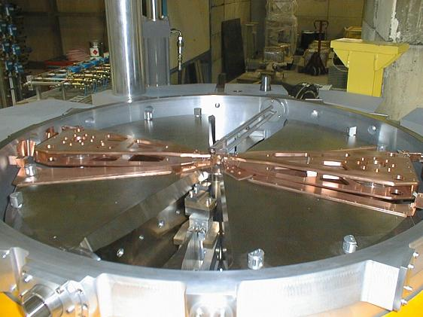
Compact Deep-valley Cyclotron Design
yoke
Central region
Ion Source
Dees
flaps
hill
valley
stripper
targets
Vacuum chamber

Slide 18
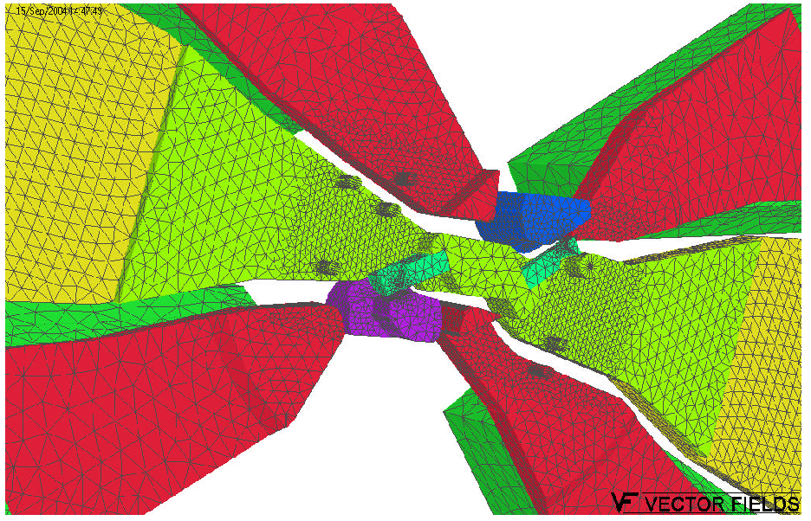
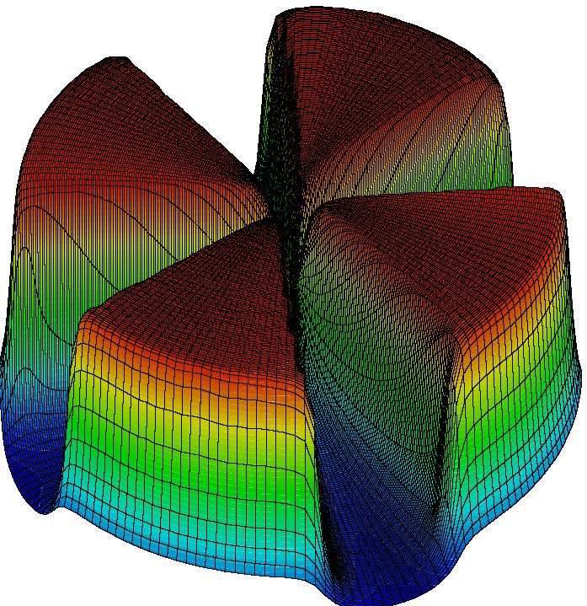
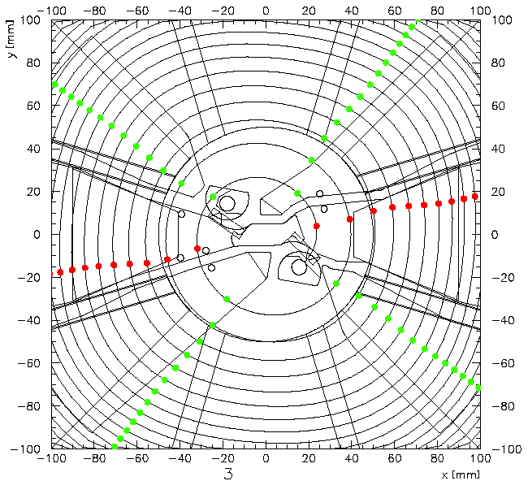
3D EM and beam-dynamics simulations
3D E-field calculations
Essential in cyclotron design
3D B-field calculations
Orbit calculations

Slide 19
External Ion Source => Axial Injection
External ion source => beam injection along the vertical axis
Bend from vertical to horizontal with an electrostatic inflector
Higher currents can be achieved
More different ion species can be injected
Better cyclotron vacuum (less stripping losses for H⁻⁻)
Injection line needed with buncher, lenses, diagnostics, pumping…

Slide 20
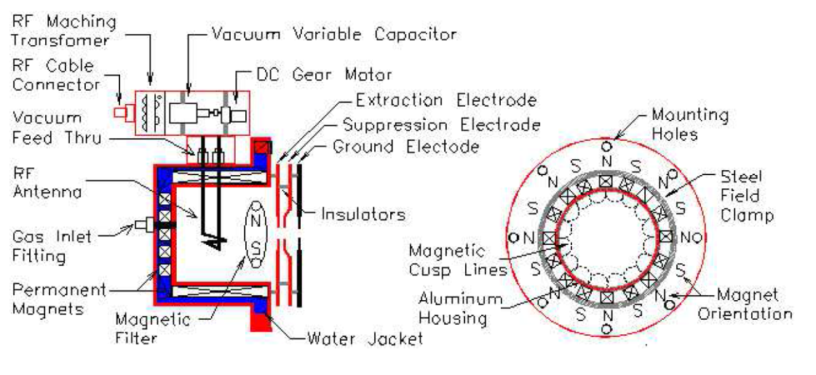
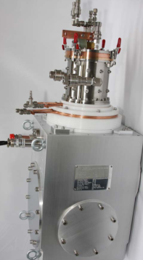
Ion source: considerations for axial injection
H⁻ is a very fragile ion =>ion source requires carefull design and optimization to get good performance
Multicusp volume ion source with special 3D magnetic field shape (permanent magnets) to maximize plasma-confinement
A separate zone of lower plasma temperature is made with magnetic filter, where H⁻ can be formed and stabilized
filament
Multiple extraction electrodes for beam divergence adjustment
High current: 15 mA
Good emmittance: 100 π mm-mrad (4-rms) at 30 keV

Slide 21
Considerations for the injection line
Good vacuum to minimize stripping losses (H⁻)
Differential pumping to separate ion source vacuum from beam line
Source is DC but Cyclotron is RF => matching needed
  Bunching to increase injection efficiency
Focusing: small beam spot at the entrance of the inflector => space charge effects
Steering: good alignment of beam spot on inflector
Beam diagnostics needed
Compact (short) design to reduce stripping and space charge
  Install several elements in the return yoke

Slide 22
An example of an injection line and ion source
C30-HC achieved 1.2 mA extracted beam with this injection line

Slide 23
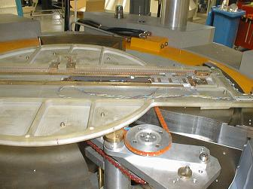
Automized Magnetic Field Mapping
Precise mapping and iron pole shimming is needed in order to isochronize the magnetic field
Move Hall-probe on a 2D polar grid to obtain a full fieldmap in the median plane of the cyclotron
Analyse the magnetic field on equilibrium orbits in order to evaluate isochronism
Shim the hill sectors of the iron in order to improve the isochronism (reduce RF phase slip)

Slide 24
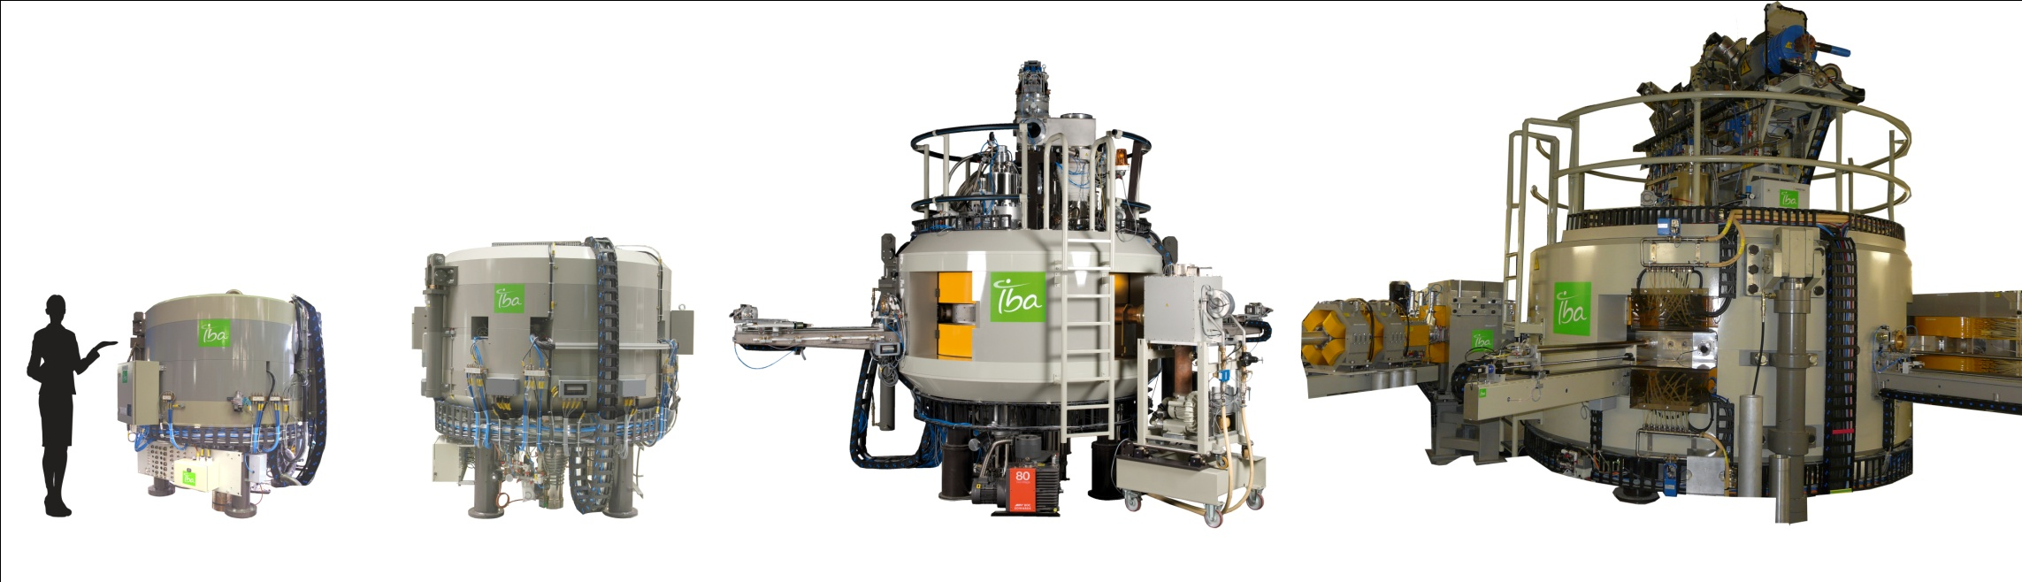
A family of cyclotrons for isotope production
PET
PET+SPECT
Multi-purpose
30 units
160 units
27 + 2 units
2 units
C10/5
C18/9
C30-family
C70
Notes:
30 x Cyclone 11 – 160 x Cyclone 18 - 28 x Cyclone 30 – 2 x Cyclone 70

Slide 25
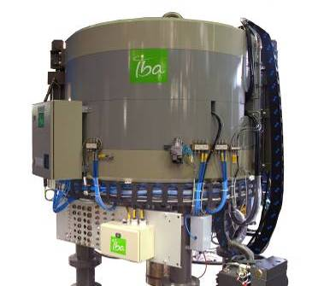
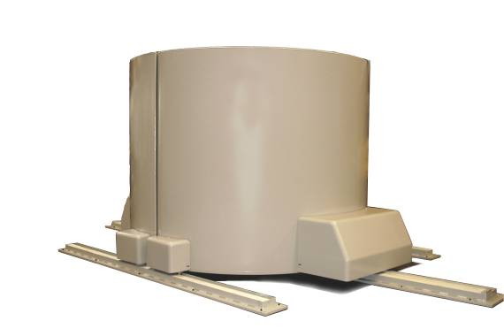
Baby-cyclotron 11 MeV
11 MeV proton.. limited capacity for PET
H⁻ (proton only) - 120 µA ~ 1300 watts
Usually hospital based 18F- 11C system
External shielding for neutrons and gammas
IBA Cyclone11

Slide 26
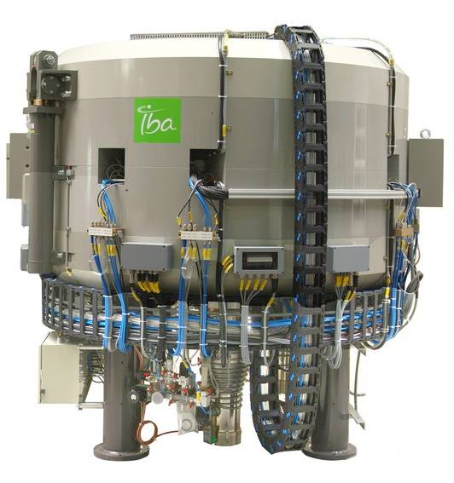
Medium energy Cyclone 18
18 MeV proton (9 MeV deuteron) or TWIN proton
H⁻⁻ (proton) 150 µA ~ 2700 watts
D⁻ (deuteron) 50 µA
Access to common PET
  18F
  11C
  13N
  15O
And new RI
  64Cu,89Zr,124I,..
  Also 123I solid tgt

Slide 27
Cyclone 18 with an external beam line
More diverse target technologies for external beams

Slide 28
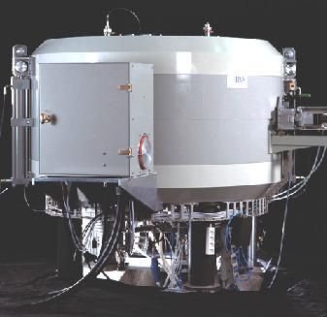
Cyclone 18+ for Pd-103 production (Brachyterapy)
¹⁰³Rd(p,n)¹⁰³Pd
Large doses, lower cross-section require high current operation: example
18 MeV p @ 2mA on internal target
14 cyclotrons in the same factory
30 kW of beam with 100 kW of electrical power ⇒ 30 % accelerator efficiency
80% of the RF power is for beam acceleration; 20 % for building the accelerating field

Slide 29
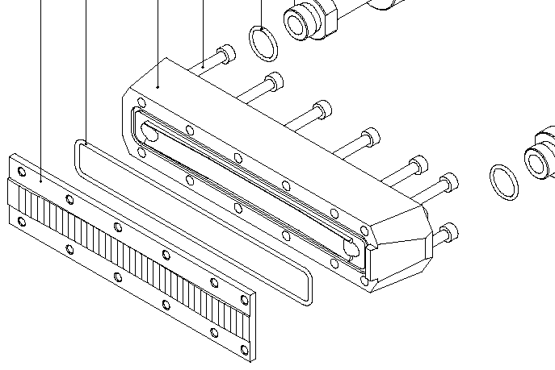
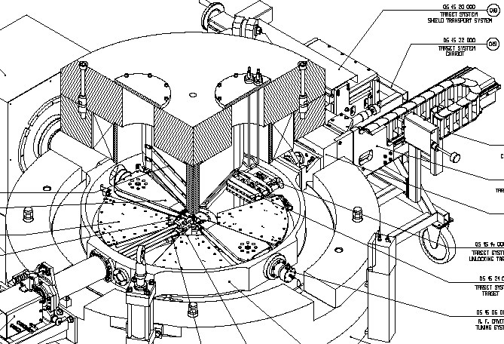
IBA C18+ with internal target for Pd-103
Rhodium target
Target surface at a small angle wrt the beam =>
Increase beam spot but
Try to minimize beam reflection

Slide 30
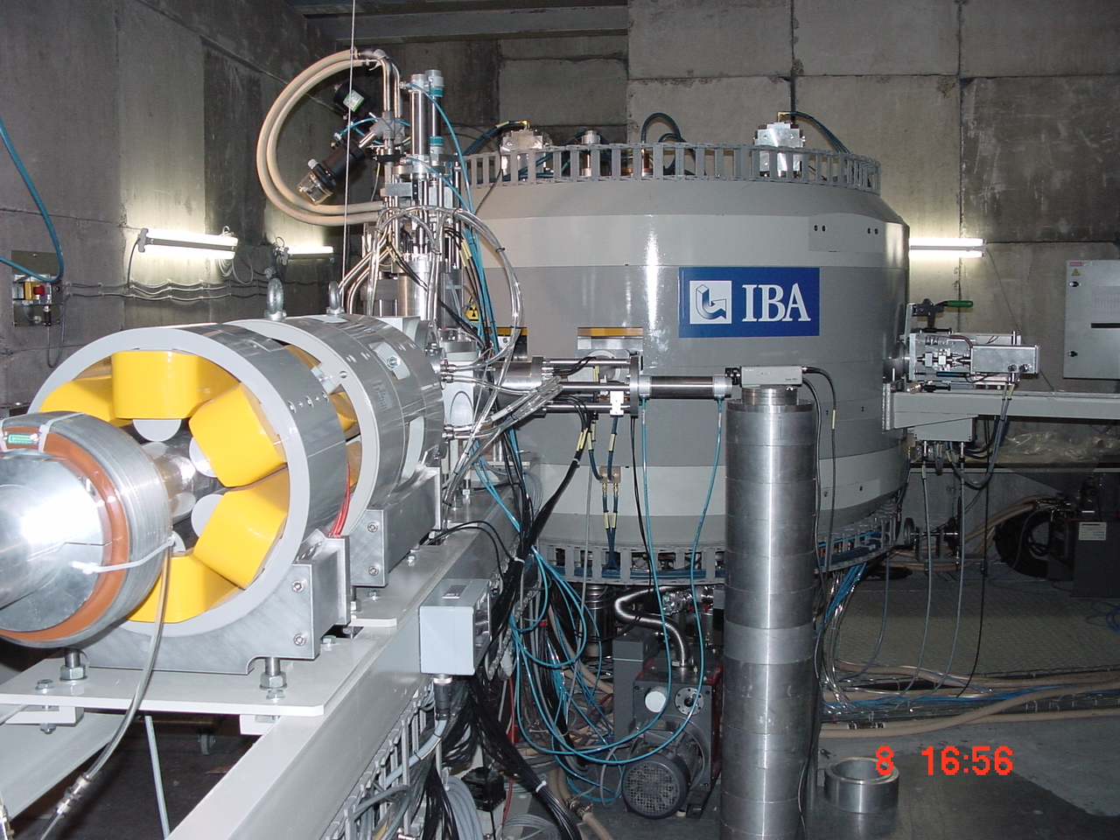
The C14SE self-extraction cyclotron for 103-Pd
Accelerate high intensity 14 MeV protons
Good vacuum not required
  Internal ion source
  Less expensive pumping
High current protons
  ESD not possible
  Extraction completely from magnetic design
  IBA patented
The ion source reached 15mA on internal beam stop.
Extracted beam intensities reached 1.4 mA
On target reached 0.8 mA
IBA is currently studying if SE principle can be more widely applied for PET-cyclotrons
30

Slide 31
The C70 cyclotron for Arronax
Multi-purpose isotope production cyclotron
Routine PET and SPECT
Radio-chemistry research
Therapeutic isotopes
  ²¹¹At, alpha emitters
  ⁶⁷Cu, ¹⁷⁷Lu, beta emitters
  Pulsed alpha (research)

Slide 32
C70 multiple particles => additional complexity
Particles with different charge sign
  B-field must be inversed between + and – particles
  Two different types of ion sources (multicusp vs ECR)
Particles with different q/m ratio (1/1 and 1/2)
  Isochronous field shape not the same for both types
  Central region geometry not the same for both types
  Harmonic mode of acceleration not the same types
Different methods of extraction needed
  Stripping for H⁻ and D⁻
  ESD for α and H₂⁺
High intensity H⁻ requires very good vacuum

Slide 33
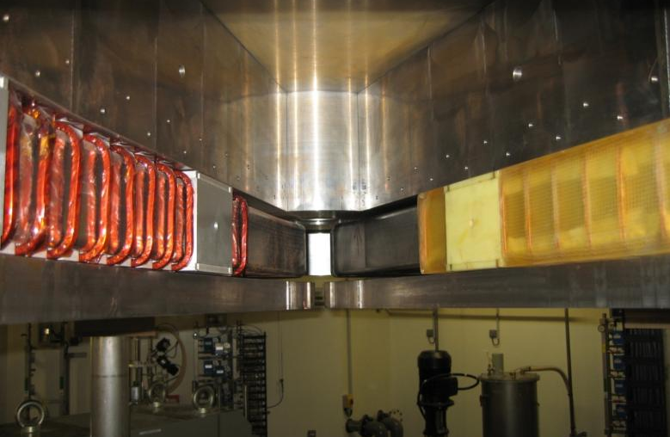
C70 => additional complexity of magnetic field
centering coils
extraction coils
Isochronization coils

Slide 34
C70 => additional complexity of central region
Horizontal deflector at exit of the inflector needed to place different both particle types on the equilibrium orbit (orbit centering)

Slide 35
Illustration of the C70 dual extraction system
Stripping extraction for negative particles
ESD for α-particle
Two opposite exit ports
Simultaneous dual beam capability for H- and D-
Variable energy for H- and D-
External switching magnet to direct different energies and particle into the beam lines

Slide 36
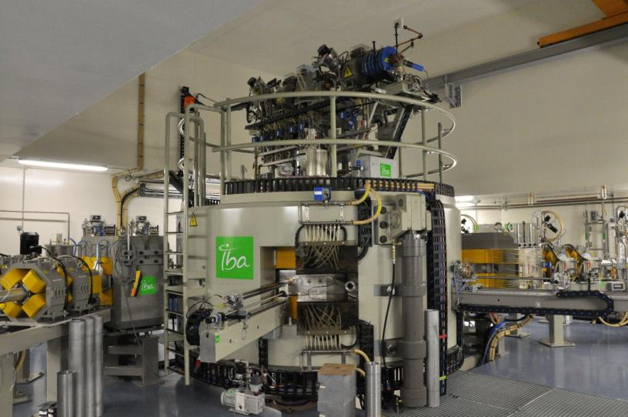
The C70 multiple particle cyclotron
Injection line with two ion sources on top
Two beam exit ports at opposite angles
Two stripper probes at opposite angles
36

Slide 37
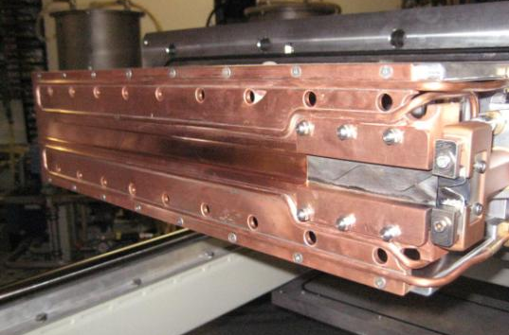
The C70 electrostatic deflector (ESD)
Water-cooled pre-septum
adjustable
Septum 2nd part (copper)
Septum first part (tungsten)
allowing heat expension
37

Slide 38
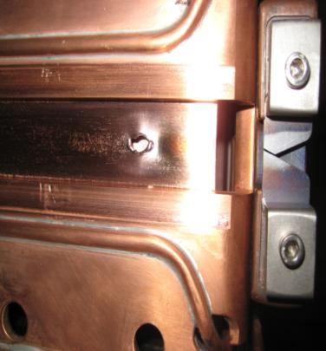
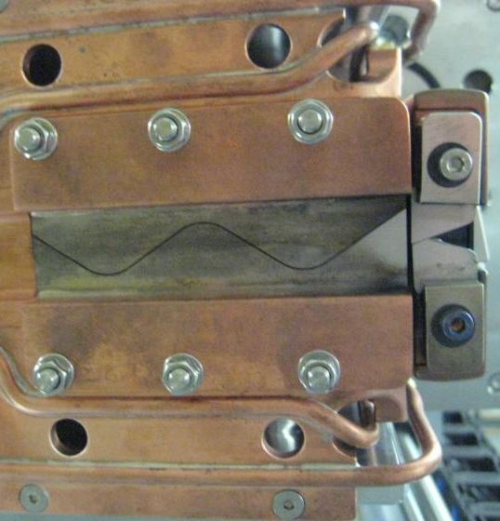
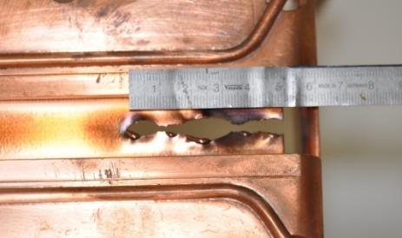
The ESD if you don’t do it right
α - beam 5kWatt
extraction efficiency 90%
500 Watt on thin septum
38

Slide 39
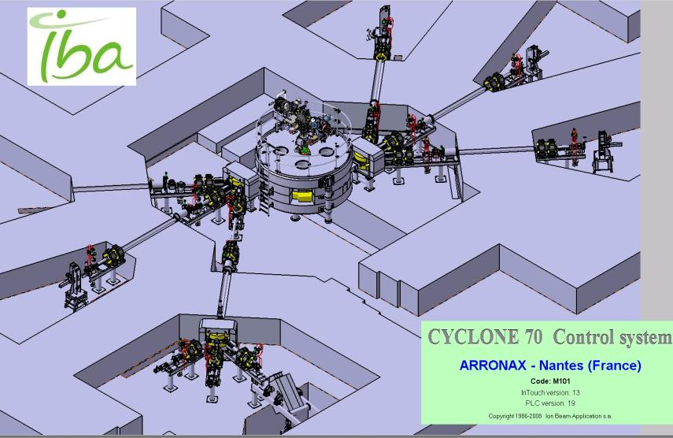
C70 at Arronax => a versatile RI production site
Six different vaults for routine RI production, development and research
39

Slide 40
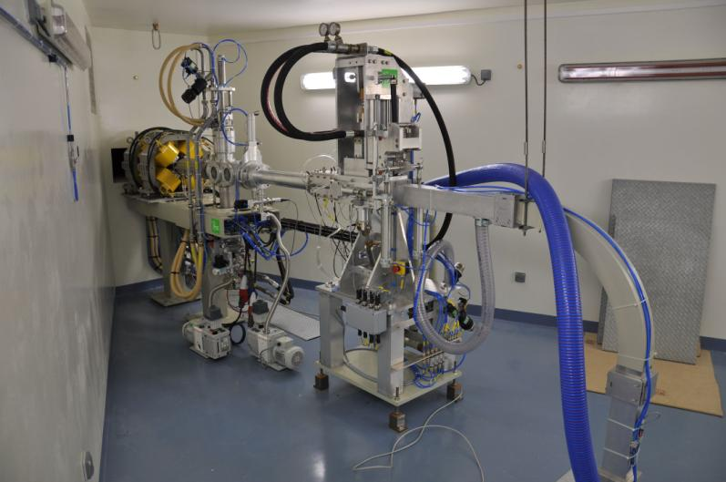
A typical RI Production beam line
Diagnostics (Faradyay cup and viewer
Solid target station with remote handling and water cooling
Wobbler for beam spreading on target
Quadrupolz doublet for beam transport/focusing
4-finger collimator
Rabit system for automatic transport of the irradiated target to the hot cells
40

Slide 41
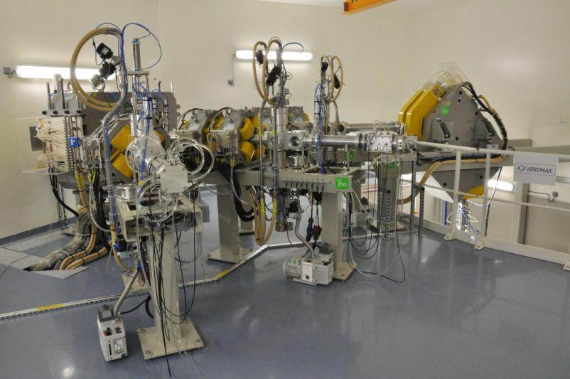
Experimental vault at Arronax Nantes
41

Slide 42
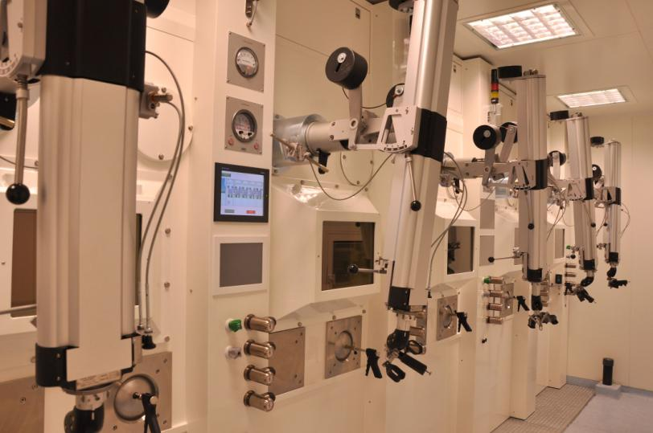
Hot-cells are needed for the remote handling of irradiated target material
15 cm lead shielding
42

Slide 43
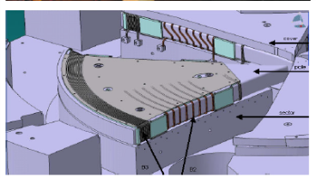
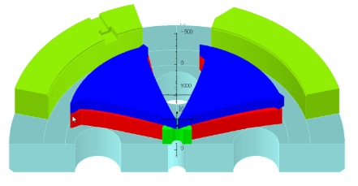
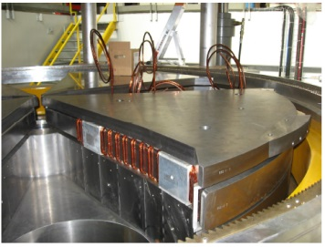
A simpler version of the Cyclone 70 => proton only
Zevacor Molecular USA
Optimize proton acceleration => currently under development at IBA
Starting from Cyclone 70 XP installed in Arronax, France
Optimize : Magnet : isochronism for proton only
  Compensation coils not needed => simplifies magnet considerably
3D Tosca finite element design of the magnetic structure
Notes:
Sector – pole (with coils) – Cover

Slide 44
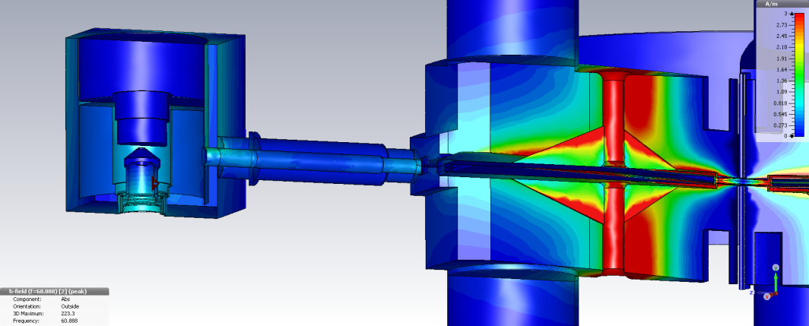
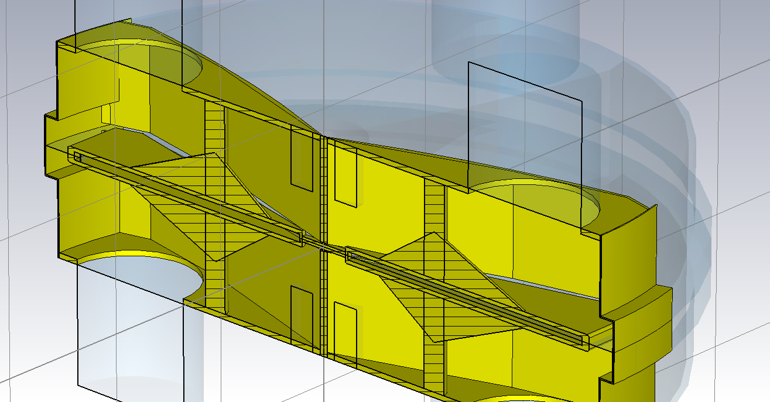
Cyclone 70 proton only
Optimize proton acceleration mode for high intensity
Optimize : RF for proton only : 35-70 MeV , > 750 µA ,
Accelerate H- at Harmonic 4 => less turn, lower losses
3D CST finite element design of the accelerating structure

Slide 45
Vacuum stripping in a high intensity H⁻⁻ cyclotron
H⁻ interacting with rest-gas may loose its electron
Neutral H-atom moves on straight line and hits vacuum chamber wall
Extra out-gassing on the walls induced by the beam
May lead to an avalanche effect
  Vacuum deteriorates with current => more stripping losses => more outgassing
  Max extracted current is limited by vacuum
How to reduce stripping losses
  Better base vacuum => more pumping
  Less outgassing => local cooling of vacuum chamber walls
  More efficient acceleration => less turns in the machine
Choose optimum harmonic mode of acceleration H
  4-fold symmetric cyclotron => dee-angle 45°=> H=4

Slide 46
The C30XP cyclotron
Very similar to the C70 (multi-purpose, multiparticle) but 30 MeV instead of 70 MeV
Most important difference is the RF-system
  Can operate in two modes with frequencies that exactly differ with a factor 2 (dual frequency)
  Allows to accelerate all four particles at the same optimum harmonic mode H=4
  Minimum turns => minimum stripping losses

Slide 47
Dual frequency RF system
coaxial cavity made up of two resonating volumes which are coupled by a capacity.
Low frequency mode is the quarter wave (λ/4) mode
High frequency mode as the 3λ/4 mode.
By proper dimensioning of the structure, the condition of frequency-doubling is obtained.
dual band IMPA + FPA
66 and 33 MHz on the same cavities
Without any moving RF parts

Slide 48
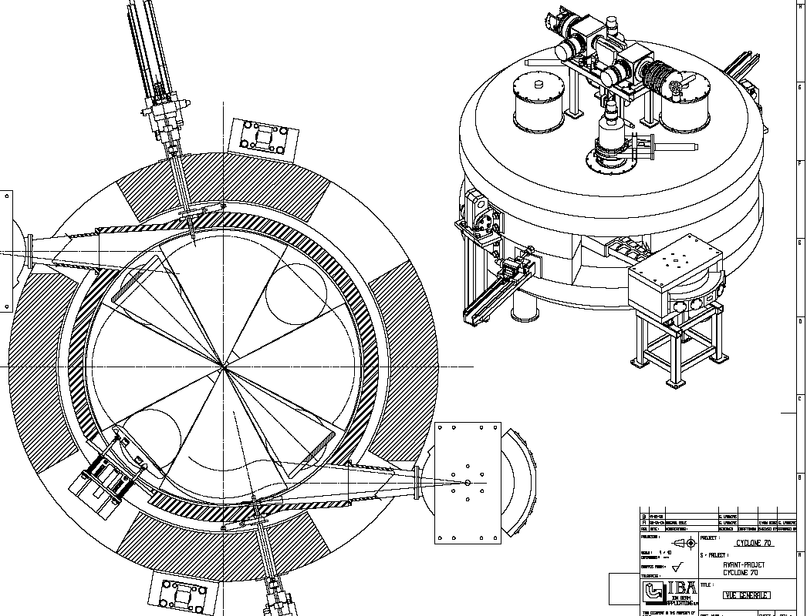
Cyclone® 30 XP ; proton- deuteron- alpha
based on the successful Cyclone® 30; eXtra Particles
Proton (H- accelerated)
18 - 30 MeV 350µA
2 exits , H+ (proton)
Deuteron (D- accelerated)
9 - 15 MeV; 50 µA
2 exits, D+ (deuteron)
Alpha (He2+ accelerated)
30 MeV, 50 µAe
1 common exit with H+
Electrostatic deflector
Ref: ECPM 2012; Cyclone 30 multiparticles status

Slide 49
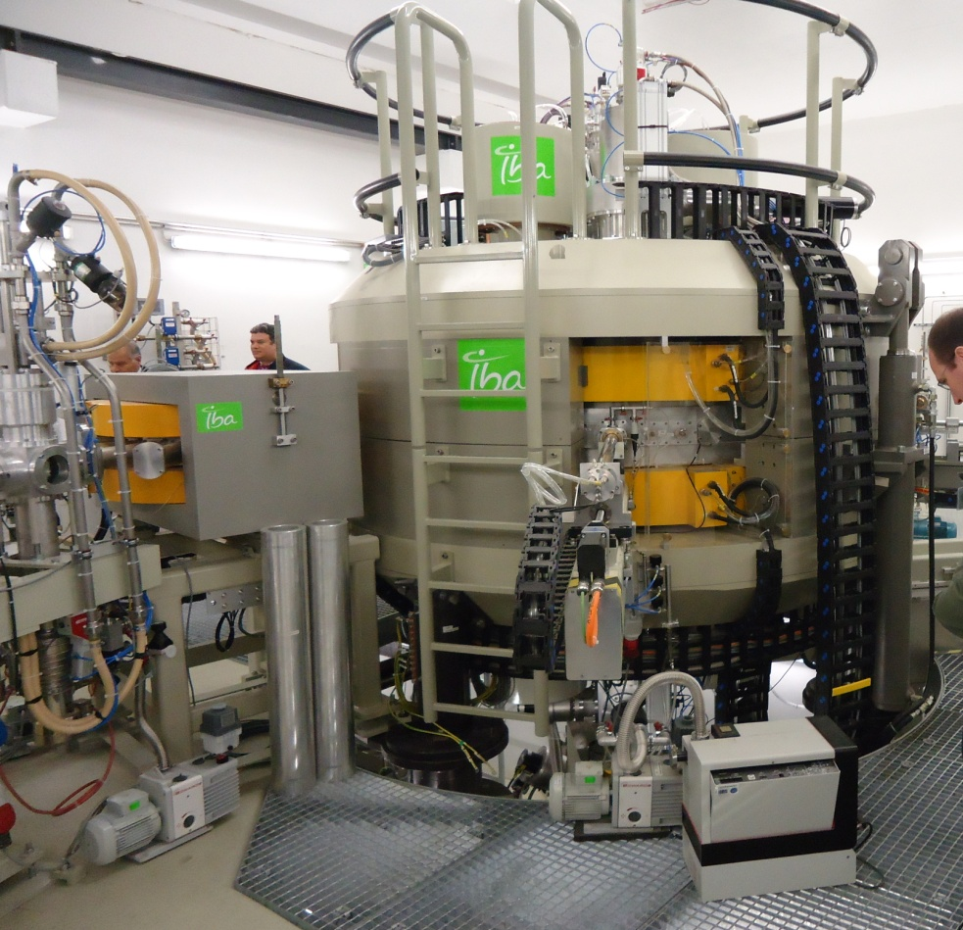
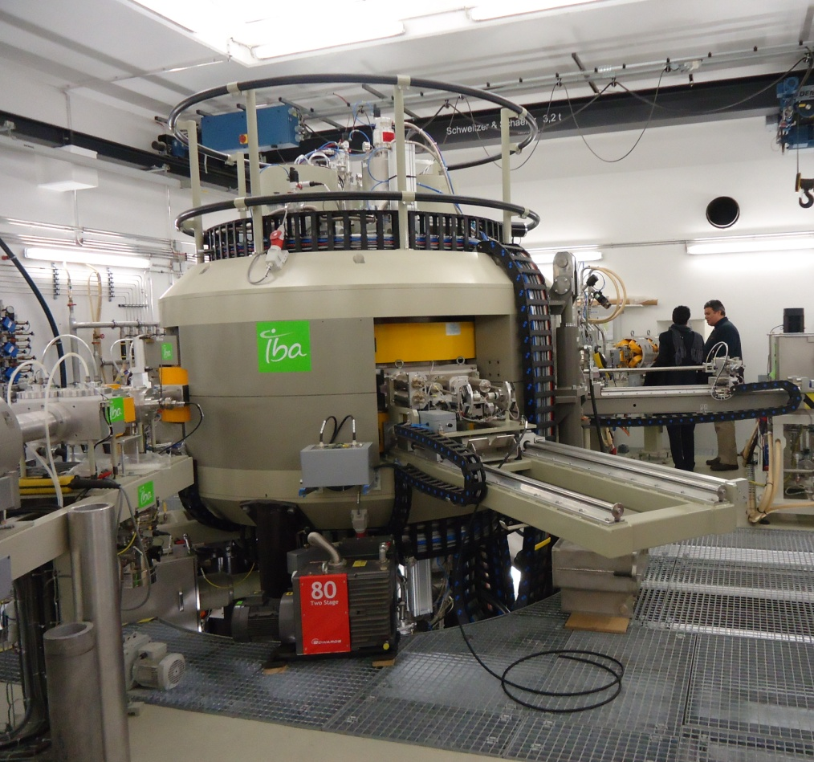
Cyclone 30 XP :
30 MeV proton – alpha – deuteron machine
Cyclotron fully installed with 2 long beam lines, one short line in Jülich Waiting for beam license.
Notes:
Dual Frequency RF system; OK
Ion sources + injection; OK

Slide 50
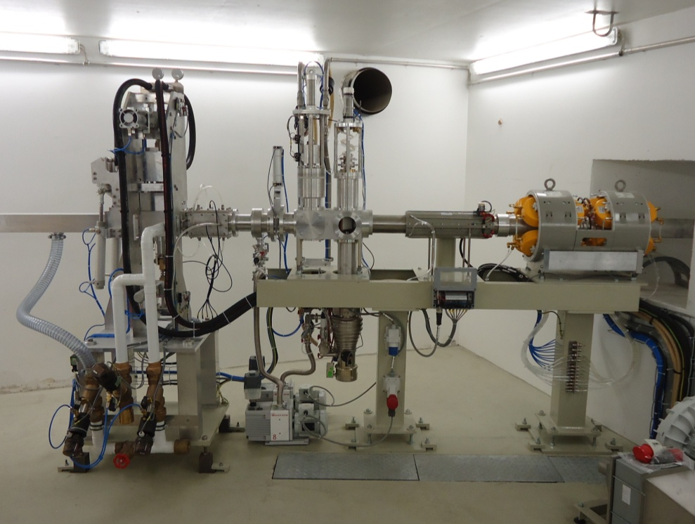
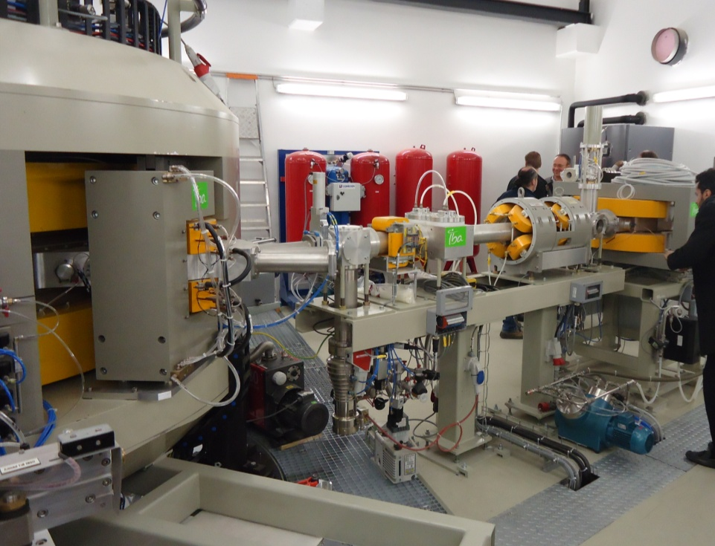
Beam lines and targets
Cyclone 30XP with Solid target high current + PET system
Target technologies
Liquid targets
Solid targets
Gas-targets

Slide 51
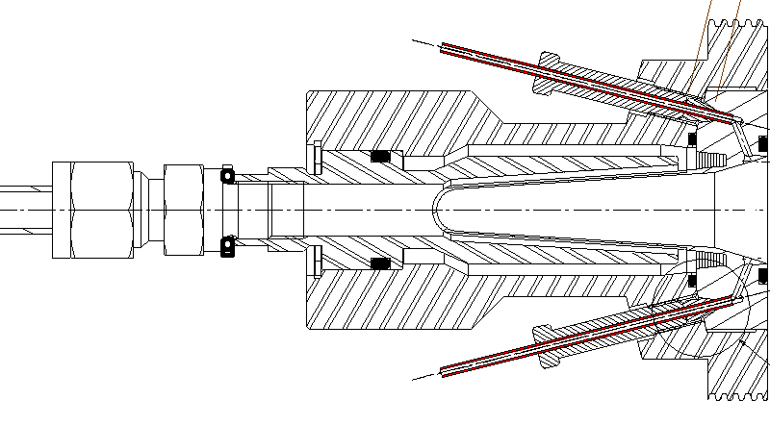
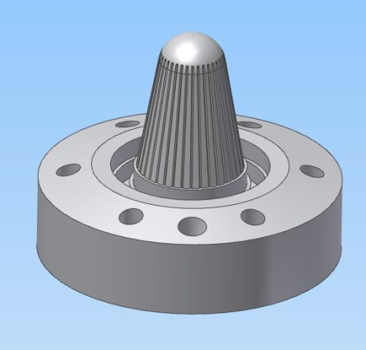
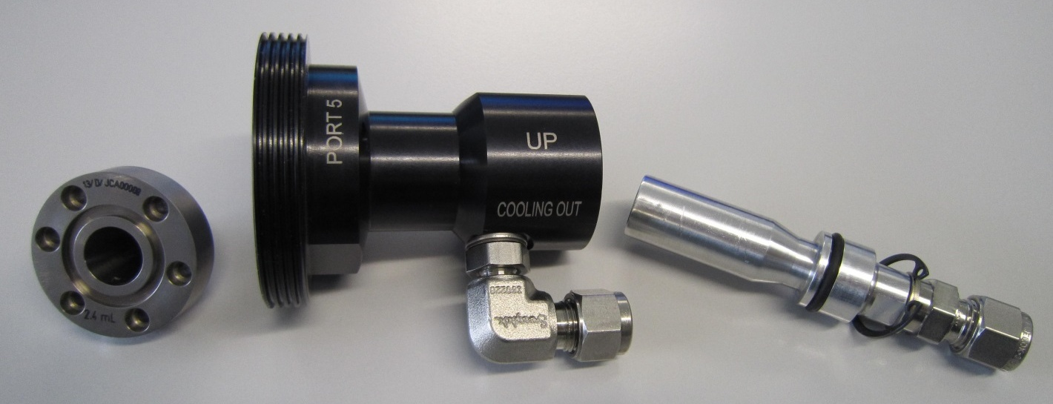
18F target development => liquid target
IBA new Conical shaped [¹⁸O] water targets
He in
H₂O in
foils
He out
¹⁸O(p,n)¹⁸F
Enriched H₂¹⁸O
150 μA, 4ml => 18 Ci ¹⁸F
High pressure (50 bar)
He-window cooling
Water cooiling
International applicationWO2012005970A1

Slide 52
Solid target irradiation

Slide 53
Solid target: ²⁰³Tl(p,3n)²⁰¹Pb => ²⁰¹Tl

Slide 54
¹²³I production using ¹²⁴Xe gas target
¹²⁴Xe(p,pn)¹²³Xe=>¹²³I

