Slide 1
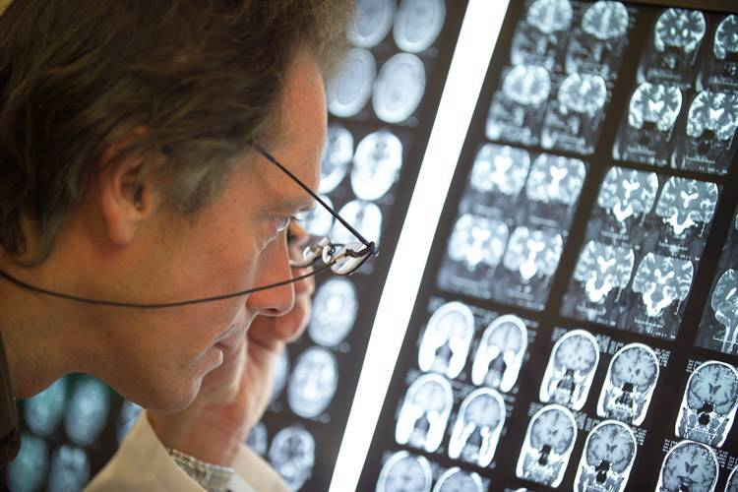
PART IV:
The Superconducting Synchrocyclotron Project S2C2
MID 42331
1

Slide 2
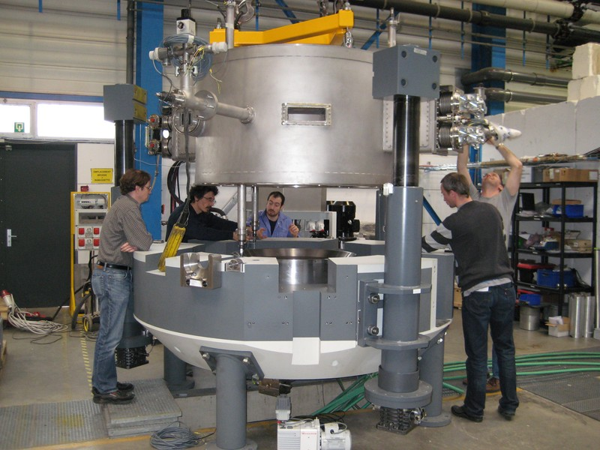
Outline
Intro (ProteusONE® and compact gantry)
Main features and parameters
Subsystems:
      Magnetic Circuit
      Superconducting coil
      RF System
      Ion Source+Central Region
      Extraction System
      Extracted beam line
Current status

Slide 3
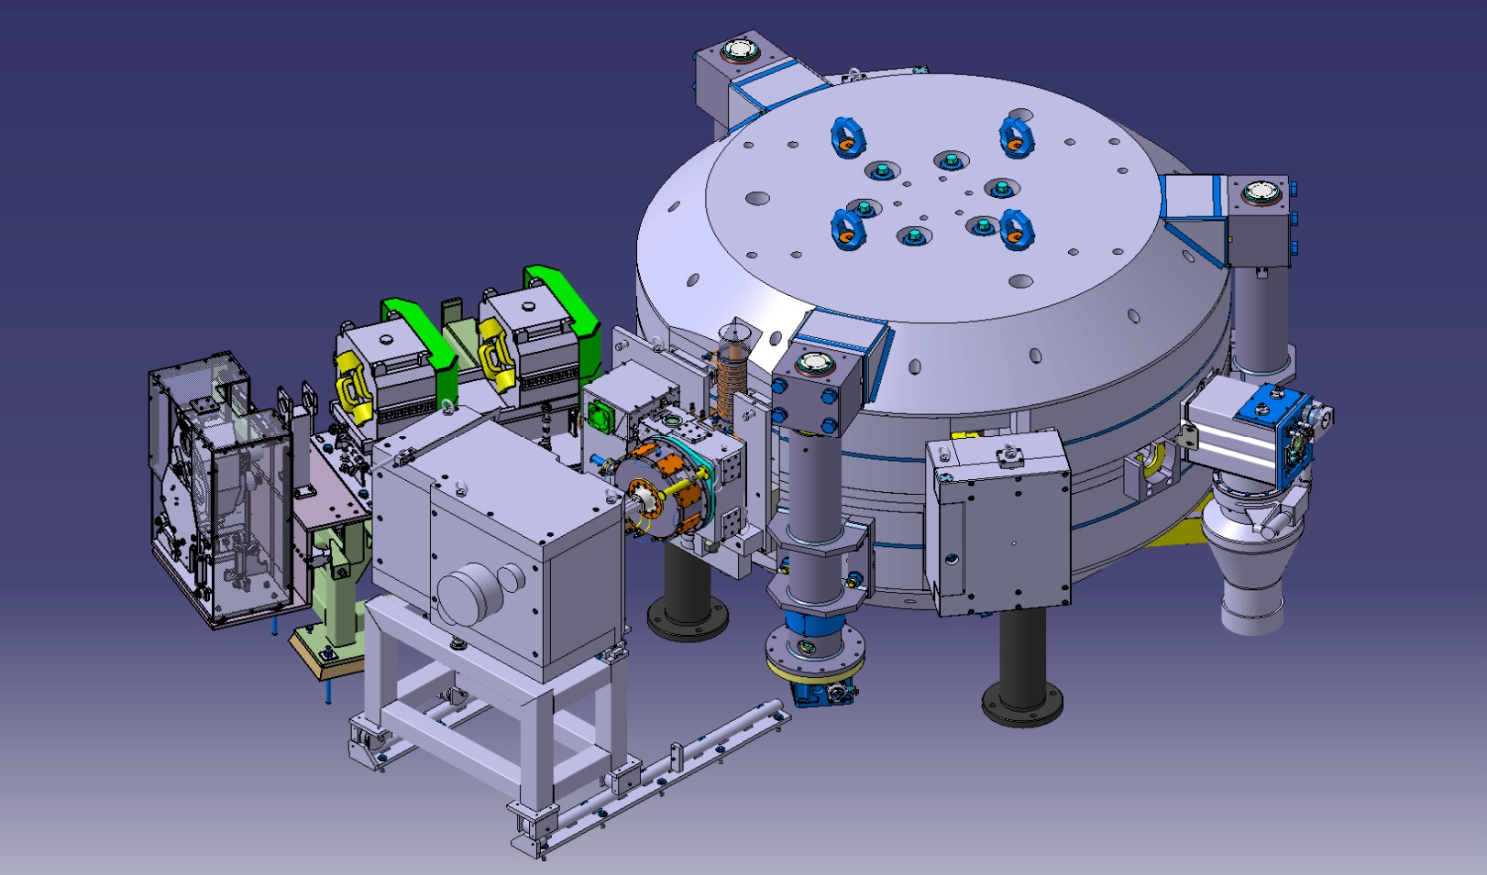
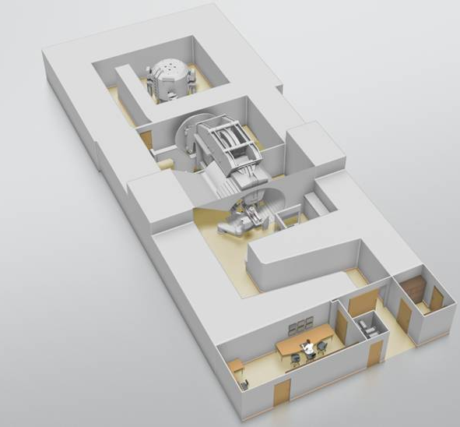
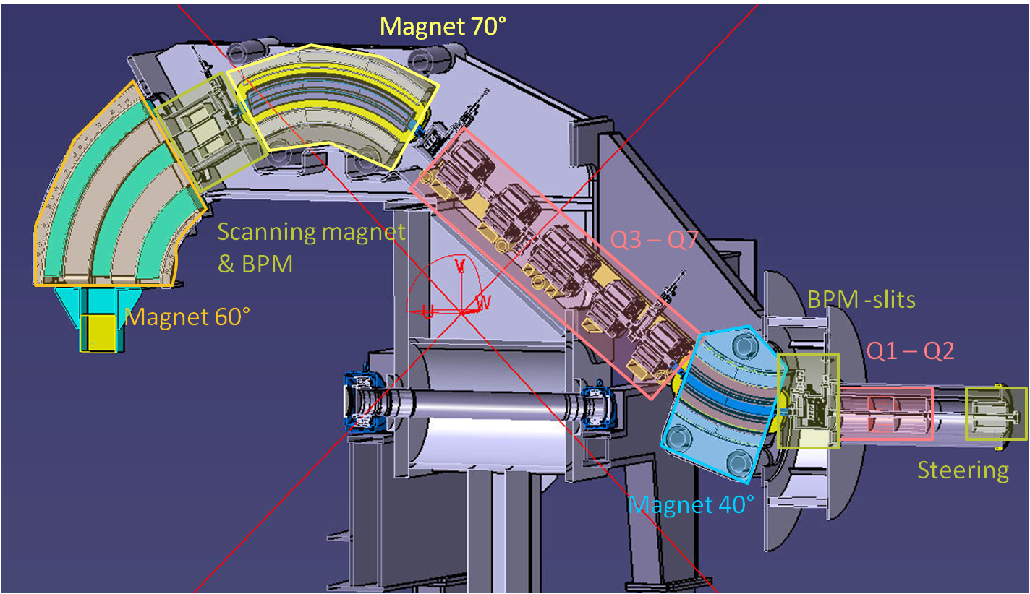
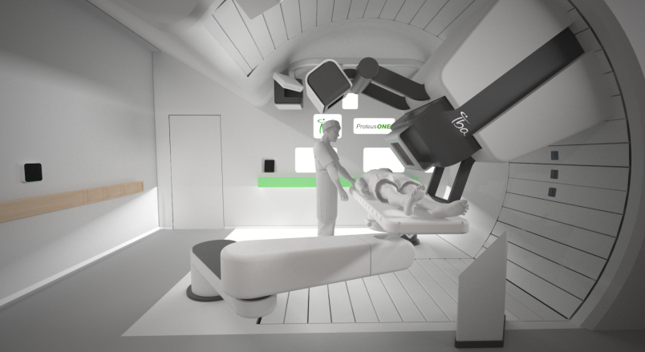
The New IBA Single Room Proton Therapy Solution: ProteusONE®
High quality PBS cancer treatment: compact and affordable
12.8 m
Synchrocyclotron with superconducting coil: S2C2
New Compact Gantry for pencil beam scanning
30.4 m
Patient treatment room

Slide 4
The new compact gantry for pencil beam scanning
Design aimed at reducing footprint and cost
Scanning magnets are placed upstream of the last bending magnet
ESS integrated in the 45 deg inclined part
Rotation angle 220°
Gantry has been fully manufactured and tested. Now installed at the customer site in Shreveport where the beam has already been transported to the gantry isocenter

Slide 5
How a Synchrocyclotron differs from a Cyclotron
Isochronous cyclotron:
  Requires B to increase proportionally to m.
  Requires sector focusing for vertical stability.
  This leads to a smaller average magnetic field, thus a larger structure.
  All parameters being constant, operation is CW.
Synchro cyclotron:
  Requires B to decrease for weak focusing.
  Requires f to decrease during acceleration.
  Smaller structure due to high average magnetic field.
  Acceleration being frequency dependant, operation is pulsed.
5

Slide 6
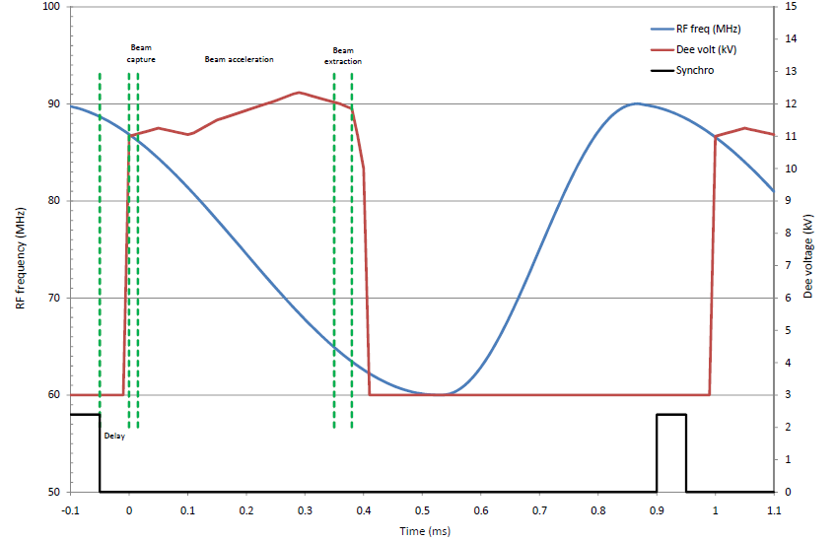
What is a Synchrocyclotron ?
A Synchrocyclotron is a circular accelerator in which the frequency of the accelerating electric field is modulated in order to compensate the decreasing period of revolution of the particles. This decrease is due to the relativistic mass increase and the decreasing field during acceleration.
6

Slide 7
S2C2 overview
General system layout and parameters
An invited talk on this project was presented at the 2013 cyclotron conference in Vancouver
Several contributions can be found on the ECPM2012-website
Notes:
The idea grew in more detailed drawings and specifications, thanks to a fully dedicated team of Physicists and engineers inside and outside IBA

Slide 8
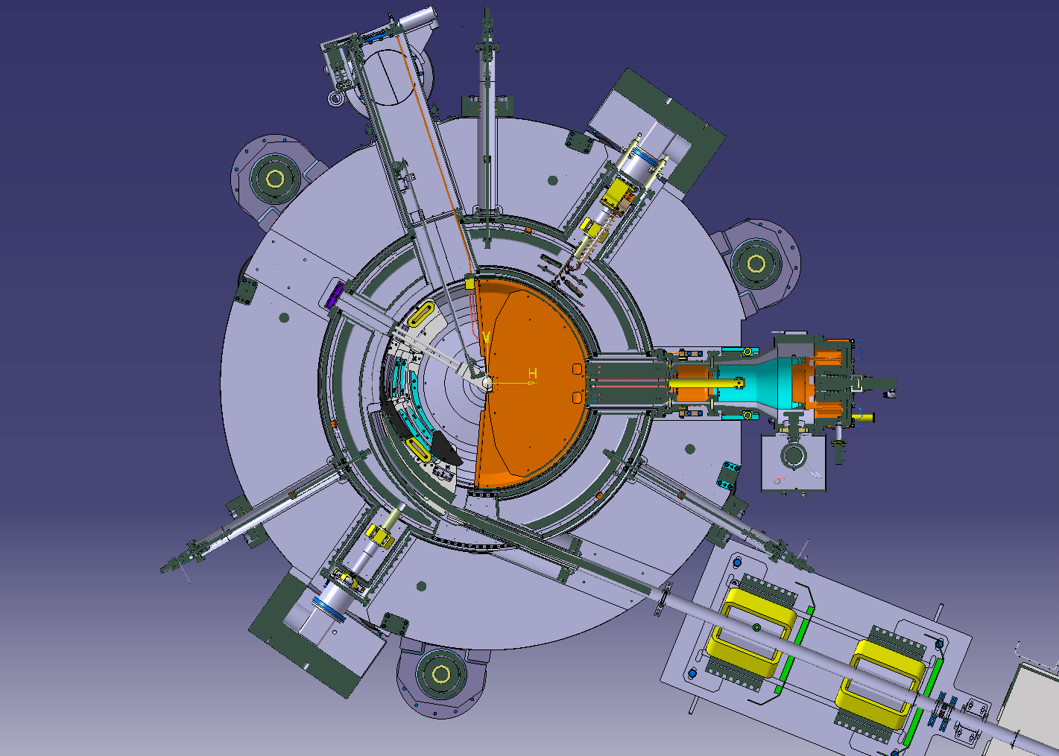
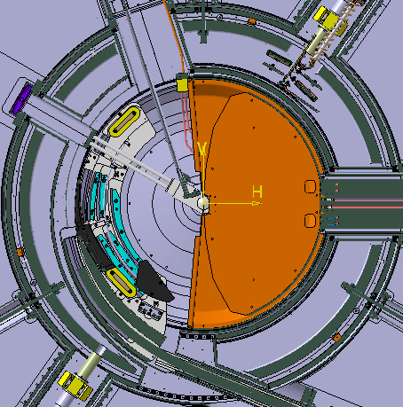
S2C2 overview
Main subsystems
Magnet yoke
Superconducting coil
RF system
Ion source+central region
Extraction system
Vacuum system
Yoke lifting system
Extracted beam line
Notes:
As for every guided tour, a small map is always welcome…

Slide 9
Magnetic circuit-modeling
OPERA3D full model with many details
Long and tedious optimization process
Yoke iron strongly saturated
Influence of external iron systems on the internal magnetic field
Stray-field => shielding of rotco and cryocoolers
pole gap < => extraction system optimization
Influence of yoke penetrations
Median plane errors
Magnetic forces
ITERATIVE PROCESS WITH STRONG INTERACTION TO BEAM SIMULATIONS

Slide 10
Magnetic circuit modeling
Some examples of OPERA2D results
Pole-gap profile
Iron and coil fields
B_{max} on the coil

Slide 11
Magnetic circuit
Forces acting on the coil => implications for tierod design
Unstable forces act on displaced cold mass
  2 tons/mm
Large forces for well-centered coil due to
  External elements
  Extraction system
  Vertical asymmetries
MEASURED
SIMULATED

Slide 12
Magnetic circuit: Centering of the cold mass (1)
An innovative method was developed
Measure profiles in between the coils where the field is coil-dominated
Three ports are available: RF-port, source port and vacuum port
Horizontal centering: measure B_{z}(r) where dBz/dr is maximum
Vertical centering: measure B_{r}(r) where B_{z}=0

Slide 13
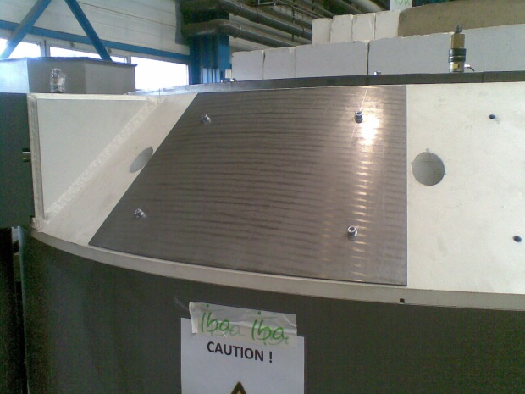
Magnetic circuit: centering of the cold mass (2)
Minimize the vertical forces on the cold mass
Forces are measured with strain gauges placed in the tierod-assemblies
Opera calculations:
  Low vertical forces ⬄ small median plane errors
Vertical forces are reduced by coil-centering and by external shimming
Horizontal forces are large due to extraction system and yoke-asymmetries
During ramp-up coil moves 1.5 mm in to the centered position

Slide 14
Magnetic circuit:
Dynamic behavior studied with Opera2D FE transient circuit model
Ramp up characteristics
Eddy current losses
AC losses in superconductor
Ramp-up characteristics
Quench behavior (qualitative)
Eddy current losses

Slide 15
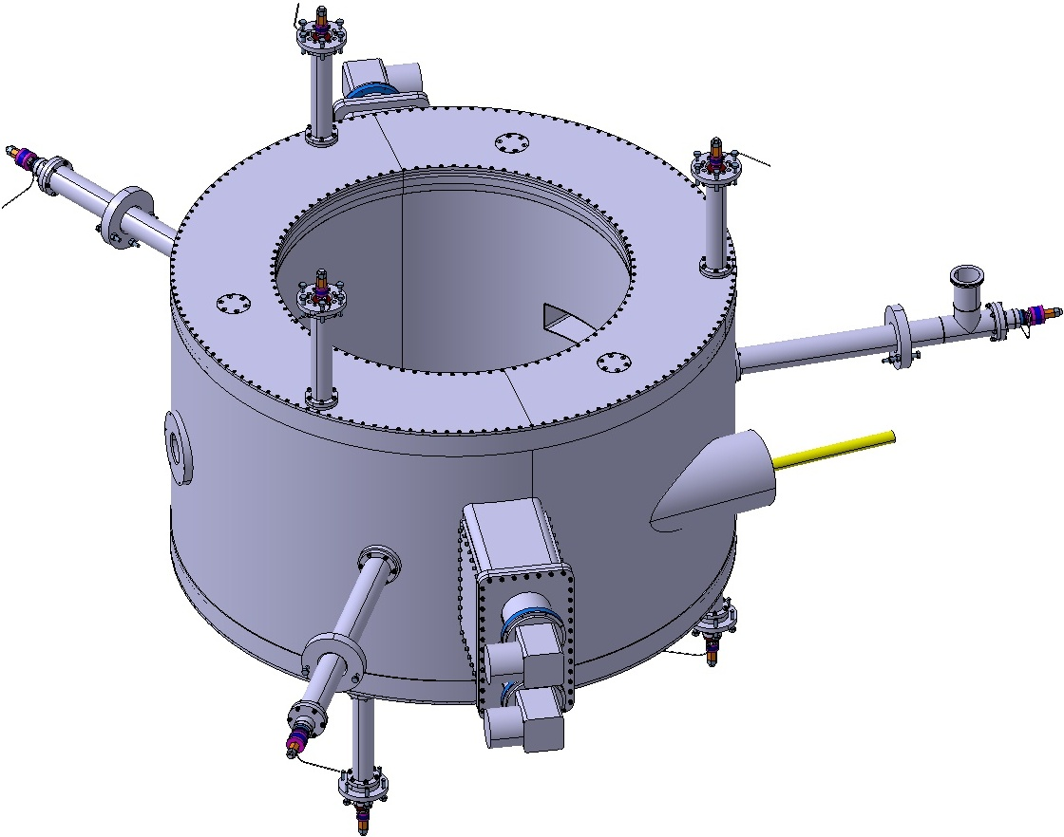
Superconducting coil
Designed and manufactured by ASG (Genua, Italy)
Radial tie rod
NbTi wire in channel coil.
Suspended cold mass: 3tons.
Overall weight: 4tons.
Nominal current: 650A (56 A/mm²).
Nominal ampere-turns: 4.3x10⁺⁶At.
Conduction cooled by 4 SHI cryocoolers.
9 Inconel tension rods with strain gauges.
(radial ø14mm; upper ø8mm; lower ø6mm)
Cryostat is the cyclotron vacuum chamber.
Vertical tie rods
RF system port
Beam exit port
Sumitomo
SRDK-415D
cryocoolers
Notes:
Niobium Titane coils, suspended cold mass of 3 tons though 9 tension rods, energy stored of 10 Mjoules.
The coil is dry cooled thankx to 4 cryo coolers, with cryo compressors stored near by, for compactness, safety
The coil has been fabricated by ASG-geneva
2 on top of each other Cryocooler configuration is to improve conduction path from coil to cold head without affecting the flux return cross section.

Slide 16
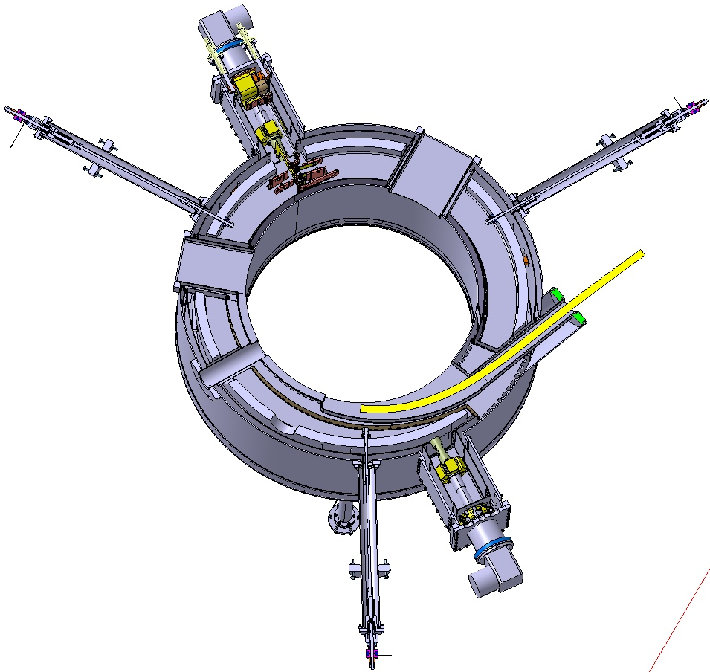
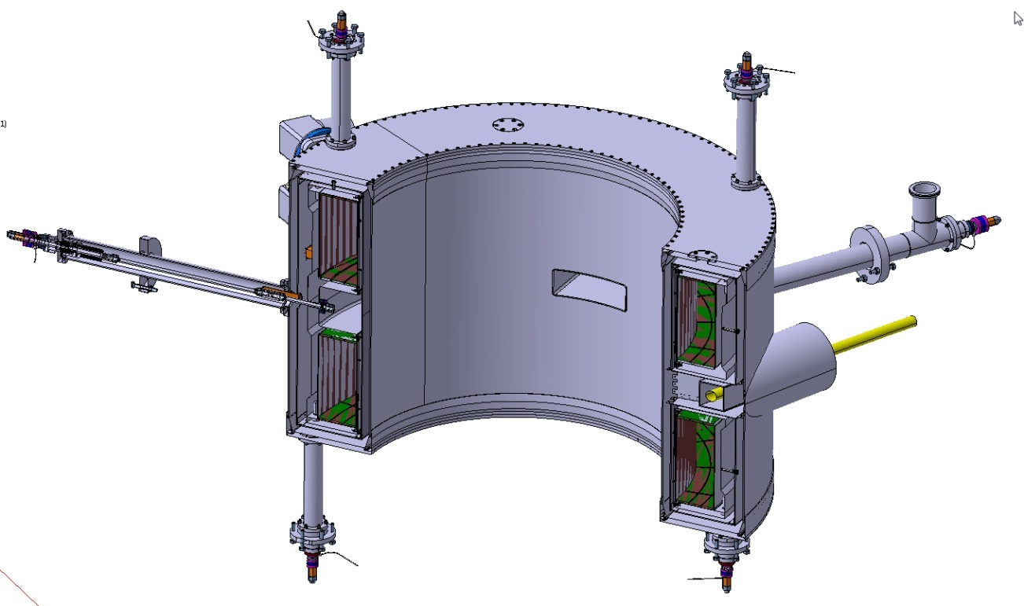
Superconducting coil
Cryostat penetrations
Four cryostat penetrations
  RF port
  Vacuum pumping/radial probe
  Ion source
  Beam extraction
Aluminium coil former

Slide 17
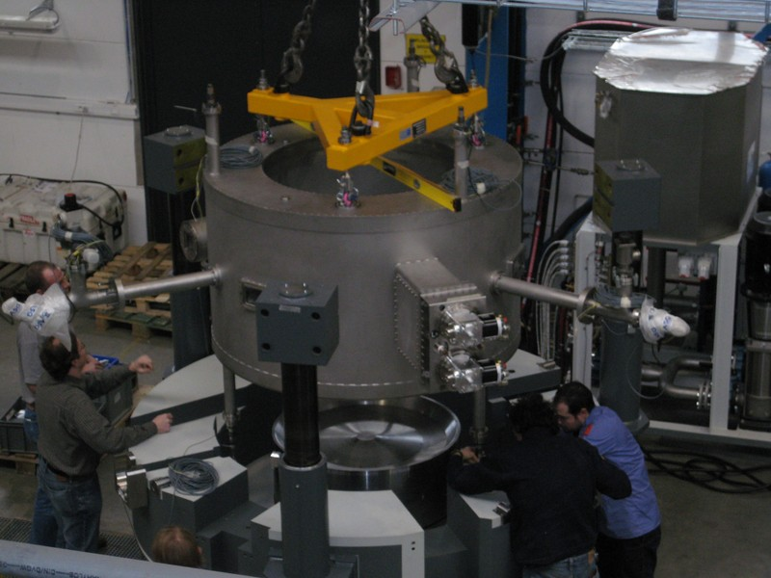
Superconducting coil
Installation of the cryostat in the yoke
Notes:
That was a real tight fit. 1mm clearance between yoke and outer wall of cryostat.

Slide 18
RF-system
A triode-based self-oscillating RF system
λ/2-structure operating in 1th harmonic mode: terminated by the 180°dee on one side and the rotco on the other side
Biased at 1 kVolt to supress mulipactor
Two side stubs provide fine-tuning of df/dt during capture
RF Frequency: 60~90MHz
Modulation frequency: 1kHz
Dee voltage: 3~12kV
Extensively modeled with CST
Placed outside yoke in shielded volume
Fully assembled in cyclotron and tested
RF system on the test bench
Notes:
Work of art of M.Abs and J.Mandrillon.
Self oscillating mecanism with adjustable frequency from 60 to 90 MHz, modulation done through a compact Rotating condenser rotating at 7500RPM.
1kHz pulse frequency. Probably the fasted in the world.
Very low consumption (low Dee and Peak power)

Slide 19
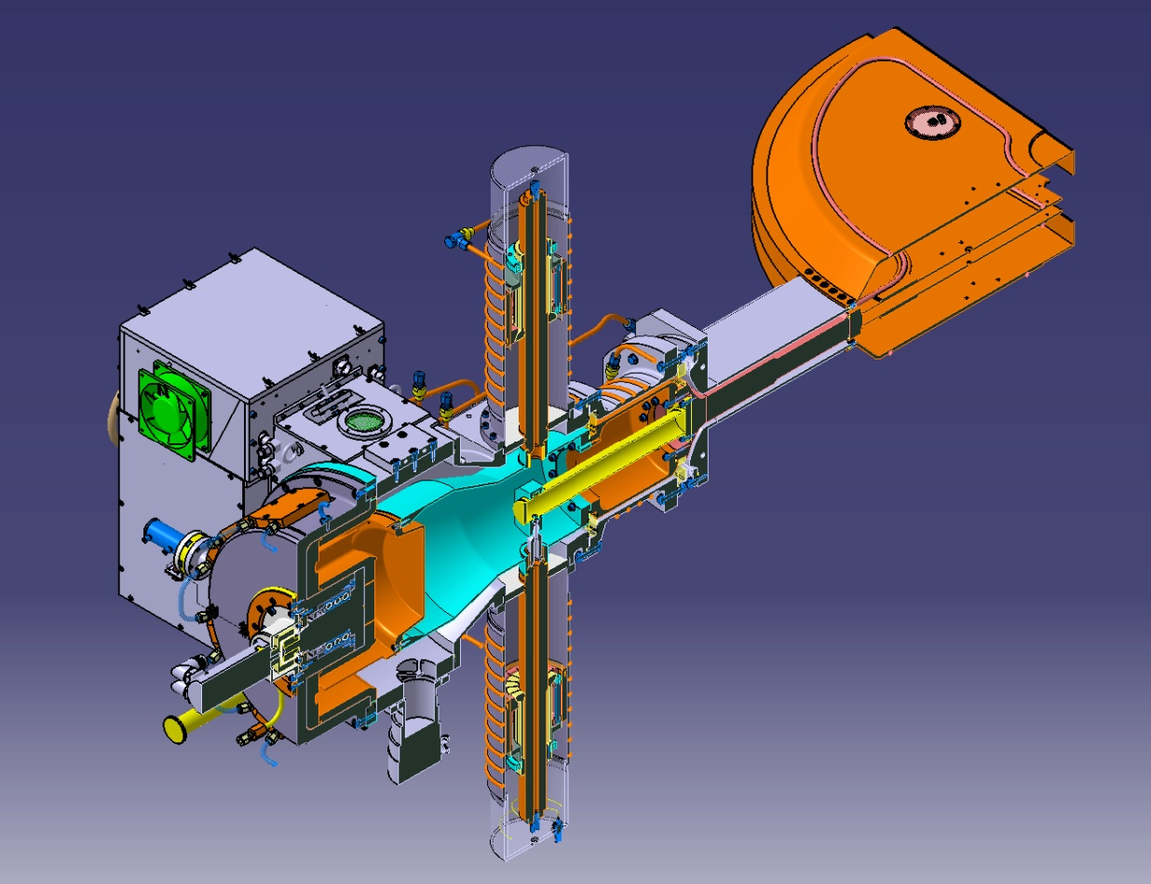
RF-system
layout
Adjustable stub
Oscillator
Pyrometer
Rotco
Servo motor
Turbo pump
Liner
RF pick-up
Dee
Line through cryostat
Vacuum feedthrough
Notes:
Stub allow to modify one end of the frequency span, bring in cooling water to the dee and bring a bias voltage to effectively kill all possibility of having multipactoring inside the RF structure.

Slide 20
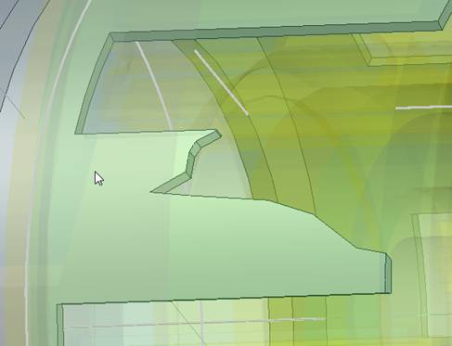
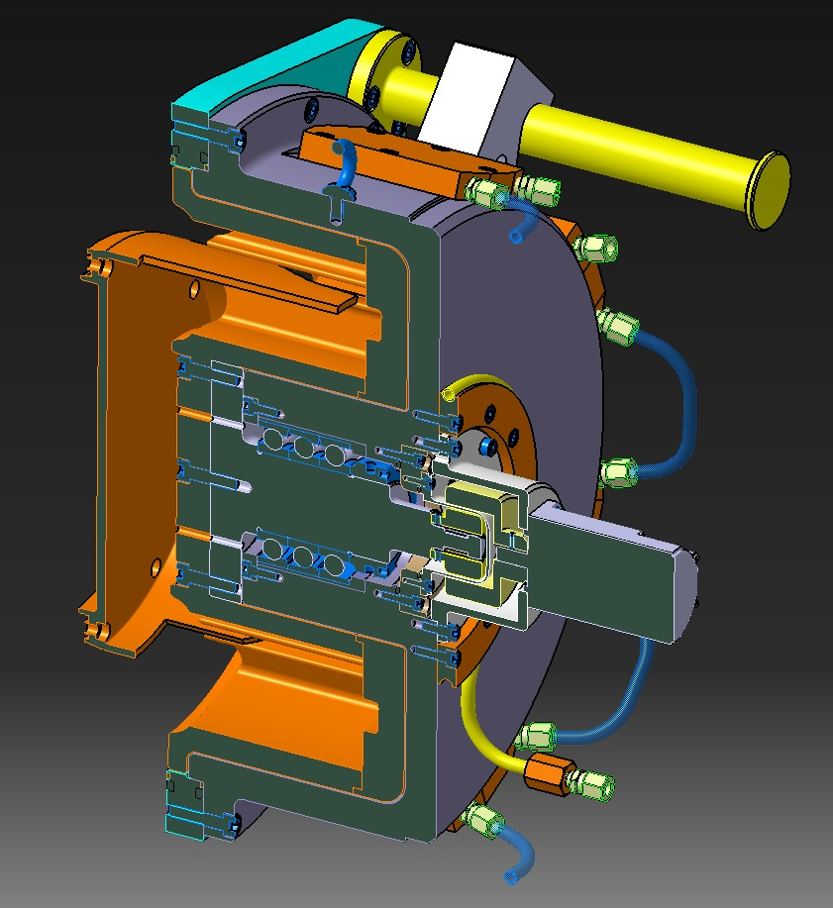
RF-system
Rotco=> Coaxially mounted with 8-fold symmetry
Innovative/patented design:
excellent mechanical stability and good pulse reproducibility
Stator: 8 blades with a carefully designed profile to have the desired df/dt curve.
Rotor: wheel with 2x8 electrodes turning at 7500rpm (1 kHz pulse)
Latest stator blade optimization
Notes:
Difficult to see here what is fixed and was is supposed to rotate. The next slide will make things a bit clearer.

Slide 21
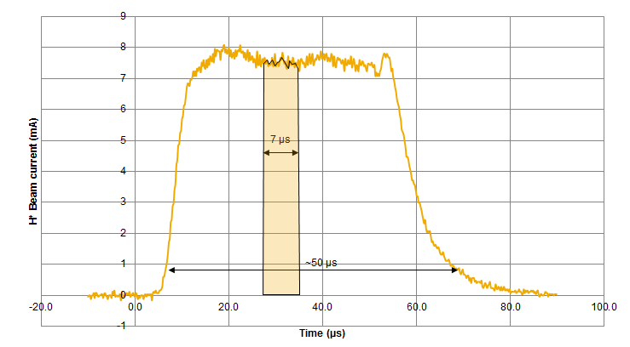
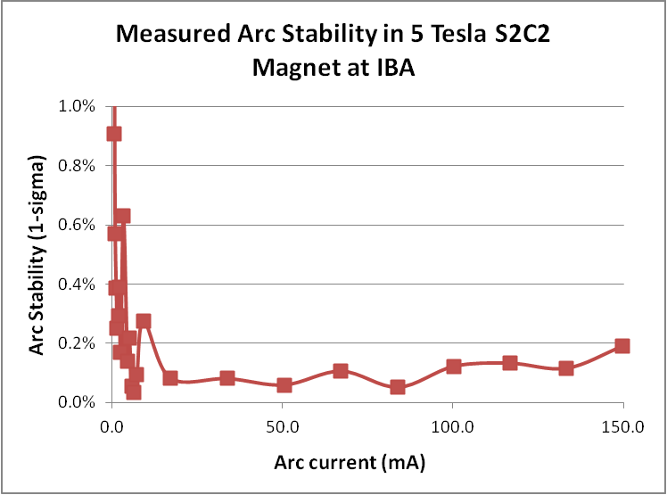
Ion source
Use of cold cathode PIG internal ion source
For fast and precise PBS treatment we want:
  High dynamic range in output current (factor 100)
  Good pulse-to-pulse stability (<1%)
  Fast rise times (< 10 μsec)
Best candidate is cold cathode PIG source:
  Slow thermal effects/decreased thermal drifts
  Long lifetime (less evaporation of cathodes)
  Pulse frequency 1 kHz (synchronized with rotco)
  Pulse duration about 50 μsec
Test-stand measurements:
  Up to 6 mA H⁺ current extracted
  Good reproducibility of plasma impedance
  Very good arc-current stability at 5 Tesla

Slide 22
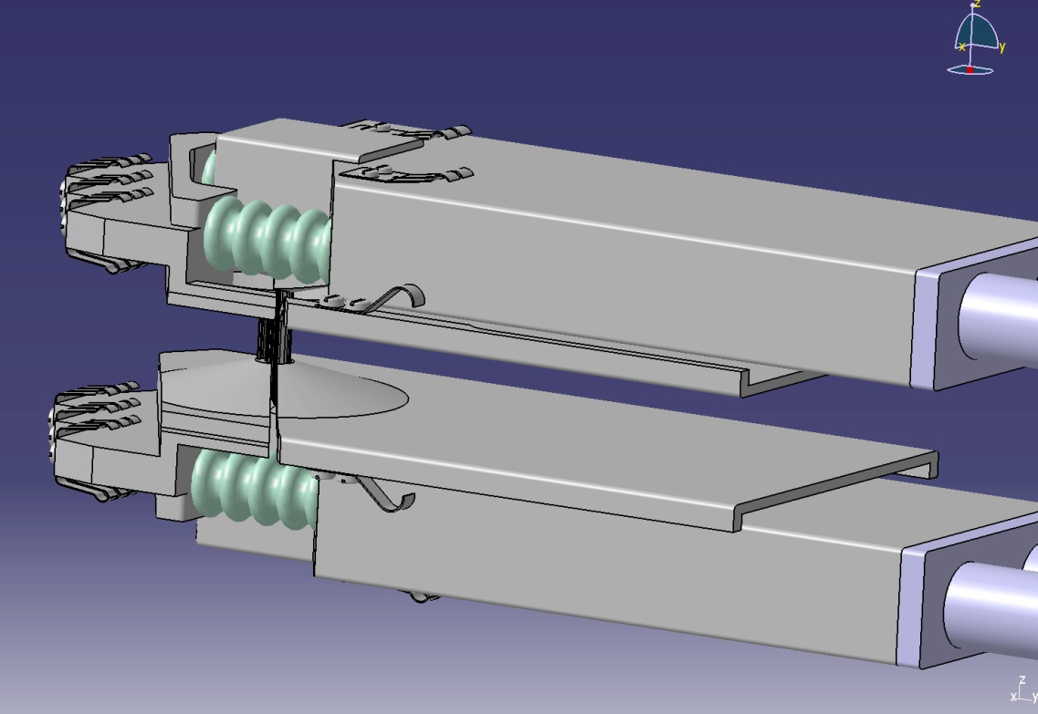
Ion source and central region
Assembly
The Ion Source and the central region, can be extracted as one assembly for easy maintenance and precise repositioning, without turning down the magnetic field.
Insulator
Both dee and counter dee are biased at 1 kV
Puller
Chimney
Source shaft
Part of dee
Polarized counter dee
Notes:
Central region can be adjusted outside and brought inside radially along with the ion source.
Advantage : easy adjustmen outside the machine, high yield (several mAmps)
Contacts to connect puller to dee.
Cones for vertical focusing.

Slide 23
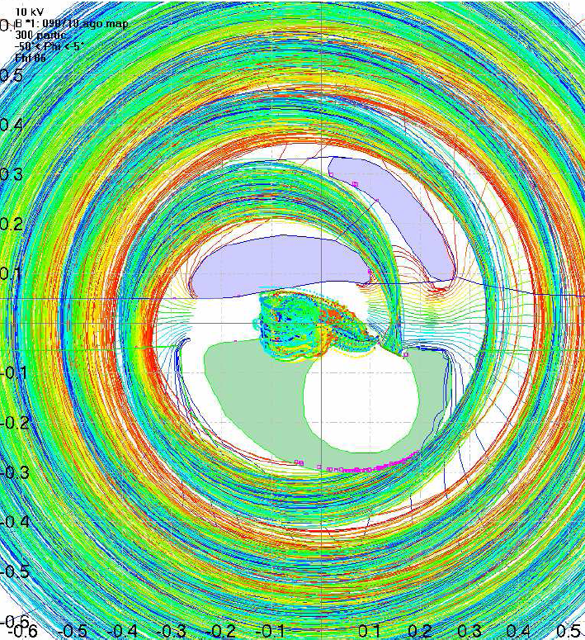
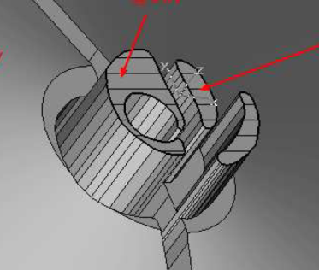
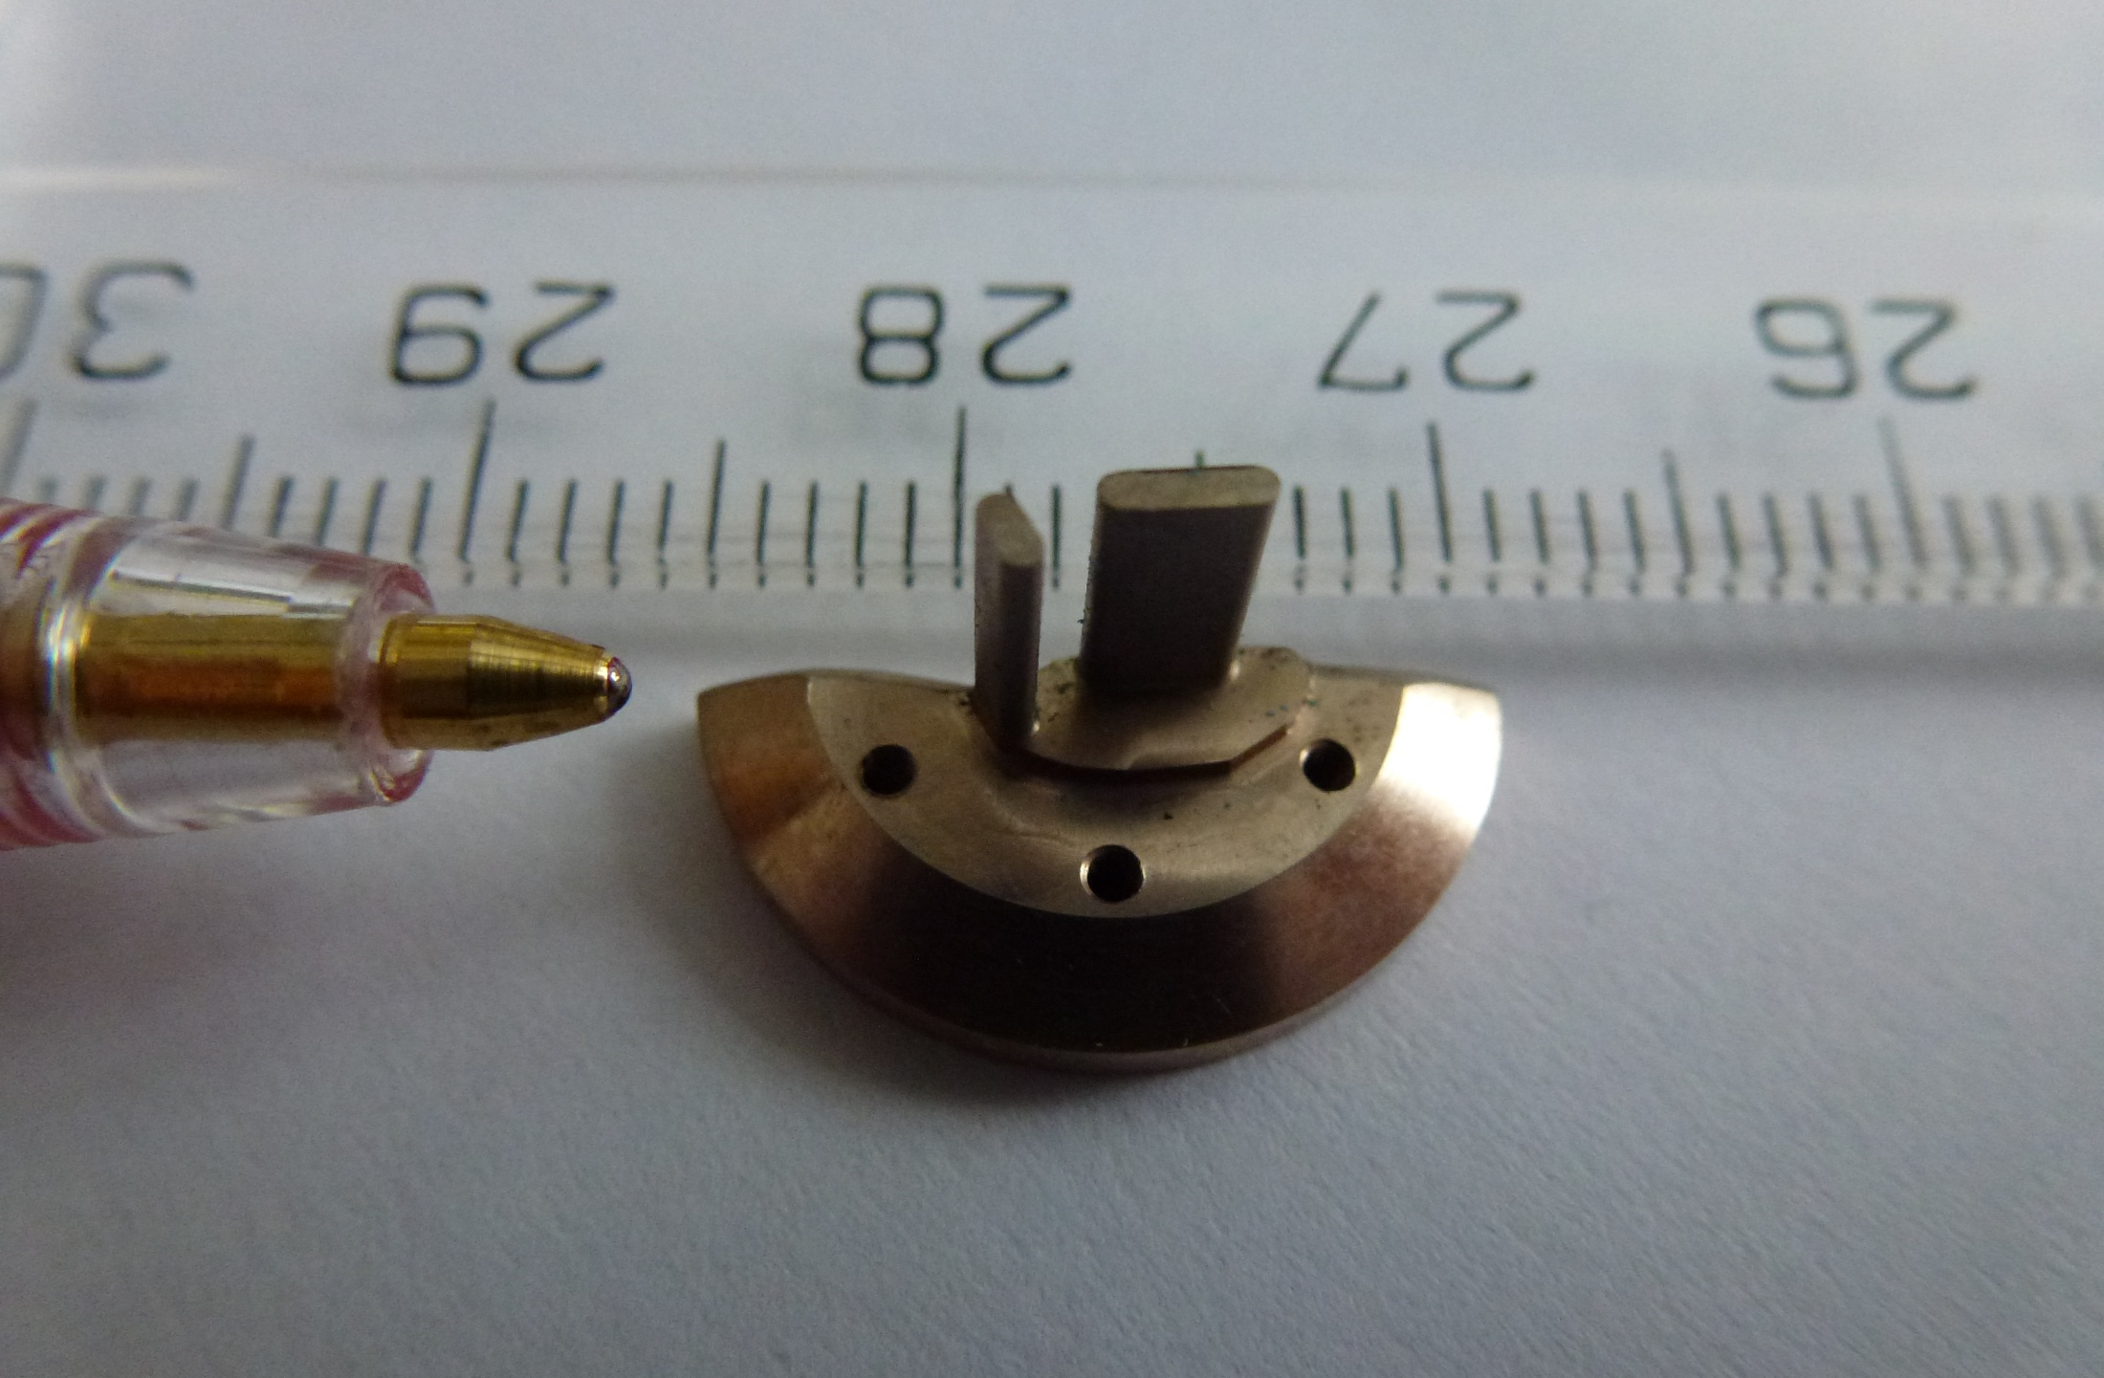
Ion source and central region
Central region size
Due to the high magnetic field (5,74T) and the low dee voltage (11kV), the source has to be extremely compact:
Chimney
Puller
Puller
Chimney
cm
Ø6mm
Source diameter < 5 mm
Vertical gap in the center 6 mm
First 100 turns within a radius of 3 cm
Tapered vertical gaps in the center, to reduce transit time factors
cm

Slide 24
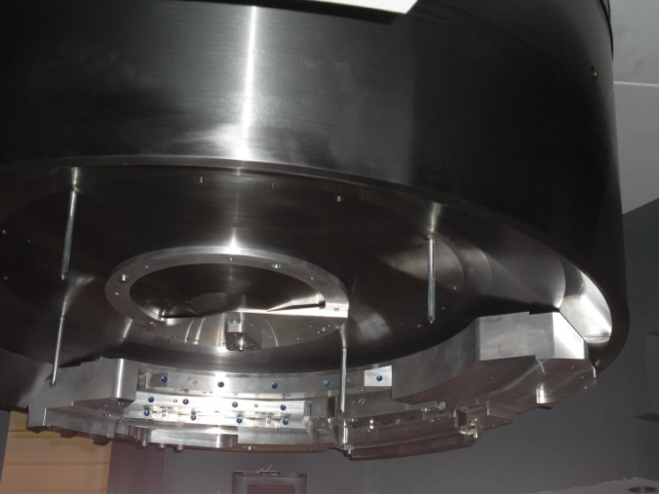
Layout of the extraction system
Fully passive system => only soft iron
Unstable orbit is pushed outward by first harmonic into the extraction channel.
Horizontal focusing by gradient corrector and permanent magnet quadrupole (PMQ) in strongly decreasing field.
Correction bars are needed to reduce strong first harmonic error during acceleration.
Slow acceleration in a synchrocyclotron
=> Electrostatic deflector difficult to use.
Use resonant extraction based on 2Q_{h}=2 resonance.
Strong local field bump produced by regenerator increases horizontal betatron frequency and locks it to unity.

Slide 25
Regenerative extraction based on 2Q_{h}=2 resonance
Regenerator bump increases Q_{h} and locks it to 1
Strong enough field bump => Q_{h}=1
Avoid Walkinshaw resonance (Q_{h}-2Q_{v})
A steady shift of the beam towards the extraction channel builts up

Slide 26
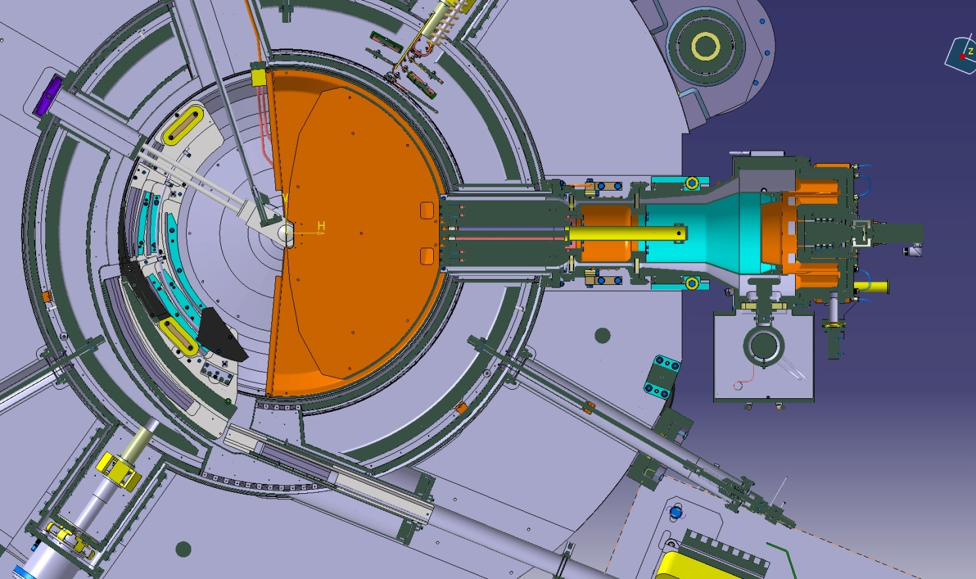
Extraction system
Layout (1)
Harmonic coils
Correction bars
Regenerator
Graphite beam stops
Magnetic septum
Anti-septum
Harmonic coils
3 bar gradient corrector
Notes:
Acceleration os done though 45 cm and Roughly 40000turns is accomplished.
Passive magnetic septum for simplicity, reliability and affordability. and allow the extraction Magnetic Field bump introducted to excite radial oscillation
Graphite Beam Stops to minimize activation of the machine (>50% extraction efficiency)

Slide 27
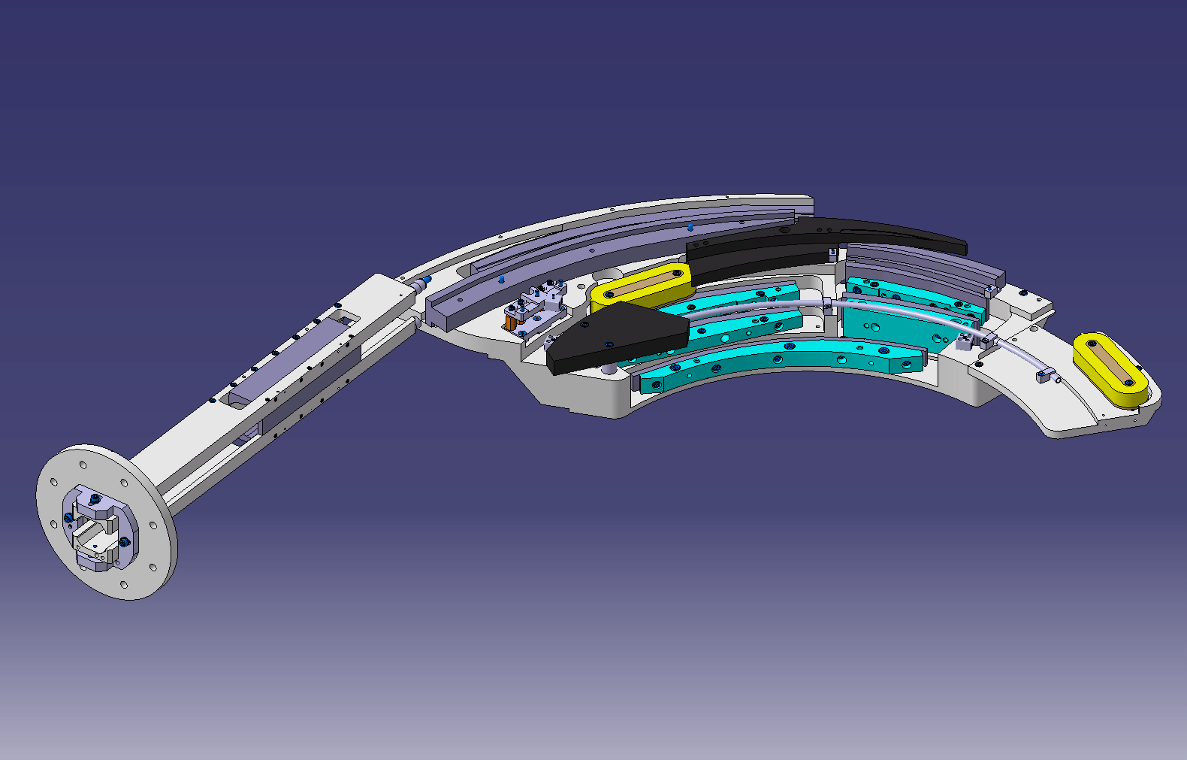
Extraction system
Layout (2)
Graphite beam stop
Septum
Anti-septum
Regenerator
3 bar corrector
Correction bars
Aluminum support frame
Harmonic coil
Notes:
Harmonic coils to steer the beam precisely into the extraction channel.
The extraction will not be without losses so we determined the distribution of these losses and introduced graphite beam stops in areas where they effectively catch most of the scattered beam.

Slide 28
External beam line
layout
A variable energy degrader is placed at 2 meters from the yoke exit
A permanent magnet quad matches the beam phase space with respect to the beam line optics
A quadrupole doublet provides a 1 mm double waist (1-sigma) on the degrader.
A variable horizontal collimator between the two quads cuts the horizontal divergence providing constant optics independent of gantry angle
Full assembly can be shifted aside for access to the quads in the shielding wall

Slide 29
Status after assembly and installation in the
Cyclotron fully assembled and installed in shielded beam test vault (August 2013)
Magnet:
  - Successfully cooled down and ramped up
  - Coil well centered in cryostat
  - Magnet fully mapped, no shimming needed
  - Extraction system fully mapped, no shimming needed
Vacuum system operational
Ion source operational; central region installed
Rotco tested and operational
RF-system installed in cyclotron and tested at full voltage
Cyclotron installed in the shielded bunker
First beam tests started middle of August
The assembled S2C2 in the IBA beam test vault, August 2013

Slide 30
Extracted beam
First extracted beam observed end of August 2013
A few days after the beginning of commissioning, beam extraction was observed by colour change of a radiation sensitive foil at the beam exit window
After beam injection from the PIG source and 40000 turns of acceleration the beam was immediately ejected by the passive extraction system without any major design or other modifications
Measured beam emittances and beam stability are in full agreement with expectations.
Beam has been transported in the external beam line to the position of the degrader
Shipment of cyclotron to Nice March 2014

Slide 31
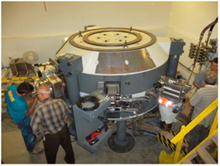
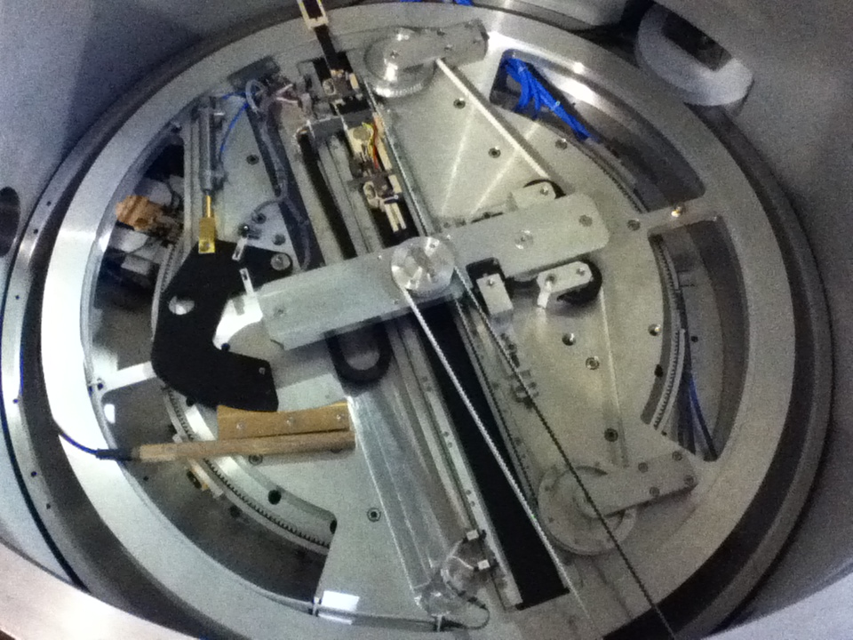
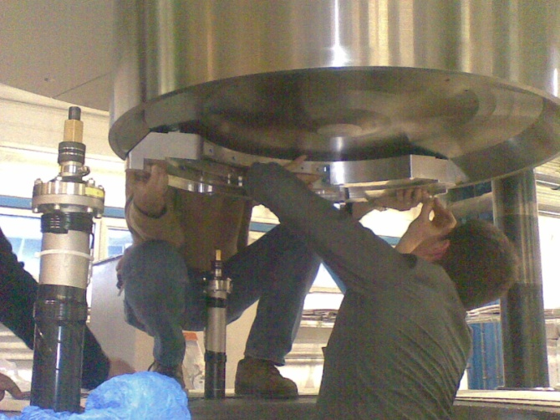
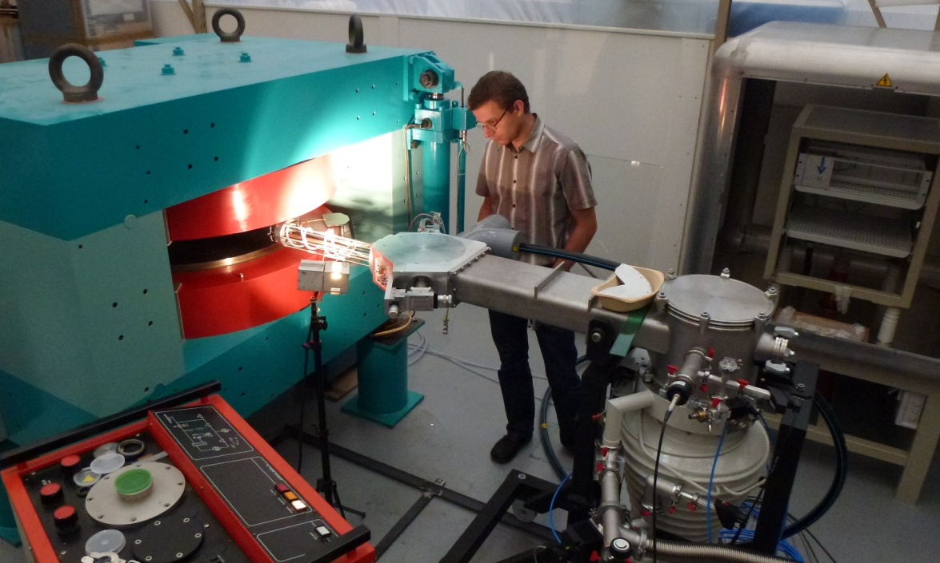
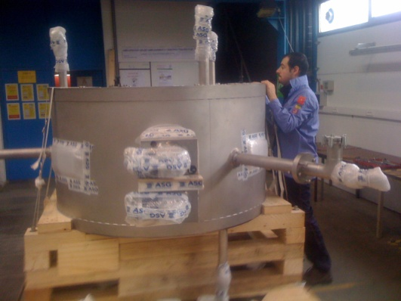
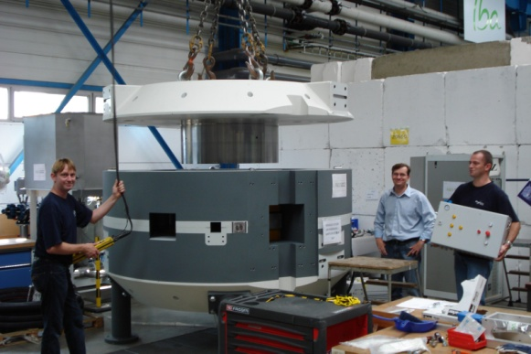
Acknowledgements
A large team of IBA, AIMA and ASG experts have taken part in the design and testing of the S2C2...
Thank you!

