Slide 1
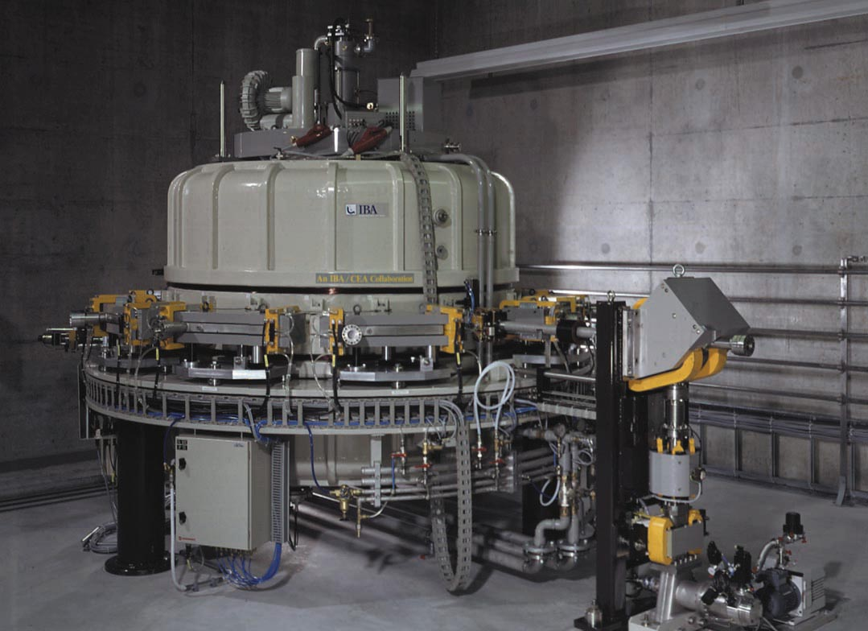
PART V:
Industrial Applications
MID 42332
1

Slide 2
Defining Industrial Applications of Accelerators?
Generally, high energy particle beams induce nuclear reactions and activation
In contrast, in industrial applications, nuclear reactions and activation are undesirable and avoided, but other effects of ionizing radiations are researched
These desired effects include:
  Sterilization
  Cross linking of polymers
  Curing of composite materials
  Modification of crystals
  Improvement of semi conductors
  Beam aided chemical reactions
2

Slide 3
Which beams are used?
The choice of particle beams used in industrial applications is defined, to a large extent, by the desire to avoid nuclear reactions and activation.
Commonly used beams include:
  Electron beams below 10MeV.
  X-Rays from e-beams below 7.5MeV.
  Intense, low energy proton beams.
  Heavy ion beams well below the Coulomb barrier.
Also, for industrial applications, large beam currents/powers are needed to reach industrial scale production rates. Beam powers from 50 kW to 1 MW are common.
3

Slide 4
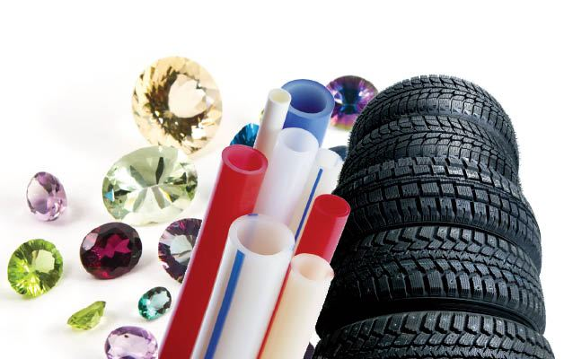
Key E-beam and X-ray Industrial Applications
Sterilization
  Sterilization of Medical Devices
  Surface Sterilization
  Food Pasteurization
E-beam induced chemistry
  Reticulation of Polymers
  Curing of composites
  Environment remediation
E-Beam induced crystal defects
  Improvement of Semiconductors
  Coloring of Gemstones
4

Slide 5
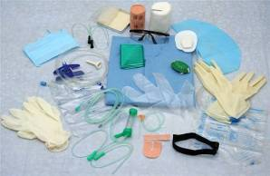
The options for the sterilization of medical devices
Steam (incompatible with most polymers)
Ethylene Oxyde
  Inexpensive
  EtO is explosive, toxic and harmful to the environment
  EtO sterilization may leave harmful residues
Irradiation
  Cobalt
  E-beam
  X-ray
5

Slide 6
The options for sterilization by irradiation (1)
Gammas from Co60 (T_{1/2}=5.2 y; γ₁=1.33 MeV; γ₂=1.17 MeV)
  Low investment cost, specially for low capacities
  Simple and reliable, scalable from 100 kCuries to 6 MCuries (about 5 kg of Co-60)
  Isotropic radiation > inefficiencies in use
  Pallet irradiation, but low dose rate > slow process
  Absolutely no activation
  Cannot be turned OFF > inefficient if not used 24/7
  Growing security concern: the cobalt from a sterilization plant could be used to make dirty bombs
6

Slide 7
The options for sterilization by irradiation (2)
Electron beams
  Directed radiation > Efficient use
  Lowest cost of sterilization for large capacities
  Can be turned OFF > safer
  Short range (4.5 g/cm² at 10 MeV) > 2-sided irradiation of boxes
  More complex dose mapping
  Minimal, hardly measurable, but non zero activation
7

Slide 8
The options for sterilization by irradiation (3)
X-Rays from E-beams
  Excellent penetration
  Simple dose mapping
  Pallet irradiation
  Directed radiation > Efficient use
  Loss of a factor 10 in energy when converting e-beams to photons
  Cost of sterilization higher than electrons
  Cost of sterilization is generally higher by X-Rays than Cobalt if used 24/7, excepted for very large capacities
  Can be turned OFF > safer
  Minimal, hardly measurable, but non zero activation
8

Slide 9

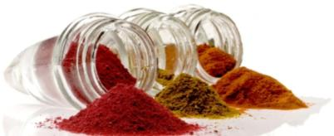
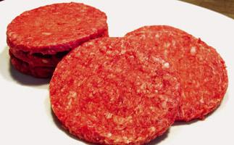
Food irradiation applications
Low Dose Applications (< 1kGy)
  Phytosanitary Insect Disinfection for grains, papayas, mangoes, avocados...
  Sprouting Inhibition for potatoes, onions, garlic...
  Delaying of Maturation, parasite disinfection.
Medium Dose Applications (1 – 10 kGy)
  Control of Foodborne Pathogens for beef, eggs, crab-meat, oysters...
  Shelf-life Extension for chicken and pork, low fat fish, strawberries, carrots, mushrooms, papayas...
  Spice Irradiation
High Dose Applications (> 10 kGy)
  Food sterilization of meat, poultry and some seafood is typically required for hospitalized patients or astronauts.
9

Slide 10
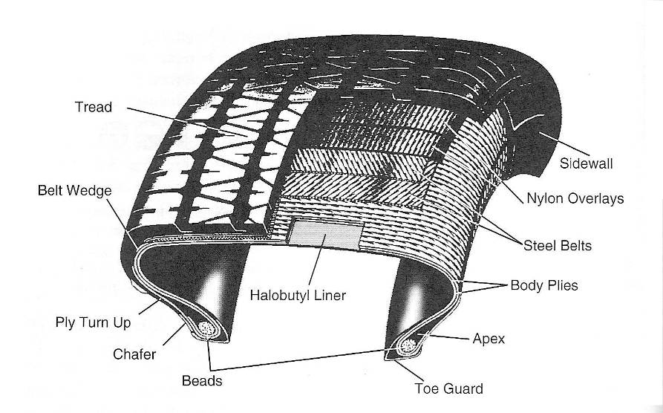
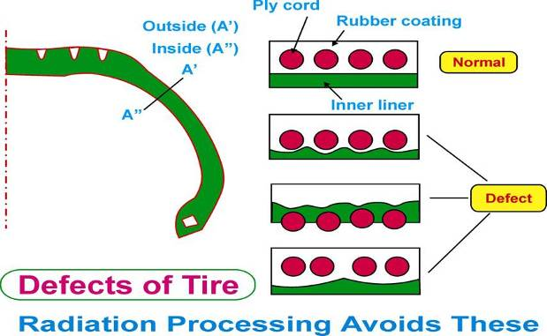
E beam treatment of Tires
Reduction in material hence in the weight of the tire
Relatively low cost synthetic rubber can be used instead of costly natural rubber without a loss in strength
The radiation pre-vulcanization of body ply is achieved by simply passing the body ply sheet under the scan horn of an electron accelerator to expose the sheet to high-energy electrons
Higher production rates
Construction of green tires
Reduction of production defects
10

Slide 11
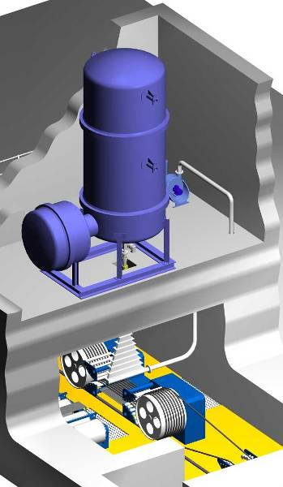
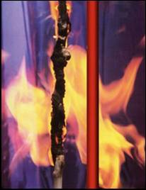
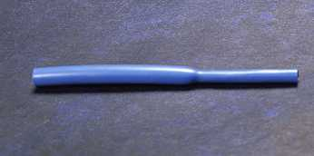
Polymer Cross-Linking
Wires stand higher temperature after irradiation
Pipes for central heating and plumbing
Heatshrink elastomers are given a memory
11

Slide 12
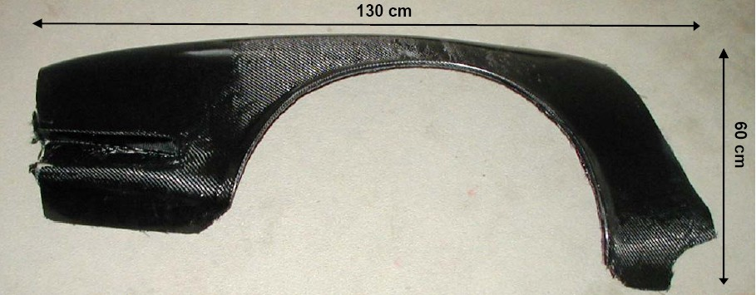
Composite curing: X-ray Cured Carbon Fiber
Sports Car Fender made light, restistant and requiring less fuel
12

Slide 13
E-beam irradiation improves SC switching speed
TµSec
T- XµSec
T- 2XµSec
ON
Volts
OFF
no added
irradiation
X kGy
of e-beam irradiation
2X kGy
of e-beam irradiation
Typical semicondutors:
  fast recovery diodes
  power diodes
  Bipolar power transistors
  power MOSFETs
  power rectifiers
  IGBT’s
  thyristors
  silicon-controlled rectifiers
13

Slide 14
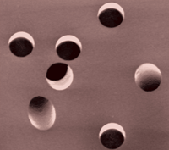
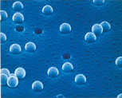
Microfiltration membranes by heavy ions
Heavy ion beams are used to produce track-etched microfiltration membranes, commercialized i.a. under the brand name “Cyclopore”
In these membranes, tracks of slow, heavy ions crossing a sheet of polymer are chemically etched, giving cylindrical pores of very accurate diameter
14

Slide 15
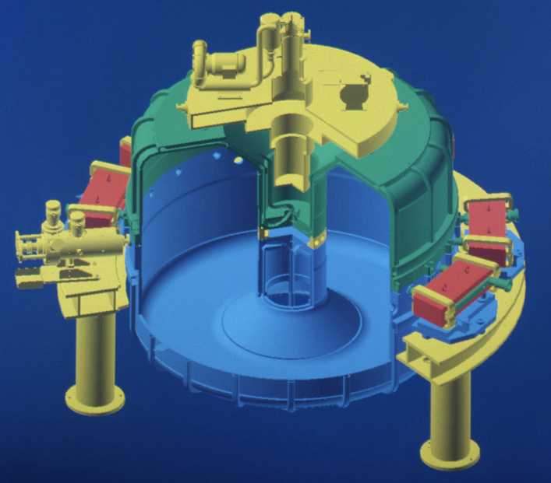
High power E-beam accelerators: 1) the Rhodotron
Typical applications of the Rhodotron:
  Modification of polymers
  Sterilization of medical devices
  Preservation of foods
  Treatment of waste materials
  Gemstones and semiconductors
15

Slide 16
Acceleration principles
E
B
Electric (E) and magnetic (B) fields in Rhodotron coaxial cavity

Slide 17
Acceleration principles
D
E
E
G

Slide 18
Acceleration principles
Operating principle (2)
D
G
Inversion of the electrical field

Slide 19
Acceleration principles
D
E
E
G

Slide 20
Acceleration principles
D
E
E
G
Deflection of the electrons
Inversion of the electrical field

Slide 21
Acceleration principles
D
G

Slide 22
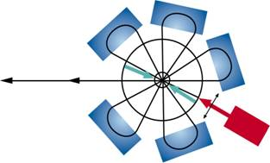
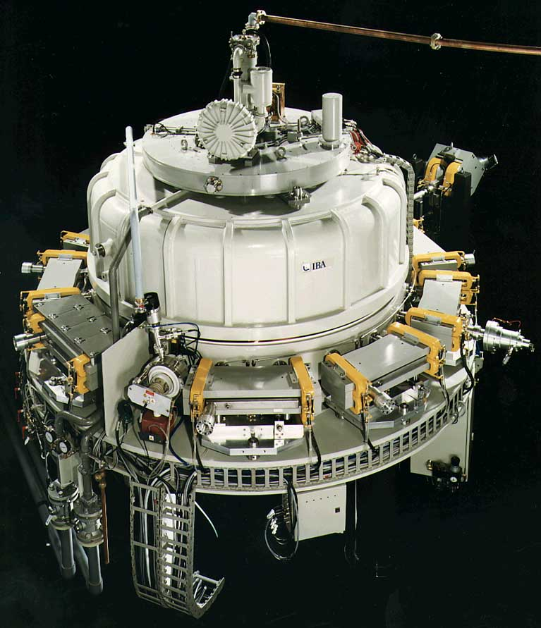
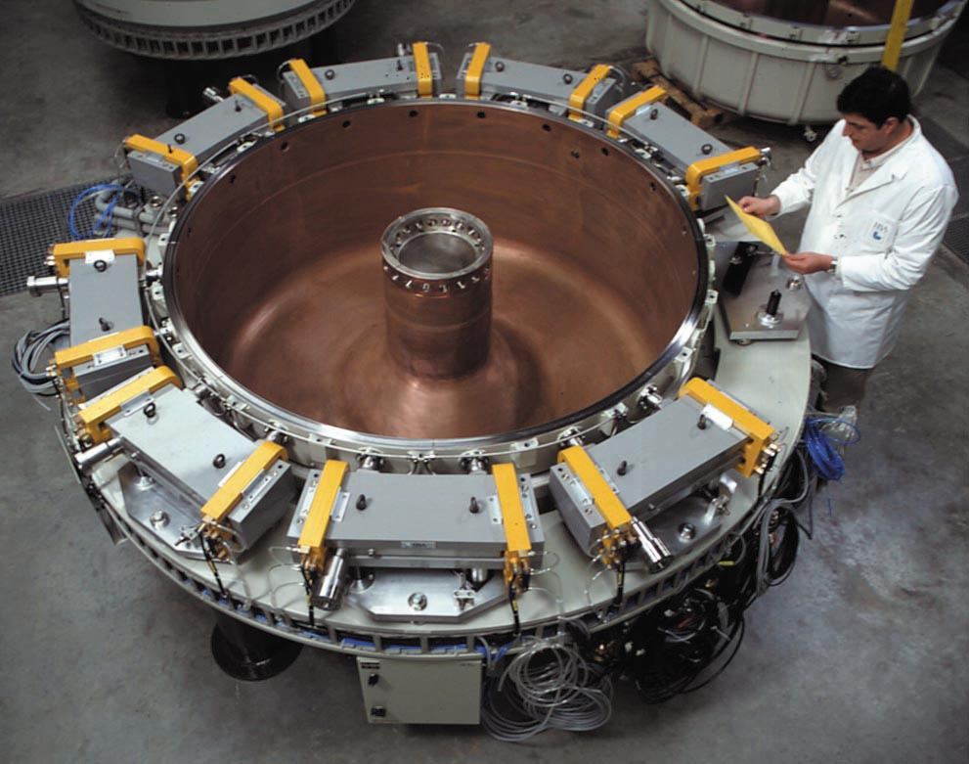
Rhodotron
TT200 – TT300
22

Slide 23
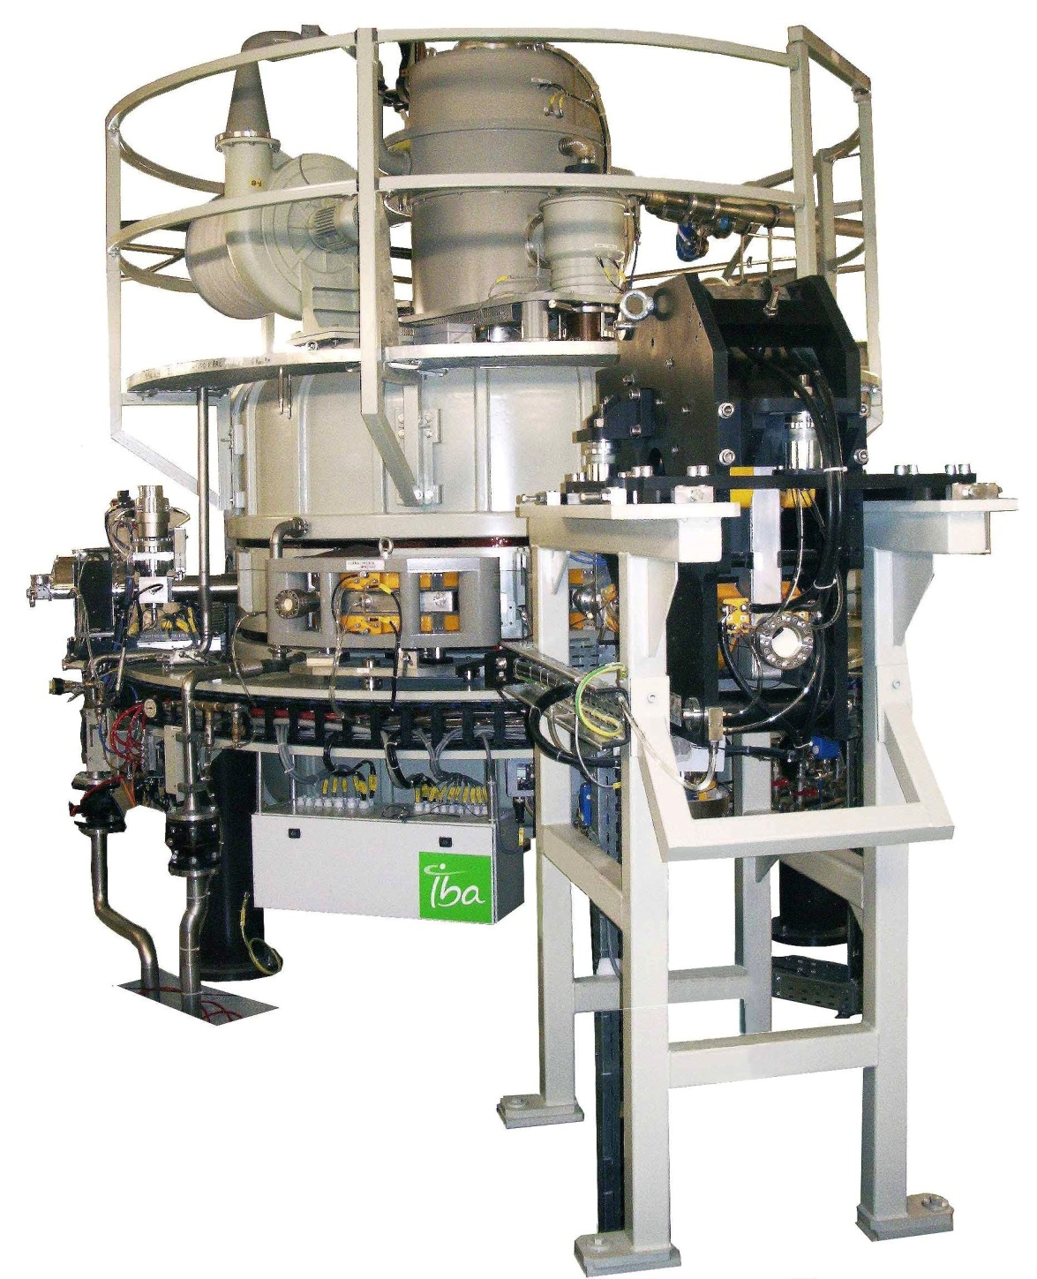
Rhodotron
TT1000
23

Slide 24
Rhodotron
TT100 TT200 TT300 TT1000
Beam energy (MeV) 3~10 3~10 3~10 2.4~7
Maximum beam power (kW) 35 80 190 700
Design value (kW) 45 100 200 1000
Cavity diameter (m) 1.60 3.00 3.00 3.00
Cavity height (m) 1.75 2.40 2.40 2.40
Weight (T) 2.5 11 11 12
MeV/pass 0.833 1.0 1.0 1.167
Number of passes 12 10 10 6
Electrical power at full beam <210 <260 <440 <1300
24

Slide 25
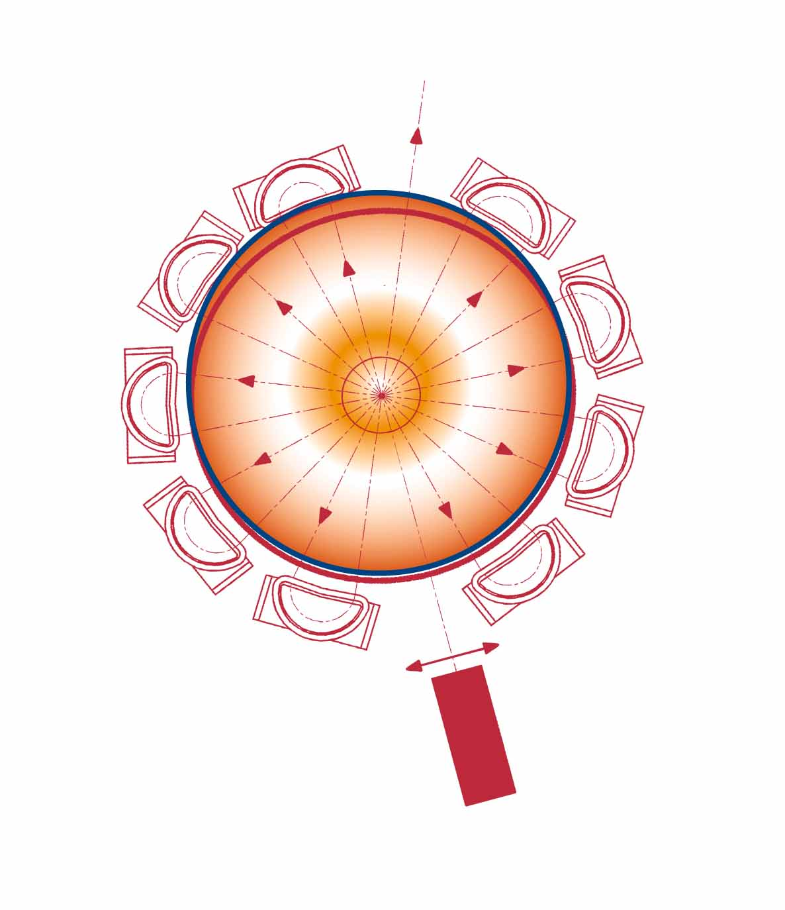
Rhodotron
Multiple checks on beam energy
  Each magnet is a energy filter
25

Slide 26
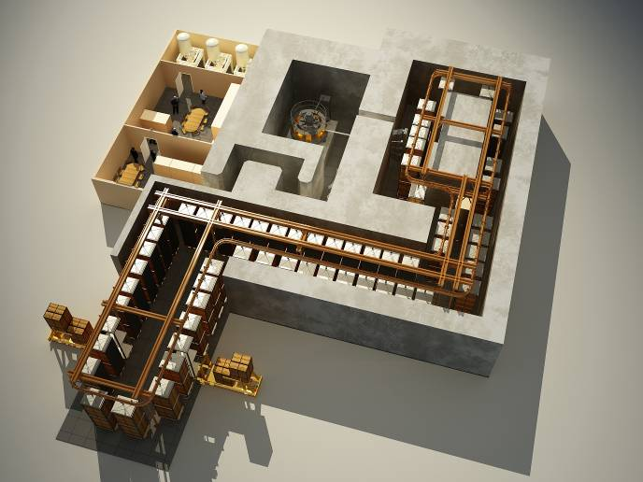
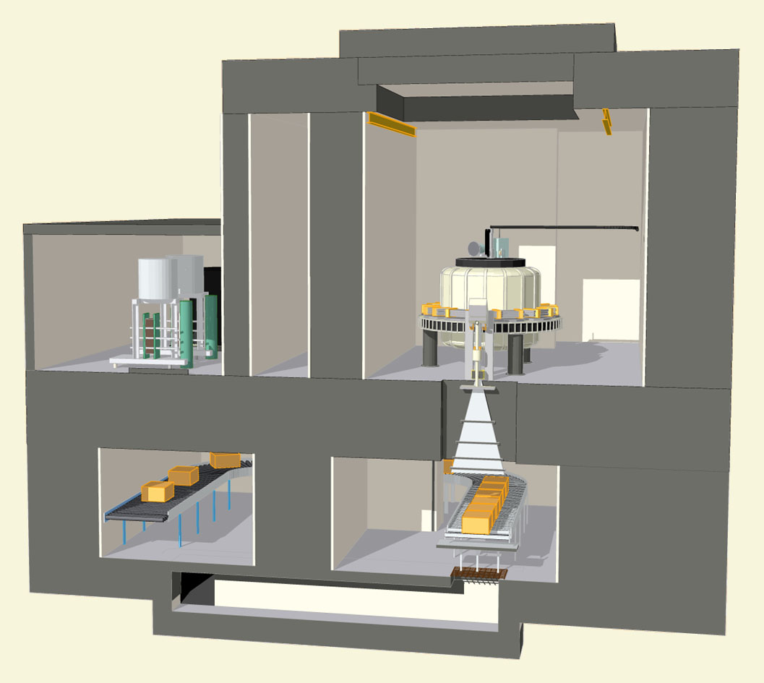
Rhodotron: typical layouts of irradiation centers
Irradiation from the side
Irradiation from above
Spreading of the beam by a magnetic scanning system
26

Slide 27
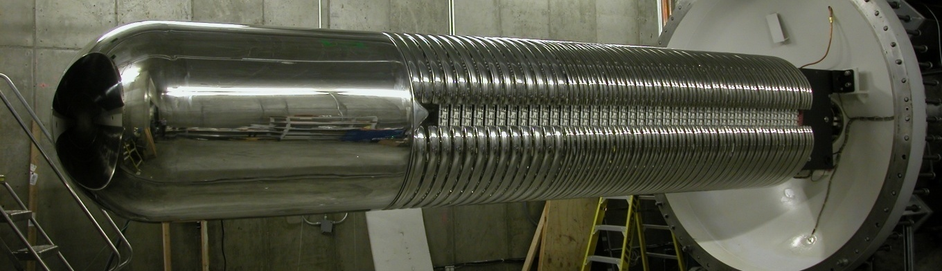
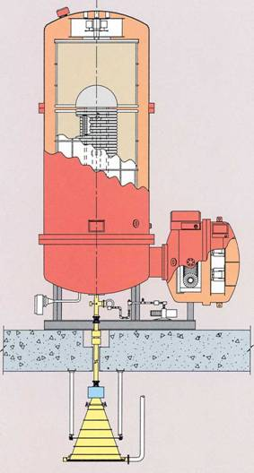
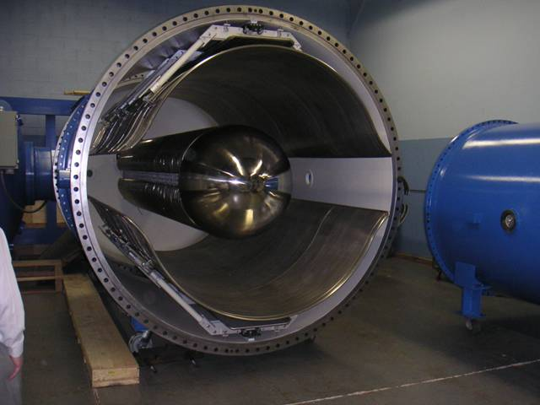
High power E-beam accelerators: 2) the Dynamitron
27

Slide 28
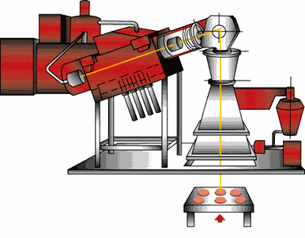
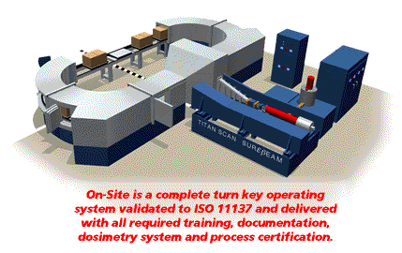
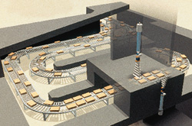
High power E-beam accelerators: 3) the Linacs
28

Slide 29

Thank you !
Wiel Kleeven
Senior Accelerator Physicist
willem.kleeven@iba-group.com
www.iba-worldwide.com

