Slide 1

Accelerators for Medical and Industrial Applications
JUAS
Archamps, March 4th 2014
Wiel Kleeven
MID 42328

Slide 2
Organization of the lecture
Intro: About IBA
Part 1: Radioisotopes for medical applications
  Diagnosis and molecular imaging
  Radioisotopes for cancer therapy
Part 2: Cyclotrons for Isotope production
Part 3: Particle therapy of cancer
Part 4: The ProteusOne and S2C2 project
Part 5: Industrial applications of electron beam technology

Slide 3
Foreword
In this lecture, I cannot present an exhaustive overview of all possible applications of accelerators
I will mainly limit myself to subjects where IBA has first hand experience

Slide 4
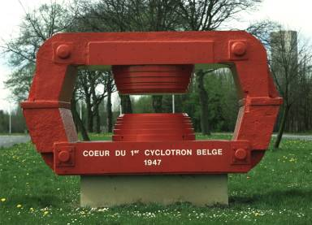
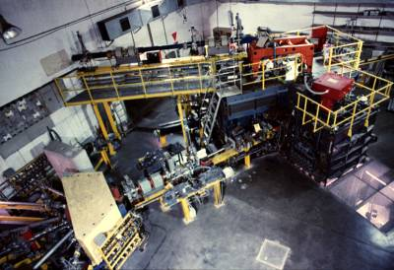
Belgium has a tradition and important know how in civil nuclear applications
Belgium is one of the first European countries to install a cyclotron in 1947
SCK/CEN Research centre for nuclear energy (MOL), founded in 1952
Cyclotron Centre at LLN was started in 1970
CRC CYCLONE-110
Thomson-CSF
p 65 MeV, d 50 MeV, α 110 MeV
Yoke of first cyclotron in Belgium

Slide 5
Foundation of IBA
1986 => spinoff from the CRC at UCL (Catholic University of LLN)
Start of IBA => Cyclone 30: a revolutionary cyclotron for medical isotopes => 5 x more output and 3 x less power consumption
Founder Yves Jongen currently IBA Chief Research Officer and recognized global leading accelerator expert

Slide 6
The origins of IBA
The initial company ambitions in 1986 were modest:
  Build one cyclotron per year
  Maximum 15 employees
  Business of 1.5 to 2 M€ per year
  Getting rich was not part of the initial objectives, but having fun clearly was…
  …and in this respect, we were quite successful !
6

Slide 7
The IBA Group in 2014
1200 employees worlwide
Turnover > 220 M€ and growing steadily every year
More than 300 systems (200 Cyclotrons) installed
Not anymore just a cyclotron company, but a company focused on medical technology for the fight against cancer:
  Cancer diagnostic: molecular imaging
  Cancer treatment: Particle therapy & dosimetry
More than 400 patents in use
Listed on Euronext Brussels
http://www.iba-worldwide.com
7

Slide 8
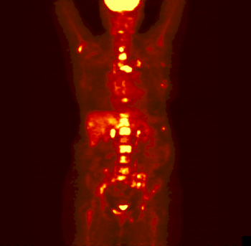
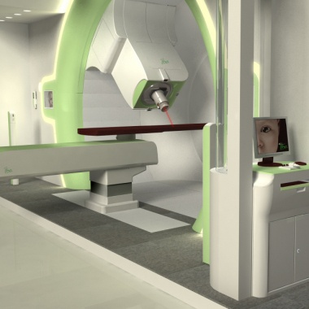
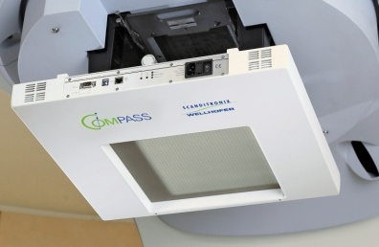
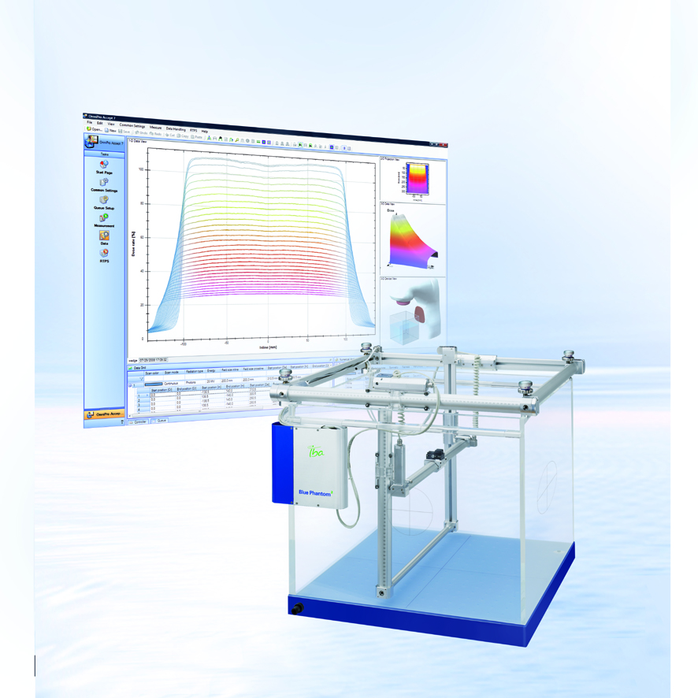
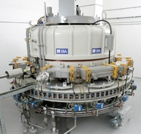
IBA Today: Centering on the fight against cancer
Pharmaceuticals
Particle Therapy
Proton Therapy is increasingly considered as the ultimate radiotherapy for cancer due to its superior dose distribution
Radiopharmaceuticals
Molecular Imaging
Nuclear Medicine (diagnostics & therapy )
Dosimetry
Accelerators
Dosimetry equipment
to measure and calibrate radiation dose for
Radiotherapy
Radiodiagnostics
Cyclotrons
To produces Radioisotopes
E-beam / X-rays
To irradiate / treat many industrial products
8
Notes:
8

Slide 9
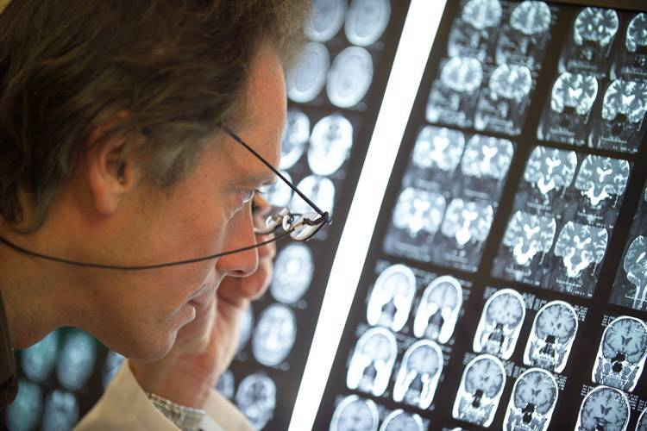
PART I:
Radioisotopes for Medical Applications
9

Slide 10
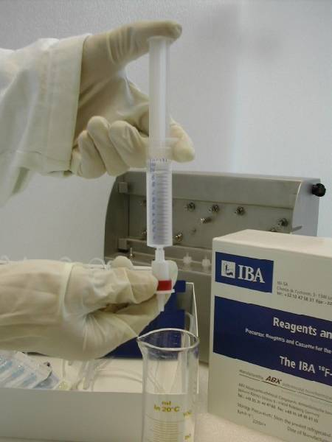
Part I-A: radio-isotopes for medical diagnosis
SPECT: Single Photon Emission Computed Tomography
PET: Positron Emission Tomography
Molecular Imaging

Slide 11
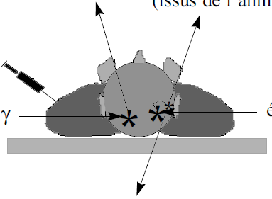
How is imaging done with radio-tracers ?
SPECT
PET
2 photons of 511keV
( β+ annihilation )
Single photon
Radio-isotope
γ emitter
β+ emitter
A camera (Gamma or PET) detects the photons emitted from the body and computes 3D distributions of the radio-activity
11

Slide 12
The use of Radio Isotopes for medical imaging
Radio tracers can be used to label a specific bio-chemical molecule.
They allow to see metabolism
  X-ray scan or MRI are better to see the anatomy (structure)
Nuclear medicine (imaging of metabolism using molecules labeled with an appropriate radioisotope) is therefore not in competition, but in complement of imaging techniques such as X-ray, X-ray CT-scan or MRI.
12

Slide 13
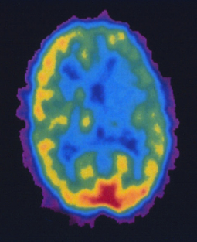
Metabolic versus anatomic imaging
MRI
PET
Anatomic View
(Tissue-structure)
Metabolic imaging
(Biological-function)

Slide 14
The three body planes
Coronal => frontal
Sagital => side
Transverse

Slide 15
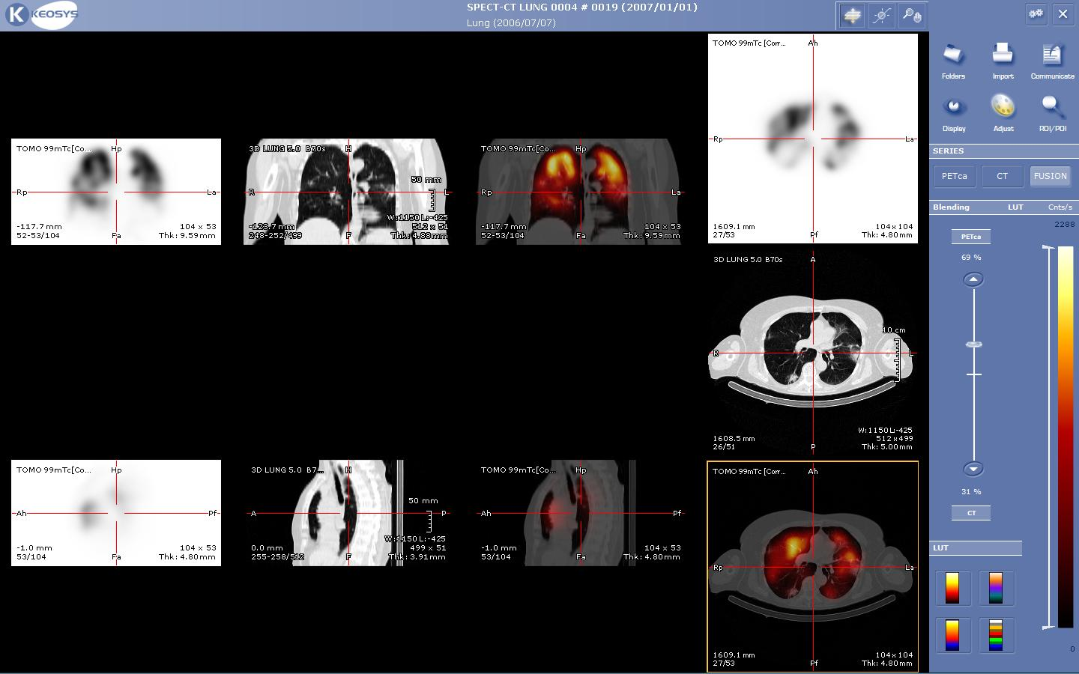
Metabolic and anatomic imaging combined: fusion of SPECT and CT to improve image quality
Transverse view
Coronal (front) view
SPECT/CT
Improved resolution
SPECT
fuzzy
CT
clear
Sagital (side) view
15

Slide 16
How is imaging done with radio-tracers ?
Single photon isotopes (SPECT)
The imaging of single photons emitters requires:
  a collimator (causes a loss of efficiency !).
  a position-sensitive detector (with good detection efficiency): the Gamma (or Anger) camera.
The image obtained is a projection.
Multiple (perpendicular) projections can be mathematically correlated to produce a 3D representation.
SPECT (Single Photon Emission Computed Tomography).
16

Slide 17
How is imaging done with radio-tracers ?
Positron emitting radio-isotopes (PET)
The emitted positron travels a few millimeters, then meets an electron and annihilates, emitting two anti-parallel photons of 511keV.
These two photons can be detected in coincidence by a ring of detectors surrounding the region of interest.
One knows then that the origin of the photons is on the line connecting the two detectors.
Several detections allow to locate the source.
By mathematical reconstruction, a 3D representation of the activity can be obtained.
PET (Positron Emission Tomography).
17

Slide 18
How to select a good single-photon radio-tracer?
The energy of the emitted photon
  Low enough to keep a good detector efficiency
  Low enough in order to achieve good collimation
  High enough to cross the body tissue
  100 keV < E < 300 keV is generally the optimum

Slide 19
How to select a good single-photon radio-tracer ?
The half-life:
  Short enough to minimize the patient’s exposure
  Long enough to allow industrial production and distribution to the hospitals
  Practically 10h < T_{1/2} < 100h is roughly best
  Generators are great too !
  ⁹⁹Mo (66 hours) = ⁹⁹Tc_{m} (6 hours)
  ⁸¹Rb (4.6 hours) => ⁸¹K_{r} (13sec)

Slide 20
How to select a good single-photon radio-tracer
The chemistry
  The radio-tracer should bind easily to organic bio-molecules of interest
  Essential bio-chemical behavior of the molecule should remain intact after labeling
    Halogens (Fluor, Iodine), Technetium ⇒good;
    Noble metals (Gold) ⇒ difficult

Slide 21
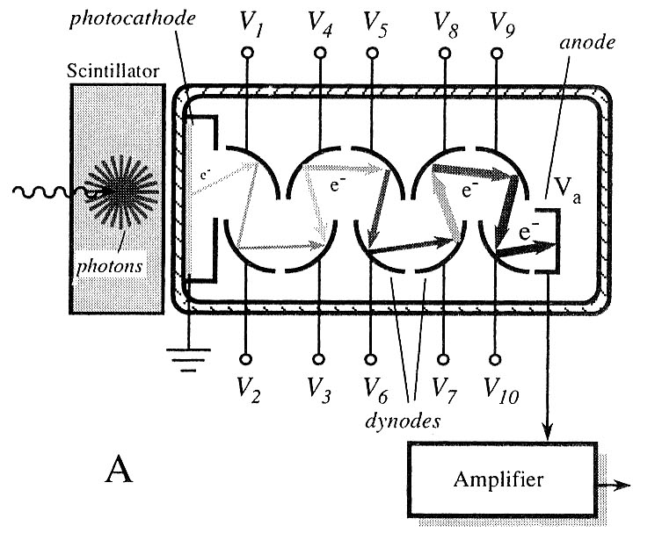
Detecting the radiation
Scintillator with photomultiplier tube
The incoming gamma ray interacts with the scintillator to produce photons. These photons dislodge electrons from the photocathode in the photomultiplier tube. These electrons are accelerated to the first nearest dynode where they dislodge further electrons. This process continues down the tube, resulting in a cascade of electrons. Multiplication factor can be up to 10⁸
21

Slide 22
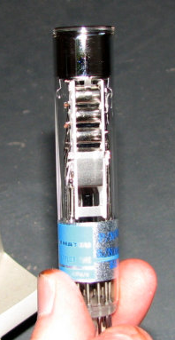
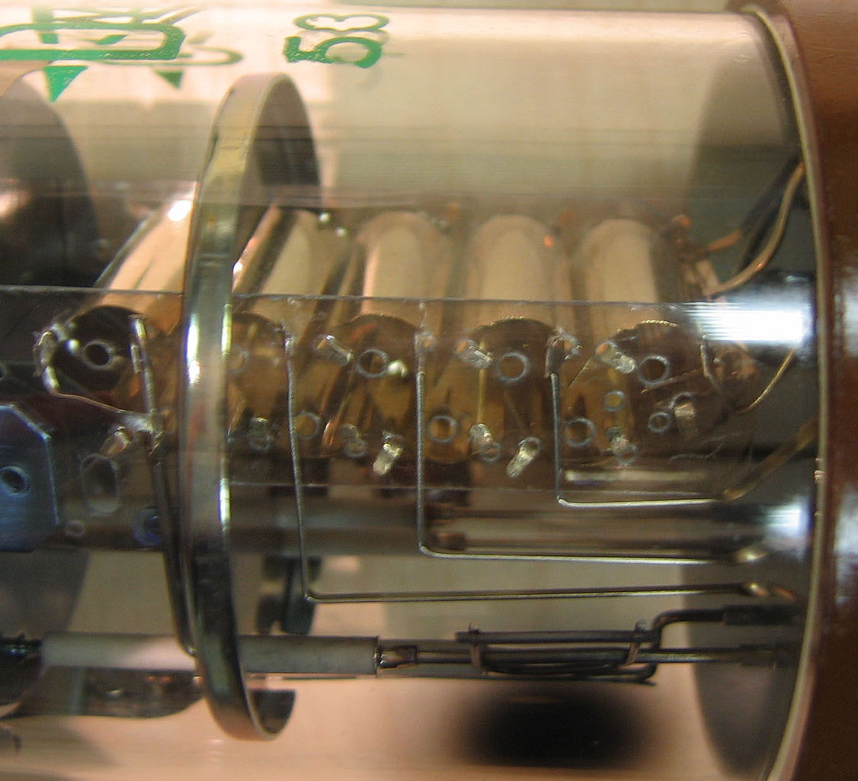
Detecting the radiation
Scintillator with photomultiplier tube
22

Slide 23
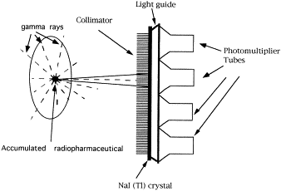
The SPECT gamma camera (Anger camera)
The collimator prevents photons that are not approximately perpendicular to the collimator holes from interacting with the detector.
Anger camera
The field of view for the detector element behind each hole of the collimator is divergent, so that in a gamma camera, spatial resolution degrades as the distance to the distance to the object is increased. Collimators are usually made of lead.
Typical dimensions: holes 3mm, walls 1mm, depth 40mm.
23

Slide 24
The SPECT gamma camera (Anger camera)
The location of the interaction between the gamma ray and the crystal can be determined by processing the voltage signals from the photomultipliers; in simple terms, the location can be found by weighting the position of each photomultiplier tube by the strength of its signal, and then calculating a mean position from the weighted positions. between scattered and direct photons.
The total sum of the voltages from each photomultiplier is proportional to the energy of the gamma ray interaction, thus allowing discrimination between different isotopes or between scattered and direct photons.

Slide 25
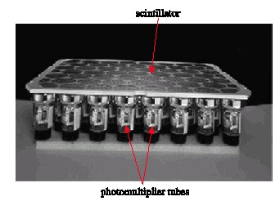
The SPECT gamma camera (collimator removed)
Scintillator
Photomultiplier tubes
25

Slide 26
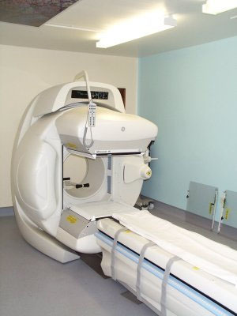
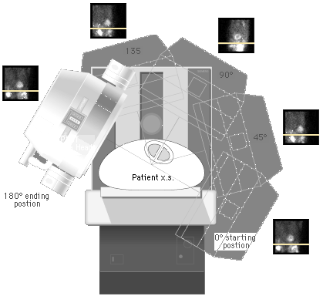
The SPECT gamma camera
Projections from different angles are taken by rotating the camera around the patient
26

Slide 27
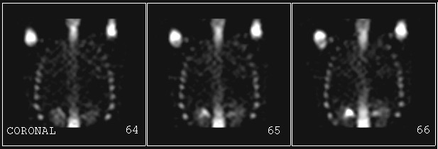
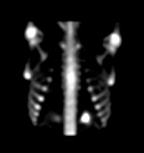
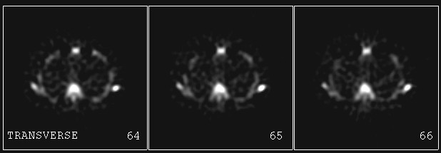
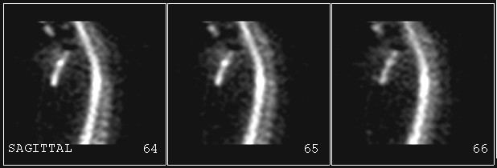
The SPECT gamma camera
3D Reconstruction
Multiple perpendicular projections
=> mathematical deconvolution
=> 3D distribution
27

Slide 28
Nuclear reactions used for the production of medical isotopes
Nuclear Reactors ⇒ neutrons
  Neutron capture, as well as fission is performed in nuclear reactors (famous example: Mo-Tc generator)
Accelerators (often cyclotrons) ⇒ charged particles
  To bring a positive charged particle into a nucleus requires to overcome the Coulomb barrier and requires therefore the use of accelerators
  The compound nucleus formed is unstable, and immediately cools off by emitting neutrons or alpha particles (more rarely protons)
  Typical reactions are: (p, xn) , (p, α) , (d, xn)….

Slide 29
Nuclear reactions for Radio-Isotopes production
Radioisotope Half-life Reaction Energy
(MeV)
²⁰¹Tl 73.1 h ²⁰³Tl (p,3n) => ²⁰¹Pb => ²⁰¹Tl 17~28
⁶⁷Ga 78.3 h ⁶⁸Zn (p,2n) => ⁶⁷Ga 12~28
¹¹¹In 67.4 h ¹¹²Cd (p,2n) => ¹¹¹In 12~28
¹²³I 13.2 h ¹²⁴Te (p,2n) => ¹²³I 20~25
¹²⁴Xe (p,2n) => ¹²³Cs => ¹²³I 20~30
¹²⁴Xe (p,pn) => ¹²³I
¹²⁷I (p,5n) => ¹²³Xe => ¹²³I 45~68
A 30 MeV cyclotron can often do the job
29

Slide 30
“Traditional” nuclear medicine
Technetium 99m, the most commonly used radio-isotopes in nuclear medicine is produced in reactors.
  90% of diagnostic studies in hospitals is done with ^{99m}Tc !
But a number of other, very important nuclear medicine radio-isotopes are produced with cyclotrons of higher energy.
  ²⁰¹Tl (Cardiac studies).
  ¹²³I (Thyroid, Various examinations).
For these longer life isotopes, international distribution is possible.
Large, very powerful cyclotrons are owned by radiopharmaceutical companies.
30

Slide 31
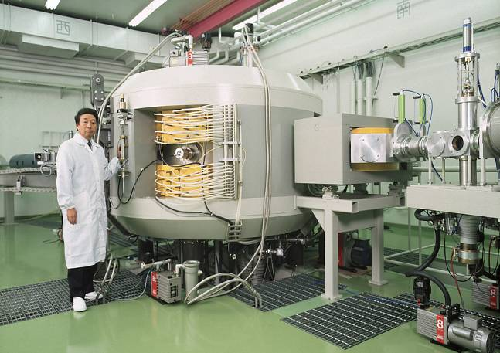
The Cyclone 30
The cyclotron used by all radiopharmaceutical producers
31

Slide 32
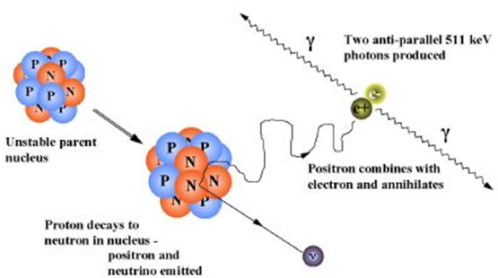
The positron (anti-electron)
Proton rich nucleus decays: proton → positron + neutrino.
Positron cools off by Coulomb interaction with electrons.
At thermal energy: positron annihilates producing two anti-parallel 511keV photons. (within 4mrad due to momentum conservation)
The finite positron range and the non-collinearity of the annihilation photons give rise to positional inaccuracy (±5mm).
32

Slide 33
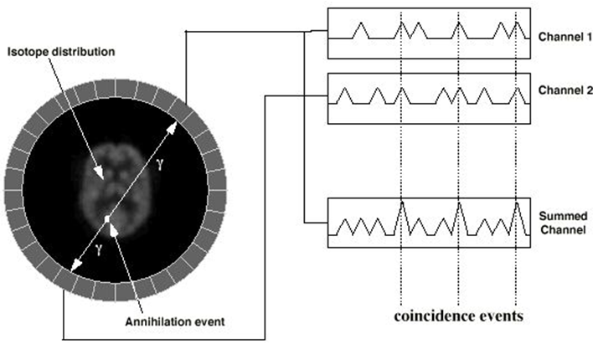
Coincidence detection in a PET scanner
In a PET camera, each detector generates a timed pulse when it registers an incident photon. These pulses are then combined in coincidence circuitry, and if the pulses fall within a short time-window, they are deemed to be coincident. A coincidence event is assigned to a line of response joining the two relevant detectors. In this way, positional information is gained from the detected radiation without the need for a physical collimator.
33

Slide 34
The PET scanner
Currently available are
PET scanners integrated with CT: PET-CT
PET scanners integrated with MRI: PET-MRI
PET scanner in a hospital
Coincidents events are grouped into projected images (sinograms) and sorted by the angle of view
Analogous to the projections obtained with Computed Tomography (CT) scanners
3D image re-construction is similar
34

Slide 35
Common positron emitting radioisotopes for PET
Radioisotope Half-life Positron Reaction Energy
(min) energy (MeV)
(MeV)
¹¹C 20.4 1.0 ¹⁴N (p,α)=> ¹¹C 5=>16
¹³N 9.96 1.2 ¹⁶O (p,α)=> ¹³N 8=>16
¹²C (d,n)=> ¹³N 3=>8
¹⁵O 2.07 1.7 ¹⁵N (p,n)=> ¹⁵O 5=>14
¹⁴N (d,n)=> ¹⁵O 3=>8
¹⁸F 109.8 0.6 ¹⁸O (p,n)=> ¹⁸F 5=>14
35

Slide 36
FDG = Fluoro-Deoxy-Glucose
Most commonly made PET scan (90% of cases) is done with 18F-FDG (Fluoro-Deoxy-Glucose)
Metabolic activity by virtue of glucose uptake in tissue
This tracer is mainly used to explore the possibility of cancer metastasis
In glucose one OH-group is replaced by a 18-F atom
Both atoms have about the same size =>
Bio-chemical behaviour almost not altered

Slide 37
FDG was used to study brain function
PET also allowed for fundamental medical research

Slide 38
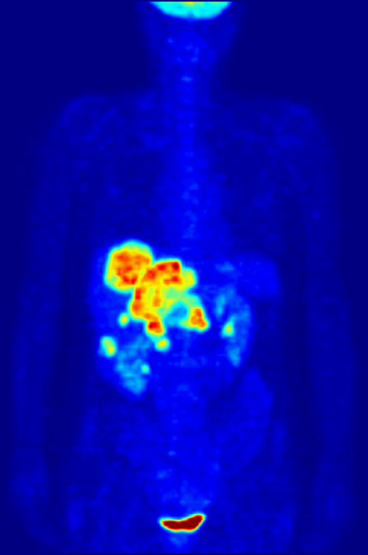
Cancer imaging with PET
¹⁸F FDG
45 minute scan time
normal heart, bladder.
normal kidney, brain.
colon tumor.
metastatic liver lesions.
38

Slide 39
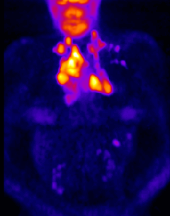
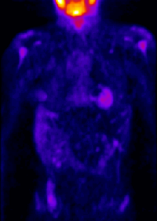
PET Scan - Response to therapy => cancer staging
31 yo female with newly diagnosed Non-Hodgkin‘s Lymphoma
Staging PET Scan
Post Chemotherapy
39

Slide 40
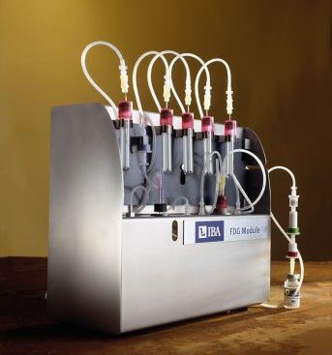
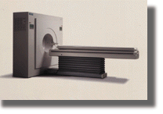
Production and Application of PET radio-isotopes
Target materials
H₂¹⁸O enriched ( → ¹⁸F)
H₂¹⁶O natural ( → ¹³N)
¹⁴N natural ( → ¹¹C)
¹⁴N natural ( → ¹⁵O)
Cyclotron Beam
Target
Radioactive products
¹⁸F, ¹³N, ¹¹C, ¹⁵O
PET Scan
Injection
Labeled compounds
¹⁸FDG, ¹³NH₃ , ¹¹CO₂ , ¹⁵O₂

Slide 41
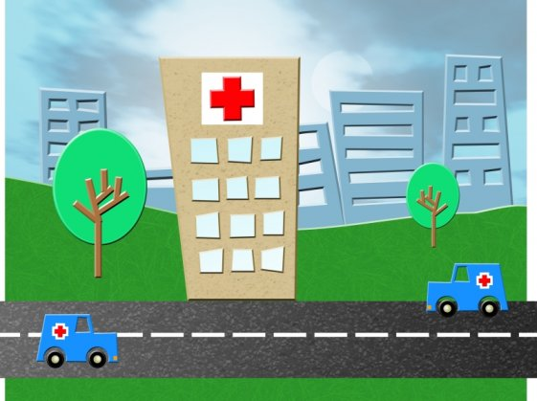
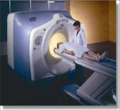
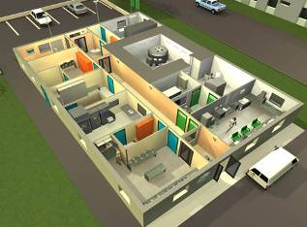

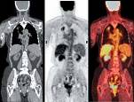


IBA Molecular
200 PET & SPECT Cyclotrons sold worldwide to Hospitals, R&D centers, Radiopharma companies
… distributed daily to
hospitals
33 facilities Worldwide producing Radiopharmaceuticals…
41

Slide 42



52 PET Radiopharmaceuticals Production Facilities
IBA realized many facilities and made alliances to enlarge network for distribution of future new drugs.
These facilities were sold last year but presently IBA is still connected via share-holding
EUROPE – Mid-East: 26
23 operational
3 in construction
USA+Canada: 17
16 operational
1 in construction
Asia: 9
8 operational
1 in construction
Operational
In construction
Partnership
42

Slide 43
Part I-B: Cancer therapy with radio-isotopes
Systemic radio-isotope therapy
Brachytherapy

Slide 44
Four different types of radiation therapy
External beam radiation therapy (teletherapy)
  Radiation source is external (like proton therapy)
Brachy therapy:
  Sealed radioactive sources placed precisely in the tumor
  Can use temporary or permanent placement of radioactive sources
Systemic radiation therapy
  Radioistopes are given by infusion or by oral ingestion
BNCT: Boron Neutron Capture Therapy
  mixture of 1 and 3.

Slide 45
Systemic radiation therapy
When the cancer is not limited to a well defined, primary tumor, systemic therapies can be used.
A form of targeted therapy. Targeting can be obtained by:
  Isotope chemical property. Example: iodine => thyroid gland
  Attach isotope to molecule or antibody that finds the target
    Iodine labeled MIBG to treat neuroblastoma (brain tumor-children)
    Hormone-bound Lutetium-177 or Yttrium-90 for neuroendocrine tumors
Injection of Yttrium-90 radioactive glass microspheres
  Liver tumors or metastatis. Sphere diameter about 30 μm
Treatment of bone-metastasis with Strontium-89
Alpha-particles or Auger electron emitting radio-isotope are often preferred because of short range of dose delivery.

Slide 46
Pairs of radioisotopes for systemic therapy
Diagnostic (PET) RI | Therapy RI
¹²⁴I | ¹³¹I
⁸⁶Y | ⁹⁰Y
⁶⁴Cu | ⁶⁷Cu
Etc!
Problem of dosimetry and treatment planning: how to assess the radiation dose received by the tumor and by the healthy organs at risk.
Biochemical properties of pairs are exactly the same
PET-study allows quantitative diagnostics of distribution and uptake of the labelled molecule
With this information the actual delivered dose of therapeutic treatment can be predicted
46

Slide 47
Brachy therapy
Dose is delivered by placing the radiation source directly inside the area requiring treatment
Commonly used for cervical (uterus), prostate, breast and skin cancer
Irradiation affects only a very localized area => healthy tissues are spared
Much higher doses can be delivered. For comparison:
  Proton therapy: about 40 Gray
  Prostate brachytherapy: about 100 to 150 Gray
Brachytherapy can often be completed in less time
  Reduce the possibility of recovery of cancer cells between treatment intervals

Slide 48
Brachytherapy
Local irradication of tumors by sealed radioactive implants placed directly inside the cancerous tissue
Theragenics
IBt
48

Slide 49
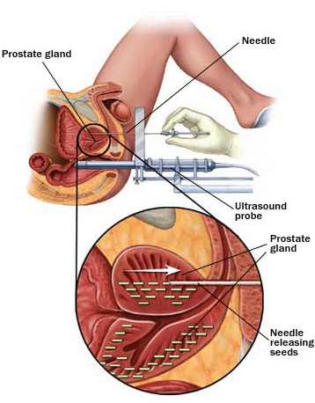
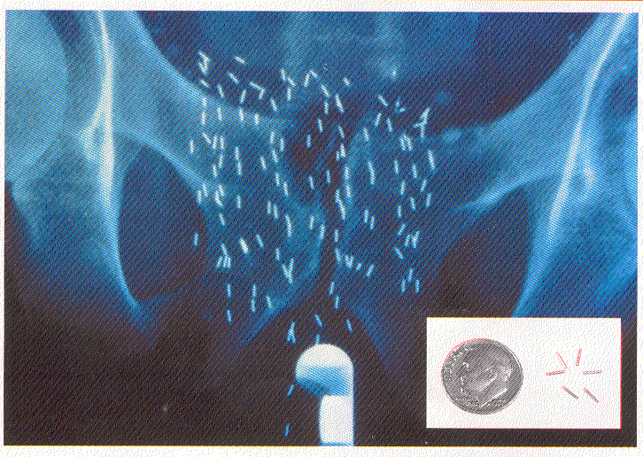
Prostate brachytherapy with Pd-103 or I-125
Seeds placed with 3D precission verified with ultrasound probe
Seeds are not harmfull and can stay in place after treatment
49

Slide 50
Pd-103 vs. I-125
¹⁰³Pd ¹²⁵I
Half-life (days) 16.97 60
Photon energy (keV) 20~23 27~35
Half-value-layer (mm.Pb) 0.008 0.02
Total delivered dose (Gy) 115 160
Initial dose rate (cGy/hr) 20~24 6~10
50

