Slide 2
Training in Vacuum Technology for
JUAS 2014 Students
Paolo Chiggiato
Technology Department
Vacuum Surfaces and Coatings Group
CERN, CH-1211 Geneva
Vacuum @ CERN
Material and Surface Science: Activity 1
Mechanical Engineering
Instrumentation: Activity 2
Simulation: Activity 3
Operation: Activity 4 and 5

Slide 3
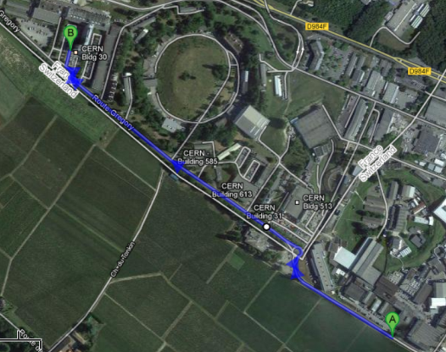
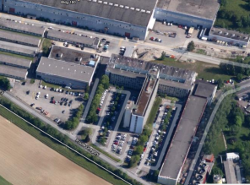
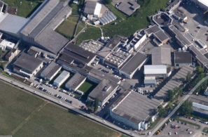
The Circuit in the CERN’s Meyrin Site
B. 30 and 113
B. 101
1 Km from B. 30 to B. 101

Slide 4
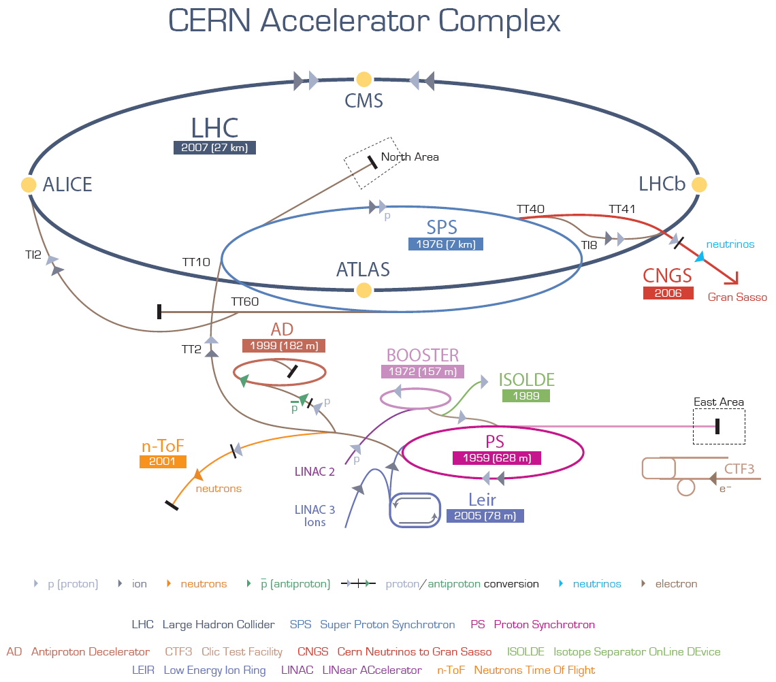
Vacuum @ CERN
Vacuum is necessary for the free circulation of beams.
128 Km long vacuum system: the longest in the world.
All vacuum degrees and all vacuum technologies are employed at CERN

Slide 5
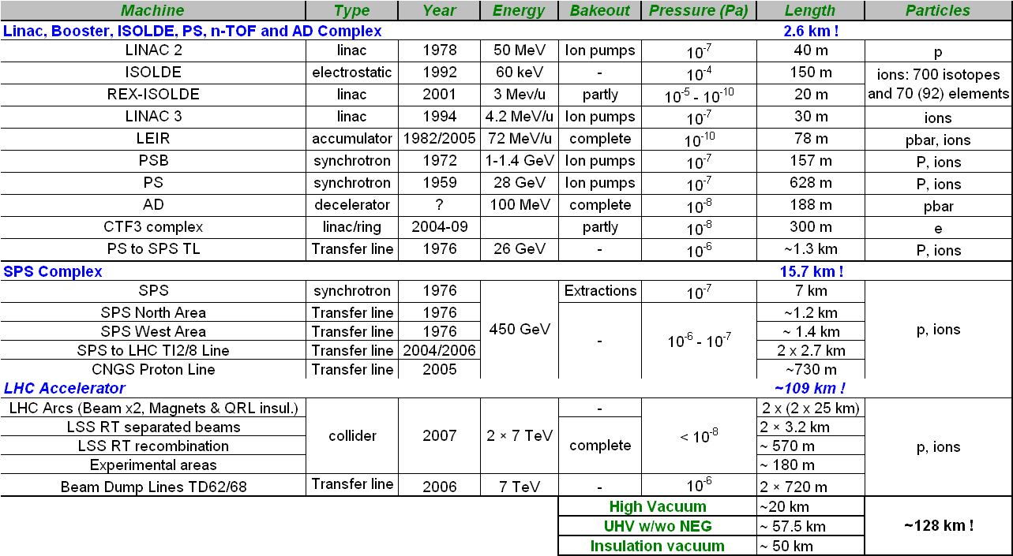
Vacuum @ CERN
  2850 ion pumps, 450 turbomolecular pumps, 325 Ti sublimation pumps,…
  6 Km of NEG coated beam pipes, 2750 pressure gauges, 40 leak detectors and 100 RGAs,1930 roughing valves and 510 gate sector valves

Slide 6
Vacuum Tech.
Material & Surface Science
Mechanical Engineering
Instrumentation and control
Simulation
Operation

Slide 7
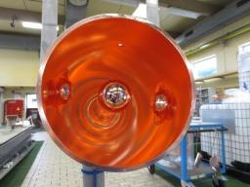
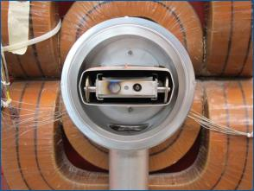
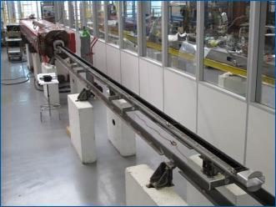
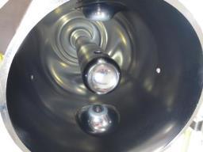
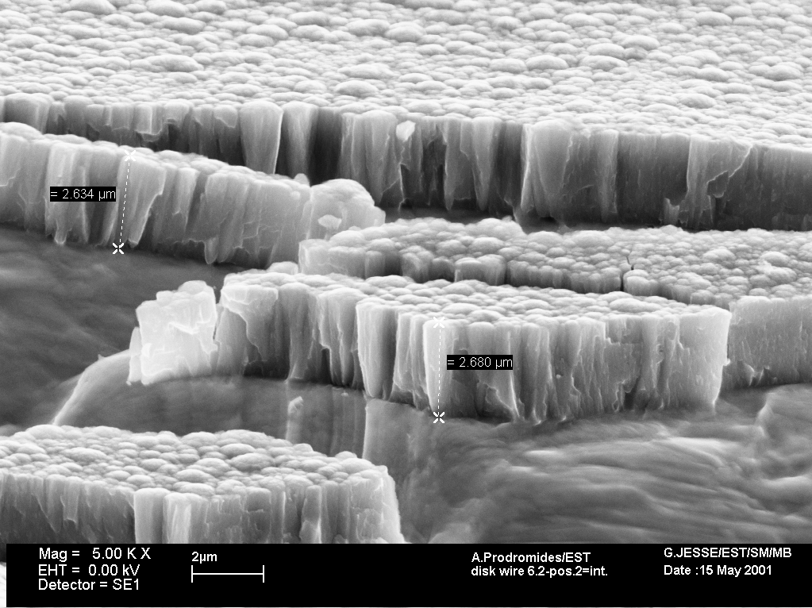
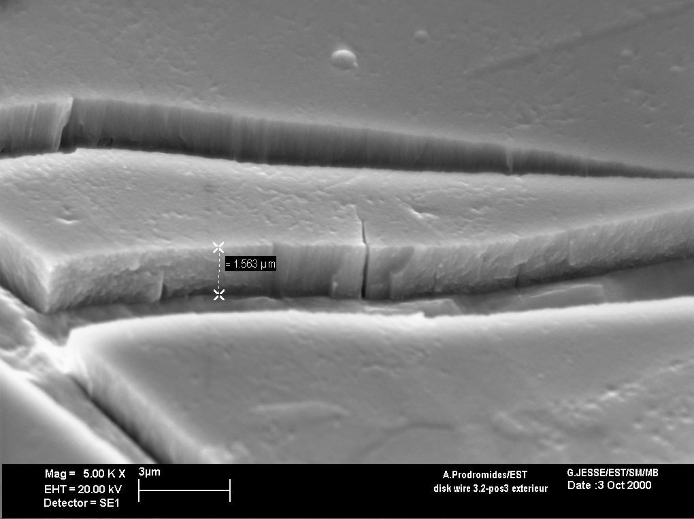
Vacuum Tech.
Material & Surface Science
Thin Films: TiZrV
Thin Films: Amorphous Carbon
Thin Films: Nb

Slide 8
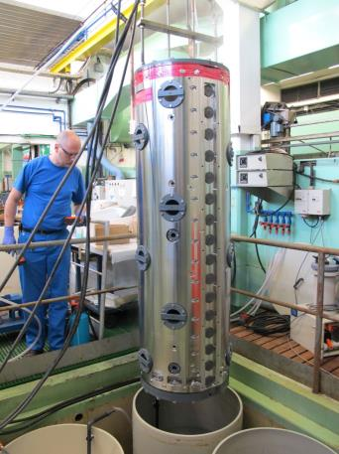
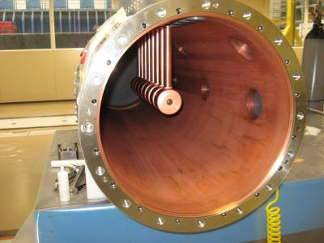
Vacuum Tech.
Material & Surface Science
Electroplating

Slide 9
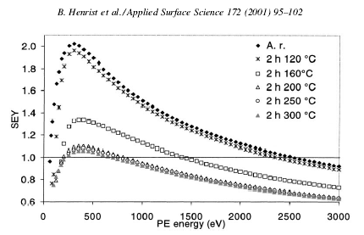
Vacuum Tech.
Material & Surface Science
Beam induced surface modification.
Surface analysis.
SEY
Primary electron energy [eV]

Slide 10
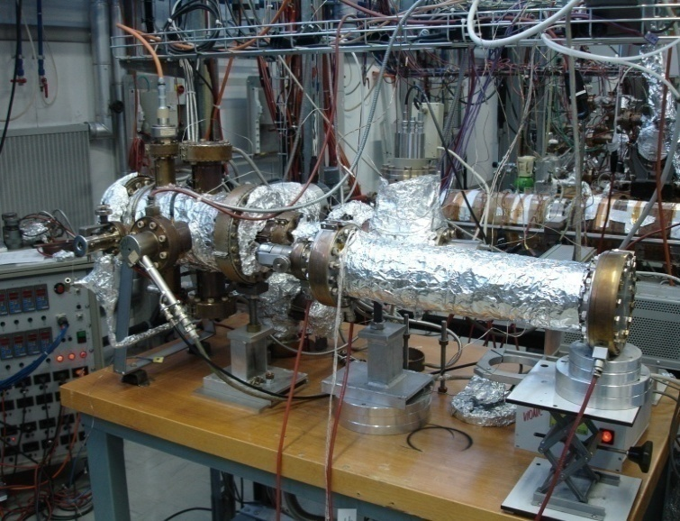
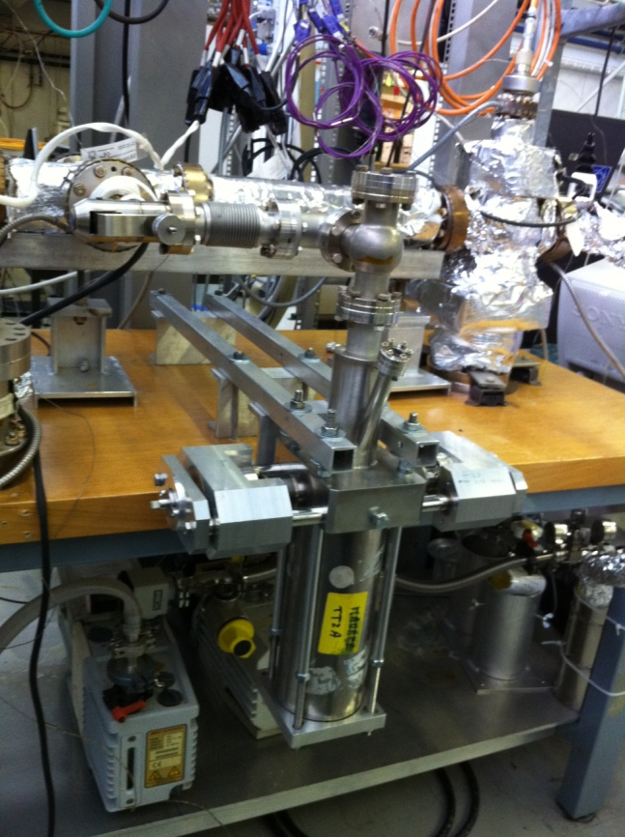
Activity 1: gas from metals
Vacuum Tech.
Material & Surface Science
Thermal and particle induced outgassing
Gas permeation in polymers and metals
Assessment of vacuum components
Thin film coatings for the reduction of material outgassing

Slide 11
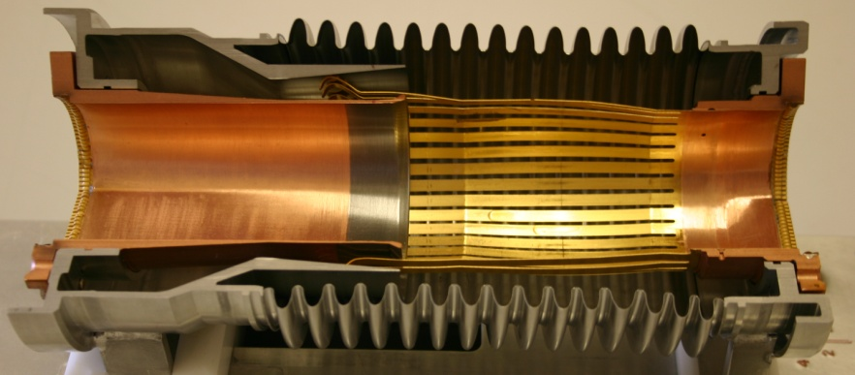
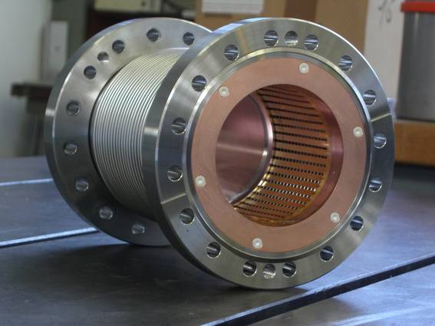
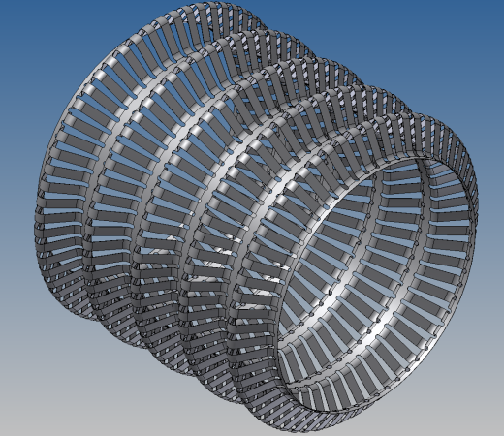
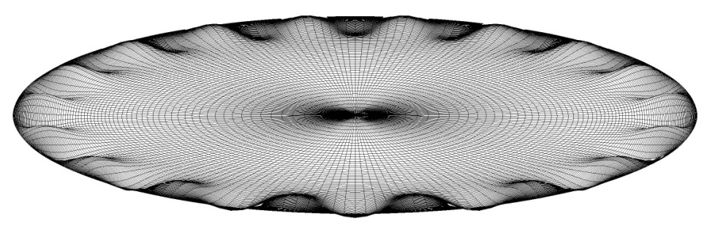
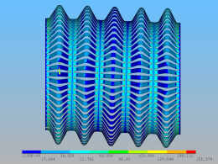
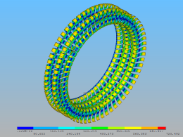
Vacuum Tech.
Mechanical Engineering
Design
Thin walls
Production
Computation

Slide 12
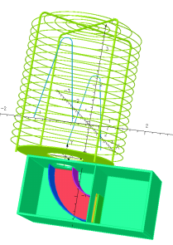
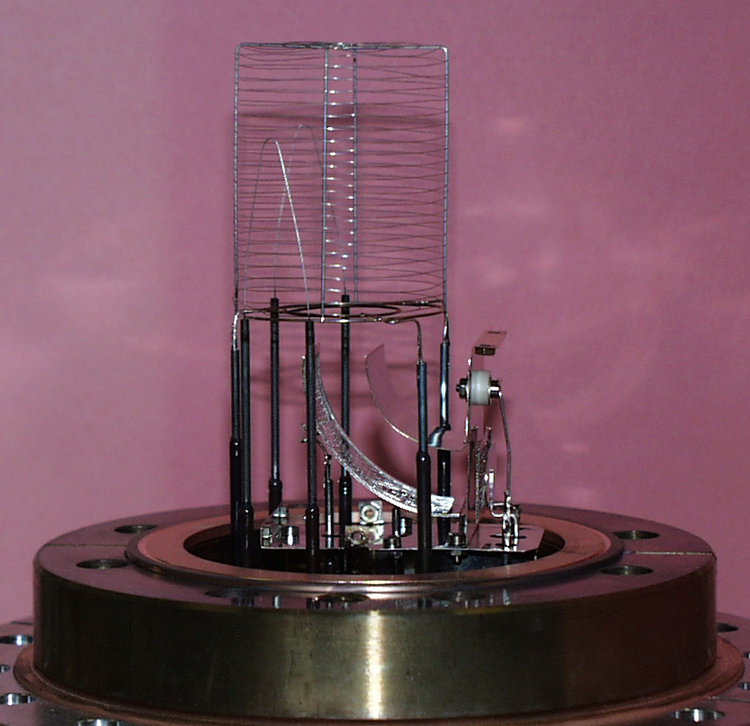
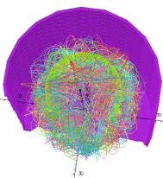
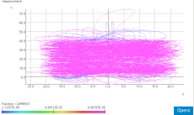
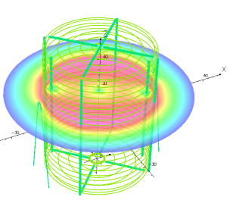
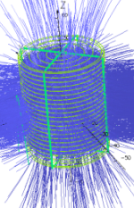
Vacuum Tech.
Instrumen-tation
SVT 305
Electron trajectories
Geometric mode of a Helmer gauge
Electrical potentials
(here during modulation)
Ion trajectories
(here illustration of ion losses)

Slide 13
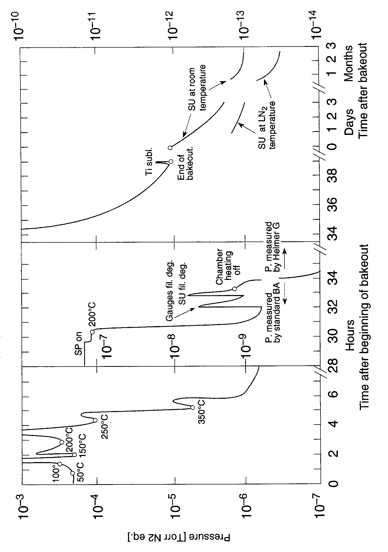
Vacuum Tech.
Instrumen-tation
Lowest pressure ever measured at room temperature

Slide 14
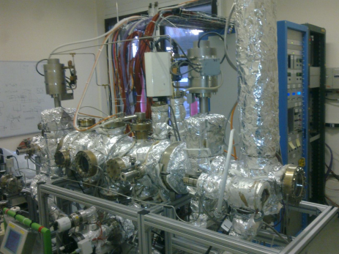
Activity 2: pressure measurement
Vacuum Tech.
Instrumen-tation
Pressure measurement by gas ionization
Quadrupole gas analyzers and partial pressure measurement
The training lab
Calibration of instruments

Slide 15
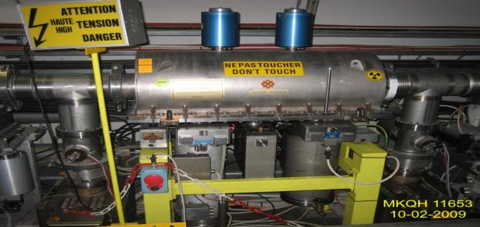
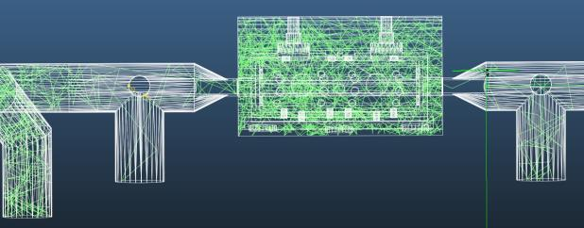
Vacuum Tech.
Simulation

Slide 16
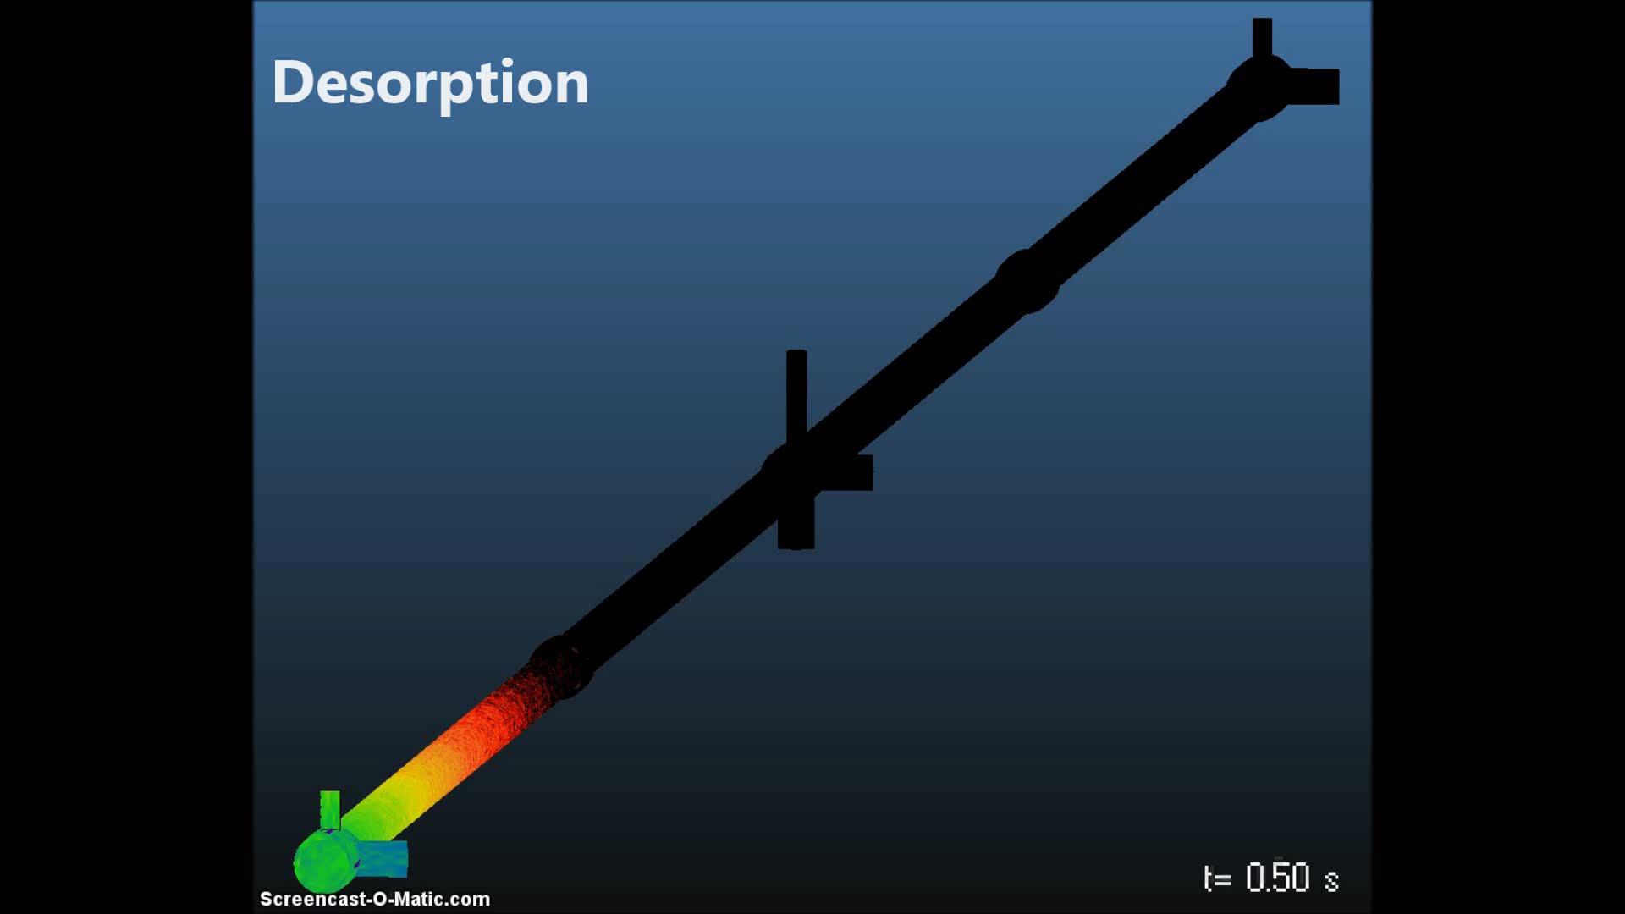
time-dependent processes
Vacuum Tech.
Simulation

Slide 17
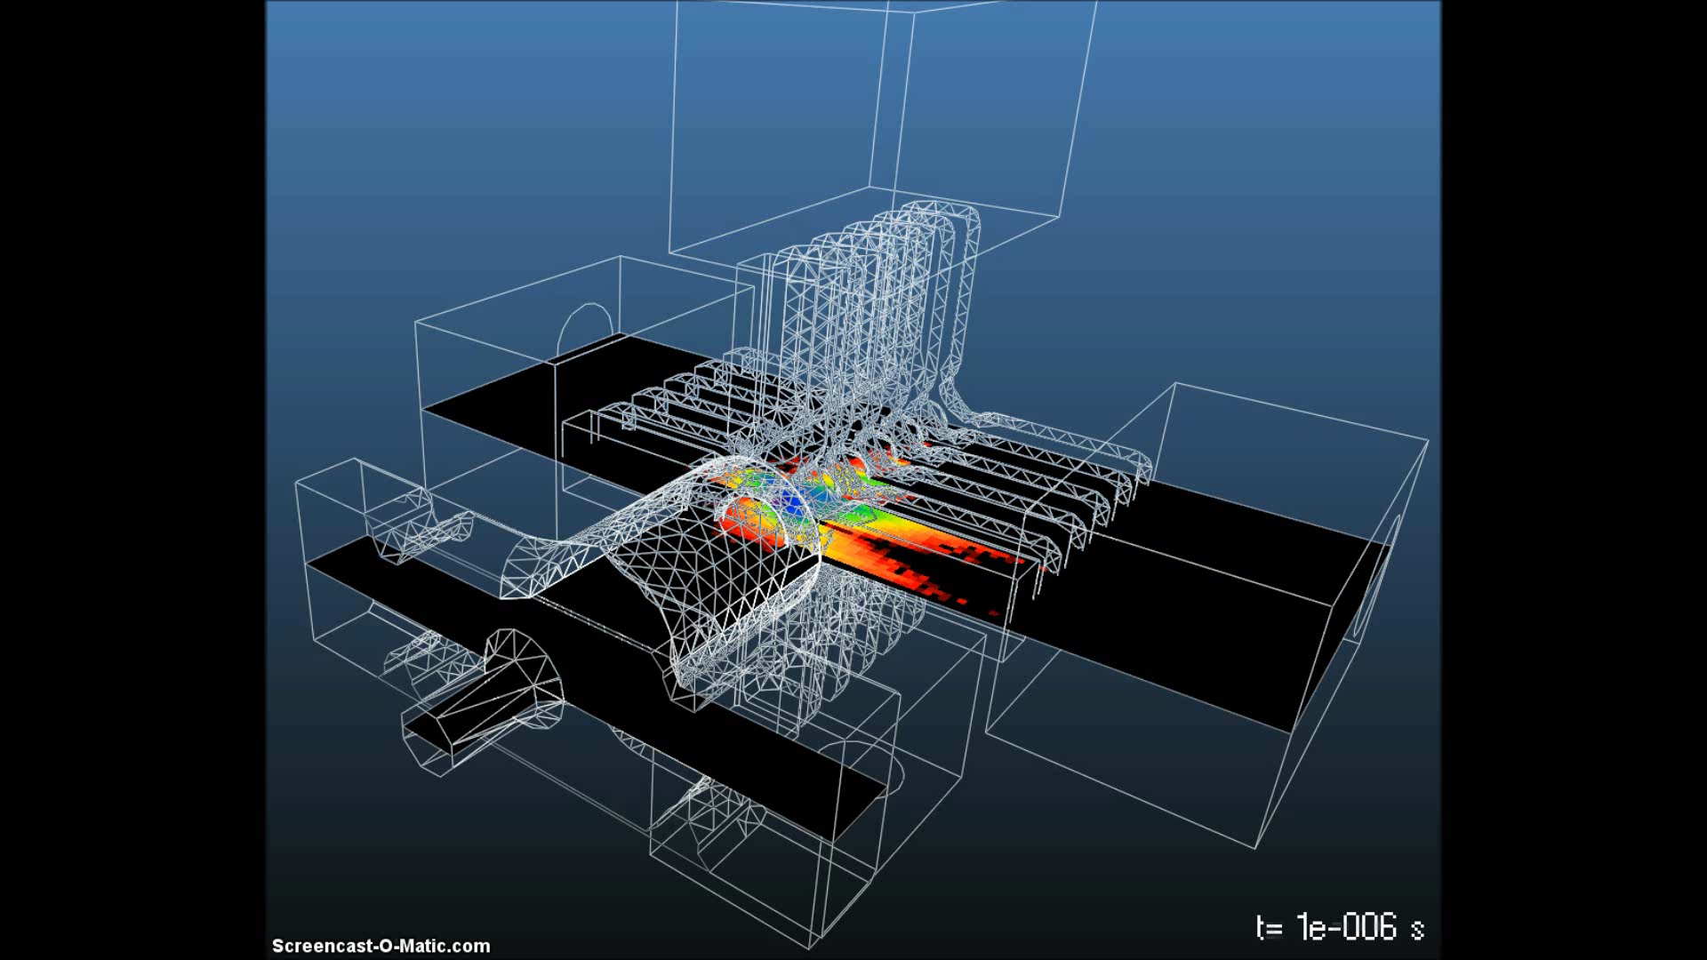
Activity 3: MC simulation
Vacuum Tech.
Simulation

Slide 18
Vacuum Tech.
Operation

Slide 19
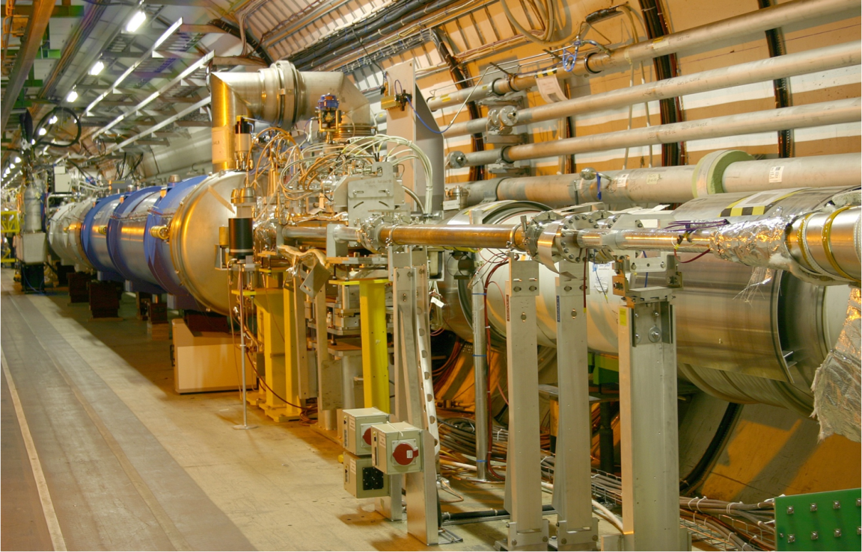
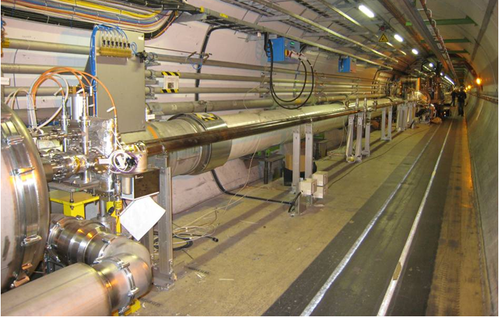
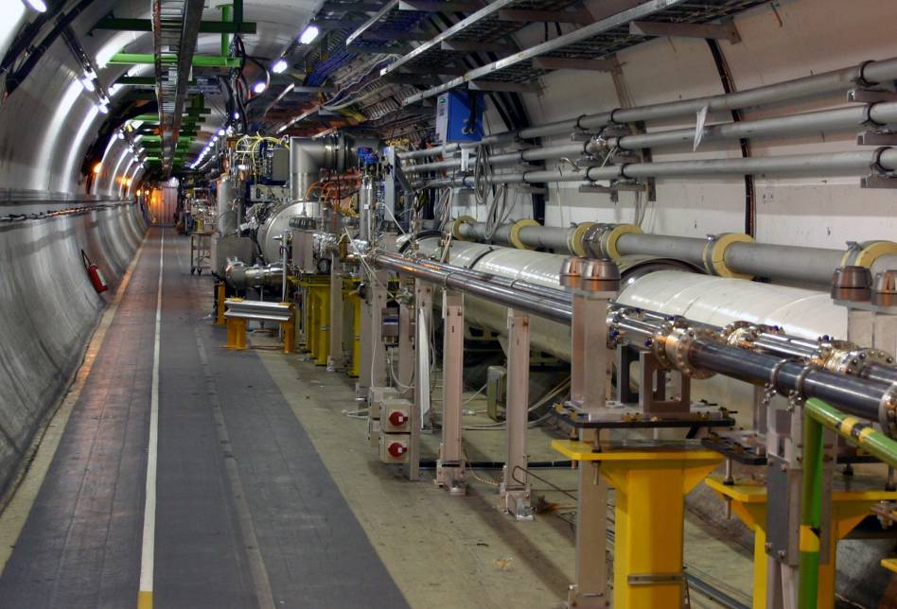
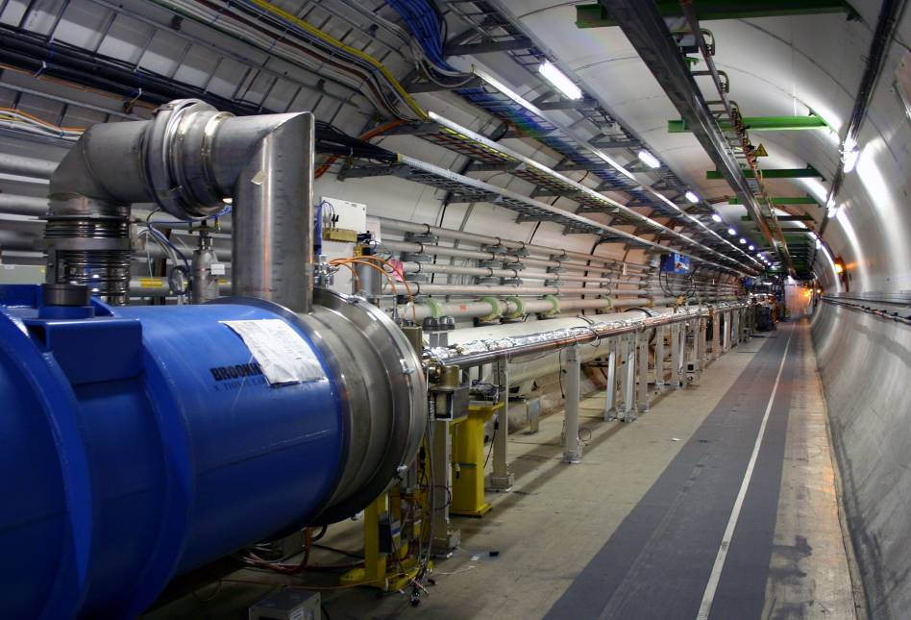
Vacuum Tech.
Operation
Examples of vacuum systems in the LHC
LHC

Slide 20
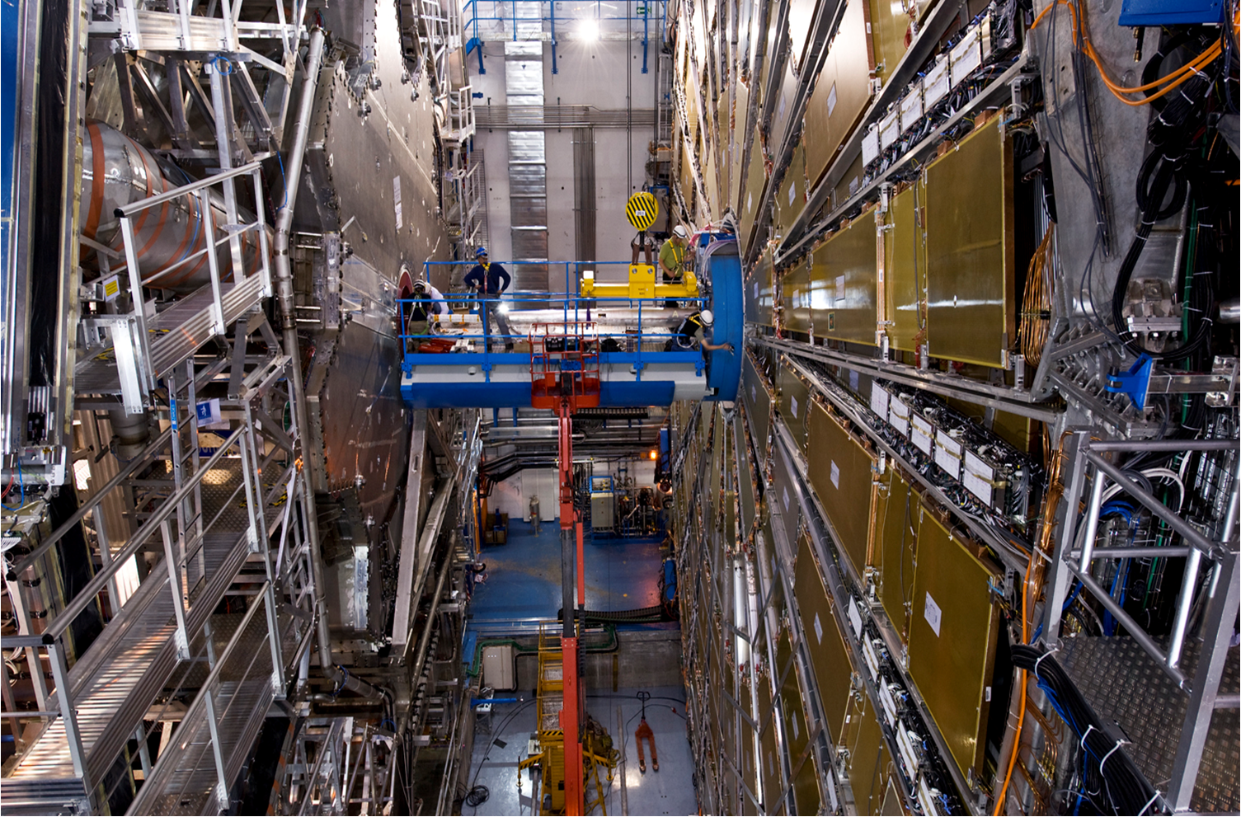
Vacuum Tech.
Operation
Examples of vacuum systems in the LHC
Vacuum technicians installing part of the beam pipe support system

Slide 21
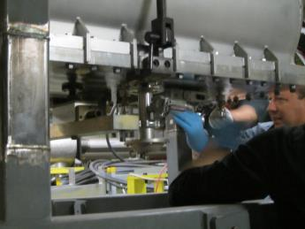
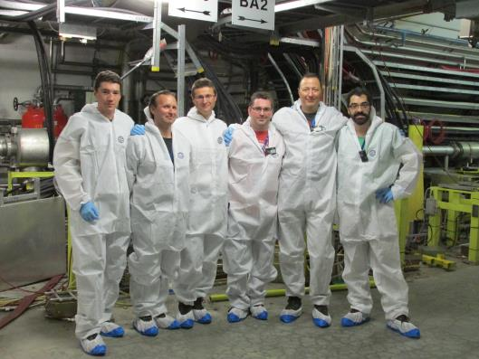
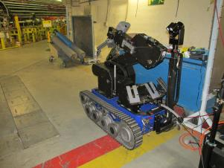
Interventions in controlled areas
Vacuum Tech.
Operation

Slide 22
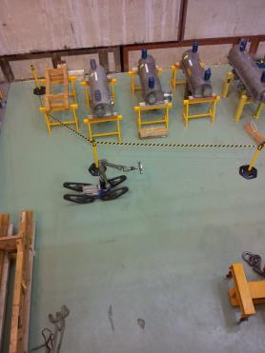
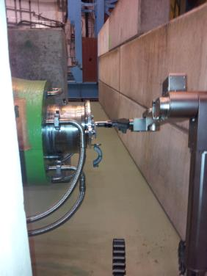
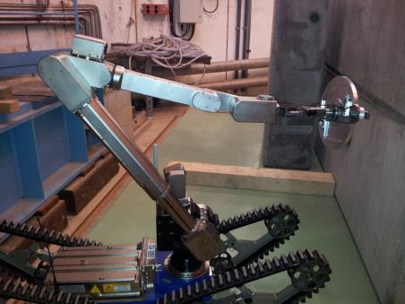
Remote interventions in controlled areas
Vacuum Tech.
Operation

Slide 23
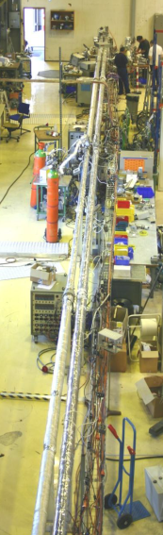
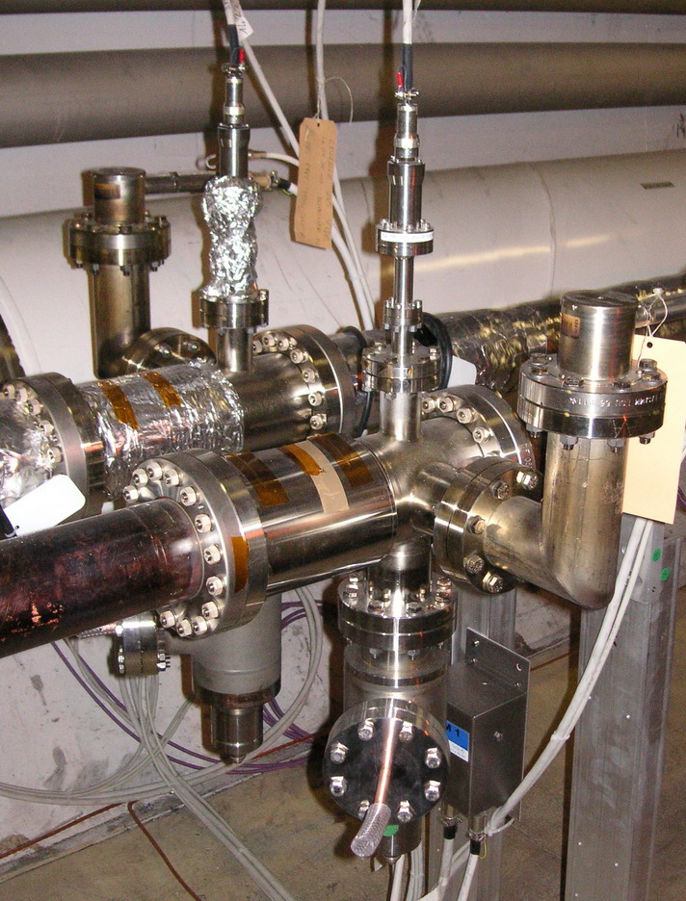
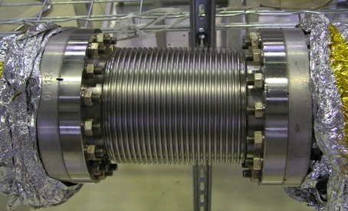
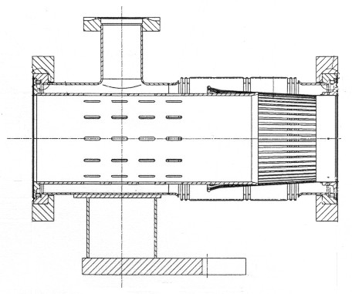
Activity 4: LHC vacuum system with NEG
Vacuum Tech.
Operation
Thin film coating for the LHC
LHC vacuum components
The LHC collimators and their vacuum system
Bakeout and NEG activation

Slide 24
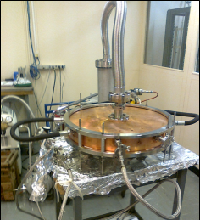


Activity 5: leak detection
Vacuum Tech.
Operation
Leak and pressure test of PIMS disks
Leak test of new source
Acceptance test of CCDTL module
Leak test
of DTL
Drift tubes.
This is just a few of the leak, pressure and acceptance test done in 2013 for the new material to be installed in Linac 4.

Slide 25
We are looking forward to
sharing our work with you at CERN !

