Slide 1


Practical Work @ CERN
Normal Conducting Magnets
Friday 21st February 2014, 9:00 – 17:00

Slide 2

Programm and Organization
8 to 10 participants
Hands-on practical work in CERN laboratories
Guided by CERN‘s magnet experts
Split into two half-day sessions
  Magnet production and certification
  Magnetic measurements

Slide 3
Magnet production and certification
Introduction to magnet production
  materials for magnets
  magnet components
  manufacturing technologies
  testing and measurement techniques
Practical work in magnet test facility NORMATEF
  participants will perform certification tests and measurements on recently built magnets
Visit the CERN normal conducting magnet prototype workshop (NORMAPRO) in Prévessin site
  Yoke manufacturing
  Coil winding and impregantion

Slide 4
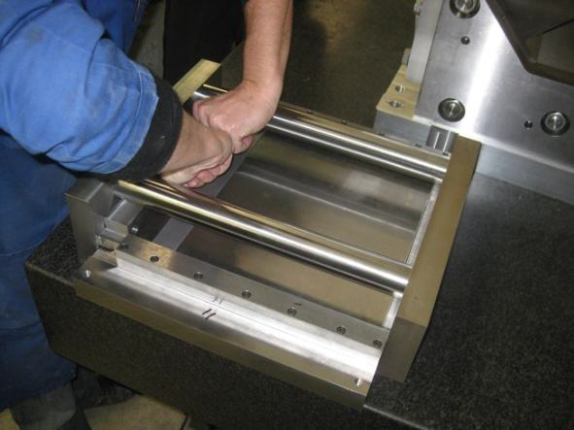
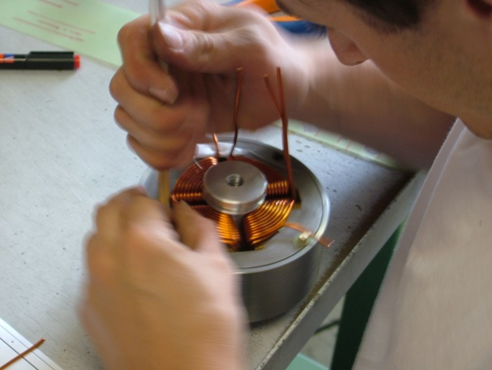
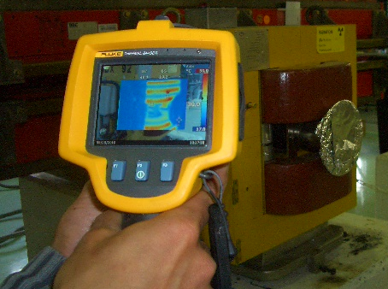
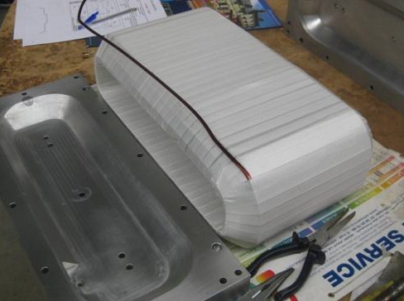
Magnet production and certification
Yoke manufacturing
Magnet assembly
Magnet testing
Coil fabrication

Slide 5
Magnetic measurements
Visit the Magnetic Measurement Laboratory
Introduction to different measurement techniques
  field-map bench
  rotation coil technique
  stretched wire technique
Practical work in magnetic measurement lab I8
  participants will measure magnets using rotating coil bench
Analysis of mesurement results with CERN experts

Slide 6
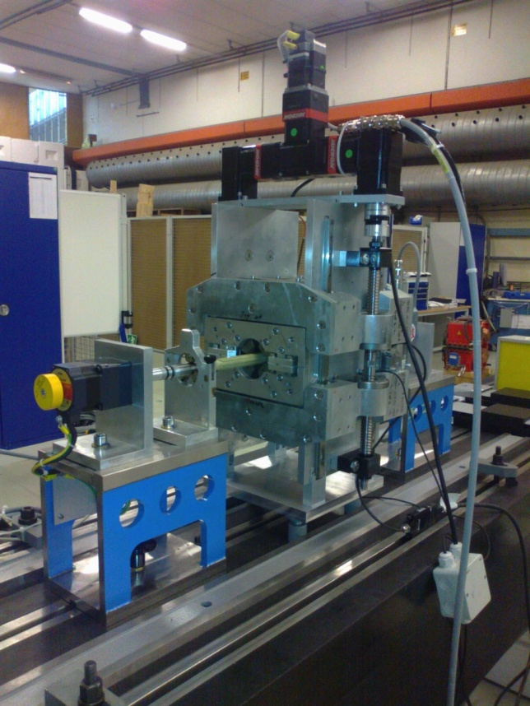
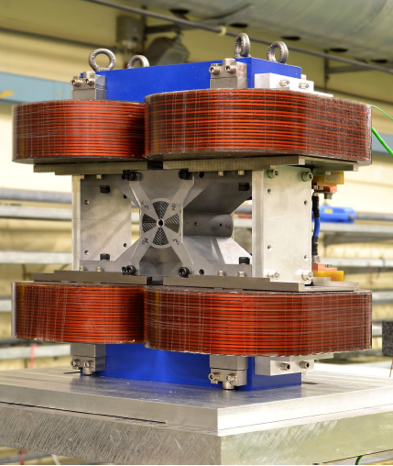
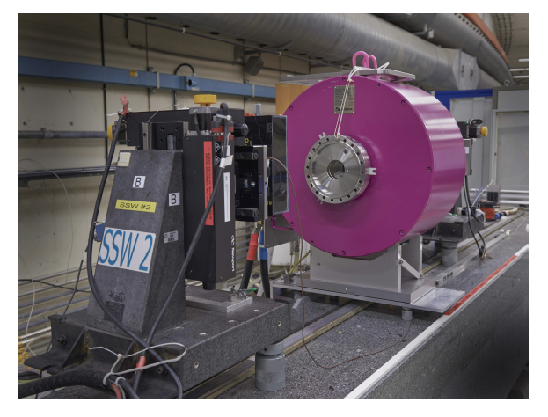
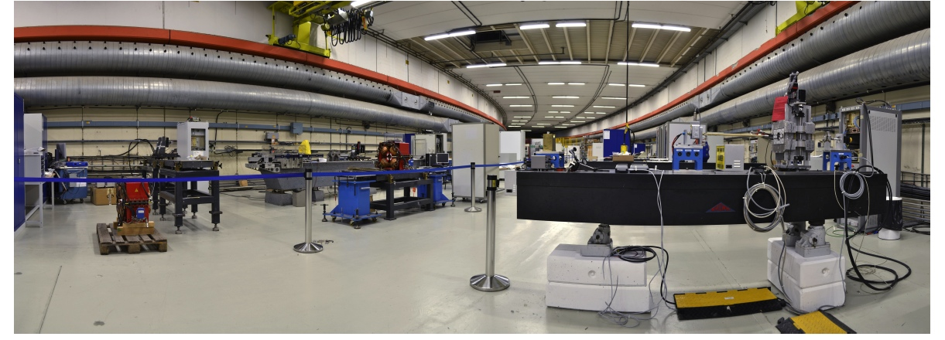
Visit of Magnetic Measurement Laboratory

Slide 7
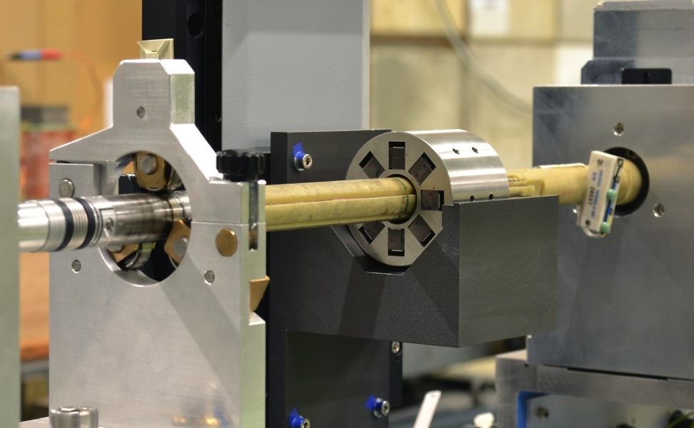
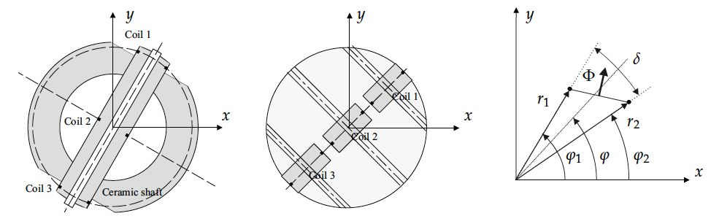
Rotating Coil Measurements
Tangential coil
Radial flux
Radial coil
Tangential flux

Slide 8
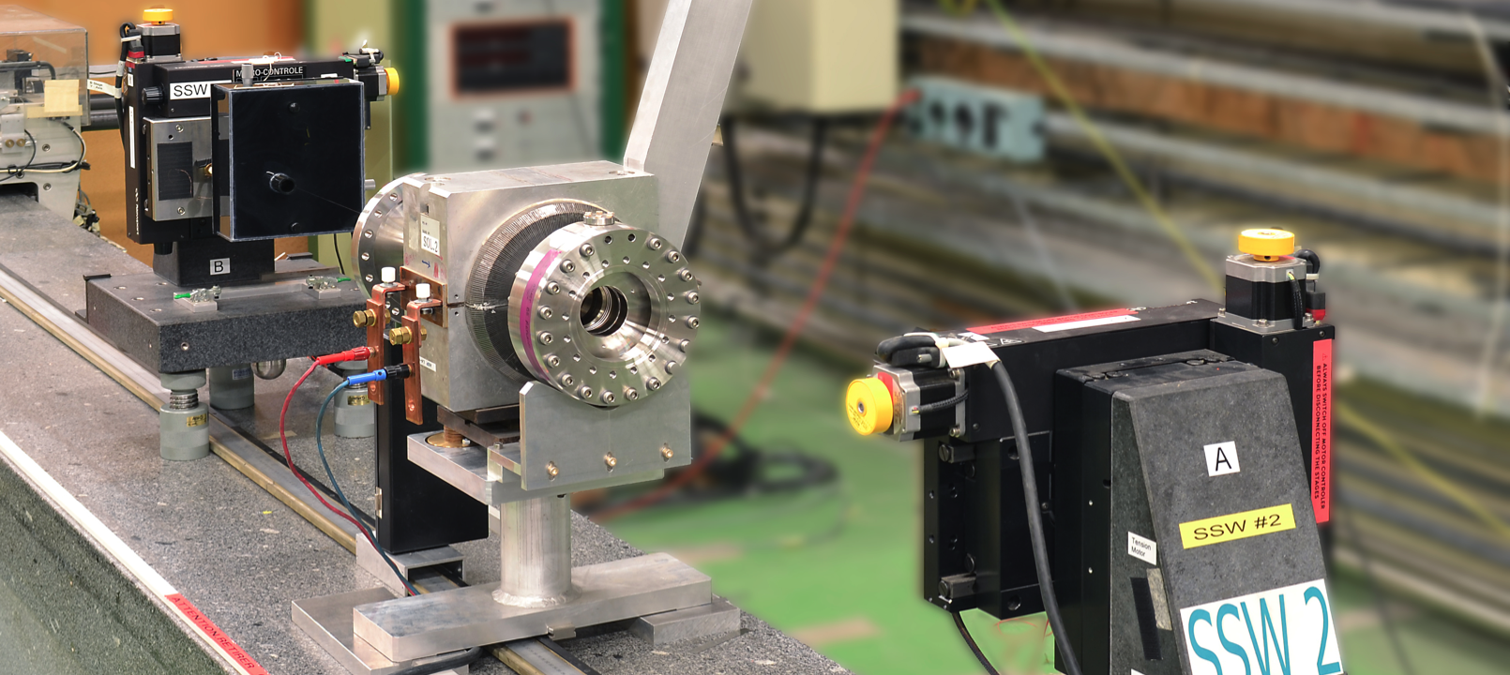
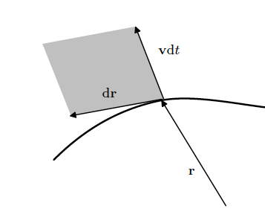

Streched Wire Measurements

Slide 9
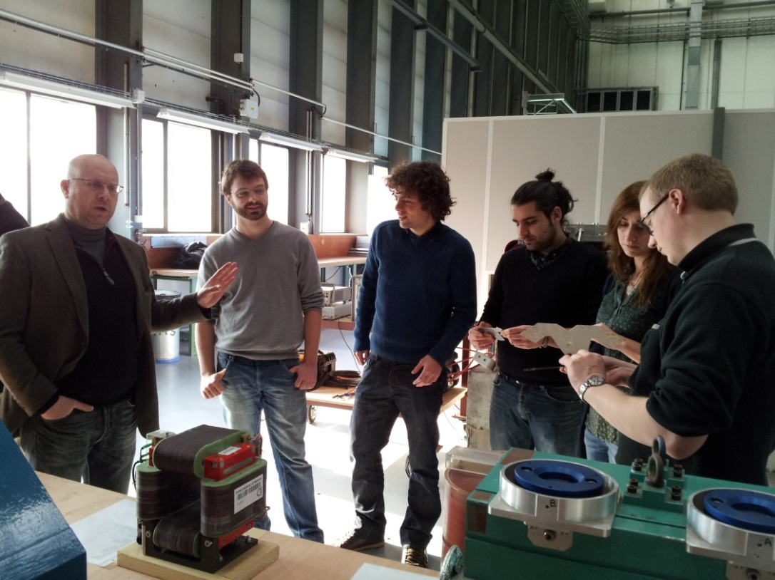
Looking forward...
Practical work @ CERN 2013
...to welcome you at CERN!

