Slide 1

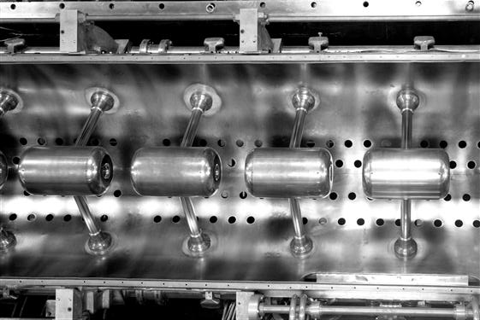
Part2: Cavities and Structures
Modes in resonant cavity
From a cavity to an accelerator
Examples of structures
JUAS 2014

Slide 2
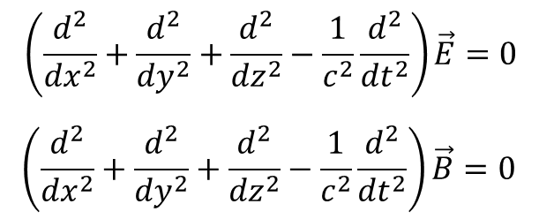
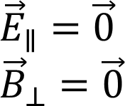
Wave equation
Cavity modes
Maxwell equation for electromagnetics waves
In free space the electromagnetic fieds are of the transverse electromagnetic, TEM type: Electric and magnetic field vectors are ⊥ to each oher and to the direction of propagation !
In a bounded medium (cavity) the solution of the equation must satisfy the boundary conditions:

Slide 3


TE and TM modes
Cavity modes
TE mode (transverse electric): The electric field is perpendicular to the direction of propagation in a cylindrical cavity.
TM mode (transverse magnetic): The magnetic field is perpendicular to the direction of propagation in a cylindrical cavity.
m: azimuthal
n: radial
m: azimuthal
n: radial

Slide 4
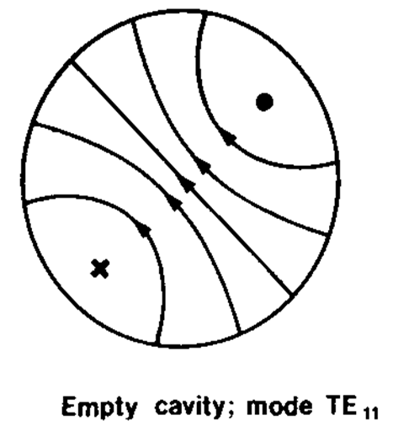
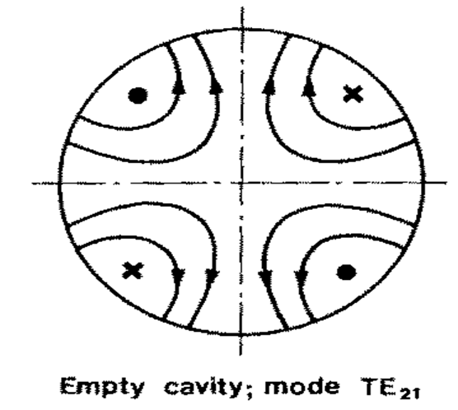
TE modes
Cavity modes
The two Transverse Electric modes for accelerating structures are:

Slide 5

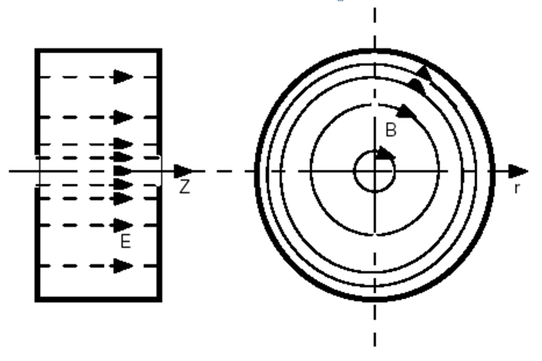
TM modes
Cavity modes
The most commonly used Transverse Magnetic mode for accelerating structures is:

Slide 6
TM modes
Cavity modes
The most commonly used for accelerating structures are the TM modes:
TM₀₁₀ : f=352.2 MHz
TM₀₁₁ : f=548 MHz
TM₀₂₀ : f=952 MHz

Slide 7
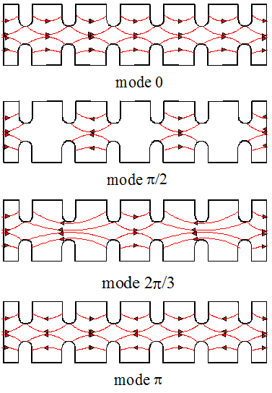
Standing Wave Modes
Cavity modes
From a cavity to an accelerator
Mode 0 also called mode 2π.
For synchronicity and acceleration, particles must be in phase with the E field on axis (will be discussed more in details in part.3).
During 1 RF period, the particles travel over a distance of βλ.
The cell L lentgh should be:
Mode | L
2π | βλ
π/2 | βλ/4
2π/3 | βλ/3
π | βλ/2
Named from the phase difference between adjacent cells.

Slide 8
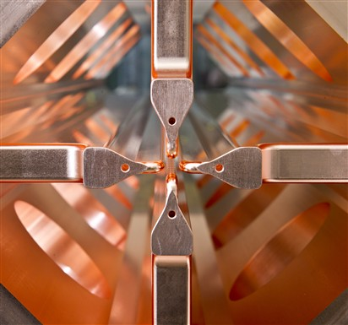
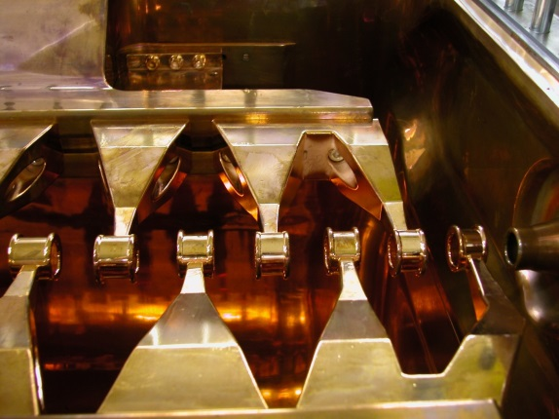
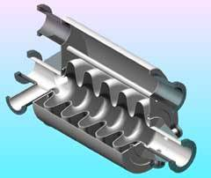
Basic accelerating structures
Basic structures
TE mode:
  Radio Frequency Quadrupole: RFQ
  Interdigital-H structure: IH
TM mode:
  Drift Tube Linac: DTL
  Cavity Coupled DTL: CCDTL
  PI Mode Structure: PIMS
  Superconducting cavities

Slide 9
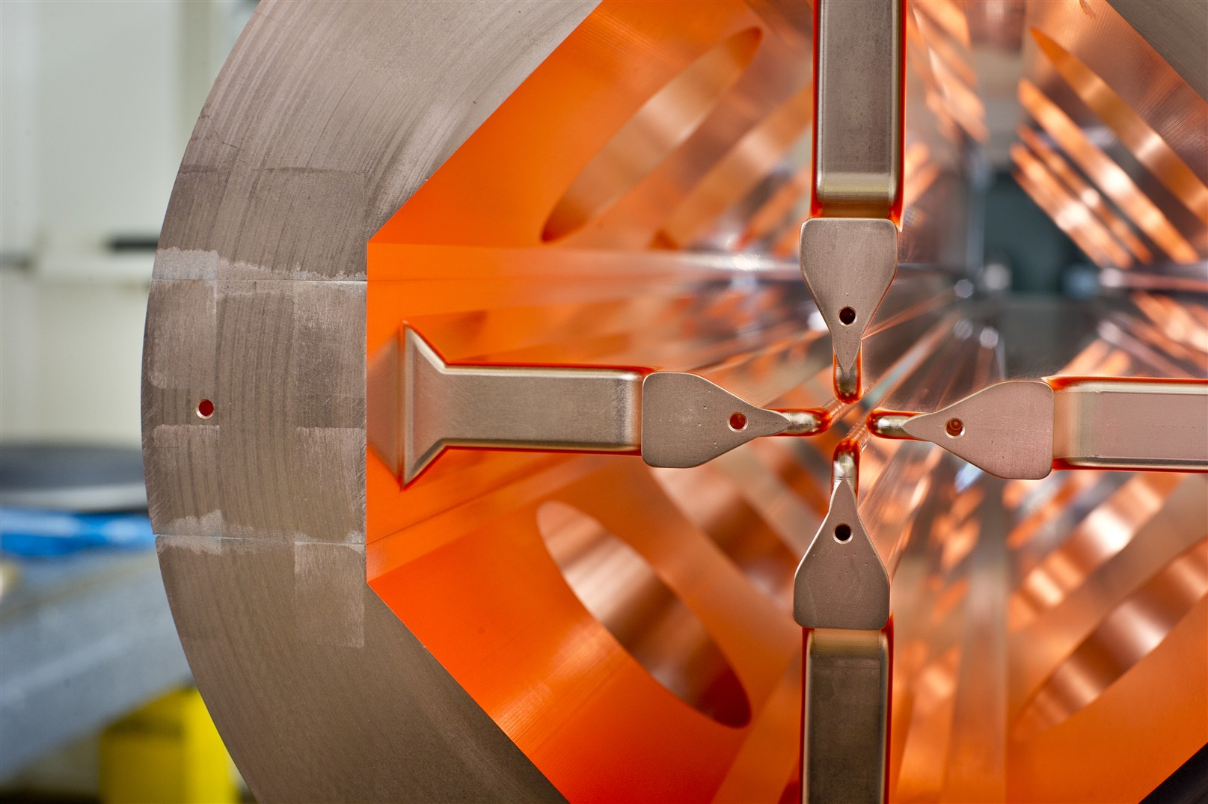
Radio Frequency Quadrupole
Basic structures
RFQ

Slide 10
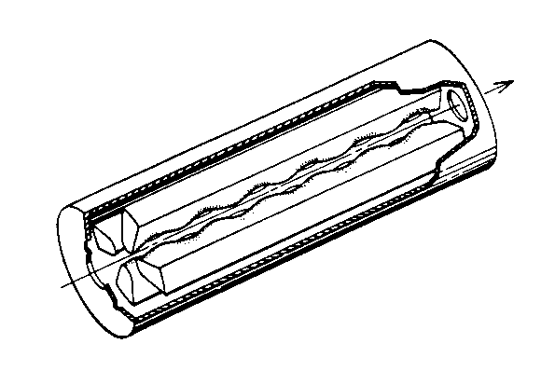
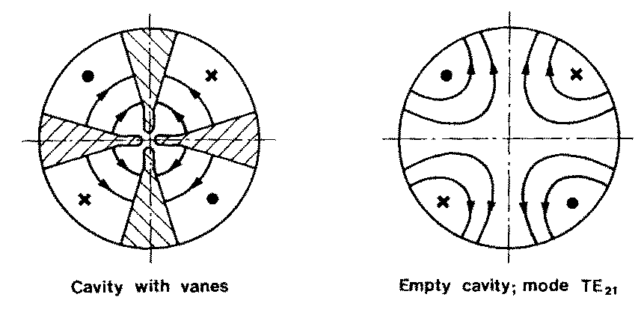
Radio Frequency Quadrupole
Basic structures
RFQ

Slide 11
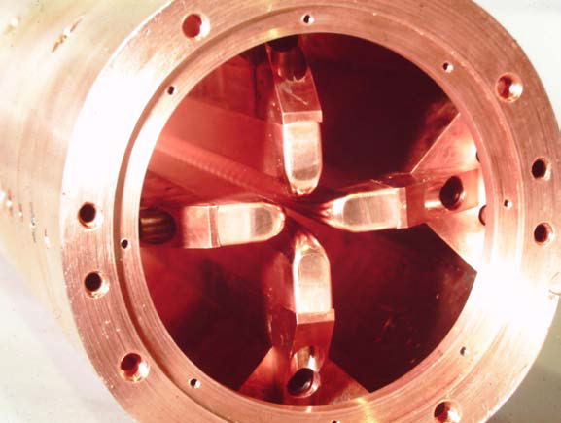
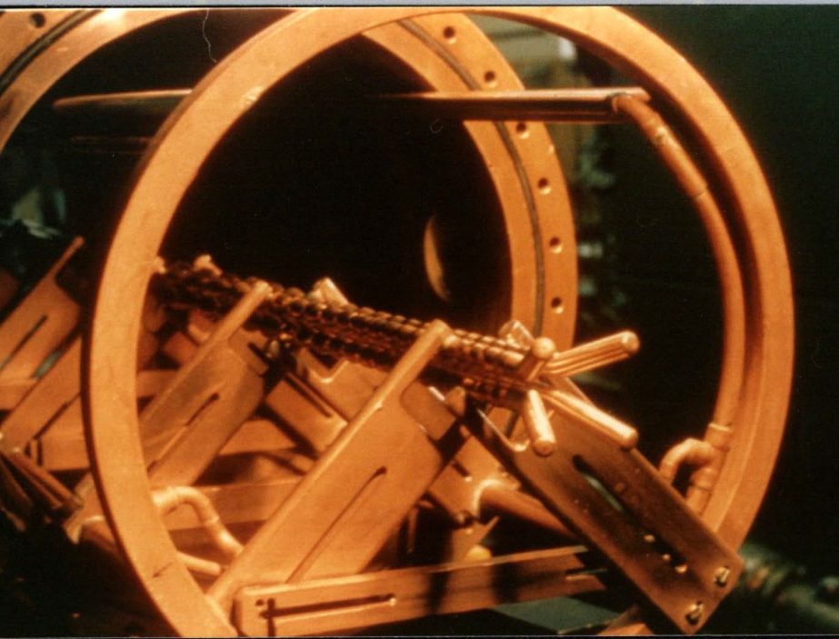
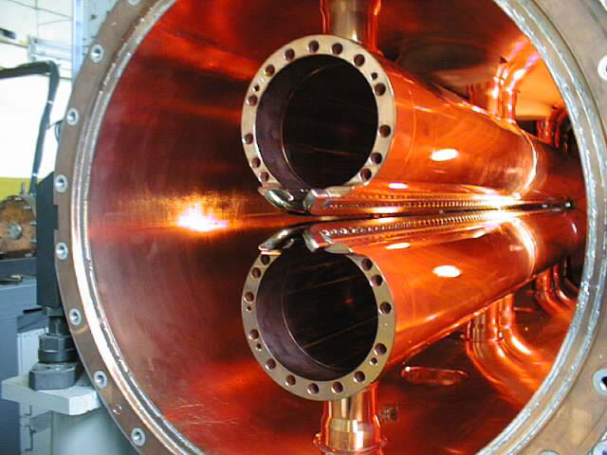
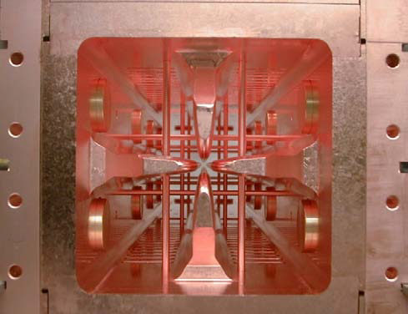
Radio Frequency Quadrupole
Basic structures
RFQ

Slide 12
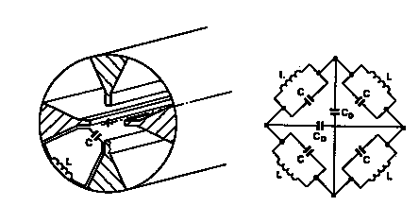
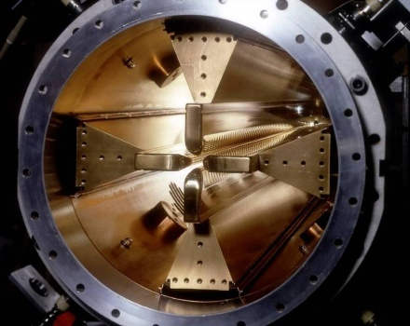
4 vane-structure
Basic structures
RFQ
Capacitance between vanes, inductance in the intervane volume.
Each quadrant is a resonator
Frequency depends on cylinder dimensions.
Vane tip are machined by a computer controlled milling machine.
Need stabilization (problem of mixing with dipole mode TE11).

Slide 13
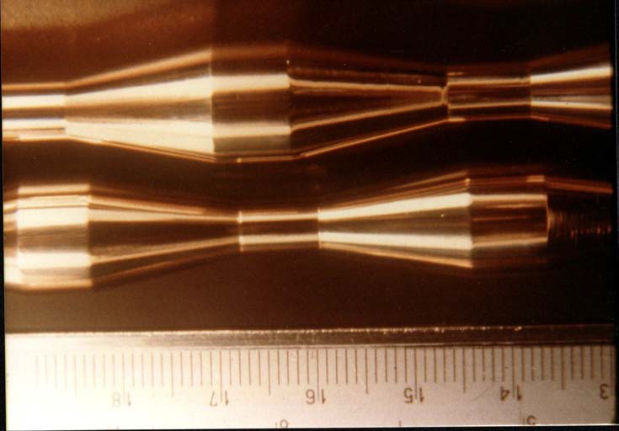
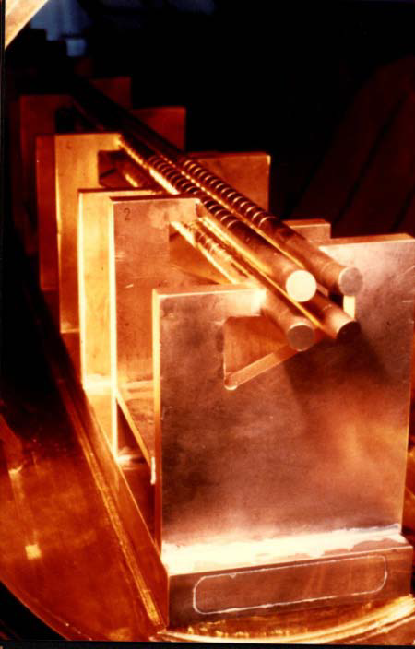
4 rod-structure
Basic structures
RFQ
Capacitance between rods, inductance with holding bars.
Each cell is a resonator
Cavity dimensions are independent from the frequency.
Easy to machine.
Problem with end cells. Less efficient than 4-vane due to strong current in holding bars.

Slide 14
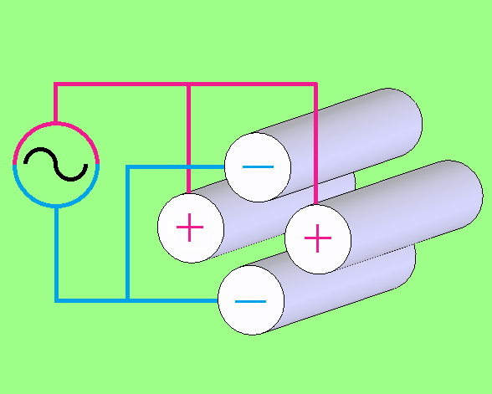
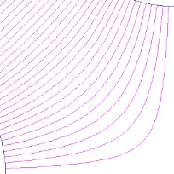
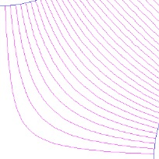
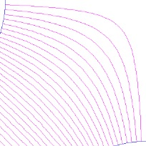
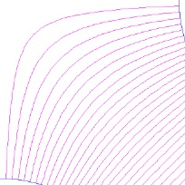
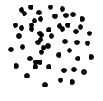


Radio Frequency Quadrupole
Basic structures
RFQ
-
-
+
+
+
-
-
-
-
-
-
+
-
+
+
+
+
+
-
+
-
+
+
-

Slide 15
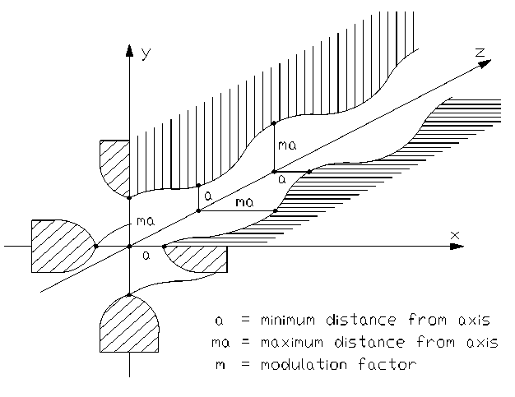
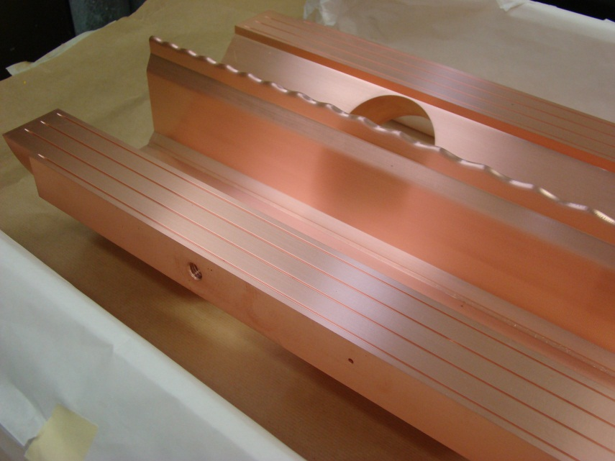
Acceleration in RFQ
Basic structures
RFQ
longitudinal modulation on the electrodes creates a longitudinal component in the TE mode

Slide 16
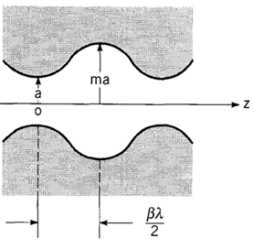
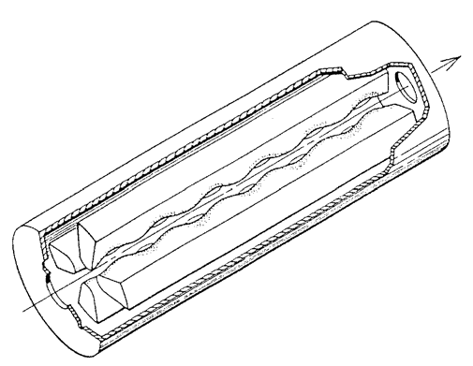
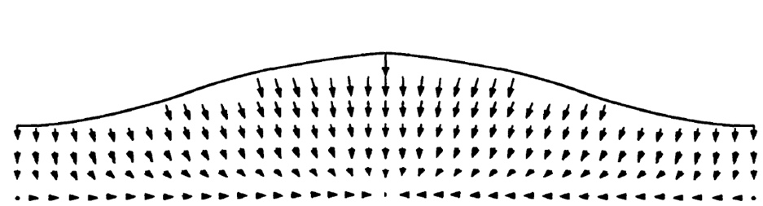
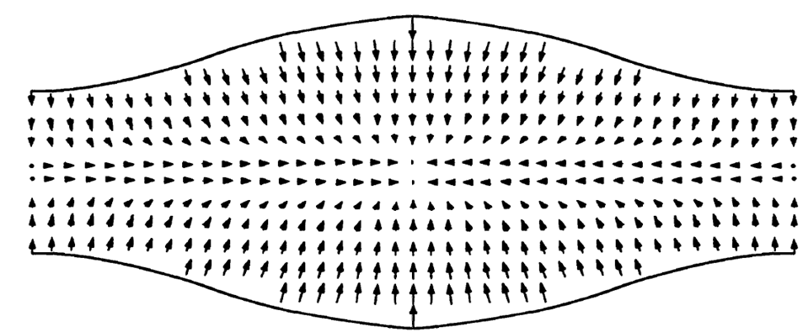
Acceleration in RFQ
Basic structures
RFQ
+
+
+
-
-
-

Slide 17
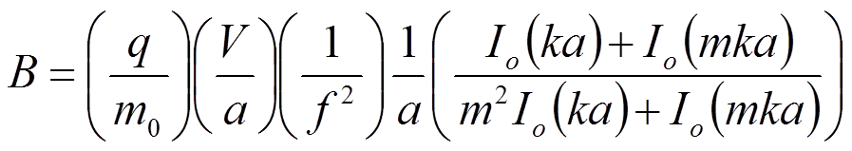
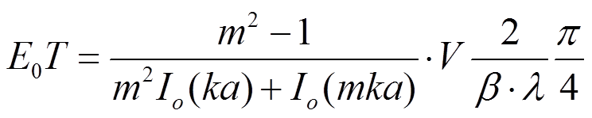
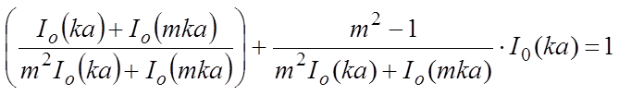
RFQ parameters
Basic structures
RFQ
Focusing term
Acceleration term
a=bore radius
m=modulation
m₀=rest mass
β=reduced velocity
λ=wave length
f=frequency
k=wave number
V=vane voltage
I_{0,1}= zero and first order Bessel function

Slide 18
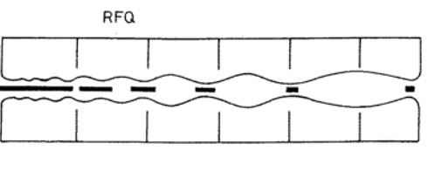
RFQ
Basic structures
RFQ
The resonating mode of the cavity is a focusing mode
Alternating the voltage on the electrodes produces an alternating focusing channel
A longitudinal modulation of the electrodes produces a field in the direction of propagation of the beam which bunches and accelerates the beam
Both the focusing as well as the bunching and acceleration are performed by the RF field
The RFQ is the only linear accelerator that can accept a low energy CONTINOUS beam of particles
1970 Kapchinskij and Teplyakov propose the idea of the radiofrequency quadrupole ( I. M. Kapchinskii and V. A. Teplvakov, Prib.Tekh. Eksp. No. 2, 19 (1970))
Acceleration
Bunching
Transverse focusing

Slide 19

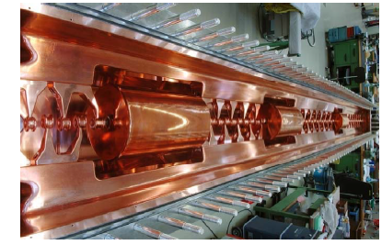
Interdigital H structure
Basic structures
IH

Slide 20
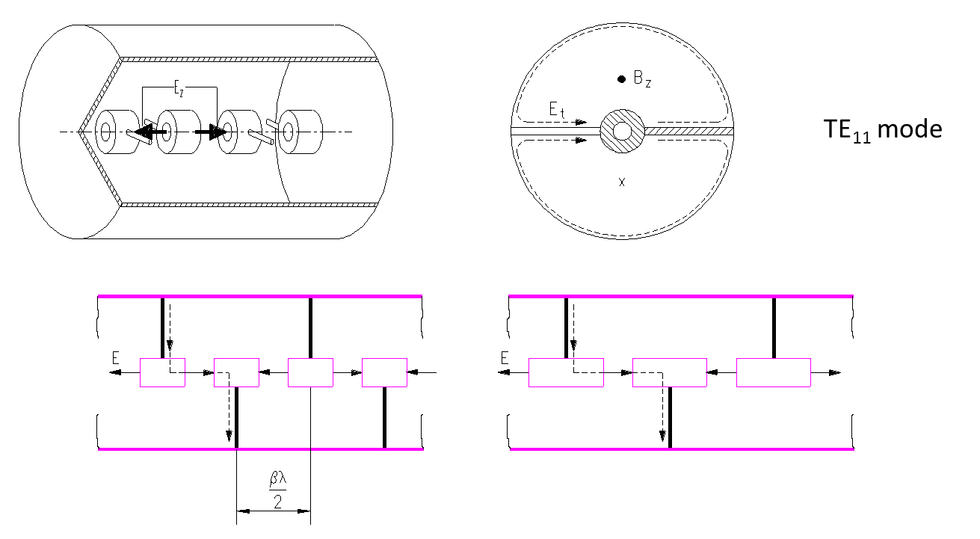
Interdigital H structure
Basic structures
IH
Stem on alternating side of the drift tube force a longitudinal field between the drift tubes
Focalisation is provided by quadrupole triplets places OUTSIDE the drift tubes or OUTSIDE the tank

Slide 21
Interdigital H structure
Basic structures
IH
very good shunt impedance in the low beta region ((β ≅ 0.02 to 0.08 ) and low frequency (up to 200MHz)
not for high intensity beam due to long focusing period
ideal for low beta heavy ion acceleration

Slide 22
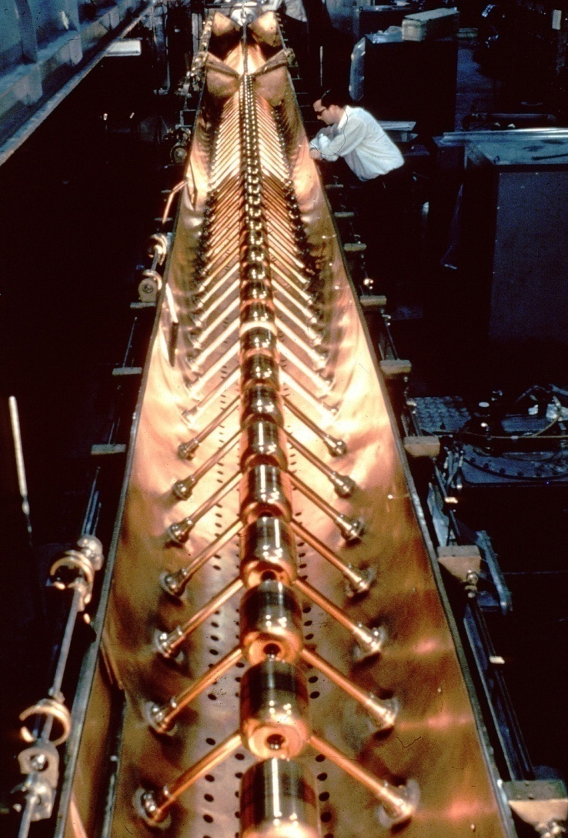
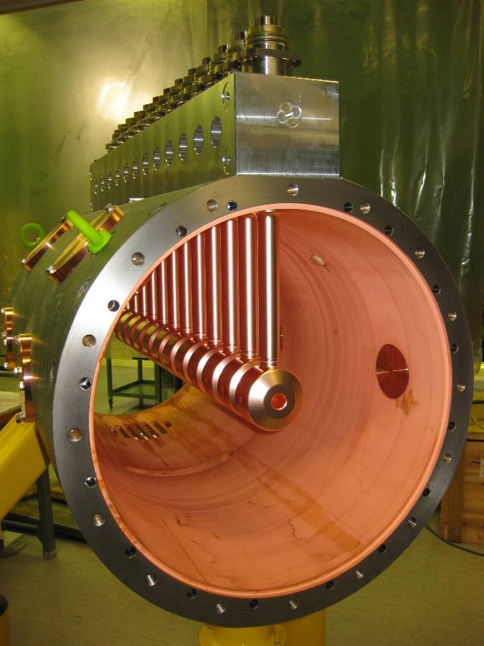
Drift Tube Linac
Basic structures
DTL

Slide 23
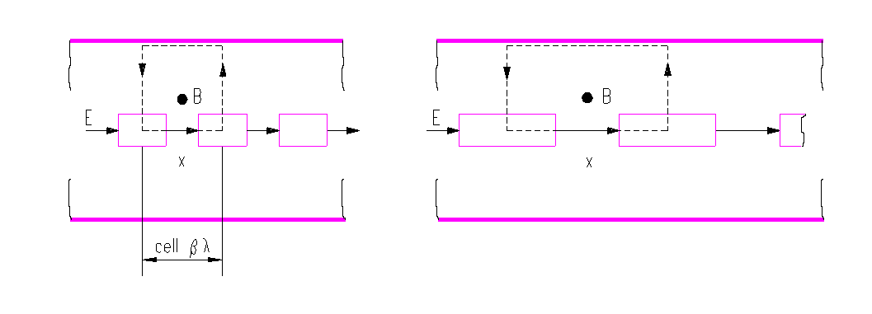
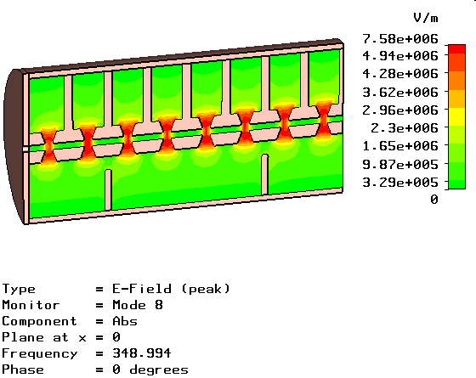
Drift Tube Linac
Basic structures
DTL
Tutorial !

Slide 24
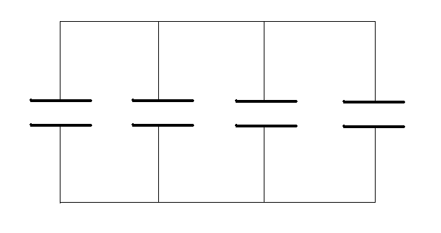
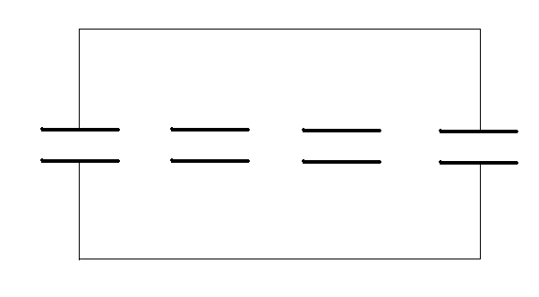
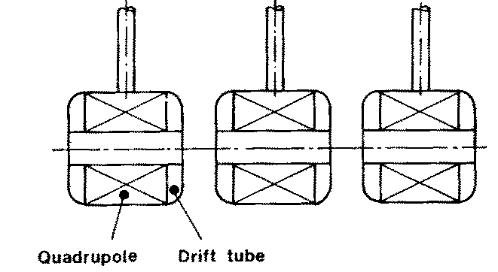

Drift Tube Linac
Basic structures
DTL
Disc loaded structure
Operation in 2π mode
Add tubes for high shunt impedance
Remove the walls to increase coupling between cells
Particles are inside the tubes when the electric field is decelerating.
Quadrupole can fit inside the drift tubes.
β=0.04-0.5 (750 keV – 150 MeV)
Synchronism condition for 2π mode :
Cell length should increase to account for the beta increase
Ideal for low β – low W - high current

Slide 25
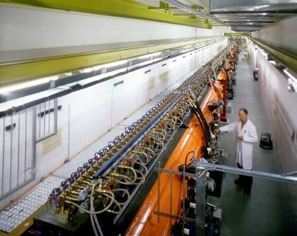
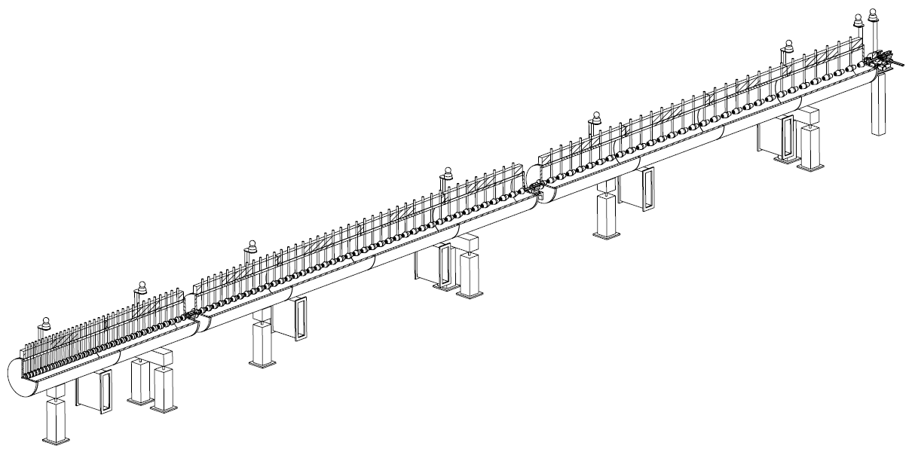
Drift Tube Linac
Basic structures
DTL
CERN Linac2 DTL
CERN Linac4 DTL

Slide 26
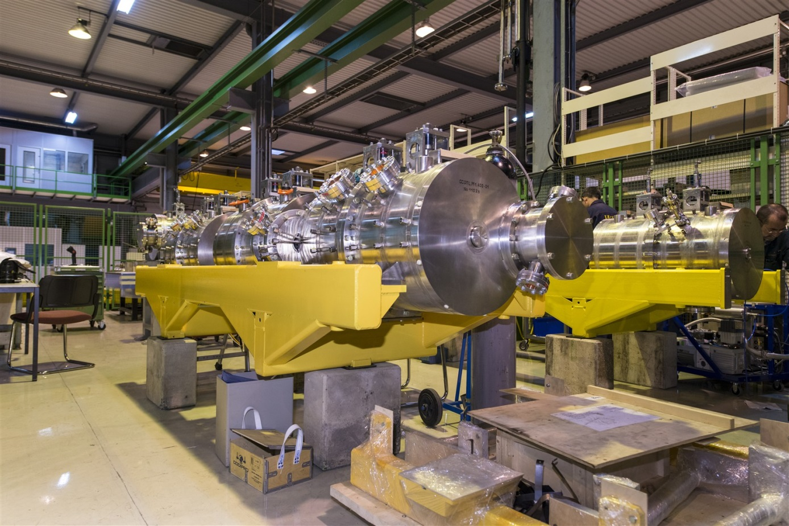
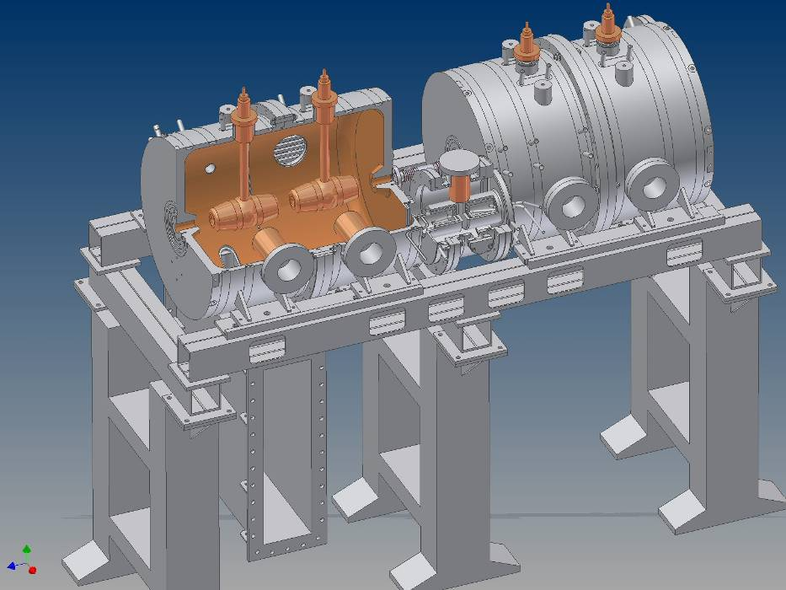
Coupled Cavity DTL
Basic structures
CCDTL

Slide 27

Coupled Cavity DTL
Basic structures
CCDTL

Slide 28


Side Coupled Cavity
Basic structures
SCL
multi-cell Standing Wave
structure in p/2 mode
frequency 800 - 3000 MHz
for protons (b=0.5 - 1)
Rationale: high beta ⇒ cells are longer ⇒ advantage for high frequencies
at high f, high power (> 1 MW) klystrons available ⇒ long chains (many cells)
long chains ⇒ high sensitivity to perturbations ⇒ operation in p/2 mode
Side Coupled Structure:
- from the wave point of view, p/2 mode
- from the beam point of view, p mode

Slide 29




Pi Mode Structure
Basic structures
PIMS
beam

Slide 30



Superconducting cavities
Some examples
Basic structures
SC cavities
Multi gap cavities (elliptical)
Operate in π mode
β>0.5-0.7
350-700 MHz (protons)
0.35-3 GHz (electrons)
Other SC cavities (spoke, HWR, QWR)
β>0.1
From 1 to 4 gaps.
Can be individually phased.
Space for transverse focusing in between
Ideal for low β - CW proton linacs.

Slide 31
The choice of the structures
Basic structures
Particle type : mass and charge
Beam current
Duty factor (pulsed, CW)
Frequency
Energy
Operational constraints
Cavity Type | Beta Range | Frequency | Particles
RFQ | Low! – 0.1 | 40-500 MHz | Protons, Ions
IH | 0.02 – 0.08 | 40-100 MHz | Ions (Protons)
DTL | 0.05 – 0.5 | 100-400 MHz | Protons, Ions
SCL | 0.5 – 1 (ideal is 1) | 600-3000 MHz | Protons, Electrons
HWR-QWR-Spokes | 0.02-0.5 | 100-400 MHz | Protons, Ions
Elliptical | > 0.5-0.7 | 350 – 3000 MHz | Protons, Electrons
Not exhaustive list – To take with caution !!!

Slide 32
The choice of the structures
Basic structures
Particle type : mass and charge
Beam current
Duty factor (pulsed, CW)
Frequency
Energy
Operational constraints
Cavity Type | Beta Range | Frequency | Particles
RFQ | Low! – 0.1 | 40-500 MHz | Protons, Ions
IH | 0.02 – 0.08 | 40-100 MHz | Ions (Protons)
DTL | 0.05 – 0.5 | 100-400 MHz | Protons, Ions
SCL | 0.5 – 1 (ideal is 1) | 600-3000 MHz | Protons, Electrons
HWR-QWR-Spokes | 0.02-0.5 | 100-400 MHz | Protons, Ions
Elliptical | > 0.5-0.7 | 350 – 3000 MHz | Protons, Electrons
To
Take with
CAUTION !!!
Not exhaustive list – To take with caution !!!

