Slide 1
JUAS
February 17th 2014
Introduction to MAGNETS
Davide Tommasini

Slide 2

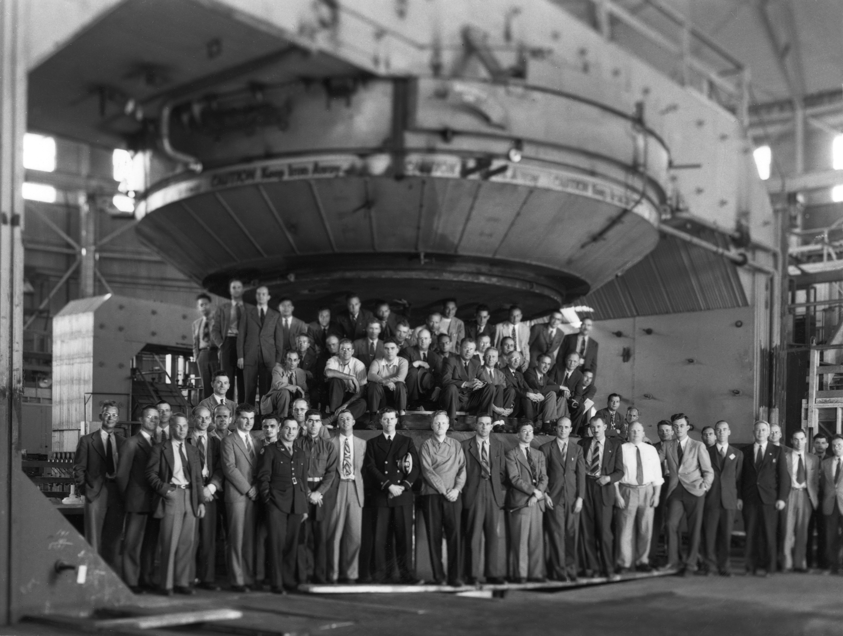
You know how to use a magnetic field
You will learn how to produce a magnetic field

Slide 3
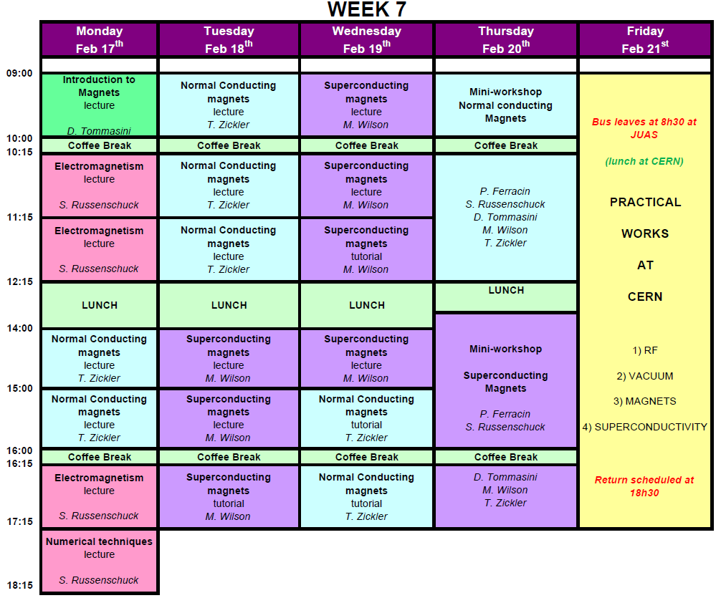
The magnet week

Slide 4
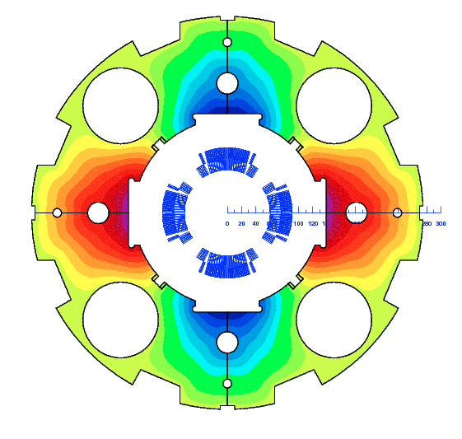
Electromagnetism
Stephan Russenschuck
Studying the structure of Maxwell’s equations yields a deeper understanding of the concepts in magnet design and raises awareness of their limitations.
Course outline:
The global and local forms of Maxwell’s equations, magnetic circuits
The solution of boundary value problems
The generation of harmonic fields
Integral quantities of fields; magnetization, energy and inductance

Slide 5
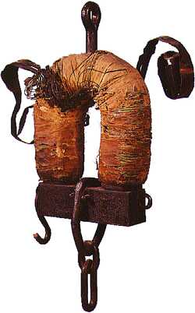
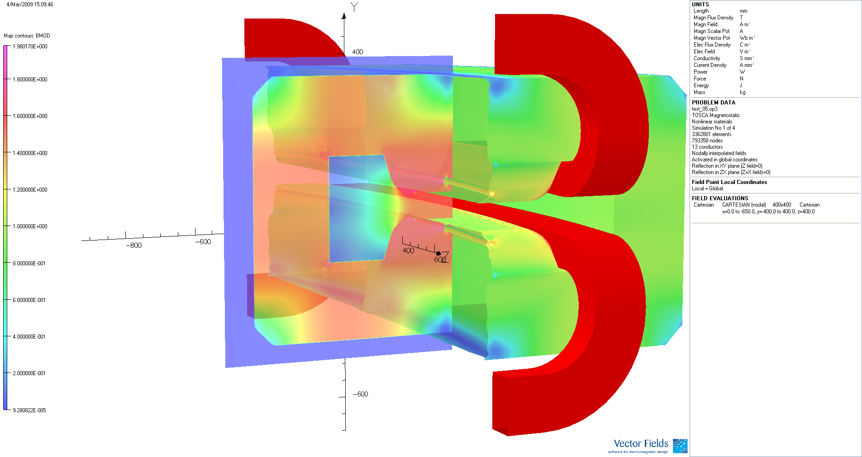
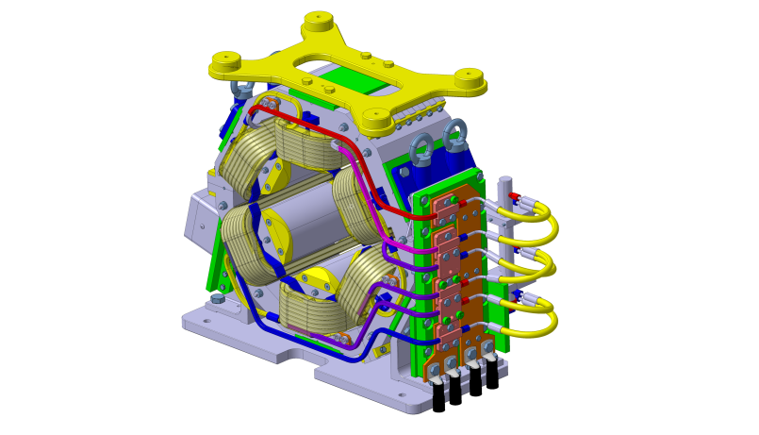
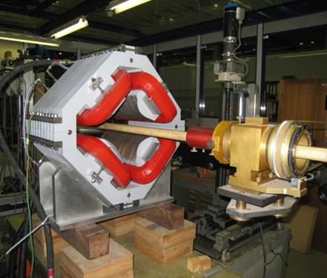
Normal-conducting accelerator magnets
Thomas Zickler
Main goal is to:
    create a fundamental understanding in accelerator magnet technology
    provide a guide book with practical instructions how to start with the design of a standard accelerator magnet
    focus on applied design aspects using ‘real’ examples
    introduce finite element codes for practical magnet design
    present practical aspect of magnet construction, testing and measurements supported by examples of recently built magnets
3D-field homogeneity

Slide 6
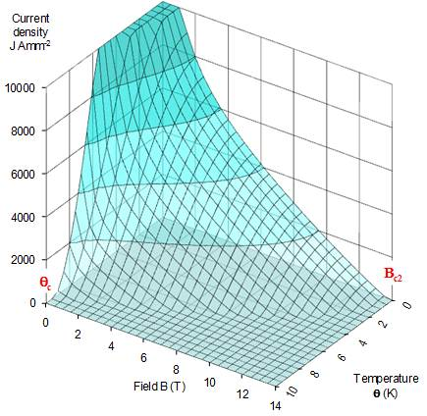
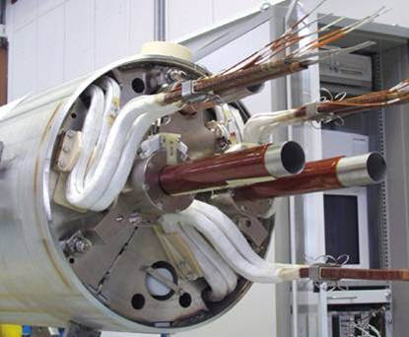
1) Introduction to Superconductors: critical field, temperature & current, superconductors for magnets, manufacture of superconducting wires, high temperature superconductors HTS.
2) Magnetization, Cables & AC losses: superconductors in changing magnetic fields, filamentary superconductors and magnetization, coupling between filaments in wires, why cables, coupling in cables, AC losses in changing fields.
3) Magnets, ‘Training’ & Fine Filaments: coil shapes for solenoids, dipoles & quadrupoles, engineering current density & load lines, degradation & training, minimum quench energy, critical state model & fine filaments.
4) Quenching and Cryogenics: the quench process, resistance growth, current decay, temperature rise, quench protection schemes, cryogenic fluids, refrigeration, cryostat design
5) Practical Matters: LHC quench protection, current leads, accelerator magnet manufacture, some superconducting accelerators.
Superconducting Accelerator Magnets
Martin Wilson

Slide 7
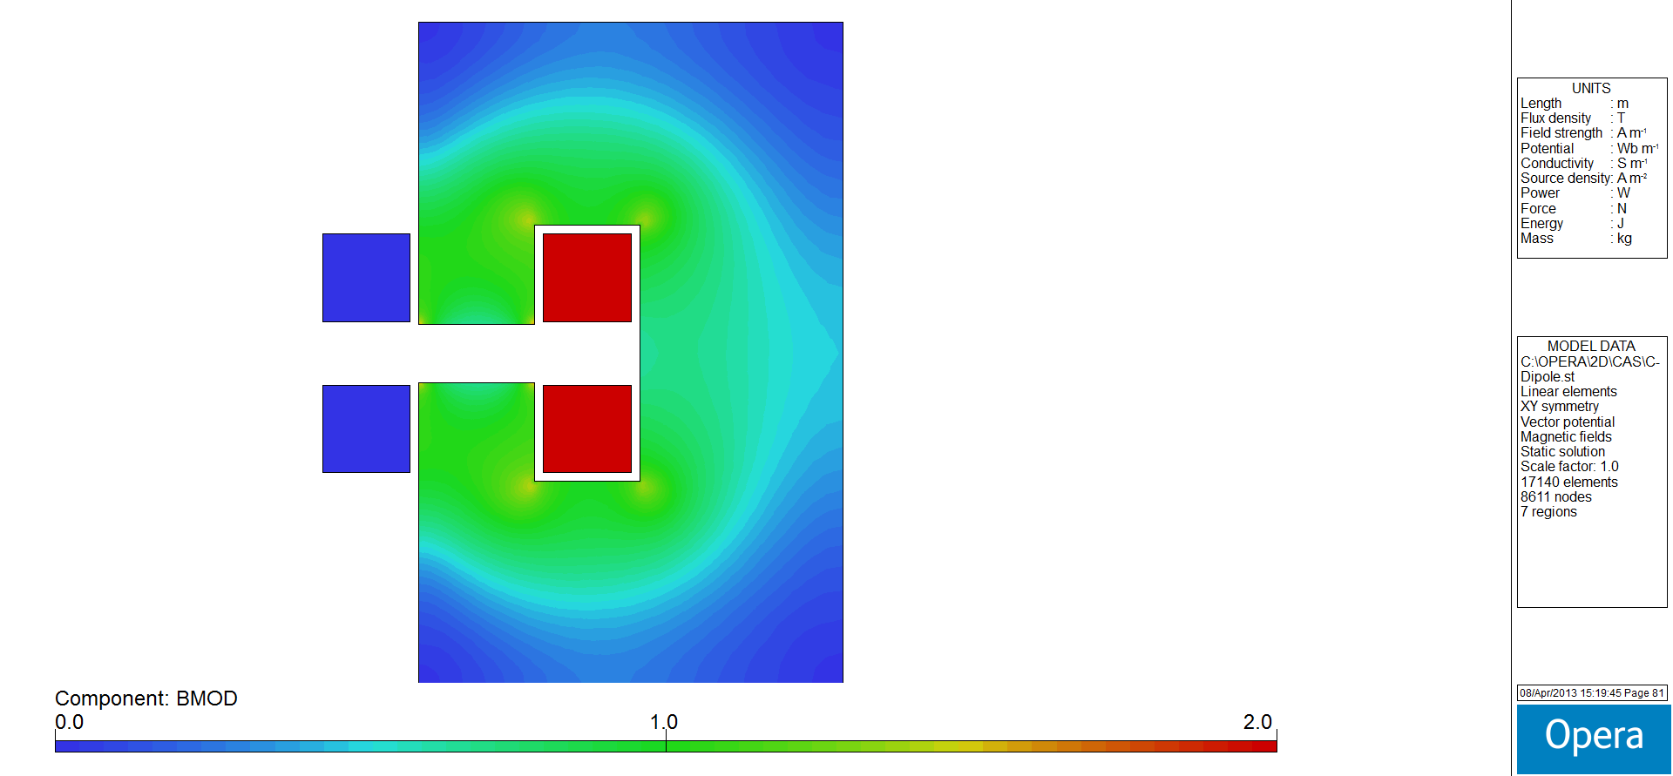
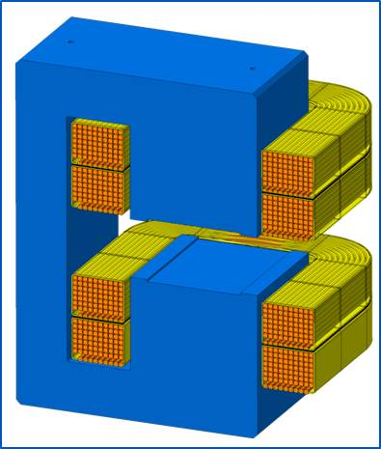
Mini-workshop on normal conducting magnets
Coordinated by Thomas Zickler
Goal: outline design of a normal conducting magnet
  Apply the theory explained during lectures to a practical case
  Solve a case study using the tools provided during the presentations
  Understand physics and reasoning behind design options
Provide a short report of the results (credit points)

Slide 8
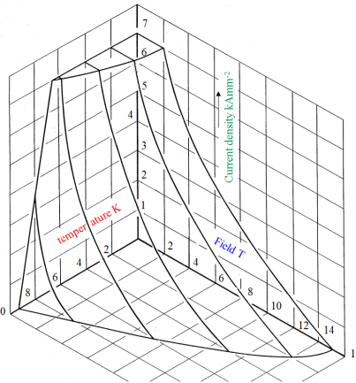
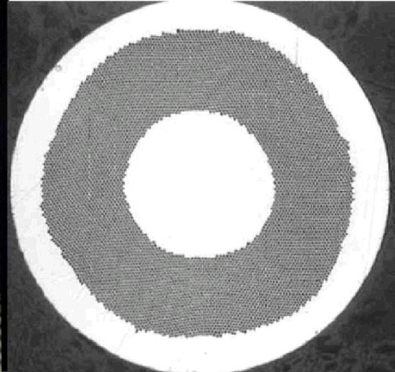

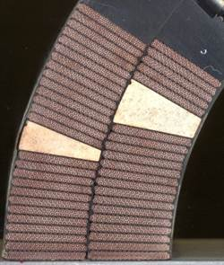
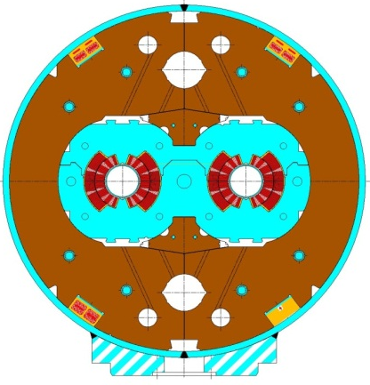
Mini-workshop on superconducting magnets
Coordinated by Paolo Ferracin
Goal: outline design of a super-conducting magnet
  Apply the theory explained during lectures to a practical case
  Solve a case study using the tools provided during the presentations
  Understand physics and reasoning behind design options
Provide a short report of the results (credit points)
Superconducting material
Superconducting strand
Superconducting cable
Superconducting coil
Superconducting magnet

Slide 9
Example 1
you need a bending field integral of 2.5 Tm over
How big is the magnet (cross section, length, weight)?
How much does it cost?
What do you need to operate it?
  Nothing?
  Water?
  Oil?
  Electricity?
  Other?
How do you manufacture it?
How do you check that it works well?

Slide 10
Example 1I
you need a bending field integral of 2.5 25 Tm over
How big is the magnet (cross section, length, weight)?
How much does it cost?
What do you need to operate it?
  Nothing?
  Water?
  Oil?
  Electricity?
  Other?
How do you manufacture it?
How do you check that it works well?

Slide 11
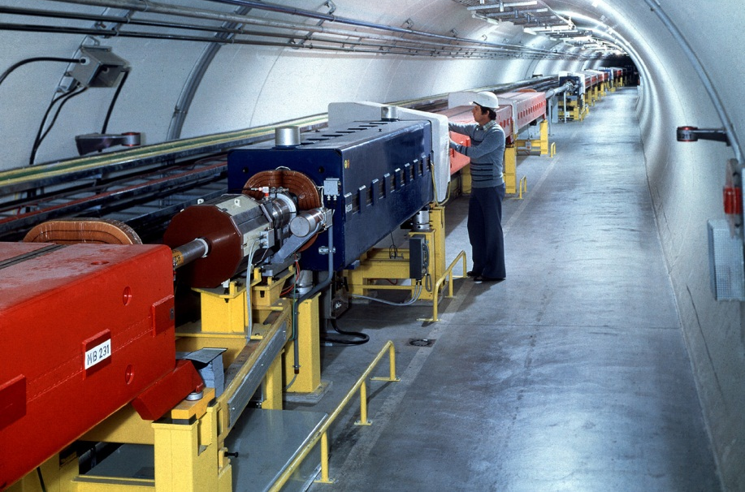
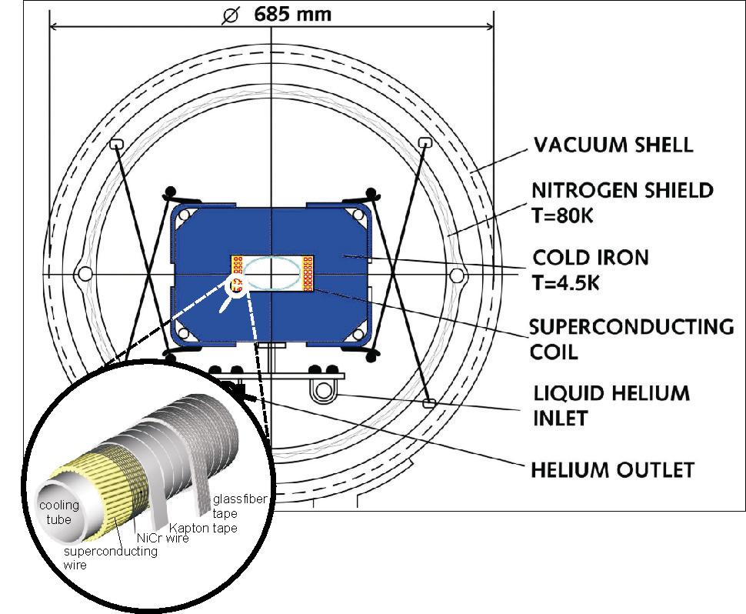
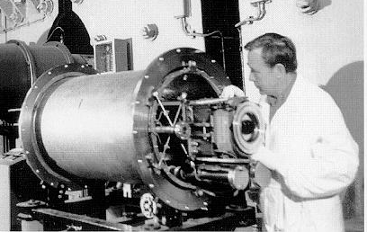
Field range up to 2 T
I
I
B

Slide 12
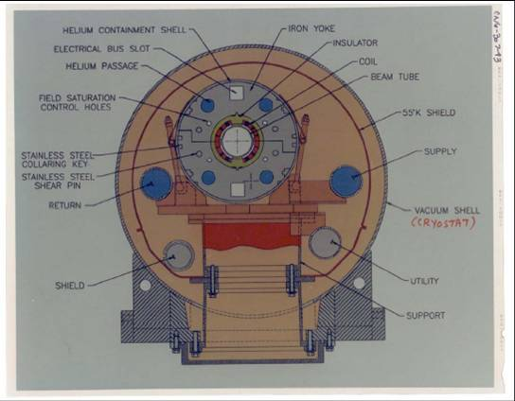
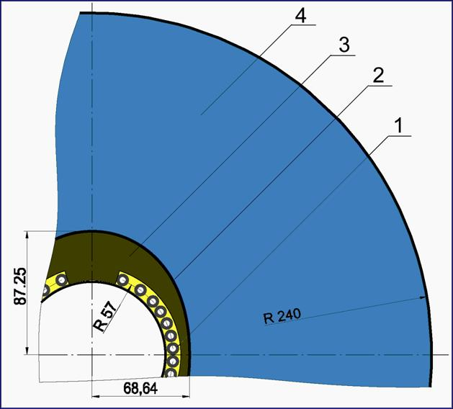
Field range up to 4 T
Above 2 T the magnet is no longer iron dominated, but can be “iron helped”
A Kovalenko

Slide 13
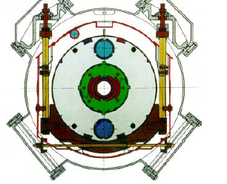
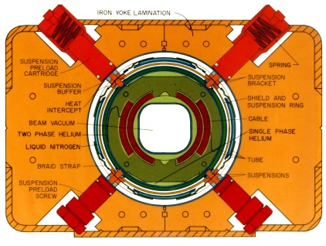
Field range from 4 to 7 T
76.2 mm aperture, 4 T
75 mm aperture, 4.7 – 5.5 T
TEVATRON
The first successful use of sc magnets in a machine Commissioned in 1983, running today at 980 GeV
HERA
The first massive industrialization.
Commissioned in 1989 at 800 GeV, 920 GeV today

Slide 14
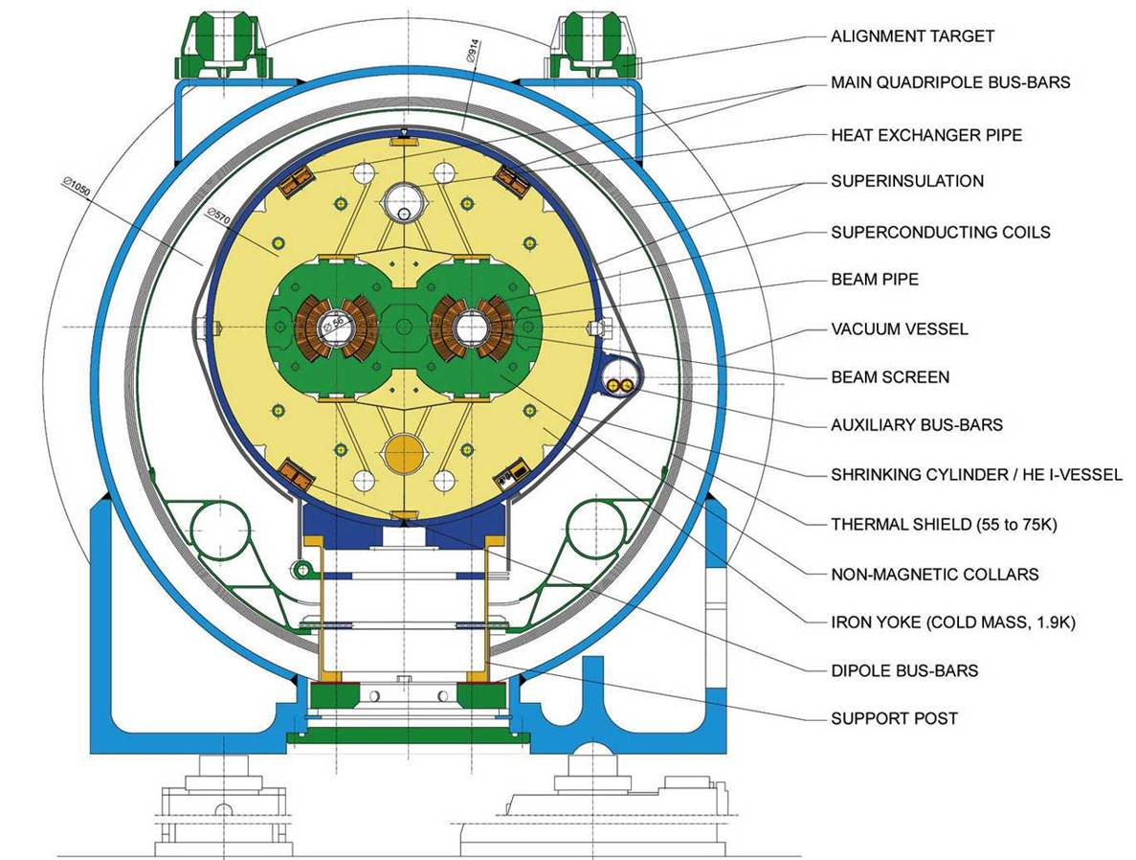
Up to 9T

Slide 15
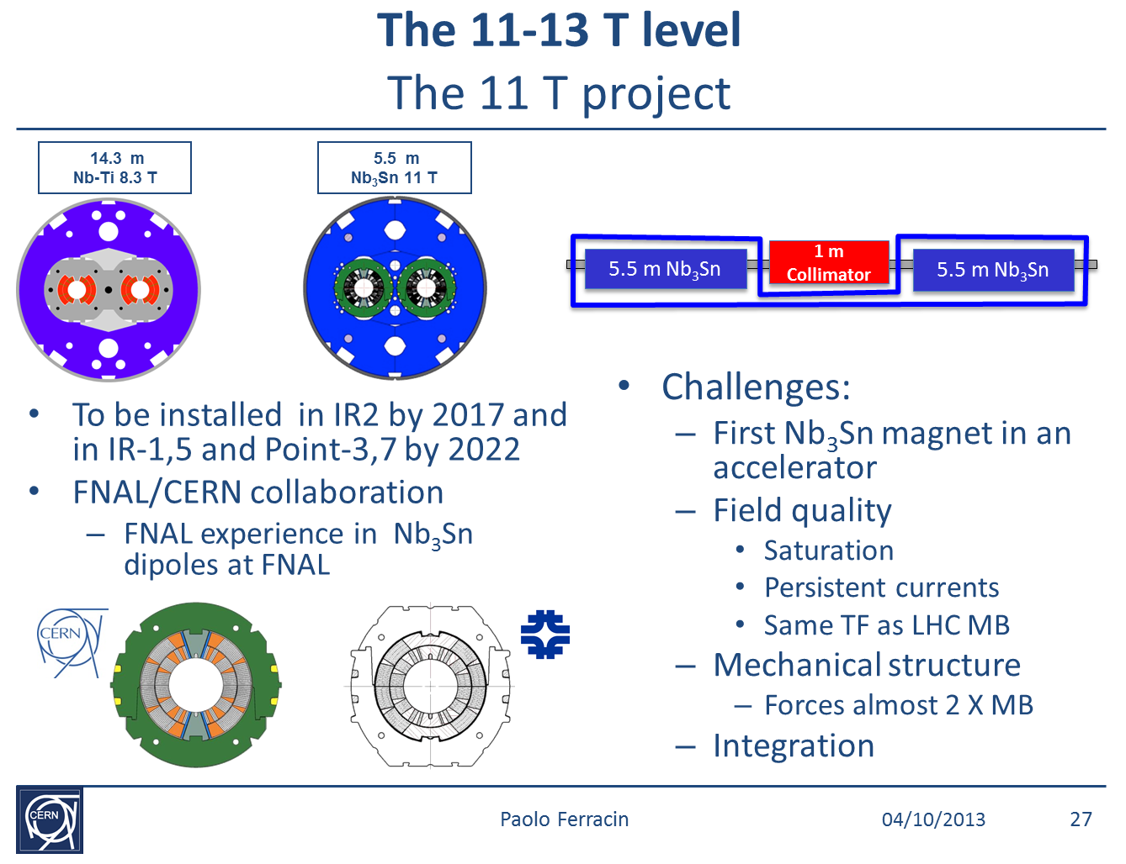

Slide 16
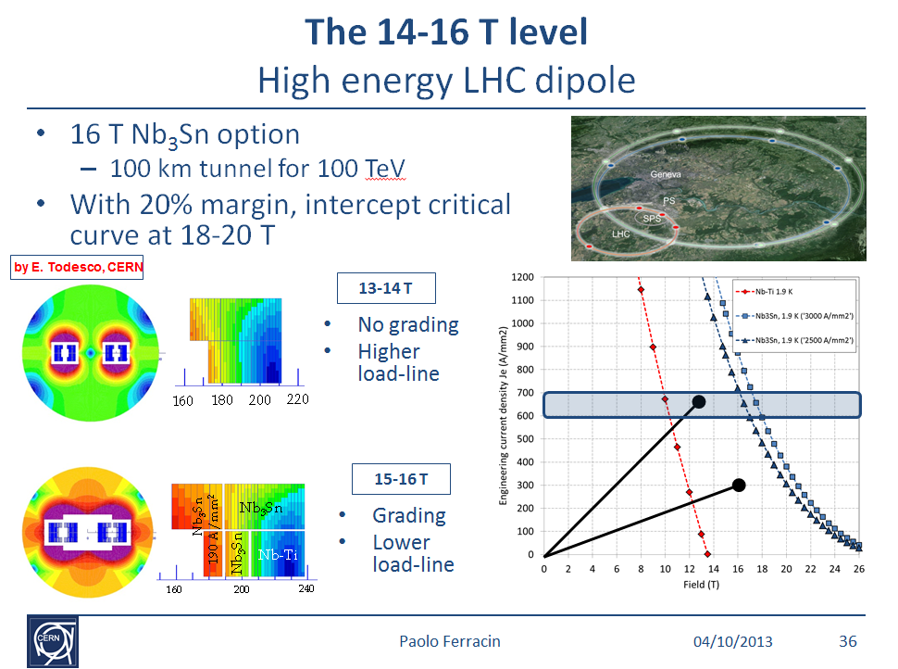

Slide 17
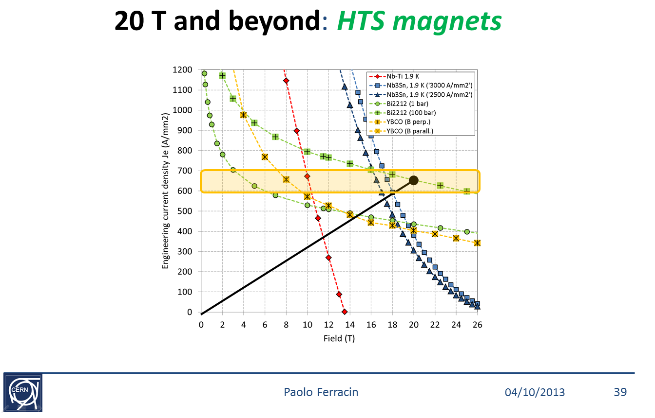

Slide 18
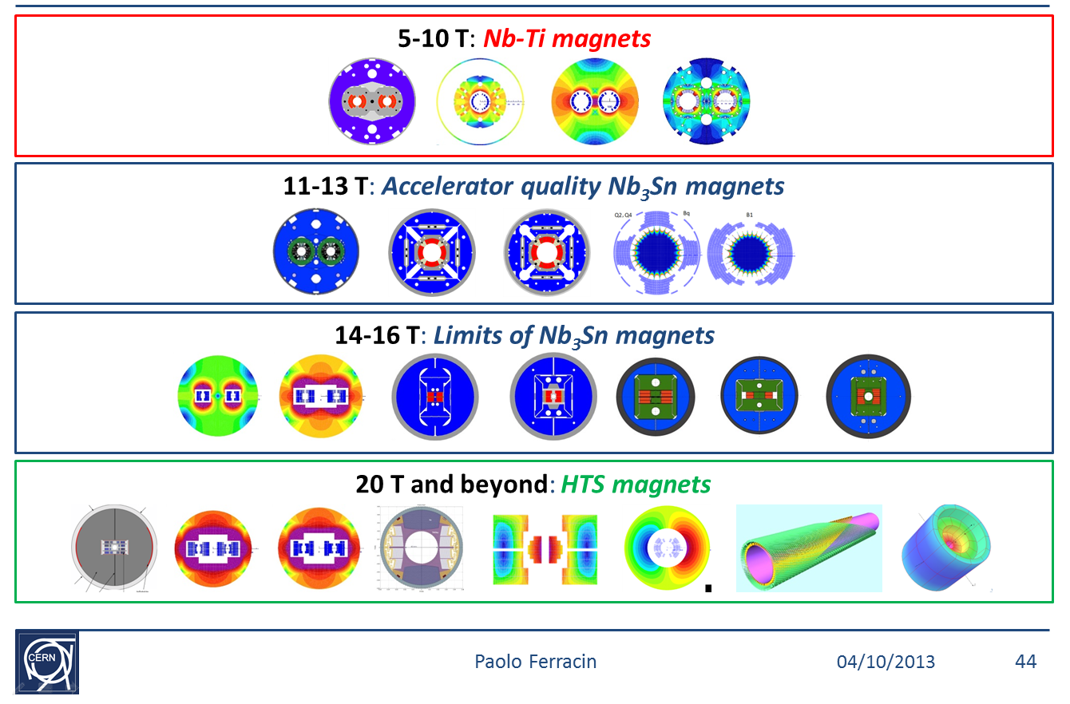

Slide 19
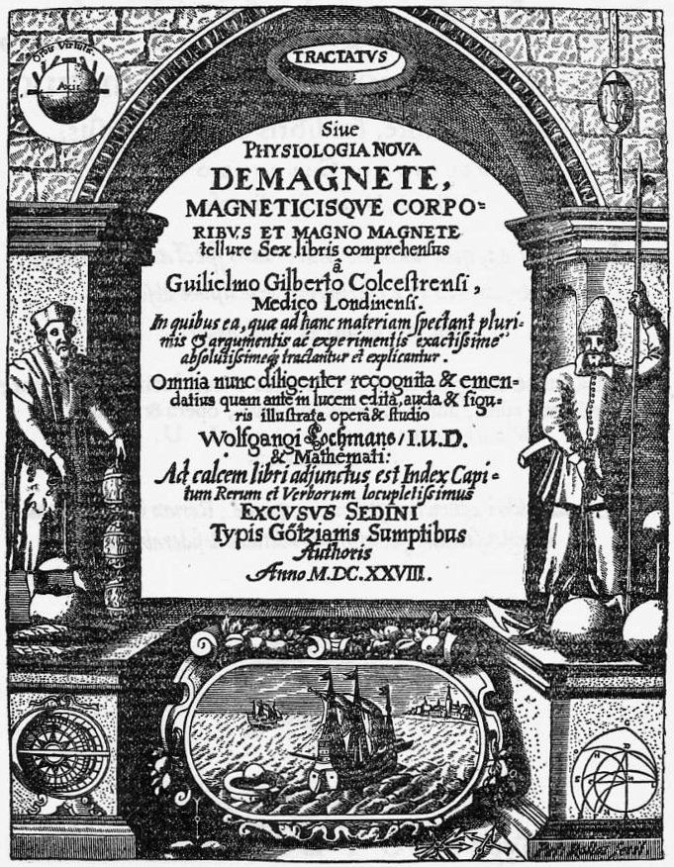
Basic Principles

Slide 20
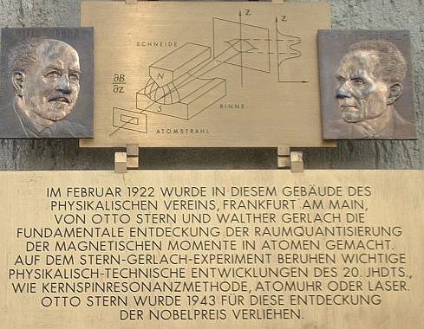
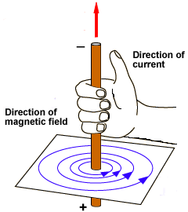
Generation of a Magnetic Field
originated by electrical charges
when they produce an electrical current or a variation of electrical field over time
not only transport and orbital but also spin

Slide 21
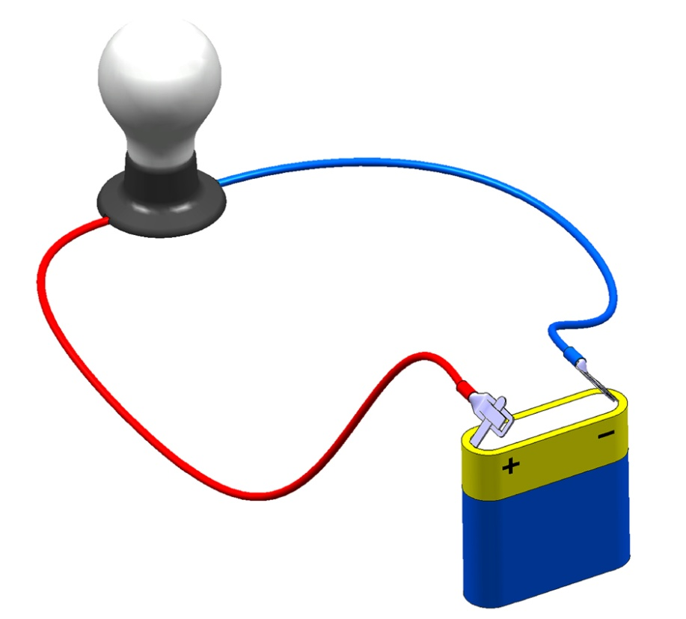
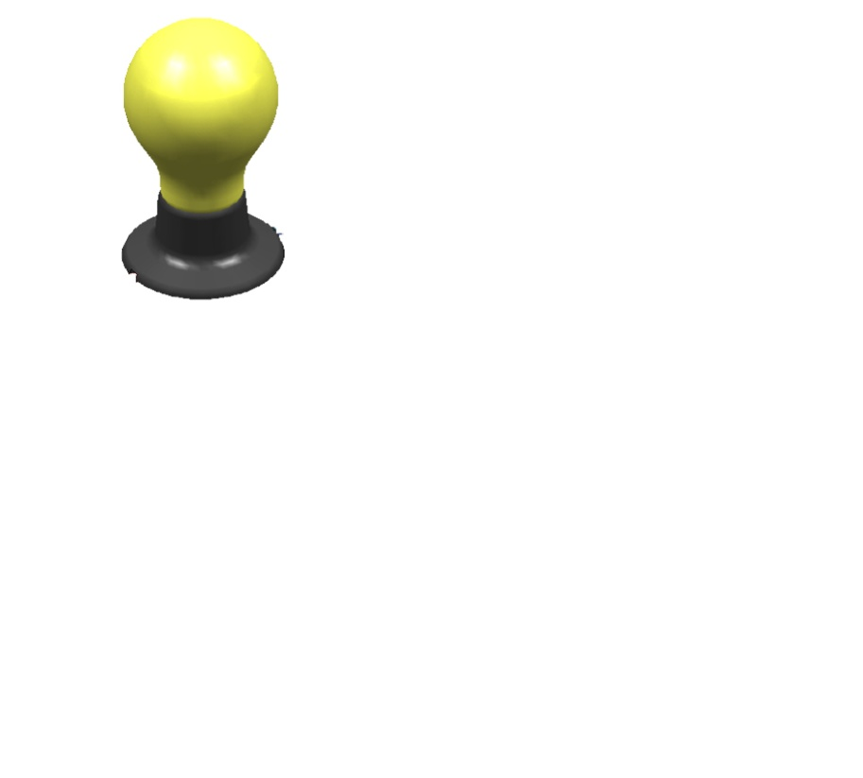
Magneto-motive force
Basic principles : electric circuit
iron
core
coil
magnetic field
current
air
gap
NI = R x Φ
Little magnetomotive force in the iron
Iron is the highway of magnetic field
ΔV = R x I
Little voltage drop across the wires
Wires are the highways of electricity

Slide 22
Inductance
Basic principles : inductance
The inductance is the equivalent of the inertia.
A large inertia (I)/inductance (L) means you need:
a large force to suddenly increase the speed
a large voltage to suddenly increase the current/field
you can store energy in a wheel rotating at speed ω
you can store energy in a coil supplied by a current i
When the magnetic field has to be quickly changed you want to keep the inductance low, typically by reducing the number of coil turns.

Slide 23
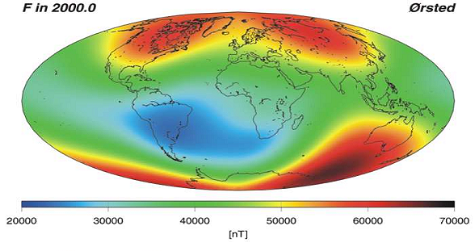

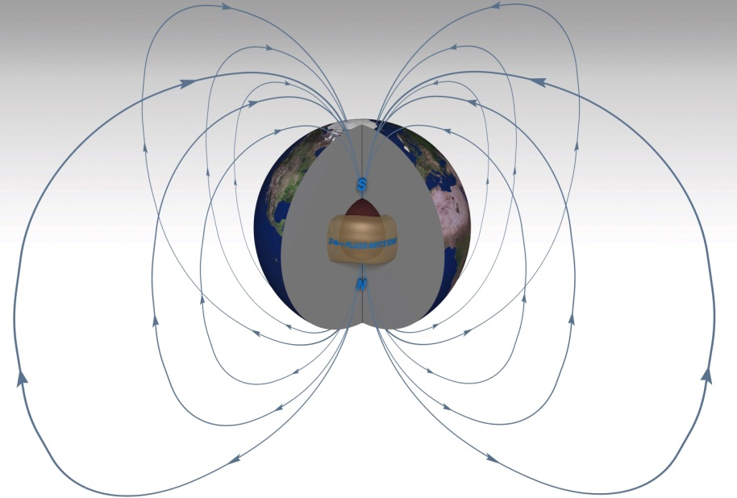
FLUX
speed=flow/section
field=flux/section
Source: http://smsc.cnes.fr/OVH/

Slide 24
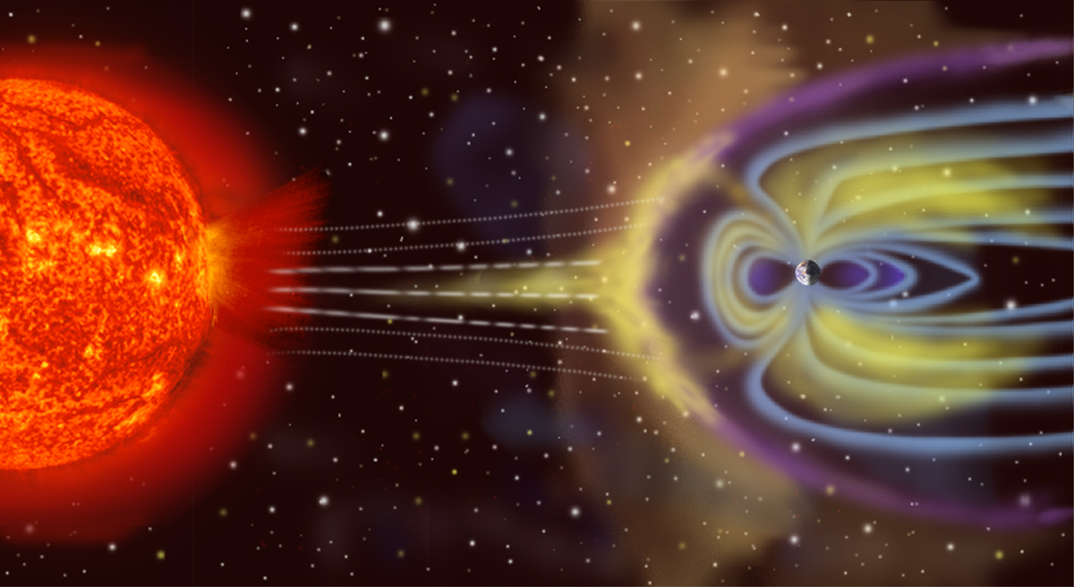

Slide 25


Slide 26
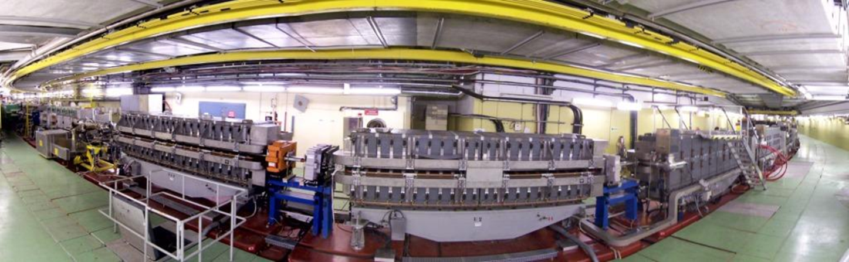
Accelerator magnets
operation mode
physical constraints (space, transport, weight ...)
strength
good field region (may depend on working point)
field quality at the different working conditions
physical aperture
power supply
cooling
radiation
alignment
reliability
protection
do consider the global picture
1959

Slide 27
Thanks

