Slide 2
Vacuum Technology for Particle Accelerators
JUAS 2013
Paolo Chiggiato
Technology Department
Vacuum Surfaces and Coatings Group
CERN, CH-1211 Geneva
A quick view of vacuum technology
The basis of vacuum technology: pressure, conductance, pumping speed
Calculation of simple pressure profiles
Gas sources: thermal outgassing and beam-induced desorption
Gas pumping: momentum-transfer and capture pumps
Instruments
Seminar: Example of vacuum system design for particle accelerators (by Roberto Kersevan)

Slide 3
Selected books
Karl Jousten (Ed.), Handbook of Vacuum Technology Book (Verlag-VCH, Weinheim, 2008)
James M. Lafferty (Ed.), Foundations of Vacuum Science and Technology (John Wiley and Sons, 1998)
Berman, Vacuum Engineering calculation, Formulas, and Solved Exercises (Academic Press, 1992)
P. A. Redhead, J. P. Hobson, E. V. Kornelsen, The Physical Basis of Ultrahigh Vacuum, (Chapman and Hall, 1968)
John F. O'Hanlon, A User's Guide to Vacuum Technology
Handbook of Materials and Techniques for Vacuum Devices (AVS Classics in Vacuum Science and Technology)
A. Berman, Total pressure measurement in vacuum technology, Academic Press, 1985

Slide 4
Part 1
A quick view of vacuum technology

Slide 5
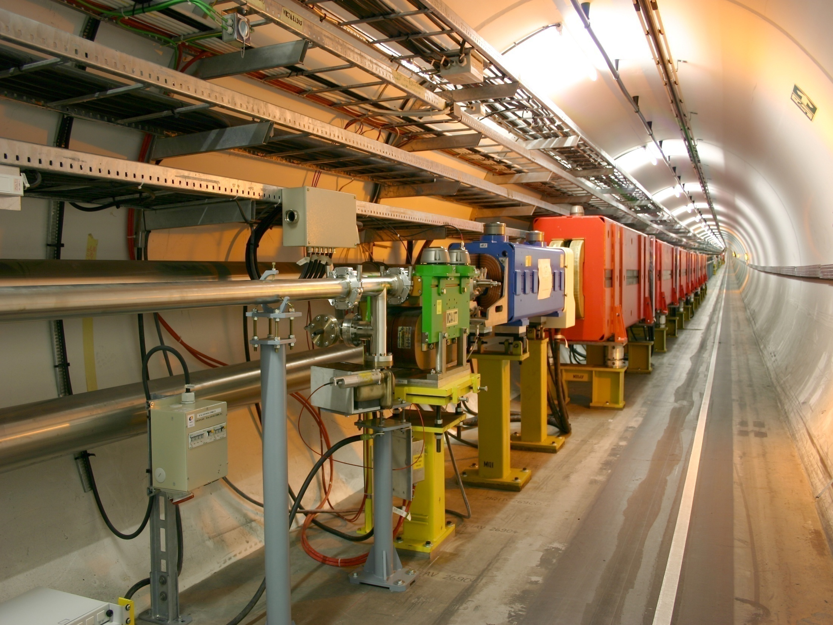
A quick view of vacuum technology
Vacuum systems are made of several components. The connection between them is obtained by flanges.
Flange
Beam pipe
Pump (sputter ion pump)

Slide 6
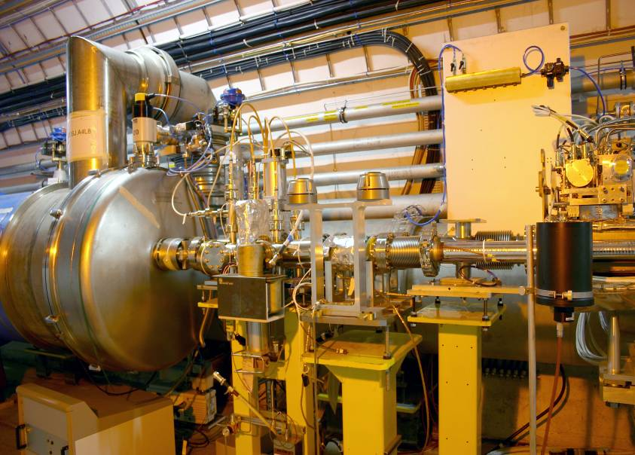
A quick view of vacuum technology
Sector valves
Beam pipe & NEG coating
A vacuum sector is delimited by gate valves.
The pressure is monitored in each vacuum sector by gauges.
The beam pipes can be at different temperatures
Room temp.
cold
Pressure measurement
Flange
Pump (sputter ion pump)

Slide 7
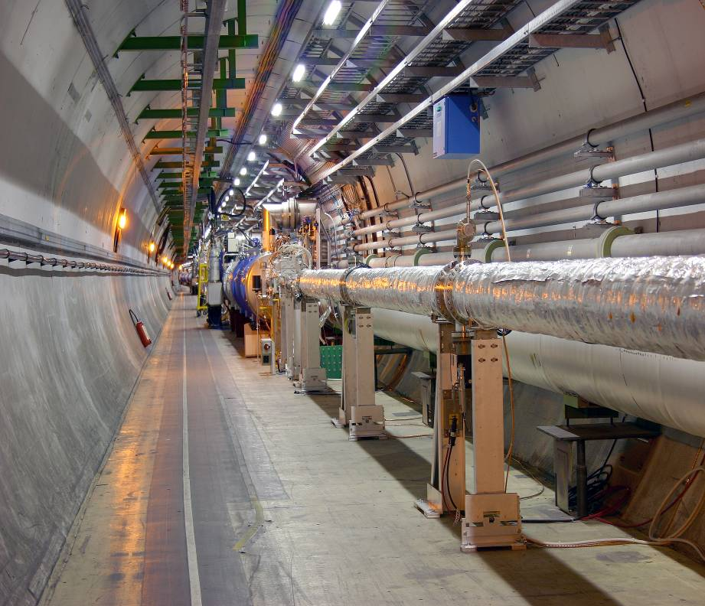
A quick view of vacuum technology
Sector valves
Beam pipe & NEG coating
Gauge
Pump (sputter ion pump)
Flange

Slide 8
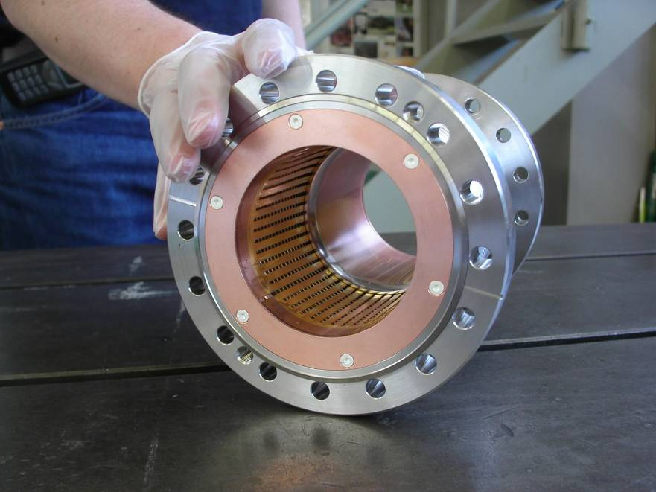
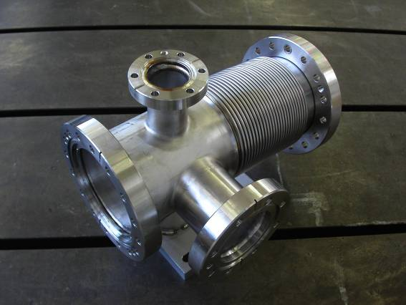
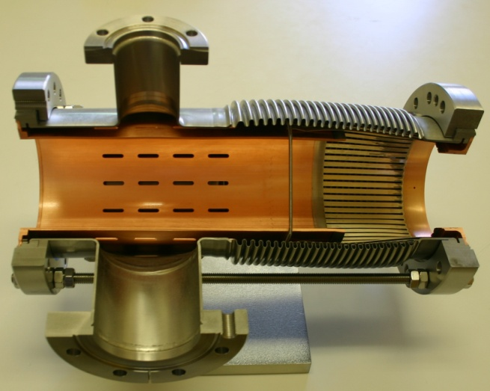
A quick view of vacuum technology
Sector valves
Example of vacuum components:
pumping ports
bellows
RF shield
flanges

Slide 9
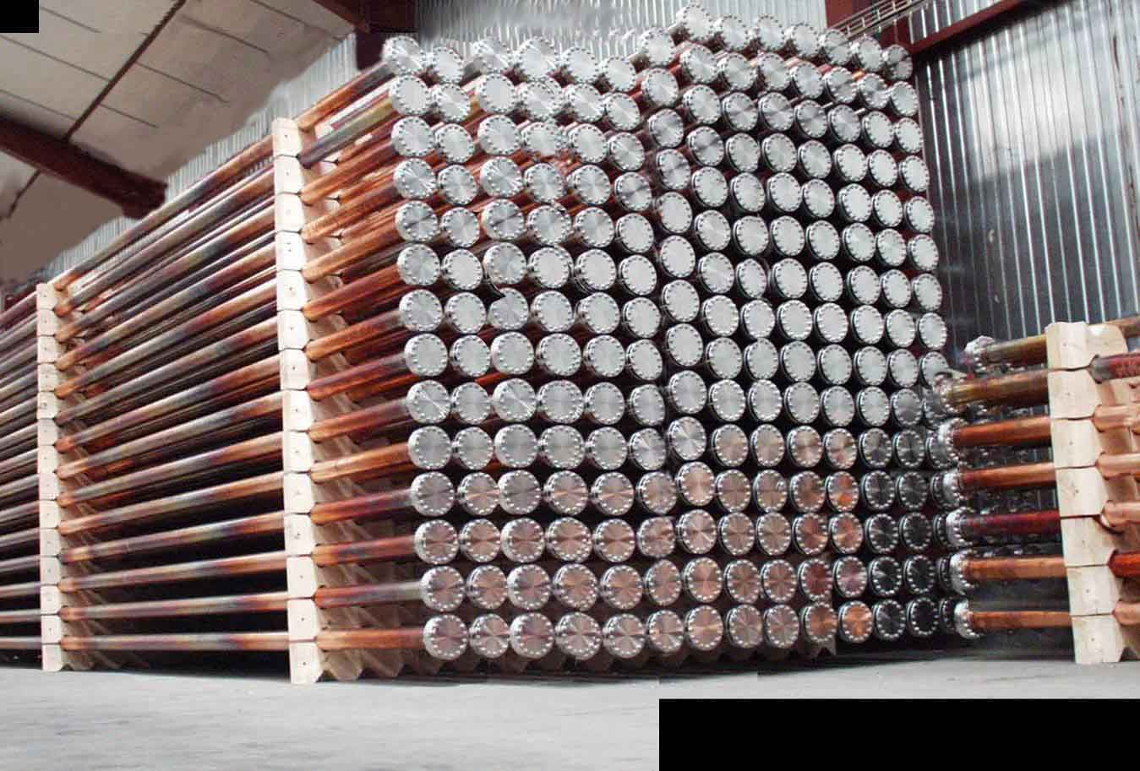
A quick view of vacuum technology
Sector valves
Example of vacuum components:
Copper beam pipes with stainless steel flanges

Slide 10
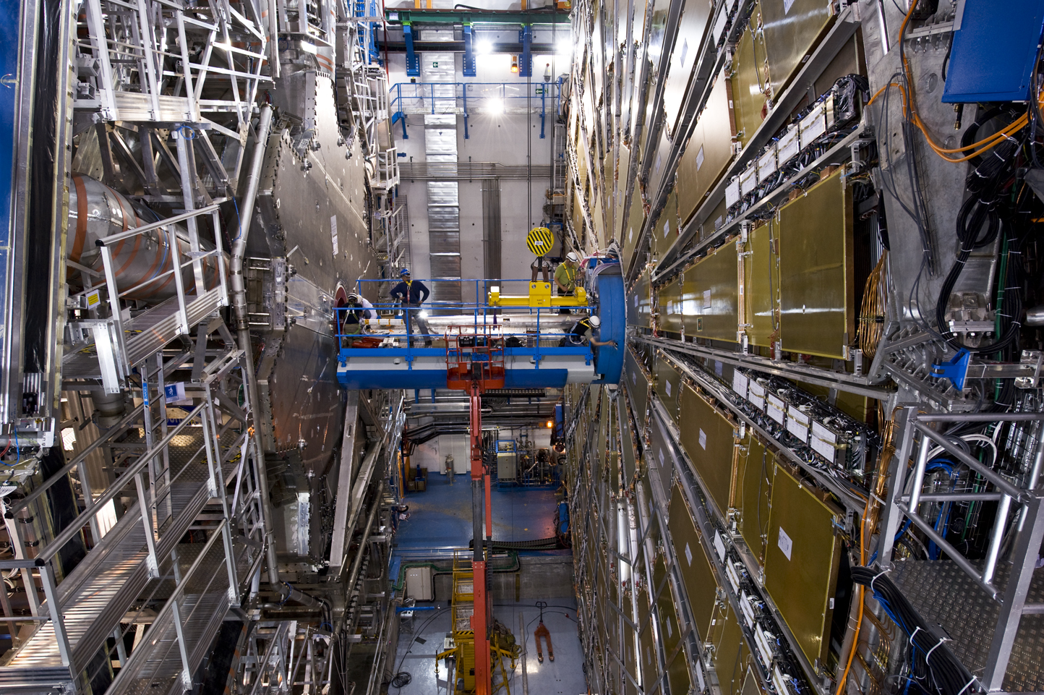
A quick view of vacuum technology
Sector valves
Example of vacuum components:
Beryllium beam pipes in the collision area of the ATLAS experiment (CERN)

Slide 11
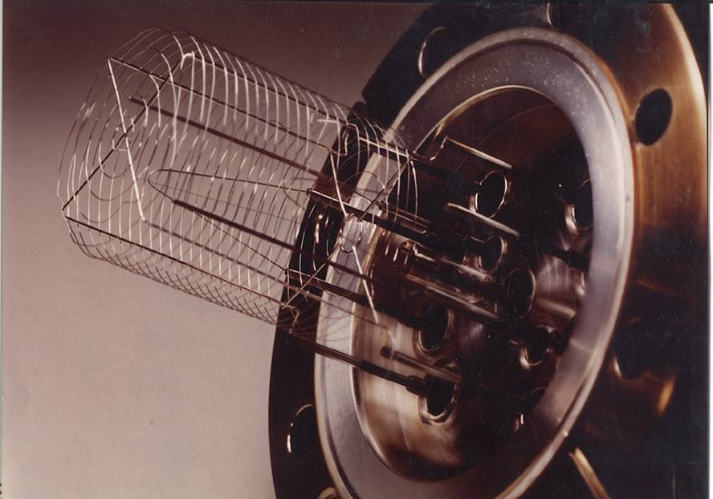
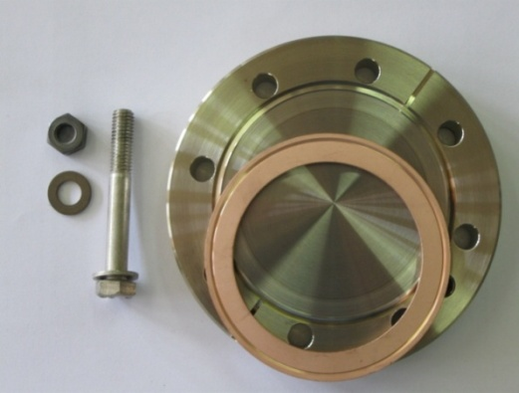
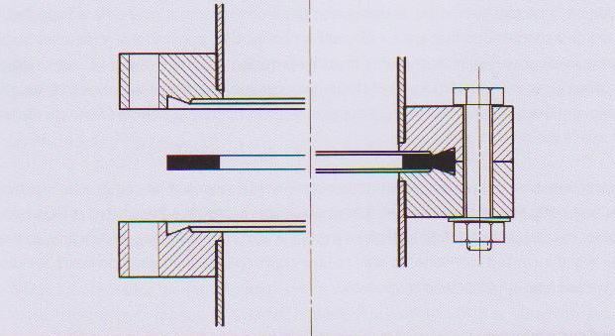
A quick view of vacuum technology
Sector valves
In general the leak-tight connection is made by copper gaskets that are squeezed between two stainless steel knives.

Slide 12
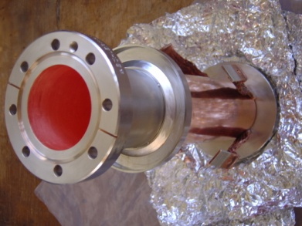
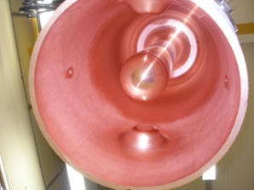
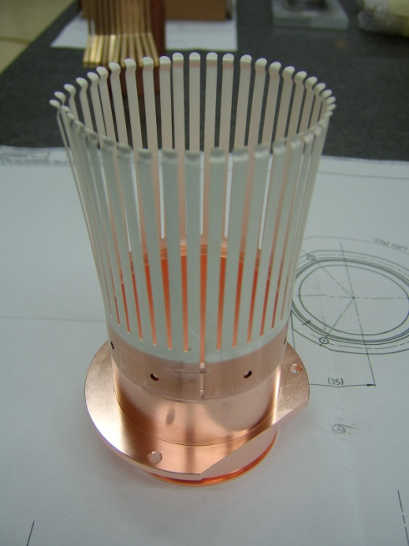
In general vacuum systems for particle accelerators are made of metals:
Austenitic stainless steel
Copper and its alloys
Aluminum and its alloys
Inconel (a Ni alloy)
Beryllium
In several components the characteristics of the surface is modified by chemical treatment and coating.

Slide 13
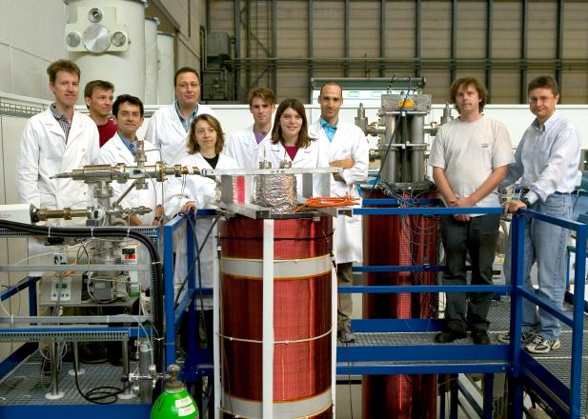
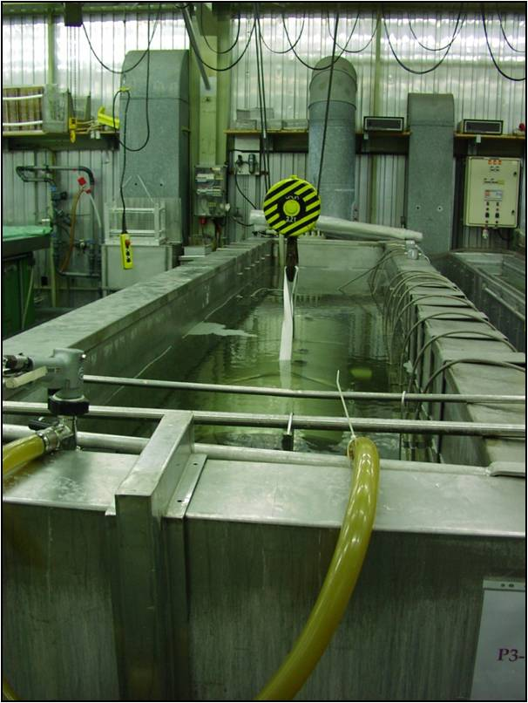
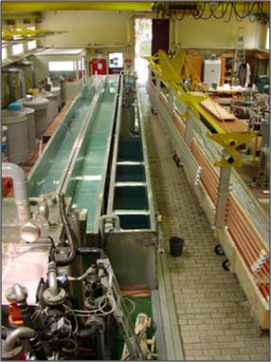
Some example of surface treatments:
Chemical cleaning (mandatory!)
Electropolishing
Passivation
Elecroplating
Thin-film coating by sputtering

Slide 14
A quick view of vacuum technology
Steps in the production of vacuum systems:
Identification of requirements
Choice of materials and treatments
Design, mechanical evaluation and pressure profile calculation
Machining & assembly (welding, brazing)
Surface treatments
Leak test and global assessment.
Installation and in situ final check.

Slide 15
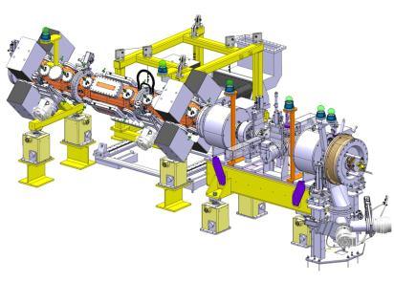
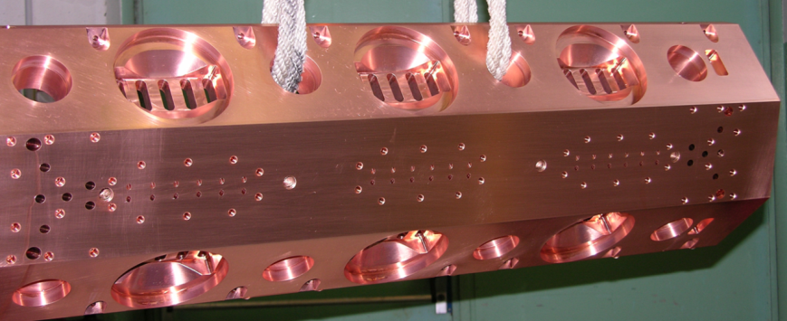
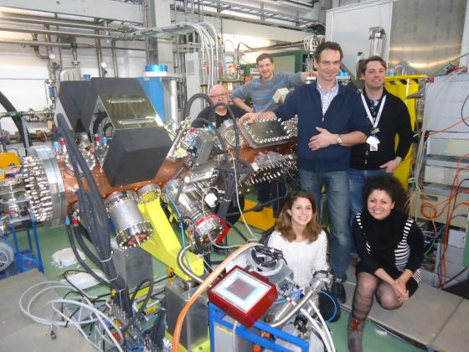
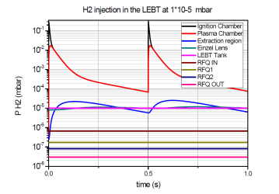
Example of vacuum system:
The H⁻ source of the Linac4

Slide 16
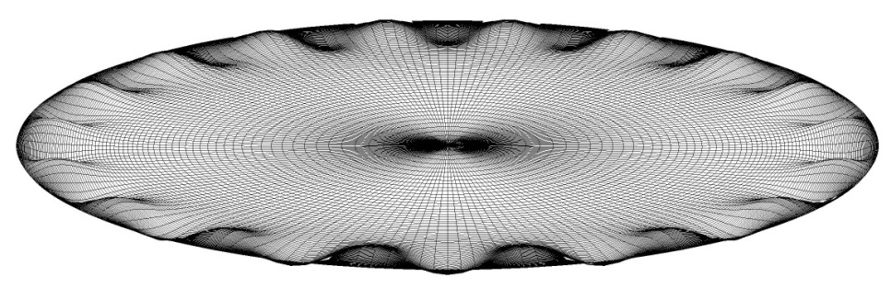
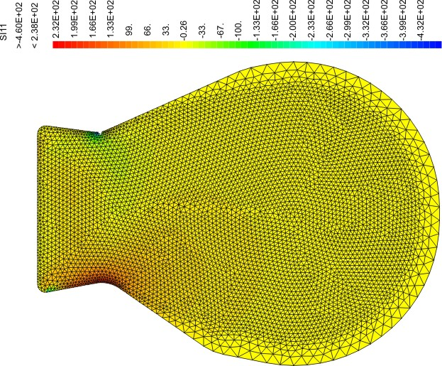
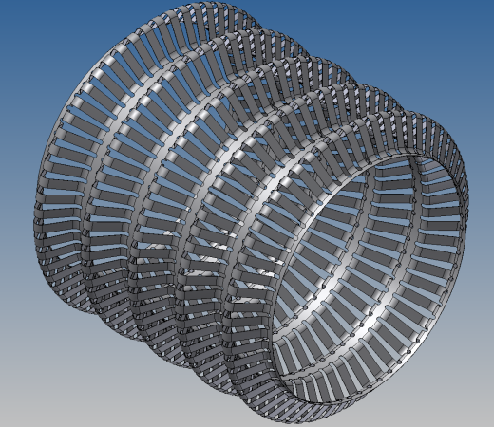
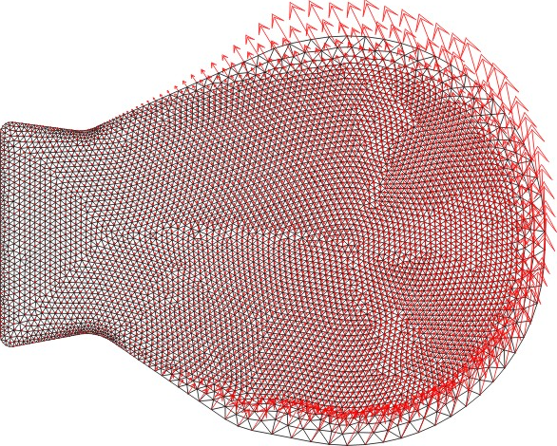
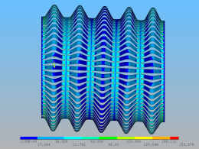
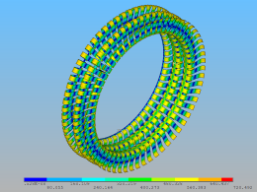
A quick view of vacuum technology
Mechanical engineering for vacuum technology
Buckling mode
Dynamic nodal forces
Principal stress

Slide 17
Part 2
The basis of vacuum technology

Slide 18

The basis of vacuum technology: pressure
$$\vec{F}$$
Definition of pressure: $\frac{\left|Force component in normal direction\right|}{Surface area}$
Unit of measurement: $\frac{\left[Force\right]}{\left[Surface\right]}$ $→ \frac{N}{m^{2}}$ = $Pa→{10}^{5}Pa=1 bar→1 atm=1.013 bar$
I$n vacuum technology : mbar or Pa$
Still used in vacuum technology: $1 Torr=pressure exerted by a column of 1 mm of Hg$; $1 atm=760 Torr$
Conversion Table
 | Pa | bar | atm | Torr
1 Pa | 1 | 10⁻⁵ | 9.87 10⁻⁶ | 7.5 10⁻³
1 bar | 10⁵ | 1 | 0.987 | 750.06
1 atm | 1.013 10⁵ | 1.013 | 1 | 760
1 Torr | 133.32 | 1.33 10⁻³ | 1.32 10⁻³ | 1

Slide 19
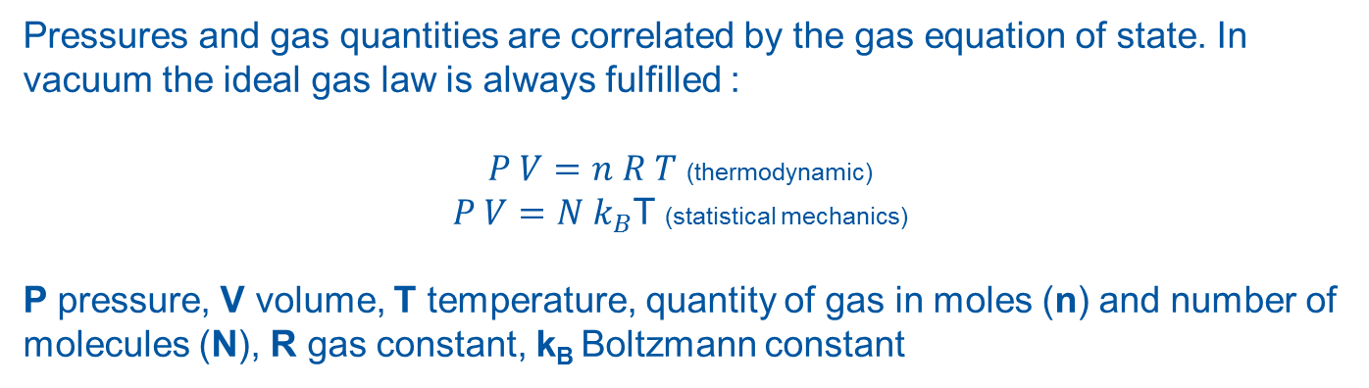
The basis of vacuum technology: pressure
Degree of Vacuum
 | Pressure boundaries [mbar] | Pressure boundaries [Pa]
Low Vacuum LV | 1000-1 | 10⁵-10²
Medium Vacuum MV | 1-10⁻³ | 10²-10⁻¹
High Vacuum HV | 10⁻³-10⁻⁹ | 10⁻¹-10⁻⁷
Ultra High vacuum UHV | 10⁻⁹-10⁻¹² | 10⁻⁷-10⁻¹⁰
Extreme Vacuum XHV | <10⁻¹² | <10⁻¹⁰
Pressures and gas quantities are correlated by the gas equation of state. In vacuum the ideal gas law is always fulfilled :
$P V=n R T$ (thermodynamic)
$P V=N k_{B}$T (statistical mechanics)
P pressure, V volume, T temperature, quantity of gas in moles (n) and number of molecules (N), R gas constant, k_{B} Boltzmann constant

Slide 20

The basis of vacuum technology: gas density
$\frac{molecules}{{cm}^{3}}$
 | Pressure [Pa] | Gas Density 293 K | Gas Density 4.3K
Atmosphere | 1.013 10⁵ | 2.5 10¹⁹ | 1.7 10²¹
Plasma chambers | 1 | 2.5 10¹⁴ | 1.7 10¹⁶
LINAC pressure upper limit | 10⁻⁵ | 2.5 10⁹ | 1.7 10¹¹
Lowest pressure ever measured at room T | 10⁻¹² | 250 | 1.7 10⁴
$P V=Nk_{B}T→P=\left(\frac{N}{V}\right)$ $k_{B}T k_{B}=1.38 {10}^{−23 }\frac{Pa m^{3}}{K}=1.04 {10}^{−22}\frac{Torr l}{K}$

Slide 21
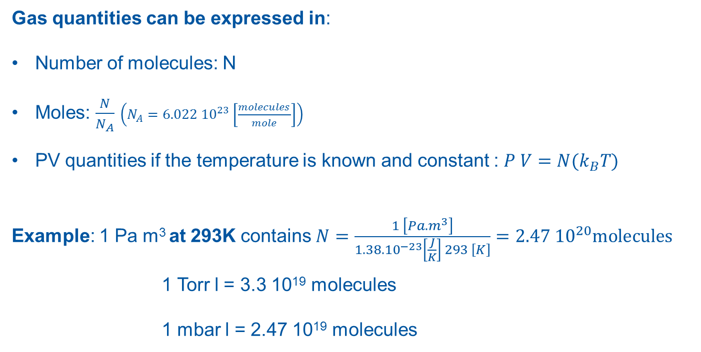
The basis of vacuum technology: gas quantity
Gas quantities can be expressed in:
Number of molecules: N
Moles: $\frac{N}{N_{A}}$ $\left(N_{A}=6.022 {10}^{23}\left[\frac{molecules}{mole}\right]\right)$
PV quantities if the temperature is known and constant : $P V=N{(k}_{B}T)$
Example: 1 Pa m³ at 293K contains $N=\frac{1 \left[Pa.m^{3}\right]}{1.38.{10}^{−23}\left[\frac{J}{K}\right] 293 \left[K\right]}=2.47 {10}^{20}molecules$
1 Torr l = 3.3 10¹⁹ molecules
1 mbar l = 2.47 10¹⁹ molecules

Slide 22
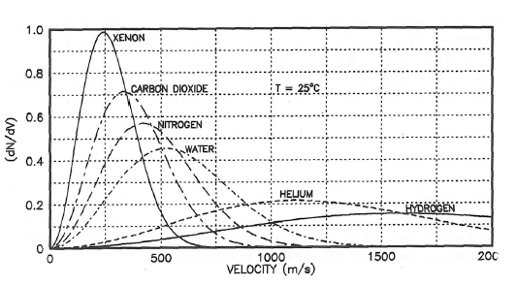
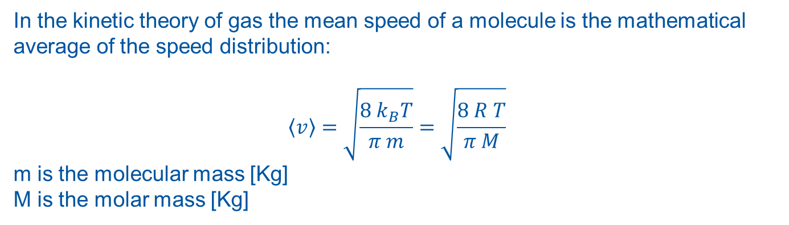
The basis of vacuum technology: gas kinetics
In the kinetic theory of gas the mean speed of a molecule is the mathematical average of the speed distribution:
$$\left\langle v\right\rangle =\sqrt{\frac{8 k_{B}T}{π m}}=\sqrt{\frac{8 R T}{π M}}$$
m is the molecular mass [Kg]
M is the molar mass [Kg]

Slide 23
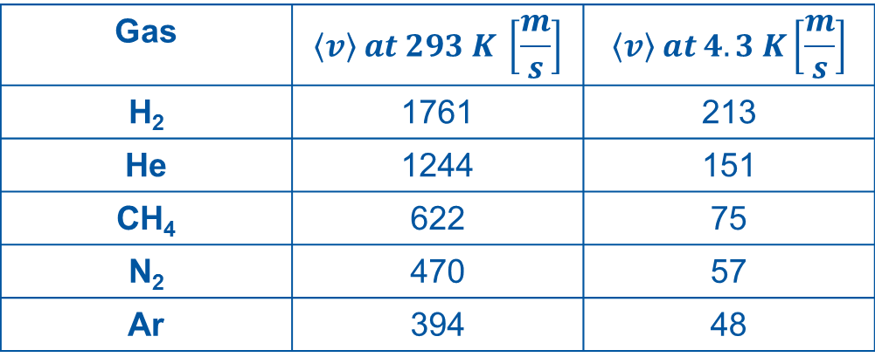
The basis of vacuum technology: gas kinetics
Gas | $$\left\langle v\right\rangle at 293 K \left[\frac{m}{s}\right]$$ | $$\left\langle v\right\rangle at 4.3 K\left[\frac{m}{s}\right]$$
H₂ | 1761 | 213
He | 1244 | 151
CH₄ | 622 | 75
N₂ | 470 | 57
Ar | 394 | 48

Slide 24

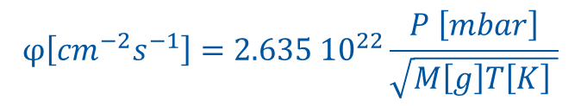
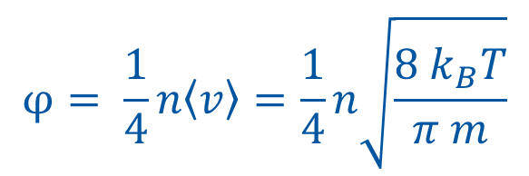
The basis of vacuum technology: impingement rate
$$φ= \frac{1}{4}n\left\langle v\right\rangle =\frac{1}{4}n\sqrt{\frac{8 k_{B}T}{π m}}$$
$$φ\left[{cm}^{−2}s^{−1}\right]=2.635 {10}^{22}\frac{P \left[mbar\right]}{\sqrt{M\left[g\right]T\left[K\right] }}$$
Gas | Pressure [mbar] | Impingement rate 293 K [cm⁻²s⁻¹]
H₂ | 10⁻³ | 1.1 10¹⁸
 | 10⁻⁸ | 1.1 10¹³
 | 10⁻¹⁴ | 1.1 10⁸
N₂ | 10⁻³ | 2.9 10¹⁷
 | 10⁻⁸ | 2.9 10¹²
Ar | 10⁻³ | 2.4 10¹⁷
 | 10⁻⁸ | 2.4 10¹²

Slide 25
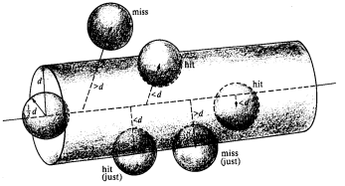
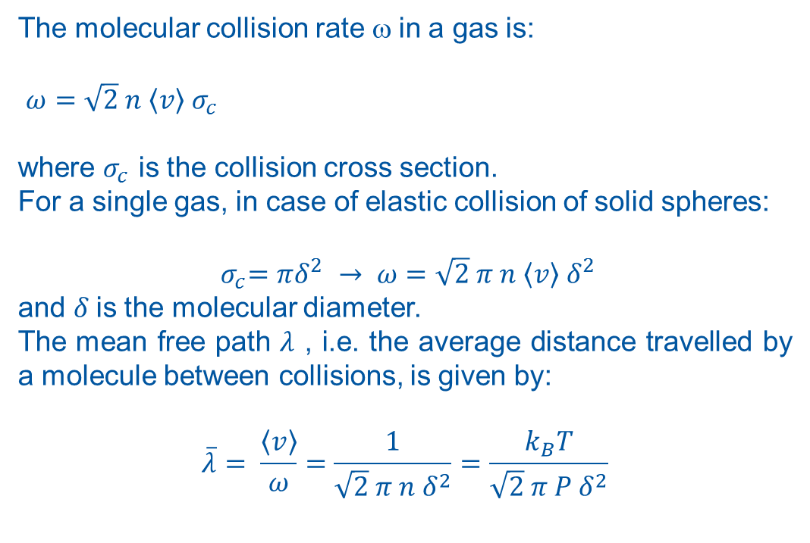
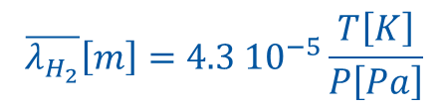
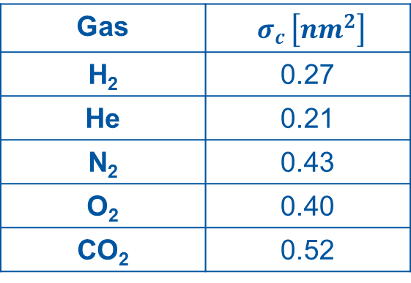
The basis of vacuum technology: mean free path
The molecular collision rate ω in a gas is:
$ω=\sqrt{2} n \left\langle v\right\rangle { σ}_{c}$
where $σ_{c}$ is the collision cross section.
For a single gas, in case of elastic collision of solid spheres:
$${ σ}_{c}=πδ_{}^{2} → ω=\sqrt{2} π n \left\langle v\right\rangle δ_{}^{2}$$
and $δ$is the molecular diameter.
The mean free path $λ$ , i.e. the average distance travelled by a molecule between collisions, is given by:
$$\overline{λ}= \frac{\left\langle v\right\rangle }{ω}=\frac{1}{\sqrt{2} π n δ^{2}}=\frac{k_{B}T}{\sqrt{2} π P δ^{2}}$$
Gas | $${ σ}_{c }\left[{nm}^{2}\right]$$
H₂ | 0.27
He | 0.21
N₂ | 0.43
O₂ | 0.40
CO₂ | 0.52
$$\overline{λ_{H_{2}}}\left[m\right]=4.3 {10}^{−5}\frac{T\left[K\right]}{P\left[Pa\right]}$$

Slide 26
The basis of vacuum technology: mean free path
Earth
diameter
Moon-Earth
distance
Paris-New York
distance
Typical dimension
of standard vacuum
system
K_{n}≈1

Slide 27
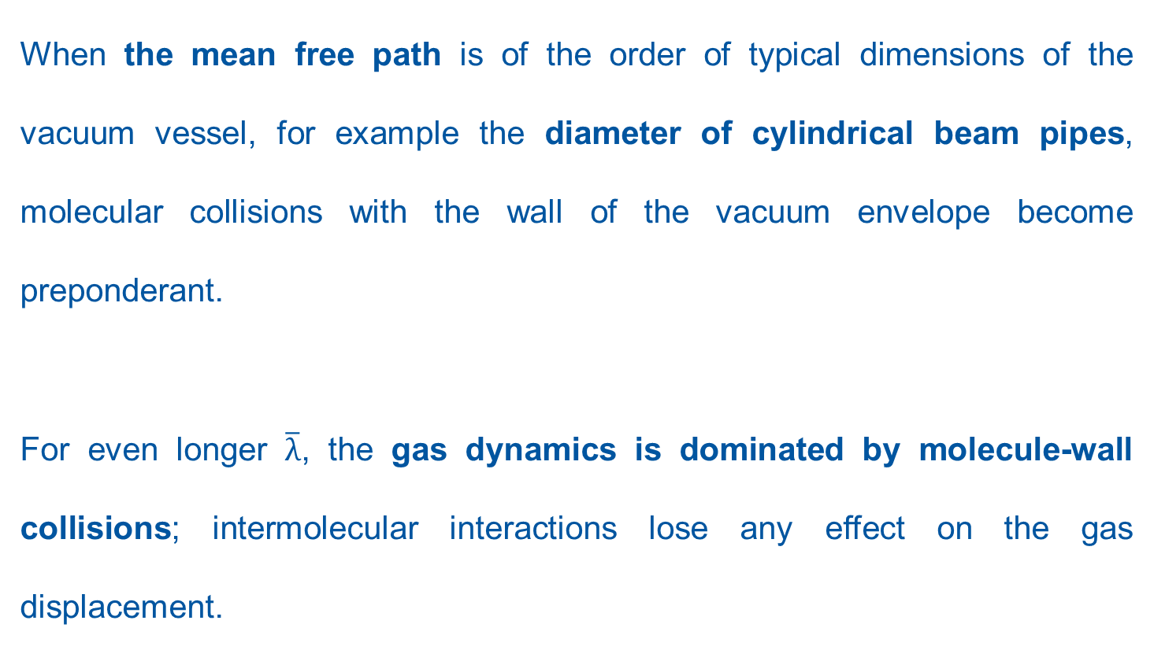
The basis of vacuum technology: mean free path
When the mean free path is of the order of typical dimensions of the vacuum vessel, for example the diameter of cylindrical beam pipes, molecular collisions with the wall of the vacuum envelope become preponderant.
For even longer $\overline{λ}$, the gas dynamics is dominated by molecule-wall collisions; intermolecular interactions lose any effect on the gas displacement.

Slide 28
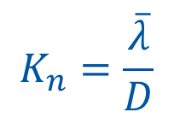
The basis of vacuum technology: Knudsen number
$$K_{n}=\frac{\overline{λ}}{D}$$
$\overline{λ}$ is the mean free path and D is a characteristic dimension of a vacuum system (p.ex. the diameter of a beam pipe).
K_{n} range | Regime | Description
K_{n} >0.5 | Free molecular flow | The gas dynamic is dominated by molecular collisions with the walls of the system
K_{n} <0.01 | Continuous (viscous) flow | The gas dynamic is dominated by intermolecular collisions
0.5<K_{n} <0.01 | Transitional flow | Transition between molecular and viscous flow
Except for ion source’s plasma chambers, vacuum systems of accelerators operate in free molecular regime; only this vacuum regime is considered in this lesson.

Slide 29
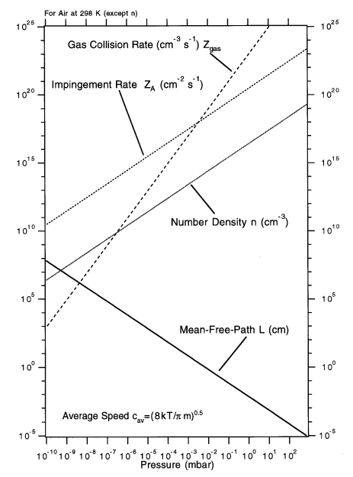

Slide 30
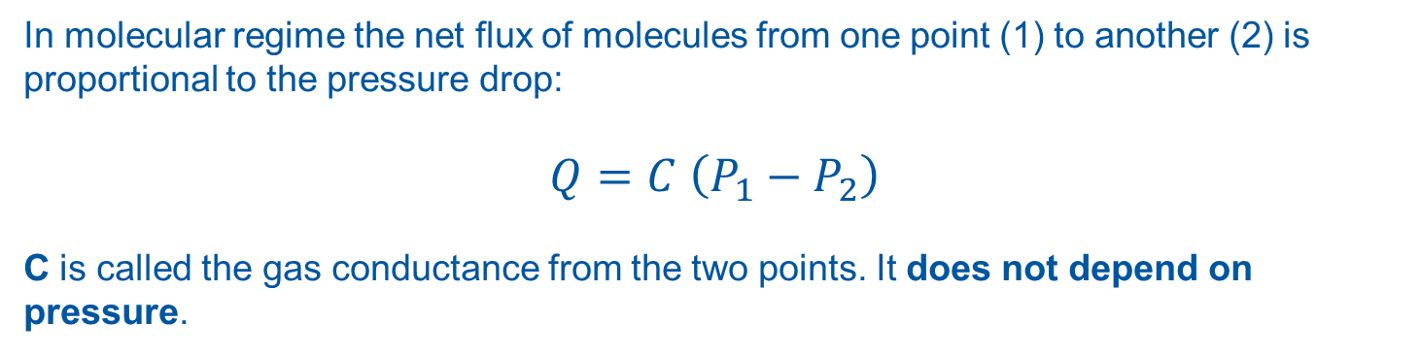
The basis of vacuum technology: conductance
In molecular regime the net flux of molecules from one point (1) to another (2) is proportional to the pressure drop:
$$Q=C \left(P_{1}−P_{2}\right)$$
C is called the gas conductance from the two points. It does not depend on pressure.
It depends only on the mean molecular speed and vacuum system geometry.
If the gas flow units are expressed in terms of pressure-volume, the conductance is reported as volume per unit time, i.e. l s⁻¹ or m³ s⁻¹.

Slide 31

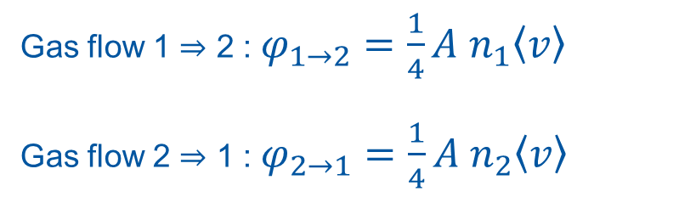
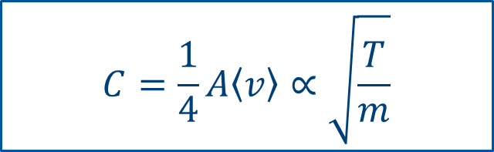
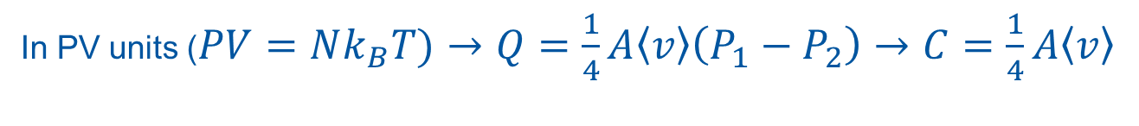

The basis of vacuum technology: conductance
The simplest example is the gas flow through a small wall slot of area A and infinitesimal thickness
$$φ= \frac{1}{4}n\left\langle v\right\rangle =\frac{1}{4}n\sqrt{\frac{8 k_{B}T}{π m}}$$
T, P₁
T, P₂
Gas flow 1 $⇒$ 2 : $φ_{1→2}=\frac{1}{4}{A n}_{1}\left\langle v\right\rangle$
Gas flow 2 $⇒$ 1 : $φ_{2→1}=\frac{1}{4}{A n}_{2}\left\langle v\right\rangle$
A
Net flow: $\frac{1}{4}A \left(n_{1}−n_{2}\right)\left\langle v\right\rangle =\frac{1}{4}A\frac{\left\langle v\right\rangle }{k_{B}T}\left(P_{1}−P_{2}\right)$
In PV units ($PV=Nk_{B}T)→Q=\frac{1}{4}A\left\langle v\right\rangle \left(P_{1}−P_{2}\right)→C=\frac{1}{4}A\left\langle v\right\rangle$
$$C=\frac{1}{4}A\left\langle v\right\rangle ∝\sqrt{\frac{T}{m}}$$

Slide 32
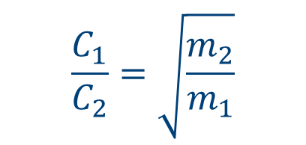
The basis of vacuum technology: conductance
The conductance of the wall slots is inversely proportional to the square root of the molecular mass.
Therefore, for equal pressure drop the gas flow of H₂ is the highest.
For gas molecules of different masses, the conductance scales as the square root of the inverse mass ratio:
$$\frac{C_{1}}{C_{2}}=\sqrt{\frac{m_{2}}{m_{1}}}$$

Slide 33
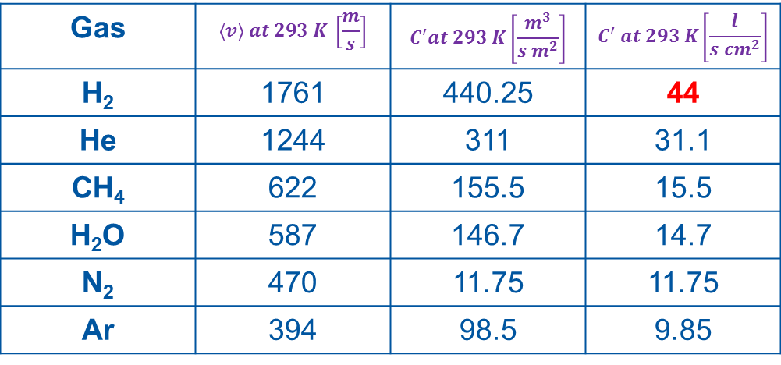
The basis of vacuum technology: conductance
This table collects conductance values, for an orifice, per unit surface area (C’) at room temperature for common gas species.
Conductance of a wall aperture in PV units, per unit area: $C^{′}=\frac{1}{4}\left\langle v\right\rangle$
Gas | $$\left\langle v\right\rangle at 293 K \left[\frac{m}{s}\right]$$ | $$C^{′}at 293 K\left[\frac{m^{3}}{s m^{2}}\right]$$ | $$C^{′} at 293 K\left[\frac{l}{s {cm}^{2}}\right]$$
H₂ | 1761 | 440.25 | 44
He | 1244 | 311 | 31.1
CH₄ | 622 | 155.5 | 15.5
H₂O | 587 | 146.7 | 14.7
N₂ | 470 | 11.75 | 11.75
Ar | 394 | 98.5 | 9.85
T= 293 K

Slide 34
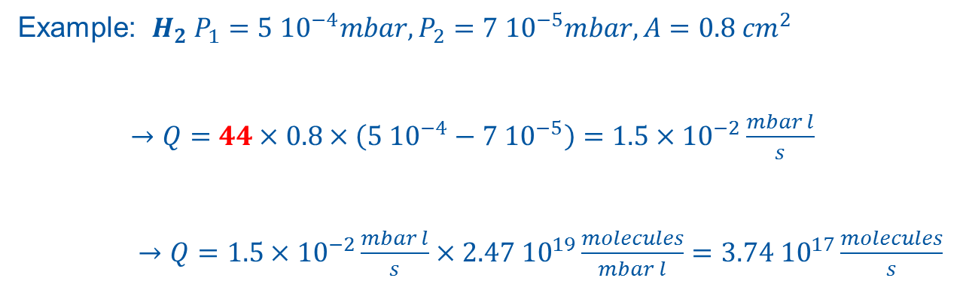
The basis of vacuum technology: conductance
P₁
P₂
A
Example: ${H_{2} P}_{1}=5 {10}^{−4}mbar,P_{2}=7 {10}^{−5}mbar, A=0.8 {cm}^{2}$
$→Q=44×0.8×\left(5 {10}^{−4}−7 {10}^{−5}\right)=1.5×{10}^{−2}\frac{mbar l}{s}$
$→Q=1.5×{10}^{−2}\frac{mbar l}{s}×2.47 {10}^{19}\frac{molecules}{mbar l}=3.74 {10}^{17}\frac{molecules}{s}$
If the gas was N₂, the flow would have been $\sqrt{\frac{28}{2}}=3.7$ times smaller

Slide 35
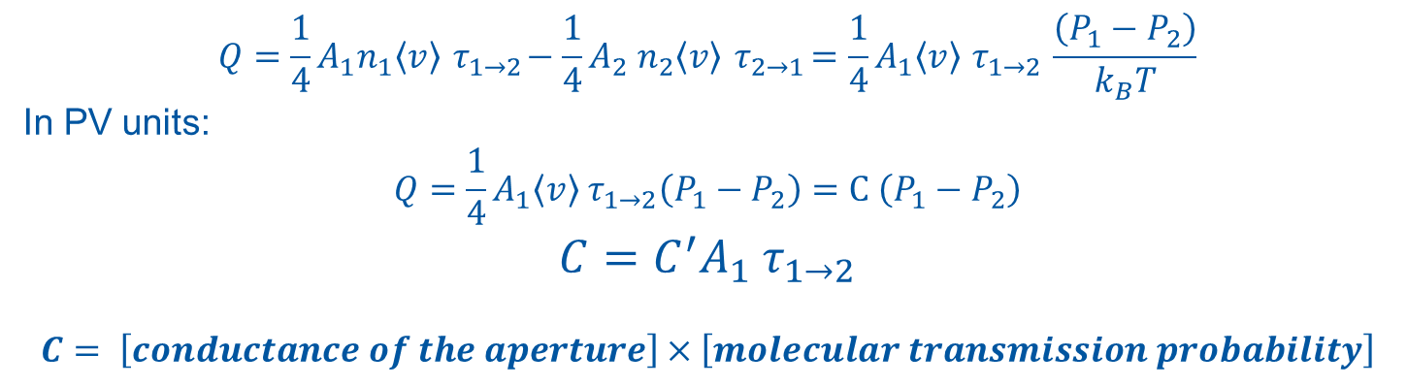

The basis of vacuum technology: conductance
For more complex gas flow restrictions, the transmission probability τ is introduced.
Vessel 1
Vessel 2
Gas flow 1 $⟹$ 2 : $φ_{1→2}=\frac{1}{4}{A_{1}n}_{1}\left\langle v\right\rangle { τ}_{1→2}$
Gas flow 2 $⟹$ 1: $φ_{2→1}=\frac{1}{4}{A_{2} n}_{2}\left\langle v\right\rangle { τ}_{2→1}$
P₁
P₂
A₁
A₂
In absence of net flow: $φ_{1→2}=φ_{2→1}$ and P₁=P₂ $→{ A_{1}τ}_{1→2}={ A_{2}τ}_{2→1}$
$$Q=\frac{1}{4}{A_{1}n}_{1}\left\langle v\right\rangle { τ}_{1→2}−\frac{1}{4}{A_{2} n}_{2}\left\langle v\right\rangle { τ}_{2→1}=\frac{1}{4}A_{1}\left\langle v\right\rangle { τ}_{1→2} \frac{\left(P_{1}−P_{2}\right)}{k_{B}T}$$
In PV units:
$$Q=\frac{1}{4}A_{1}\left\langle v\right\rangle { τ}_{1→2}\left(P_{1}−P_{2}\right)=C \left(P_{1}−P_{2}\right)$$
$$C=C^{′}A_{1}{ τ}_{1→2}$$
$$C= \left[conductance of the aperture\right]×\left[molecular transmission probability\right]$$

Slide 36
The basis of vacuum technology: conductance
$$C= \left[conductance of the aperture\right]×\left[molecular transmission probability\right]$$
The molecular transmission probabilities:
Depend only on the geometry of the vacuum system;
They are accurately obtained by Monte Carlo methods.
They can be calculated analytically only for simple geometry;

Slide 37

The basis of vacuum technology: conductance
Example:
Tubes of uniform circular cross section ($L$ length, R radius); Santeler formula (max error 0.7%):
$${ τ=τ}_{1→2}={ τ}_{2→1}=\frac{1}{1+\frac{3L}{8R}\left(1+\frac{1}{3\left(1+\frac{L}{7R}\right)}\right)}$$
For long tubes ($\frac{L}{R}≫1$): $τ≈\frac{1}{1+\frac{3L}{8R}}≈\frac{8}{3}\frac{R}{L}$
For N₂ and $\frac{L}{R}≫1$ $→$
$$C=C^{′}A τ≈11.75×\frac{πD^{2}}{4}×\frac{4D}{3L}=12.3\frac{D^{3}}{L} \left[\frac{l}{s}\right]$$
$$\left(\left[D\right] and \left[l\right] in cm \right)$$

Slide 38

The basis of vacuum technology: conductance
Monte Carlo

Slide 39



The basis of vacuum technology: conductance
Other analytical expressions for the transmission probability can be found for ducts of circular, rectangular and elliptical cross section (see for example J. M. Lafferty, Foundation of Vacuum Science and Technology, Wiley Interscience).
For more complicated geometry, Test-Particle Monte Carlo methods (TPMC) are used.
roberto.kersevan@cern.ch

Slide 40
The basis of vacuum technology: conductance
The TPMC:
generates “random” molecules according to the cosine distribution at the entrance of the tube;
then follows their traces until they reach the exit of the tube
each collision with the walls is followed by a random emission
many simulated molecules are needed in order to reduce the statistical scattering
The software used at CERN is Molflow+, written and maintained by Roberto Kersevan and Marton Szakacs (CERN, TE-VSC)

Slide 41


The basis of vacuum technology: conductance
Conductance of components connected in series:
C₁
$$Q_{1}=C_{1}\left(P_{1}−P_{2}\right)$$
$$Q_{2}=C_{2}\left(P_{2}−P_{3}\right)$$
$$Q_{TOT}=C_{TOT}\left(P_{1}−P_{3}\right)$$
P₁
P₂
C₂
P₃
In stable conditions, there is no gas accumulation in the whole system:$Q_{1}$=$Q_{2}$=$Q_{TOT}$
It can be easily verified that:${ C}_{TOT}=\frac{C_{1}C_{2}}{C_{1+}C_{2}}$ and $\frac{1}{{ C}_{TOT}}=\frac{1}{{ C}_{1}}+\frac{1}{{ C}_{2}}$:
In general for N vacuum components traversed by the same gas flux, i.e. placed in series :
$$\frac{1}{{ C}_{TOT}}=\sum_{1}^{N}{\frac{1}{{ C}_{i}}}$$

Slide 42


The basis of vacuum technology: conductance
For components connected in parallel (same pressures at the extremities):
C₁
$$Q_{1}=C_{1}\left(P_{1}−P_{2}\right)$$
$$Q_{2}=C_{2}\left(P_{1}−P_{2}\right)$$
$$Q_{TOT}=C_{TOT}\left(P_{1}−P_{2}\right)$$
$Q_{TOT}$=$Q_{1}$+$Q_{2}→$ $C_{TOT}=C_{1}+C_{2}$
P₁
P₂
C₂
$$C_{TOT}=\sum_{1}^{N}{C_{i}}$$

Slide 43

The basis of vacuum technology: pumping speed
In vacuum technology a pump is any ‘object’ that remove gas molecules from the gas phase.
The pumping speed S of a pump is defined as the ratio between the pump throughput Q_{P} (flow of gas definitively removed) and the pressure P at the entrance of the pump:
$$S=\frac{Q_{P}}{P}$$
$$\left[S\right]=\frac{\left[Volume\right]}{\left[Time\right]}=[conductance]$$
vacuum vessel
A_{p}
pump
aperture

Slide 44


The basis of vacuum technology: pumping speed
The gas removal rate can be written as:
$Q_{P}=\frac{1}{4}A_{P} n\left\langle v\right\rangle σ=A_{P} C^{′}n σ$
$A_{P}:$is the area of the pump aperture
$C^{′}$: is the conductance of the unit surface area
n: the gas density
$σ$ : the capture probability, i.e. the probability that a molecule entering the pump is definitively captured
As usual, in term of pressure and PV units:
$Q_{P}= A_{P}C^{′}n σ\left(k_{B}T\right)=A_{P}C^{′}σ P$
From the definition of pumping speed:
$S=A_{P}C^{′}σ$

Slide 45


The basis of vacuum technology: pumping speed
S depends on the conductance of the pump aperture $A_{P}C^{′}$ and the capture probability σ$.$
$σ$ is in general not a constant; it may depend on many parameters including pressure, kind of gas and quantity of gas already pumped.
$$S=A_{P}C^{′}σ$$
The maximum pumping speed is obtained for $σ=1$ and is equal to the conductance of the pump aperture.
vacuum vessel
Maximum pumping speed [l s⁻¹]for different circular pump apertures
ID [mm] | H₂ | N₂ | Ar
36 | 448 | 120 | 100
63 | 1371 | 367 | 307
100 | 3456 | 924 | 773
150 | 7775 | 2079 | 1739
A_{p}
pump
aperture

Slide 46

The basis of vacuum technology: pumping speed
A gas flow restriction interposed between a pump and a vacuum vessel reduces the ‘useful’ pumping speed.
The effective pumping speed S_{eff} seen by the vacuum vessel is easily calculated:
vacuum vessel
$Q=C_{1}\left(P_{1}−P_{2}\right)$ $=SP_{2}=S_{eff}P_{1}$
$$\frac{1}{S_{eff}}=\frac{1}{S}+\frac{1}{C}$$
For C<<S:$S_{eff}≈C$
P₁
vessel
aperture
C
P₂
pump
aperture
S

Slide 47

The basis of vacuum technology: pumping speed
Example:
Vessel and pump connected by a 10 cm diameter tube; N₂, S=250 l/s and 1000 l/s.
vacuum vessel
P₁
vessel
aperture
S_{eff} and C [l/s]
C
P₂
pump
aperture
S
$$\frac{L}{D}$$

Slide 48

Efficient pumping?

Slide 49
Part 3
Calculation of simple pressure profiles

Slide 50


Simple pressure profiles: stationary values
Q
Q
P
P
S
C
$$P=\frac{Q}{S}+P_{0}$$
S
$$P=\frac{Q}{S_{eff}}+P_{0}=\frac{Q\left(C+S\right)}{C×S}+P_{0}$$
P₀ is the pressure attained in the vacuum system without any gas load. It is an
intrinsic limitation of the pump.

Slide 51



Simple pressure profiles: stationary values
Q
P₁
C₁
P₂
C₂
P₃
C₃
P₄
S₁
S₂
S₃
S₄
Flux balance at the connexions (node analysis):
$$Q={P_{1}S_{1}+C}_{1}\left(P_{1}−P_{2}\right)$$
$C_{1}\left(P_{1}−P_{2}\right)=C_{2}\left(P_{2}−P_{3}\right)$+$P_{2}S_{2}$
$$C_{2}\left(P_{2}−P_{3}\right)=C_{3}\left(P_{3}−P_{4}\right)\text{+}P_{3}S_{3}$$
$$C_{3}\left(P_{3}−P_{4}\right)=P_{4}S_{4}$$
C_{x}
$$P_{0}=\frac{Q}{S}$$
Q
$$P_{x}=P_{0}+\frac{Q}{C\left(x\right)}$$
$$C\left(x\right)=C\left(L\right)\frac{L}{x}$$
x
L
S

Slide 52
Simple pressure profiles: stationary values
Pressure profiles with distributed gas load can be calculated analytically (for simple geometry), by electrical analogy or by Monte Carlo simulation.
x
x+Δx
Distributed gas load, one pump
at one extremity only
P(x)
x
P(0)
Distributed outgassing
x
S
L

Slide 53
Simple pressure profiles: stationary values
Distributed gas load, one pumps
at each extremity
P(x)
P_{MAX}
x
P(0)
Distributed outgassing
P(0)
x
S
L
S

Slide 54


Simple pressure profiles: time dependent values
In time dependent condition:
$Q_{in}≠$ $Q_{out}$
Therefore, the variation of the gas density in the system has to be taken into account.
From the ideal gas equation: $PV=Nk_{B}T→V\frac{dP}{dt}=k_{B}T\frac{dN}{dt}$
A gas balance equation can be written as: $\frac{dN}{dt}=Q_{in}−Q_{out}$
$V\frac{dP}{dt}=k_{B}T\left(Q_{in}−Q_{out}\right)$;
in PV units: $V\frac{dP}{dt}=\left(Q_{in}−Q_{out}\right)$
The pumped gas rate is: $Q_{out}=SP→V\frac{dP}{dt}=Q_{in}−SP$
Q_{in}
P
Q_{out}
S
t

Slide 55




Simple pressure profiles: time dependent values
Q_{in}
P
$$V\frac{dP}{dt}=Q_{in}−SP$$
Q_{out}
$$P\left(t\right)=Ae^{−\frac{t}{τ_{p}}}+\frac{Q_{in}}{S}$$
A = integration constant
S
$$P\left(0\right)=P_{0}→P\left(t\right)=\left(P_{0}−\frac{Q_{in}}{S}\right)e^{−\frac{t}{τ_{p}}}+\frac{Q_{in}}{S}$$
$$P\left(0\right)=0→P\left(t\right)=\frac{Q_{in}}{S}\left(1−e^{−\frac{t}{τ_{p}}}\right)$$
P
τ_{p}
$τ_{p}=\frac{V}{S}$ characteristic time of pumping
P₀
τ_{p} characterizes all pressure transients in a vacuum system
t

Slide 56

Simple pressure profiles: time dependent values
When Q_{in} is a function of time:
$$P\left(t\right)=\frac{\int{e^{\frac{t}{τ_{p}}}\frac{Q_{in}\left(t\right)}{V}dt+A}}{e^{\frac{t}{τ_{p}}}}=\frac{\int{Q_{in}\left(t\right)dt}}{V}−\frac{e^{−\frac{t}{τ_{p}}}}{Vτ_{p}}\int{e^{\frac{t}{τ_{p}}}}\left[\int{Q_{in}\left(t\right)dt}\right]dt+Ae^{−\frac{t}{τ_{p}}}$$
Q_{in}
Q
P
A = integration constant
P
Q_{out}
S
t
t
For a network of vacuum chambers, systems of coupled differential equations for each chamber have to be solved.
However, a simpler method exists. It is based on the analogy between vacuum systems and electrical networks. Very powerful software is available for the time dependent analysis of electrical networks.

Slide 57
Simple pressure profiles: time dependent values
Vacuum element | Electrical elements
Conductance C | Conductance 1/R
Gas Flow Q | Current I
Pressure P | Voltage V
Volume V | Capacitance C
Pump | Conductance to ground
Gas source | Current generator
Constant pressure source | Voltage supply
Vacuum chamber with conductance and volume
The ground potential is equivalent to zero pressure.
Long tubes are subdivided in smaller units and considered as single vacuum chambers (conductance + volume) in series.
The conductance of a single small unit is equal to the conductance of the entire vacuum chamber times the number of units
Non-linear electric characteristics can be used to simulate pressure and time dependent conductances and pumping speeds.

Slide 58


Simple pressure profiles: time dependent values
Electrical analogy of a vacuum chamber with gas injection and pumping
Q
S
Electrical analogy of a vacuum system with differential pumping
Q
P₁
P₂
C
V₁
V₂
S₁
S₂
The electrical network is solved by dedicated software, for example LTSpice

Slide 59




Simple pressure profiles: time dependent values
Example 1: the Linac4 ion source

Slide 60

Simple pressure profiles: time dependent values
Example 1: the Linac4 ion source

Slide 61

Simple pressure profiles: time dependent values
Example 2: the MedAustron facility

Slide 62

Simple pressure profiles: time dependent values
Example 2: the MedAustron facility

Slide 63


Simple pressure profiles: time dependent values
Example 3: pumpdown of one vacuum sector of the SPS
Lay-out of the SPS vacuum sector 560.
Equivalent electrical network for sector 560.

Slide 64

Simple pressure profiles: time dependent values
Example 3: pumpdown of one vacuum sector of the SPS
Current dependent resistances simulate conductance variations in the whole pressure range, even in viscous regime.
Comparison between calculated pumpdown curves for original (green) and halved (orange) longest SPS vacuum sector.

Slide 65
Part 4
Gas sources in particle accelerators

Slide 66
Gas sources
Outgassing is the spontaneous evolution of gas from solid or liquid.
Degassing is the deliberate removal of gas from a solid or a liquid.
Desorption is the release of adsorbed chemical species from the surface of a solid or liquid.

Slide 67

Gas sources
After production, the surface of vacuum components is always contaminated.
They must be thoroughly cleaned before installation.
Solvents: their molecules interact and transport contaminants away by diffusion (dilution) -> quite selective! (C₂Cl₄, wide spectrum; HFC, more restricted action)
Detergents in water: allows organics and water to combine by forming micelle (surfactant: surface acting agent ). Based on molecule with hydrophilic heads and lipophilic tail: less selective than solvents

Slide 68
Gas sources: outgassing
The bulk of materials is also a source of gas.
Gas molecules dissolved in the materials diffuse towards the surfaces and are then released
Polymers dissolve huge quantity of molecules in the voids between the molecular chains.
Metals can dissolve only limited quantities of small atoms that are immobile in the lattice at room temperature, except for hydrogen.
In one day, H atoms travel in average 4 μm in austenitic stainless steels, while O atoms travel the same distance in 1000 years.
Therefore, amongst the dissolved elements in the bulk of metals, only H₂ is released at room temperature.
For comparison, in one day, H₂O molecules move along about 20 μm in PEEK, a high performance polymer.

Slide 69
Gas sources: outgassing
Materials | Characteristics that determine outgassing rates
Polymers | Dissolve entire molecules, for example H₂O, O₂, CO₂, solvents, etc.
 | The solubility in the bulk can be very high in particular for H₂O (up to a few weight percentage)
 | The dissolved molecules have a relatively high mobility
Metals | Only single atoms are dissolved (H, O, C, S, etc.)
 | The atom solubility is in general very low at room temperature (typically up to 10³ at. ppm)
 | Only H has a significant mobility at room temperature

Slide 70


Gas sources: outgassing
Metals
After state-of-art surface cleaning
If not heated in situ: mainly H₂O for the first months in vacuum, then also H₂.
$$q_{H_{2}O}≈\frac{3×{10}^{−9}}{t\left[h\right]}\left[\frac{mbar l}{s {cm}^{2}} \right]$$
The source of H₂O is recharged after each venting to air.
If heated in situ (baked-out): mainly H₂. The outgassing rate can be assumed as constant; it depends on the accumulated effect of the previous thermal treatments
Organics (Polymers)
High solubility of gas in the bulk, in particular H₂O.
In general, the outgassing process is dominated by H₂O release.
In the initial phase of pumping:
$$q_{H_{2}O}∝\frac{1}{\sqrt{t}}$$
Heavier gas molecules can be outgassed (remnant of polymerisation, fraction of polymeric chains)
The permeation of light molecules is not negligible, in particular He.

Slide 71
Gas sources: outgassing
Neoprene (10 h pumping):
q_{H2O} ≈ 10⁻⁵ Torr l s⁻¹ cm⁻²
q_{H2O}=3.3x10¹⁴ molecules cm⁻²
Unbaked stainless steel (10 h pumping):
q_{H2O}=2x10⁻¹⁰ Torr l s⁻¹ cm⁻²
q_{H2O}=6.6x10⁹ molecules cm⁻²
Baked stainless steel (150º C x 24 h):
q_{H2}=2x10⁻¹² Torr l s⁻¹ cm⁻²
q_{H2}=6.6x10⁷ molecules s⁻¹ cm⁻²
Baked OFS Copper (200º C x 24 h):
q_{H2}=2x10⁻¹⁴ Torr l s⁻¹ cm⁻²
q_{H2}=6.6x10⁵ molecules s⁻¹ cm⁻²
Some examples of outgassing rates

Slide 72


Gas sources: outgassing of metals
Outgassing rate of water vapour for unbaked metals
H.F. Dylla, D. M. Manos, P.H. LaMarche
Jr. J. Vac. Sci. and Tech. A, 11(1993)2623
$$q_{H_{2}O}≈\frac{3×{10}^{−9}}{t\left[h\right]}\left[\frac{mbar l}{s {cm}^{2}}\right]$$
The most effective way to accelerate the water vapour outgassing rate is by in situ bakeout.
At least 120°C for 12 hours
Water vapour outgassing rate of stainless steel that underwent four different surface treatments

Slide 73
Gas sources: outgassing of metals
When water vapour outgassing is strongly reduced, by either long pumping or bakeout, the outgassing process is led by H₂.
This gas is dissolved in metals as single H atoms. Its diffusion is relatively fast and, after recombination on the surface, it can be released as molecular hydrogen
Most of the H atoms are dissolved in metals at the liquid state, during the production process.
H atoms mobility and solubility in the liquid are higher than in the solid.
Typical sources of H are:
metals ores;
tools needed for fusion;
refractory materials of furnaces;
combustion and treatment gas;
water vapour and fluids used for quenching (for example the hyperquench of austenitic stainless steels is carried out from 1100°C in water, air, or oil).

Slide 74


Gas sources: outgassing of metals
Example of a process of H₂ dissolution
in liquid Al
If the solidification is fast, the gas is
trapped in the solid far form the
equilibrium
Typical H₂ contents are about 1 wt. ppm for
copper, aluminum, and austenitic stainless steel

Slide 75
Gas sources: outgassing of metals
As for water vapour, hydrogen-outgassing rate is reduced by heating.
The high temperatures increase the H atoms mobility and, as a result, accelerate the depletion of the residual hydrogen content.
However, there is a crucial difference between water vapour and hydrogen.
Each time the vacuum system is exposed to air, water molecules re-adsorb on the surface, while hydrogen is not recharged in the bulk of the metal.
For most of the materials used for the manufacturing of vacuum chambers, the H solubility is very low in the solid state.
For example, to recharge 1 wt. ppm of hydrogen at room temperature in stainless steel, the material has to be in equilibrium with the gas at 7 bar. The hydrogen pressure in air is roughly 10⁻⁴ mbar, which gives a maximum recharging of about 2.10⁻⁴ wt. ppm.

Slide 76
Gas sources: outgassing of metals
For copper and aluminium alloys, a few bakeout at 150-200°C for 24 hours are sufficient to reduce the hydrogen-outgassing rate to less than 10⁻¹³ mbar l s⁻¹ cm⁻².
For austenitic stainless steel, higher temperatures are needed to have a similar effect for a few mm thick vacuum chambers. Repeated bakeout at temperature higher than 200°C may have a significant influence.
Materials | Bakeout T[°C] x 24 h | q [mbar l s⁻¹ cm⁻²]
Austenitic st. steel | 150 | 3 10⁻¹²
Austenitic st. steel | 200 | 2 10⁻¹²
Austenitic st. steel | 300 | 5 10⁻¹³
Copper Silver added (OFS) | 150 | 3 10⁻¹²
Copper Silver added (OFS) | 200 | ≈ 10⁻¹⁴
Beryllium | 150 | < 10⁻¹⁴
Al alloys | 150 | < 10⁻¹³

Slide 77


Gas sources: outgassing of metals
For austenitic stainless steels, a radical effect is obtained by heating in a vacuum furnace to temperature up to about 1000°C.
Such a treatment is called ‘vacuum firing’. At CERN it is carried out at 950°C for 2 h in a vacuum better than 10⁻⁵ mbar at the highest temperature.
The CERN’s large furnace: useful height and diameter: 6 m and 1 m, respectively. Maximum charge weight: 1000 Kg. Ultimate pressure: about 10⁻⁷ mbar; pressure at the end of the 950°Cx2h treatments: 10⁻⁵mbar.

Slide 78
Gas sources: outgassing of metals
Diffusion model of H₂ outgassing
Diffusion, in most of the cases of interest, is described by the Fick’s equations:
E_{b}
where c(x,t) is the concentration in the solid and Γ is the flow of molecules per cm²
In the limit of this model, the outgassing rate is equal to a half of the flux of atoms arriving at the surface by diffusion (2 H atoms = 1 H₂ molecule):

Slide 79
Gas sources: outgassing of metals
Diffusion model of H₂ outgassing: semi-infinite solid approximation
c_{o}
c(x,t)
diffusion length
x
The t^{-0.5} evolution holds also for solid of finite dimension L (slab) when L>>(Dt)^{0.5}
The total amount of substance M(t) which has left the solid is:

Slide 80
Gas sources: outgassing of metals
Diffusion model of H₂ outgassing: slab approximation
c(x,t)
L
x
For Dt>0.05 L² only the first term of the series is relevant :

Slide 81
Gas sources: outgassing of metals
Diffusion model of H₂ outgassing: Sievert’s law
If hydrogen in the gas phase and on the surface are in equilibrium, the surface concentration c_{w} may be calculated by the Sievert’s law:
P_{H2} is the pressure of hydrogen in the gas phase
K_{s}(T) is the hydrogen solubility in the metal
E_{s} is the H₂ solubility energy
K₀ a constant.
For stainless steel, E_{s} is positive; therefore, the solubility increases with temperature. At room temperature and for typical hydrogen pressure, c_{w} is negligible with respect to the residual hydrogen content. This is not true at higher temperature; for example during a vacuum firing treatment.
Sievert’s law for austenitic stainless steel

Slide 82
Gas sources: outgassing of metals
Diffusion model of H₂ outgassing: Fourier number
If the slab is heated to a temperature T_{H} for a time t_{H}, the outgassing rate, when back at room temperature is:
T
T_{H -} t_{H}
T_{RT}
t
For an arbitrary thermal cycle T=T(t), it can be show that:
The dimensionless number:
is called the Fourier number

Slide 83

Gas sources: outgassing of metals
Diffusion model of H₂ outgassing: consecutive bakeouts
F_{o} ‘records’ the thermal history of the material and determines how much of the initial concentration is depleted.
When thermal treatment of F_{o}≈ 3 are applied, the solid is actually emptied or in equilibrium with the surrounding gas phase.
In case of multiple identical thermal treatments (for example bakeouts) with a given constant F₀, the calculated ratio of the outgassing rate at room temperature after two successive thermal cycles is:
$$\frac{q_{n+1}}{q_{n}}=exp\left[{−π}^{2}F_{0}\right]$$
That is to say that each bakeout reduces the outgassing rete of hydrogen by the same constant factor. This is in line with the experimental results.

Slide 84
Gas sources: outgassing of metals
Diffusion model of H₂ outgassing: consecutive bakeouts
1.00E-12
bakeout at 300°C, 24 h
1.00E-13
H₂ outgassing rate [Torr l s⁻¹ cm⁻²]
1.00E-14
1.00E-15
1.00E-16
1
2
3
4
5
Bakeout cycles

Slide 85
Gas sources: outgassing of metals
Diffusion model of H₂ outgassing: vacuum firing
semi-infinite model
Parameters | Symbol | Values
Temperature of the firing treatment | T_{f} | 950°C
Duration of the firing treatment | t_{f} | 2 hours
In situ bakeout temperature | T_{bo} | 150°C
Duration of the in situ bakeout | t_{bo} | 24 hours
Initial content of residual hydrogen | c_{o} | 1 ppm wt (≈50 ppm at.)
Hydrogen equilibrium concentration on slab surfaces during firing | c_{w} | 0.06 ppm wt. Equivalent to P_{H2}=1.3x10⁻⁵ mbar
q [Torr l s⁻¹ cm⁻²]
10⁻⁵ Torr pressure in the furnace
For zero pressure in the furnace
L [cm]

Slide 86
Gas sources: outgassing of polymers
Polymers, in particular their amorphous structures, can dissolve huge quantities of gas.
The water vapour solubility is very high; for example for common materials like Viton, PEEK, and Vespel the content of water in equilibrium with 50% humidity air at 20°C is 0.21, 0.2, and 1 wt. %, respectively.
The huge quantity of dissolved gas and the relatively high mobility through the polymeric chains result in much higher outgassing rates than the ones for metals. This is particularly marked for water vapour.
The maximum bakeout temperature depend on the type of polymer; it is limited to about 200 °C for Viton®.

Slide 87
Gas sources: outgassing of polymers
The outgassing rates of thick ( L>Dt) slab of polymers, as expected by the diffusion model, decrease with the inverse of the square root of the pumping time t:
Compared to unbaked metals, thick polymers experience a much slower reduction of water outgassing rate.

Slide 88

Gas sources: outgassing of polymers
Outgassing rate of water vapour for polymers
R. N. Peacock, J. Vac. Sci. Technol., 17(1), p.330, 1980
10⁻⁶
unbaked Viton
baked Viton
10⁻¹⁰

Slide 89
Gas sources: outgassing of polymers
Another important limitation of polymers used as seals is the high gas permeability.
Gas penetrates into the material and diffuses towards the vacuum system. The permeation flow may limit the ultimate water vapour pressure in vacuum systems and affect the sensitivity of helium leak-detection.
As an example, the permeation flow of atmospheric water through a Viton O-ring, 5 mm cross section diameter, 6 cm torus diameter, is about 10⁻⁷ mbar l s⁻¹ This value is equivalent to the outgassing of 1 m² of stainless steel after 100 h of pumping.

Slide 90
Gas sources: outgassing of polymers
Part 3: Outgassing of polymers
Application of polymers in UHV technology is hindered by the huge outgassing and permeability.
This drawback has been partially overcome in other technological domains (i.e. packaging) by coating polymers with metals or metal oxides (more recently also with a:C-H).
How effective are coatings in reducing outgassing and permeation rate?
Since the permeability of metals is negligible for all gases, metallic coatings should entirely block the polymer outgassing and permeation.
However, experimental results show that only a partial reduction of the flux is attained.
This is attributed to defects on the coating (pinholes or scratches) that cause discontinuity on the surface coverage.
Pinholes are produced during the deposition process and they are presumably due to atmospheric dust particles.

Slide 91


Gas sources: outgassing of polymers
Part 3: Outgassing of polymers
Examples of pinholes on Al coating deposited on PEEK
2.00 μm
20.0 μm

Slide 92
Gas sources: outgassing of polymers
Part 3: Outgassing of polymers
Transmitted light optical microscopy has been used to detect uncoated surfaces on metal films, showing that they mainly consist of pinholes of different diameters.
Al/PEEK
Normalised uncoated surface areas of the order of 10⁻⁴ are measured

Slide 93
Gas sources: outgassing of polymers
Part 3: Outgassing of polymers
However, experiments have shown that the permeability is reduced much less than expected from the uncoated fraction
Example:
Al/PEEK(0.125 mm thick)
The uncoated fraction is 10⁻⁴, but the permeability of He is 10⁻² of that of the uncoated polymer.

Slide 94
Gas sources: outgassing of polymers
Part 3: Outgassing of polymers
This apparent inconsistency can be justified considering that the pinhole gas throughput is enhanced by lateral diffusion.
ρ =Normalised permeability → order of 10⁻²
Θ =Normalised uncoated area → order of 10⁻⁴
For L/R₀ >0.3 :
*
1.18
L
R₀
Amplification factor
* After W.Prins and J.J.Hermans, J.Phys.Chem., 63 (1959) 716.

Slide 95
Gas sources: outgassing of polymers
Part 3: Outgassing of polymers
In the literature the barrier efficiency is called “barrier improvement factor” or BIF. It is the inverse of normalized permeability.
Normalized permeability:
Barrier improvement factor:
The fact that ρ depends on L means that for L>10R the flux value does not depend on the polymer thickness. In other terms, all the concentration gradient is localized near the pin-hole.
It follows also that, for similar coating, the improvement due to the coating is less significant for thicker polymer substrates.

Slide 96

Gas sources: outgassing of polymers
Part 3: Outgassing of polymers
The BIF for Al coated PEEK.
For thickness larger than 5 mm, the coating is useless.
In conclusion, metallic coatings are very efficient in the reduction of the permeation and outgassing rate in thin polymers. For polymers thicker than 5 mm, the benefit of the coating is negligible.

Slide 97

Gas sources: beam induced desorption
The impingement of electrons and photons, of energy higher than some eV, on solid surfaces can result in ions and neutral molecules desorption.
The first observations of induced desorption are very old and they go back to the origin of modern vacuum technology.
In 1918, Dempster observed ion desorption from electron bombarded salts (Phys. Rev. 11, 323)
ESD: electron stimulated desorption

Slide 98

Gas sources: beam induced desorption
Millikan reported the first evidence of photon induced desorption in 1909 during the measurement of the photoelectric current of metals exposed to ultraviolet radiation. The first interpretation is given by Winch in 1930 (Phys. Rev. 36, 601).
Winch was the first to see the implication of photoelectrons on photon induced desorption.
PSD: photon stimulated desorption

Slide 99

Gas sources: beam induced desorption
The desorption yield η, i.e. the number of molecules desorbed per impinging particle, is needed to design the vacuum system of particle accelerators.
$$η=\frac{\text{number} \text{of} \text{molecules} \text{desorbed}}{\text{number} \text{of} \text{particules} \text{impinging} \text{on} \text{the} \text{surface}}$$
depends on many parameters, in particular:
on the nature and energy of the impinging particle;
the material of the vacuum chamber;
the nature of the desorbed gas;
quantity of particles that have already impinged on the surface, namely the dose D $\left[{\text{particles}}/{{\text{cm}}^{\text{2}}}\right]$.
The cleanliness of the surfaces has also a crucial influence.

Slide 100
Gas sources: electron induced desorption
Typical values of η for baked structural vacuum materials vary between 10⁻¹ and 10⁻³ molecules per electron at 500 eV. Neutral desorption is much more likely than ion desorption, about 100 times higher.
η
500 eV
0
200
400
600
800
1000
1200
Electron Energy [eV]
For typical metals used in vacuum technology, η of hydrogen is the highest followed by those for CO, CO₂ and CH₄, in decreasing order.

Slide 101

Gas sources: electron induced desorption
Electron bombardment cleans metallic surfaces by gas desorption.
As a consequence, the desorption yields decrease when the electron dose increases.
η_{e} values have a power law dependence on the dose of electrons D_{e} (for doses higher than 10¹⁸ e⁻ cm⁻²):
α=0.77
where a is between 0.6 and 1.
E_{e}=300 eV
J. Gomez-Goñi and A. G. Mathewson
J. Vac. Sci. Technol. A 15, 3093 (1997)
The samples were baked at 150 C for 24 h and at 300 C for 2 h

Slide 102

Gas sources: electron induced desorption
α=0.62
α=0.68
E_{e}=300 eV
J. Gomez-Goñi and A. G. Mathewson J. Vac. Sci. Technol. A 15, 3093 (1997)

Slide 103

Gas sources: electron induced desorption
The total quantity of gas desorbed exceed by far one monolayer.
In order to explain the huge quantity of gas desorbed, some authors considered stimulated gas diffusion from the oxide layer
The accumulated dose effect is lost when the surface is vented to air for long time. For short exposure to air (for example a few hours) a residual effect is measured; it is called ‘memory effect’: η values similar to those attained before venting are achieved after a smaller dose.
1ML=2x10¹⁵ molecules/ cm²
J. Gomez-Goñi and A. G. Mathewson J. Vac. Sci. Technol. A 15, 3093 (1997)

Slide 104

Gas sources: electron induced desorption
The ESD process can be considered as an isolated interaction between an electron and an adsorbate.
The maximum energy ΔE transferred during the collision between a low energy electron of mass m_{e} and a molecule of mass M is calculated by classical kinematics. For hard-sphere scattering and m_{e}<<M, one can estimate that:
For H₂ the fraction of energy transferred to the molecules is about $2/{1840}$. For typical electron energy of about 300 eV, ΔE is of the order of 0.1 eV.
These values are much lower than the measured energies of desorbed molecules, typically in the 2-10 eV range. Therefore, the direct momentum transfer is not the dominant process in ESD. Electronic energy transfers are then considered.

Slide 105
Gas sources: electron induced desorption
One of the earliest and general models to explain ESD from surfaces was introduced independently by Menzel, Gomer, and Redhead (MGR) in 1964.
The interaction with the incident electron provokes an adiabatic transition (Franck-Condon principle) to exited states of different nature:
antibonding
metastable
ionic state
The adiabatic transition implies a change of electronic energy in about 10⁻¹⁶ s with a frozen distance z between nuclei. The transition is vertical in potential energy vs. distance diagram.

Slide 106
Gas sources: electron induced desorption
After the excitation, nuclear motion may occur over a time scale of about 10⁻¹³-10⁻¹⁴ s: part of the potential energy is converted into kinetic energy.
The crossing of potential curves is possible resulting in different de-excitation pathways.

Slide 107
Gas sources: electron induced desorption
Whenever the original state is reached during the downward transition (rebonding), the molecule can escape if it has acquired enough kinetic energy to overpass the potential binding energy at the position of transition.
The desorption as a stable neutral is possible when the downward transition occurs at a distance from the surface which is larger than a critical distance r_{c} .

Slide 108

Gas sources: photon induced desorption
Particle beams emit photons whenever they are accelerated, namely whenever their velocity vectors are changed.
Synchrotron radiation (SR) is emitted when charged particles moving with relativistic speeds are forced to follow curved trajectories in magnetic fields.
The emitted photons impinge on the wall of the vacuum system and may desorb gas molecules.
There is experimental evidence that the photon stimulated desorption is generated by a two-step process:
The impinging photons extract photoelectrons.
The extraction and recapture of the photoelectrons stimulate
the desorption of gas molecules by the ESD mechanism.

Slide 109
Gas sources: photon induced desorption
A particle of charge ‘e’, energy E and rest mass m₀, moving on a circular orbit (radius ρ) radiates electromagnetic radiation with the following power P_{rad}:
where ε₀ and c are the vacuum permittivity and the speed of light, respectively.
The emitted power depends strongly on the beam energy and the radius of the bent trajectory.
Consequently, electrons emit much more synchrotron radiation power than protons for the same bending radius and energy:

Slide 110


Gas sources: photon induced desorption
Synchrotron emission is strongly beamed along the direction of motion, which is perpendicular to the acceleration.
The emission is concentrated into an angle of the order of 2/γ rad along the direction of motion:
$${γ=1}/{\sqrt{1−{\left(v/c\right)}^{2}}}=E/{mc^{2}}$$

Slide 111
Gas sources: photon induced desorption
Synchrotron radiation from bending magnets has a very broad energy spectrum, which is characterised by the critical energy ε_{C}:
The critical energy subdivide the photon spectrum in two parts of equal emitted power.
For electrons
For protons

Slide 112

Gas sources: photon induced desorption
Courtesy of Roberto Kersevan

Slide 113

Gas sources: photon induced desorption
Courtesy of Roberto Kersevan

Slide 114
Gas sources: photon induced desorption
It can be shown that the number of emitted photon per unit time:
Mean photon energy: max of the distribution
For electrons
The linear flux, i.e. the emitted photons per second and meter, is given by
For electrons

Slide 115


Gas sources: photon induced desorption
Photons with energy lower than the photoelectron extraction threshold (workfunction, about 5 eV for metals used in UHV) do not stimulate gas desorption.
η_{ph} depends linearly on the critical energy of the photon spectrum when ε_{c} < 280 eV:
0.74< β <1.12
J. Gomez-Goñi, O. Groebner and A. G. Mathewson J. Vac. Sci. Technol. A 12, 1714 (1994)

Slide 116
Gas sources: photon induced desorption
η_{ph} does not depend significantly on the photon dose D up to about 10²⁰ photons/m. For higher doses, η_{ph} varies as a power law function of the dose:
Photon desorption yields for baked stainless steel as a function of the accumulated dose of photons.

Slide 117

Gas sources: photon induced desorption
unbaked chamber

Slide 118
Gas sources: e⁻ & ph induced desorption
Methods for the reduction of electron and photon induced desorption
The gas desorbed by electrons or photons is extracted from the surface of vacuum chambers or from the first tenths of atomic layers underneath.
Therefore, a state of art surface cleaning is essential to avoid excessive desorption.
A beneficial effect is obtained by in situ bakeout at temperature higher than 120°C; heating the material results in a cleaner surface; however, the effect on the η values is limited and, in general, less than a factor of 10.

Slide 119
Gas sources: e⁻ & ph induced desorption
Methods for the reduction of electron and photon induced desorption
Electropolishing and vacuum firing have a very limited effect on the η values.
Air exposure after these treatments oxidizes again the surface and regenerates the gas source.
Electron energy: 500 eV

Slide 120
Gas sources: e⁻ & ph induced desorption
Part 8: Induced desorption
Electron energy: 500 eV
Electropolishing does not influence the desorption yield of H₂. Very small variations are recorded for the other gasses.

Slide 121
Gas sources: e⁻ & ph induced desorption
The accumulated dose effect lead to a significant reduction of the desorption yields. Power law reductions are measured for both accumulated electron and photon impingements.
LEP
Particle accelerators, whose performance is limited by beam induced desorption, are run at progressively increasing current to accumulate photon or electron dose.
This operation is called ‘beam conditioning’ or ‘beam scrubbing’ of the vacuum chambers. It can last several hours to several days.

Slide 122
Gas sources: e⁻ & ph induced desorption
Another radical method to reduce stimulated desorption is coating the inner wall of the beam pipes with a thin non-evaporable getter film.
After in situ bakeout at temperature higher than 180°C, the oxide layer covering the film is dissolved leaving an extremely clean surface.
This treatment is considered in the chapter dedicated to pumps.

Slide 123
Gas sources: ion induced desorption
There are two sources of energetic ions:
Beam particles may collide with the residual gas and create ions (H₂⁺, CH₄⁺, CO⁺, CO₂⁺, etc.). If the beam is positively charged, the ions are accelerated by the beam potential and collide on the nearby walls with energy between 1 eV to several KeV. The collision results in gas desorption.
When heavy ions are accelerated, beam losses may lead to collision of high-energy heavy ions with the wall of the vacuum system. Typical ions are Pb⁵³⁺, U⁷³⁺, and Ar¹⁰⁺. Experimental studies have been carried out with beam energy in the range from 1 MeV/nucleon to 100 GeV/nucleon. In this case, the desorption yields may be orders of magnitude higher than those for residual-gas ions.

Slide 124
Gas sources: ion induced desorption
Residual-gas ion
Ions are more effective in desorbing gas than electrons and photons. Typical η_{i} values for baked copper and ion energy of about 1 KeV are about 1 for H₂ and CO; 5 and 10 times lower for CO₂ and CH₄, respectively.

Slide 125
Gas sources: ion induced desorption
High-energy heavy-ions
In the last 15 years, several experiments have shown that high energy (E > 1 MeV/nucleon) ions can induce the desorption of a huge quantity of gas molecules.
Desorption yield up to 10⁵ molecules/ion were measured for In⁴⁹⁺ at 158 GeV/nucleon at the CERN SPS.

Slide 126

Gas sources: ion induced desorption
High-energy heavy-ions
Pb 53+ ions
Grazing incidence:89.2°
4.2 MeV/u
The accumulated dose has a beneficial effect also on the ion induced desorption

Slide 127
Gas sources: ion induced desorption
Ion induces desorption can trigger a rapid pressure rise in accelerators where positive beams circulate.
This phenomenon was shown first at the CERN ISR when increasing the proton current to about 1 A

Slide 128
Gas sources: ion induced desorption
The pressure rise is generated by a positive feedback process that can be depicted with the following block diagram.
The residual gas is ionised by the positive-particle beam
The ionised molecules are accelerated by the beam potential
The ions collide on the surface and extract gas

Slide 129

Gas sources: ion induced desorption
The critical current at which the runaway process starts can be obtained in the following way:
The ionisation probability for one proton is $σ_{i}n=σ_{i}P/{k_{B}T}$ and the flow of circulating protons is $I/e$. Therefore, the total gas flow of desorbed molecules per unit length of vacuum chamber is:
The pressure in the beam pipe is:
The pressure diverges when:

Slide 130
Gas sources: ion induced desorption
Gas | σ_{i} [10⁻¹⁸ cm²] 26 GeV | σ_{i} [10⁻¹⁸ cm²] 7 TeV
H₂ | 0.22 | 0.37
He | 0.23 | 0.38
CH₄ | 1.2 | 2.1
CO | 1.0 | 1.8
CO₂ | 1.1 | 2.0
Ar | 1.6 | 2.8
Critical current:
Example:
For an effective pumping speed of 10 l s⁻¹ and an ionisation cross section of 10⁻¹⁸ cm² (CO ionised by protons at 26 GeV), the critical current is about 16 mA if the desorption yield is 1.

Slide 131
Part 5
Gas pumping in particle accelerators

Slide 132
Gas pumping
In molecular regime:
gas molecules cannot be removed by suction: the molecules do not transfer energy and momentum amongst them; pumps act on each molecule singularly;
pumps are classified in two families:
        momentum transfer pumps;
        capture pumps.
In the first, molecules receive a momentum component pointing towards the pump outlet (foreline) where the gas is compressed and evacuated by pumps working in the viscous regime (for example: rotary vane, diaphragm, and scroll pumps).
Capture pumps remove molecules from the gas phase by fixing them onto an internal wall.

Slide 133

Gas pumping: momentum transfer
Molecular pumps
In molecular pumps, molecules are headed for the outlet by moving surfaces.
Molecules impinge and adsorb on the moving surface; on desorption, the velocity distribution is superimposed to the drift velocity of the wall$→$
As a result, molecules are preferentially redirected towards the direction of the wall movement, i.e. the density of molecules increases in the same direction.
A moving wall produces a gas flow.
u≠0

Slide 134


Gas pumping: momentum transfer
Molecular pumps
The first molecular pump was invented by W. Gaede. In the original design, the moving surface is a rotor revolving at high frequency
To prevent backstreaming, the inlet and the outlet were separated by a very thin slot (locking slot). The slot height was of the order of 10⁻² mm.
The most important characteristics of molecular pumps are:
    Pumping speed S
    Maximum compression ratio $K_{0}=\left(\frac{P_{OUT}}{P_{IN}}\right)$_{MAX}
The parameters affecting S and K₀ can be identified by a simple model.

Slide 135


Gas pumping: momentum transfer
Molecular pumps
At any time, half of the molecules have just collided with the moving surface (rotor) and drift in the direction of the velocity $\vec{u}$. The other half hits the stator where the drift component is lost.
As a result, the drifted molecular flow Q_{p} towards an imaginary section A is:
Where ‘bh’ is the area of the cross section A and ‘ubh’ is the gas volume drifting through section A in one second.

Slide 136

Gas pumping: momentum transfer
Molecular pumps
Converting in pressure-volume units and dividing by P, the pumping speed is obtained:
The pumping speed of molecular pumps:
Depends linearly on the speed of the moving wall
Does not depend on the nature of the gas (in the frame of this model)$→$molecular pumps are not selective!

Slide 137




Gas pumping: momentum transfer
Molecular pumps
The moving wall produces a higher gas density near the pump outlet. In turn, the pressure gradient generates a gas backflow Q_{bf} that can be written as:
$$Q_{bf}=−\overline{c} ∇P$$
where $\overline{c}$ is the conductance of the unit-length duct of cross section area bh. For h<<b:
$$\overline{c}=\frac{2}{3}\frac{{\left(bh\right)}^{2}}{b+h}〈v〉$$
$${Q=Q_{p}−Q}_{bf}=\frac{1}{2}P u bh−\overline{c} ∇P$$
The net flow is therefore given by:
When the net flux is zero, the maximum compression ratio is reached; in this case:
$$\frac{dP}{P}=\frac{1}{2}\frac{u bh}{\overline{c} }dx$$

Slide 138

Gas pumping: momentum transfer
Molecular pumps
Integrating between inlet and outlet (distance L) the maximum compression ratio is obtained:
L and h length and width of the pump duct
High compression ratio for molecular pumps can be obtained for:
Fast moving surfaces: at least of the same order of the average molecular velocity (>100 ms⁻¹).
Narrow and long pumping ducts (lower backstreaming).
Heavy masses $→$ the maximum compression ratio depends strongly on the molecular mass, the lowest being for H₂ $→$ The ultimate pressure of molecular pumps is dominated by H₂.

Slide 139


Gas pumping: momentum transfer
Turbomolecular pumps
For many years, the industrialisation of molecular pumps was hindered by the machining of the locking slot. The narrow gap between rotor and stator created mechanical issues due to tolerances and thermal expansion.
The problem was overcome in 1957 when W. Becker invented the turbomolecular pump (TMP). In the TMP, the momentum transfer is produced by rapidly rotating blades rather than parallel surfaces.
The molecules seen from the blades have a velocity oriented toward the blades’ channels when they come from space 1. From space 2, most of the molecules hit the blades and are backscattered$.$
A significant gas flow is set only if at least $\left\langle v\right\rangle ≈u$.

Slide 140
Gas pumping: momentum transfer
Turbomolecular pumps
In the real turbomolecular pump, the gas is compressed by several series of rotating blades.
Every series of rotating blades is followed by a series of static blades. Molecules transmitted through the rotating blades’ channels hit the static blades; as a result, the angular distribution of velocity is randomized and the molecules are ready for the next compression stage.
The momentum transfer is effective only if the molecules do not experience inter-molecular collisions after hitting the blades; this is equivalent to say that the mean free path has to be larger than the blade distances. As a result, this type of pumps works at full pumping speed only in molecular regimes (P < 10⁻³ mbar).

Slide 141

Maglev Turbopump Design
High vacuum flange
Maglev electronic
Turbo blades
Holweck stage
Drive- and levitation unit
Fore Vacuum Flange
Cooling Water
Purge Gas
Courtesy of Florian Hess

Slide 142
Different Flow Areas
Molecular flow
Kn > 10
Knudsen flow
Kn = 0,1…10
Viscous flow
Kn < 0,1
Courtesy of Florian Hess

Slide 143
Theory of Turbo Pumping Effect
Courtesy of Florian Hess
u
1
b
h
α
2
t
Compression ratio
g = geometric factor
Source: Karl Jousten, Wutz Handbuch Vakuumtechnik, edition 9, Vieweg, p. 329

Slide 144

Gas Type dependant Compression Ratio
Courtesy of Florian Hess

Slide 145
Theory of Turbo Pumping Effect
u
1
b
h
α
2
t
Pumping Speed
Source: Karl Jousten, Wutz Handbuch Vakuumtechnik, edition 9, Vieweg, p. 328 f

Slide 146
Gas Type dependant Pumping Speed

Slide 147

History of the Turbopump
In 1958 Dr. W. Becker invents the worlds first Turbopump
Invention was done by chance
TVF 400
Pumping speed
140 l/s for N₂
Weight: approx. 60 Kg
Courtesy of Florian Hess

Slide 148

Turbopumps today
HiPace 300
Pumping speed
260 l/s for N₂
Weight: 6.2 Kg
Courtesy of Florian Hess

Slide 149
General Turbopump Design
Classical Design
Modern Design
Double flow design
Single flow design
Courtesy of Florian Hess

Slide 150
Different Bearing Concepts
Hybrid Bearing
Cantilever Bearing
Maglev Bearing
Robust design
Less vibrations
Easy maintenance
Oil lubrication
No field service
Grease lubrication
Compact size
Optimized crash design
Courtesy of Florian Hess

Slide 151


Different Rotor Concepts
Pure Turbo
With Holweck Stage
Gas flow optimized
Suitable for process applications
Compression optimized
Ultra High Vacuum
Courtesy of Florian Hess

Slide 152


Gas pumping: momentum transfer
Turbomolecular pumps
High pumping speed
Courtesy of Pfeiffer Vacuum
High compression ratio
The indications given by the simplified model for molecular pumps are valid also for the TMP:
S: no strong influence of gas molecular mass + linear dependence on revolution speed
K₀: exponentially dependent on: revolution speed and square root of gas molecular mass

Slide 153




Gas pumping: momentum transfer
TMP pumping speeds are in the range from 10 l/s to 25,000 l/s.
Their ultimate pressure (H₂) is of the order of 10⁻¹⁰, 10⁻¹¹ mbar
Courtesy of Pfeiffer Vacuum
http://www.pfeiffer-vacuum.com
Vacuum Technology KnowHow

Slide 154

Gas pumping: momentum transfer
Turbomolecular pumps
At the pump outlet, the compressed gas is evacuated by a mechanical pump (often called backing pump) operating in viscous regime. The turbomolecular and its backing pump are in general assembled in a single unit that includes power supplies, controls and instrumentation.

Slide 155

Gas pumping: momentum transfer
Turbomolecular pumps
The main drawback of TMP is related to possible mechanical failures leading to definitive damage of the high-speed rotor.

Slide 156

Gas pumping: momentum transfer
Turbomolecular pumps
Advantages of TMP:
    constant pumping speed in a large range of pressure
    no memory effect (the gas is definitively evacuated) nor gas selectivity
    start working at relatively high pressure (as soon as molecular regime is attained)
Disadvantages of TMP:
    mechanical fragility
    risk of contamination from the backing pump
    need of venting anytime the pump is stopped to block backstreaming of contaminations$→$need of valve between TMP and vacuum vessel
    intrinsic limitation in ultimate pressure of H₂
Present trend:
    Use of dry pumps as backing pumps (but lower compression ratio than oil pumps)
    Increase compression ratio by adding molecular drag stages below the set of TMP blades (very compact design)
    Remove all lubricated mechanical bearing by magnetic rotor suspension (higher cost).

Slide 157

Gas pumping: momentum transfer
Turbomolecular pumps
http://www.youtube.com/watch?v=1xZe1H2XHhM&feature=youtube_gdata_player
http://www.youtube.com/watch?v=XOca57gPsq4

Slide 158

Gas pumping: capture pumps
Capture pumps remove gas molecules by fixing them on an internal wall.
To be efficient, capture pumps must block the gas molecules for an average time (sojourn time t_{s}) much longer than the typical running time of the accelerator.
To do so the sojourn time on the wall has to be much longer than the typical time of the accelerator run. An estimation of sojourn time is given by the Frenkel law J. Frenkel, Z. Physik, 26, 117 (1924):
$t_{s}=t_{0}e^{\frac{E_{a}}{k_{B}T}}$
where E_{a} is the adsorption energy and $t_{0}≈\frac{h}{k_{B}T}≈{10}^{−13}$s.
E_{a} >> k_{B}T $→$ Chemical pumps (getter pumps)
T << $\frac{E_{a}}{k_{B}}$ $→$ cryopumps
E_{a}

Slide 159
Gas pumping: capture pumps
In chemical pumps, the binding force involves electron exchange between gas molecules and surfaces (chemisorption). T
Typical binding energies for getter pumps are higher than 1 eV/molecule.
In cryogenic pumps, Van der Waals interactions might be sufficiently strong to fix molecules to cold surfaces (physisorption).
In this case, the binding energy can be much lower than 0.5 eV/molecule.

Slide 160

Gas pumping: capture pumps / sputter ion pumps
In SIP the residual gas is ionized in a Penning cell.
The ions are accelerated towards a cathode made of reactive metal
The collisions provoke sputtering of reactive metal atoms that are deposited on the nearby surfaces.

Slide 161

Gas pumping: capture pumps / sputter ion pumps
In the diode SIP, the anode is composed of several open cylinders made of stainless steel at a positive electrical potential (from 3 to 7 kV). The cathodes are plates of Ti -at ground potential- placed a few millimetres from both anode extremities.
A magnetic field parallel to the cells’ axis is generated by external permanent magnets (about 0.1 T). In this configuration, the crossed electrical and magnetic fields trap electrons in long helical trajectories resulting in an increased probability of gas ionisation.
http://www.youtube.com/watch?v=_snzYepQTjI

Slide 162
Gas pumping: capture pumps / sputter ion pumps
The pumping action is given by:
    chemical adsorption onto the reactive metal layer and subsequent burial by additional metallic atoms of gas molecules: all gases except rare gases
    implantation of gas ions in the cathode and of energetic neutrals bounced back from the cathode in the deposited film: only mechanism of pumping for rare gases
    diffusion into the cathode and the deposited film: only H₂
http://www.youtube.com/watch?v=_snzYepQTjI

Slide 163

Gas pumping: capture pumps / sputter ion pumps
Molecular implantation in the cathodes is not a permanent pumping; in fact, the progressive erosion due to gas ion sputtering soon or later frees the implanted gas.
Once released from the cathodes, reactive gas species are chemisorbed while rare gases remain in the gas phase until the next implantation.

Slide 164

Gas pumping: capture pumps / sputter ion pumps
Pressure instabilities have been reported after excessive pumping of rare gas:
the continuous erosion liberates gas that increases the pressure, which in turn increases the erosion.
Consequently, a pressure rise is generated; this is stopped when most of the rare gas is implanted in a deeper zone of the cathode.
This type of instability is typically observed when large quantities of air are pumped (Ar 1% in air) and are known as ‘argon disease’.

Slide 165

Gas pumping: capture pumps / sputter ion pumps
To increase the pumping efficiency of noble gas, the rate of ions implantation in the cathode has to be reduced while increasing the rate of energetic neutrals impingement on the anode and their burial probability.
Two different approaches:
  Heavier atoms for the cathode
  Ta (181 amu) is used instead of Ti (48 amu). The ions, once neutralized, bounce back at higher energy and rate $→$these pumps are called ‘noble diode’

Slide 166


Gas pumping: capture pumps / sputter ion pumps
  Different geometry of the Penning cell.
    Three electrodes are used: triode pumps. The cathodes consists of a series of small platelets aligned along the cell axis.
    The collisions ion-cathode are at glancing angle $→$ higher sputtering rate of Ti atoms + higher probability of neutralization + higher energy of bouncing + lower probability of implantation in the cathode.

Slide 167


Gas pumping
DIODE
TRIODE

Slide 168


Gas pumping: capture pumps / sputter ion pumps
An improved triode pump is the StarCell® produced by Agilent. Two sheets of Ti that are cut and bent to form radial blades (see Fig 55) replace the series of small plates. This increases the rigidity of the cathode and reduces the risks of short circuits

Slide 169

Gas pumping: capture pumps / sputter ion pumps
Pumping speed for SIP depends on the pressure at the pump inlet and the nature of the gas.
Nominal pumping speed
GAS | DIODE PUMPS | TRIODE PUMPS
AIR | 1 | 1
N₂ | 1 | 1
O₂ | 1 | 1
H₂ | 1.5-2 | 1.5-2
CO | 0.9 | 0.9
CO₂ | 0.9 | 0.9
H₂O | 0.8 | 0.8
CH₄ | 0.6-1 | 0.6-1
Ar | 0.03 | 0.25
He | 0.1 | 0.3
Nominal pumping speed for N₂:
Agilent StarCell ®
DN | S [ l s⁻¹]
63 | 50
100 | 70/125
150 | 240/500
Pumping speed normalized to air

Slide 170


Gas pumping: capture pumps / sputter ion pumps
Courtesy of Agilent Vacuum
http://www.chem.agilent.com/en-US/Products/Instruments/vacuum

Slide 171
Gas pumping: capture pumps / sputter ion pumps
Hydrogen pumping by SIP
H₂ is mainly pumped by diffusion into the cathode.
To be adsorbed, H₂ must be dissociated. Only 2.5% of the ions created in a low-pressure H₂ Penning discharge are H⁺ ions.
The dissociation is possible only on atomically clean Ti.
H₂⁺ ions have poor sputtering yield: 0.01 at 7 KeV on Ti.
When H₂ is the main gas, it takes a long time to clean the cathode surface by sputtering.
As a consequence, at the beginning of the operation the pumping speed for H₂ is lower than the nominal and increases gradually with time.

Slide 172

Gas pumping: capture pumps / sputter ion pumps
Hydrogen pumping by SIP
The simultaneous pumping of another gas has strong effects on H₂ pumping speed.
        Higher sputtering yield$→$faster cleaning$→$ higher pumping speed
        Contaminating of the Ti surface$→$ lower pumping speed
        Desorption of implanted H ions$→$ lower pumping speed
When the concentration of H₂ is higher than the solubility limit in Ti, hydride precipitates are formed $→$ Ti expansion and hydrogen embrittlement $→$ short circuits and cathode brittleness (for 500 l/s pumps: typical value are 13000 mbar.l of H₂)

Slide 173
Gas pumping: capture pumps / sputter ion pumps
High Pressure Operation
High pressure (>10⁻⁵ mbar) operation can generate thermal run-away. It is frequently noticeable during the pumping of H₂ or after the absorption of high quantity of H₂ (for example due to pumping of H₂O).
The Penning discharge heats the cathode and provokes gas desorption, which enhance the discharge. This positive feedback mechanism can melt locally the cathode.
The total electrical power given to the pump has to be limited at high pressure.

Slide 174

Gas pumping: capture pumps / sputter ion pumps
Pressure measurement by ion pumps
The discharge current of the penning cells can be used for pressure measurement.
In the low pressure range, the current measurement is limited by field emission (leakage current): pressure reading limitation in the 10⁻⁹ mbar range.
By reducing the applied voltage in the lower pressure range, the pressure measurement is possible down to 10⁻¹⁰ mbar.
Courtesy of Agilent Vacuum

Slide 175

Gas pumping: capture pumps / getter
The surface of getter materials reacts with gas molecules by forming stable chemical compounds.
This is possible only if the surface is clean, free of contamination and native oxide.
The clean metallic surface is obtained by:
Sublimating the reactive metal in situ $→$ Evaporable Getters, Sublimation Pumps
Dissolving the surface contamination into the bulk of the getter material by heating in situ (activation): Non-Evaporable Getters NEG.

Slide 176

Gas pumping: capture pumps / getters
Sticking probability
Getter surfaces are characterized by the sticking probability α :
$$α=\frac{number of molecules captured}{number of molecules impinging}$$
$$0≤α≤1$$
$$S={α A}_{getter}C^{′}$$
For α=1, the pumping speed of the surface is equal to its maximum theoretical pumping speed.
Getter materials do not pump rare gases and methane at room temperature.
In that respect, they always need auxiliary pumping to keep a stable pressure

Slide 177
Gas pumping: capture pumps / getters
Sticking probability
The sticking probabilities of homonuclear diatomic molecules are in general lower than that of molecules composed of dissimilar atoms.
The values of α for common gas species in vacuum systems may be ordered in a growing series as follows:
N₂ < H₂ < O₂ < H₂O < CO < CO₂
For N₂ typical α are in the high 10⁻³ to low 10⁻² range; for CO and CO₂, α close to 1 may be measured (for negligible coverage).

Slide 178
Gas pumping: capture pumps / getters
Sticking probability
The sticking probability is strongly dependent on the gas surface coverage, i.e. the quantity of gas previously pumped on the getter material.
As the gas surface coverage increases, the sticking probability decreases. The pumping becomes negligible when the surface is fully covered by gas molecules. The pumping is restored by regenerating the surface.
As an example, complete saturation of a smooth NEG surface is obtained when about 10¹⁵ CO molecules cm⁻² are adsorbed. Quantities about 5-10 times higher are reported for H₂O and O₂.
H₂ dissociates on the getter surface and diffuses into the bulk of the NEG material. As a result, its pumping does not block the adsorption of other molecules.
The pumping capacity of hydrogen is orders of magnitude higher than that for other gas species.

Slide 179

Gas pumping: capture pumps / getters
Sievert’s law
Due to the high mobility of H atoms and the relatively low binding energy, the pumping of this gas is reversible: H₂ may be released by heating.
The opposite effects of pumping and desorption set up an equilibrium pressure P_{H2} that depends on heating temperature T and hydrogen concentration c_{H}.
The three variables are correlated by the Sievert’s law. In the logarithmic form:
$$\log{P_{H2}=A+2\log{c_{H}−\frac{B}{T}}}$$
A and B are typical values for a given getter material.

Slide 180


Gas pumping: capture pumps / sublimation pumps
For particle accelerators Ti is the sublimated metal.
Ti alloy rods are heated up to 1500°C attaining a Ti vapour pressure of about 10⁻³ mbar.
The Ti thin film is deposited onto the pump vessel.
In some cases, the wall of the sublimation pumps may be cooled to liquid nitrogen temperature. In this case, the sublimated film is rougher and consequently the sticking probabilities are higher.
Courtesy of Kurt J. Lesker Company
http://www.lesker.com/newweb/Vacuum_Pumps

Slide 181


Gas pumping: capture pumps / sublimation pumps
The sticking probabilities depend on the nature
of the gas and the quantity of gas already pumped.
    $H_{2}: {10}^{−2}≤α≤{10}^{−1}$
    $${CO:5×10}^{−1}≤α≤1$$
The sticking probability is negligible:
For CO, one monolayer adsorbed
For of O₂ several monolayer
For N₂ fraction of monolayer
A new sublimation is needed.
Hydrogen diffuses in the Ti film$→$much higher
capacity
max
A K Gupta and J H Leek, Vacuum, 25(1975)362

Slide 182
Gas pumping: capture pumps / NEG
The dissolution of the native oxide layer (ACTIVATION) is possible only in metals having very high oxygen solubility limit, namely the elements of the 4th group: Ti, Zr and Hf.
T = T_{a}
T = RT
T = RT
Surface oxide
Heating in vacuum
Oxide layer dissolution-> activation
Active surface
No pumping
Pumping

Slide 183

Gas pumping: capture pumps / sublimation pumps
High O
solubility limit
La

Slide 184
Gas pumping: capture pumps / NEG
The activation temperature of the 4th group elements can be decreased by adding selected elements that increase oxygen diffusivity.
NEG materials are produced industrially by powder technology. Small grains are sintered to form pellets, discs or plates. The grains can also be pressed at room temperature on metallic ribbon.
A typical alloy produced by SAES Getter is St707:
Element | Concentration [wt. %] | Main role in the alloy
Zr | 70 | High O solubility limit. Chemical reactivity
V | 24.6 | Increases O diffusivity, Chemical reactivity
Fe | 5.4 | Reduces pyrophoricity
Full pumping speed is obtained after heating at 400°C for 45’ or 300°C for 24h

Slide 185



Gas pumping: capture pumps / NEG
Different shapes of NEG pumps
Courtesy of SAES Getters, www.saesgetters.com

Slide 186



Gas pumping: capture pumps / NEG
The high porosity of NEG materials allows pumping of relatively high quantities of gas without reactivation: for CO about 100 times higher than those for sublimation pumps per unit of geometrical surface of active metal.
Courtesy of SAES Getters, www.saesgetters.com

Slide 187
Gas pumping: capture pumps / NEG
The maximum H₂ sorption capacity is limited by H₂ embrittlement of the NEG elements.
In general a safe limit is 20 Torr l/g is given by the supplier.
The stored H₂ can be desorbed by heating and pumping out with an auxiliary pump (for example a turbomolecular pump).

Slide 188

Gas pumping: capture pumps / NEG
Courtesy of SAES Getters, www.saesgetters.com

Slide 189


Gas pumping: capture pumps / NEG
The time t_{R} needed to regenerate a NEG pump is given by:
Where:
q_{f} and q_{i} are the final and initial concentrations in Torr l/g
S_{aux} is the pumping speed of the TMP
M_{NEG} the mass of the NEG in g
A and B typical values of the NEG material
For St707: A=4.8, B= -6116
The equilibrium pressure during the regeneration heating is given by:
$$Log\left(P\right)=A+2Log\left(q\right)+\frac{B}{T}$$
q is the actual hydrogen concentration

Slide 190
Gas pumping: capture pumps / NEG
In general in particle accelerators the gas source is uniformly distributed along the beam pipe
Pumps located at regular distances from each other give rise to a parabolic pressure profile with minima at the pumps location.
Even for large aperture, the average pressure is quickly limited by the chamber conductance when increasing the spacing between the pumps: the benefit of increasing the lumped pumping speed is minimal.
It is more efficient to increase the number of pumps. But this can be very expensive or not possible due to space limitation. Linear pumping is the solution.

Slide 191

Gas pumping: capture pumps / NEG
Linear pumping may be obtained by NEG ribbons.
LEP dipole vacuum chamber
The first application was in the LEP.

Slide 192
Gas pumping: capture pumps / NEG
The trend in vacuum technology consists in moving the pump progressively closer to the vacuum chamber wall.
The ultimate step of this process consists of transforming the vacuum chamber from a gas source into a pump.
One way to do this is by “ex-situ” coating the vacuum chamber with a NEG thin film that will be activated during the “in situ” bakeout of the vacuum system.
NEG films do not need space, electric power, insulation and feedthroughs
⇒ simplified design and larger pumping speed
NEG strip
NEG film
The coating techniques is sputtering.

Slide 193


Gas pumping: capture pumps / NEG
Ti-Zr-V coating production for the LHC: coating facility
NEG coating unit at CERN
manifold
Solenoid
L=8m
φ=60cm
chambers
extensions

Slide 194


Gas pumping: capture pumps / NEG
NEG coating unit
manifold
3mm wires of Ti, Zr and V
Solenoid
L=8m
φ=60cm
chambers
extensions

Slide 195


Gas pumping: capture pumps / NEG

Slide 196

Gas pumping: capture pumps / NEG
The lowest activation temperature has been found in a wide range of composition in the Ti-Zr-V system: 180 °C (24 h heating).
Intertwisted Ti, Zr, and V elemental wires give rise to Ti30 -Zr30 -V40 film composition
Which is the necessary condition for the exceptional fast activation in the TiZrV system?

Slide 197


Gas pumping: capture pumps / NEG
Substrate
TiZrV
TiZrV
Substrate
30
40
50
60
30
40
50
60
Θ (degrees)
Θ (degrees)
Nanocrystalline (3÷5 nm grain size) structure as confirmed by TEM
Well crystallised structure (grain size ≥ 100 nm)

Slide 198

Gas pumping: capture pumps / NEG
Ti-Zr-V coating production for the LHC
About 1400 chambers for the warm zones of the LHC were coated with a Ti-Zr-V film.

Slide 199

Gas pumping: capture pumps / NEG
TiZrV/Smooth Cu
TiZrV/St.St.
1 µm
TiZrV/Glidcop.
TiZrV/Al

Slide 200

Gas pumping: capture pumps / NEG
TiZrV on rough copper: Cu6
TiZrV/Al

Slide 201






Gas pumping: capture pumps / NEG
100°C
150°C
200°C
1 μm
250°C
300°C
350°C

Slide 202
Gas pumping: capture pumps / NEG
After activation a NEG film surface is very clean resulting in both a large pumping speed and reduced degassing (both thermal and ion/radiation/electron induced).
Very important bonus: low secondary electron yield.
NEG films trap the gas coming from the substrate material

Slide 203
Gas pumping: capture pumps / NEG
PSD at ESRF

Slide 204
Gas pumping: capture pumps / cryo
Cryopumps rely on three different pumping mechanisms:
Cryocondensation: is based on the mutual attraction of similar molecules at low temperature:
  the key property is the saturated vapour pressure, i.e. the pressure of the gas phase in equilibrium with the condensate at a given temperature. The attainable pressure is limited by the saturated vapour pressure.
  Only Ne, H₂ and He have saturated vapour pressures higher than 10⁻¹¹ Torr at 20 K.
              The vapour pressure of H₂ at 4.3 K is in the 10⁻⁷ Torr range, at 1.9 lower than 10⁻¹² Torr.
              Large quantity of gas can be cryocondensated (limited only by the thermal properties of the condensate phase)

Slide 205


Gas pumping: capture pumps / cryo

Slide 206
Gas pumping: capture pumps / cryo
Cryosorption: is based on the attraction between molecules and substrate. The van der Waals forces are much stronger than those between similar molecules:
  Gas molecules are pumped at pressure much lower than the saturated vapour pressure providing the adsorbed quantity is lower than one monolayer.
  Porous materials are used to increase the specific surface area; for charcoal about 1000 m² per gram are normally achieved.
  The important consequence is that significant quantities of H₂ can be pumped at 20 K and He at 4.3 K.
  Submonolayer quantities of all gases may be effectively cryosorbed at their own boiling temperature; for example at 77 K all gases except He, H₂ and Ne.

Slide 207


Gas pumping: capture pumps / cryo
Cryotrapping : low boiling point gas molecules are trapped in the layer of an easily condensable gas. The trapped gas has a saturation vapor pressure by several orders of magnitude lower than in the pure condensate. Examples: Ar trapped in CO₂ at 77 K; H₂ trapped in N₂ at 20 K.

Slide 208


Gas pumping: capture pumps / cryo
Modern cryopumps take advantages of the first two mechanisms.
The cryocondensation takes place on a cold surfaces, in general at 80 K for H₂O and 10 or 20 K for the other gases.
The cryosorption of H₂, Ne and He is localised on a hidden surface where a porous material is fixed. This surface is kept away from the reach of the other molecules.
Helium is the working fluid of modern cryopumps.

Slide 209



Gas pumping: capture pumps / cryo
Courtesy of Oerlikon Leybold Vacuum www.oerlikon.com/leyboldvacuum

Slide 210
Gas pumping: capture pumps / cryo
Characteristics of Cryopumps
Starting Pressure
  Cryopumps should be started when the mean free path of molecules is higher than the pump vessel diameter: P<10⁻³ mbar. Otherwise the thermal load is too high.
  In addition a thick condensate layer must be avoided.
  They always need auxiliary pumps.
Pumping speed
  High effective pumping speed for all gases. Pumping speed from 800 l/s up to 60000 l/s are commercially available .
  Pumping speed for water vapour close to the theoretical maximum.

Slide 211
Gas pumping: capture pumps / cryo
Maximum Gas Intake (Capacity)
  At the maximum gas intake, the initial pumping speed of the gas is reduced by a factor of 2.
  Condensed gases: the limitation is given by the thermal conductivity of the gas layer.
  Adsorbed gases: the capacity depends on the quantity and properties of the sorption agent; it is pressure dependent and generally several orders of magnitude lower compared to that of condensable gases.

Slide 212
Gas pumping: capture pumps / cryo
Cryopumps require periodic regeneration to evacuate the gas adsorbed or condensed.
To remove all captured gas, the pump is warmed at room temperature. The desorbed gas is removed by mechanical pumps (in general, for accelerators, mobile TMP).
During regeneration, the rest of the system must be separated by a valve.
In the majority of application, the performance deterioration is given by the gas adsorbed on the second stage (10-20 K). A partial regeneration may be carried out for a shorter time while water vapour is kept on the first stage at temperatures lower than 140 K.

Slide 213

Gas pumping: capture pumps / cryo
Courtesy of Oerlikon Leybold Vacuum www.oerlikon.com/leyboldvacuum

Slide 214
Gas pumping
 | Advantages | Disadvantages
TMP | No memory effects Constant pumping speed for pressures lower than 10⁻³ mbar Pumping speed independent of total gas load Starts working at high pressures (molecular regime) | Mechanical fragility Risk of contamination from the backing pump Need of venting anytime the pump is stopped Need of valve on the main flange Intrinsic limitation in ultimate pressure of H₂ Possible vibrations Maintenance
SIP | Clean pumping No maintenance No vibrations Installation in any orientation Relatively long lifetime Relatively low cost Limited but high H₂ capacity The pump current gives a pressure reading | Low capture probability Gas Selectivity and limited capacity Memory effects (in particular for rare gases) Ignition in 10⁻⁵ mbar range Bulky Difficult starting for old pumps Production of charged particles in particular at start-up Field emission problems for old pumps Fringing magnetic field Safety issue: high voltage

Slide 215
Gas pumping
 | Advantages | Disadvantages
NEG pumps | Clean vacuum High pumping speed for reactive gases With SIP, extremely low vacuum can be achieve High gas capacity for porous NEG Low cost Electrical power needed only for activation; it works in case of power cut No maintenance No vibration | Selective pumping (no pumping of rare gases and methane) H₂ enbrittlement if regeneration is not applied Formation of dust particles is not excluded Safety issue: pyrophoric, it burns when heated in air at high temperature

Slide 216
Gas pumping
 | Advantages | Disadvantages
Sublimation Pumps | Clean vacuum High pumping speed for reactive gases With SIP, extremely low vacuum can be achieve Low cost Electrical power only for sublimation; it works in case of power cut Limited maintenance (filament change) No vibration | Very limited capacity Need frequent sublimations at high pressure Ti film peel-off for high sublimation rates Selective pumping (no pumping of rare gases and methane) Risk of leakage current in high voltage insulators Ideal for low pressure applications

Slide 217
Gas pumping
 | Advantages | Disadvantages
Cryopumps | Very large pumping speed for all gases Clean vacuum High pumping capacity Limited selectivity | Cost and maintenance Relatively large volume needed (including refrigerator) Gas release in case of power cut Reduced pumping efficiency for H₂ for high quantity of gas adsorbed: regeneration needed Need of valve on the main flange

Slide 218
Part 6
Instrumentation

Slide 219

Instrumentation

Slide 220
Thermal Conductivity Gauges
Instrumentation
Principle of operation:
  Pirani gauge: temperature dependent resistance of a hot wire
  Thermocouple gauge: temperature dependent voltage from a thermocouple joint
W_{G}
  Four possible mechanisms to take heat away from sensing element:
    Radiative heat transfer to surroundings
    Conduction along the sensing element
    Conduction through the residual gas
    Convective heat flow to the residual gas
Hot wire
Heating
current
1/2 W_{C}
1/2 W_{C}
W_{CNV}
Thermocouple
joint
W_{R}

Slide 221

Instrumentation
Thermal Conductivity Gauges
Radiative heat transfer: does not depend on pressure
Conduction along the wire: does not depend on pressure
Convection for pressure higher than 100 mbar
Conduction through the residual gas: linear
with pressure. Gas properties determine
variation in sensor response to
pressure

Slide 222


Instrumentation
Thermal Conductivity Gauges
Constant current mode:
  As pressure decreases, less heat is removed by conduction through the gas from the sensing element, and temperature increases.
  $→$Measure temperature dependent change of resistance (or TC voltage).
Constant temperature mode:
  Adjust current to heater to maintain constant sensor property (resistance or voltage)
  Use Wheatstone bridge arrangement to optimize sensitivity
  $→$Correlate current flow against pressure

Slide 223

Instrumentation
Thermal Conductivity Gauges

Slide 224

Instrumentation
Ionization Gauges
Hot cathode gauge
  Thermionic source (electrons) cause inelastic collisions with gas, producing ions
  Ions collected at (-) biased surface
  Electrons travel to a grid
Pre-1950 lower limit of 10⁻⁸ mbar
  Soft x-rays produced at grid result in photo-electron flow away from collector (same as ion flow to collector)
  Bayard-Alpert modification: fine wire collector surrounded by grid  range extended to 10⁻¹² mbar
collector
+
grid
-
-
filament

Slide 225

Bayard-Alpert gauges are used for vacuum measurement purposes in the range 10⁻⁵ -10⁻¹² mbar.
It is a hot filament ionization gauge. Electrons emitted by the
filament perform oscillations inside the grid and ionize the
molecules of the residual gas. Ions are then collected by an
electrode.
  Where :
    I⁺ is the ion current
    I⁻ is the filament current
    σ is the ionisation cross section
    n the gas density
    L the electron path lenght
The gauge needs to be calibrated
X-ray limit of a few 10⁻¹² mbar

Slide 226

Instrumentation
Ionization Gauges
SVT Bayard Alpert modulated gauge 10⁻¹² Torr

Slide 227


Instrumentation
Ionization Gauges
Cold Cathode Gauge: Invented by Penning in 1937 - electrical configuration like diode SIP
1952 design of wire-in-cylinder with reverse polarity (+ wire) provides key performance improvement
“Inverted Magnetron” - Magnetic field produces long helical path for electrons & ions  many collisions
Ionizing electrons part of self-sustaining gas discharge
No background current to mask the ion current
Power into CCG ~ 0.1 W

Slide 228


Instrumentation
Ionization Gauges
“Striking time” is delay before discharge starts.
At 10⁻⁴ Pa, t_{s} ~ seconds; at 10⁻⁸ Pa, t_{s} ~ hours or days
Nearly linear dependence of ion current with pressure:
Typical anode voltage +3 kV

Slide 229

Instrumentation
Residual gas analyzers

Slide 230
RGA

