Slide 1
OTR Interference test in CTF3
BE-BI-PM

Slide 2
Background
R&D on beam size measurements techniques: Optical Diffraction Radiation (ODR – non invasive) and high resolution OTR.
Since Dec. 2012: ODR installation at CESR (Cornell) to perform beam size measurements at 2 GeV (plus test for materials, alignment, experimental procedure etc. )
Plan to complement with high resolution ODR at ATF2 (KEK)

Slide 3
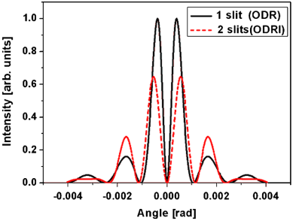
ODR Interference
Actually an ODR Interference experiment
Cianchi et al, PRST 14 102803 (2011)
Fiorito and Rule, Nucl. Instr. and Meth. in Phys. Res. B 173, 67-82 (2001)
target
SR mask
Mask (FW) and target (BW interference
3

Slide 4
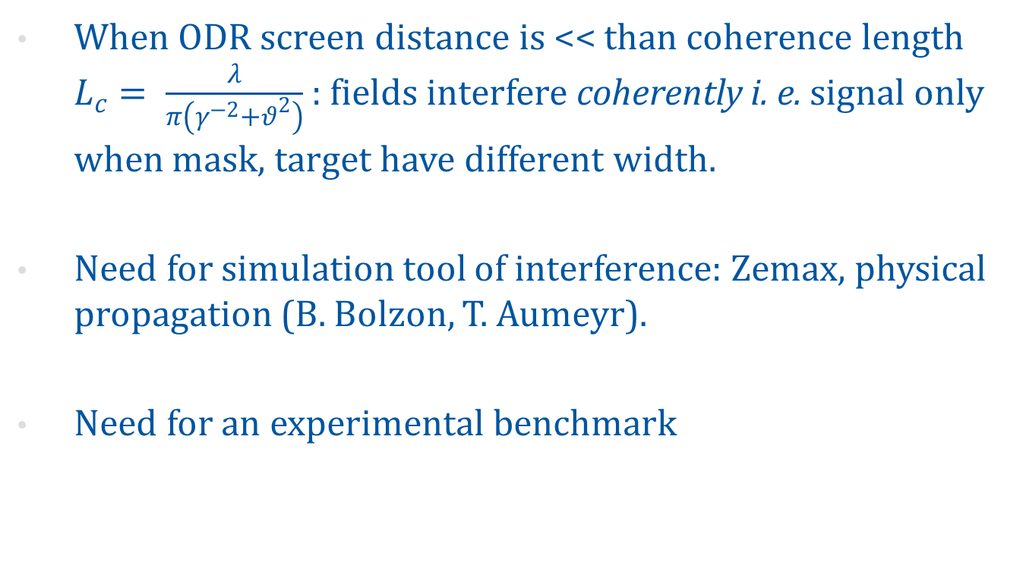
ODR interference - continued
When ODR screen distance is << than coherence length $L_{c}= \frac{λ}{π\left(γ^{−2}+θ^{2}\right)}$ : fields interfere coherently i. e. signal only when mask, target have different width.
Need for simulation tool of interference: Zemax, physical propagation (B. Bolzon, T. Aumeyr).
Need for an experimental benchmark

Slide 5
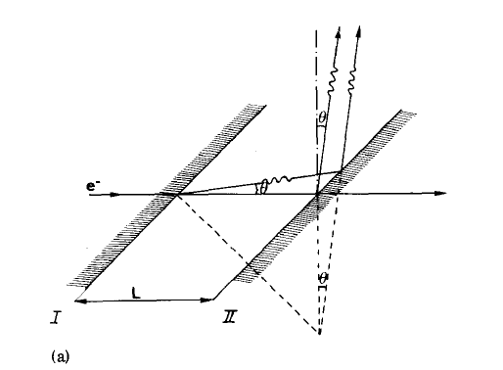
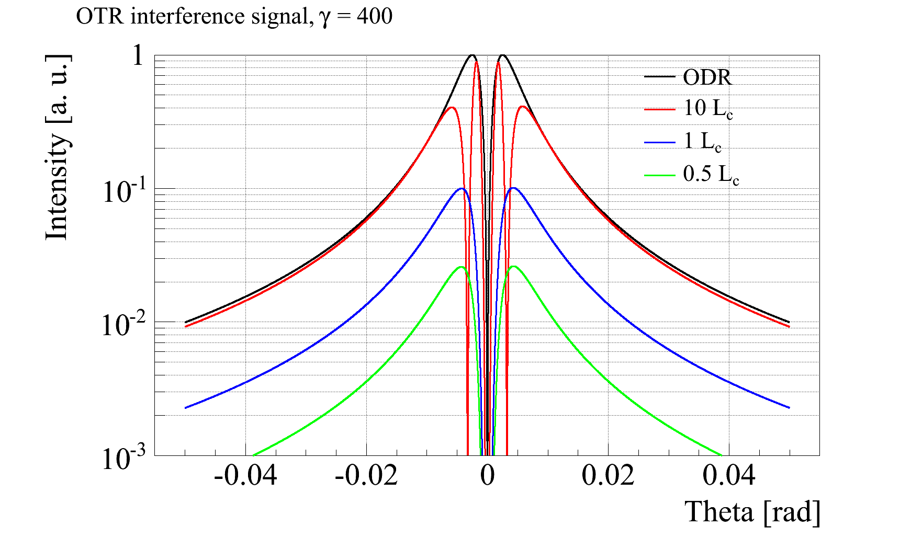
OTR interference
Experimental results : Wartski (1975) for distances >> L_{c}
Califes: L_{c} ≅ 2.5 cm @ 200 MeV, λ = 500 nm
Ideal to study the coherent regime

Slide 6
OTR interference
Vertical position of OTR screen assembly determines distance
Same ODR geometrical configuration
Single screen OTR
Between 0.5 and 1 L_{c} fourfold increase of OTR signal

Slide 7
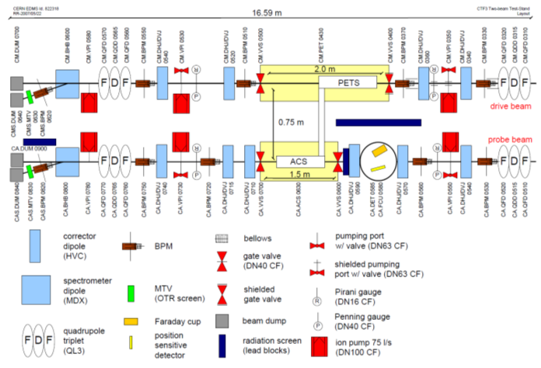
Installation - 1
c

Slide 8
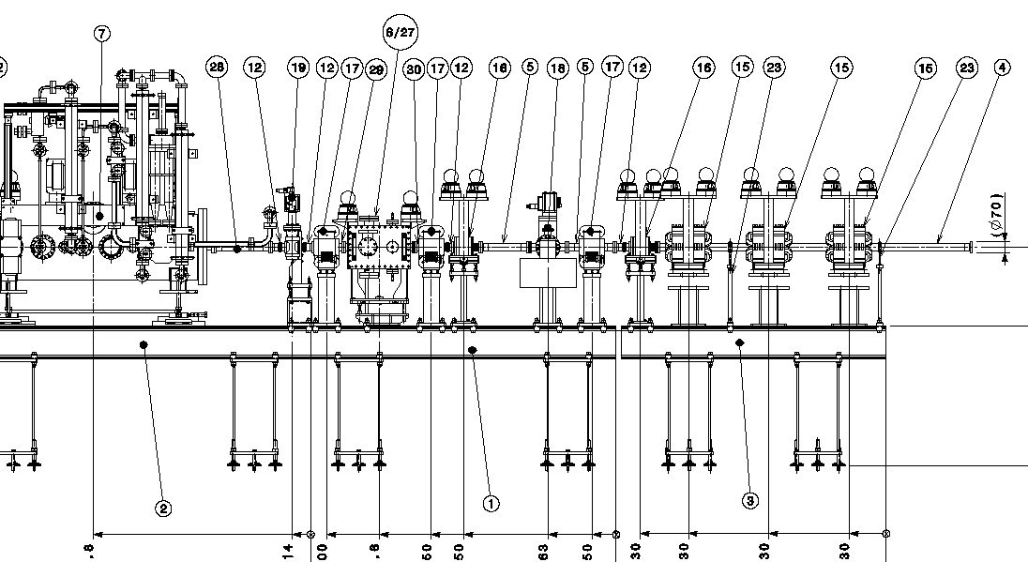
Installation - 1
299 mm segment
Small beam size (down to 50 um)
c

Slide 9
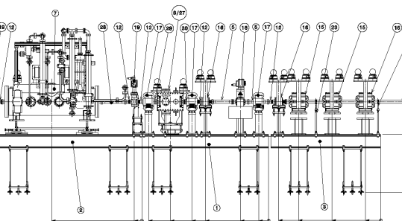
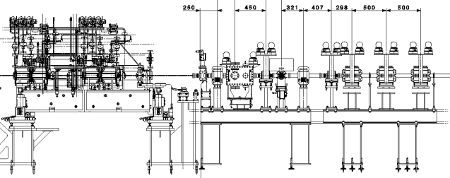
Installation - 1
Installation incompatible with new module
Install during winter shutdown, remove in summer 2014
Critical item: 9 weeks delivery for actuator

Slide 10
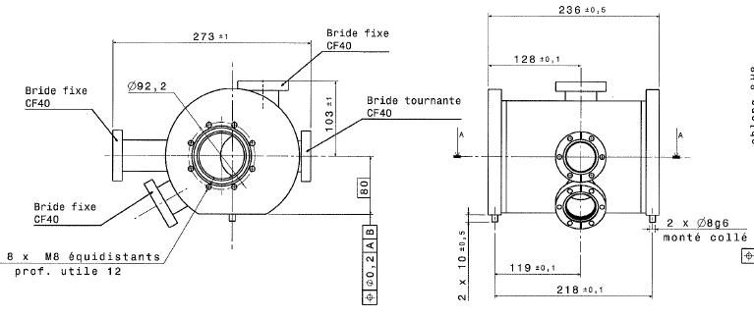
Installation - 2
Modification of an existing MTV (390).
Feasibility to be studied

Slide 11
Summary
An OTR interference test is proposed in Califes/TBTS line
As stand-alone: still possible (but critical) during winter shutdown. Not compatible with new module
As modified MTV chamber. No time constraints, feasibility to be studied.

