Slide 1
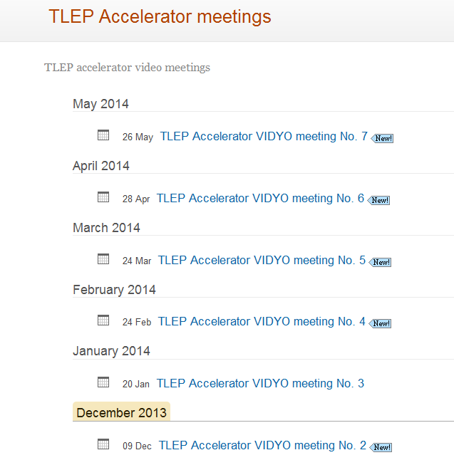
Preliminary dates for 2014 meetings
Tentative dates for first 5 meetings in 2014.

Slide 2
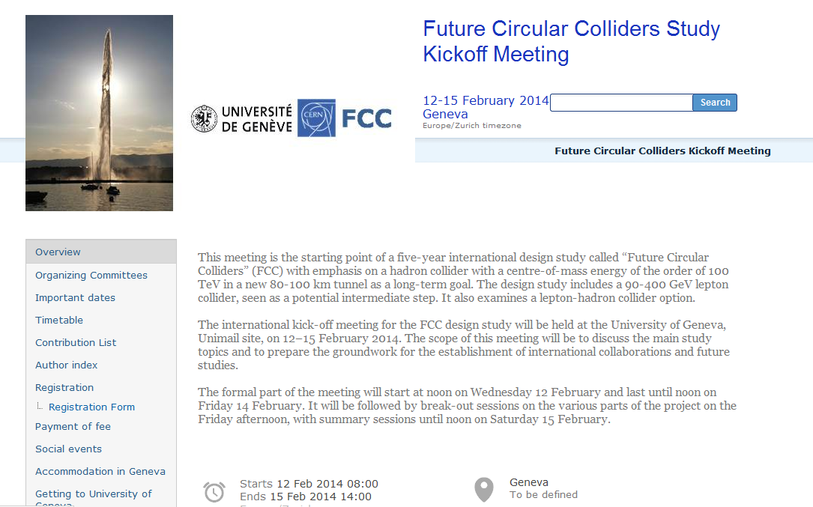
The FCC kick-off meeting
http://indico.cern.ch/conferenceDisplay.py?ovw=True&confId=282344

Slide 3
Friday afternoon and Saturday morning at University
14:00 break out sessions (coffee break at 16:00)
-- Technical infrastructure and civil engineering Lebrun
-- Hadron collider design (+ SC magnet technology, + injectors) Schulte
-- Lepton collider design (+ SC RF technology + injectors) Wenninger
-- Hadron Physics, Experiments, Detectors Ball +Gianotti
-- Lepton Physics, Experiments, Detectors Blondel+Janot
-- e-p Physics, Experiments, Detectors Klein
-- FCC Overall physics and phenomenology Ellis + Mangano
Saturday morning 9:00 (coffee break at 11:00)
-- reports by conveners
-- Warp-up and next steps (Michael Benedikt)
➔Do enter your name and subject you would like to see discussed

