Slide 1
TLEP injector requirements -
beam production rates
J. Wenninger

Slide 2
Injection into TLEP
Injection into the TLEP ring has to be done in top-up mode since the beam lifetime from Beamstrahlung & luminosity will be < 1 h. The ring is operated at constant energy.
Full energy injector (TLEP booster) in the same ring than TLEP. Reuse magnets and main lattice, but no low beta and no collisions.
  Energy range: ~10-20 GeV (injection) to 175 GeV (TLEP max).
  Question: do we accelerate e+ and e- at the same time or in separate cycles? If separate cycles: no need for beam separation schemes, no issue with one RF system for 2 beams… but double cycling rate.
Pre-injector complex delivering 10-20 GeV beams.
  Revive LEP chain,
  Re-circulating linac,
  ‘SuperKEKB-like’ linac ,
  ….
Injector study !

Slide 3
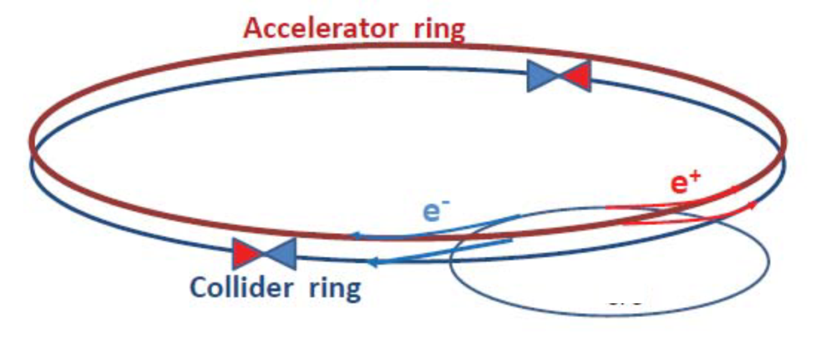
Booster
To be defined what this ‘circle’ will be…

Slide 4
Boundary conditions
For simplicity the cases for 45 GeV and 175 GeV are considered here, as they are at the extreme of the spectrum.
The total number of particles per beam for a synchrotron power loss of 50 MW per beam (100 km option – more current):
  45 GeV : 3.5x10¹⁵ e⁺/e⁻ I = 1540 mA
  175 GeV : 1.5x10¹³ e⁺/e⁻ I = 6.7 mA
Values depend of course on filling factor and other details

Slide 5
Filling the machine
Even though we aim to operate in top-up mode, we have to also consider filling from scratch after beam loss, stop etc.
Let’s consider that the complete filling process from empty to full machine should take ~30 minutes.
For 100% injection efficiency, the beam production rate must be:
  45 GeV : 3.5x10¹⁵ in 30 minutes → 2x10¹² e⁺⁻/s
  175 GeV : 1.5x10¹³ 8x10⁹ e⁺⁻/s
  With a 50% transfer efficiency from damping ring (e+) to TLEP, the required production rate should be 4x10¹² e⁺⁻/s.

Slide 6
Top-up operation (1)
The average top-up rate depends on total no. particles N_{tot} and lifetime τ. The top-up frequency depends on the tolerable luminosity drop and other technical considerations.
For the luminosity drop it is assumed here that operation is not beam-beam limited and L ~ N².
The tolerable luminosity drop is set to 5% → 2.5% loss in N_{tot}. This defines the top-up period T_{tu}(i.e. time between 2 top-up phases).
E (GeV) | N_{tot} | τ (s) | dN/dt (1/s) | T_{tu} (s) | ΔN_{tu}
45 | 3.5 ⋅10¹⁵ | 3600 | 8.9 ⋅10¹¹ | 91 | 8.8 ⋅10¹³
45 | 3.5 ⋅10¹⁵ | 1750 | 2.0 ⋅10¹² | 41 | 8.8 ⋅10¹³
175 | 1.5 ⋅10¹³ | 300 | 4.8 ⋅10¹⁰ | 8 | 3.6 ⋅10¹¹

Slide 7
Top-up operation (2)
E (GeV) | N_{tot} | τ (s) | dN/dt (1/s) | T_{tu} (s) | ΔN_{tu}
45 | 3.5 ⋅10¹⁵ | 3600 | 8.9 ⋅10¹¹ | 91 | 8.8 ⋅10¹³
45 | 3.5 ⋅10¹⁵ | 1750 | 2.0 ⋅10¹² | 41 | 8.8 ⋅10¹³
175 | 1.5 ⋅10¹³ | 300 | 4.8 ⋅10¹⁰ | 8 | 3.6 ⋅10¹¹
At 45 GeV one can top-up every ~ minute for lifetimes ≥ 1 hour.
For a lifetime below ~1/2 hour at 45 GeV the beam production rate is higher than for injection from ‘scratch’.
At 175 GeV and for very low lifetimes, one has to top-up at ~0.1 Hz.
  For alternate e⁺ and e⁻ injection, the booster cycle time is ~4 seconds.
  Such a top-up rate almost excludes re-activation of old LEP chain, since the proton injectors would be > 50% busy filling TLEP !

Slide 8
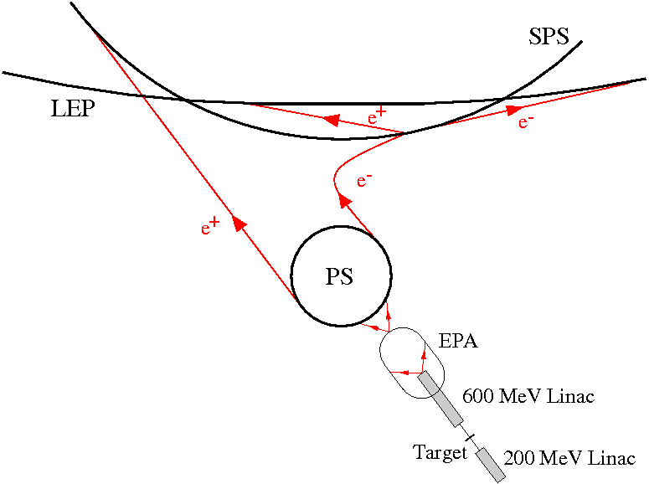
LEP chain
SPS : injection at 3 GeV, extraction at 22 GeV.
Max. flux ~1.5 ⋅10¹¹ e⁺/cycle, 1 cycle every 14.4 seconds.

Slide 9
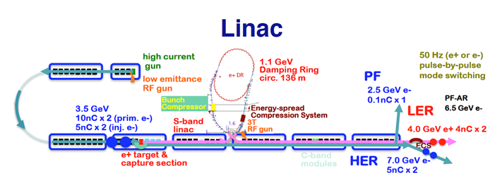
superKEKB
Y. Funakoshi, 6th TLEP WS, Oct 2013
Rate : 50 Hz
Particles/pulse : N e⁺/e⁻ = 5 ⋅10¹⁰ / 6.3 ⋅10¹⁰ [2x4 nCb/ 2x5 nCb]
Particles/s : N e⁺/e⁻ = 2.5 ⋅10¹² / 3.2 ⋅10¹² (1/s)
We need (a bit) more (+more E), but not far off.

Slide 10
Summary
Requirements on the injector complex for top-up and for filling at Z in ~30 minutes:
  Production rate of ≥ 2 ⋅10¹² /s (100% efficiency of transfers)
    Production of ~ 10¹² /s for 1 hour filling and top up at Z.
  Booster cycle time ~4 s
With those parameters it seems not very likely that a chain passing through PS and SPS can be used (duty cycle).

