Slide 1
Discussion of CLIC beam loss parameters
E. Nebot

Slide 2
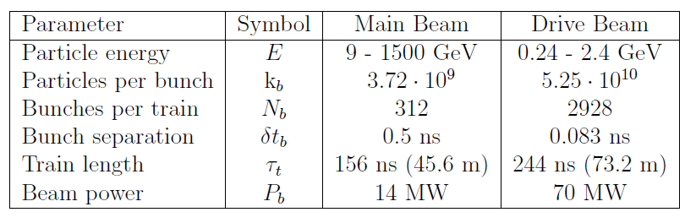
CLIC parameters and BLM requirements
BLM requirements (CDR):
  Time response 8 ms (CLIC@100Hz) to allow for after pulse analysis. But for diagnostics the faster the better
  Sensitivity. Beam dynamics considerations (luminosity losses due to beam loading). FLUKA simulations distributed
  Dynamic range. Onset of dangerous losses (10% desirable). FLUKA simulations single aperture

Slide 3
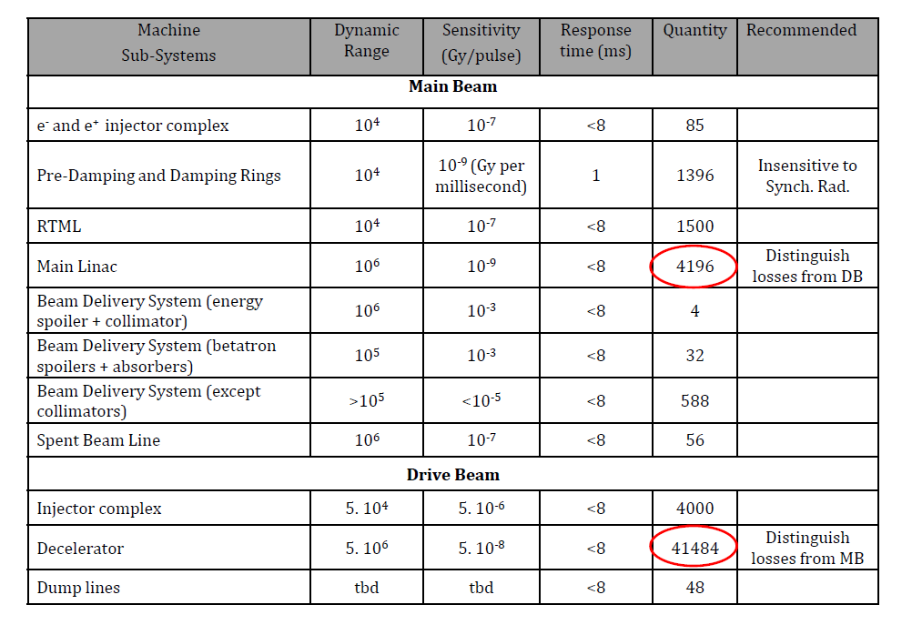
CLIC BLM requirements

Slide 4
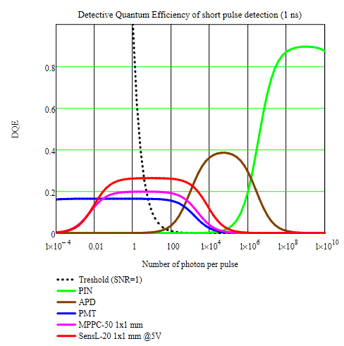
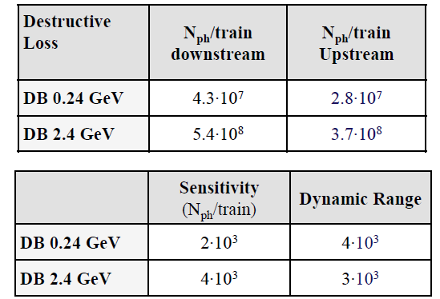
Photon yield estimation
Translating into photon yield:

