Slide 1



BLM Quasar working group
Deconvolution of fibre signals with single electron response (SER)
Part 2- Update and corrections
Lee

Slide 2
Reminder
The output of a detector is a mixture of the input into the detector and the signal response of that detector (the fingerprint of the detector)
Input Signal s(t)
Output Signal v(t)
Detector h(t)
This “Convolution” of the input signal and the detector input response is given by the convolution integral:
(Eq 1)
In terms of fibre and SiPM using the Fourier transform and a convolution in the time domain is equal to a multiplication in the frequency domain.
Inverse FFT to recover Fibre signal in

Slide 3
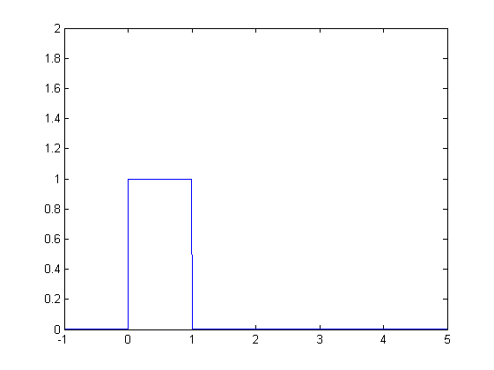
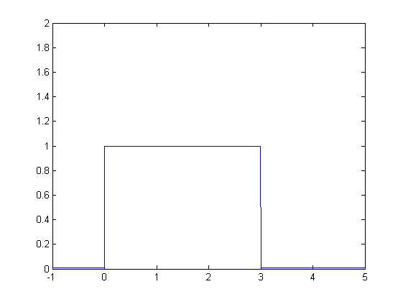
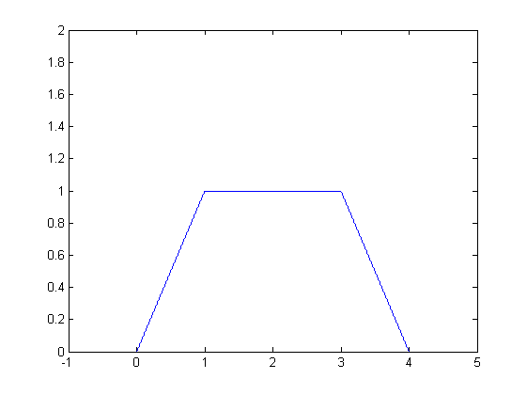

Testing the method with simple shapes
New approach. Start from simple shapes, calculate convolution mathematically and deconvolute in Matlab
x
y
z
*
=
Not exactly zero, otherwise it doesn’t work
In Matlab: To convolve two signals x and y to a signal z: z=abs(ifftshift(ifft(fftshift(fft(x)).*fftshift(fft(y)))));
To deconvolve (reverse above convolution): y= abs(ifft((z)./ftshift(fft(x))));
To deconvolve a signal calculated from eq(1):y=abs(ifftshift(ifft(fftshift(fft(zcalc))./fftshift(fft(x)))));
Z is easy to define mathematically so using x to recover y:
Next: I know my technique works for a ‘simple’ (though not exactly simple for FFT) and apply it to the fibre.

Slide 4
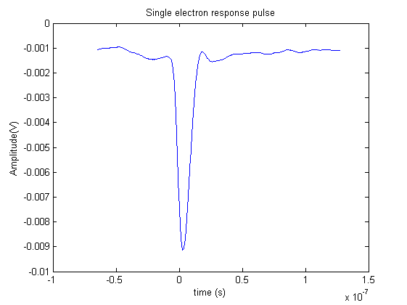
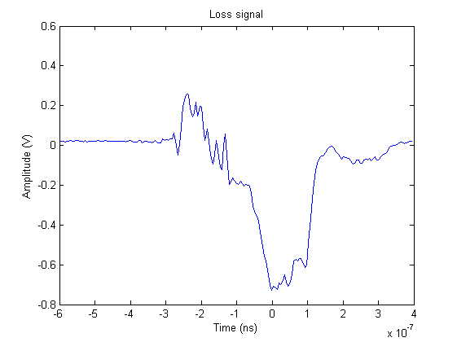
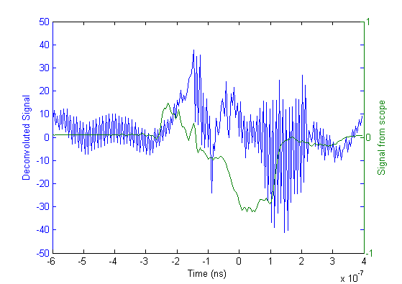
Testing the method with simple shapes
New approach. Start from simple shapes, calculate convolution mathematically and deconvolute in Matlab
Positive because in all cases background fibre sees higher signal than TBL fibre
Stretched
Stretched
Input from fibre before SiPM
*
=
Deconvoluting in matlab
Single photoelectron response
Upstream corrected signal
Input signal looks noisy. What could cause this?
Sample rate? Currently is 1 point each 5 ns (order or rise time)
More points are needed?
How does sample rate effect reconstruction
Is Analytical solution for SER better?

Slide 5
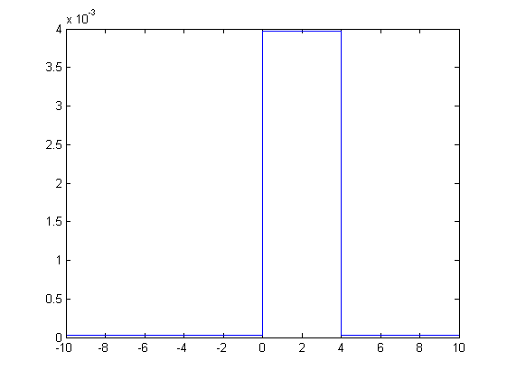
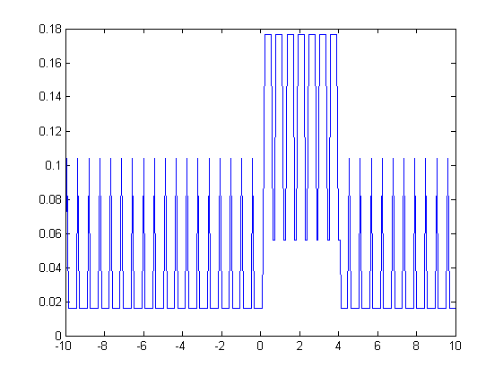
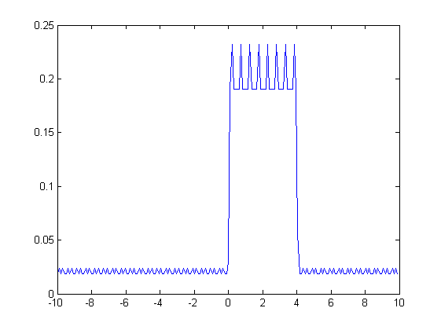
Sample rate?
Going back to my simple shapes and see how the number of data points effects the deconvolution.
This time, deconvolving the convolution of a 4s pulse with a 0.5s pulse (similar to fibre analysis)
Number of data points n: Deconvolution to recover y Comments
10000 Perfect reconstruction
of y
250
Artificial spikes appear
192 Slight improvement (maybe luck) but spikes appear
Matlab offers the ability to increase the number of Fourier points but with such a low sample rate it does not help, In short, sample rate of OASIS might not be not enough for these measurements

Slide 6
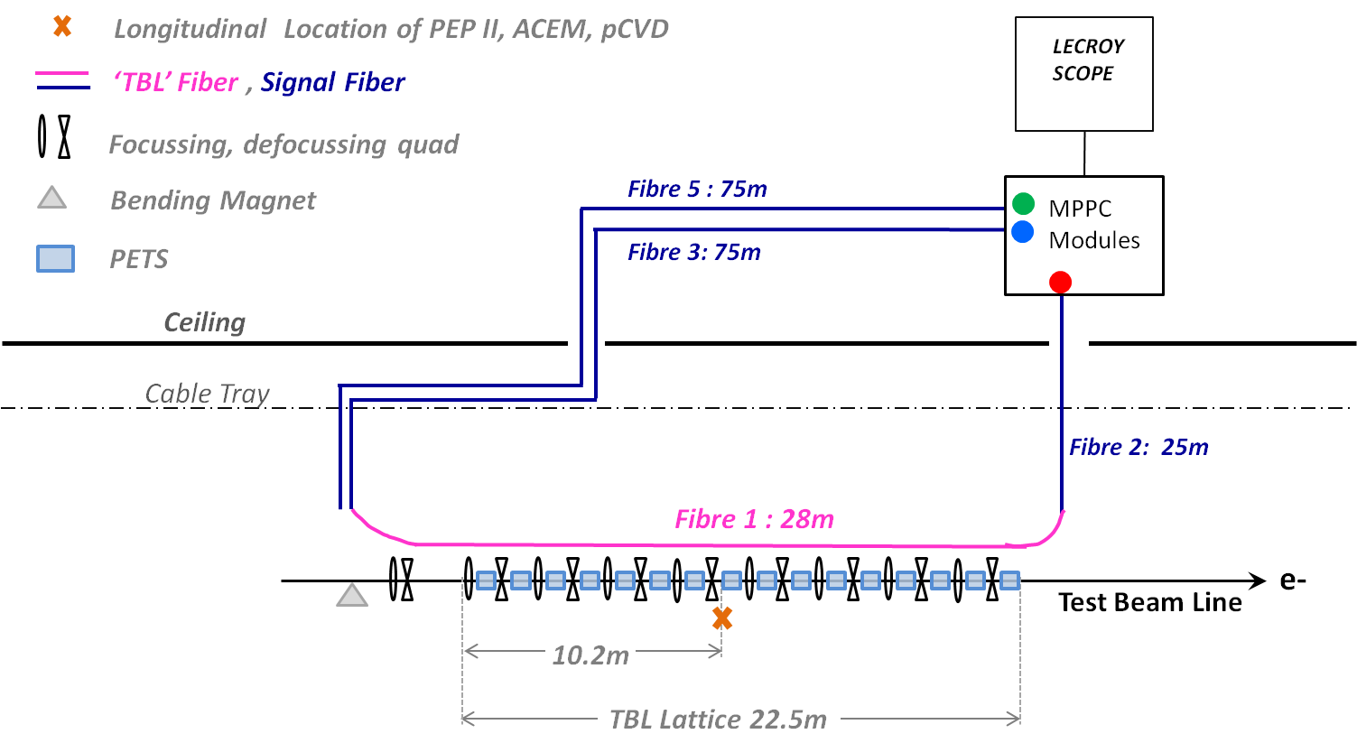
Bonus Slides- Fibre placement

Slide 7
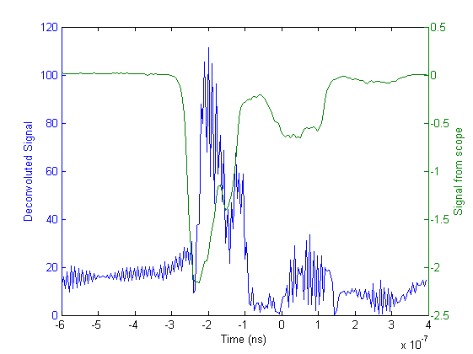
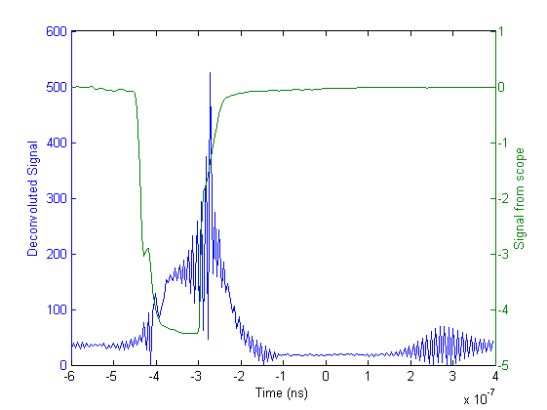
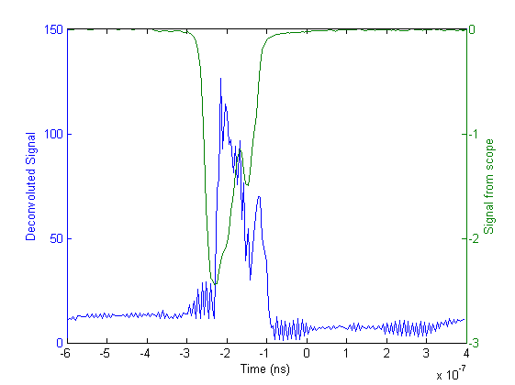
Bonus slides- Deconvolutions with individual fibres
Upstream TBL
Downstream TBL
Upstream Background
Downstream Background- Damaged. No Signal

