Slide 1

YBCO - Cable reference designs and open issues
L. Bottura
12.12.13

Slide 2
Cable design principles
Attempt to achieve
  Comparable critical current (target 600 A/mm², aim at least at 400 A/mm² for initial magnet work)
  High compaction for high current density and homogeneous stress distribution
  Cable transposition
  Comparable dimensions
YBCO tape: consider Roebel as a baseline. Stack of tapes pursued by INPG. Drop other concepts (e.g. CORC, twisted pair) for magnet design purposes
BSCCO wires: consider only Rutherford as the baseline. Other configurations (e.g. 6-around-1) are presently pursued by other laboratories (e.g. LBNL, FNAL)

Slide 3
REBCO Roebel – tape
Tape parameters
  Tape width: 12 (mm)
  Tape thickness: 0.15 (mm)
  Engineering current density (15 T, 4.2 K): 450 (A/mm²)
  Critical current (15 T, 4.2 K): 810 A
    NOTE: this implies a critical current of about 500 A at 77 K and SF
  SC layer: 1.5… 2 μm, or larger ? Effectiveness of YBCO layer ?
  Cu layer: 75…100 μm ? Can we reduce the substrate to 50 μm ?
  Homogeneity and defects TBD to assess the effect of punching (see later)

Slide 4
REBCO Roebel – cable design
Cable proposal:
  Number of tapes: 16
  Cable width: 12 (mm)
  Cable thickness: 1.2 (mm)
  Transposition pitch: ≈ 250 mm – estimated, depends on punched tape geometry
  Cable critical current: 5350 (A) (10 % degradation assumed)
  Engineering current density (15 T, 4.2 K): 400 (A/mm²)

Slide 5
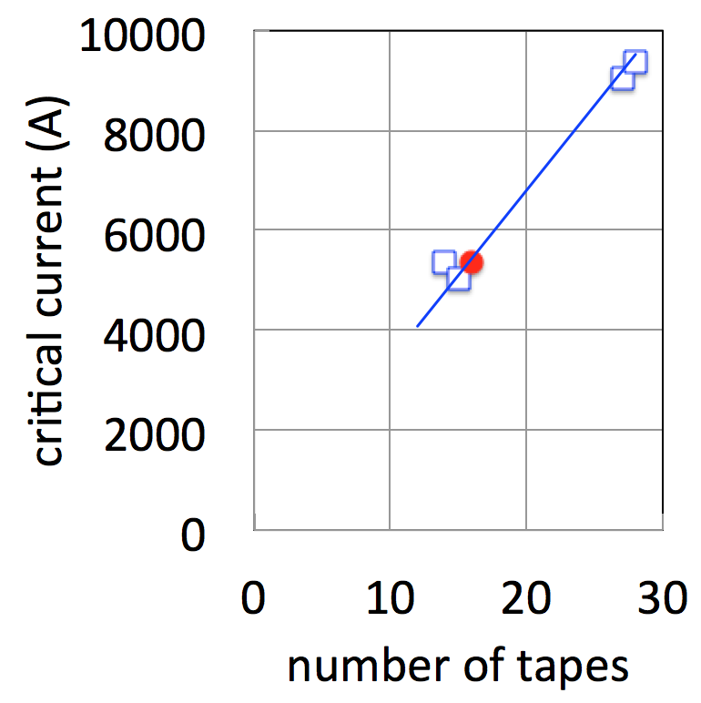
REBCO Roebel – KIT “stock”
Transposition 226 mm
  15 tapes (only SC)
    cable thickness: 1.1 mm
    critical current with 10% degradation: 5030 A
Transposition 426 mm
  28 tapes (only sc)
    cable thickness: 2.1 mm
    critical current with 10% degradation: 9390 A
  27 superconducting tapes and 27*0.15 mm Cu
    cable thickness: 4.2 mm
    critical current with 10% degradation: 9054 A
  14 superconducting tapes (loose cable)
    critical current with 10% degradation: 5350 A
By courtesy of A. Karlo, ITEP KIT

Slide 6
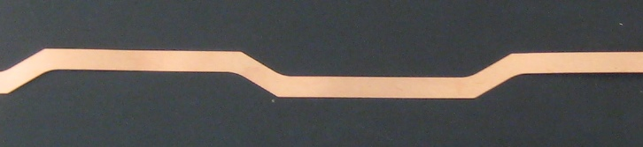
Cut tape geometry
Optimal geometry as proposed (KIT)
α
t
g
p
Present baseline at KIT:
t= 5.5 mm
g= 1 mm
α = 30 °
p=126, 226, 426 mm
R = 1-2 mm to reduce stresses , see C. Barth, et al. Supercond. Sci. Technol. 25 (2012) 025007
By courtesy of A. Karlo, ITEP KIT

Slide 7
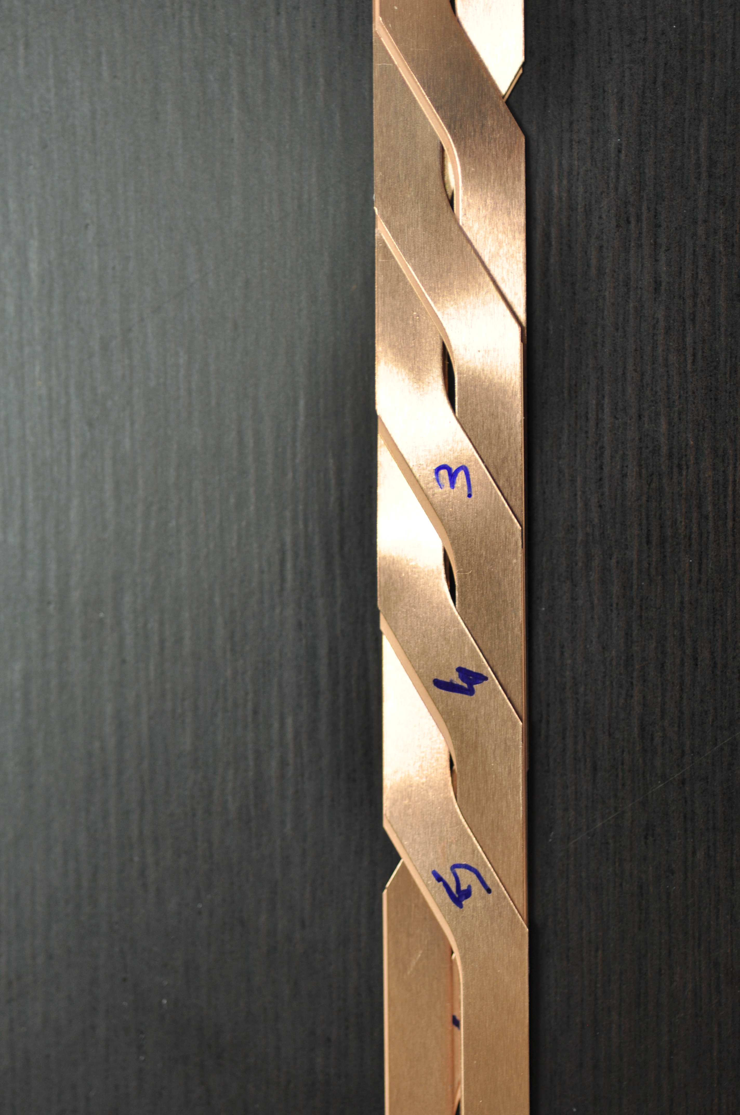
Comments from KIT
Tape sample for Roebel assembly needed (punching test, different substrate and tape architecture for Superpower and Theva which was used up to now) – need material for tests
Bruker tape has steel substrate replacing Hastelloy, thicker YBCO, thicker tape in comparison to SP
Winding properties: denser strands packing or looser? May have consequences for transverse stress situation (we can offer dummy preparation, experiments with transverse stress possible in Twente) – need feedback from WP10.3
Fitting transposition pitch to no. of strands and current regarding the remarks above !
By courtesy of A. Karlo, ITEP KIT

Slide 8
Roebel cable issues
Material is needed: test the punching, check the degradation, assembly, striation, develop first-hand experience, and optimize the parameters to reduce degradation
Current distribution/redistribution: to what extent ? What is the effect on field quality ? Is there a need for striation ?
Detection and protection: how much copper is required ?
Effect of strain and stress: measure a cable prototype
A number of somewhat trivial and practical matters: insulation (how ?), winding (cable geometry stable ? Bending radius ?), impregnation (does it work ?)
We need to get movin’

