Slide 1
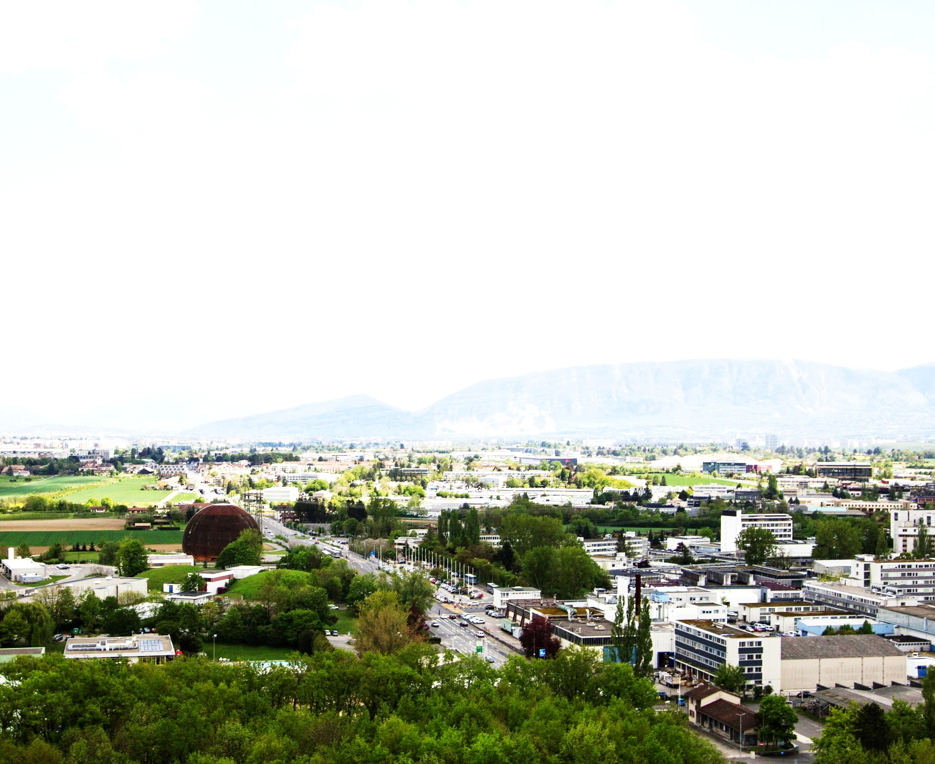

Indico 1.2
4 February 2014
José Benito González López
IT-CIS-AVC

Slide 2
Last year
1.0 released - 31th June 2013
Many enhancements and some new features
11 years of development
9 years in production at CERN (CHEP 2004)
Stable!
Notes:
Enhancements:
cleaning up old interfaces
standardizing

Slide 3
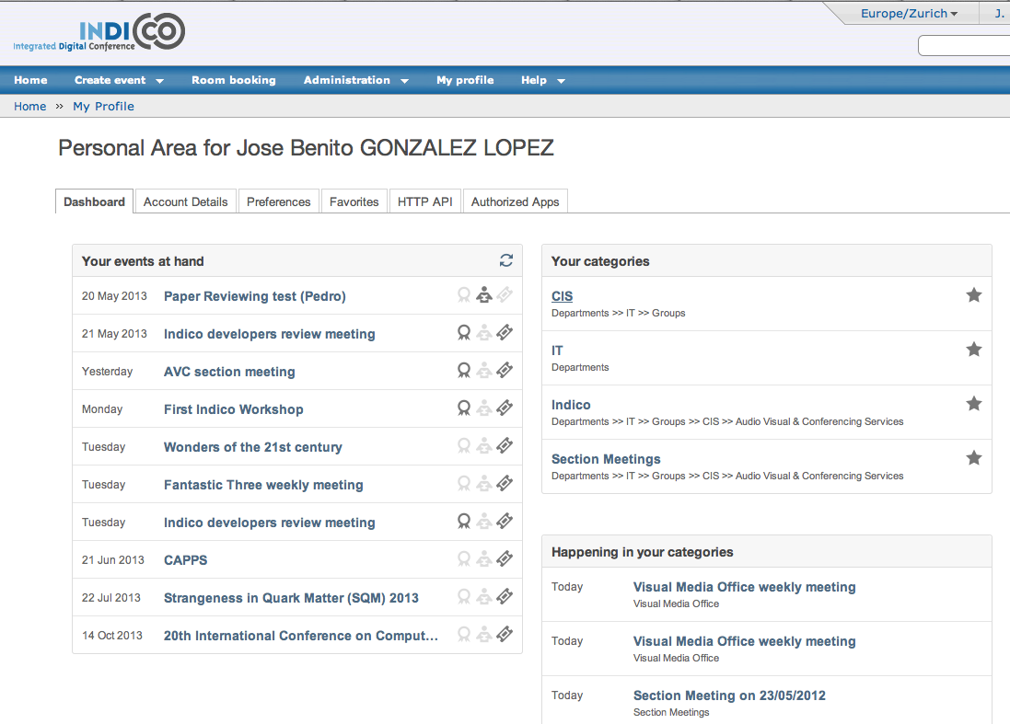
Last year
1.1 released
2nd September 2013
User Dashboard
Indico Mobile
Redis for caching
More:
  https://indico.cern.ch/news.py
  http://indico-software.org/blog/Indico1.0
  http://indico-software.org/blog/Indico1.1
Notes:
Enhancements:
cleaning up old interfaces
standardizing

Slide 4
Release 1.2
6th February 2014 @ CERN
New features and improvements
End of Indico 1.x series
Next version will be Indico 2.0 (New DB)
Notes:
Enhancements:
cleaning up old interfaces
standardizing

Slide 5

New FEATURES
Version 1.2

Slide 6
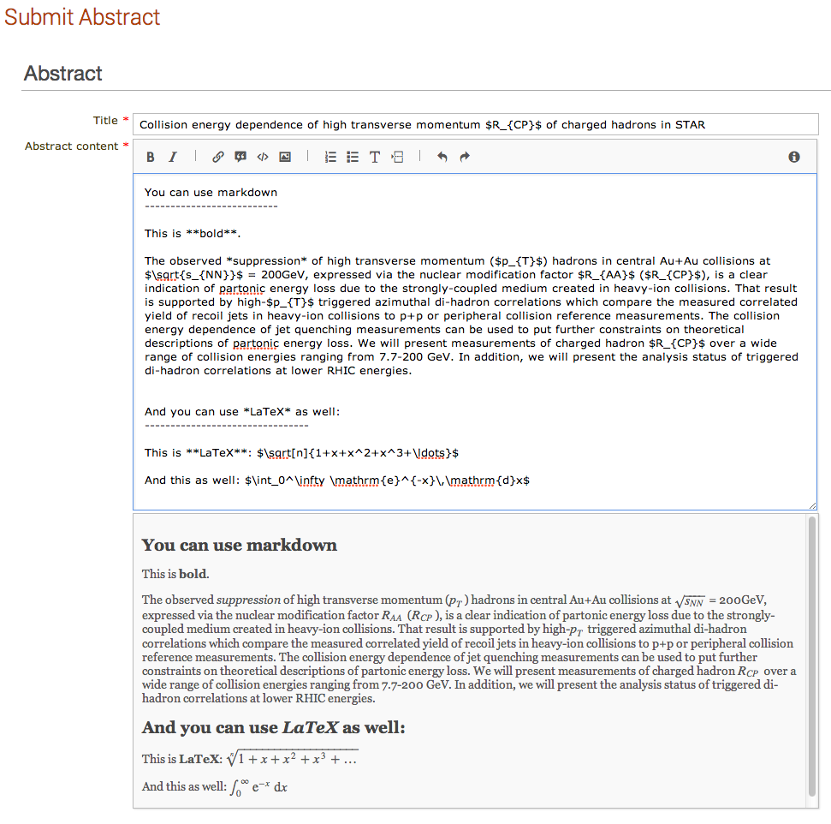
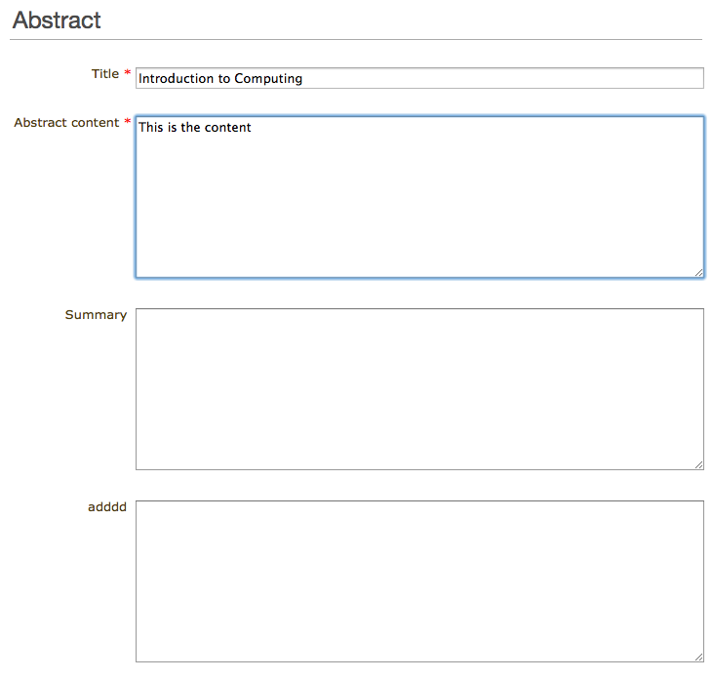
RICH ABSTRACT EDITOR

Slide 7
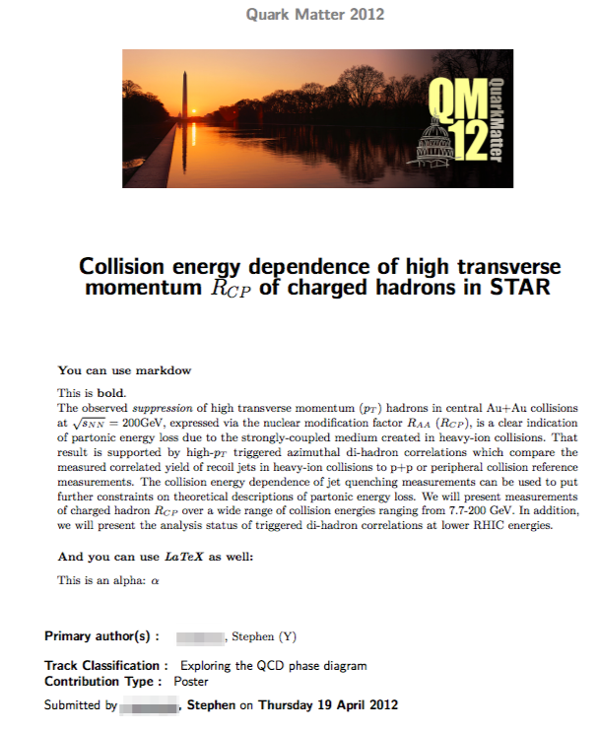
RICH ABSTRACT EDITOR

Slide 8
Registration form
One of the most popular modules
WYSIWYG Easy to create and edit

Slide 9
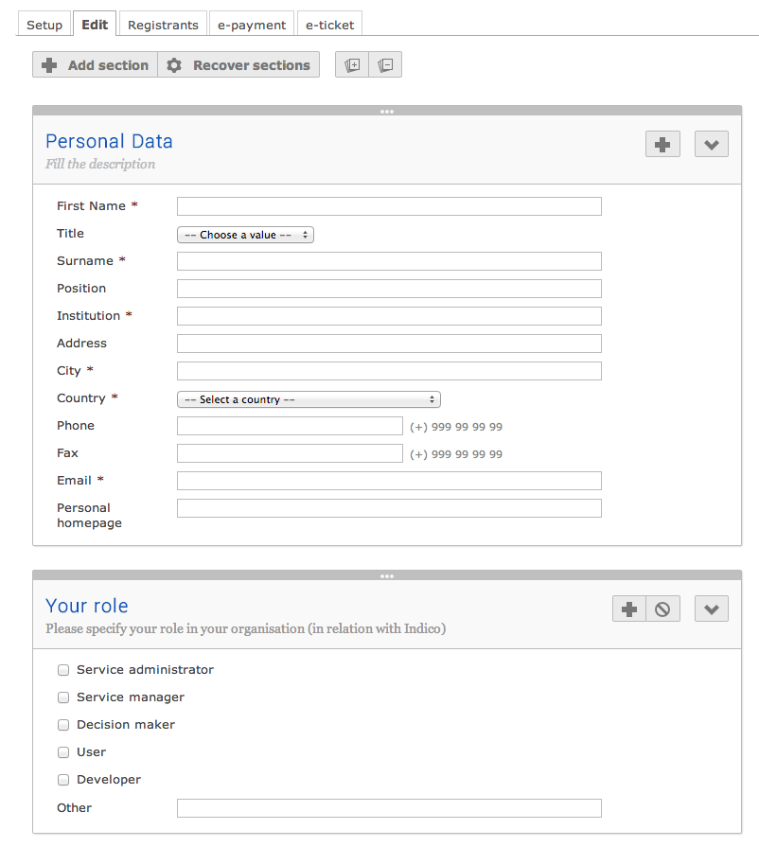
Registration form

Slide 10

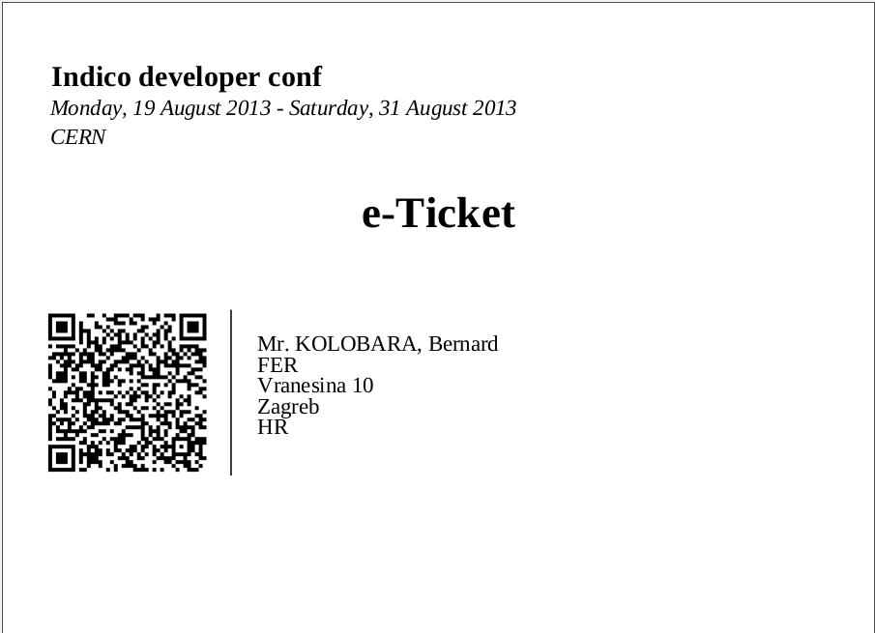
E-Ticket

Slide 11
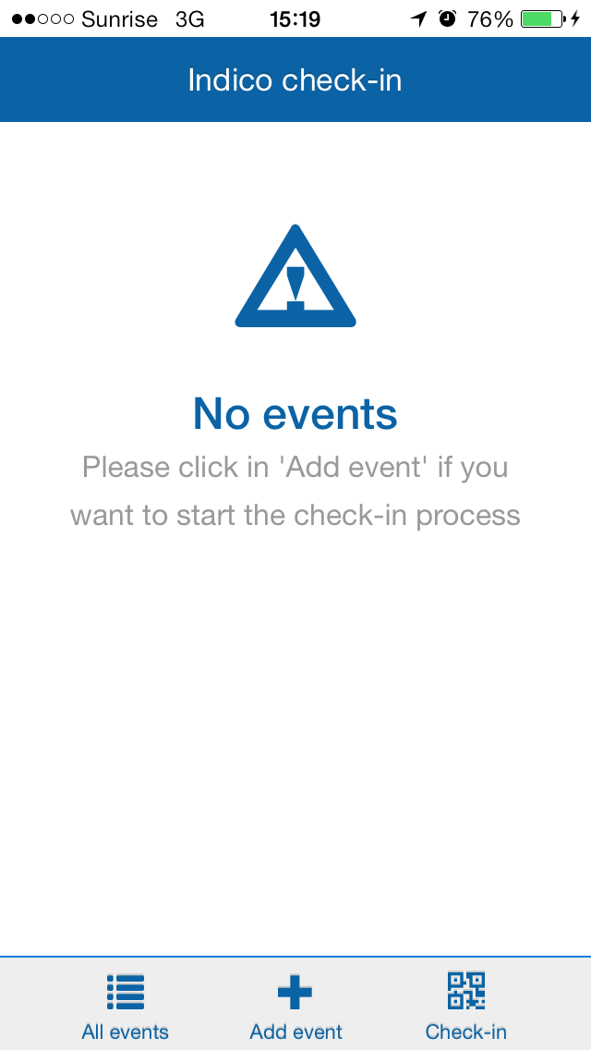
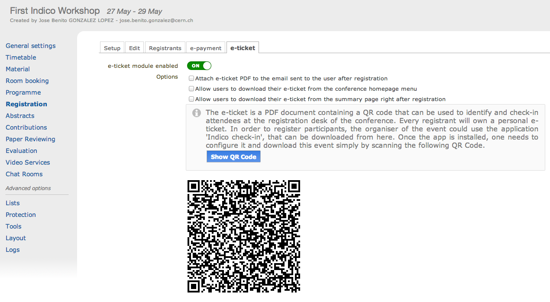
E-Ticket

Slide 12
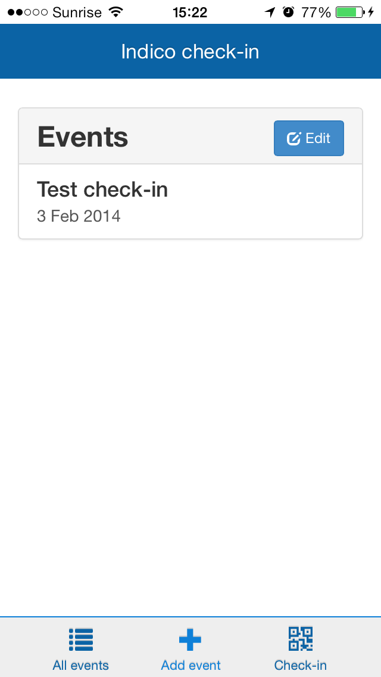
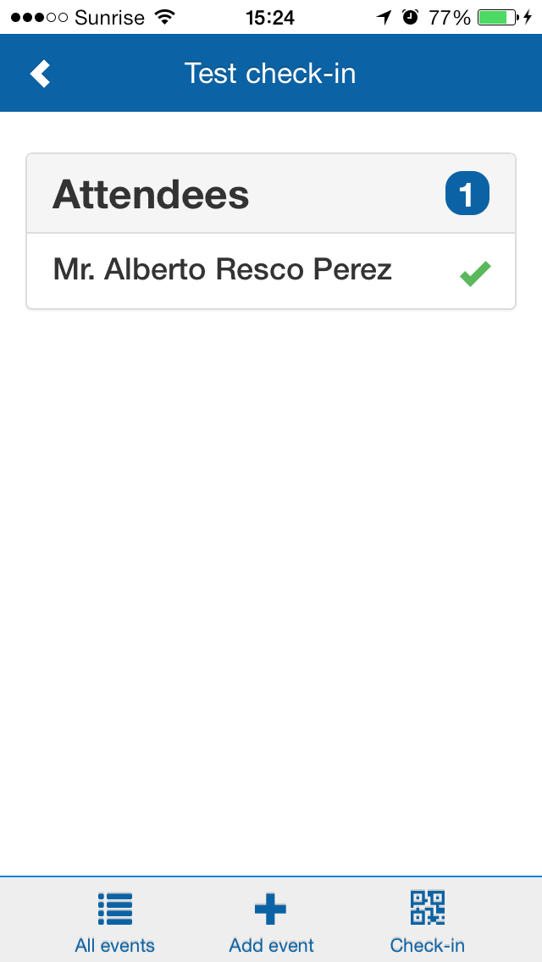
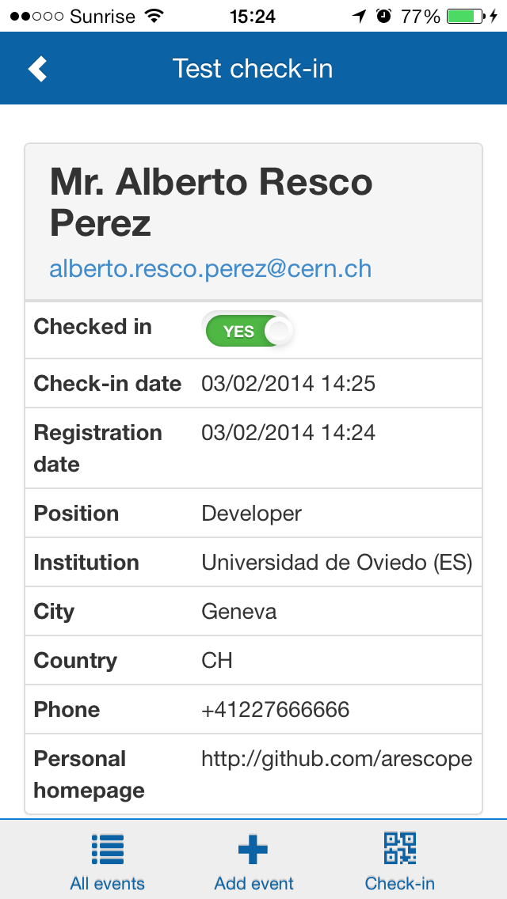

E-Ticket

Slide 13
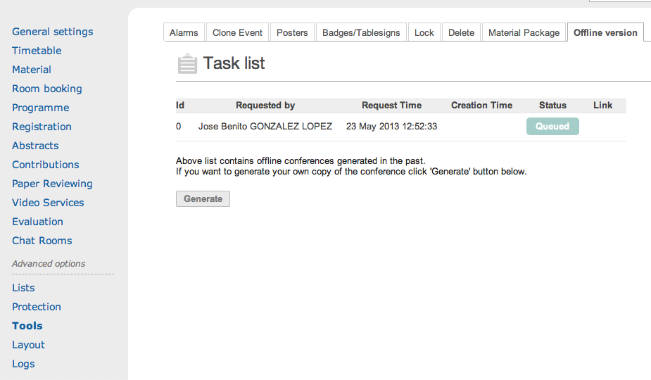
OFF-line website
STORE your event in a pendrive, etc
works off-line
access to files

Slide 14
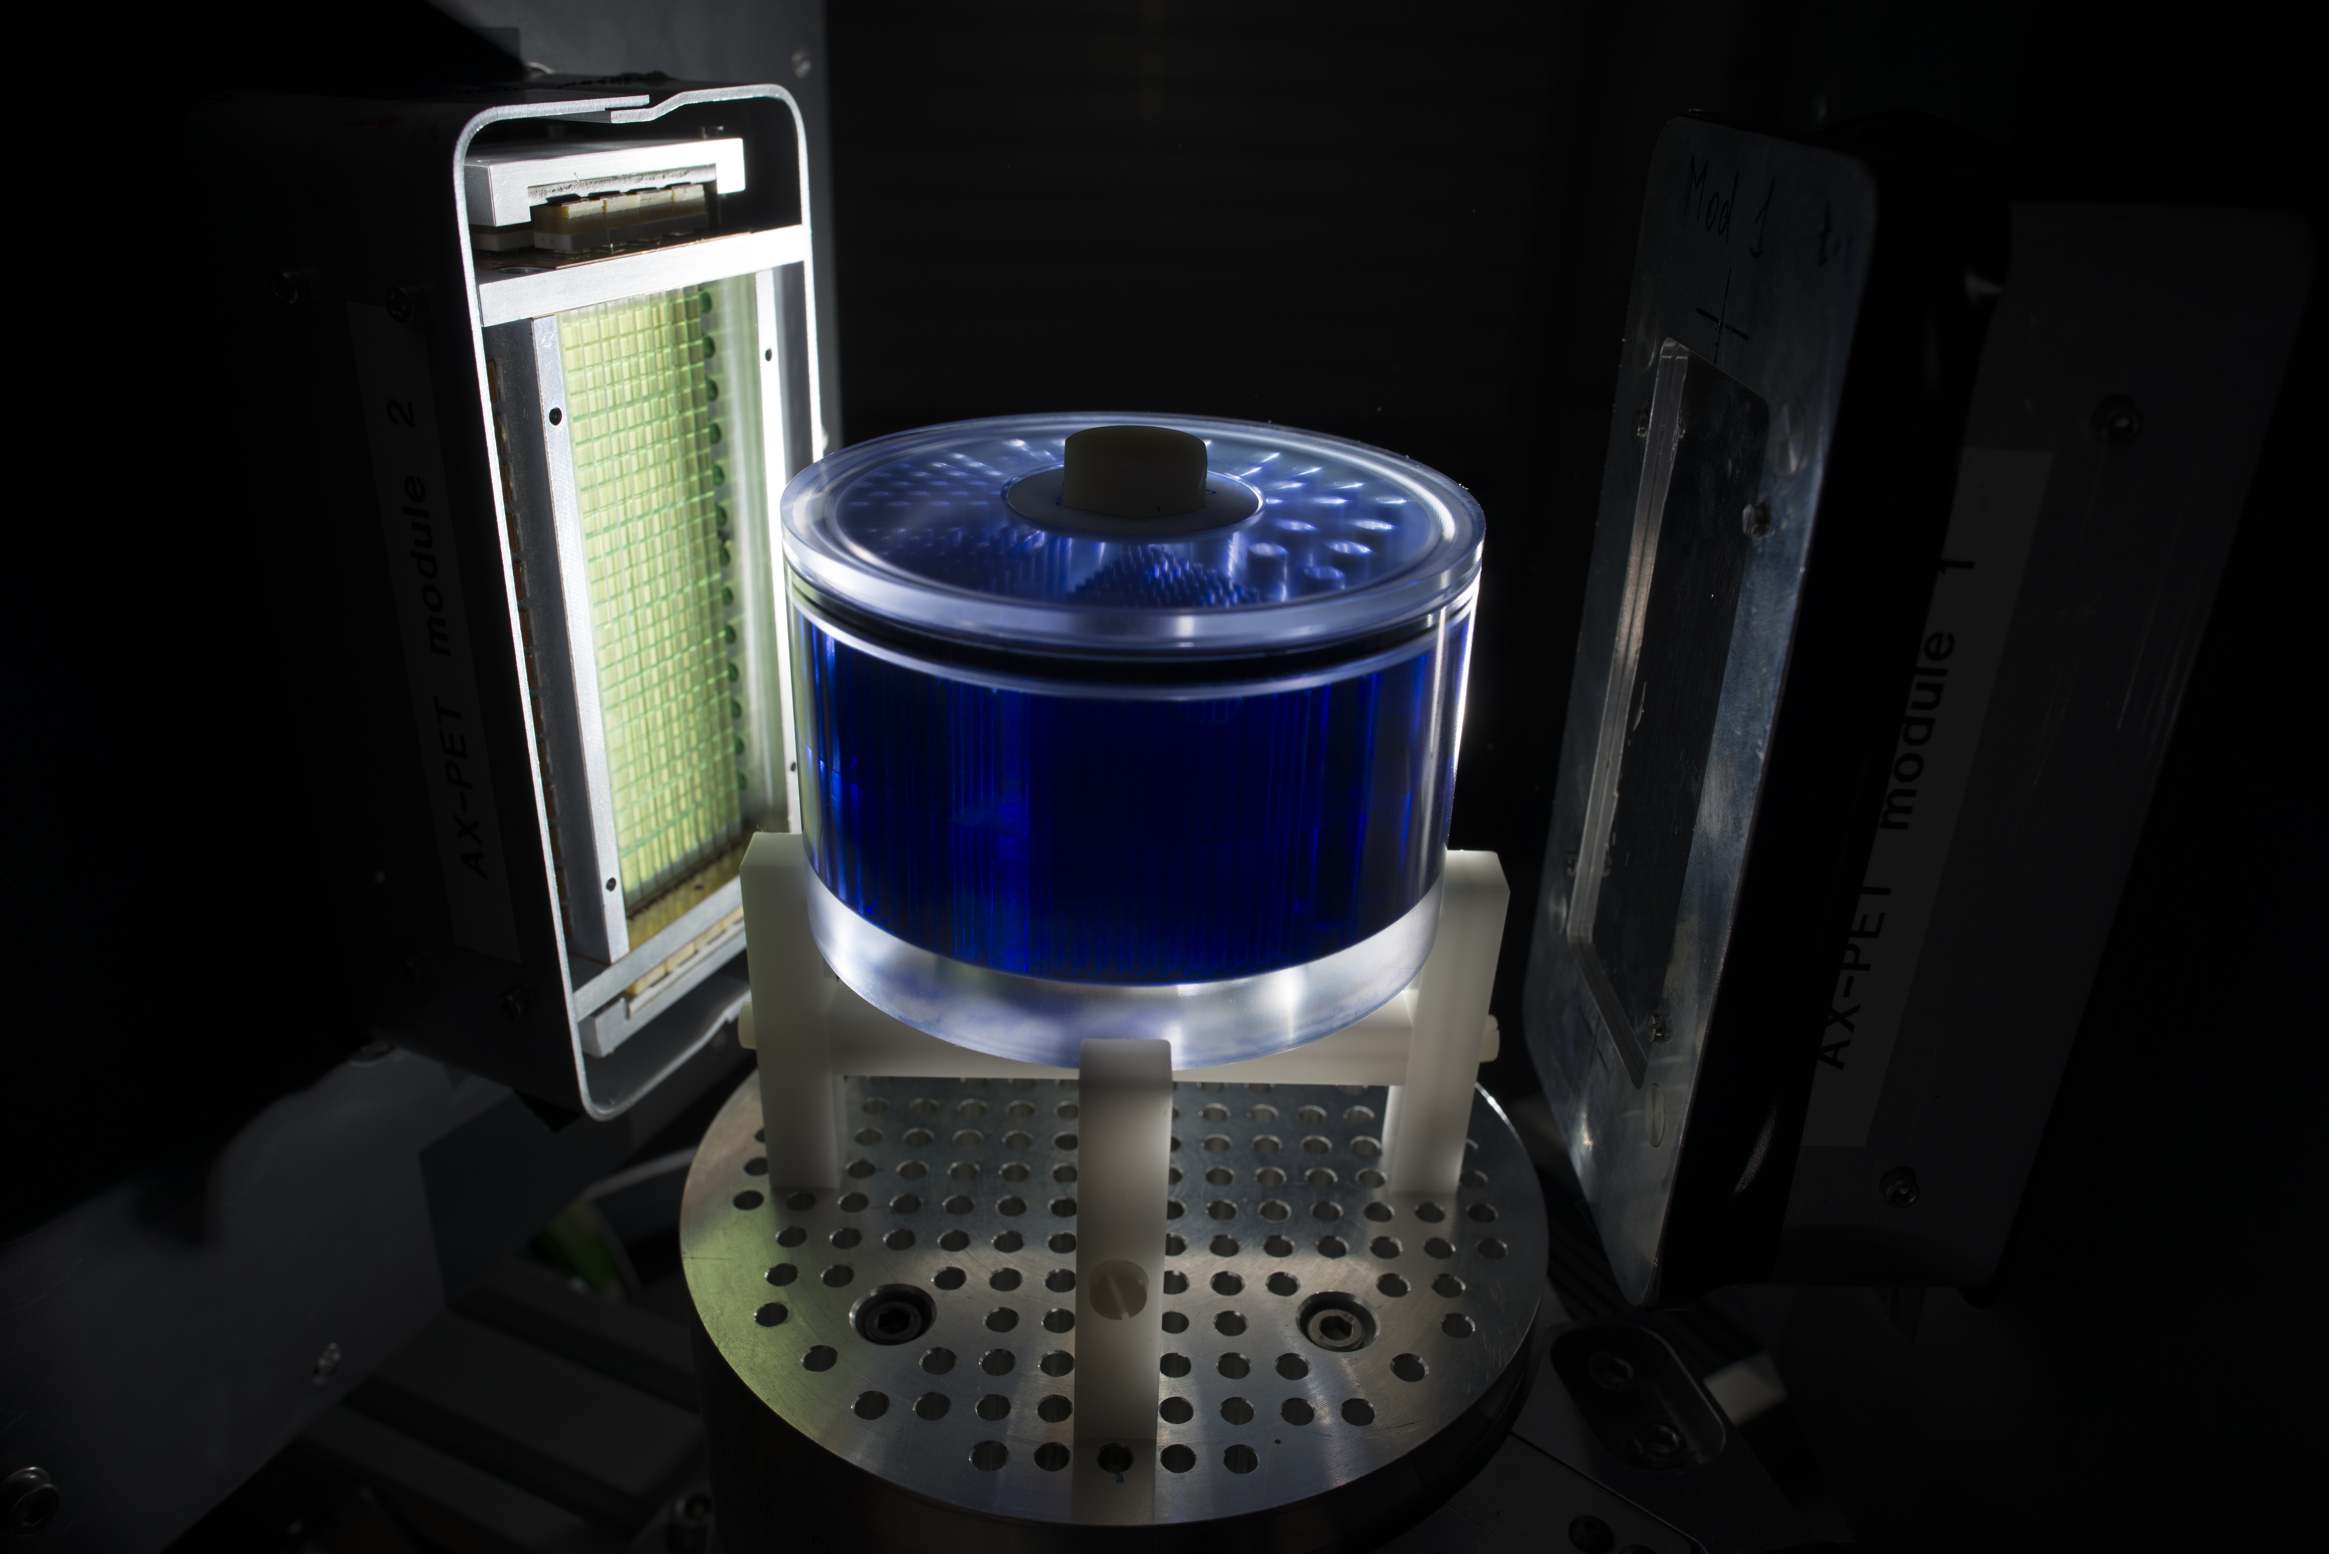
technology
Version 1.2

Slide 15

FLASK & URLs
Homemade framework (2002)
Moved to Flask: micro-framework, well documented
Benefit to shorten and beautify URLs:
http://indico.cern.ch/user/dashboard
http://indico.cern.ch/event/1234/
http://indico.cern.ch/category/123/
http://indico.cern.ch/category/123/create/event/meeting
http://indico.cern.ch/event/456/call-for-abstracts/my-abstracts
http://indico.cern.ch/rooms/book/

Slide 16

Authentication system
Indico core Redesigned, easier to extend, faster
indico.conf Local, LDAP, SSO

Slide 17
Tech 4 developers
Backend On-going migration to Flask
Frontend SASS, COMPASS, AngularJS
GOAL Easy/Fast development, enhance collaboration

Slide 18
More about 1.2?
Give it a try now!
http://indico-next.cern.ch
Check our project website:
http://indico-software.org/milestone/v1.2
https://indico.cern.ch/news.py

Slide 19



Thanks to all collaborators!
http://github.com/indico
project-indico-administrators@cern.ch project-indico-devel@cern.ch
indico@conference.jabber.cern.ch
irc.freenode.net #indico

Slide 20
Questions?
Jose Benito Gonzalez
http://github.com/jbenito3
jbenito@cern.ch

