Slide 2
Indico Virtual Event
Welcome and Introduction
4 February 2014

Slide 3
Welcome
Indico Virtual Events series
To complement the Indico workshops
About twice a year
Open content: contact us to propose
Recorded and will be made available from the Indico page

Slide 4
Programme
Indico v1.2 - Jose Benito Gonzalez Lopez (20mn)
Indico DB project update - Pedro Ferreira (30mn)
Indico Built-in search plugin - Giorgio Pieretti (15mn)
Open Discussions
What’s next – Thomas Baron (5mn)
Foreseen end: 16:30-17:00

Slide 5
Format
Come and Go
  First half for users, second half for administrators
Please keep the questions for the end of the presentations

Slide 6
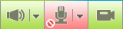

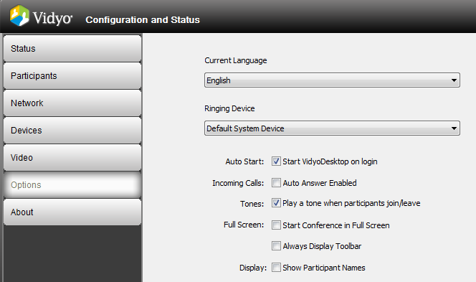

Vidyo Tips
Better stay muted when not speaking
Select the shared content
Double-click on the content window to separate and enlarge it
Avoid tone playing on participants joining/leaving

