Slide 1




ON THE USE OF FIBER OPTIC SENSORS FOR STRUCTURAL AND ENVIRONMENTAL MONITORING OF THE BELLE II VERTEX DETECTOR
Forum on Tracking Detector Mechanics, June 2014
D. Moya, I. Vila, A. L. Virto, E. Currás , A.Ruiz
Instituto de Física de Cantabria
M. Frovel, J.G. Carrión
Instituto Nacional de Técnica Aeroespacial
A. Oyanguren, C. Lacasta, P. Ruiz
Instituto de Física Corpuscular
David Moya Martín, IFCA (CSIC-UC)
Notes:
Cambios cosméticos menores, centrado cambio tamaña de letra…

Slide 2
Outline
Introduction Belle II Vertex detector
FBG monitoring system for Belle II vertex detector
Introduction to FBG sensors
Environmental sensor characterization
Displacement transducers
Belle II PXD/SVD common test beam environmental and structural monitoring.
Summary and Outlook

Slide 3
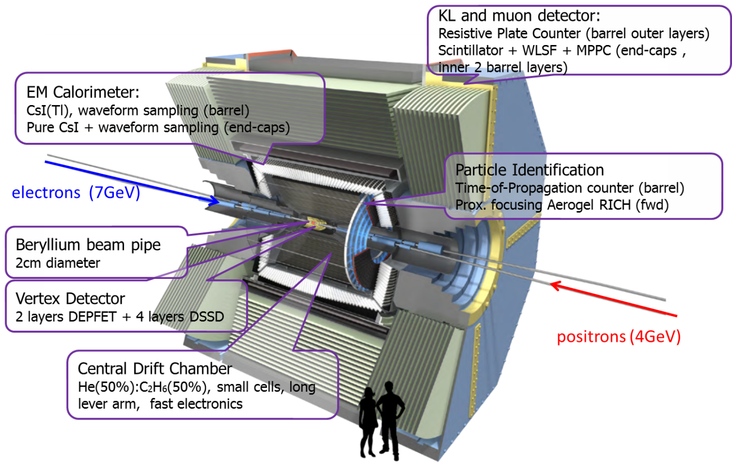
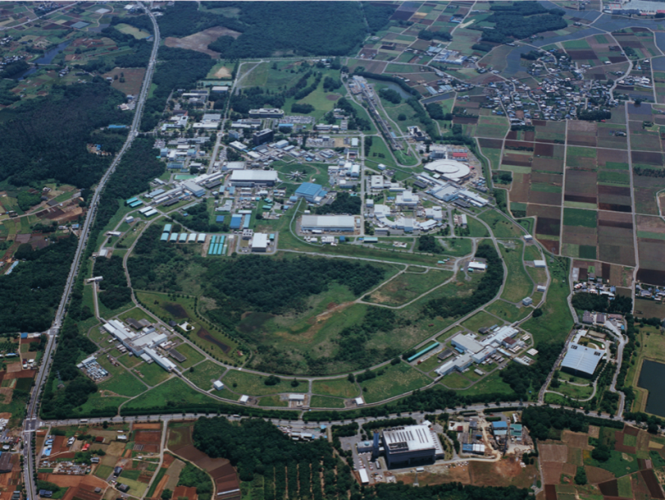
Introduction to Belle
,
Belle II is an experiment for flavor physic studies expected to be commissioned at KEK in 2016
KEK
Notes:
Cambios menores (colocar figuras)

Slide 4
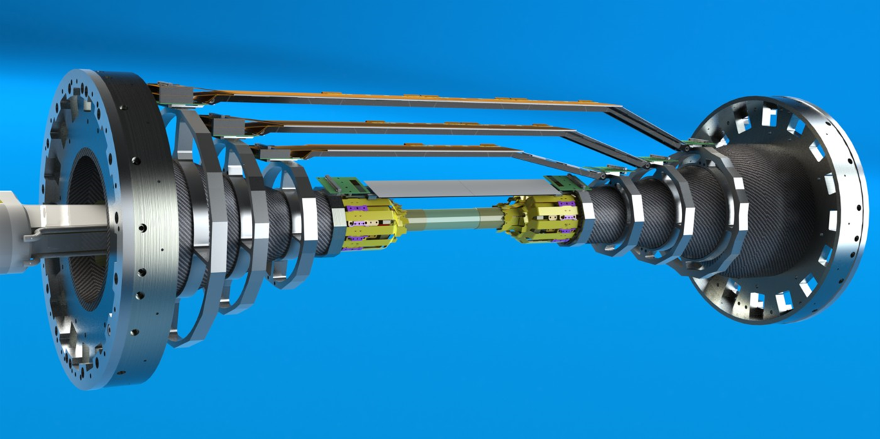
Belle-II Vertex Detector
,
Strip Vertex detector
(microstrips)
≈300mm
DEPFET PIXELS (90-122 mm length)
≈900mm
Notes:
Overall geometry and technology
Independent support
Central drift chamber
Thermal envelope
SVD sensors, origami sensors Supported by rips, and endrings.

Slide 5
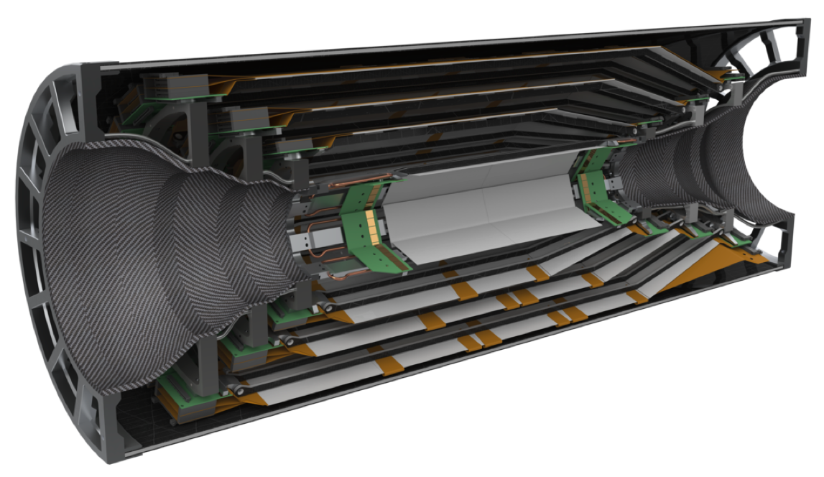
Belle-II Vertex Detector: svd
,
Strip Vertex detector
(microstrips)
Central drift chamber
Thermal envelope
Support cone
End rings
Support cone
Notes:
ESTA ME GUSTA MÁS QUE LA ANTERIOR DEJARíA ESTA Y QUITARIA LA ANTERIOR:
Overall geometry and technology
Independent support
Central drift chamber
Thermal envelope
SVD sensors, origami sensors Supported by rips, and endrings.

Slide 6
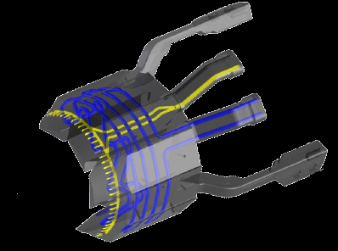
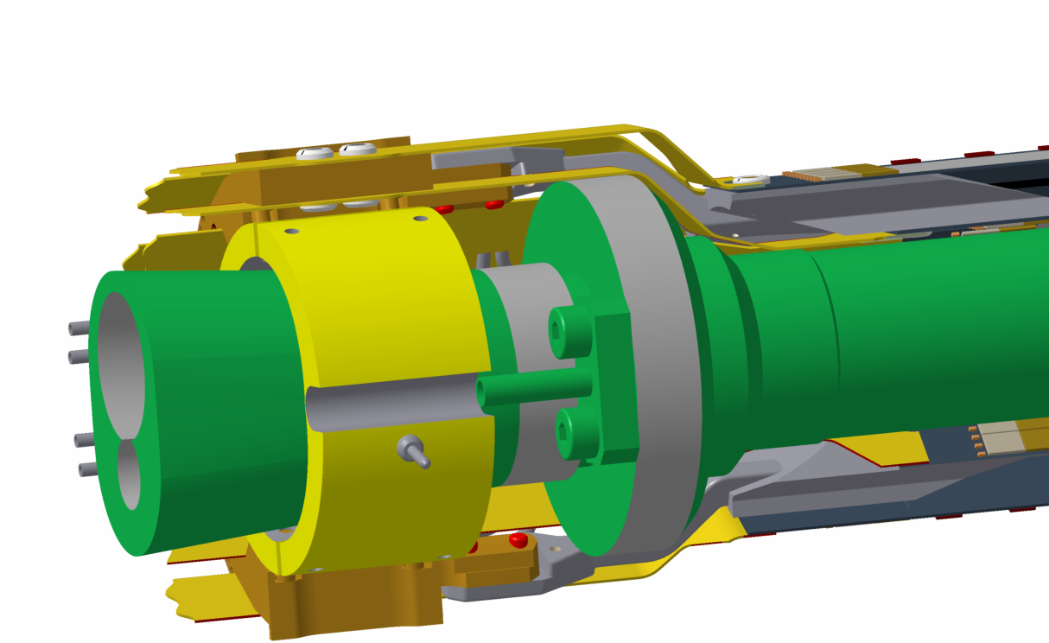
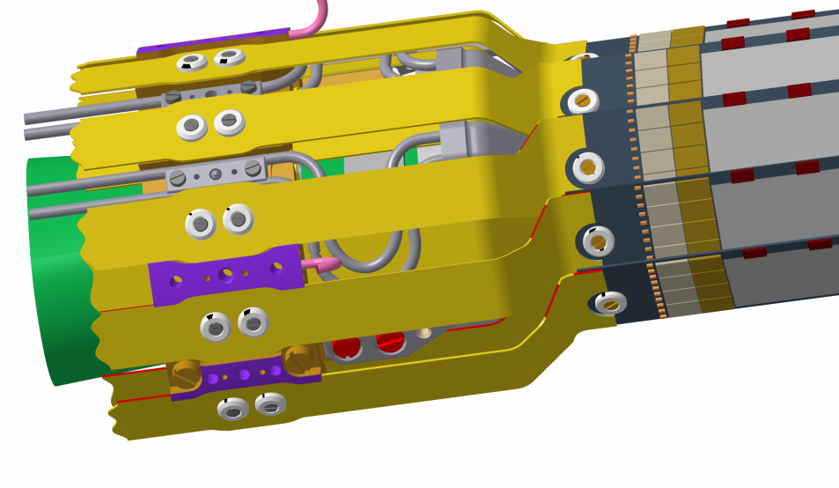
PXD Cooling Strategy
,
Cooling block screwed to ring, attached to the beam pipe
CO2 inlet
Air inlet
Cooling block
DEPFET PIXEL
Notes:
Foto PXD especifica
Cooling PXD (Co2 cooling, beampipe, blowing air)
Support on beampipe
Air cooling
Para el SVd lo mismo.
In consequience thermal gradients, vibrations…..

Slide 7
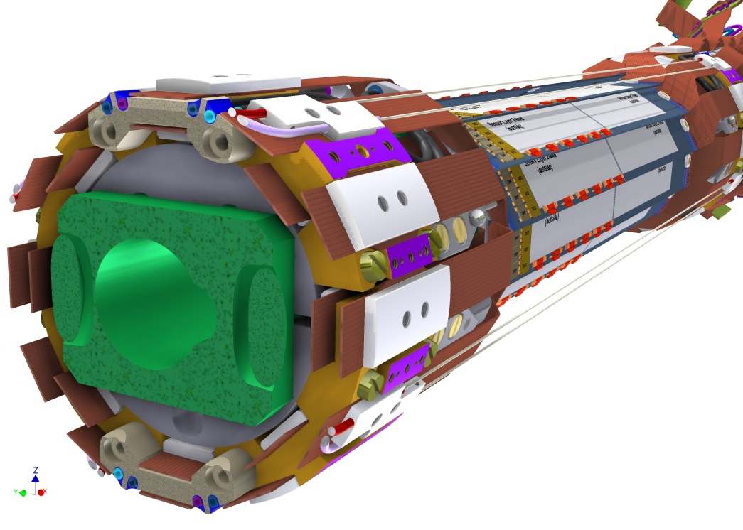
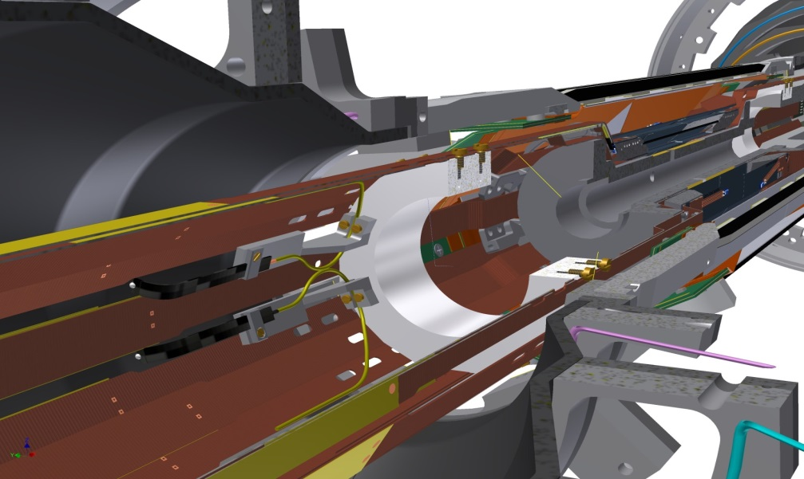
Solution: FOS Monitor system
Four L-shapes per side in order to measure relative PXD - SVD radial displacements or relative displacements in Z direction
Eight fibers for environmental monitoring ( 4 for temperature and 4 for RH% measurement)
Notes:
Esquema de instalación de sistema para medida ambiental con un resumen del numero de fibras que vamos a tener. Las fibras con las que queremos medir temperatura quizas deban de ir empaquetadas ( de ahí el milimetro de diametro en la zona de medida ) para evitar el efecto de la humedad, pero esto es algo que tenemos que estudiar

Slide 8
Introduction to FBG sensors

Slide 9
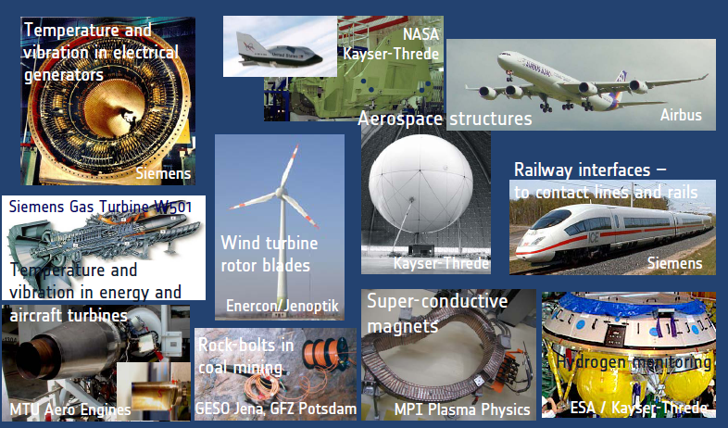
FOS for environmental and structural monitoring industry driven technology
Main advantages for particle physics:
  Immunity against:
    High electromagnetic fields, high voltages.
    Nuclear radiation environments
    High magnetic fields
  Small footprint, Light-weight
  Low-loss, long-range signal transmission
  Multiplexing capability (sensor network) and fast readout (1kHz)
  Embedding in composite materials.
  Wavelength encoded ( neutral to intensity drifts)
  Mass producible at reasonable costs.
Notes:
Message: FOS (FBG is a established technology)

Slide 10
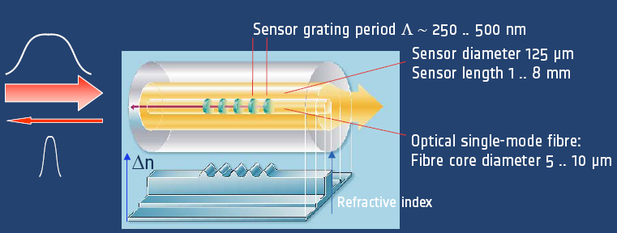


_Bragg grating sensor basics
,
FOS monitoring is an standard technique in aeronautic and civil engineer
Mechanical sensitivity
Thermal sensitivity

Slide 11
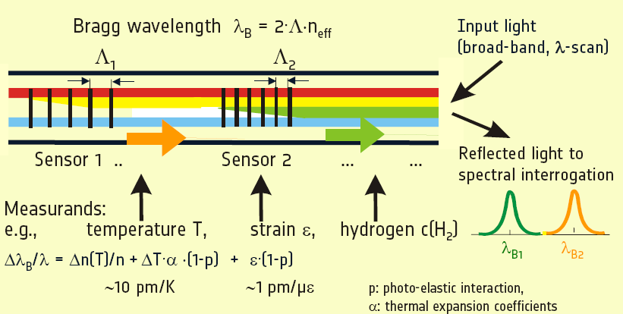
_Bragg grating Multiplexing
Notes:
FBG is a direct transducer for temperarute and strain. Overall sensitivy 10pm/kelvin & 1pm/uepsilon (recall the typical resolution
Scientific quality interrogator is 0.1-0.2 pm

Slide 12
FBG Environmental sensor development

Slide 13
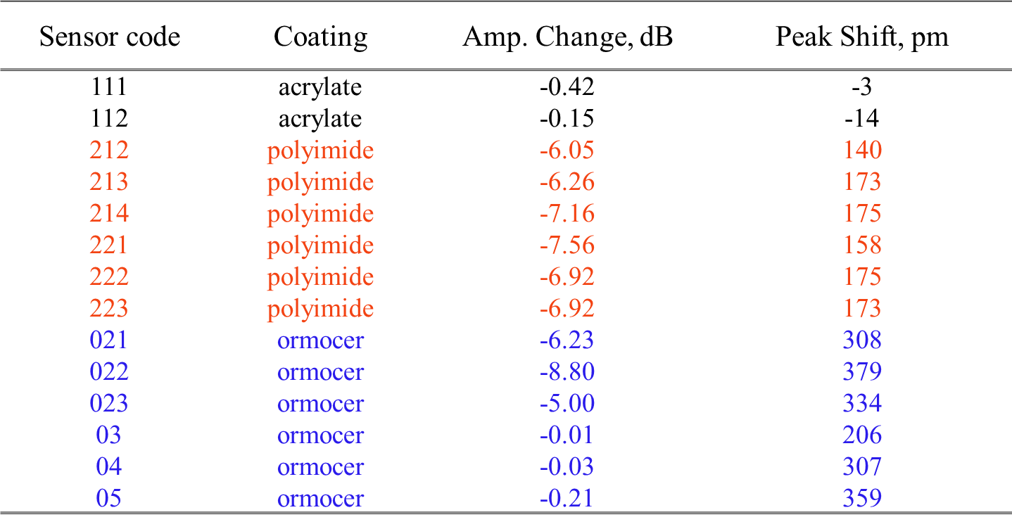
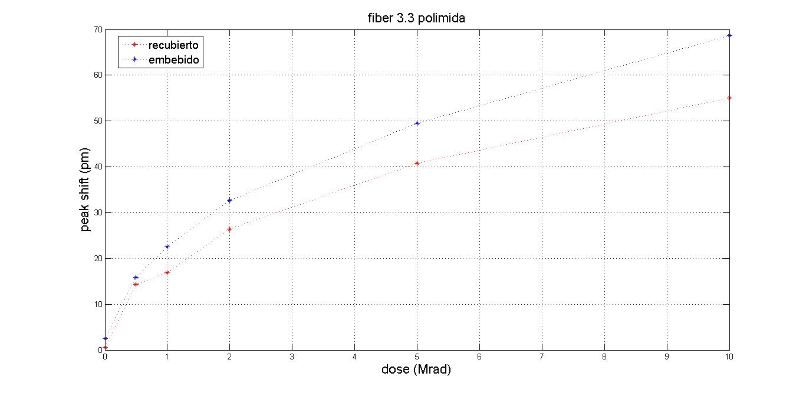
Radiation Resistance Assessment
Sensors resistance to irradiation must be Checked. ( Two irradiation with protons up to 1500 and 10 Mrads )
Irradiation up to 1.5Grads:
Acrylate coated sensors less peak shift ( not sesible at all)
Fiber type ( Ge doped, H2 loaded… ) main parameters affecting the attenuation
Irradiation up tu 10 Mrads (expected dose at Belle II after 10 years):
FBGs sensitivity to radiation seems to saturate at higher absorbed doses.
After two weeks we saw an annealing effect an the sensors (nearly recovered initial wavelength value)
Notes:
211 (¿fue irradiada?)

Slide 14
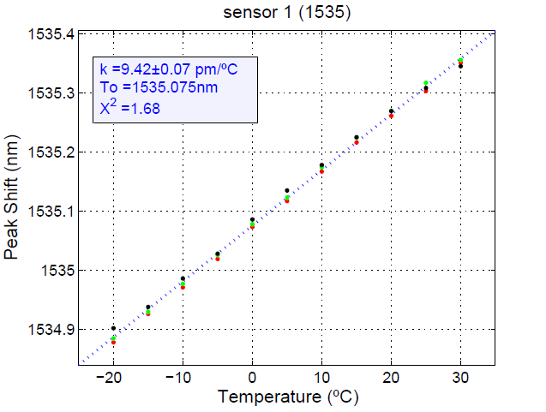
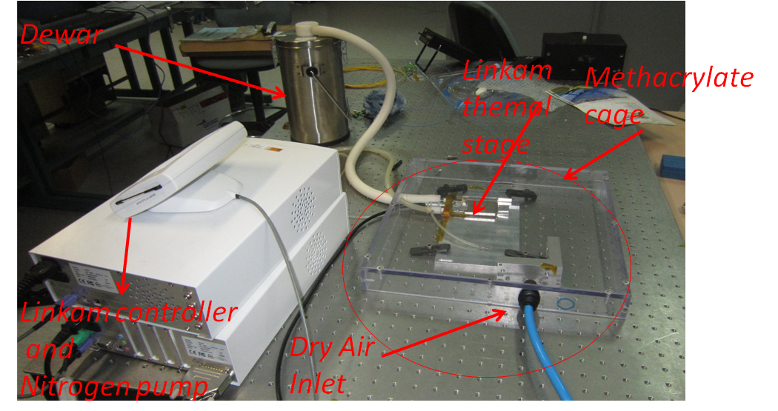
Thermal Sensivitity: calibration
Thermal sensitivity is measured in a custom set-up. A thermal stage ( peltier + nitrogen pumping system) is used for the calibration. All the system is inside a methacrylate cage with dry air injection system.
The temperature sensitivity is measured at ambient humidity ( is not humidity dependant).
Notes:
211 (¿fue irradiada?)

Slide 15
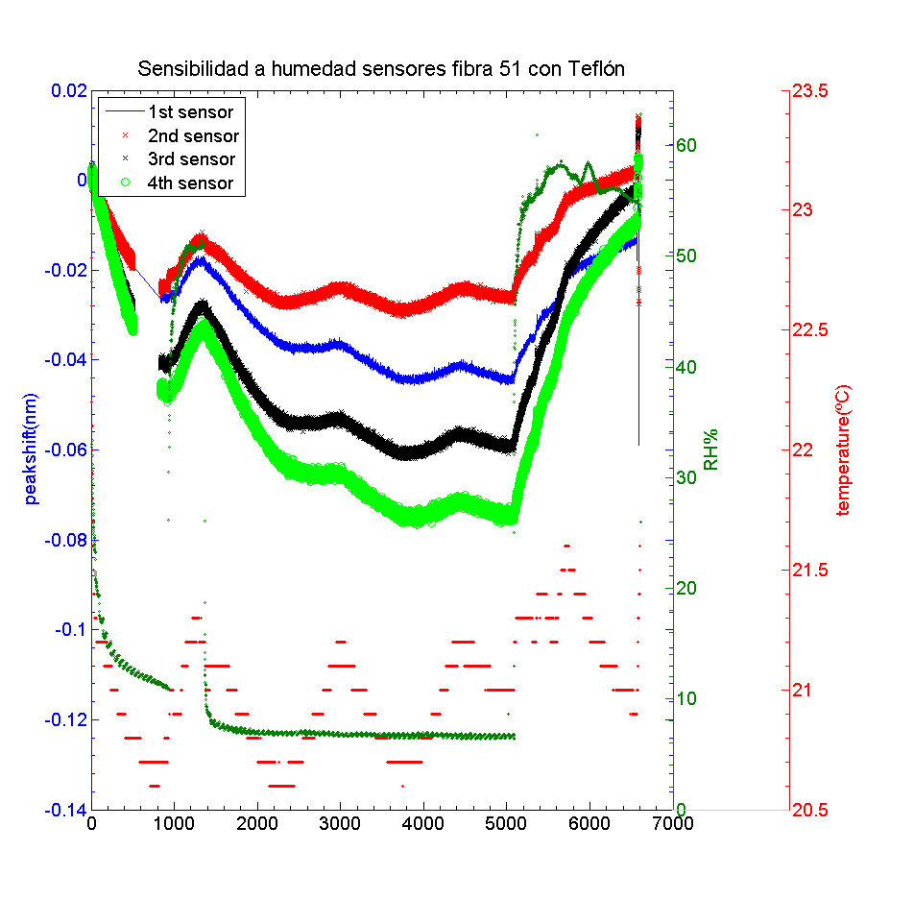
Residual dependence with Humidity
Ormocer/Polyimide coated fibers are sensitive both to humidity and temperature.
To avoid humidity sensitivity, sensors are protected with a jacket (polyethylene, teflon or metallic)
Still a residual humidity sensitive remains (tested inside a air dry atmosphere during several days )
The residual humidity sensitivity depends on jacket material and its internal diameter.
  The humidity sensitivity has a large latency response (not sensitive to fast humidity changes)
Bottom line: the humidity effect should be accounted as an off-set and be taking into account during the FBGs calibration.
Notes:
He cambiado el orden de esta… creo que va mejor después de la calibración térmica.

Slide 16
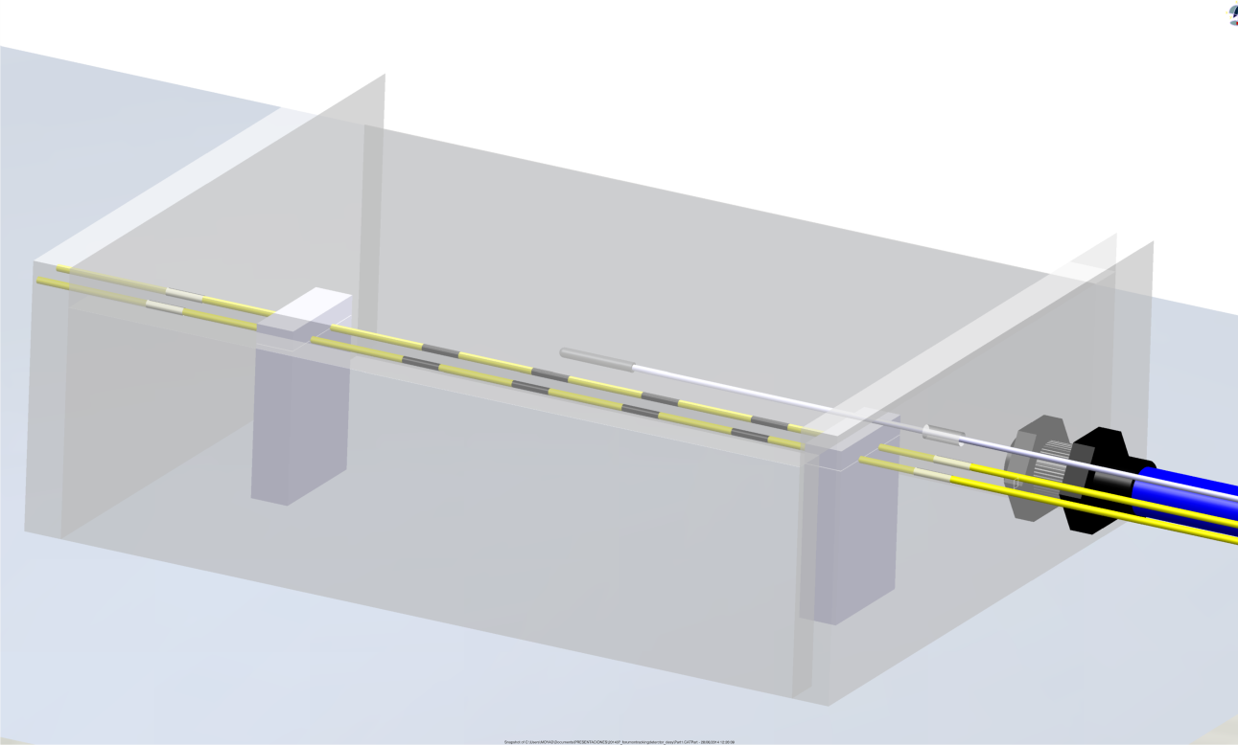
Temperature Offset calibration
For the case of Belle II ( and generally in most of detector trackers) there will be a low humidity environment ( below 10%) while the detector is working.
For the offset calibration a mechanical set-up inside the methacrylate cage will be used. The fibers sensors will be positioned mechanically in a similar way as in the final application. A temperature reference sensor ( non sensitive to humidity) will be positioned near the sensors in order to measure temperature inside the cage.
The environmental humidity will be reduced up to the humidity expected for real application ( 10 %) and maintain during 2-3 days (until the sensor signal became stable ).
The sensors measured value will be taken as the offset value at the temperature measured with the reference sensor.
Temperature Reference sensor
Methacrylate cage
Dry air Inlet
Calibrated sensors
Notes:
Cambios menores de inglés

Slide 17
Humidity sensitive sensors calibration
For the humidity + temperature sensors the process will be slightly different
Using the thermal sensitivity calibration set-up, the sensors will be calibrated with temperature at three different humidity's ( 10% ,25% and 50%)
At this three different humidity’s thermal sensitivity and offset will be measured.
During operation, the temperature will be compensated with near positioned temperature sensors.
Notes:
211 (¿fue irradiada?)

Slide 18
Strain Displacement transductor : L-shape.

Slide 19
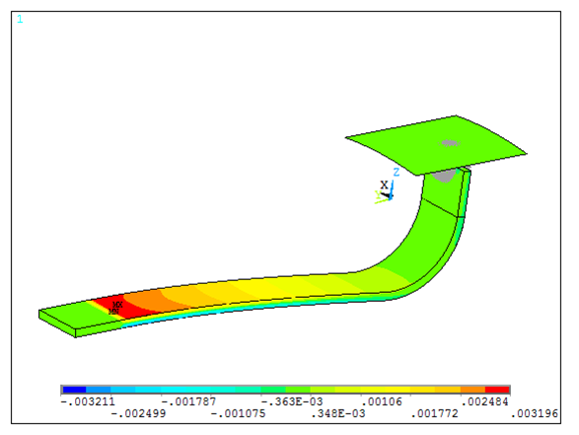
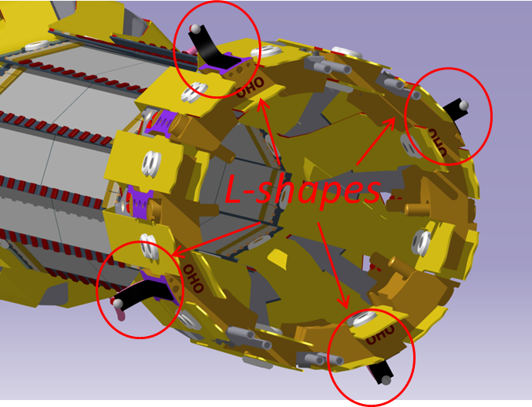
Position transducer: The L-shape
Temperature & strain to displacement transducer with custom geometry for integration in PXD
Readout speed from zero to 1KHz (vibrations)
Currently eight demonstrators manufactured
Contact surface
Locked part
FBG sensors
Contact ball
Notes:
Apply a displacement

Slide 20
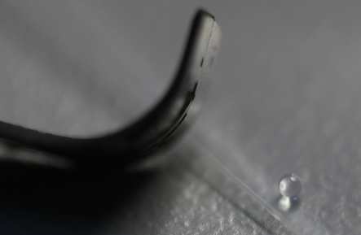
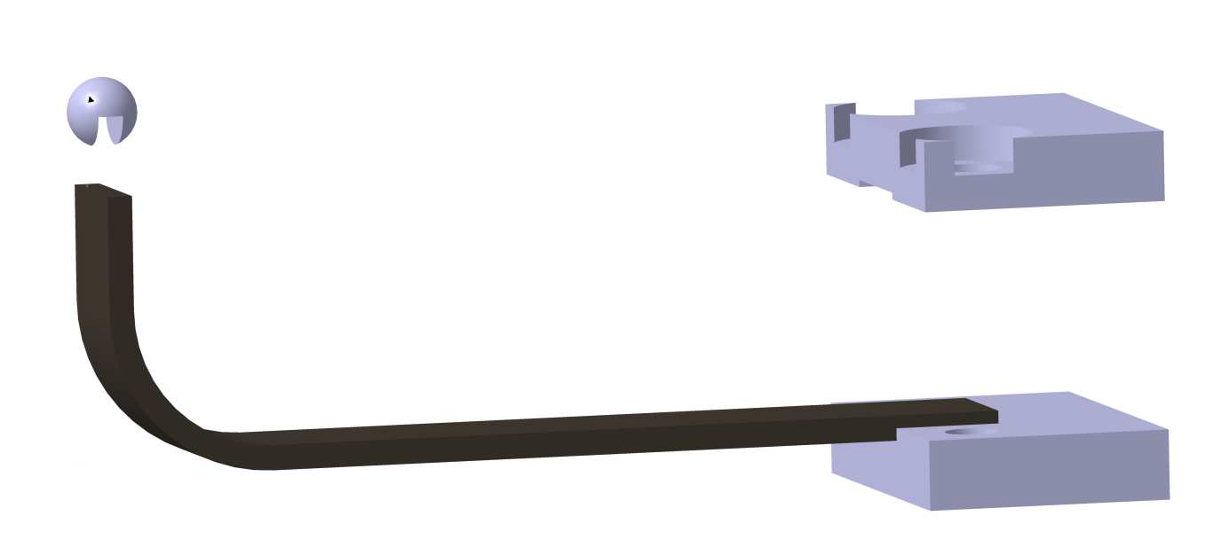
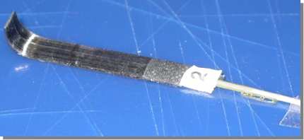
L-Shape Demostrators
One millimiter Diameter Quartz contact ball
Clamping system
ball glued
L-shape tip
Notes:
Rougness and friction (wear)

Slide 21
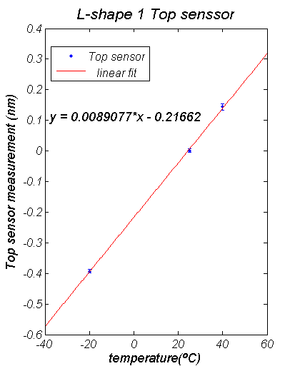
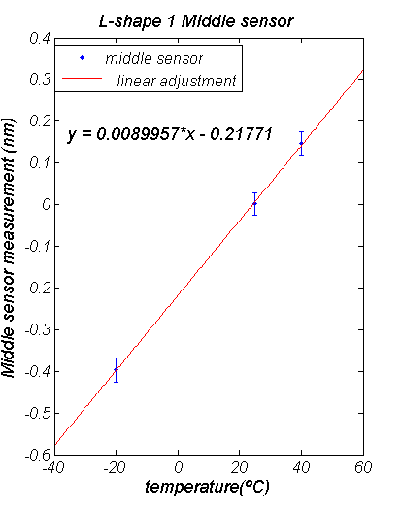
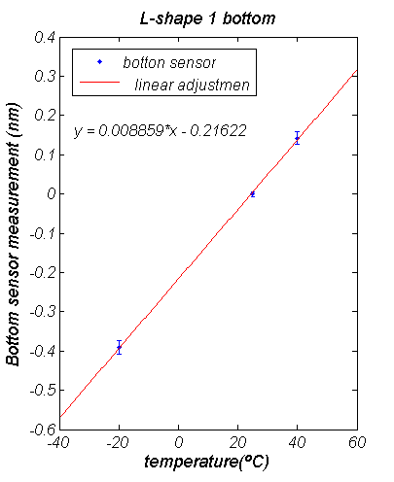
Thermal calibrations & temperature compensation
Calibration using a SIKA thermocouples calibrator.
The temperature sensitivity of three sensors was constant and near the same (difference<0.6%)
Maximum deviation < 3 pm (0.3 ºC)
Error X 10
Error X 10
Error X 10
Trivial approach to temperature compensation

Slide 22
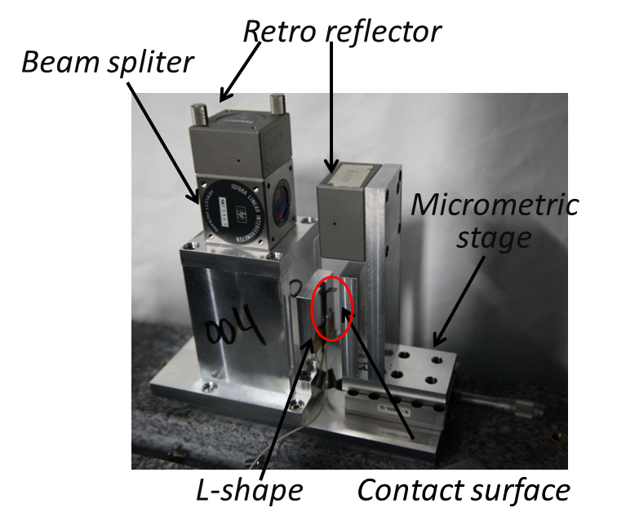
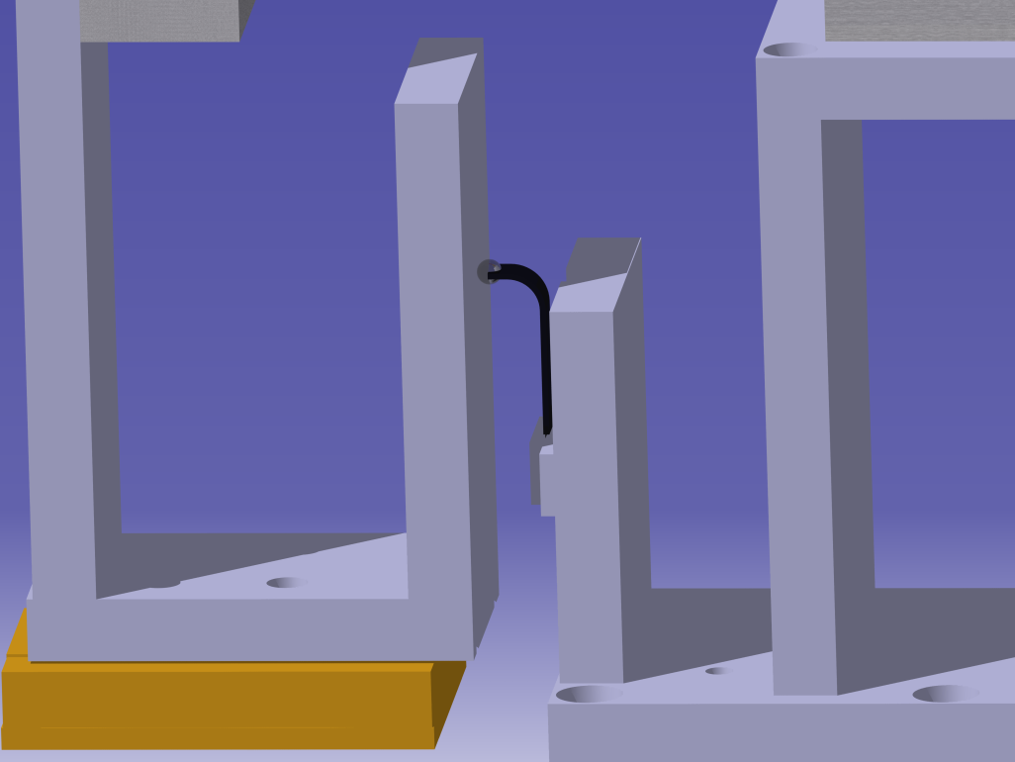
Displacement Calibration
Displacement measured with Michelson interferometer for high precision calibration (tenth of a micron)
Readout of L-shape compared with true position (interferometer)
Contact ball
Micrometric stage
Contact
surface
L-shape

Slide 23
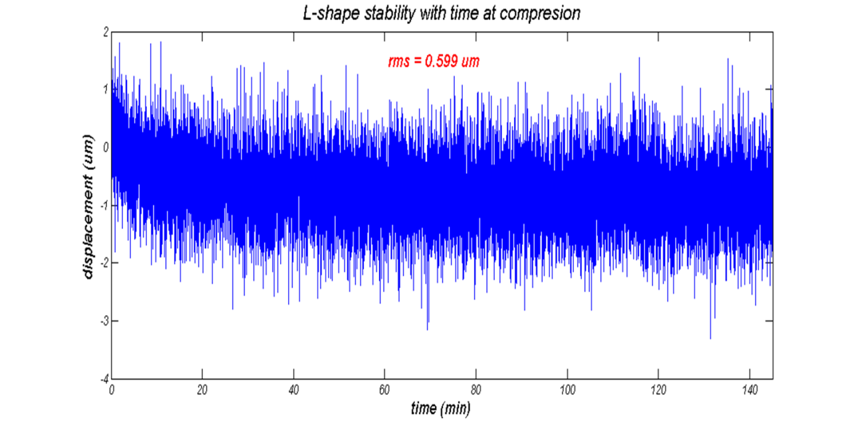
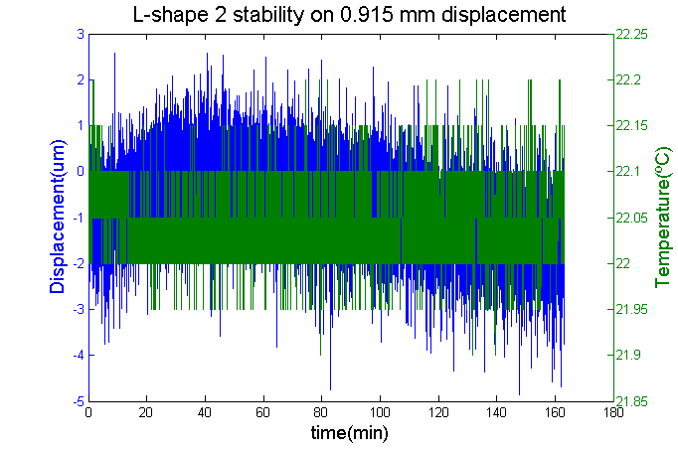
L-shape Output Stability
Short term studies (temperature constant ± 0.1° )
Continuous readout of the sensor output.
Stabilities below or about 1um (convolution with mechanics stability)
RMS ≈ 1.1 um
RMS ≈ 0.6 um

Slide 24
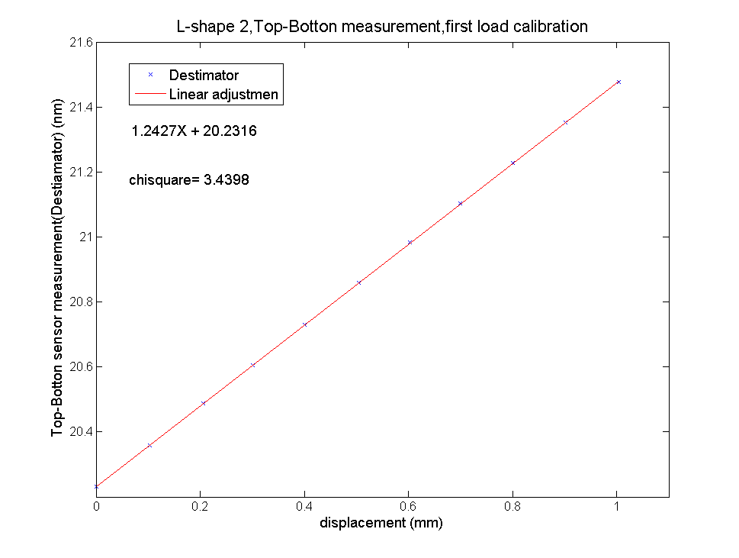
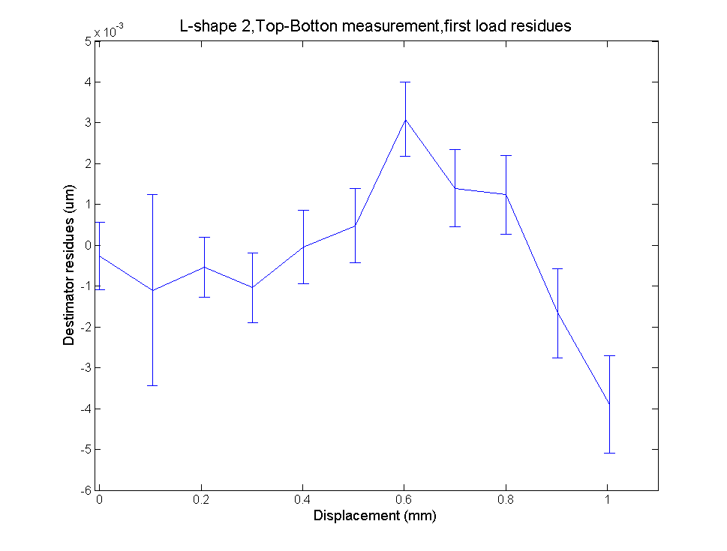
L-shape Linearity vs. Displacement
Calibration over a range of 1mm
Resolution (readout resolution) 0.5 um.
Accuracy (diff. Between inter & L-shape) ≈ 2 um
Sensitivity 1.2 pm/um
Difference load-unload cycle 2 %

Slide 25
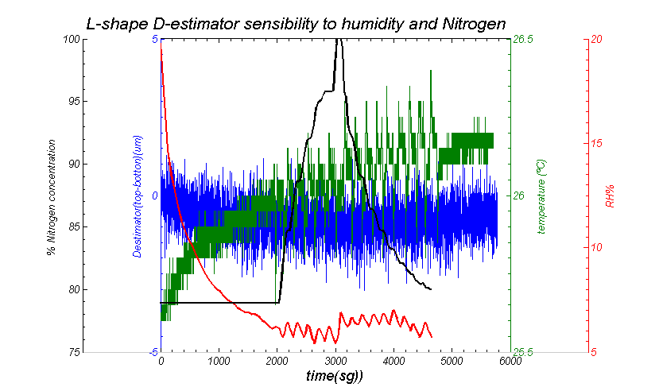
L-Shape sensitivity to enviromental conditions: HR%, T, N₂
No sensitivity to environmental conditions

Slide 26
PXD-SVD common test beam environmental and structural monitoring.

Slide 27
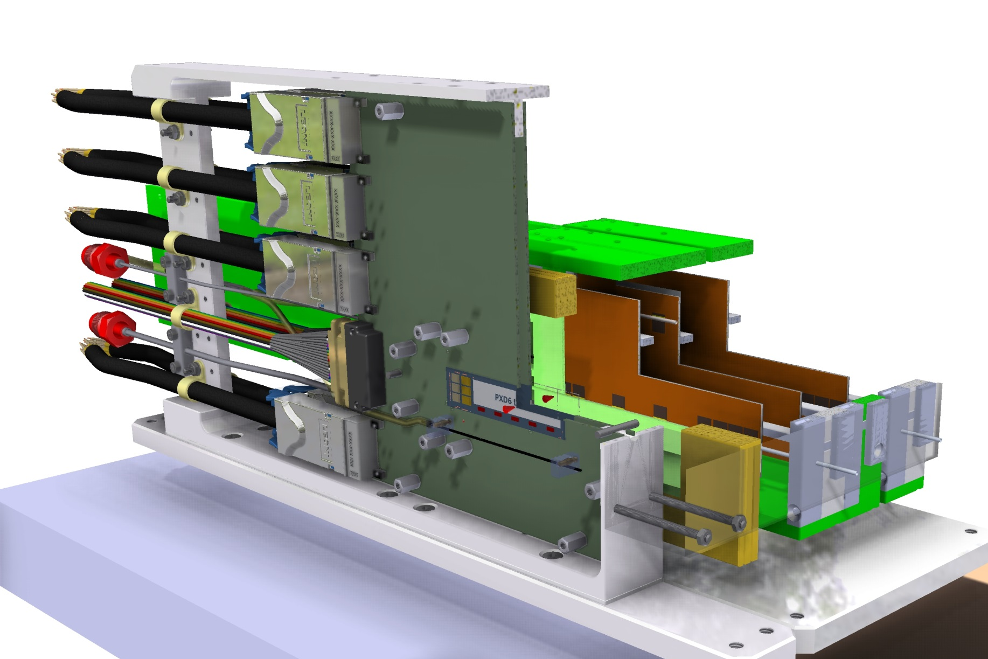
PXD-SVD common test-beam monitoring.
,
Four SVD layers CO2 cooled
One PXD layer.
Notes:
L shape, combinable con la anterior. Solo L-shape
Relative PXD-SVD radial positioning. Using displacement – strain transducers ( Omega and L-shape) we will be able to measure online, radial relative displacements between PXD and SVD. This is a degree of freedom of the detector (PXD and SVD are mechanically independent) to which software alignment is blind
Environmental measurement inside PXD-SVD volume. The PXD-SVD will be inside a thermal envelop. PXD will be cooled with CO2, and forced air convection ,and SVD will also need forced air convection. In the thermal envelop we will have a dry atmosphere ( Dry air or Nitrogen). Having a distributed FBG system for temperature and humidity monitoring, will allow us to know what is happening inside the thermal envelop at every moment, and fast detection of possible cooling problems or leakage of the cooling system.

Slide 28
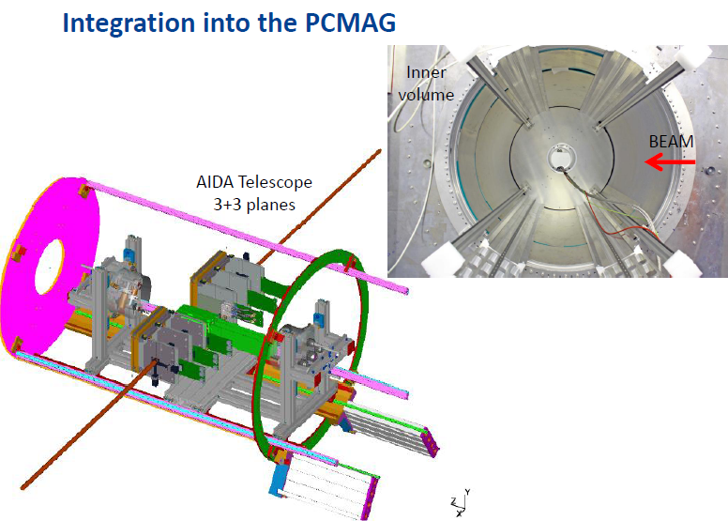
PXD – SVD Integrated test beam set-up

Slide 29
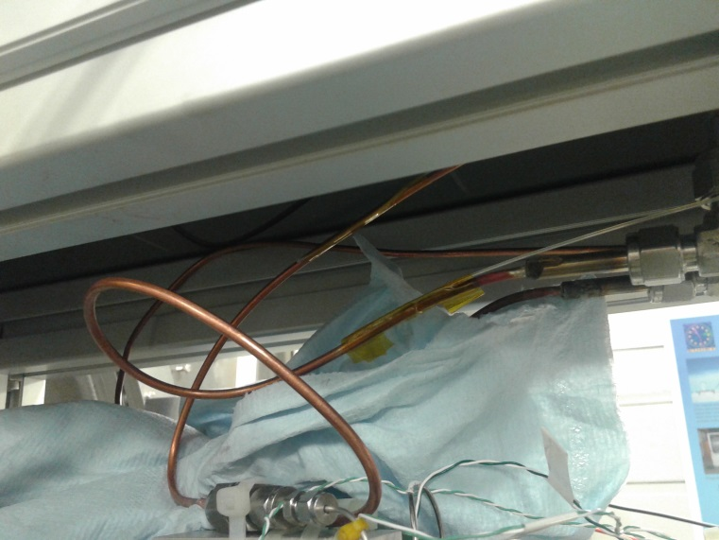
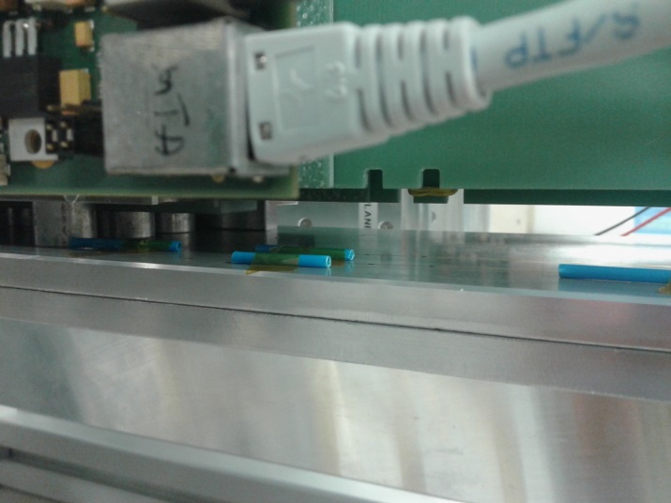
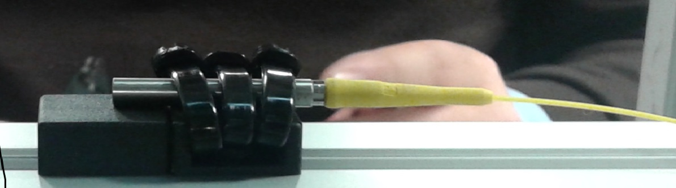
FOS Monitor: FOS Packing

Slide 30
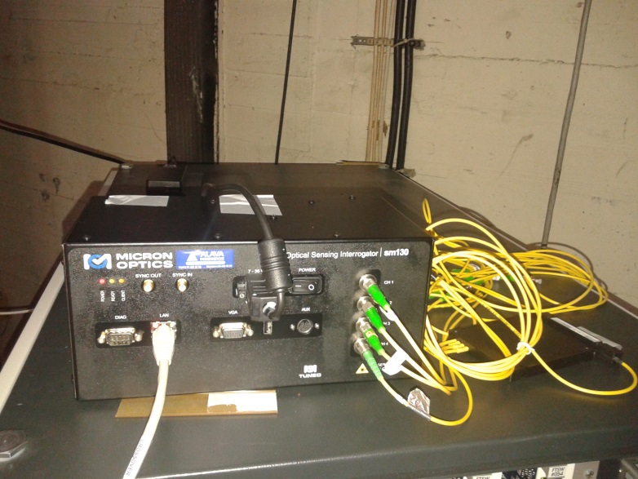
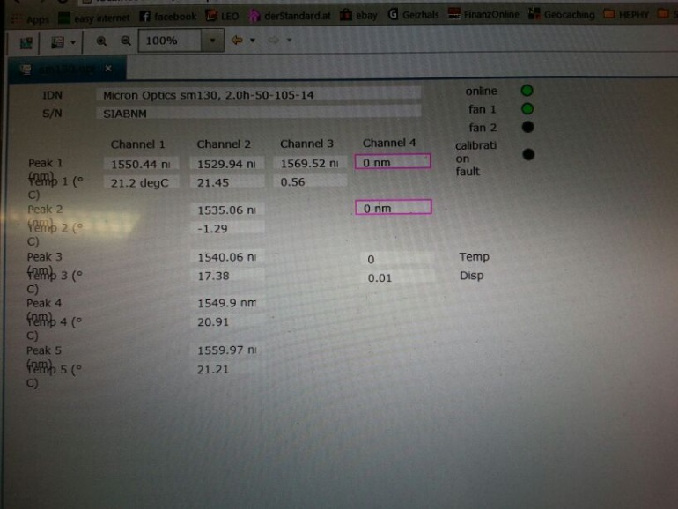
FOS Monitor: DAQ – SC integration
Optical routing of the sensors up to the interrogating units
Readout integrated in EPICS (dedicated driver over Ethernet ). The integration went very smooth ready since the January 6th

Slide 31

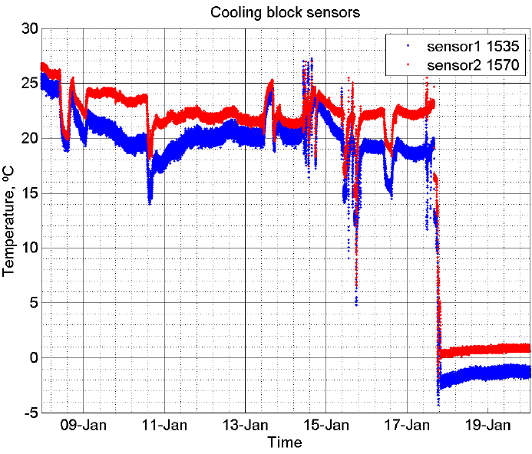
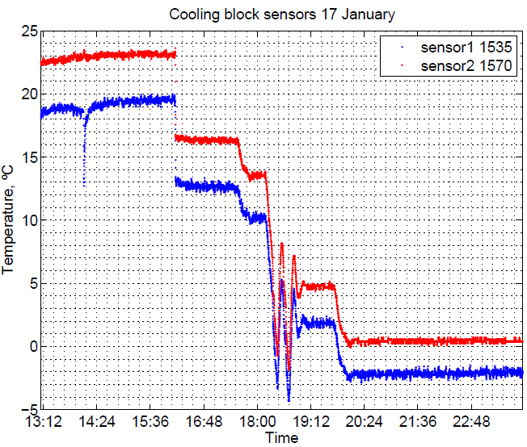
FOS Monitor: Data: MARCO in-let & out-let lines
Zero degrees cooling
Notes:
Co2 cooling profile

Slide 32
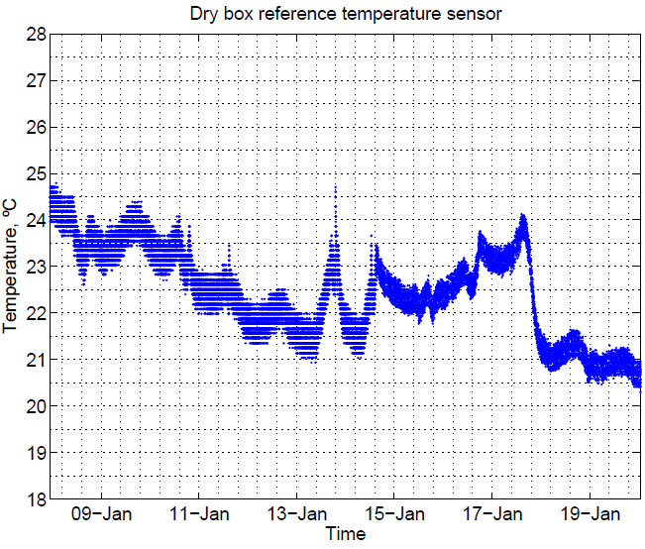
FOS Monitor Data: Ambient Temp
All FBG temperature sensors worked out of the box (In contrast, there was a problem with standard electric sensors)
Zero degrees cooling

Slide 33

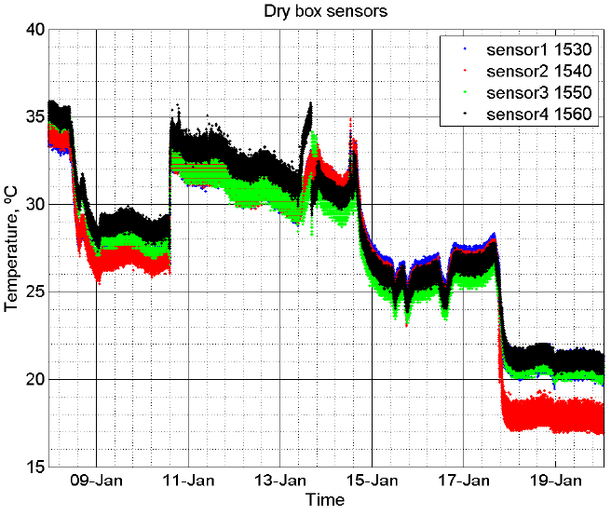
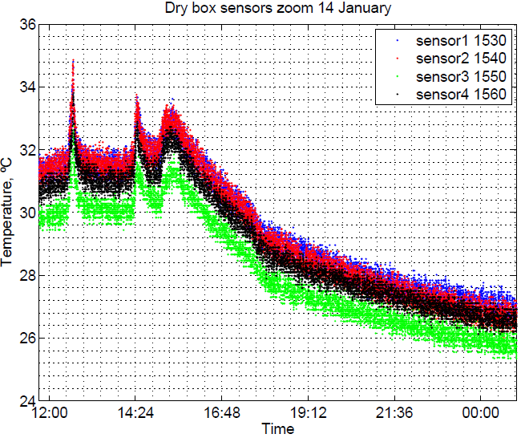
FOS Monitor: Ambient Temp+%RH
N2 injection

Slide 34
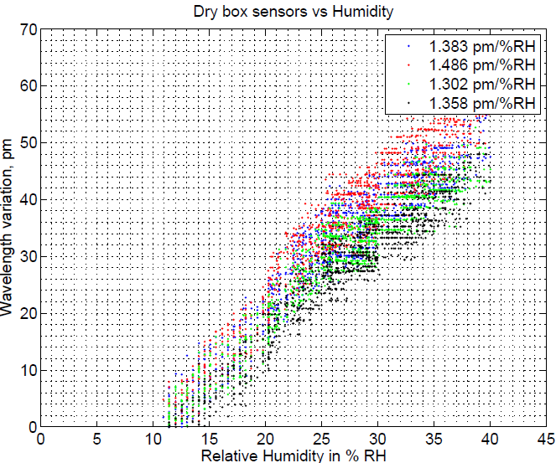
FOS Monitor:Humidity measurements
Comparing the wavelength shift of ambient sensors (naked fibers) vs. commercial Humidity sensors inside the dry box.
Excellent linearity and sensibility after temperature compensation

Slide 35
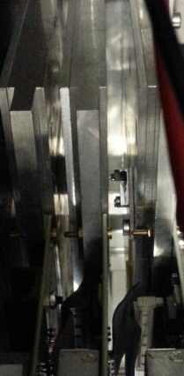
Structural monitoring
Structural monitoring done during the Test-beam
The L-shape was positioned between two telescope planes (outside the dry cage) in order to measure relative displacements on beam direction.
The displacement was measured during Test Beam last three days.
Some vibration measurements done at 100 Hz and 1000 Hz speed.

Slide 36
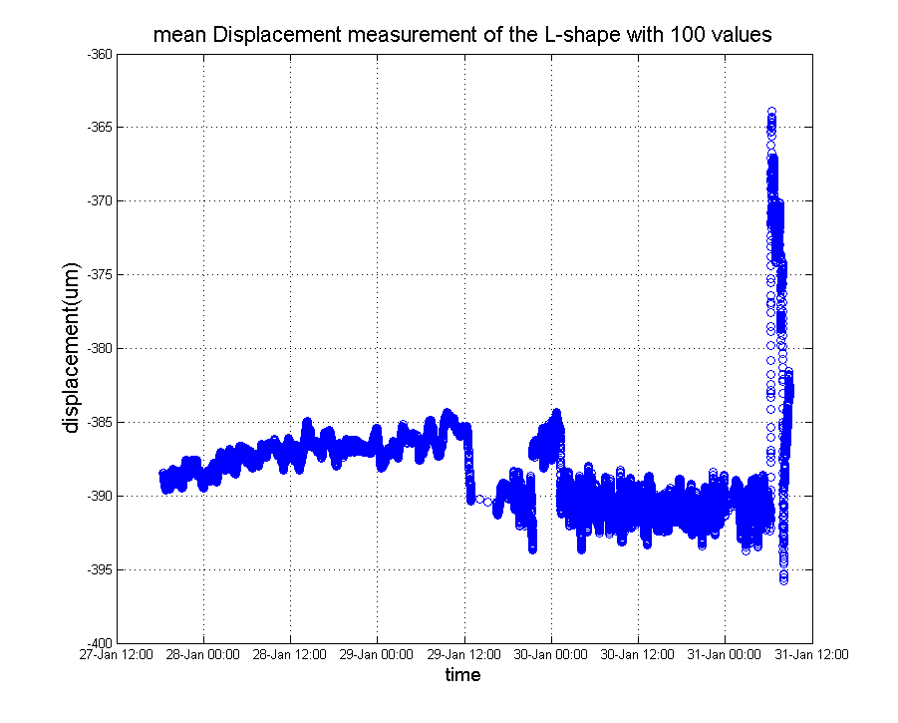
Relative displacement between telescope planes
The relative displacement measured < 10 um
Big displacements on 31th of January morning are due to the dismounting of the system

Slide 37
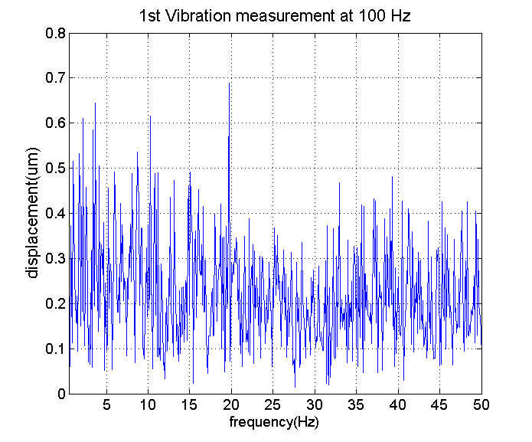
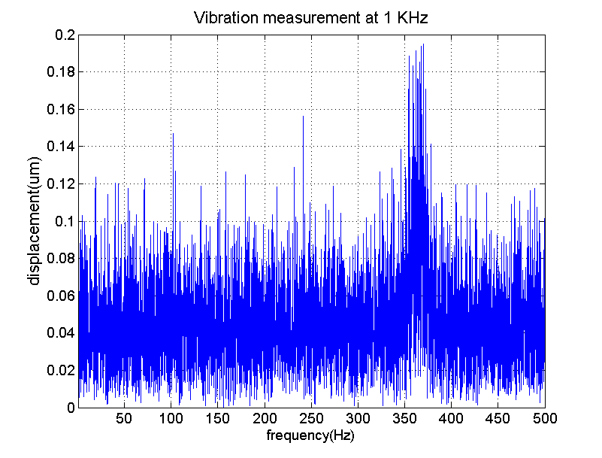
Vibration measurements between telescope planes
Two measurements done at interrogation speed of 0.1 and 1 Khz. In the pictures can be seen that at low frequencies there is no any vibration but it seems to be an small vibration between 300 and 450Hz.

Slide 38
Summary & Outlook
,
FBG sensors a very attractive monitoring technology for particle physics: radiation resistance, electromagnetic immunity, small footprint and embedding in CFRP
Case of use: FOS monitor for Belle II vertex detector
  Environmental (temperature, humidity) and structural (vibrations, deformations and displacement) monitoring system
  Miniature, application specific displacement transducer ( L-shape ) developed for PXD-SVD relative displacement monitoring in real time.
Started the study of FBGs for humidity sensing.

Slide 39

Belle-II Vertex Detector reminder
,
Thermal envelope
Strip Vertex detector
(microstrips)
≈300mm
DEPFET PIXELS (90-122 mm length)
≈900mm
Notes:
Overall geometry and technology
Independent support
Central drift chamber
Thermal envelope
SVD sensors, origami sensors Supported by rips, and endrings.

Slide 40


PXD-DAQ system
DAQ system total cost: around 34.000€
8 fiber optic cables
Humidity and temperature measuring fibers.
16 fiber optic cables
8 fiber optic cables
8 fiber optic cables
OHO side L-shape fibers
Sm230-800 interrogation unit from Micro optics
4 fiber optic cables
8 fiber optic cables
NIKKO side L-shape fibers
4 fiber optic cables
2 x Sm014-008 8x4 optical couplers
Notes:
Esquema del posible sistema de adquisición final para el PXD y una estimación del coste ( no se incluye el coste de las fibras )

Slide 41
ILC-like power pulsed Depfet sensor temperature measurement.

Slide 42


ILC-like power pulsed Depfet sensor temperature measurement.
A silicon depfet mock-up ladder with build in heaters
Sensor temperature measured with FBG sensors at 1KHz

Slide 43
Measurement set-up.

Slide 44

ILC-like power pulsed Depfet sensor temperature measurement: results.
1 ms of high consumption followed by 200 ms of no powering.
The temperature change is limited by the thermal inertia of the ladder, becoming constant in seconds.
Power pulsed
Power pulsed
Swiched
off

Slide 45


_Basic Interrogating Unit
The number of different Braggs is more than 100; moreover by using an optical switching we can use tens of sensing fiber
Optical Spectrum Analyzer
Large Bandwidth
Light source
1x2 coupler
λ_{B1}
λ_{Bn}
λ_{B2}
λ_{B3}

Slide 46
_ Monitoring requirements for Si-Trackers
Current and future silicon systems need for:
  Real-time monitoring of environment variables: temperature, humidity, CO₂, magnetic field, etc.
  Real time structural monitoring: deformations, vibrations (push & pull operation), movements.
Conventional monitoring technologies based on electric relatively bulky transducers with low multiplexing capability, low granularity, and cooper readout and powering lines (conductive EM noise propagation lines).

Slide 47

_Monitoring requirements: Weak Modes
First lesson from LHC detectors: position and deformation monitors must cover the weak modes of software (track-based) alignment algorithms.

Slide 48

L-shape Linearity (2)
L-shape sensibility presents a small dependence depending of the direction of movement (L-shape specific effect due to its shape)
Sensitivity reproducibility
0.4 %
Difference load-unload cycle
2 %

Slide 49

L-Shape Linearity (3)
Investigate the effect of the roughness of the contact surface on the asymmetric load-unload behavior.
POLISHING
OF CONTACT SURFACE
Still sensitivity asymmetry 2 %
More studies in progress
(harder materials than Al)
Still sensitivity asymmetry 2 %
More studies in progress
(harder materials than Al)

