Slide 1
Parametric Study of Materials for use in HEP Experiments
E Anderssen, F Borgnolutti, C Haber, A Lambert,
J Silber, B Coffey, L Connolly, J McCay
E Olivera, E Perez-Hoyez, J Urban

Slide 2
Advanced Materials LDRD
Lab Directed Research and Development
Leverages Engineering Division resources in support of NSD, Physics, AFRD, MSD
Generally three prongs to the effort
  Methods to increase toughness/thermal conductivity of resins understand process variables/capabilities
  Study of conductive foam as a heat exchange media
  Non-destructive evaluation of assemblies (next talk)
All goals require combined efforts from Divisions within General Science and Molecular Foundry

Slide 3
Areas of research
UHV Compatible, Hi-Tg/toughness resins and laminates—compatible with RTM/potting process
Loaded Resins/Adhesives including nano-particulates, ceramic powders and new prepregs
Low Density, thermally conductive (carbon) foam
All material presented here is preliminary—should not be used for design

Slide 4
Interest in Cyanate Esters
CE resins clearly useful for HEP detectors due to toughness and stability
Radiation tolerance and low off-gas/adsorption also interesting
Questions we asked:
  Who else might be interested in similar properties
  Are there modifications required to increase utility
  Are there new resin systems we need to process
Interesting applications:
  Pot SC Magnet coils—CE may reduce training cycles
  CE resins we already process may be UHV compatible
  Everyone wants higher thru thickness conductivity
  RTM Capability for SC Magnet and larger structures

Slide 5
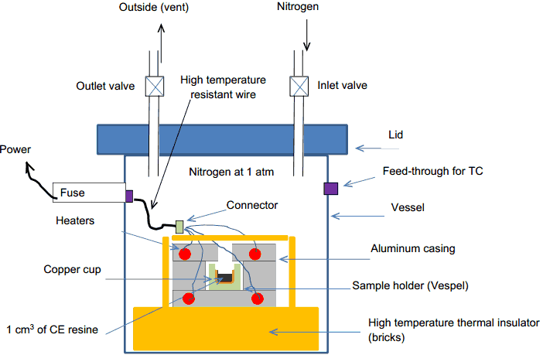
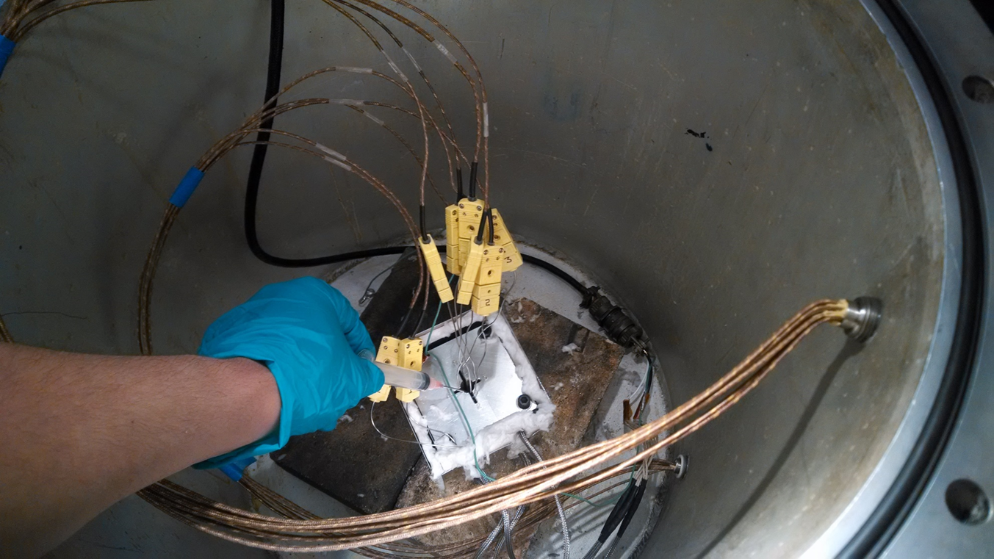
CE Resin Calorimetry
Heat (energy) of reaction 300-700 J/g for CE
Depending on speed of reaction, perhaps enough to vaporize…
This is a bomb-calorimeter…
  Without the ignition source
This excited the safety folk
Documentation ensued
Want to understand process variable effect on energy release
Want to see ‘Exotherm’

Slide 6
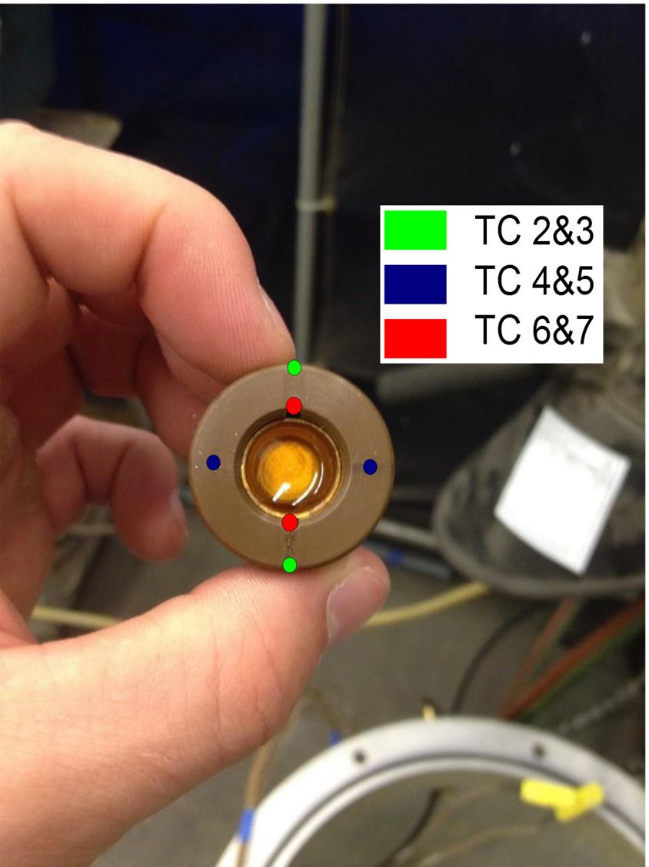
Sample Holder
~1cc mixed CE resin in Cu Cup
Tight fit in Vespel insulator
Vespel slip fit into Al Heater blocks—TC locations indicated
If TC 6/7 > 2/3 Heat is being generated by resin sample
m*Cp*ΔT with appropriate inputs yields Heat of reaction
TC 4/5 used for average T of vespel insulator for H calc
Cured sample shown

Slide 7
Different Form of CE
Composite shop uses CE regularly in prepreg
  CE in prepreg is ‘B-Staged’—partially polymerized robbing it of some heat of reaction
Looking to use RTM CE system for SuperCon
RTM also useful for larger Carbon Fiber parts
RTM CE has a risk: Exo-therm (thermal run-away)
  RTM resins have low Mol Weight—for low viscosity, require more reaction (trimerization) to fully cure
  It *might* catch fire without proper precaution
History of some magnet vendor(s?) finding this unsafe—mostly smoke, no fire
  Goal is to find fully safe operating process for resins
Small problem—Cu is the catalyst for CE resins..

Slide 8
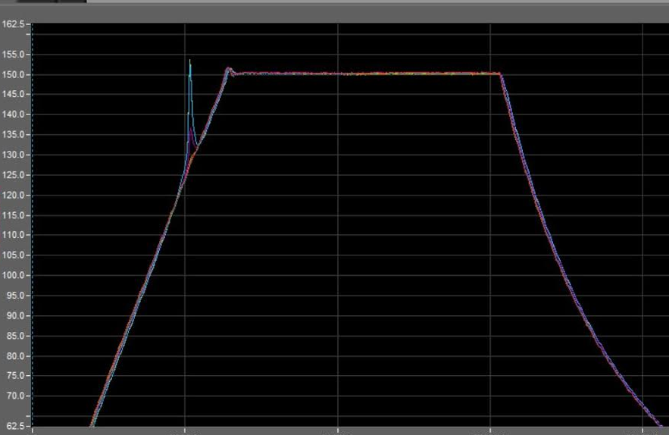
Experiment Ramp Cycle
ΔT
T_{onset}
Note: this is an aggressive cure cycle—more typical profiles will be described later. This is aimed at triggering an exothermic event.
Ramp at Max recommended rate to cure temperature
Repeat for different neat resins for baseline T_{onset}, ΔT
Add materials, e.g. SC magnet wire, nano-particles, etc
Increased ΔT means more heat, T_{onset} may be coupled

Slide 9
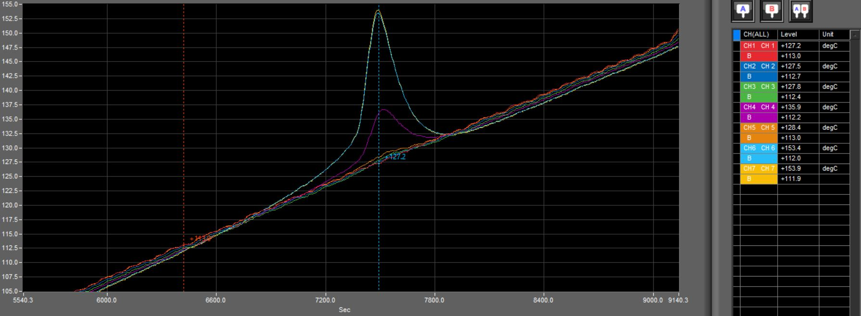
Exotherm Peak detail
Sample Cup
Vespel
Linear fit to heater block temp subtracted from Ts/Tv
DT of each with m*Cp of appropriate constituents used to calculate Joules ~250J in this case
Lower than expected, but may not have all energy release channels—OK for relative measurements…

Slide 10
Typical Cure cycle for CE Resins
t_{cure}
Note Exotherm event
Is not typical for prepreg
T
t_{hold}
Viscosity min
time
(T,t_{hold}) aimed at max flow in RTM, max compression in prepreg for part quality (also last chance if bag leaks)
Extending t_{hold} beyond some value increases viscosity via slow reaction—i.e. reduces energy available for exotherm
In all cases t_{hold} should be below T_{onset} with some margin
ΔT should decrease and T_{onset} increase with extended t_{hold}

Slide 11
Liquid CE Resins Tested
EX 1510 (Tencate Advanced Composites)
  RTM version of EX1515, close to what we typically process
  TCAC also sells RS-14, has history in magnet potting
403 and 425 (Composites Technology Development
  403 is pure CE—exotherm curve shown
  425 is a mixture of CE and Epoxy currently used on ITER
  403 has extensive testing for radiation tolerance: GGy, but also resin some vendors might want to avoid…
EX1510 showed no exotherm bump on test ramp
  Mixed with Cu NiSn cuttings, causes an exotherm
  Perhaps also nano particles (later slide)
Continue testing baseline response to added materials before moving to t_{hold} studies

Slide 12
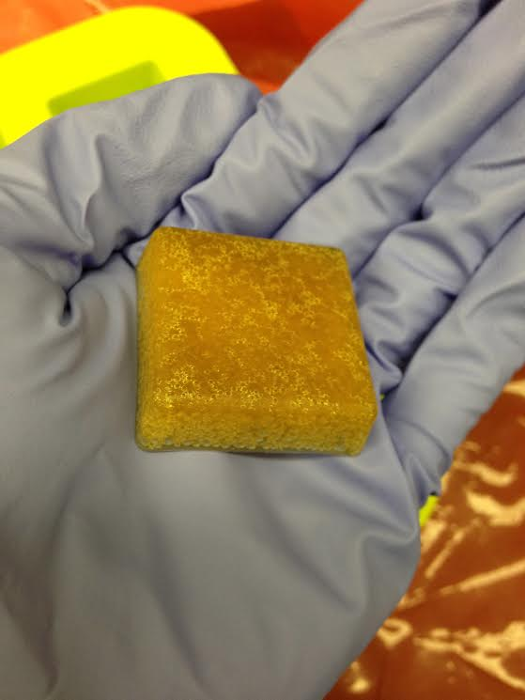
Filled Resin Study
Original intent was to concentrate on CE resins, both Liquid RTM resins and EX1515 (prepreg film)
Delayed calorimetry made it unwise to start with liquid CE—wait for more results before moving ahead (safety)
Developed technique to mix powders into resin film—essentially like making pastry (mille fuille)
Original attempts cured in oven, then in autoclave no bag, then autoclave with pressurized tool
  Need pressurized tooling to remove bubbles from B-stage resin
  Also need absence of O2 when curing CE Resins

Slide 13
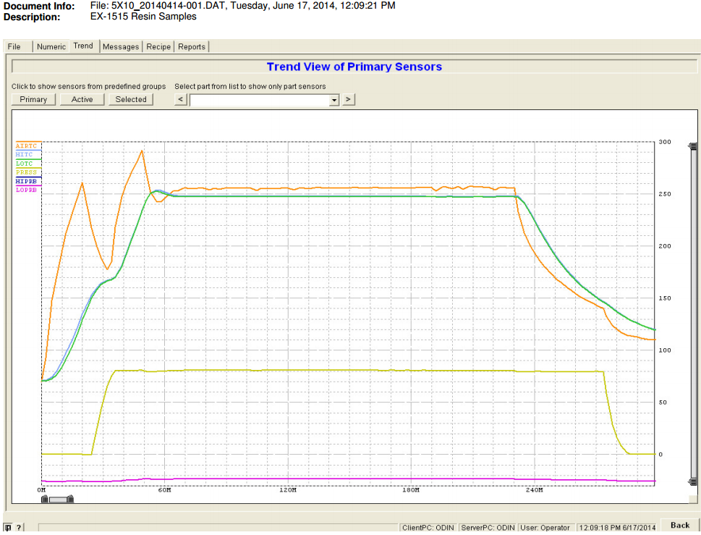
Autoclave Cycle EX1515 nano BN
Small Exotherm

Slide 14
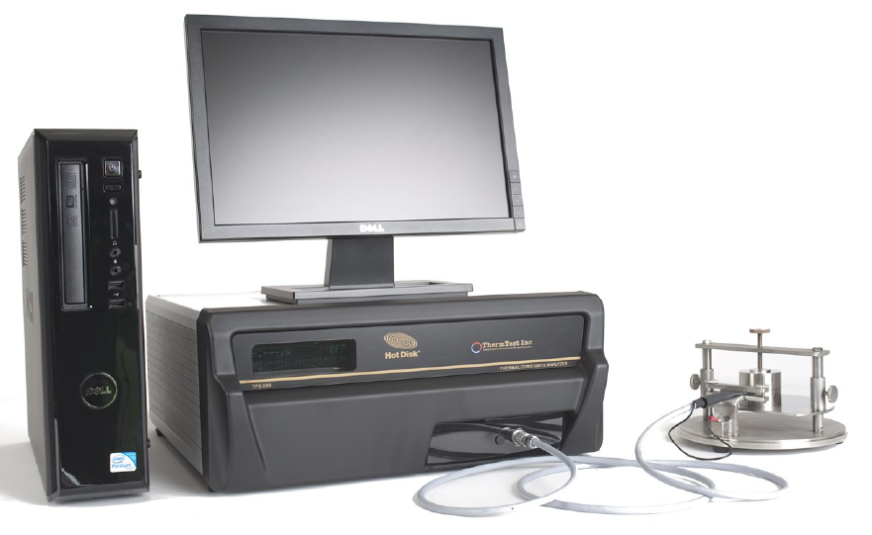

Thermal Test Instrument
It requires two bulk samples of >5mm
Range of T = [30K-1000K]
K range=[0.01-500 W/mK]
Typical Sample sizes [1-10cm^3]
Size of the sample surface should be appreciable larger than the diameter of the Hot Disk Sensor in order to allow for a not to slow transient recording.
Thickness of the sample should not be less than the radius of the hot disk.
Acquired TPS500s (http://www.thermtest.com/Products/TPS500S.aspx)
  Hot Disk Transient plane source
  Direct measurement of thermal conductivity and thermal diffusivity no calibration required
‘Smooth’ surfaces, but not contact compound is required

Slide 15
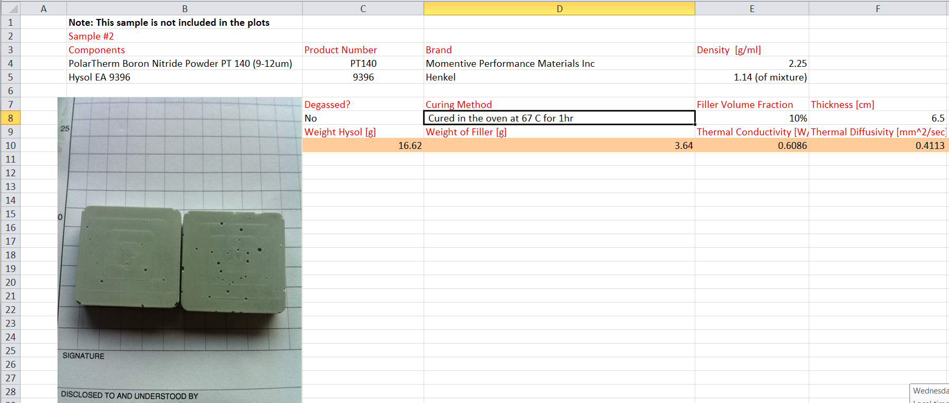
Sample Example Datasheet
Samples are Serialized, and various data is entered into a standardized spreadsheet
It has taken 16 or so samples of varying composition to track what data needs to be recorded and to understand quality control variables for sample production

Slide 16
Materials tried so far
EX1515 samples difficult to produce quickly—decided to change to Hysol EA9396 (liquid resin)
Move to RT Cure epoxy allowed production of up to 10samples/wk with testing, versus 2-3.
Goal is to quickly cycle thru various filler materials at two %Vf values and create a scatter plot survey
Several more materials on order, e.g. graphene and carbon nano-tubes
Some lessons learned fabricating samples…

Slide 17
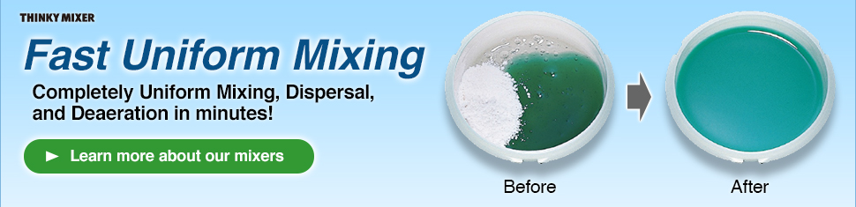
Mixing Equipment is Very important
We have the “Thinky ARE-310” planetary centrifugal mixer—excellent for incorporating powders
However we found some bubbles in filled mixes despite ‘defoam’ cycle (centrifugal action)—required vacuum
Finer powders, particular nano, adsorb lower viscosity components (Part-B) like cat litter—must pre-mix A/B then add nano-particles
Unfortunately this limits mix time—mixer mixes by viscosity (shear)—extended shearing may orient plate/fiber like particles in adhesive

Slide 18
Mixing problems
Part A 3-6kp viscosity—not great to mix into
Mixed epoxy falls to a few hundred poise, but mixing adds energy that limits pot life
References of nano-particles hastening cure exist
Some nano-particles (graphene) come as suspensions in solvents
  To mix into epoxy, would need to evaporate solvent
  OTOH, graphene is created by exfoliating (shearing) graphite in a liquid with appropriate viscosity and surface energy (perhaps an epoxy candidate exists)
CE might be a good candidate for this ~100poise mixed and unmixed.

Slide 19
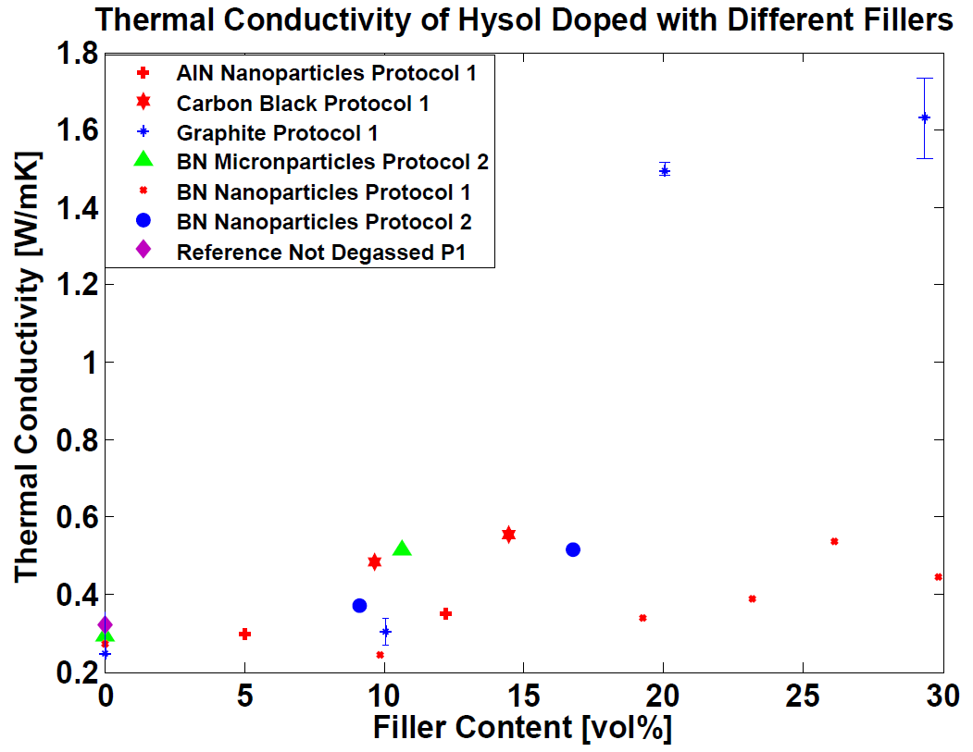
*Very* Preliminary Results
?
Protocol 1: Curing at ~48 hr at 23 C and then in the oven at 67 C for 1hr
Protocol 2: Curing at 67C in the oven for 1 hr.

Slide 20
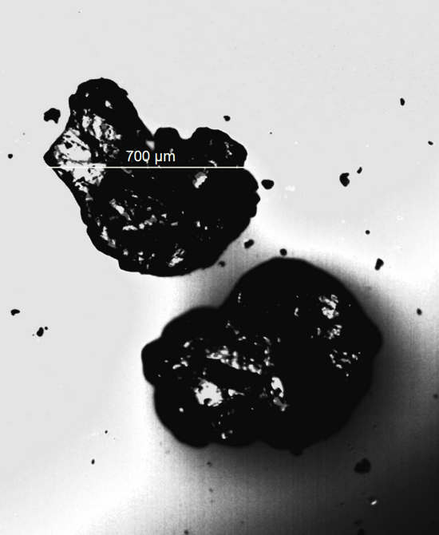
Can’t use *this* graphite…
Graphite flakes range from 0.5--0.7mm (9mm sample)
Picture is pre-mixed—some evidence of break-up in samples
Probing graphite particle releases graphite flakes
Stuff to try:
  Ball mill smaller
  Mix longer
Not usable as adhesive with this particle size, but interesting result…

Slide 21
Air Flow thru conductive Foam
Adding conductive foam to the flow has two benefits to heat exchange
  It increases the area of exchange
  It increases the effective volumetric conductivity of the flow
Foam is specified by Density, Pore Size, and Conductivity
  Given those as inputs; we should be able to predict effective heat transfer enhancement
  Density or Void fraction and Pore size should predict pressure drop characteristics
Several papers propose models relating the above but are very sensitive the inputs
  Need data to start correlating models.

Slide 22
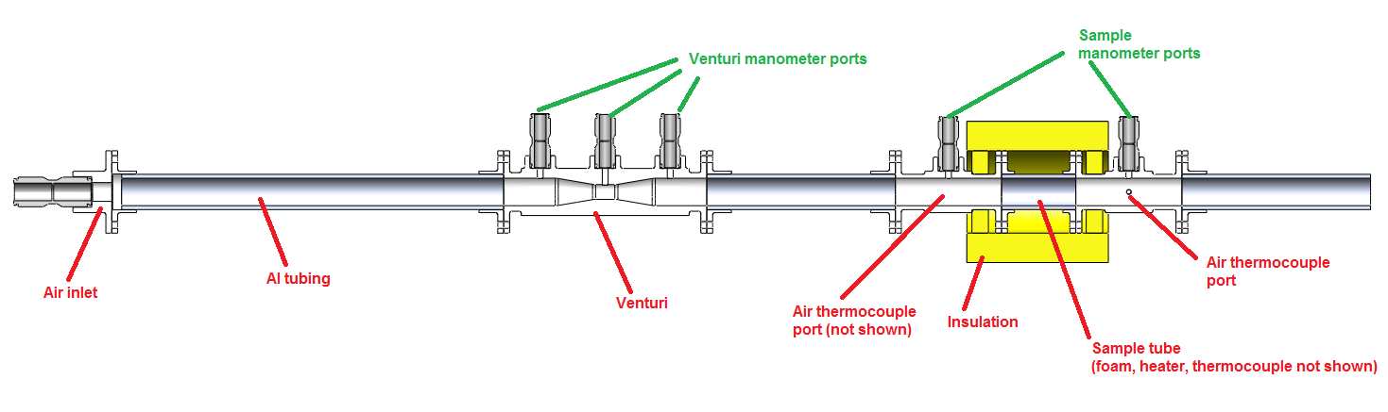
Test setup
Mass Flow Manometer
TC Port
Schematic of test setup.
Venturi measures air flow
Additional modifications required to improve accuracy

Slide 23
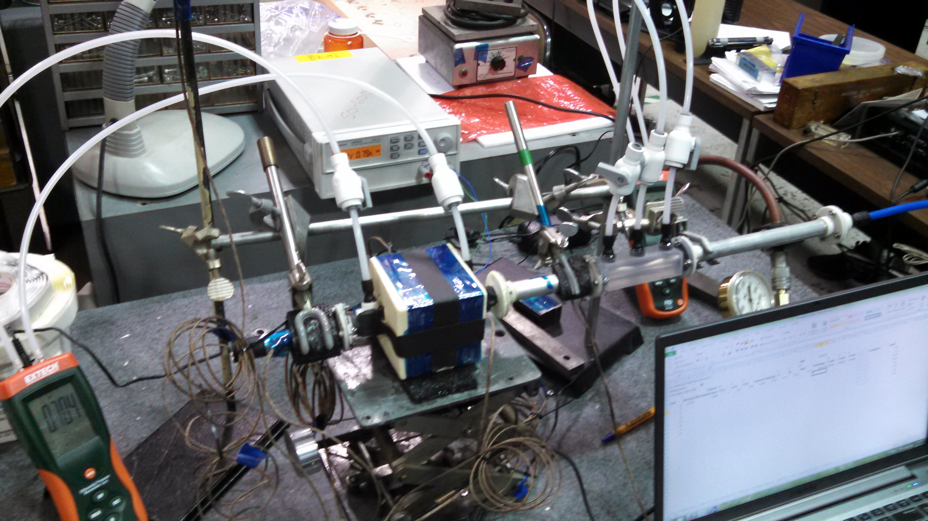
Initial Setup
Heat input in sample section with foam
Study how foam affects transfer of heat to air flow
Tests guided modification of setup to improve it

Slide 24
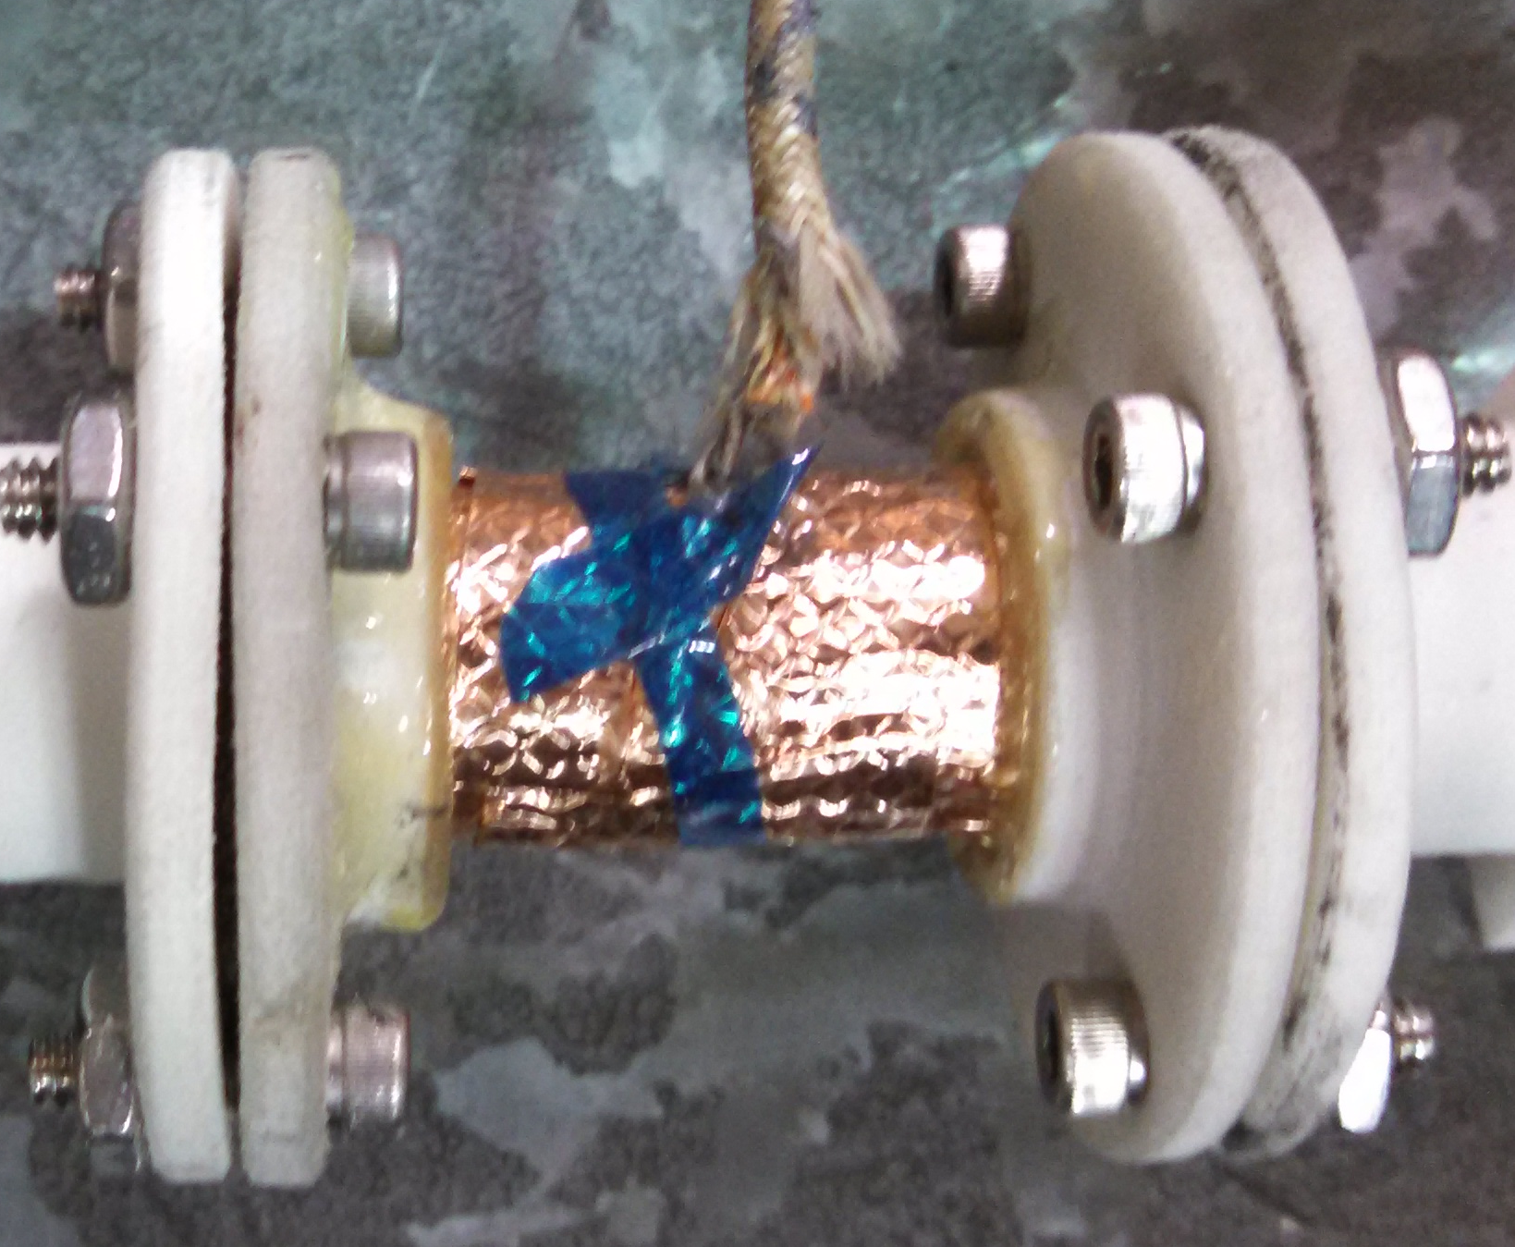
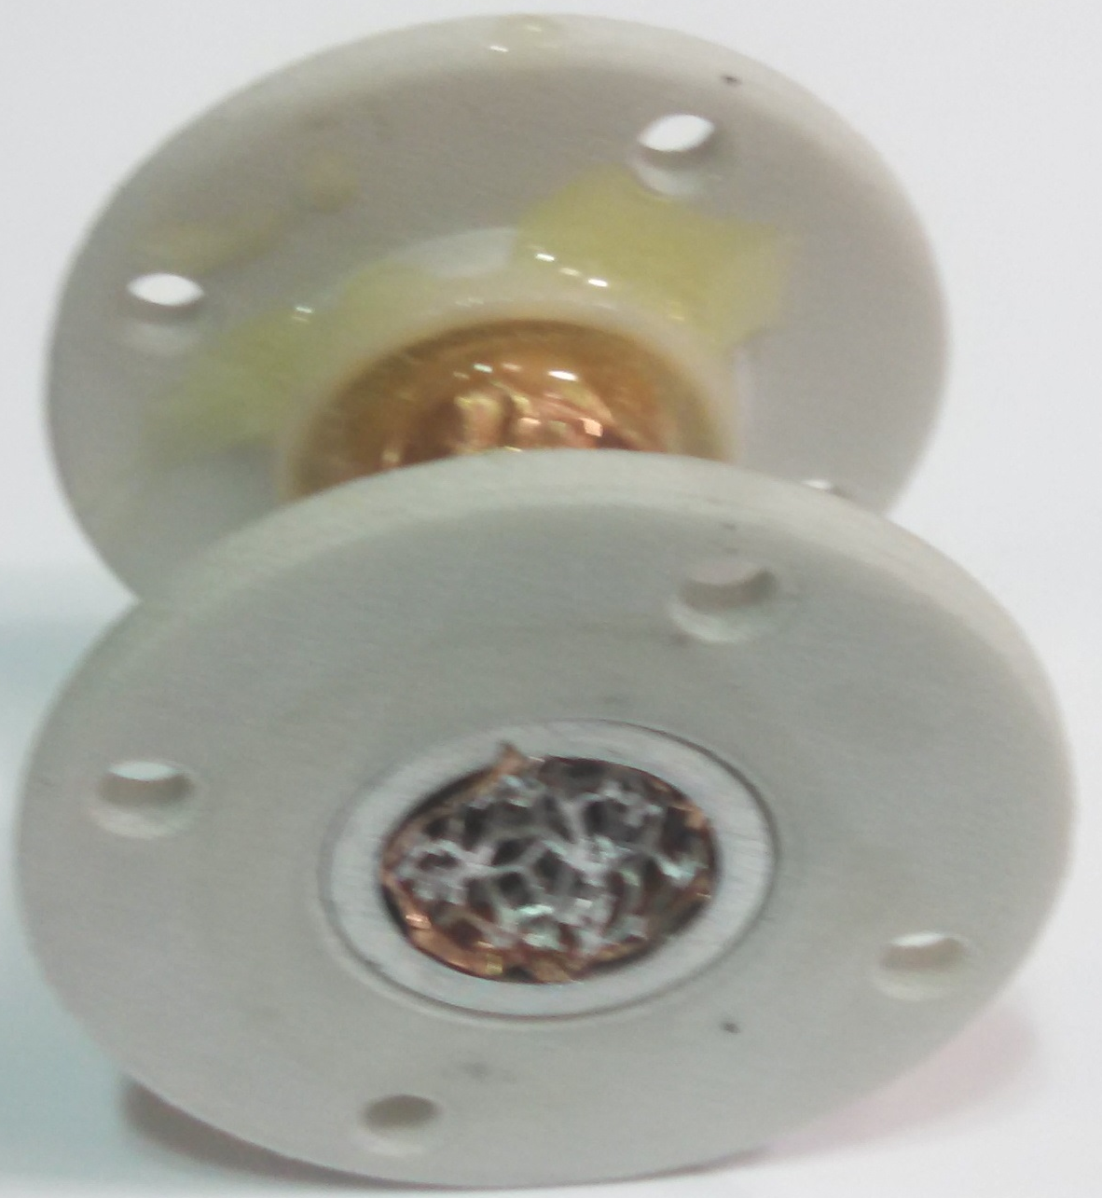
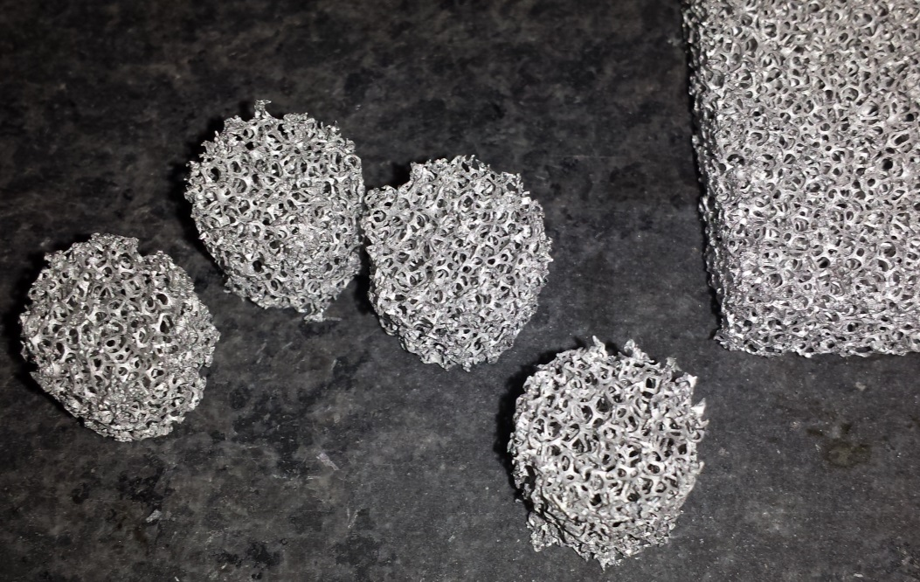
Samples
Started with Aluminum Foam
  Length diameter set by sample range 5ppi – 15mm dia.
5 proved difficult to fabricate (ligands bend, don’t cut)
EDM (Wire discharge machining) works—also works on ‘glassy’ carbon foam, and graphitic foam (slowly)
EDM improves consistency of sample preparation

Slide 25
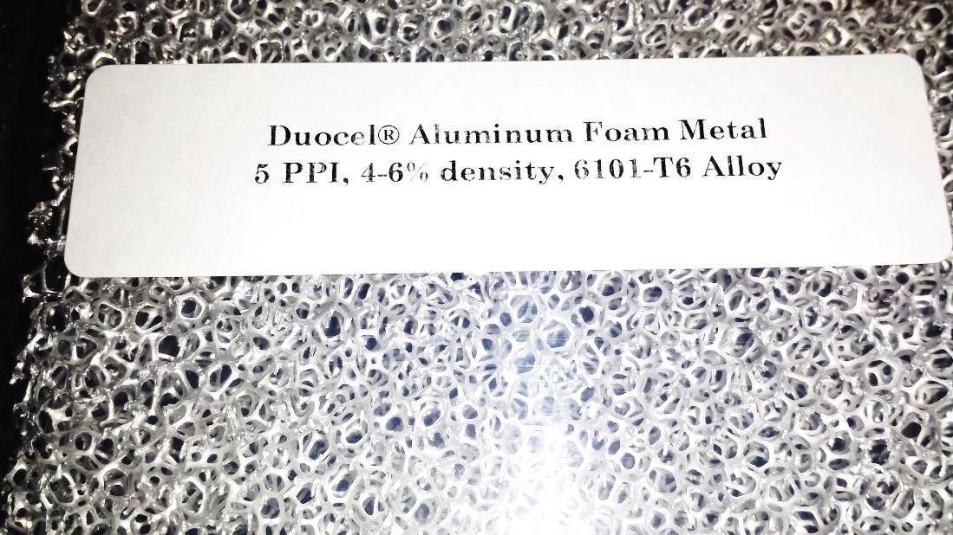
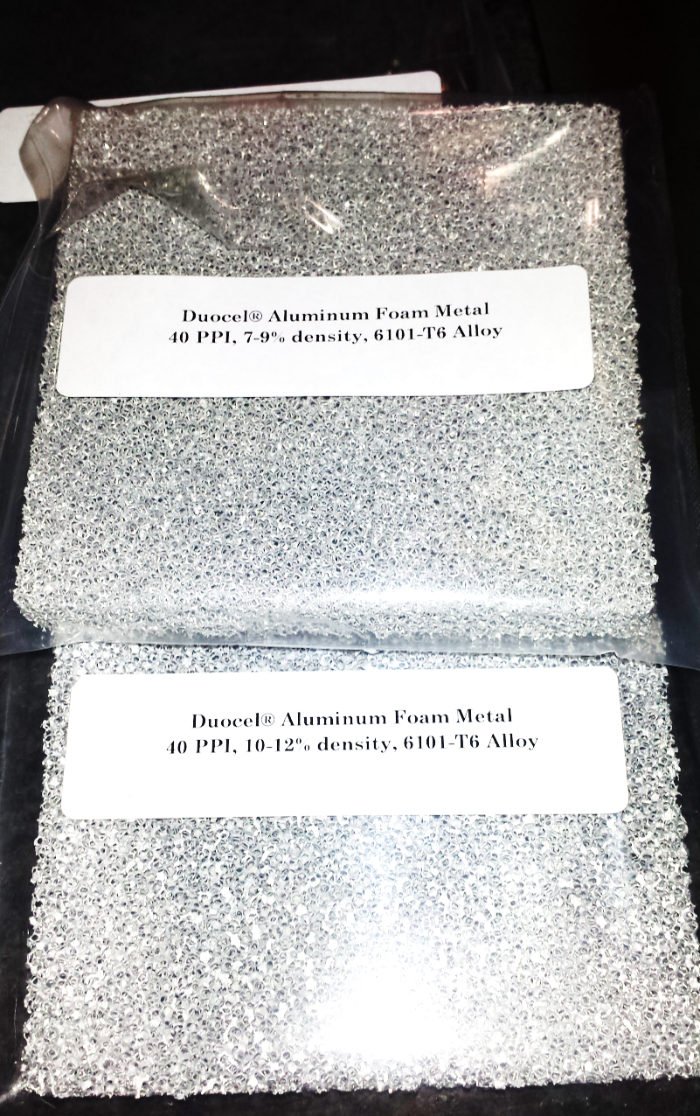
Foam Samples
Using Aluminum as a ‘known’ K (thermal conductivity)
Has similar morphology to Carbon Foam
Interested in developing machine vision tool to quantify ‘PPI’
Void fraction by mechanical weight
“K” perhaps with TPS500s

Slide 26
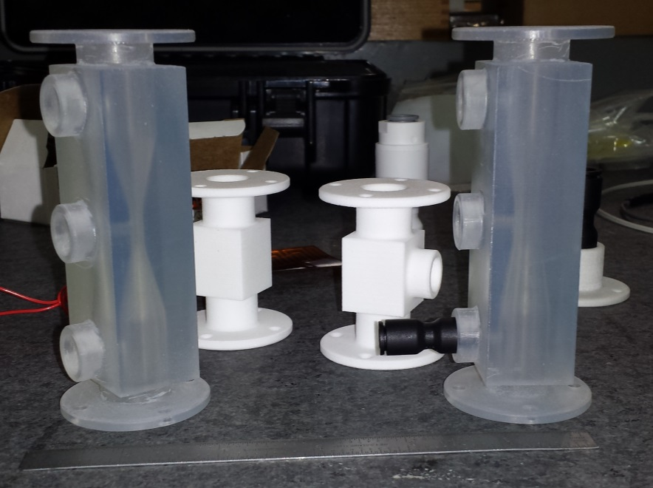
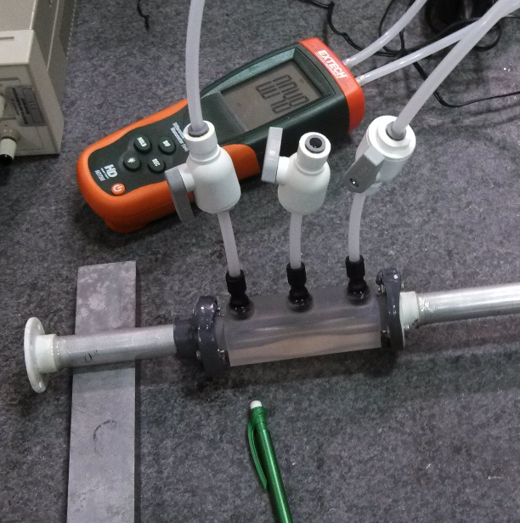
Mass Flow and velocity
Venturi for different mass-flow ranges (orifice size)
Used similar on STAR, calibrated with large bag
Good to 2-3% if not choked; had problem when using fan
Separate Manometer used across sample

Slide 27
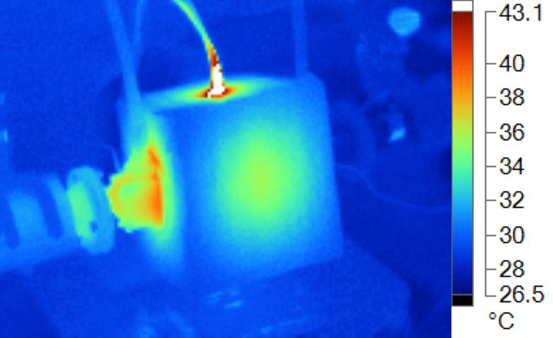
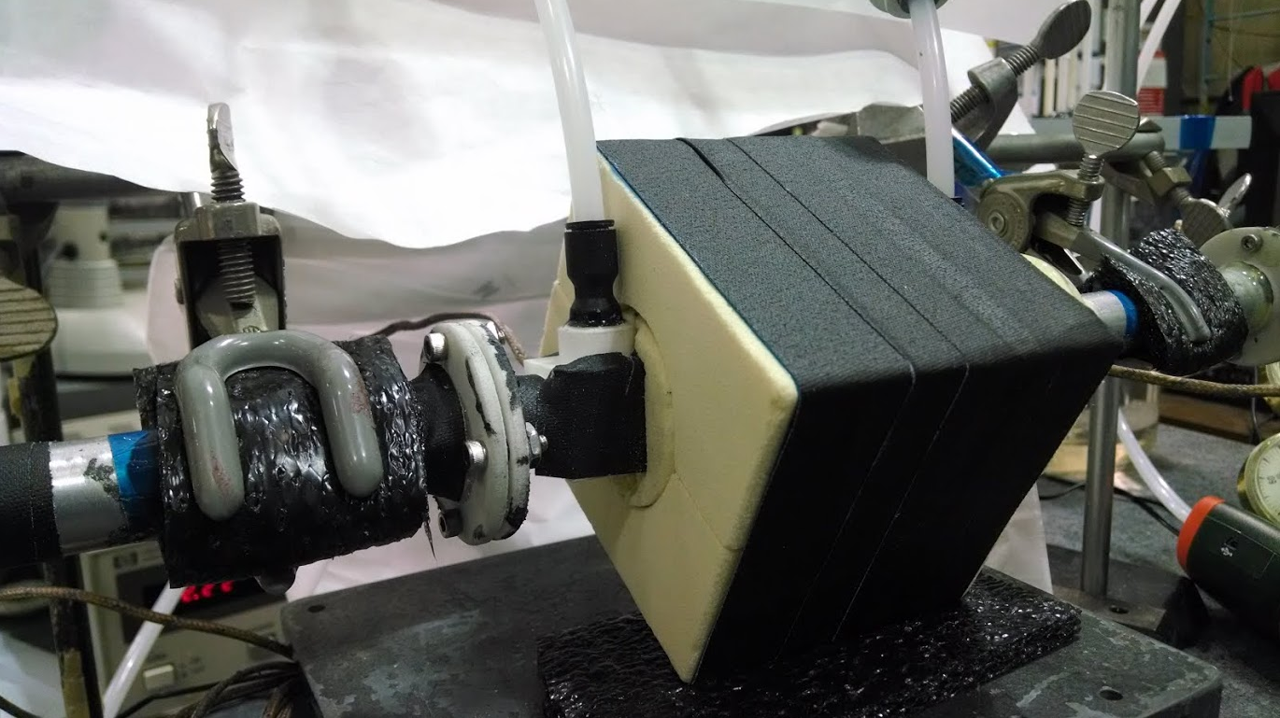
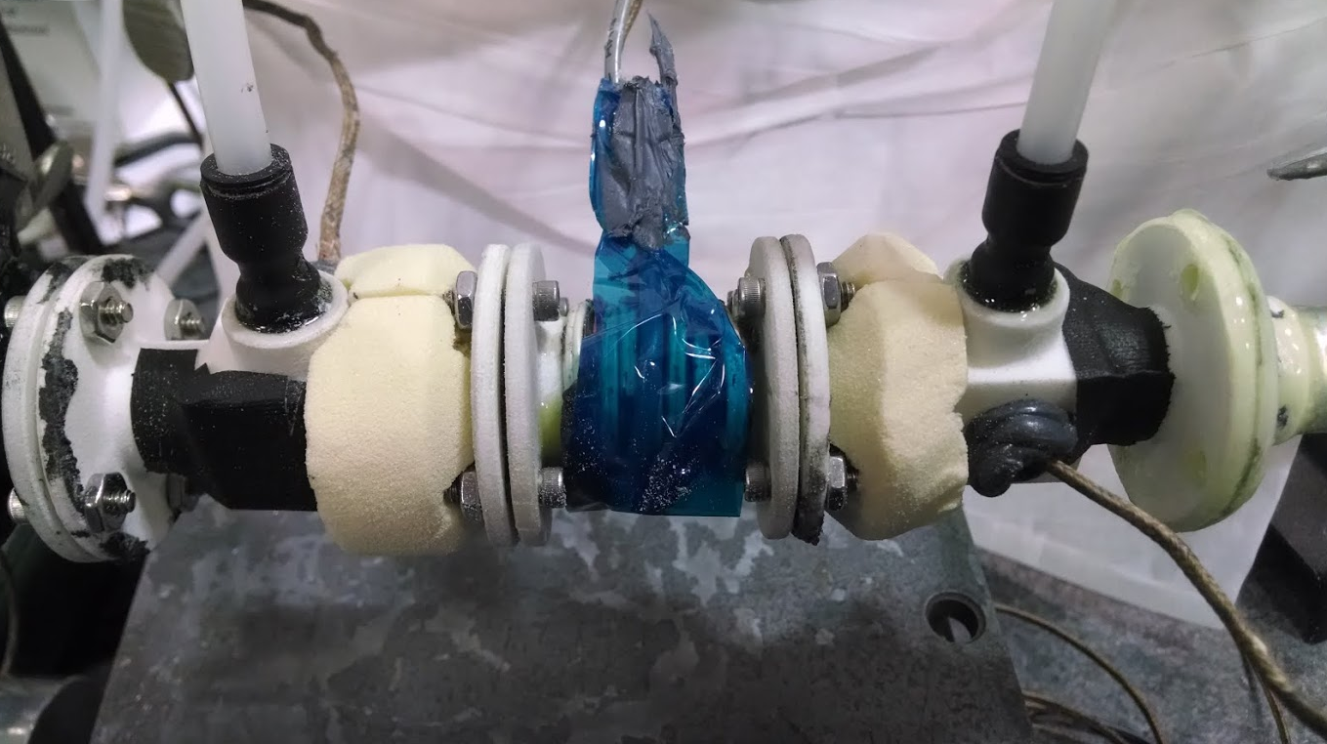
Thermal short circuit
Heat conduction along aparatus effects TC measurements
ΔT of air across sample measure of Q
When dragged together by conduction Q ~ 0
Improved isolation, both separation and insulating pipes

Slide 28
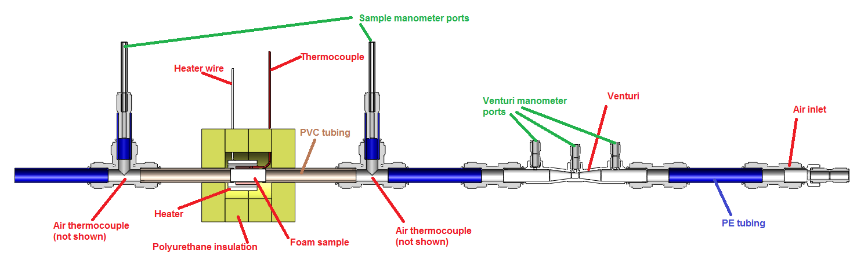
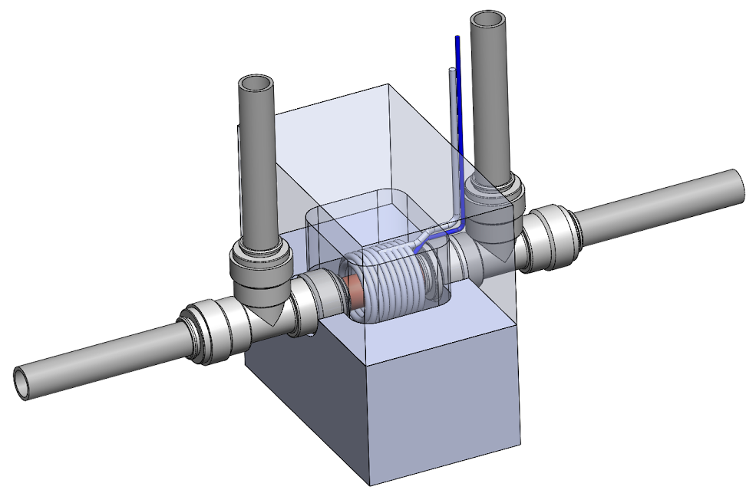
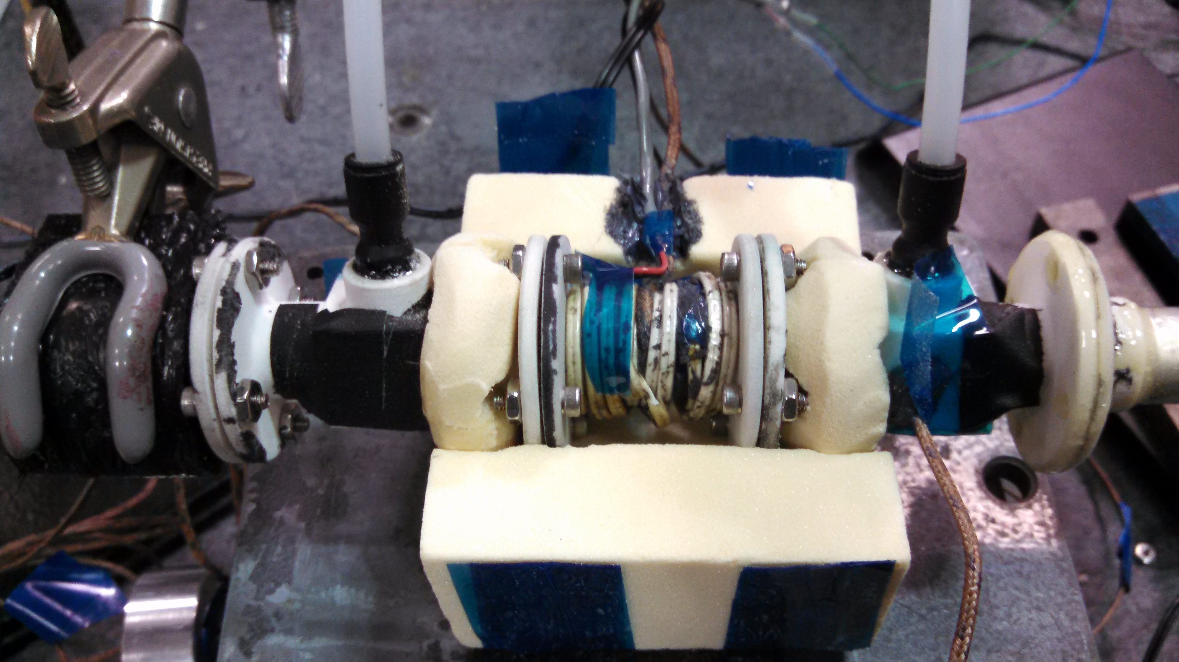
New test bench (arrives this week)

Slide 29
Recent Data original setup
W/Cm²
(2cfm)
(4cfm)
m³/s
Consistency is improving, results starting to look as expected
Effective “H” is normalized to area of outer radius of sample
These are not results, but they have the functional form of the types of curves we want to fit—more with new setup

Slide 30
Conclusion
Consistency of practice and repeatability of results are starting to improve for all efforts presented
Neat CE Resins do exotherm, but not catastrophically, safety is no longer a concern for future testing (can go faster)
Thermal conductivity results are too preliminary to conclude
Work can proceed much more rapidly on all fronts

