Slide 1

Time-dependent CP violation and stability of the entangled BB state at Belle
Christoph Schwanda
Institute of High Energy Physics
Austrian Academy of Sciences
Questioning Fundamental Physical Principles
CERN, May 6-9, 2014

Slide 2
The Belle experiment at KEK

Slide 3
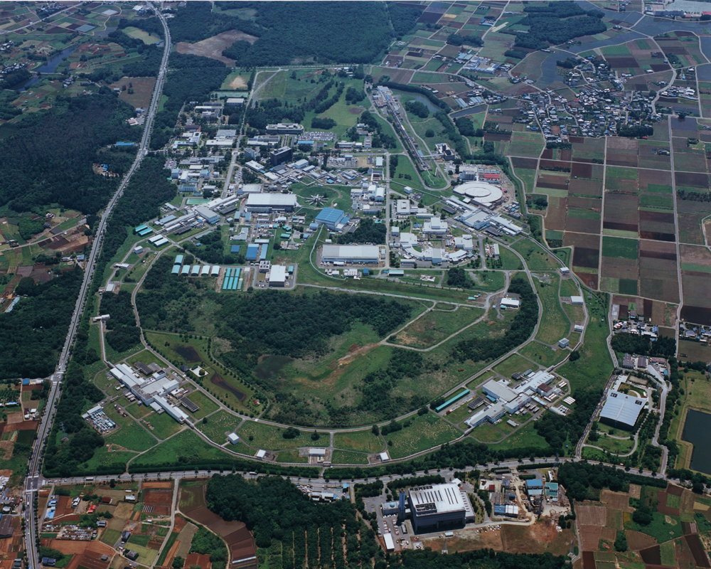
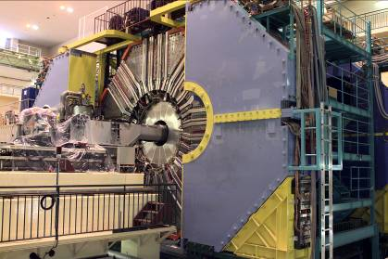
1999 – 2010: B factory at KEK (Japan)
Linac
KEKB double
ring e⁺e⁻ collider
e⁺e⁻ → Y(4S) → BB
Belle detector
World largest B meson sample
~771 million BB events
~400 Belle physics publications

Slide 4
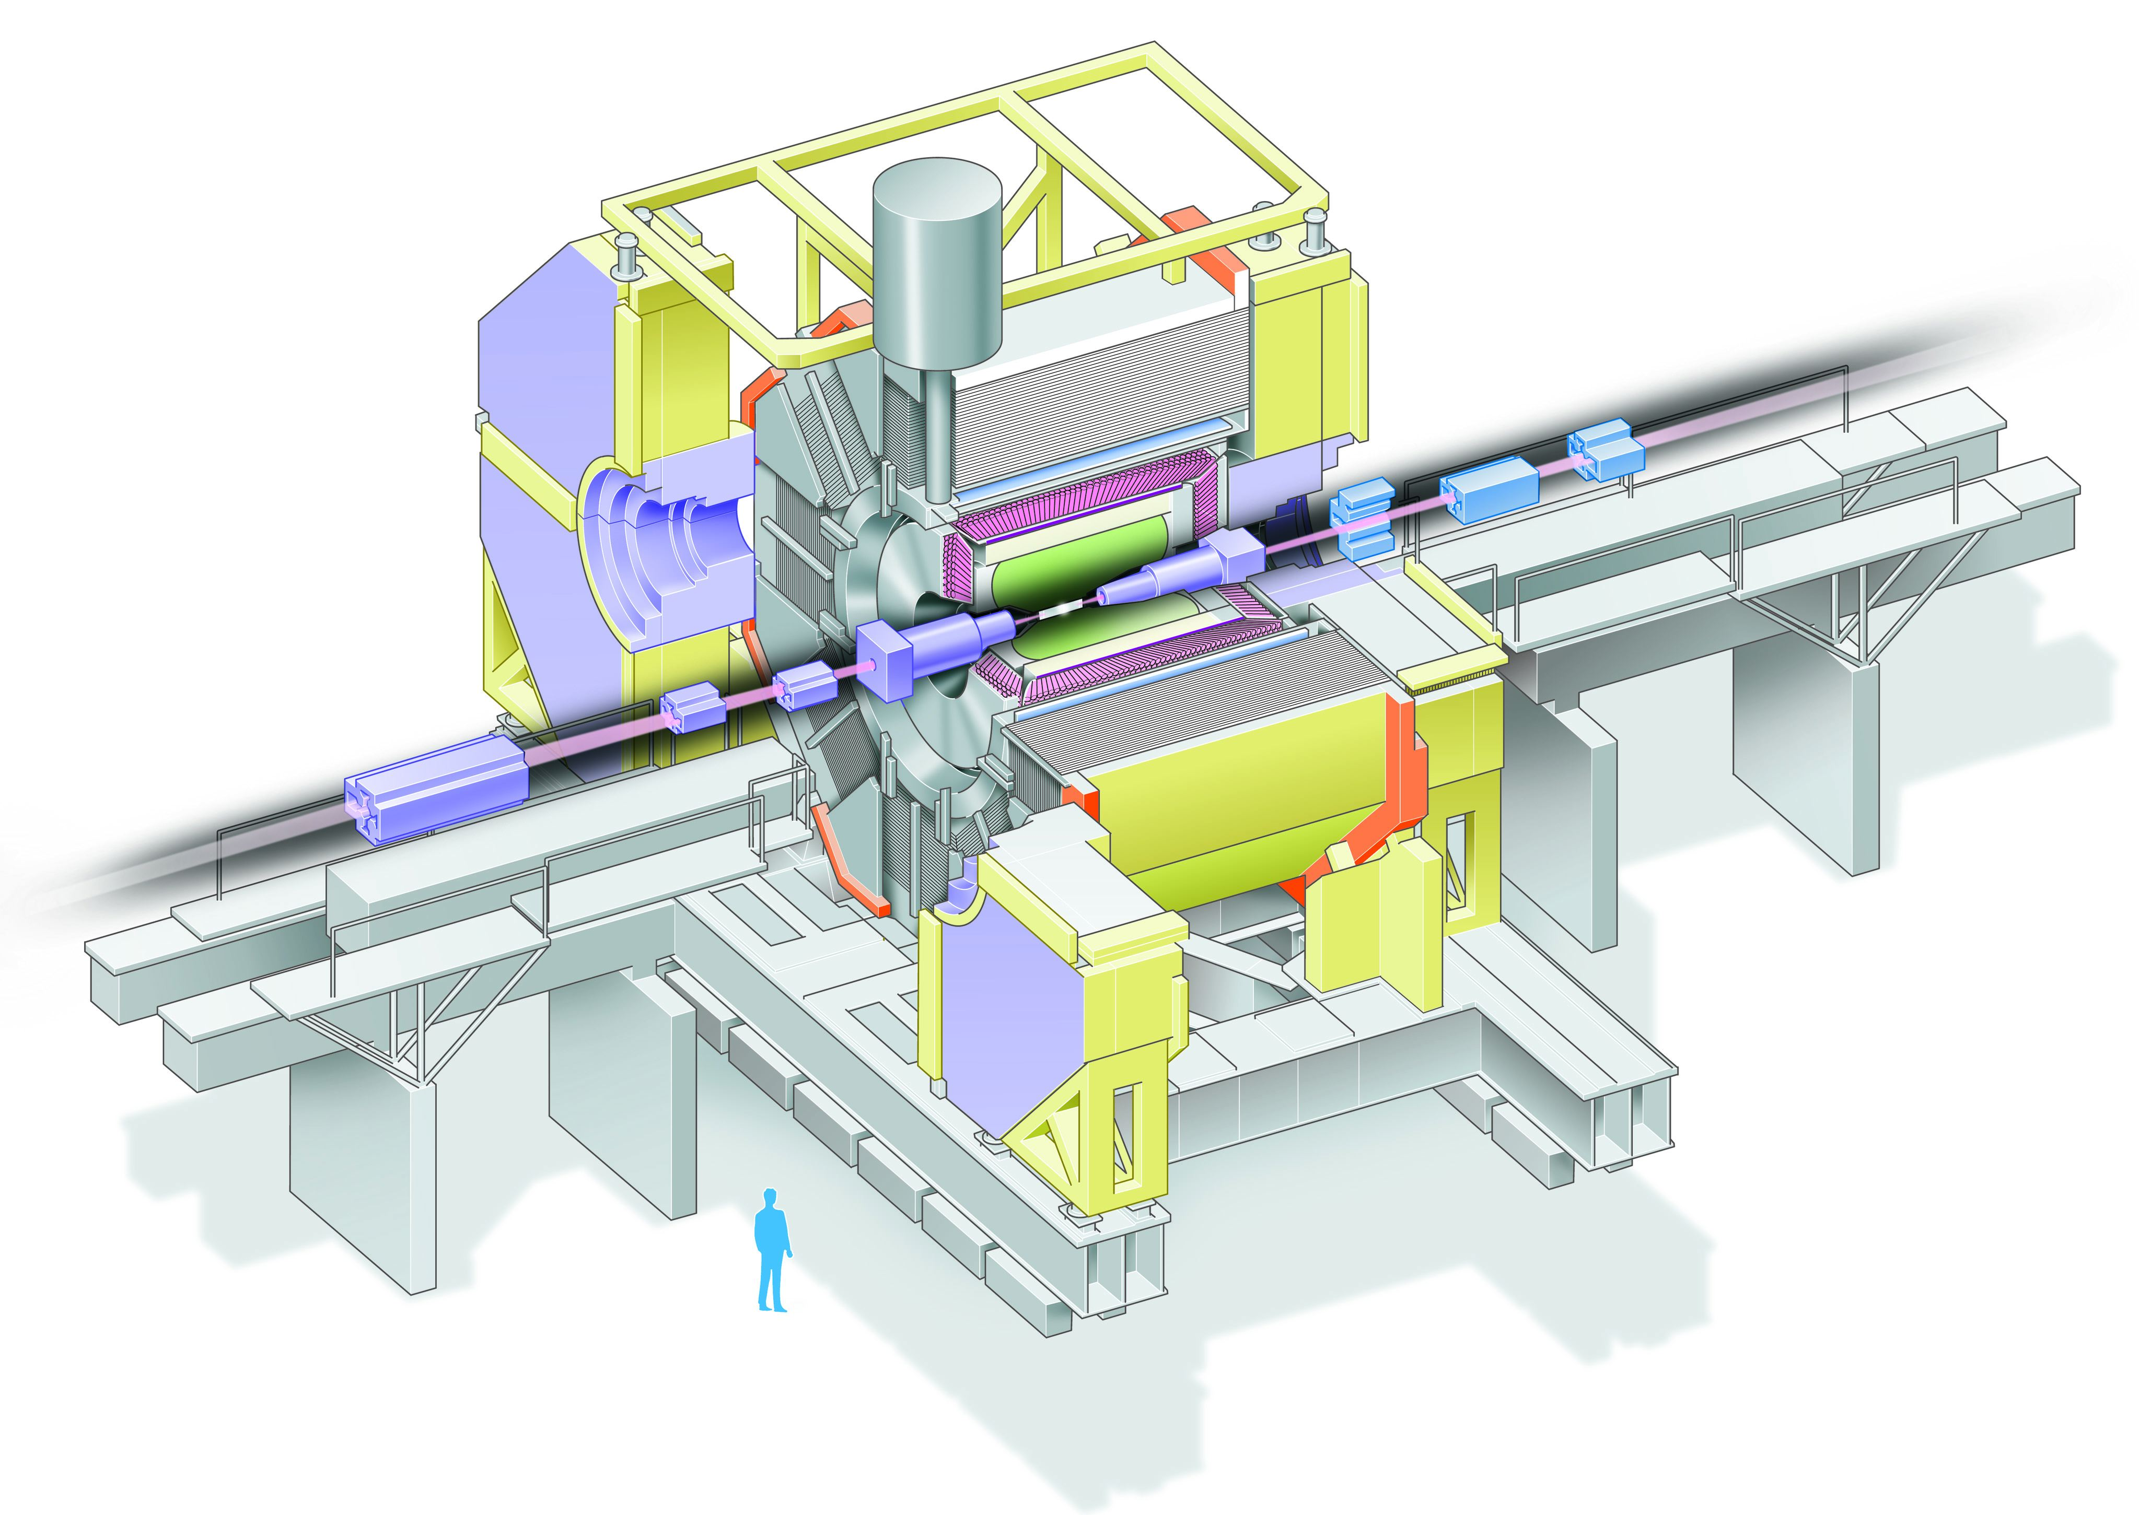
Aerogel Cherenkov cnt.
n=1.015~1.030
SC solenoid
1.5T
3.5 GeV e⁺
CsI(Tl)
16X₀
TOF counter
8 GeV e⁻
Central Drift Chamber
small cell +He/C₂H₅
Si vtx. det.
3(4) lyr. DSSD
μ / K_{L} detection
14/15 lyr. RPC+Fe

Slide 5
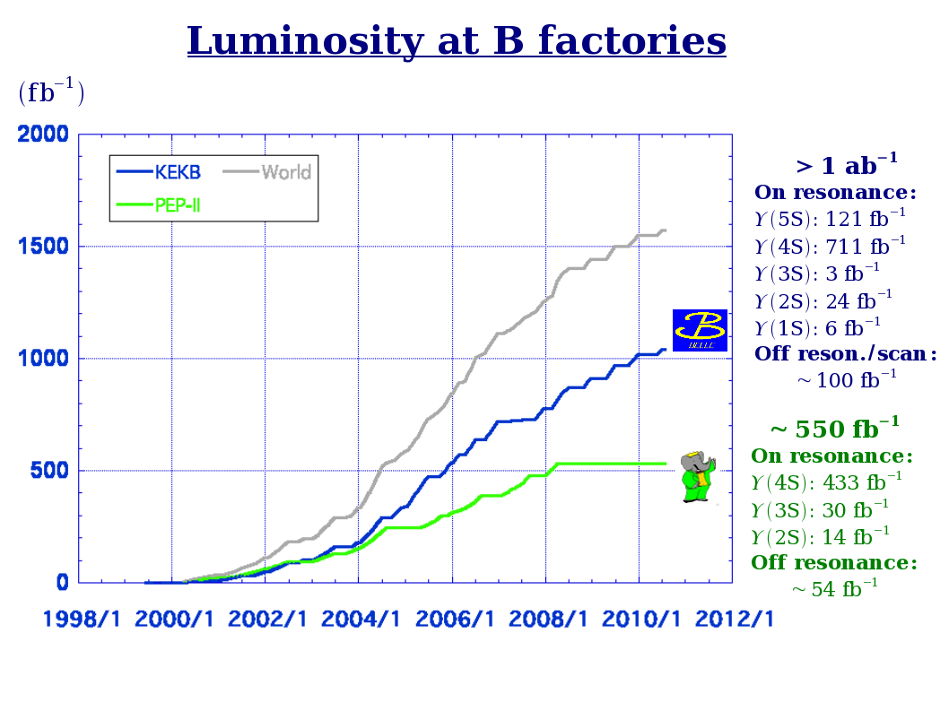
About 771 million
e⁺e⁻ → BB events in the Belle data

Slide 6
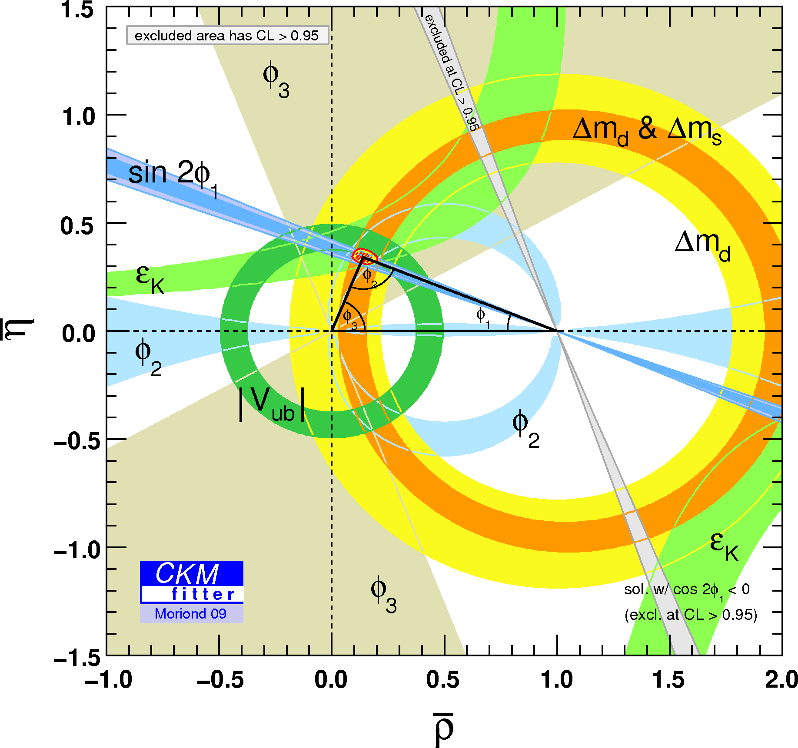
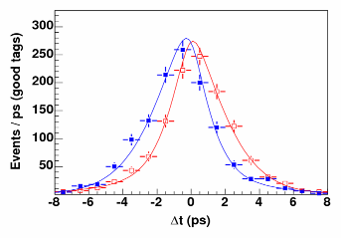

B factories: a success story
Discovery of time-dependent
CP violation in the B meson system
(2001)
Confirmation of CKM mechanism
_
B⁰→J/ψK⁰
B⁰→J/ψK⁰
Rate of the decay B⁰ (B⁰) →J/ψK⁰ as a function of the decay time difference of the two Bs in Y(4S) → BB events

Slide 7
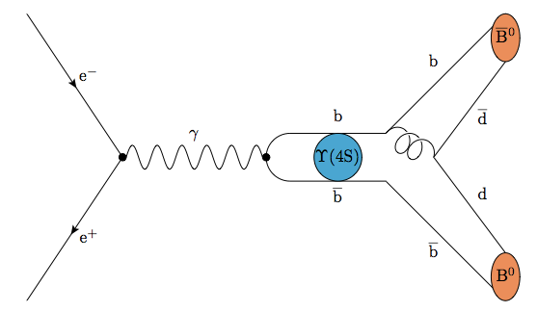
Y(4S) → B⁰B⁰
Strong decay (flavour conserving) of the Y(4S)
→ results in a
B-flavour anticorrelated pair of mesons in an entangled state
Entanglement is maintained until one of the B mesons decays

Slide 8
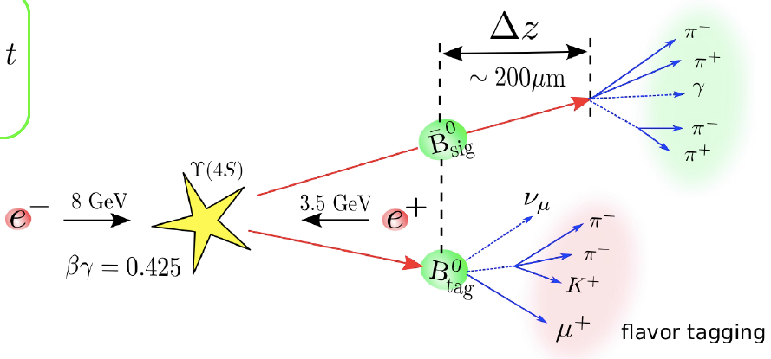

Time-dependent CP violation measurement
f (CP eigenstate)
flavour tag
Entanglement of BB state is used for the flavour tag in time-dependent CPV measurements, the main measurements of the B factories

Slide 9
Decoherence theory

Slide 10
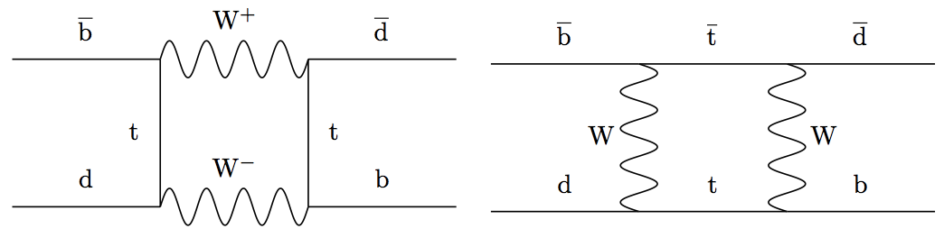
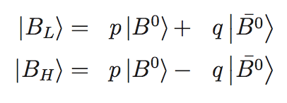
Neutral B mesons
Flavour eigenstates mix as weak interactions do not conserve flavour
Mass eigenbasis

Slide 11

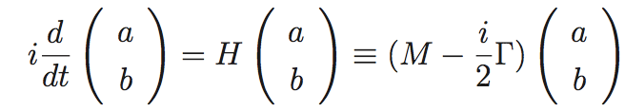
Time evolution
Arbitrary state in flavour basis
Schrödinger equation
M and Γ are Hermitian matrices

Slide 12
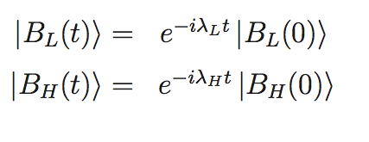

Time evolution (2)
In the mass basis, M and Γ are diagonal and the solution of the Schrödinger equation is trivial
Where the exponential parameters are the eigenvalues of H

Slide 13


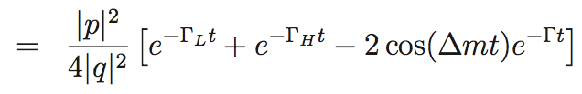
B oscillation
Δm = M_{H} – M_{L,} Γ = (Γ_{H} + Γ_{L})/2

Slide 14

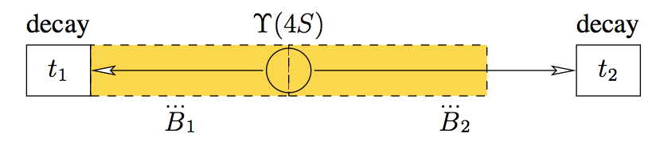
Coming back to the Y(4S)…
In classical quantum mechanics, the B meson pair is in an entangled state until t < t₁ (yellow box)
Then, a sudden change (collapse) of the wave function occurs and the B mesons oscillate independently (Bohr, Heisenberg)

Slide 15

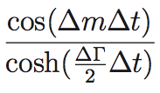
QM asymmetry
At t = t₁, the B meson pair has opposite flavour – OF
The number of oscillated (same flavour – SF) events thus depends only on the time between t₁ and t₂, Δt = t₂ – t₁
Assuming |q/p| = 1

Slide 16
Decoherence theory
W.H. Furry, Phys. Rev. 49:393 (1936)
E. Schrödinger, Naturw. 23:807,823,844 (1935)
The sudden collapse of the wave function is replaced by a continuous transition

Slide 17


Decoherence model
Density matrix
Modified von Neumann equation
λ > 0 is a parameter of the model
W. Grimus, A. Bertlmann, Phys. Rev. D64:056004 (2001)

Slide 18




Time evolution in decoherence theory
At t = 0, the 2-particle system is in a “Bell singlet state”
Density matrix at t = 0

Slide 19

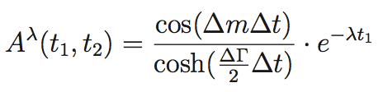


Asymmetry in decoherence theory
At t > 0
Decoherence theory predicts a different number of mixed events (SF) → experimentally testable prediction
λ = 0 corresponds to QM

Slide 20
Measuring λ in the Belle data

Slide 21
λ at Belle
The results shown here were obtained by Gerald Richter in his 2008 Ph.D. thesis
Caveat: These are not official Belle results and shown here merely for the purpose of this workshop

Slide 29
Summary
Decoherence theory leads to experimentally testable predictions in the Y(4S) → BB system
We have investigated decoherence as described by the modified von Neumann equation with the Belle data
Results are consistent with classical QM – improvement of the analysis is needed/desirable

