Slide 1

ATLAS Phase II Strip Tracker:
Electronic Developments
ACES, CERN, 19/03/2014
Peter W Phillips
On behalf of
The ATLAS ITK Strip Community

Slide 2
Outline
Conceptual Layout
  Barrels and Disks, Staves and Petals
Architecture
  ASICs
    HCC
    ABC130
  Trigger Scheme
  First ABC130 Results !!!
  ABC130 Module with Integrated Powering
  HV Multiplexing and Bias Current Measurement
Status of Petal and Stave Prototypes
  With 250nm chipset

Slide 3
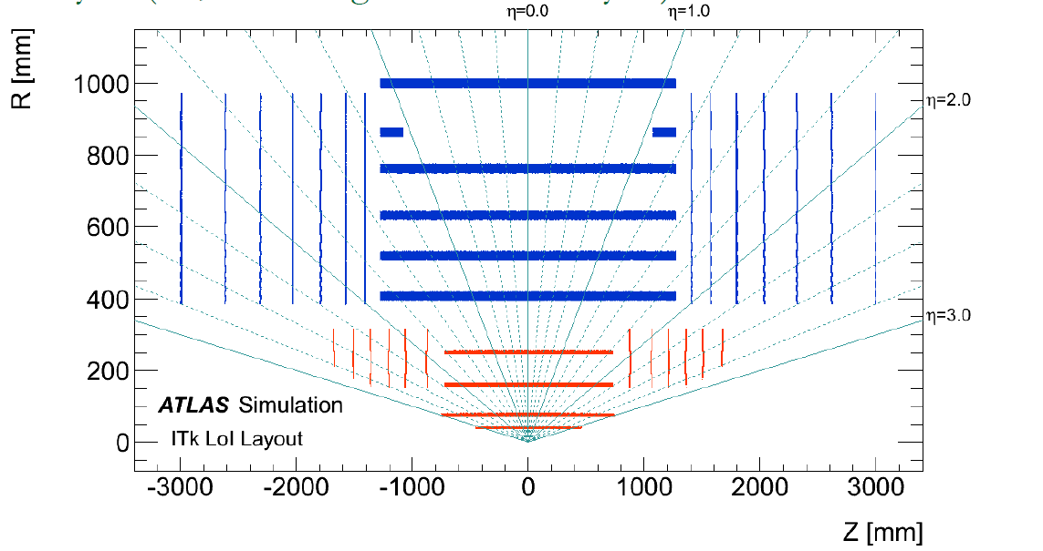
Provisional ITk Layout
1 stub barrel
2 long strip barrels
7 disks
7 disks
3 short strip barrels
Strip system: 193 m² sensor area, 74M channels

Slide 4
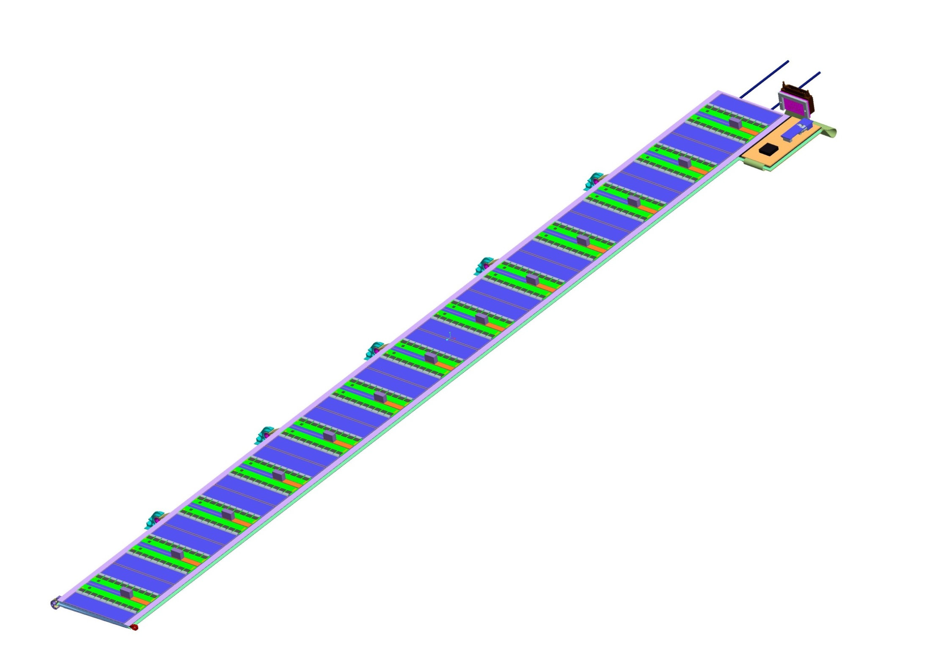
The Short Strip Stave
Power
Connector
Cooling
Key Features
Stave core with CF skins
  Integrated thermal management (CO2)
13 modules per stave side
  Planar Sensors (n in p, 320 μm thick)
    4 columns of ~23.8mm strips
    1280 strips per column
  Chipset: ABC130 & HCC
  Integrated Powering (SPP or PoL DC-DC)
Side mounted “End of Substructure” card
  Readout Interface
  Custom power connector
    on pigtail
VTRx
GBT
What will be on EoS?
First Prototype
  Electrical Readout
Second Prototype
  GBT + VTRx
Pre-Production
  lpGBT + multi channel opto

Slide 5
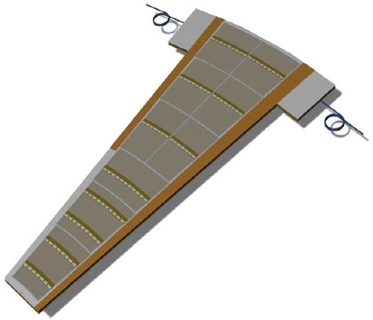
The Petal
Key Features
Petal core with CF skins
  Integrated thermal management (CO2)
Modules with wedge geometry
  Several sensor & hybrid geometries
    Varying number of ASICs
  Chipset: ABC130 & HCC
  Powering components at edges
    SPP or DC-DC converter
“End of Substructure” cards mounted on “ears”
  Readout Interface
As similar to the Stave as
geometrically possible!

Slide 6
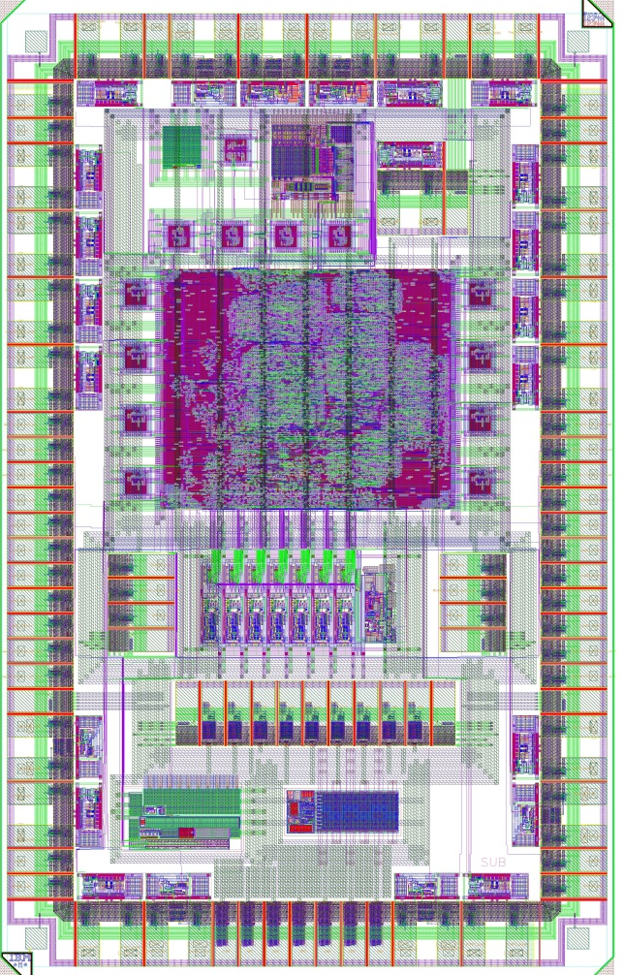
Hybrid Controller Chip (HCC)
EoS Side IO
Pad Frame optimized for hybrid mass reduction
  Smaller footprint => Smaller hybrid
  Hybrid side SLVS buses copied to both sides to suit left and right “handed” hybrids
Key Features:
  SLVS IO
    Data back to EoS at up to 320Mbits
    with optional 8b10b
  PLL to generate 40, 80, 160, 320, 640MHz synchronous to BCO
    Modified GBT ePLL
  Delays
  DCS Monitoring & General Purpose IO
    Temperature, Voltage, …
    Output ABC130 compatible fixed length packets
Status
  P&R and verification well advanced
  Probable submission in May
SLVS to ABC130
SLVS to ABC130
4.70mm
Bidirectional
SLVS to ABC130
Bidirectional
SLVS to ABC130
Bidirectional
SLVS to ABC130
Bidirectional
SLVS to ABC130
2.86mm
IBM CMOS 8RF

Slide 7
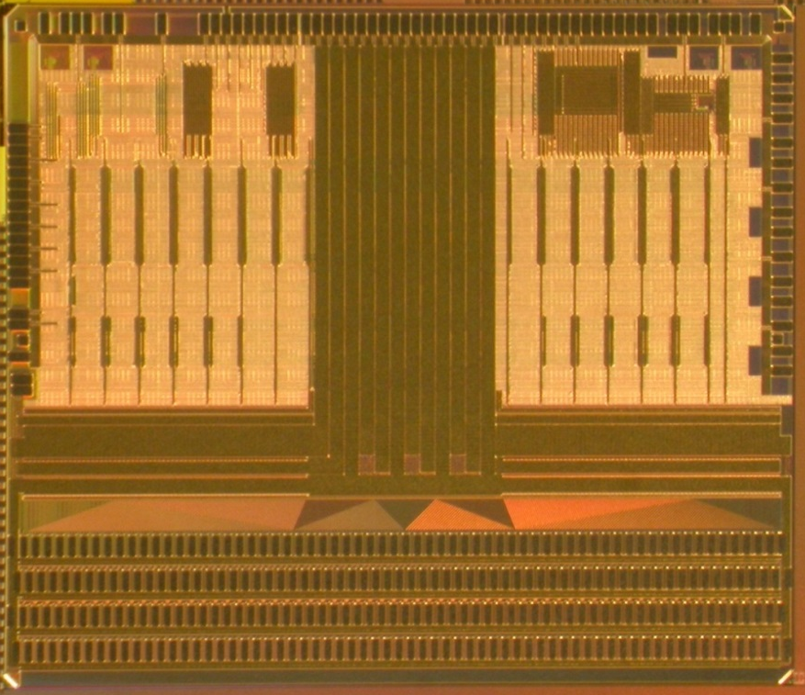
ABC130 Front End Chip
Pad Frame optimized for hybrid mass reduction
  256 channels -> reduce part count
  FE geometry suits direct sensor bonding
  All power bonds at back edge
New 2 level trigger architecture
  Level-0 - synchronous 500kHz-1MHz
    Moves event data from a pipeline to buffer in FEs, no readout
    Event data tagged with L0ID
  Level-1 - asynchronous ~200kHz
    Data retrieved from buffer using L0ID tag
Other key features
  Fixed length data packets
  Programmable LDOs for Analogue / Digital power
  Shunt to support Serial Powering
Two variants made
  One includes additional “Fast Cluster Finder” block for self-seeded trigger
First wafers back Q4 2013
  Testing in progress
Bidirectional
SLVS
VDDD
VDDA
VDDD
Bidirectional
SLVS
Shunt Control
& LDO enables
SLVS INPUTS
6.8mm
7.9mm
IBM CMOS 8RF

Slide 8
ABC130 Trigger Architecture
Additional track-trigger function
  Regional Readout (R3)
    A special trigger sent only to modules inside a Region of Interest
    L0-trigger identified regions of interest
L0A copies data from pipeline to RAM
  L0ID counter used as address
L1A and R3 requests have independent FIFOs
  Stores L0IDs - locates event in buffer
  Arbiter ensures ordered data handling - R3 has priority
  Effective as a de-randomiser
Data is formatted by dedicated blocks and serialised to HCC
Strips
Pipeline
256
Buffer RAM
256
L1 data format
Serialiser
L0A
L0ID
R3 data format
WrAddr
RdAddr
FCF
L1A
L1A FIFO
R3
R3s FIFO
Arbitration, Xoff, Control

Slide 9
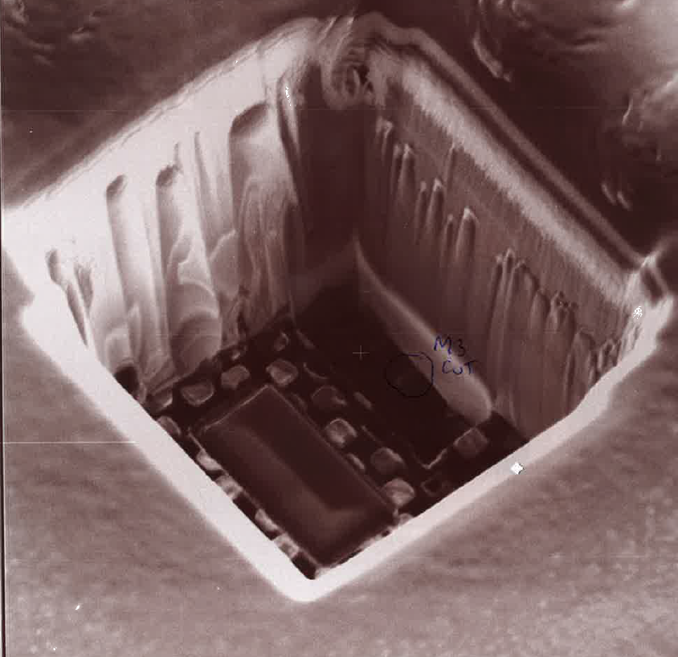
ABC130 Early Test Issue
No data output
Problem traced to custom transceiver block
  Discrepancy between reality and functional model for polarity of “direction” signal
Corrected for a small number of die by FIB edit
  Cut direction line
  Strap to VDD or 0V as required
Resubmission being prepared
  New M3 layer only
  Others unchanged
~10μm
FIB edit by NanoScope Ltd., Bristol

Slide 10
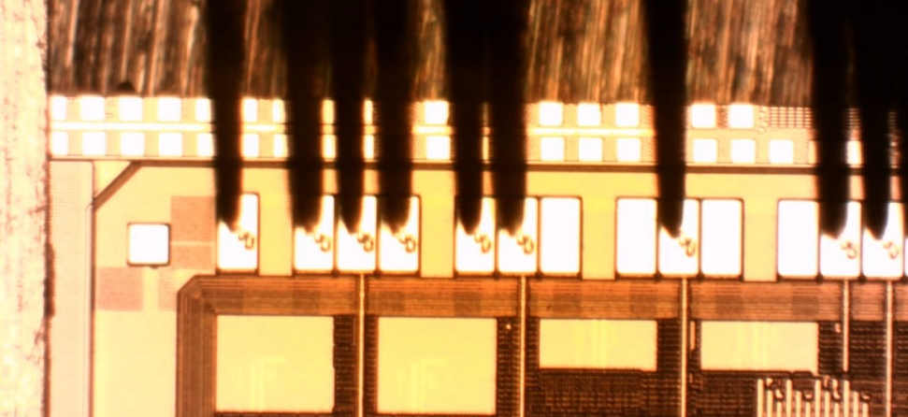
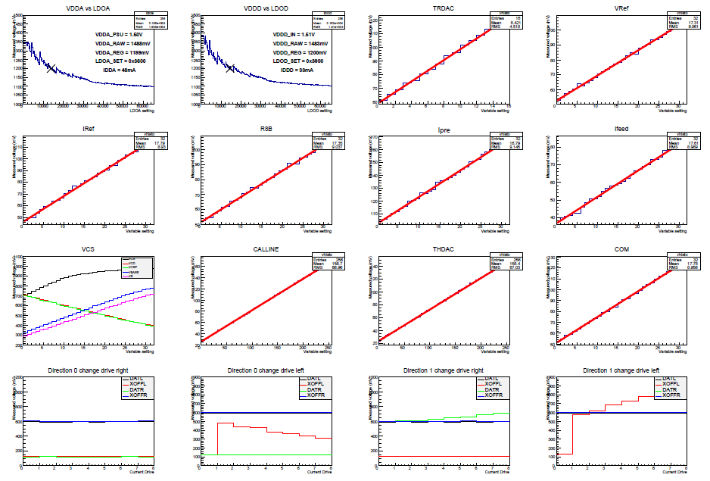
ABC130 Preliminary Results (1)
Evaluation of single FIB die continues
  Test PCB
  Probe Card
Test coverage to date:
  Register write/read
  DACs & LDOs
  40, 80, 160 MHz DCLK
  Noise with mini sensors
  Mean Power vs trigger rate
Pending
  Clock margin (higher BCO)
  Power vs time
  Gain calibration
    beam, laser, source…
  SEU studies
  Irradiation
  …
ABC130 under Probe Test
ABC130 DAC & LDO Characteristics

Slide 11
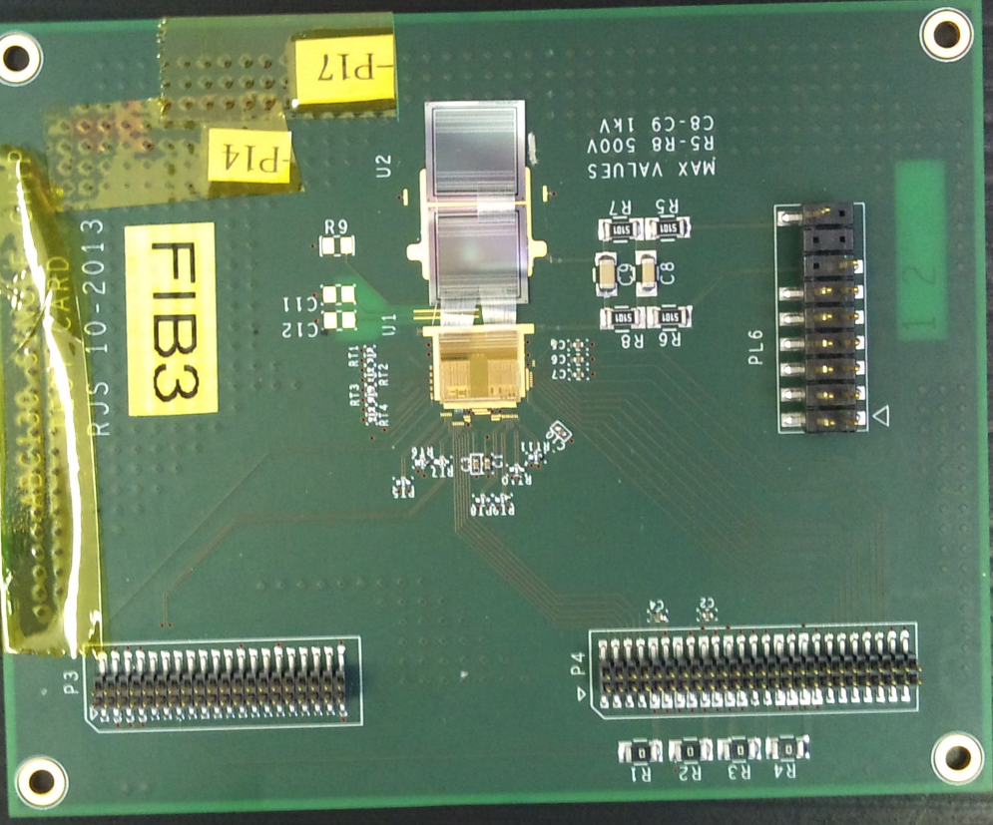
ABC130 Preliminary Results (2)
PRELIMINARY
1 sensor
~0.8pF
2 sensors
~1.6pF
unbonded
ABC130 with two ATLAS07 mini sensors
Preliminary noise data at 150V bias
Noise is as expected. To date - apart from the known “feature” - ABC130 is working well.

Slide 12
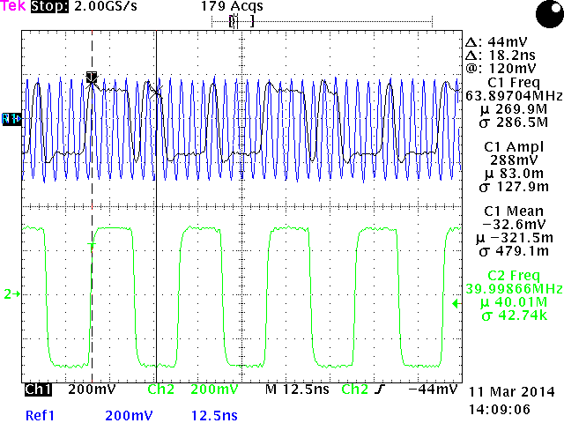
Testing The Fast Cluster Finder
Fast-Cluster-Finder is a proof-of-principle block for self-seeded triggering
  Autonomous – no interaction with other chip functions
    Outputs cluster lists at up to 640Mbits for correlation with hits from other side of stave/petal
Parallel effort to verify function of this block on uncorrected die
  Plot shows FCF output at 320 MHz
  Half speed for now, but basically working
This effort will continue
  Work is directed toward a self-seeded trigger demonstrator module
FCF Output (black) at 320 MHz (blue)

Slide 13
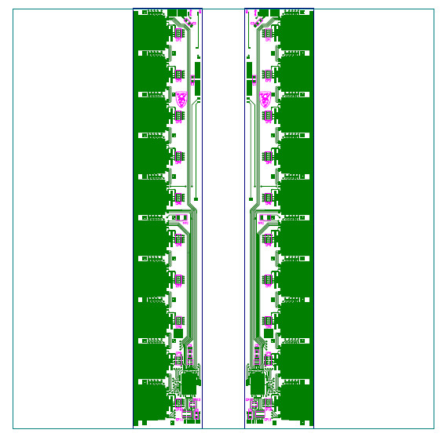
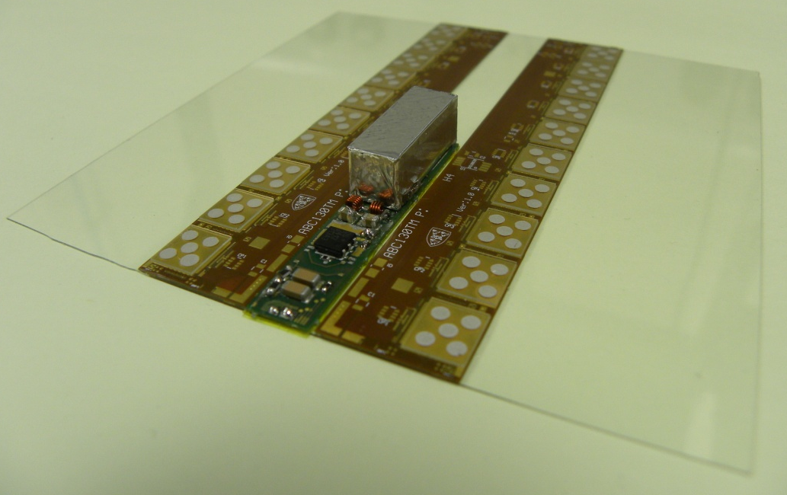
ABC130 Barrel Module
Module Power and Sensor Bias
Module is made up of 3 main parts:
  Sensor
  Flex circuits (carrier for readout asics and I/O buffer)
  Power Board (SPP or PoL DC-DC) with sensor filtering
Moving towards an integrated module
  Flex circuits and powering attached within sensor area
  Sensor provides mechanical support and thermal management
Power Board
10cm x 10cm Sensor
Hybrid (10 x ABC130 and 1 x HCC)
Hybrid (10 x ABC130 and 1 x HCC)
TTC and Module Data
16.5mm
8mm
Assembly of “half module” with
5 FIB corrected ABC130 and
5 uncorrected ABC130 pending
16.5mm
Thermo-Mechanical Module with Prototype DCDC converter

Slide 14
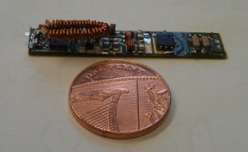
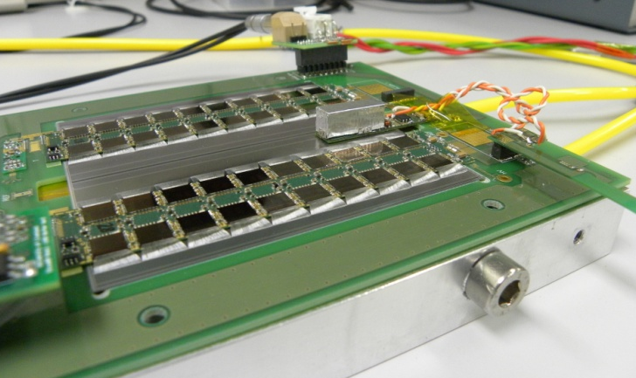
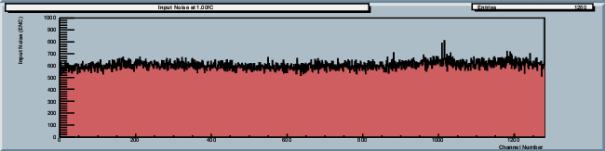

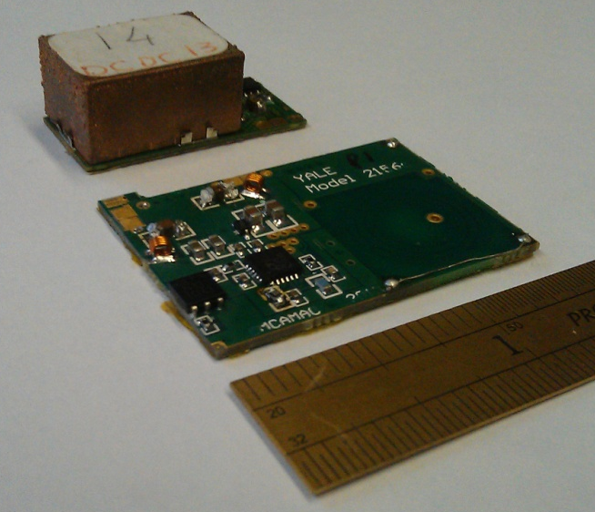
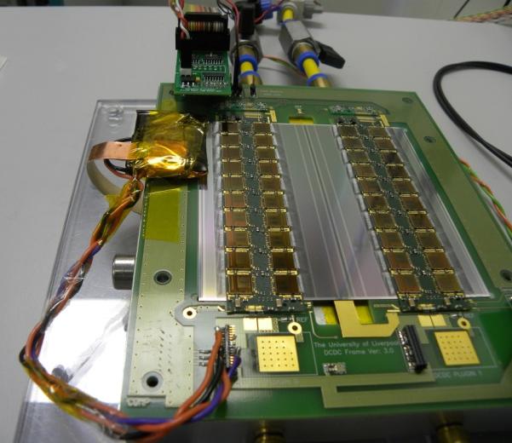
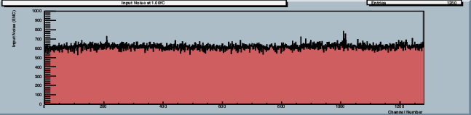

Prototype DC-DC Converters
ABC130 Prototype Converter
Converter Dimensions (L x W x H): 44 x 8 x 6.5 mm
  4 Layer build using 1oz Cu
  Hand wound elliptical inductor (200nH/26mΩ)
  Converter circuit based on CERN STV10
      With reduced sized SMDs (0805 instead of 1210)
      Plus 1-wire control and HV filtering
Test on ABCN-25 module
Leakage from shield box (~15e increase)
Input Noise: 600e (598e)
Planar Coil Prototype Converter
Input Noise: 602e (604e)
Reference measurement shown in brackets (CERN SM01C converter)
Test on ABCN-25 module
Converter placed <3mm from bond wires
Involves embedding coil within PCB
  Significant reduction in height compared to toroidal coil
    Target height <4mm with shield
  Making integration and cooling of coil easier
  Based on commercial LTC3605 buck regulator
    As per CERN type
    Wrap-around shield added to encompass noisy circuitry
    Efficiency comes in at 77% at 3A
Input Noise: 616e (598e)
Input Noise: 625e (604e)

Slide 15


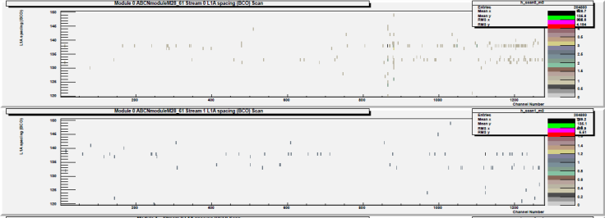
Converter at 4MHz
Switching frequency of Buck regulator increased from 2MHz to 4MHz
  Should allow smaller sized components to be used, making integration/packaging easier
  Inductor now ~110nH (was originally ~220nH) and DC resistance now ~14mΩ (was ~26mΩ)
Tests done with converter on sensor, largest sized component is 0805
  Input noise is more or less identical to previous measurements using ~200nH coil at 2MHz
  Efficiency is coming in at ~77% at 2A (predicted ABC130 module current consumption)
    Was originally 70-72% operating at 2MHz
Input Noise: 603e (600e)
Input Noise: 606e (602e)
Value in brackets is original noise measurement at 2MHz using 0805 components
DTN at 0.4fC
Only see evidence of converter at 0.4fC, all other threshold settings show approx zero occupancy

Slide 16
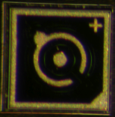
Sensor Bias (HV) Multiplexing
Propose use of rad-hard HV switches
  To be able to disconnect any failed sensors from common bias line
Present phase: Device Identification
  Study of commercial HV transistors: GaN, Silicon, Silicon Carbide
  before and after irradiation
  Devices with BV < 500V would need to be “stacked”
800 μm
Crystalonic 2N6449
Transistor | Type | Other data | Status
Crystalonic 2N6449 | Si JFET | BV = 300V, Idmax = 5 mA , Idss = 1 nA, die 0.8 x 0.8 mm² | TESTED
Interfet 2N6449 | Si JFET | Similar to Crystalonic | IRRADIATED
IXYS CPC5603 | Si MOSFET | BV = 410V, Idmax = 0.3 A, Idss = 0.02μA, packaged | IRRADIATED
ROHM R6006ANX | Si MOSFET | BV = 600V, Idmax = 6A, Idss <1nA@500V, packaged | TESTED
Infineon IPA50R950CE | Si MOSFET | BV = 500V, Idmax = 4 A, Idss <1nA, packaged | TESTED
Semisouth SJEP170 | SiC JFET | BV = 1700V, Idmax = 8 A, Idss = 10 μA | TESTED
USCi UJN1205 | SiC JFET | BV = 1200V, Idmax = 23 A, Idss = 250 μA, die 3.1 x 3.1 mm² | TESTED
CREE CPMF-1200 | SiC MOSFET | BV = 1200V, Idmax = 28 A, Idss = 50 μA, die 3.1 x 3.1 mm² | IRRADIATED
ROHM S2403 | SiC MOSFET | BV = 1700V, die 4 x 3mm² | IRRADIATED
ROHM SCT2080K | SiC MOSFET | BV = 1200V, die 2 x 2 mm² | IRRADIATED
GeneSiC GA04JT17 | SiC BJT | BV = 1700V, Idmax = 4 A, Idss = 0.5 μA, die 1.45 x1.45 mm² | TESTED
TranSiC FSICBH057A120 | SiC BJT | BV = 1200V, Idmax = 20 A, Idss = 100 μA, die 2.5 x 2.5 mm² | TESTED
Transphorm TPH2006C | GaN JFET | BV = 600V, die and packaged
EPC2012 | GaN JFET | BV = 200V, die and packaged | TESTED
GOOD but unavailable
PROMISING
GOOD

Slide 17
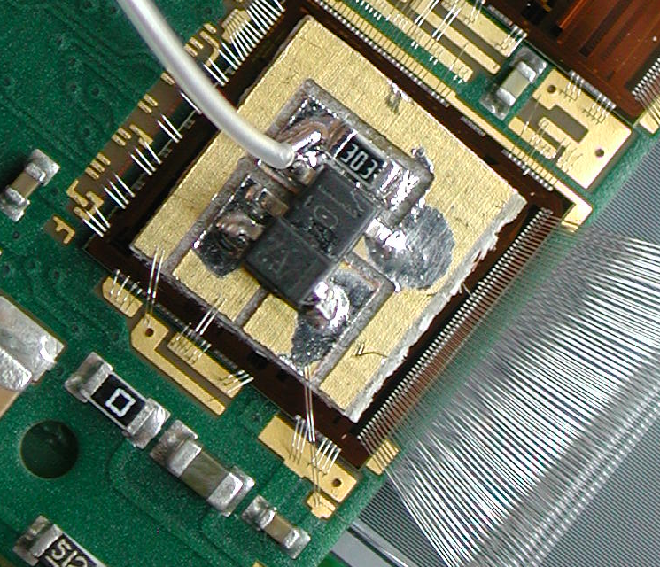
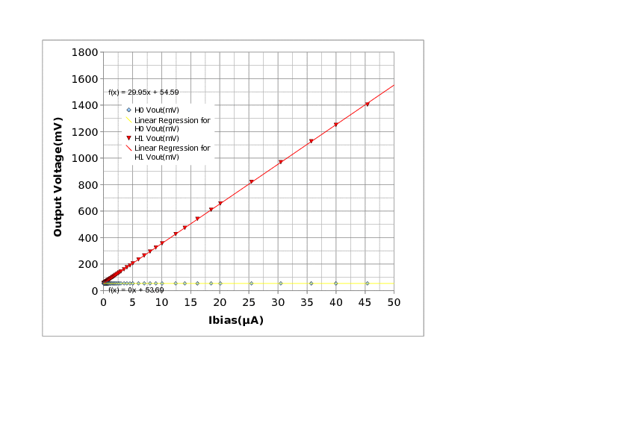
On-Hybrid Sensor Current Measurement
Signal Return on Hybrid
  Strip Bias AC coupled at every corner
DC return
  One corner has diode/op-amp combination
    Normal DC path through op-amp (later HCC or other ASIC)
    Backup DC path through diode (accommodates amplifier offset)
Proof of Principle test using commercial parts
  OPA365, 1N4148
No additional noise for test module using DC-DC converter
DC-DC

Slide 18
Status of Petal & Stave Prototypes
With 250nm Chipset

Slide 19
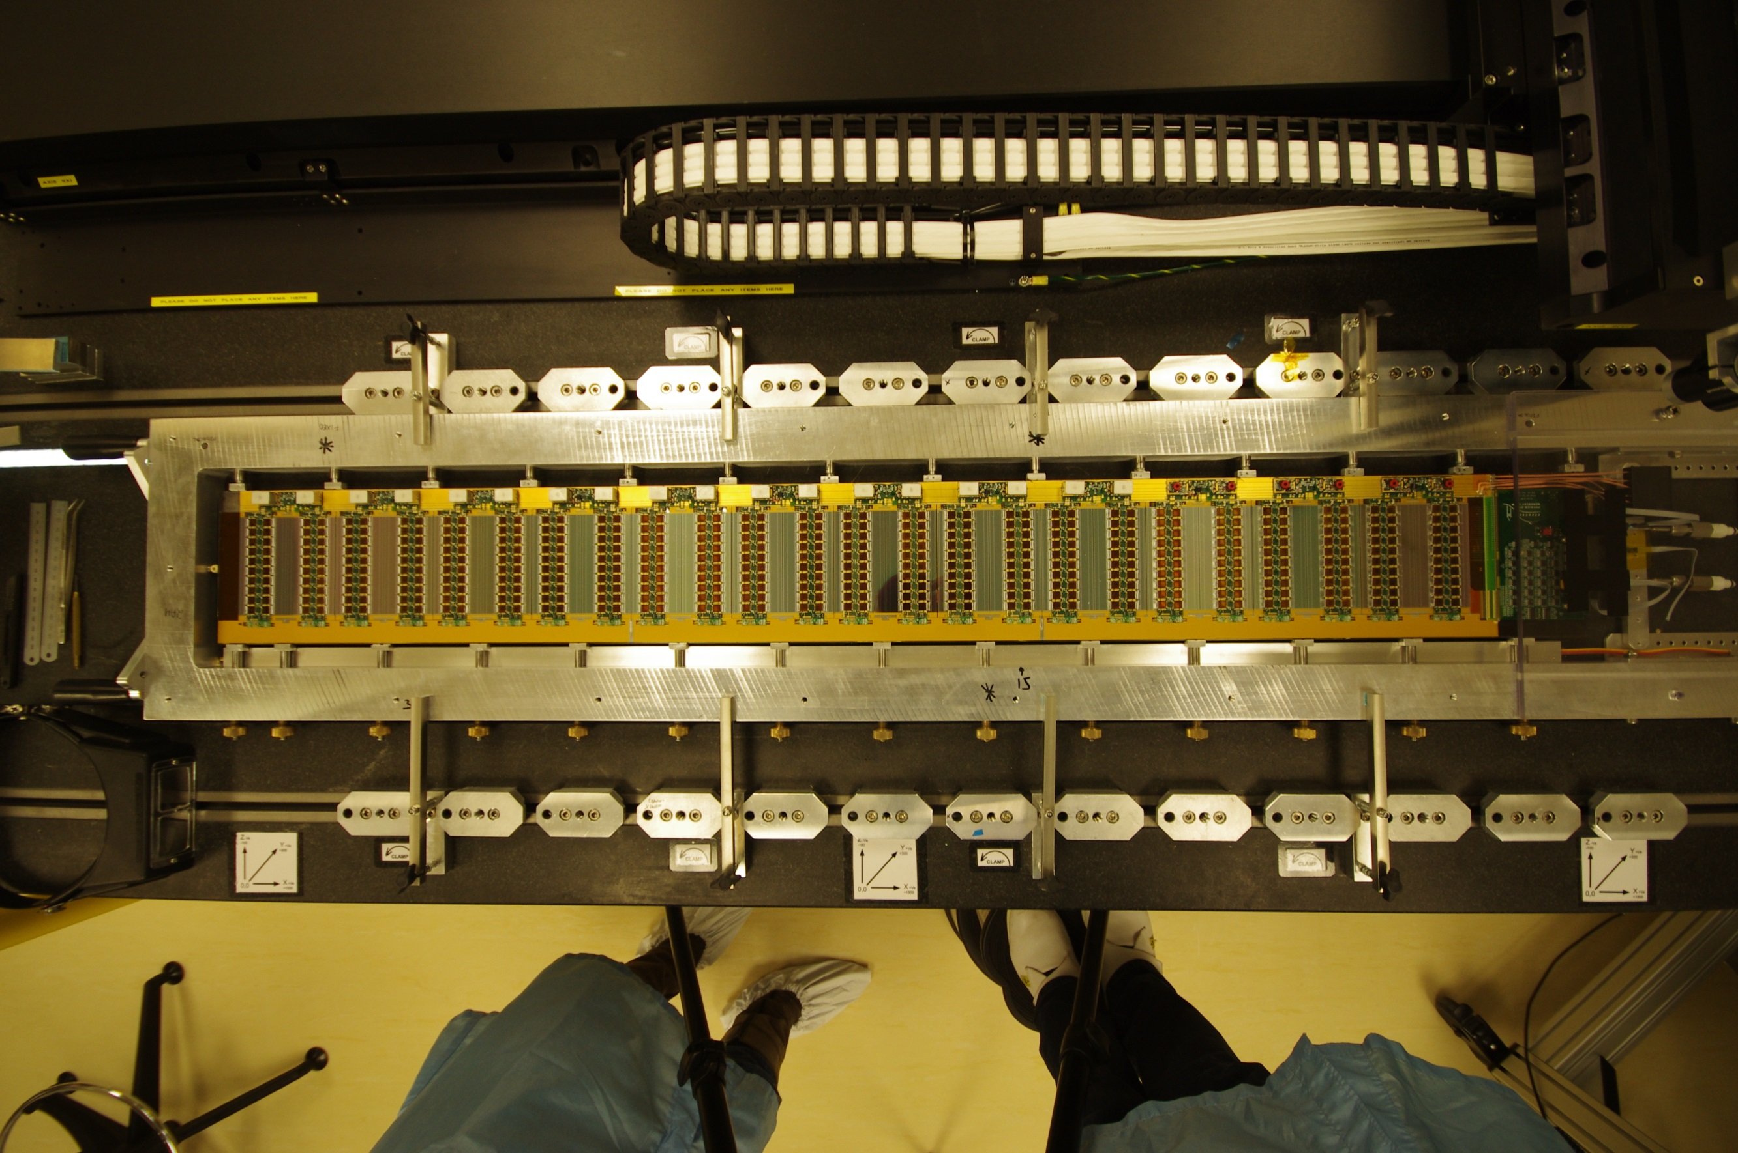
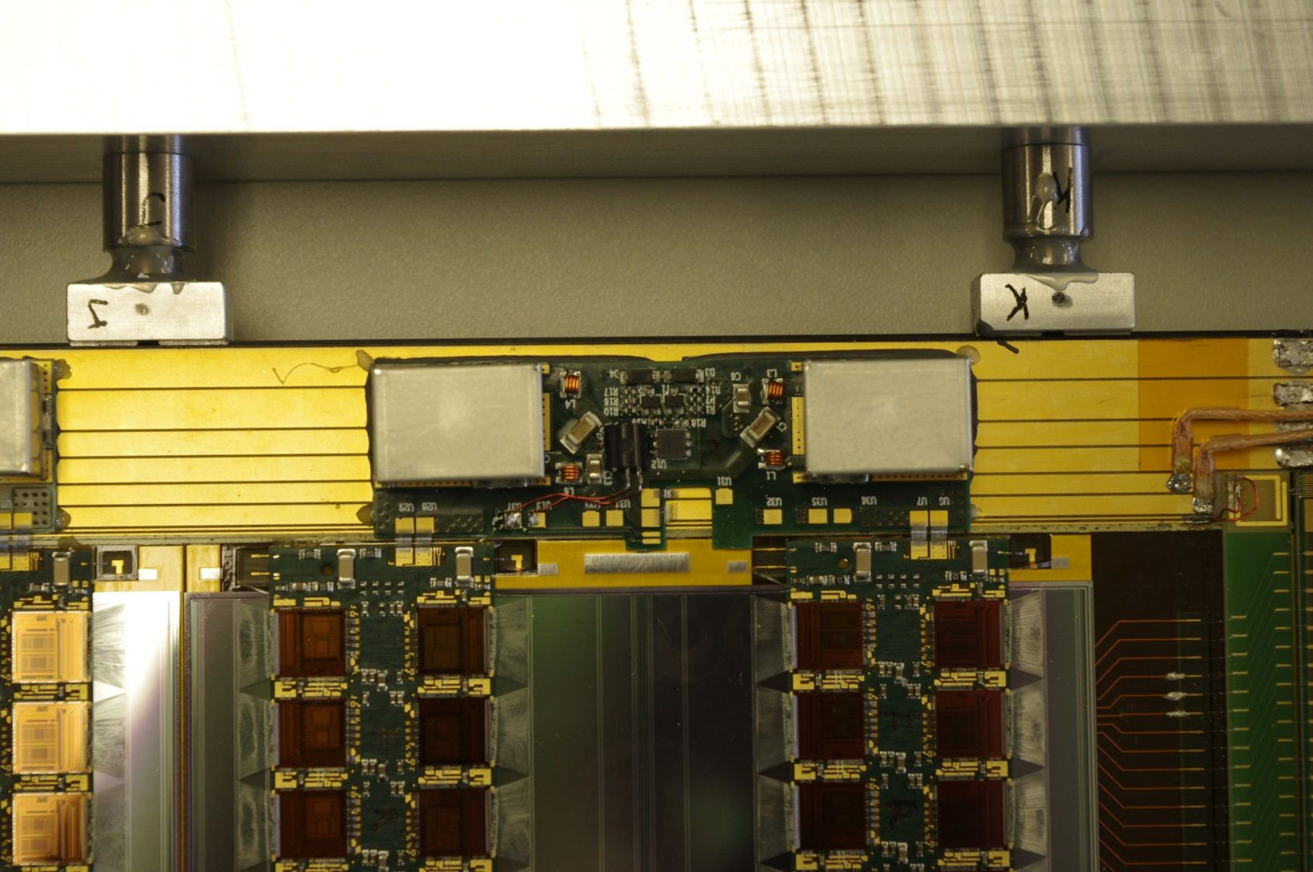
Stave 250 DC-DC
12 module stave side
  Fully loaded and working
“Tandem” DC-DC converter
  Design by CERN group
  Two converters in one PCB
    Necessary due to current demand of 250nm chipset
  LTC3605 chip
“one wire” control
  DS2413 chip
Power bus split into 4 segments
  Each drives 4 modules
Tandem DC-DC on Stave 250

Slide 20
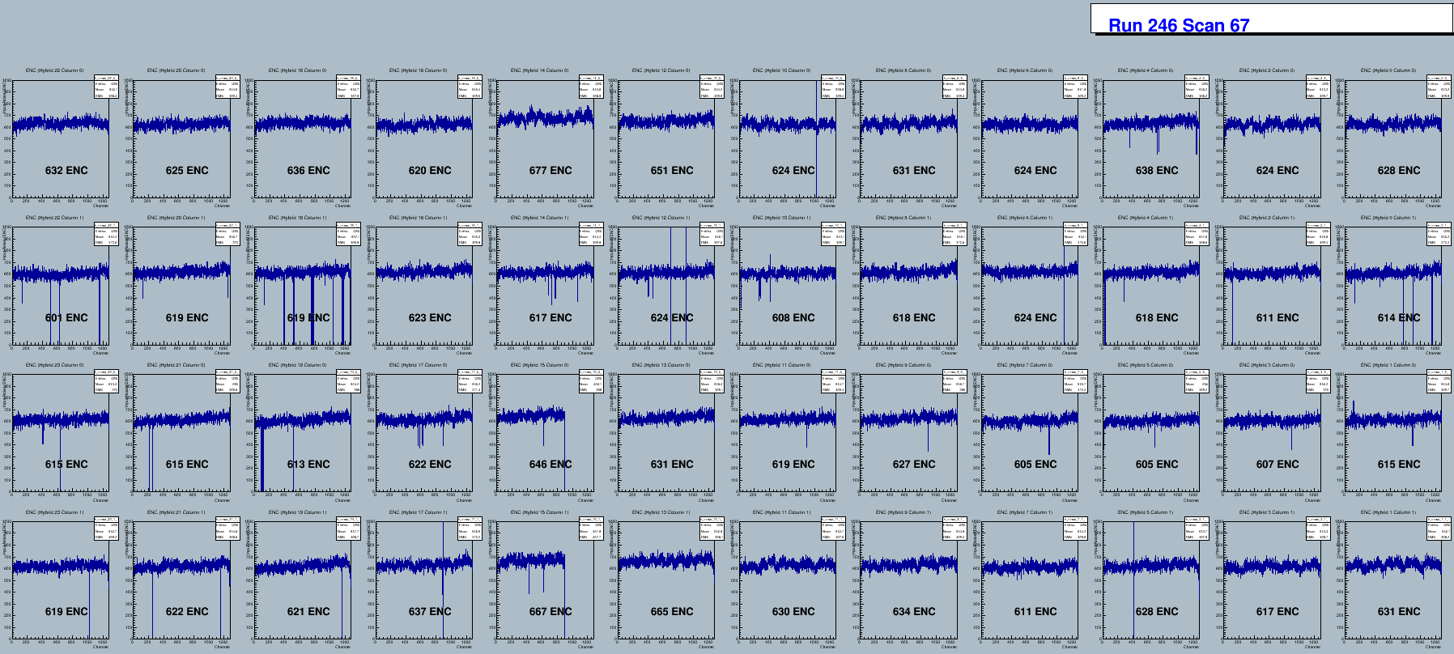
Stave 250 DC-DC ENC Results
Input Noise
  Inner Columns 600 – 646 ENC, Outer Columns in range 610 – 677 ENC
Double Trigger Noise Occupancy (not shown)
  clean at 0.75fC Low occupancy at 0.50fC due to bad channels

Slide 21
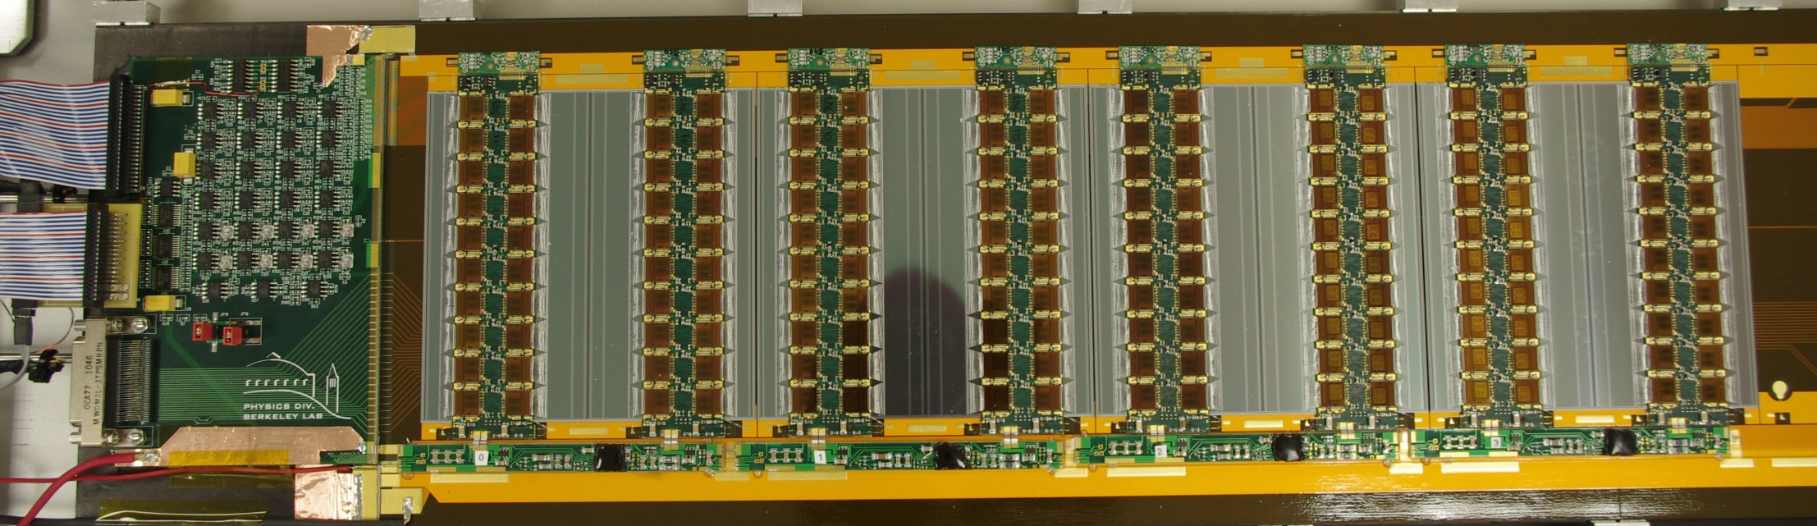
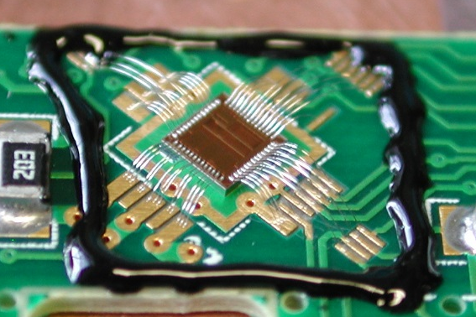
Stave 250 SPP
0V
2.5V
5.0V
7.5V
10V
Uses the Serial Power & Protection (SPP) ASIC
  shunt regulation
  bypass (under DCS control)
  over voltage protection
Still work in progress
  Presently 4 (of 12) modules on the stave
  Testing and optimisation continue
SPP chip

Slide 22
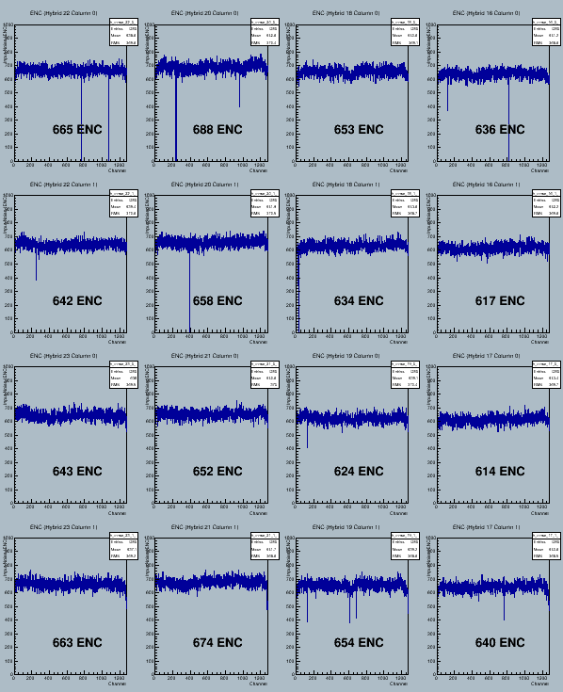
Stave 250 SPP ENC Results
Basics working, but latest ENC result is slightly higher than for Stave 250 DC-DC
  Optimisation continues
PRELIMINARY

Slide 23
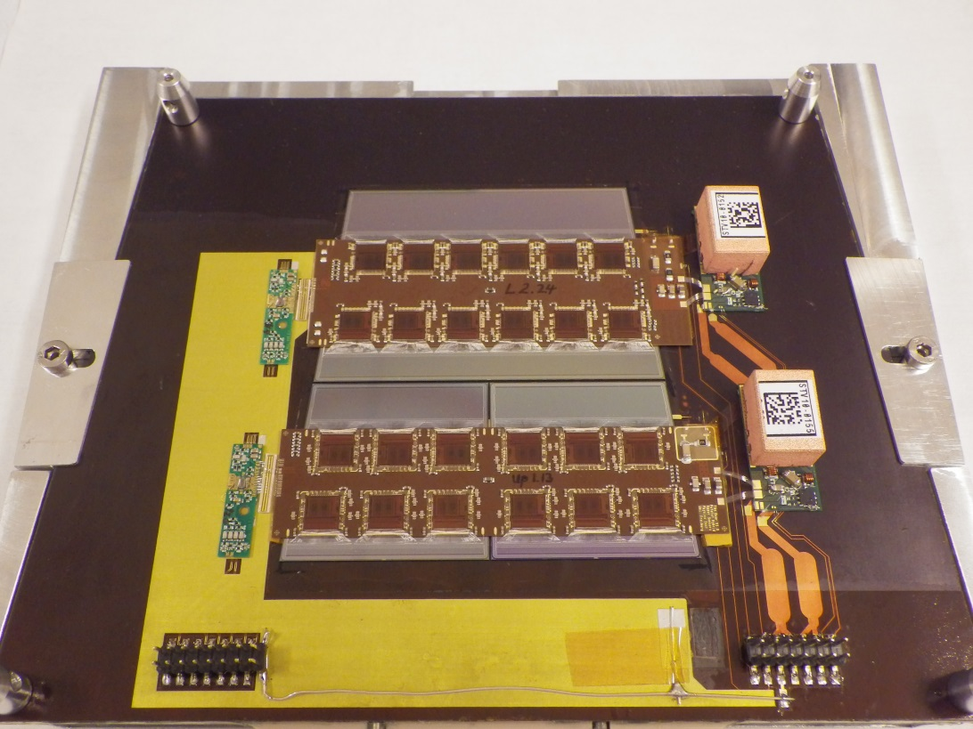
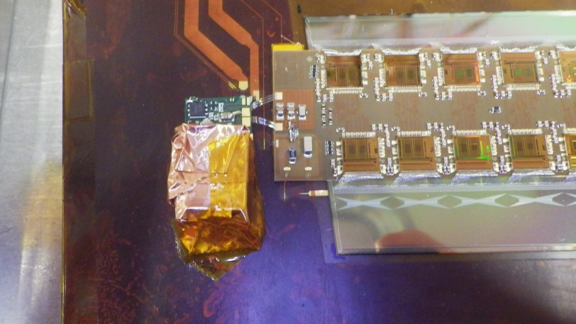
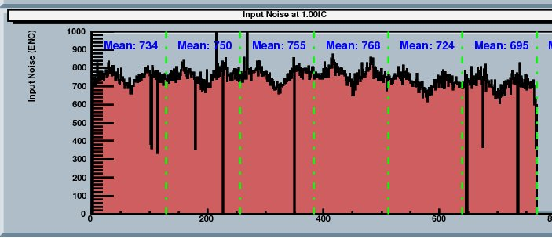
First Petalet Results
Additional Shielding around and under converter found necessary for best noise performance.
Reasons to be confirmed. Possibilities include:
  STV10 uses non-blind vias: signals may couple into CF skin and hence sensor backplane (no shield under sensor as for DC-DC staves)
  HV bonds in close proximity to gap between shield and PCB
Investigations continue
Meanwhile noise approaching expectation
  Characteristic shape related to integrated fanins on the sensors
PRELIMINARY

Slide 24
Summary
130nm chipset
HCC submission expected May
Good results from ABC130
  Results from half module in near future
Smaller DC-DC converter made and under test
  Works well but height will be a critical parameter
Programme in place to identify radiation hard HV switch transistors
  Awaiting full results from most recent irradiations
250nm chipset
12 module DC-DC powered stave
  good noise performance throughout
12 module serially powered stave
  Under construction, basics working for 4 modules
First “Petalets” assembled and under test
  Require additional shielding of DC-DC due to layout differences

