Slide 1
LHCb Upgrade
Electronics Status & Outlook
on behalf of the LHCb collaboration

Slide 2
Outline
Upgrade philosophy
Electronics Architecture
Review of electronics R&D

Slide 3
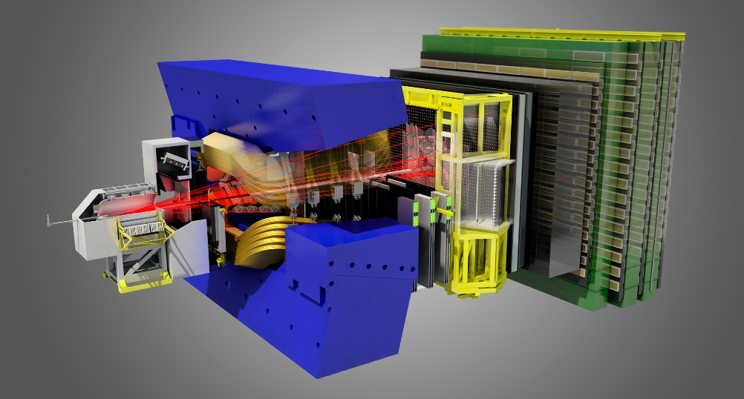
LHCb today
‘Inner’ Tracker
Si strips
Outer Tracker
Straws Tubes
Muon
MWPC
VeLo
Si strips
~ 3 fb⁻¹ collected before LS1
RICH
HPDs
Calo
PMTs

Slide 4
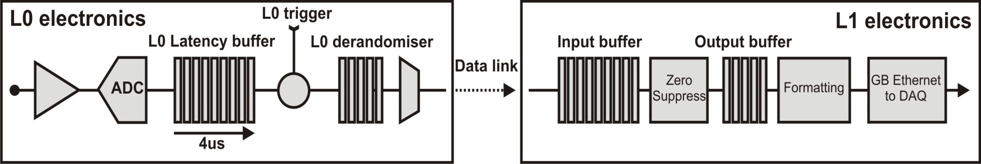

Existing readout system
Bunch crossing rate | 40 MHz *
L0 trigger rate | 1 MHz average
L0 trigger latency | 4 μs fixed (160 BXs)
Event readout time | 900 ns
Event rate to DAQ | 1 MHz
Readout Supervisor
L0 Hardware Trigger
Muons
Calorimeter
HLT
1MHz
event
rate

Slide 5
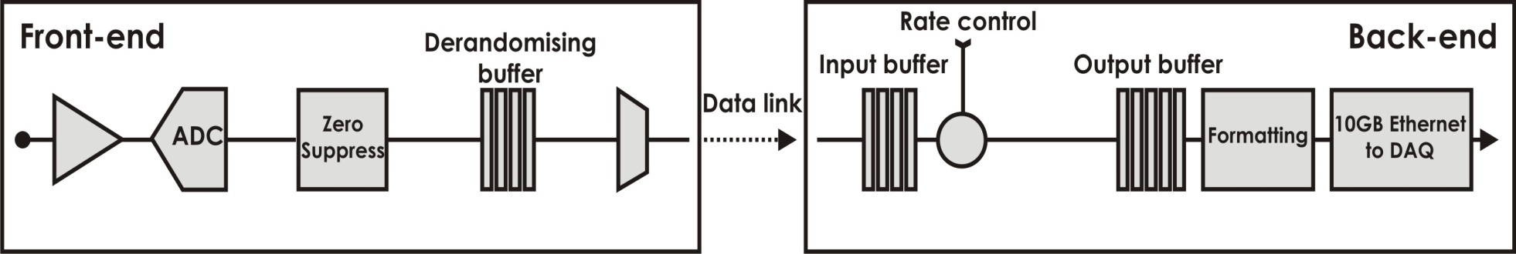
Upgrade architecture
No ‘front-end’ trigger, Event rate to DAQ nominally 40 MHz
Current
Readout Supervisor
L0 Hardware Trigger
HLT
1MHz
event
rate
Upgrade
Readout Supervisor
Low-level Trigger
HLT++
Low-level Trigger
50 Tb/s
40MHz
event
rate
Ken Wyllie, CERN
5

Slide 6
Can we do it?
……. actually, can we afford it?
Trends in high speed optical data transmission
1Gbit/s 10Gbit/s 40Gbit/s
….. and strong programme for rad-tolerance
….. and trends in embedded links in FPGAs
Upgrade installation in LS2

Slide 7
Architectural choices
Data compression on front-end driven by cost:
no compression ~ 80,000 links (4.8 Gb/s) 20 MCHF
compression ~ 12,500 links (cf 8,000 today) 3.1 MCHF
NB: Compression (zero-suppression) currently done in off-detector FPGAs:
careful balance of complexity vs robustness
needed a few iterations get it right !
=> Aim for flexibility + scale-ability in upgrade

Slide 8
Architectural choices
New compact link offers combined Data, TFC, ECS
TFC
TFC
On
detector
DOWN 4.8 Gb/s
Off detector
ECS
ECS
UP 4.8 Gb/s
Data
Data
Need UP bandwidth >> DOWN bandwidth
=> Combine TFC+ECS; Separate Data
TFC
TFC
On detector
4.8 Gb/s
Off detector
ECS
ECS
4.8 Gb/s
Off detector
Data
Data
4.8 Gb/s

Slide 9
LHCb tomorrow
Upstream Tracker
Si strips
Downstream Tracker
Sci-Fibres
Muon
MWPC
VeLo
Si pixels
RICH
MAPMTs
Calo
PMTs

Slide 10

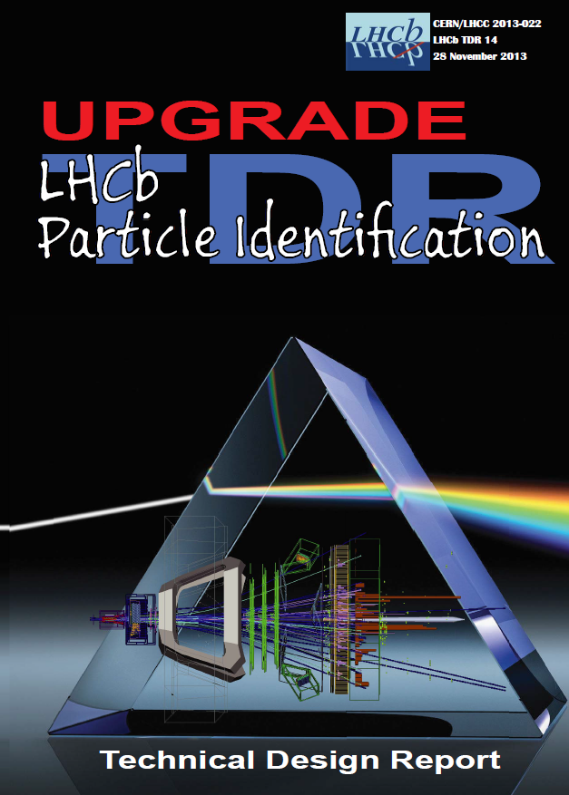
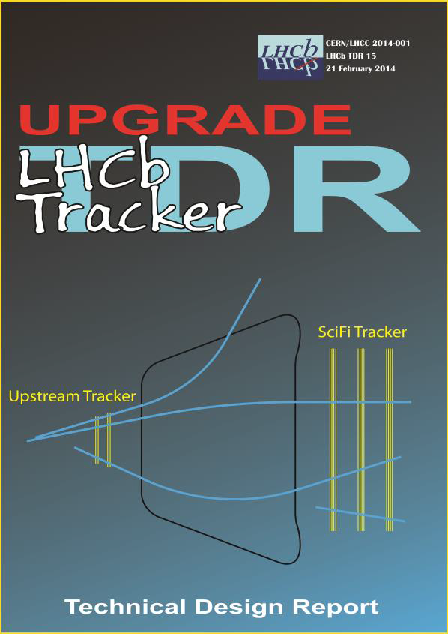

Slide 11
Review of electronics R&D
(non-exhaustive)

Slide 12
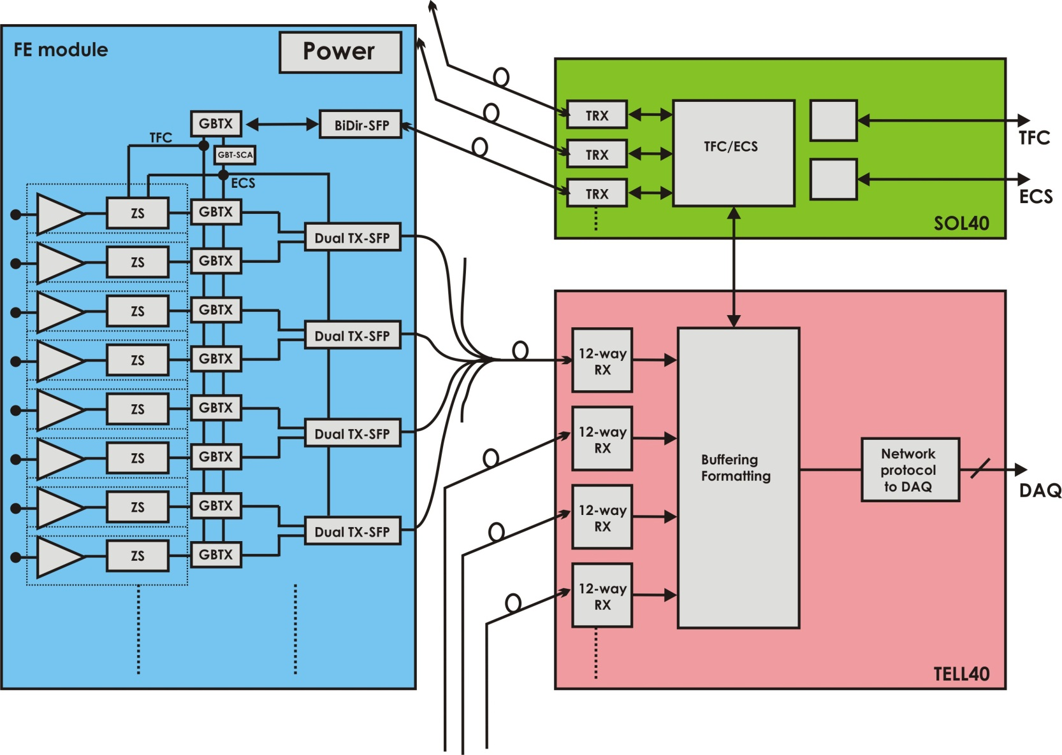
Generic Implementation
Common Electronics

Slide 13
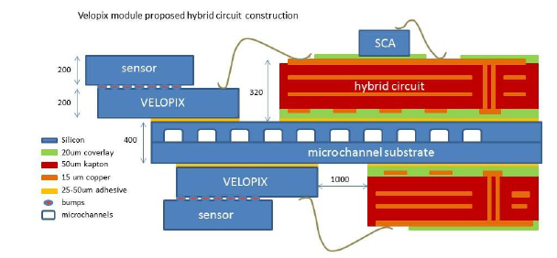
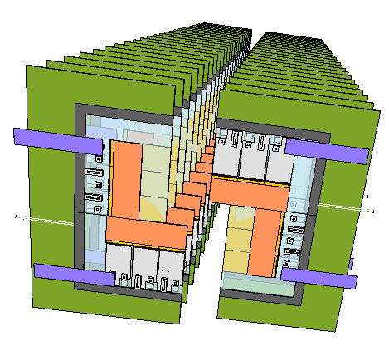
VeLo (Si pixels)
26 planes of sensor tiles
5.1mm to beam
FE Electronics in VeloPIX chip:
55 μm pixels, 256 x 256 array
130 nm CMOS
Binary readout
Development of TimePIX3

Slide 14
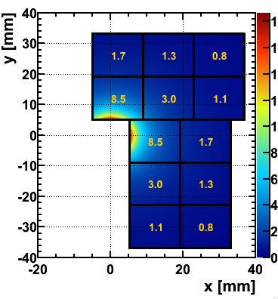
VeloPIX data rate
Matrix = 128 x 64 super-pixels
# tracks per 25ns
Data packet
110um
SP addr 13b
Timestamp 9b
Hitmap 8b
3
7
2
Super
Pixel
core
6
220um
1
5
Hottest chip:
16 Gbit/s of data
0
4
Analog FE
Four serialisers per chip @ 5.12 Gbit/s

Slide 15
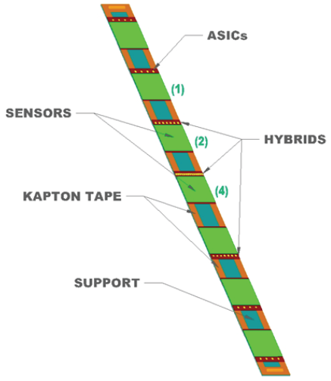
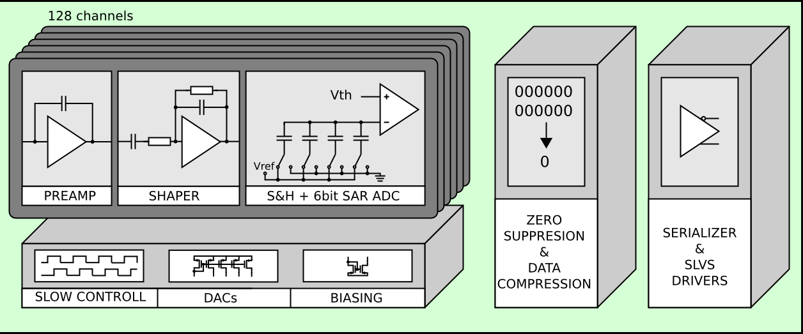
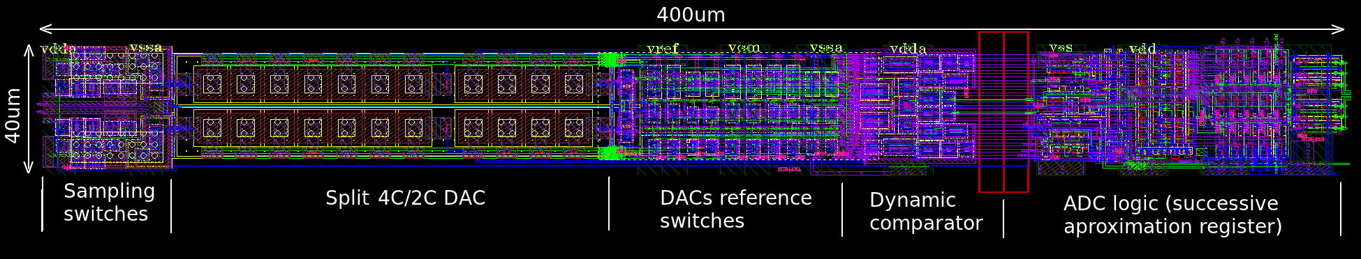
Upstream Tracker (Si strips)
4 planes of 16 staves
SALT chip in 130nm CMOS
1.3m
Prototype 6-bit SAR, 0.35 mW @ 40 MS/s

Slide 16
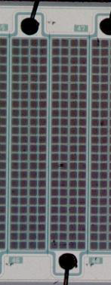
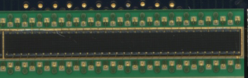
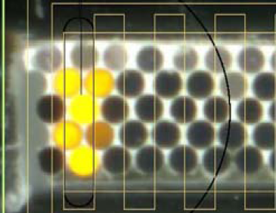
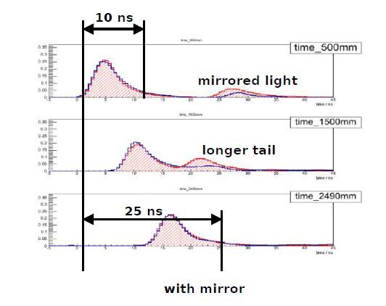
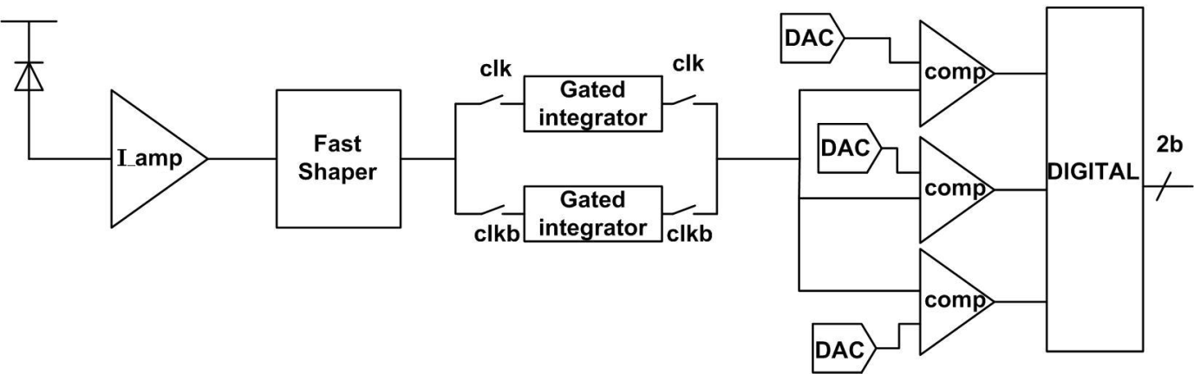
SciFi Tracker (SiPMs)
Mats of 2.5m, 250μm fibres
SiPM array
PACIFIC chip in 130nm CMOS
Digital processing in FPGA (SRAM or FLASH)
Signals arriving at SiPM
top
middle
bottom
128 channels

Slide 17
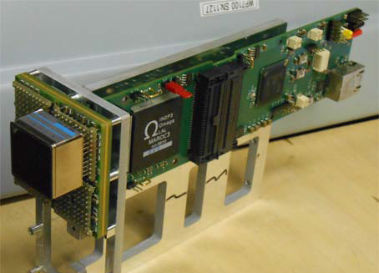
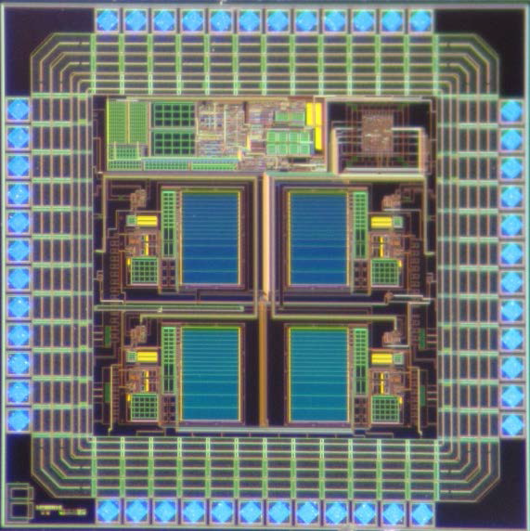
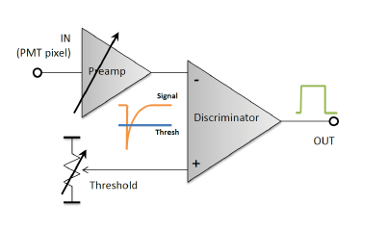
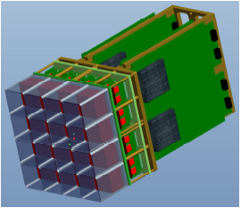
RICH (MAPMTs)
4,500 64-channel PMTs
CLARO chip in 0.35 μm
FPGA for digital processing (SRAM)
Low occ. regions => Zero Suppression
High occ. regions => no Zero Suppression

Slide 18
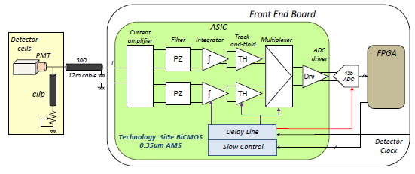
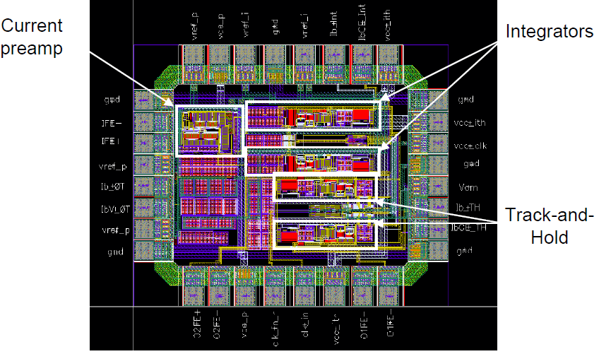
Calorimeter (PMTs)
8000 PMTs
ICECAL chip in 0.35 μm
FPGA for digital processing (FLASH)

Slide 19
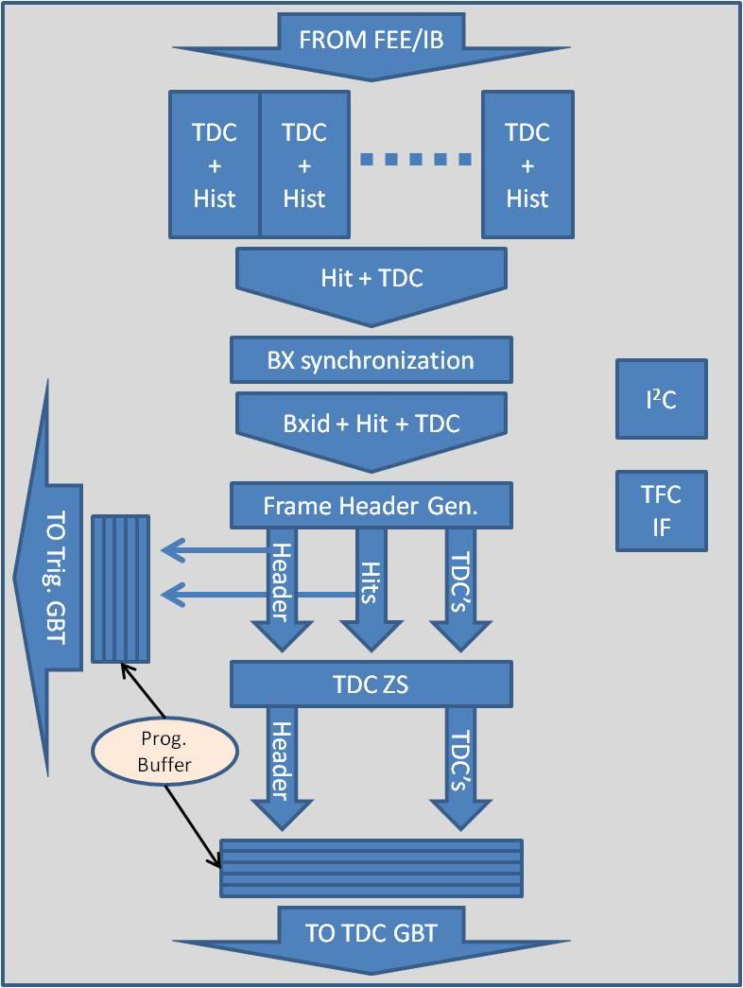
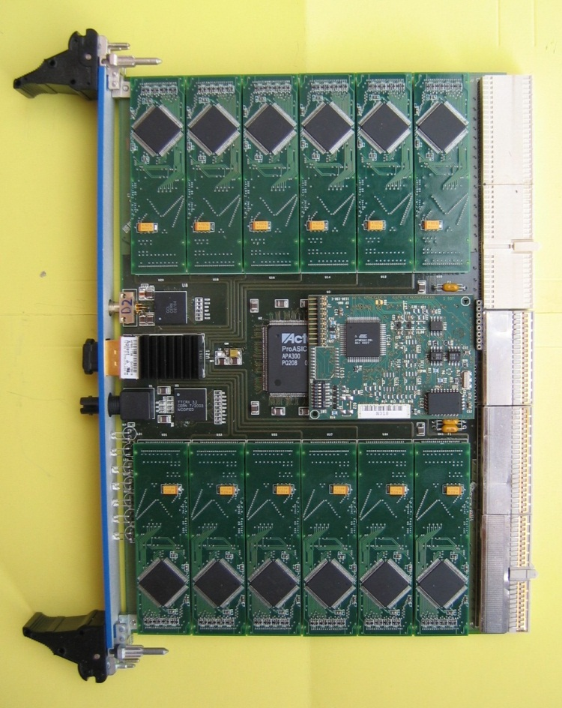
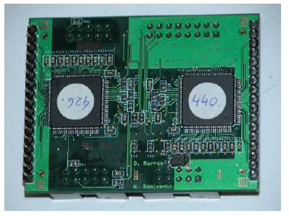
Muons (MWPCs)
Re-use front-end ASICs on chambers (CARIOCA + DIALOG)
New ‘Off-detector’ cards with new chip nSYNC

Slide 20

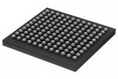
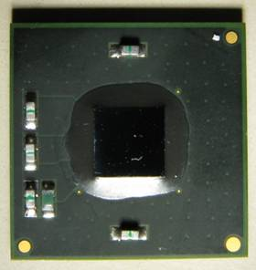
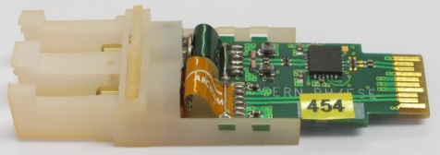
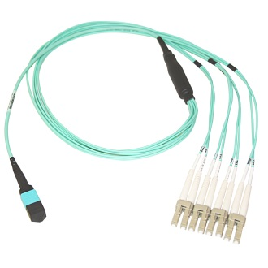
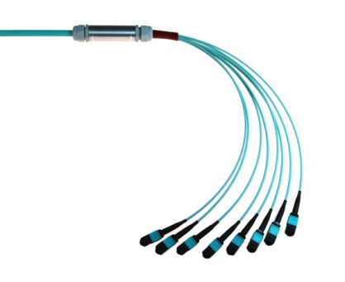
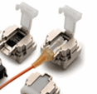
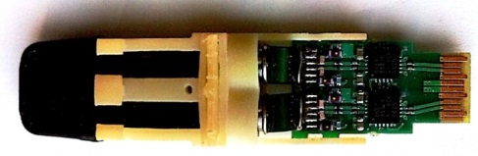
Detector Links, optical: 4.8 Gbit/s
Generic Link: GBT chips + Versatile Link + commercial components
Duplex Master Control Link (2,500)
GBT-
SCA
GBTX
VTRx
GBLD+VCSEL
GBTIA+PIN-diode
LC - MPO
MPO - MPO
miniPOD
config
TFC
FrontEnd
data
Simplex Data Link (12,500)
VTTx
GBLD+VCSEL
GBLD+VCSEL

Slide 21
Common ‘readout’ board
GOAL: Generic FPGA-based hardware for many tasks:
TELL40 for Data
SOL40 for ECS/TFC
TRIG40 for LLT
each with different firmware flavours
1st developments focussed on ATCA + AMC
R&D close to completion
Small production made for lab systems

Slide 22
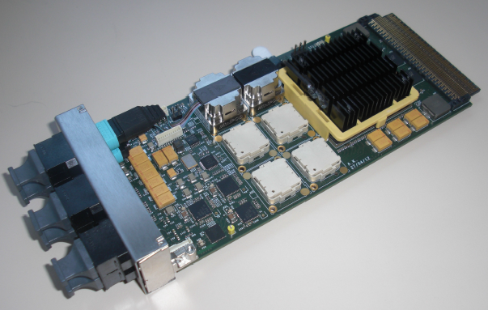
AMC40

Slide 23
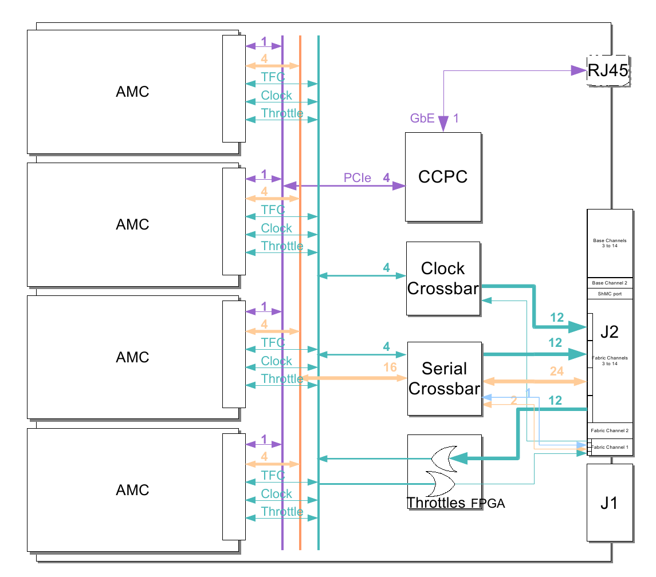
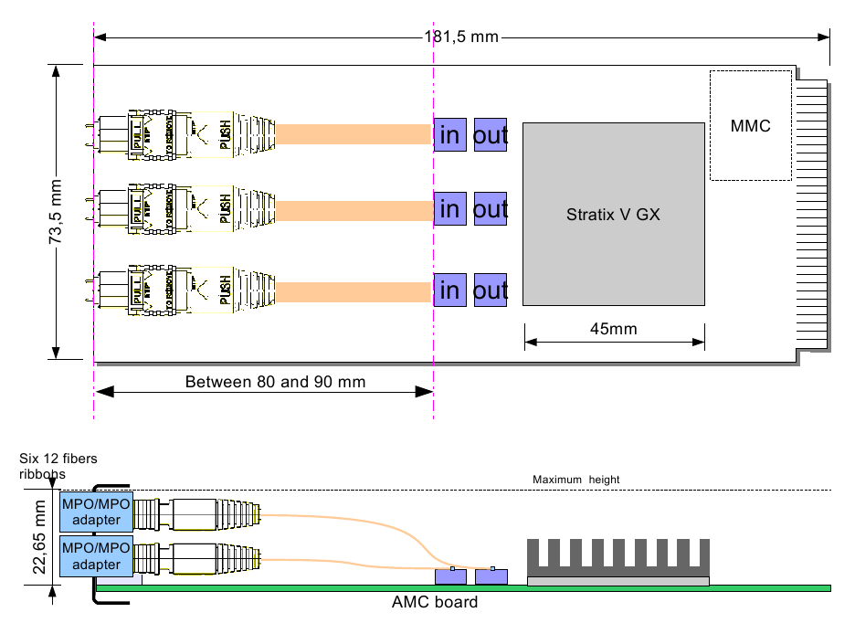
Example: TELL40
24 inputs
@ 4.8 Gb
GBT format
12 outputs/
inputs
@ 10Gb
ethernet
AMC
96 inputs @ 4.8 Gb processing in FPGA 48 10G ethernet ports

Slide 24
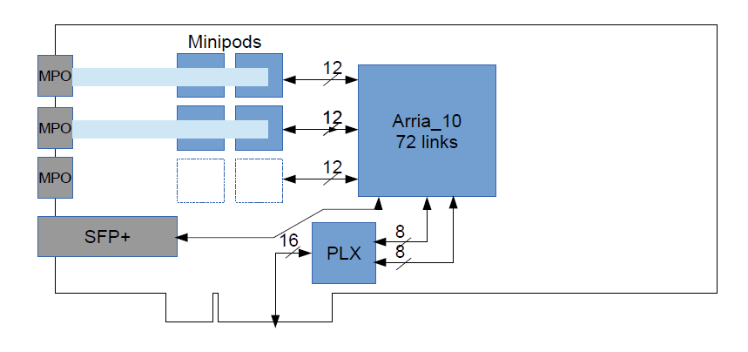
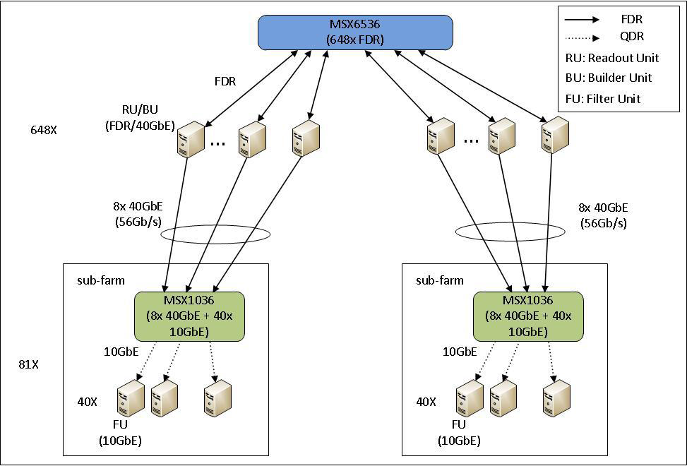
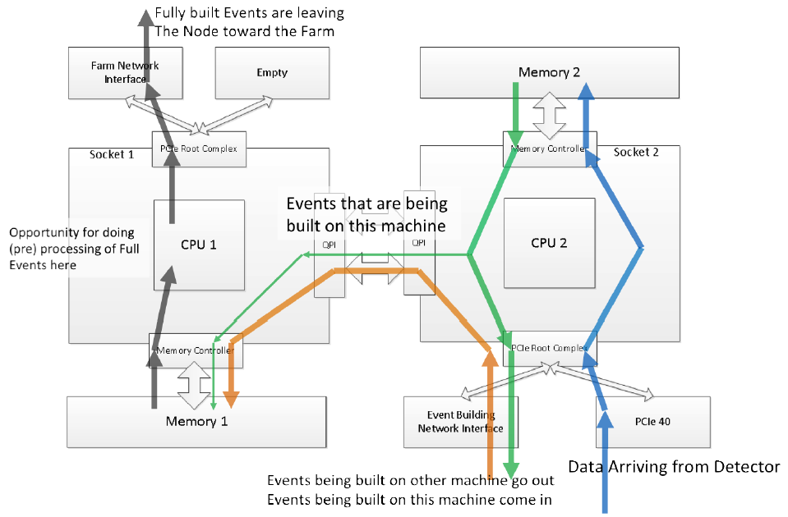
Move to PCIe ?
Use PC memory & processors for event building
Choose network interface at last moment (cheapest)
Event Builder Network Switch
FE data
Switch
Switch

Slide 25
TELL40 firmware
Project across many groups
Centrally coordinated
Common interfaces
User code for data processing

Slide 26

Long distance transmission?
FE
FE
4.8 Gbit/s
10/40 Gbit/s
Ethernet or Infiniband
100 Gbit/s
Ethernet or Infiniband
TELL40s
300 m
DAQ network
TELL40s
DAQ network
100 m rock
Compute Units
Compute Units

Slide 27
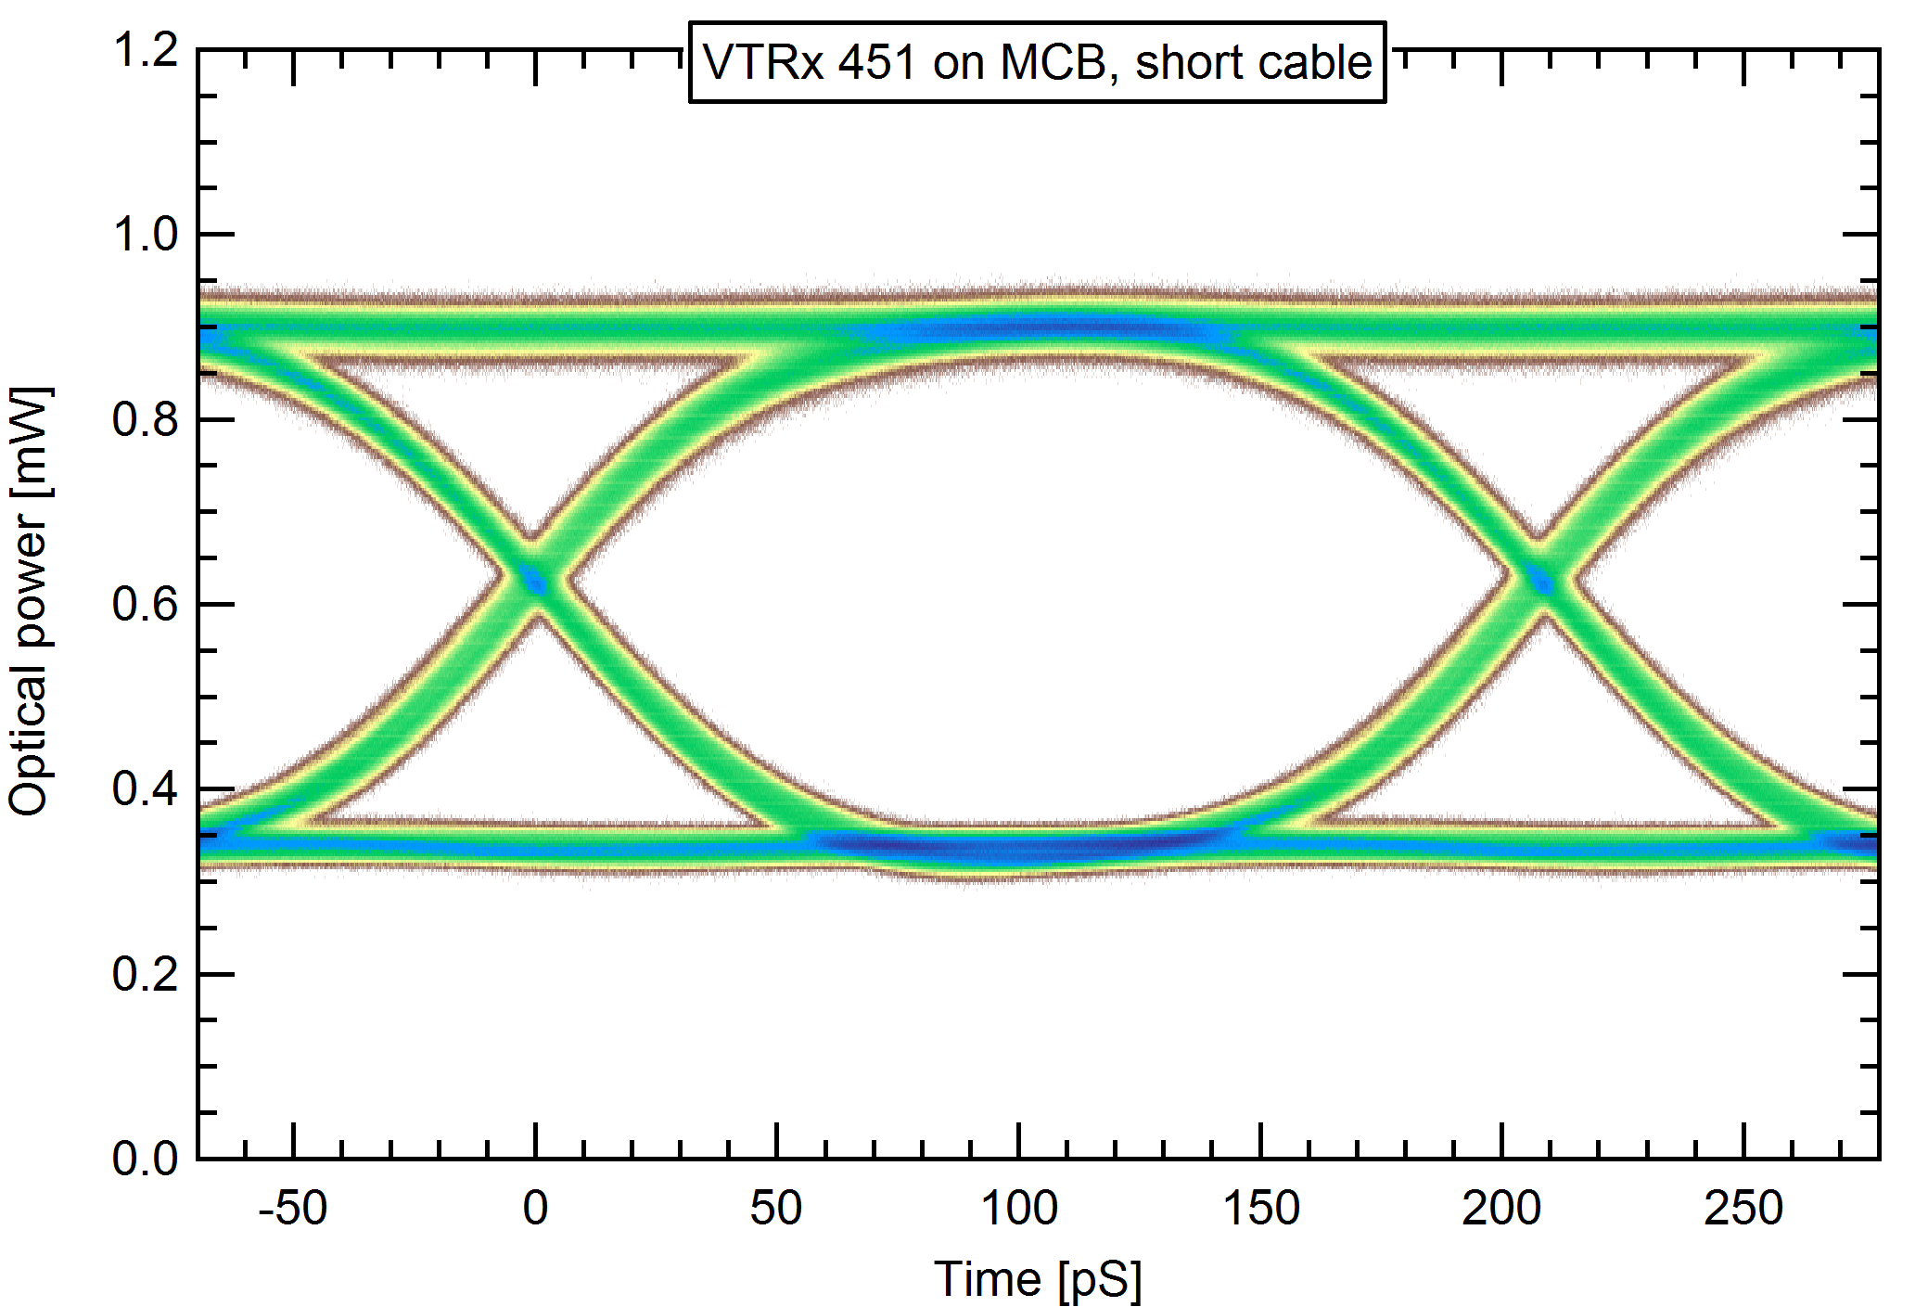
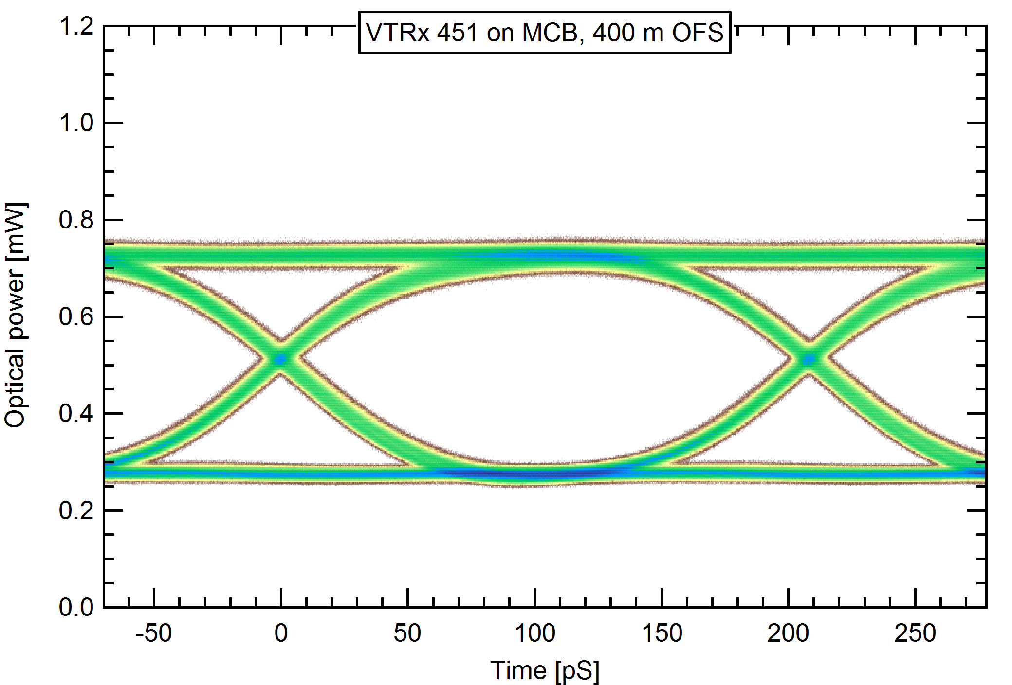
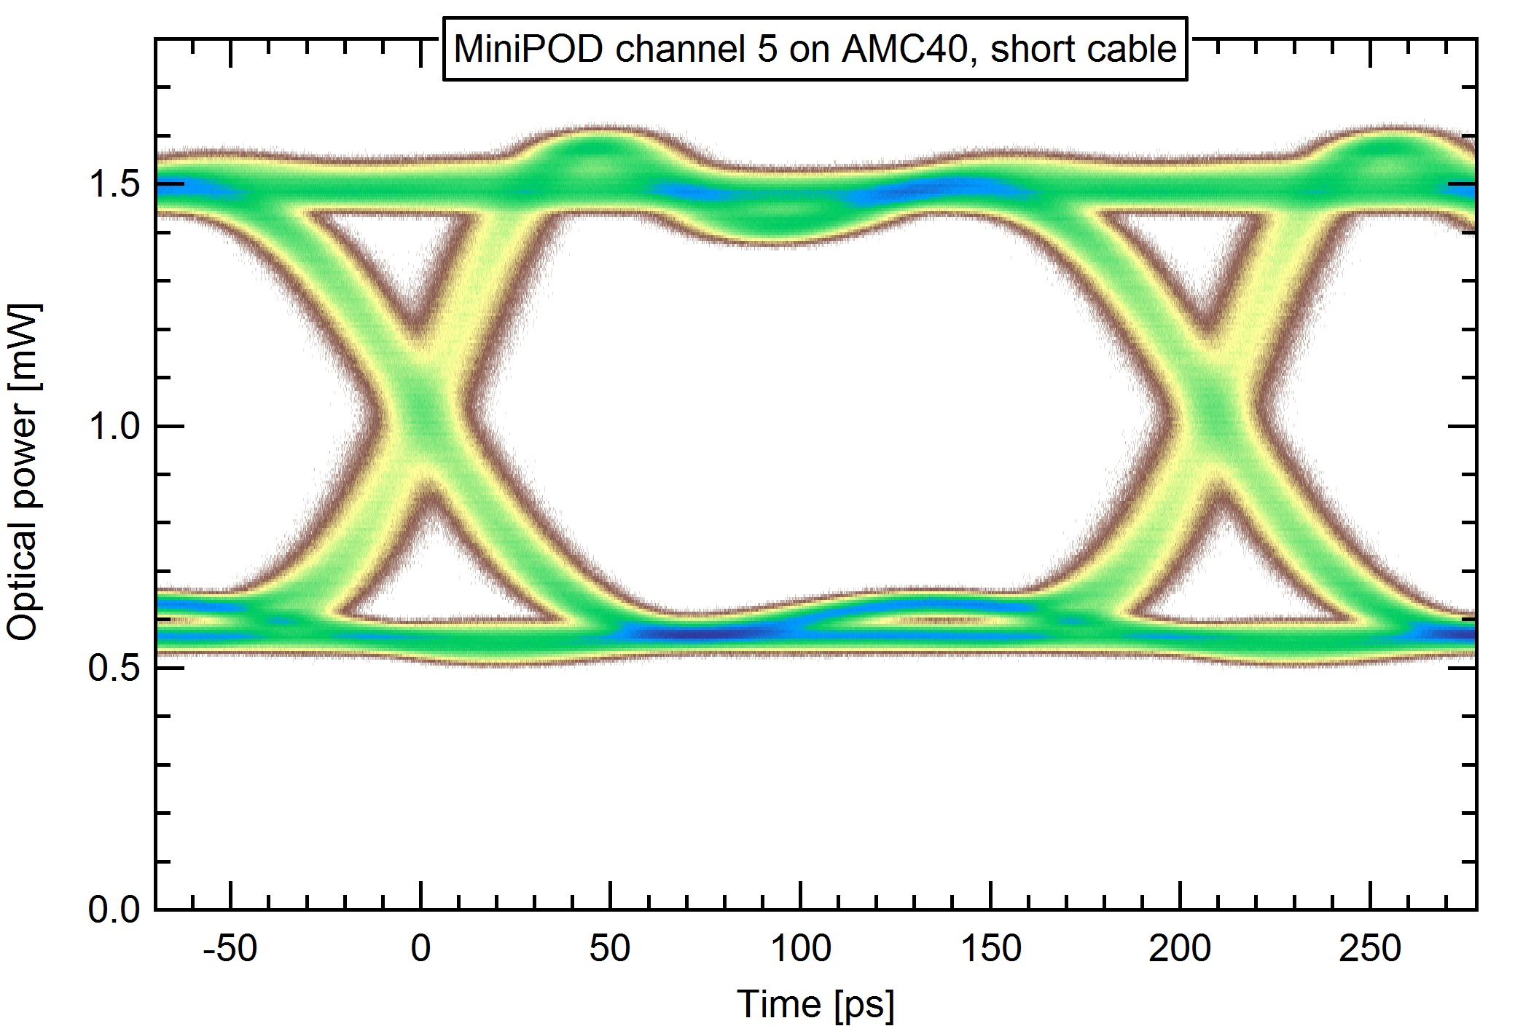
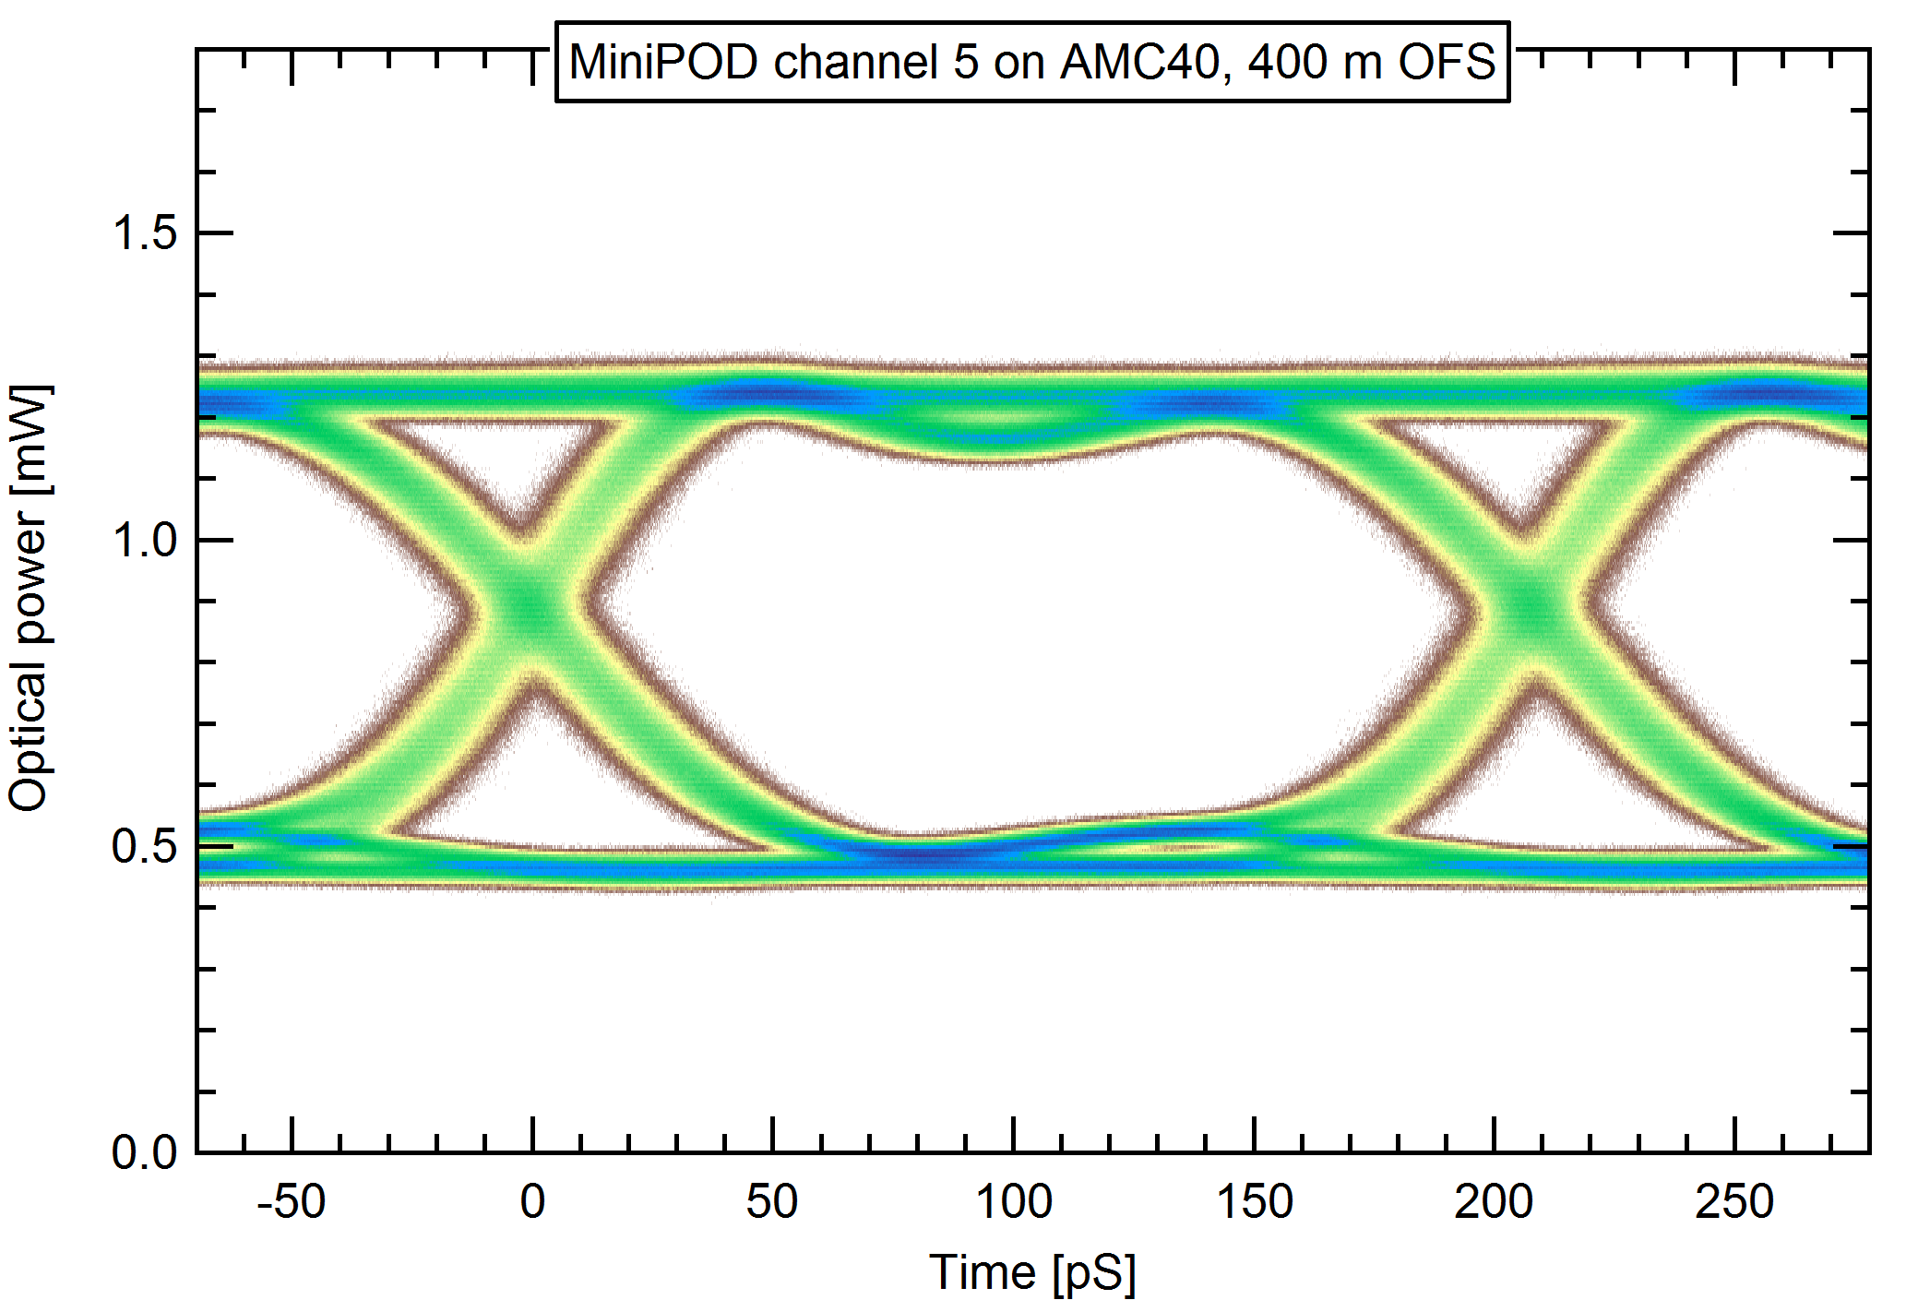
Long distance transmission?
Short fibre
400m OM4 fibre

Slide 28
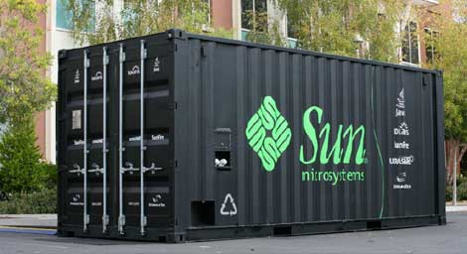
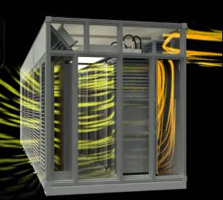

All data in a box
sponsored by . . . ?

Slide 29
Conclusions & Outlook
Clear architecture concept
with many common items
R&D for sub-detectors is moving well
We rely on new generic developments
(GBT, Versatile Link, DC-DC)
Manpower is improving
Aggressive but feasible schedule…….
Shift of LS2 helps!

Slide 30
Motivation for upgrade
At L = 2(+) x 10³² cm⁻²s⁻¹,
beyond 5 fb⁻¹, statistics don’t improve much
Big statistical improvement if:
  increase L to 2 x 10³³, AND
  improve efficiency of trigger algorithms
BUT ..... with current L0 trigger:
rate & latency limited by electronics
(1 MHz, 4 μs) => saturation

Slide 31
BUT…. efficient trigger decisions require:
  long latencies (>> 4 μs)
  computational power
  data from many (all) sub-detectors
  (momentum, impact parameter .....)
      Trigger in software
Use data from every bunch crossing
Upgrade electronics + DAQ for LS2

Slide 32
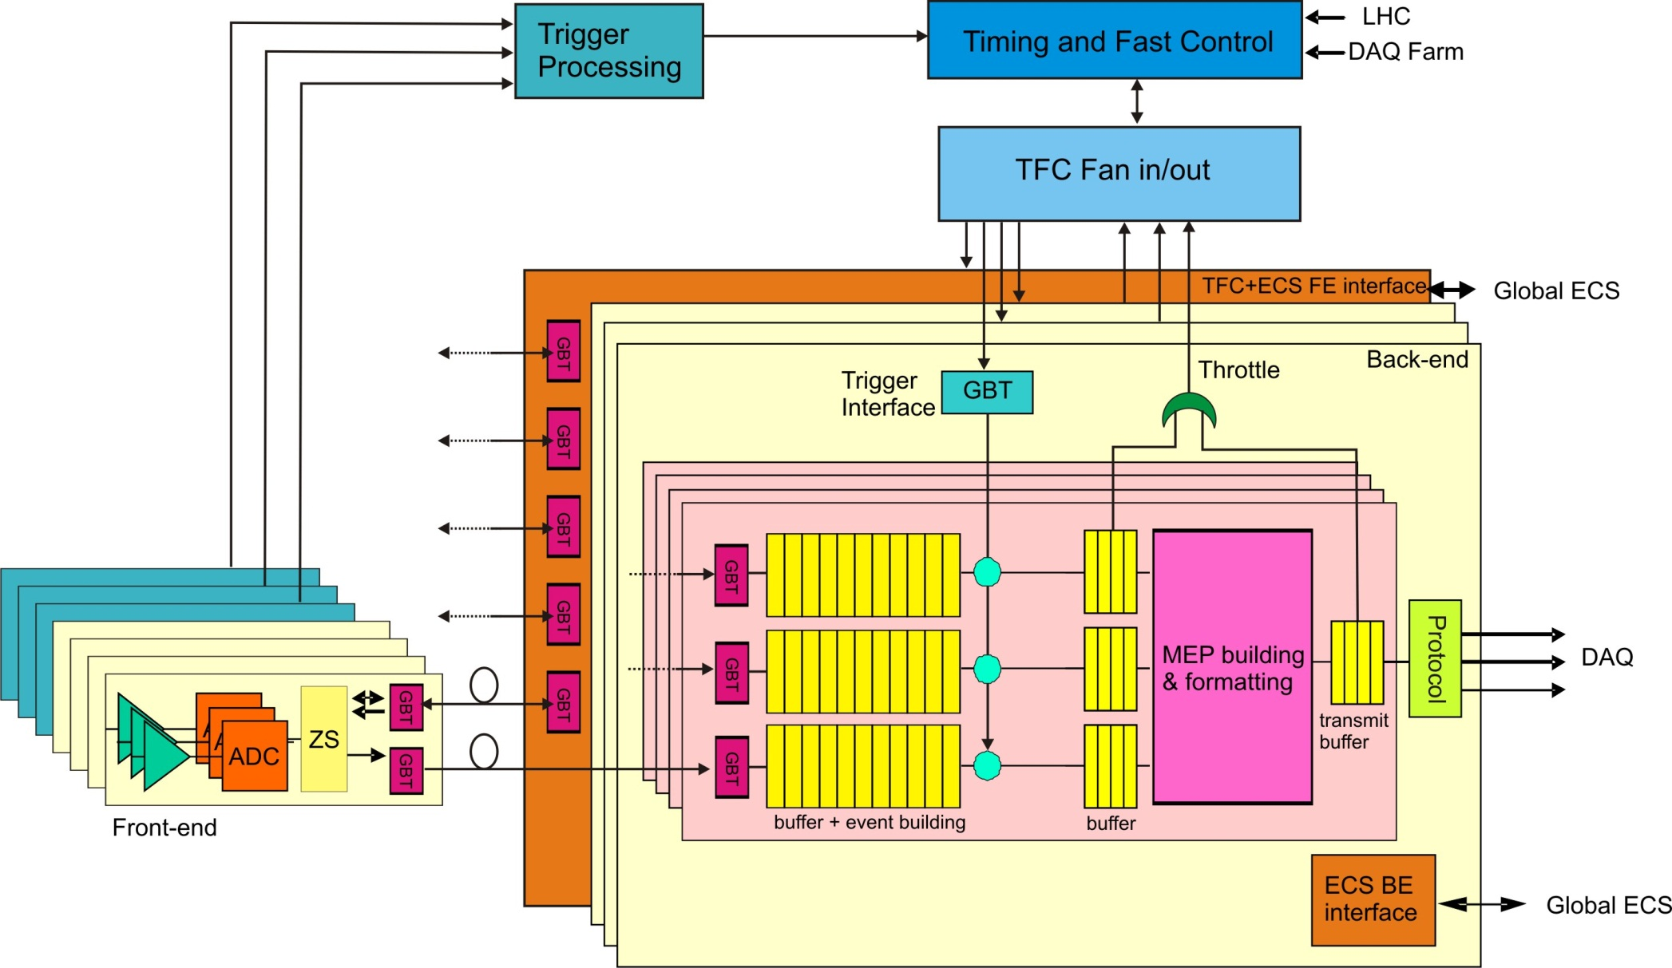
Architecture: more detail
Global
Experimental
Control
System (ECS)
LLT

Slide 33
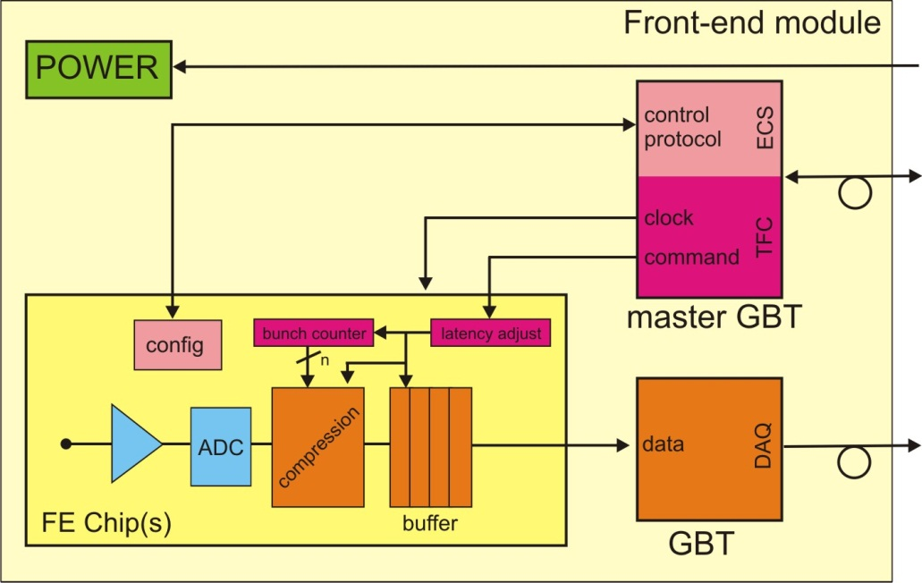
Architecture: more detail

Slide 34
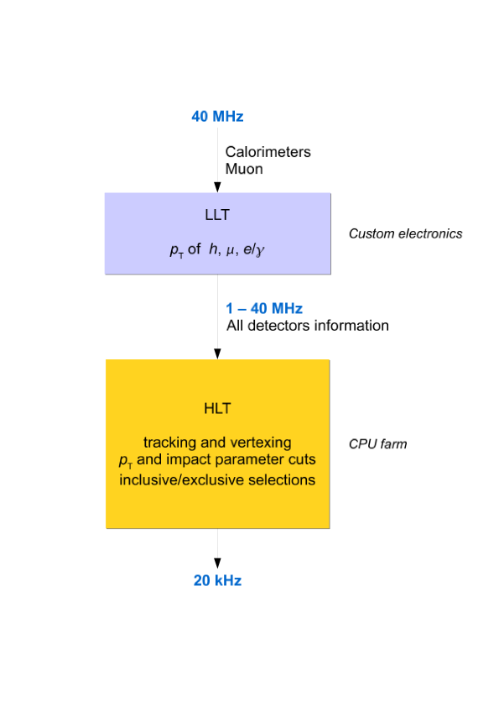
Triggering doesn’t completely disappear
Hardware
Software

Slide 35
Control & Synchronisation
Control with synchronised fast commands
eg bunch-counter reset
Detector
TFC
Master
‘Super
ODIN’
RUN Control
A
Latency A
B
Latency B
C
Latency C
Latencies will be measured => pre-scaling of commands by S-ODIN
Absolute measurement with: pulsed laser
cosmics
low intensity LHC beam collisions

Slide 36
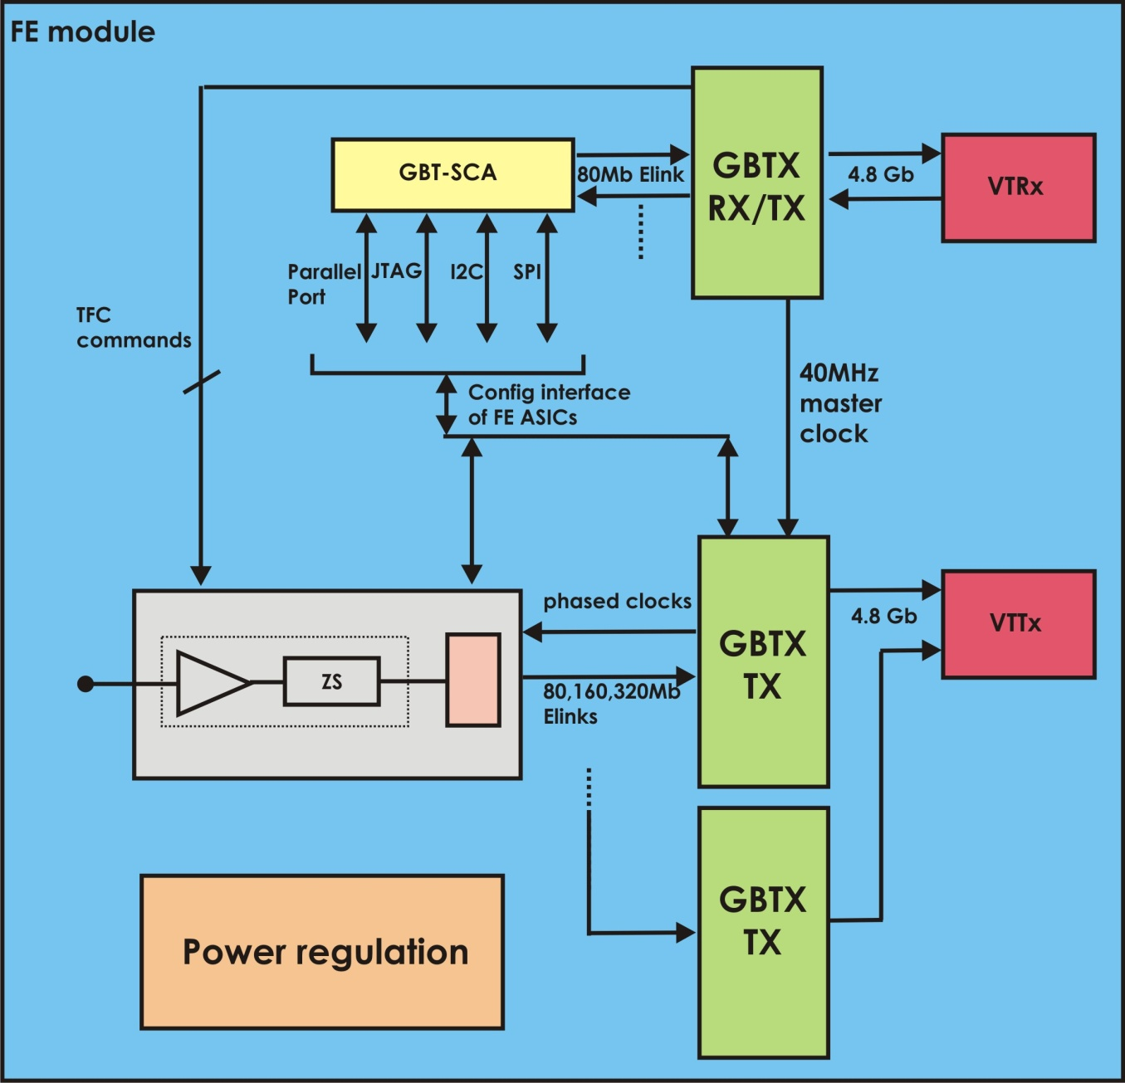
100% robust
Can allow a small rate of
errors
BUT
No loss of synch

