Slide 1
The ATLAS
New Small Wheel Trigger
Lorne Levinson
For the ATLAS NSW collaboration
ACES workshop, 19 March 2014
Thanks to my NSW colleagues for many slides

Slide 2
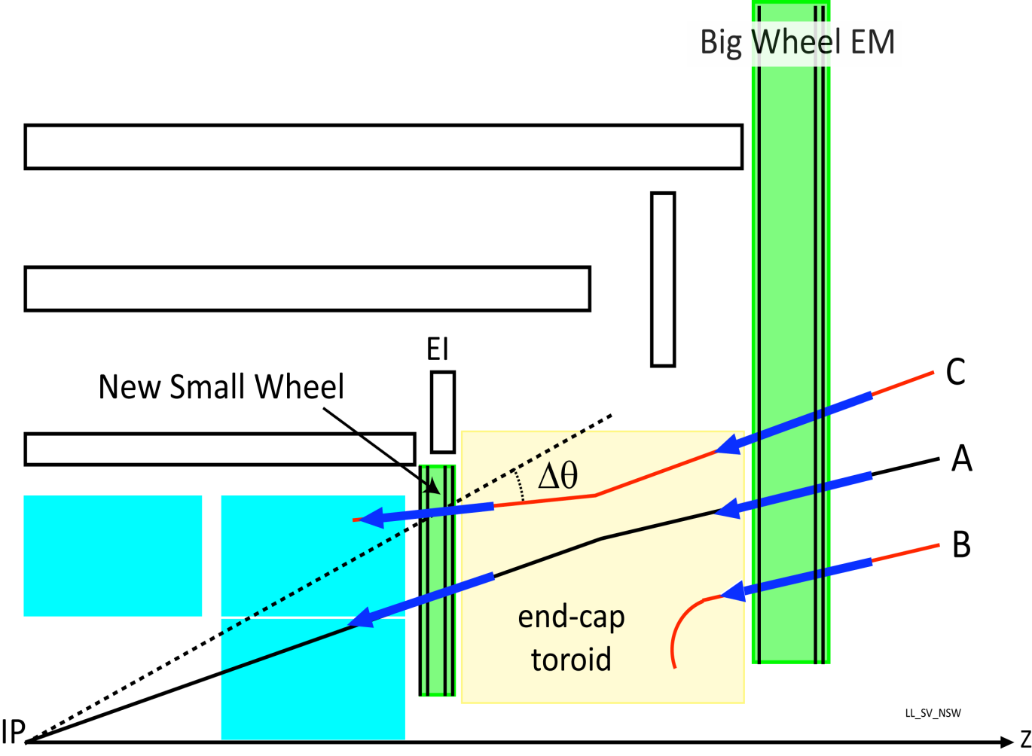
NSW trigger concept
Increased Phase I backgrounds, but must maintain existing trigger rate
Filter “Big Wheel” muon candidates to remove tracks that are not from the IP
Only track “A” should be a trigger candidate.
Challenge is latency: 500nsec for electronics + 500ns fibres to be in time for Big Wheel
Micromegas: 2M strips, 0.5mm
sTGC: 280K strips (3.2mm), 45K pads, 28K wires
sTGC, MM find candidates
independently,
list merged for Sector Logic
Hit per layer:
  sTGC:
  hit is centroid of 3-5 strips
  Micromegas:
  hit is address of strip
×

×

Slide 3
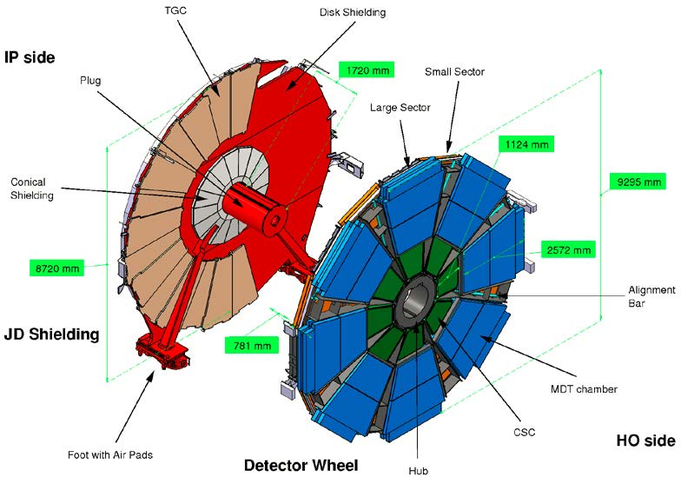
Detector layout
Micro-Mesh Gaseous detectors (Micromegas): primary precision tracker
Space resolution < 100 μm independent of track incidence angle
Good track separation due to small
0.5 mm readout granularity (strips)
Excellent high rate capability due to small gas amplification region and
small space charge effects
sTGCs: primary trigger detector
Bunch ID with good timing resolution
– additional suppression of fakes
Good space resolution providing track vectors with < 1 mrad angular resolution
Based on proven TGC technology;
Pads & strips, instead of only strips
as in current detector
9.3m
Present Small Wheel – defines basic layout and envelopes
16 detector layers in total
2 technologies, MicroMegas and sTGC

Slide 4
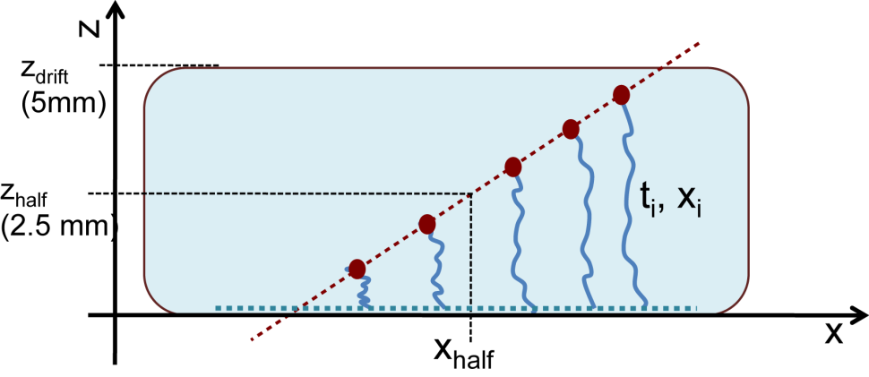
Front end outputs for trigger path
sTGC strips: one output per channel
6-bit flash ADC of peak; serial output at 160Mb/s
Centroid of 3 to 5 3.2mm strips gives track coordinate in a layer
sTGC pads: one output per channel
10nsec pulse at peak, or use leading edge of Time-over-Threshold
Coincidence in 8-layer tower of pads chooses which strips to transfer to centroid finder
Micromegas: one output per 64-channel chip
Address in Real Time (ART) of first (in time) strip hit in the BC per chip
Address of 0.5mm strip gives track coordinate
“μTPC” mode
See preceding talk on the VMM Front-end ASIC
by Gianluigi de Geronimo

Slide 5
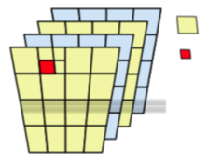
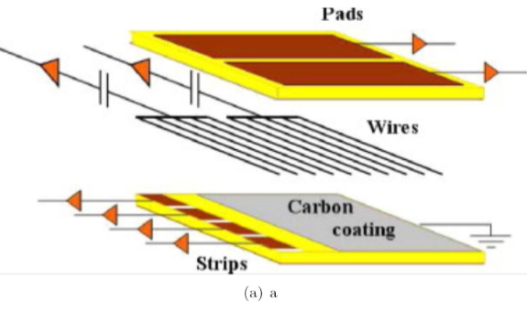
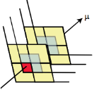
sTGC trigger scheme
1/16th sector
On Rim of NSW
FPGAs
USA 15
sTGC
Trigger Processor
Pad Trigger
Router
sTCG
sTCG
sTCG
sTCG
sTCG
Pad
TDS
Problem: no BW to read all strips
sTCG
sTCG
Pad
VMM
sTCG
Pad trigger uses pad tower coincidence to choose ONLY the relevant band of strips.
Physical pads staggered by ½ pad in both directions
Logical pad-tower defined by projecting from 8 layer of staggered pad boundaries
Pad-tower coincidence =
2 × 3-out-4 overlapping pads
Only one
Strip TDS
chosen
Strip
VMM
Strip
TDS
On-chamber
ASICS
Strip
VMM
Strip
TDS
5

Slide 6
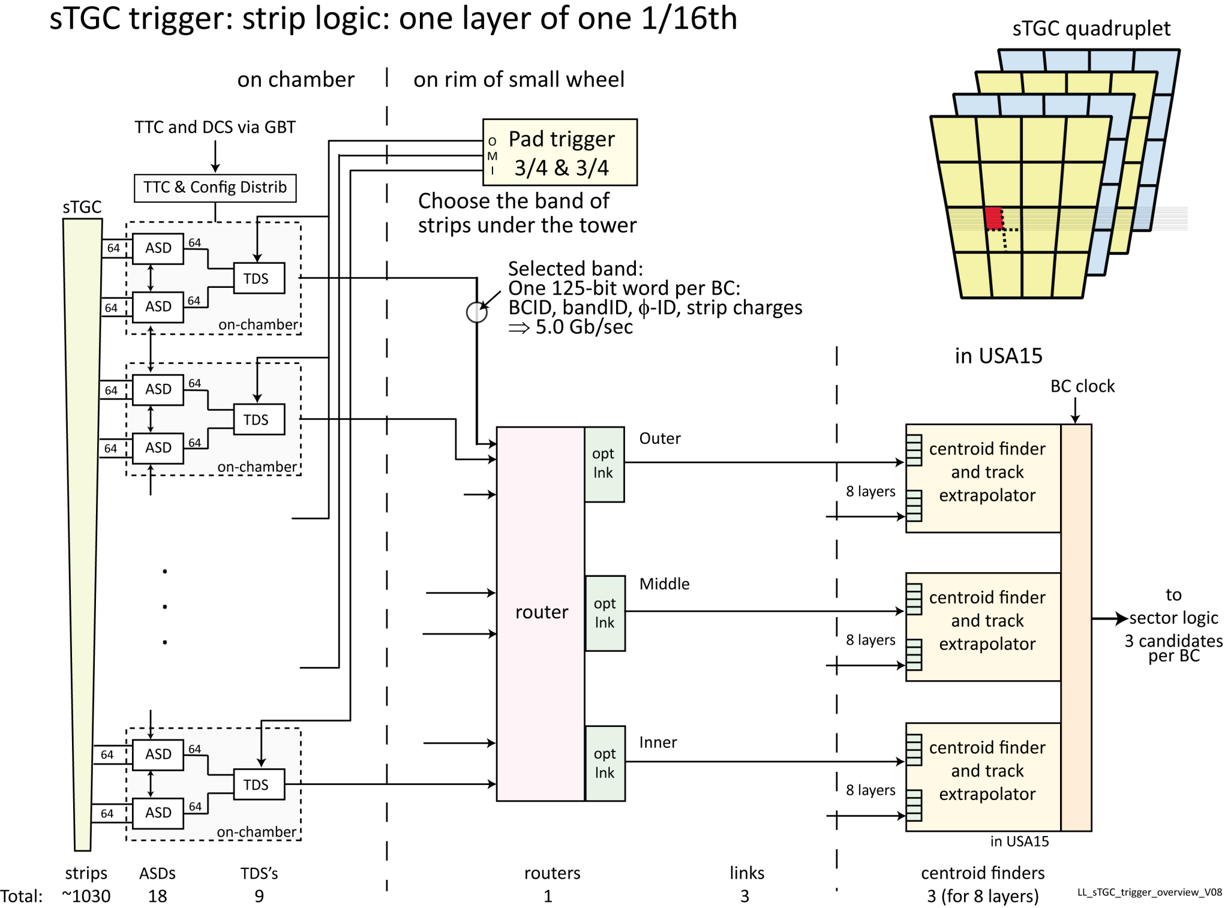

Slide 7
Micromegas trigger scheme
1/16th sector
USA 15
MM
Trigger Processor
sTCG
sTCG
sTCG
sTCG
sTCG
ART
TDS
Each VMMs send address of its first hit in each BC to an ART ASIC.
64 channels = 3.2cm
Use the coordinate of the center of the strip for the slope calculation
ART chooses up to 6 addresses from 32 VMMs to send
Less accurate than sTGC centroid
Simpler architecture
Hope to use GBT for transmission
sTCG
VMM
Strip
sTCG
M
I
c
Rom
egas
VMM
Strip
On-chamber
ASICS
VMM
Strip
7

Slide 8
Strip Trigger Data Serializer ASIC
Prepare strip trigger data to send to centroid finder:
  match pad tower to a band of strips
  serialize the FADC values of the band of strips for transmission to the Router board on the rim
  BCID, as determined by the Pad Trigger, is appended to the data
  ⇒ path to Trigger Processor has fixed latency, but is not sync’ed to BC at every step. Sync’ed to BC only on output to Sector Logic
Rad tol, SEU mitigation, IBM 130nm
Working on the 1st TDS prototype design
Requires 5G serial output over twinax to Router
Submitted Serializer core: ~1mm², 300 mW, 1.5 V, back 28 April

Slide 9
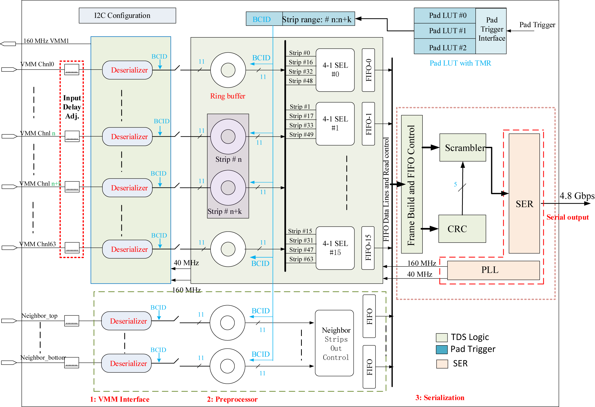
Strip Trigger Data Serializer ASIC

Slide 10
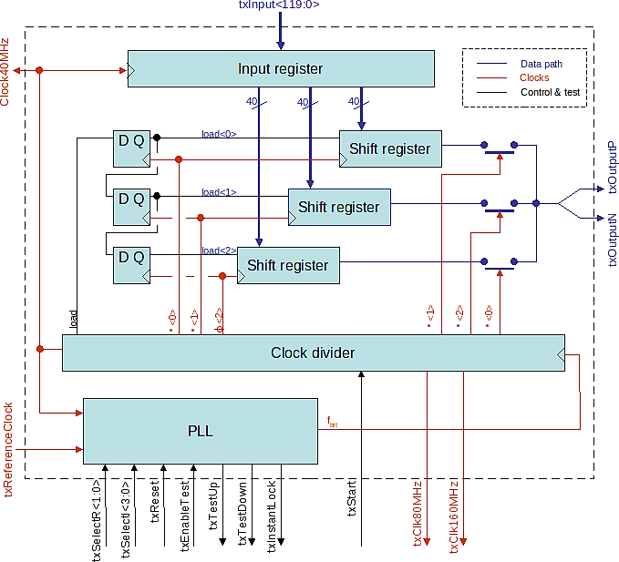
TDS output serializer
Input 30 bits @160 MHz
GBT: 120 bits @40MHz
GBT latency is too long for our trigger path.
Serializer requirements:
Low latency: 70ns TX + RX
Fast serialization speed ( ~5 Gb/s)
Low power consumption
Radiation tolerant
Use the same clock frequency as
used by the logic circuits
Modified the GBT serializer design:
Loading 30 bits at 160 MHz instead of loading 120 bits at 40 MHz
(reduce the overall latency, seamless interface to logic running at 160 MHz)
Convert IBM 8RF LM62 to DM323
(co-production with VMM)
Expect TDS to Router latency: ~65ns
clock

Slide 11
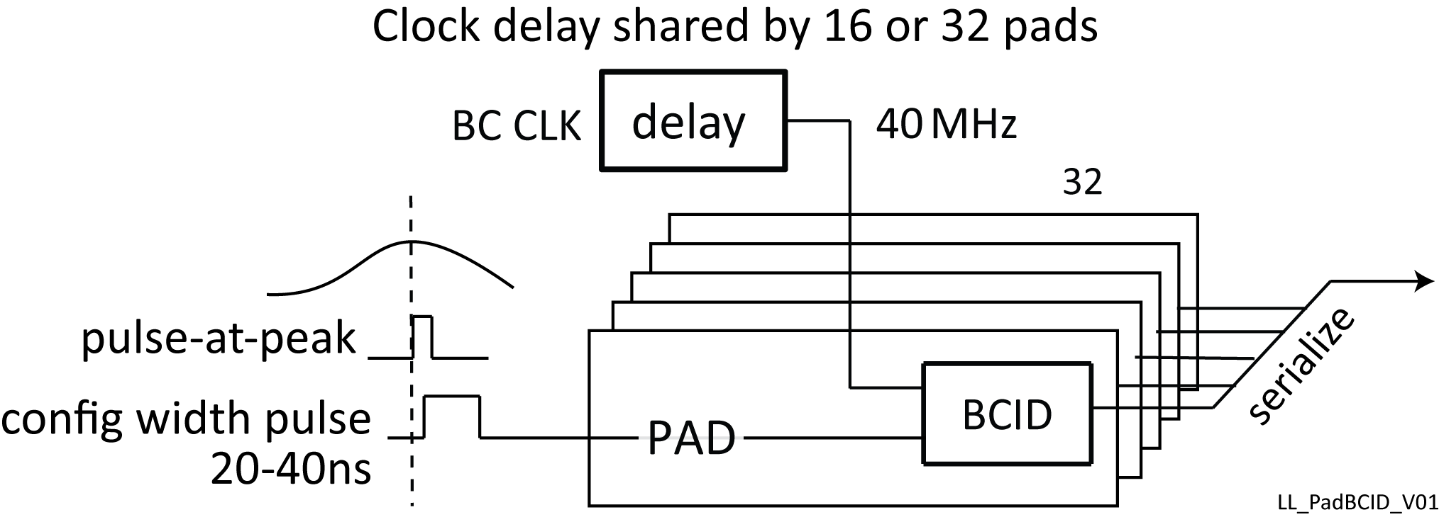
sTGC Pad Trigger Data Serializer ASIC
Assigns each pad signal to a bunch crossing
  1 bit per pad per BC
  Serialize and transmit in 1 BC to Pad Trigger on rim of wheel
Rad tol, SEU mitigation, IBM 130nm
Serialization under discussion:
64 or 96 pads at 5G (using strip serializer), or
32 pads at 1.6G, or 16 pads at 0.8G
Depends on latency, number of deserializers in Pad Trigger FPGA, cables

Slide 12
sTGC Pad trigger
One per 1/16th sector, on rim of wheel
Receives: Pad signals synchronized to BC clock
Builds tower coincidences from 3-out-4 coincidences in the two quads
Identifies which bands of strips should be read out to the centroid logic
  Priority encode bands so there is at most one coincidence per
  Outer/Middle/Inner region
  Send band ID, φ-ID for each of O/M/I region to strip TDS
Provides the BCID tagging of the strip trigger data
FPGA, so it can be programmable, but
On periphery of wheel, but SEU mitigation still required
Readout on Level-1 Accept, but also must report monitoring of non-triggering BCs.
Being prototyped with Xilinx Kintex

Slide 13
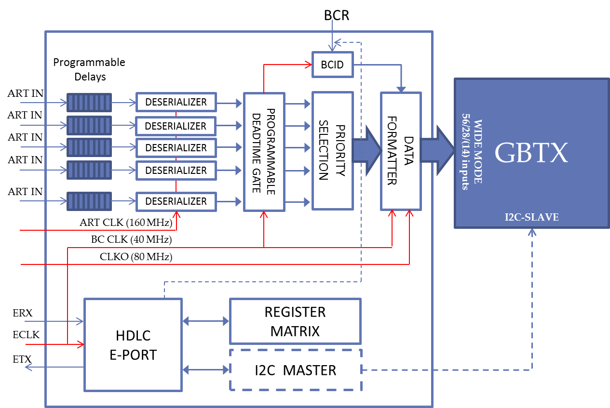
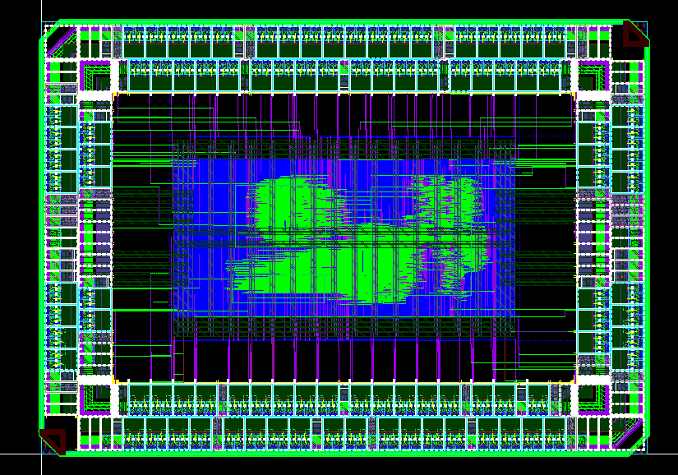
Micromegas trigger “ART” ASIC
32 serial ART inputs from 32 VMM front-end chips
chooses up to 8 hits for transmission to Trigger Processor via GBT
Rad tol, SEU mitigation, IBM 130nm
1st prototype expected end April, 4mm x 2.85 mm
1024 chips:
32 per 1/16th sector
4 per layer

Slide 14
sTGC Router
Routes strip hits from strip TDS to Trigger Processor in USA15
One Router per layer per sector
5G serial inputs from several TDS ASICs
Assumes only one per radial region is actively sending data in each bunch crossing and routes that one to Trigger Processor in USA15
  Up to 3 output fibres per Router to USA15
  Will use Versatile opto-electronics, but not GBTx
Reduces latency by discovering which inputs are active before the whole frame is received and sets up routing for that link (“cut-through routing”)
On periphery of wheel, but SEU mitigation still required
Being prototyped with Xilinx Artix, ?? IGLOO2
Option to 10G output using Multi­‐Rate Transceiver

Slide 15
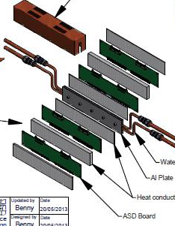
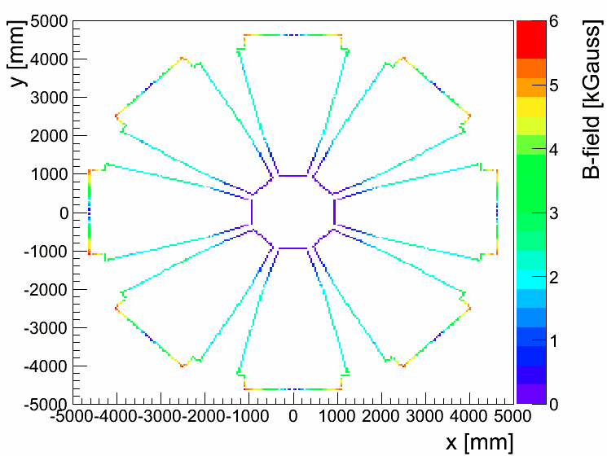
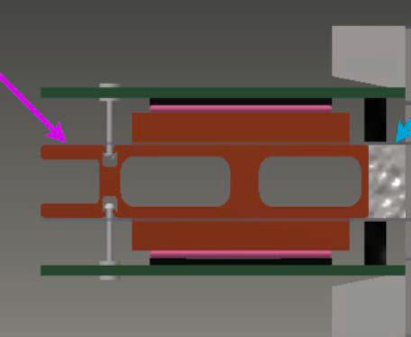
On-chamber power and cooling
2 kW per 1/16th sector ⇒ 64 KW at 1.2V
Active cooling
Point-of-Load DC-DC conversion
24V (or 12V) to 1.5V on front-end boards
Hope for rad-tol, mag-tol COTS DC-DC converters
fall back is the CERN rad-tol POL DC-DC
Can moderate demands on COTS by avoiding extreme areas
Rim:
TID: 9 kRad
NIELS: 2E13/cm²
B: 6 kG
Inner:
TID: 340 kRad
NIELS: 8E14/cm²
B: <1 kG
sTGC
MM
L. Guan Michigan

Slide 16
Optical links
GBT used for readout, TTC, calibration, configuration and MM trigger
GBT latency marginal for Micromegas, unacceptable for sTGC
⇒ custom links for sTGC from on-chamber ASICS to Router (5G twinax)
and Router to USA15 trigger processor (5G or 10G fibre)
Must preserve the redundancy of (16) detector layers
  Perhaps yearly access to periphery
  Extremely difficult to replace front-end boards
No point of failure should disable more than one layer of a sector
  Applies to trigger data sources, TTC distribution, power…
Results in proliferation of optical links: each layer must have a link
⇒ very low link occupancy
  1024 Readout links: 512 bi-dir GBT links each for MM and sTGC
  1024 (MM) + 768 (sTGC) uni-dir trigger links

Slide 17
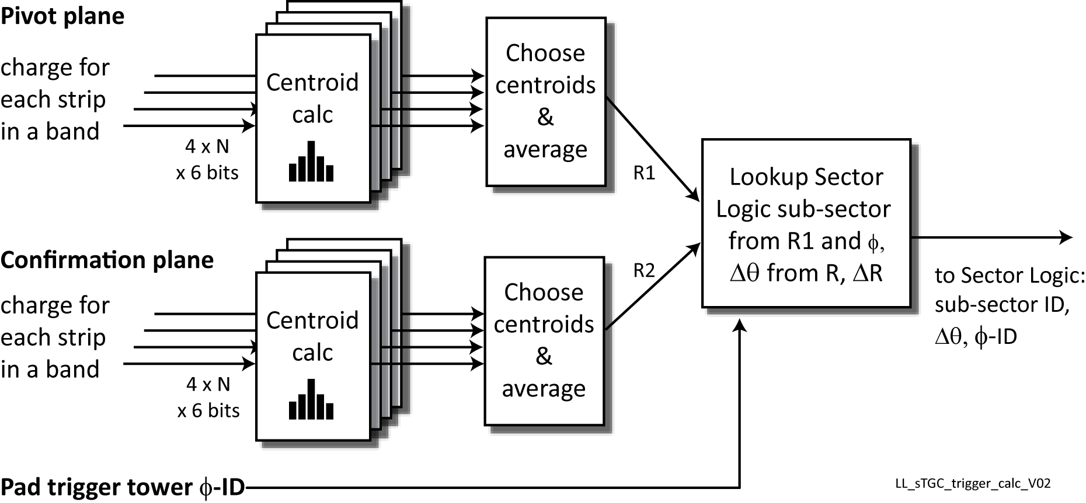
sTGC trigger algorithm
Use average of centroids in each quad to define space points R1 & R2
1, 2, or even 3 of the 4 centroids of a quadruplet are omitted from averaging if:
  δ-ray's: wide (>5 strips)
  Neutrons: large charge or wide
  Noise: single strip
  Pileup, i.e. pulse in a component strip is active before the trigger

Slide 18
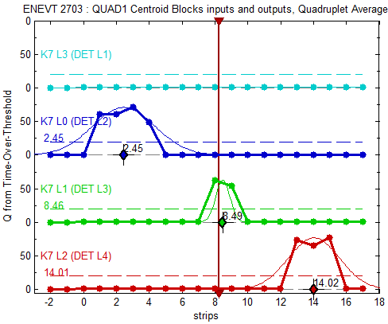
sTGC centroid finder demonstrator
Cosmic ray test of one quadruplet
Trigger demonstrator using Xilinx Virtex-6 evaluation board
Custom mezzanine cards to accept the ToT signals from 8 (16-chan) FE VMMs, 4 strip + 4 pad layers:
  Triggers on 3-out-of-4 pad layers
  Calculates Time-over-Thresholds
  (VMM1 does not have 6-bit FADC)
  Finds 4 centroids
  Selects and averages centroids
  Sends inputs and outputs to ethernet for recording, playback
Latency of centroid calc: ~45ns
A cosmic ray passing at an angle thru’ a quadruplet.
♦ are the centroids (values on the left)
Vertical line is the calculated average.

Slide 19
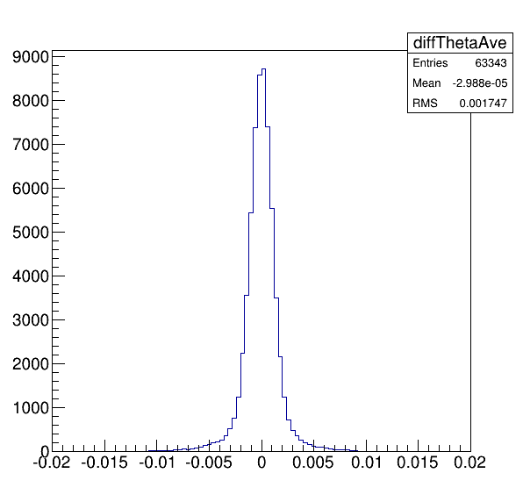
Micromegas trigger algorithm I
X plane
U plane
V plane
Layer Pair
Layer Pair Slope
Average
Multilayer
Multilayer
1
2
3
4
MicroMegas
Layers
5
6
7
8
rms=1.7 mrad
X₀
X₁
U
V
X₂
X₃
Theta Resolution at the entrance
of the Muon System
Strip #S1
Strip #S2
z
6.7 cm
18.5 cm
Interaction Point
Slope X₀ = LookUpTable (#S2 - #S1)
Local straight track selection based on strip
number difference with strip precision
Local segment slopes calculation between hits of Layers belonging to the same Layer Pair over 3 BCs.
X₀
X₁
X₂
X₃
U
V
Matching slope = track candidate
Contacts: samira.hassani@cea.fr, herve.le-provost@cea.fr

Slide 20
Implementation for 2048 strips x 8 Layers
BC3@40 MHz
x Number of Layer Pairs (6)
Slope Select Logic
A
3 ticks
5 (Storage) + 5 (Accumulate) ticks
6 Layer Pairs
BC2A
SLOPE SELECT
MATCH/SLOPE STORAGE
M₁-M₃₁
M₁-M₃₁
Layer A
BC hits
Shift
Register
OR
OR
Hit A
9x31 Match slope bit
9 BCA-BCB combinations
BC1A
SLOPE
#0
M₁
M₃₁
Tunable OR/AND
Logic
Hit B
M_{i}: Match slope value i
M₁-M₃₁
M₁-M₃₁
BC0A
2 ticks
BC2A-BC2B
M_{or}
AND
M_{or}
64
Slope
Calculation
&
Pre-selection
BC2A-BC1B
BC2B-BC1A
BC2A-BC0B
BC2A-BC2B
BC2A-BC1B
BC2B-BC1A
BC2A-BC0B
BC2B-BC0A
BC2B-BC0A
Match
Reset
Selected
Slopes
READ
@320 MHz
BC0A-BC0B
BC1A-BC1B
BC1A-BC0B
BC1B-BC0A
9x64 slopes
Data
ID
3 ticks
BC3@40 MHz
Slope #0
Slope #575
Data pointers
BC2B
Hit A
Layer A/Layer B RAW DATA
Layer B
BC hits
Shift
Register
SLOPE
#63
Shift Registers
Data
access
1 ticks
+1 per track
BC1B
Hit B
BC0B
19 ticks@320 MHz
B
MAX 8 Hits/BC
A
59,4 ns
B
From
A
to
B
ROI & Track Angle
Slice Registers 13%
Slice LUTs 17%
logic 11%
shift Register 2%
route-thru's 4%
Occupied Slices 27%
Designed (VHDL) & Simulated
XST Synthesis & P&R
Virtex-7 xc7v485t
-2 speed grade
Selected track(s)
x4 PR

Slide 21
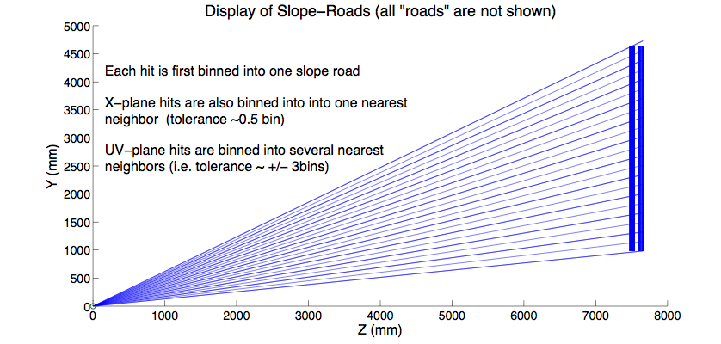
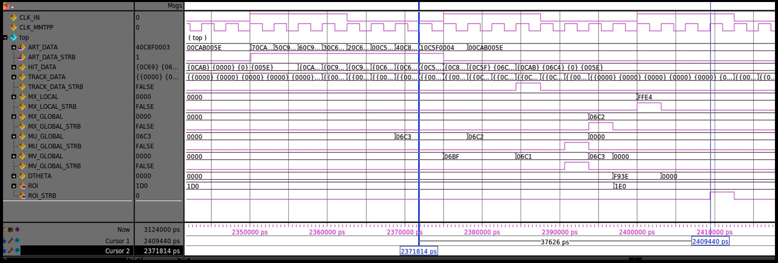
Micromegas trigger algorithm II
Projective “global” slope easy to estimate from slope road
Local slope easily calculated through local fit
“Global” stereo slope calculated to determine ROI in φ
Projective roads help:
create coincidences quickly,
reject background
from the start
θ
Global horizontal/stereo slopes calculated
Arrival of the last hit on the GBT link
Coincidence candidate formed
Local slope calculated
ROI
determined
37 ns latency

Slide 22
Performance summary -- algorithm II
Algorithm efficiency essentially 100%
Inefficiencies related to hits with late raise times, detector gaps,
low-ionization hits
Inefficiencies caused by simulated incoherent backgrounds are small
Irreducible inefficiencies due to muon brem @ 1 TeV at 5% from showering
Algorithm intrinsic resolution of measurement of θ ^{local(@NSW)} - θ ^{global(@IP)}
is 1.33mrad but affected by multiple scattering in the calorimeter

Slide 23
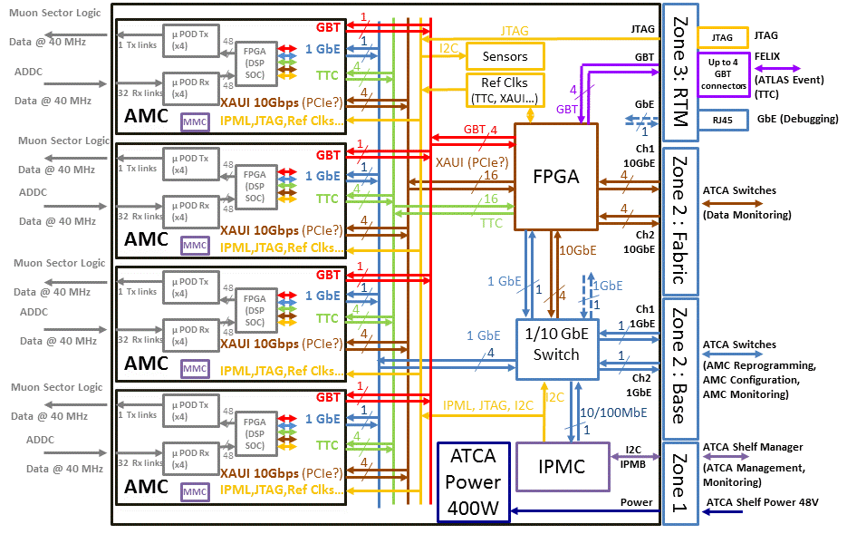
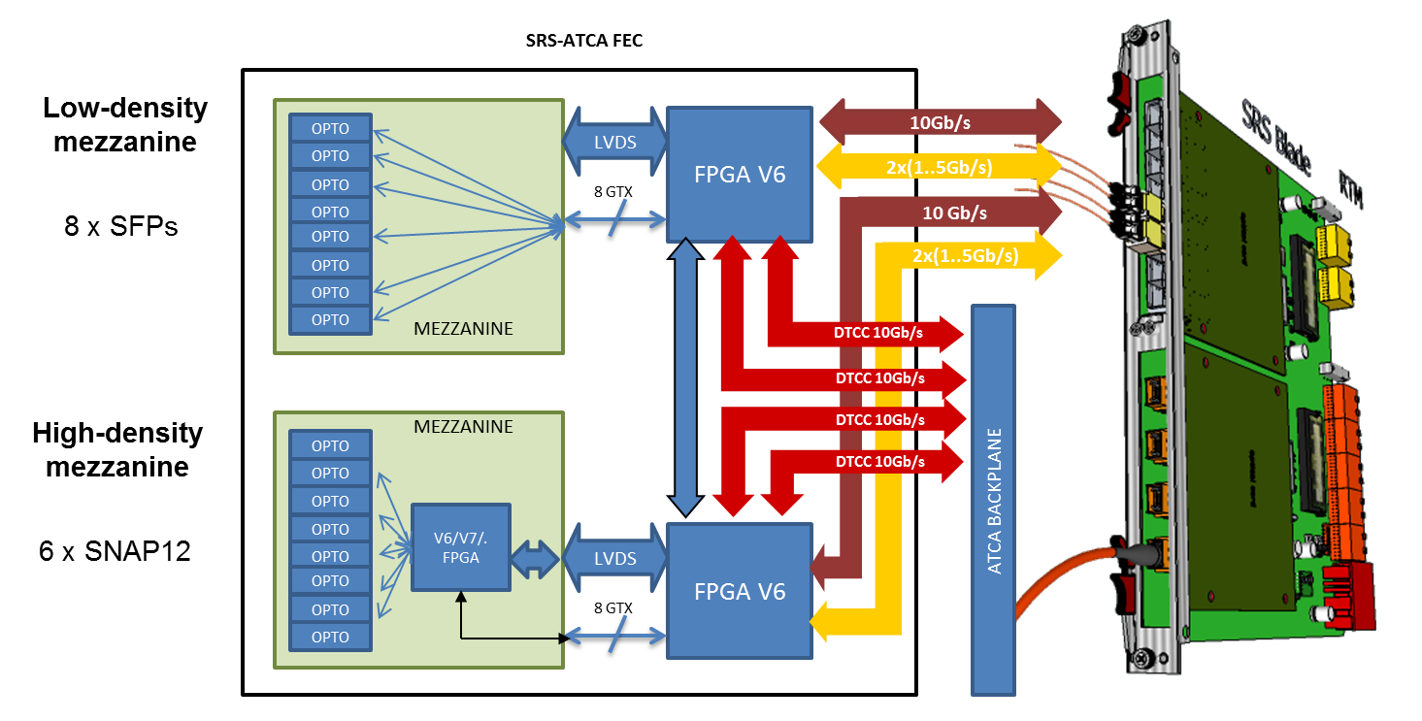
Trigger processor
ATCA-based FPGA boards,
one board per quadrant,
2 crates
Input fibers per quadrant:
MM: 128, sTGC: 96
Separate MM & sTGC
boards share candidates
via ATCA backplane
Try to avoid development
of yet-another-ATCA-FPGA board
Candidate carrier & mezz:
LAr, SRS
LAr
SRS

Slide 24
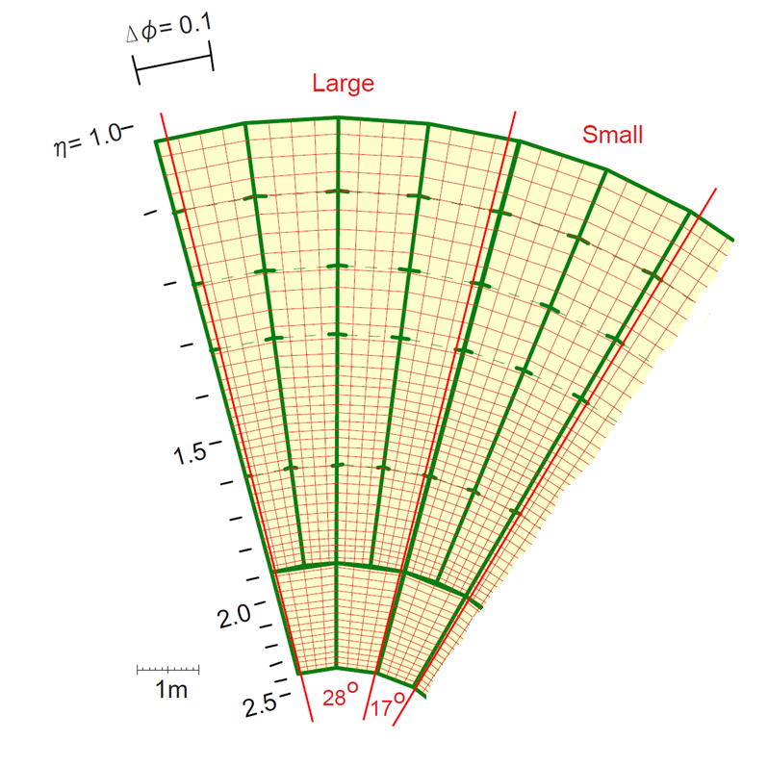
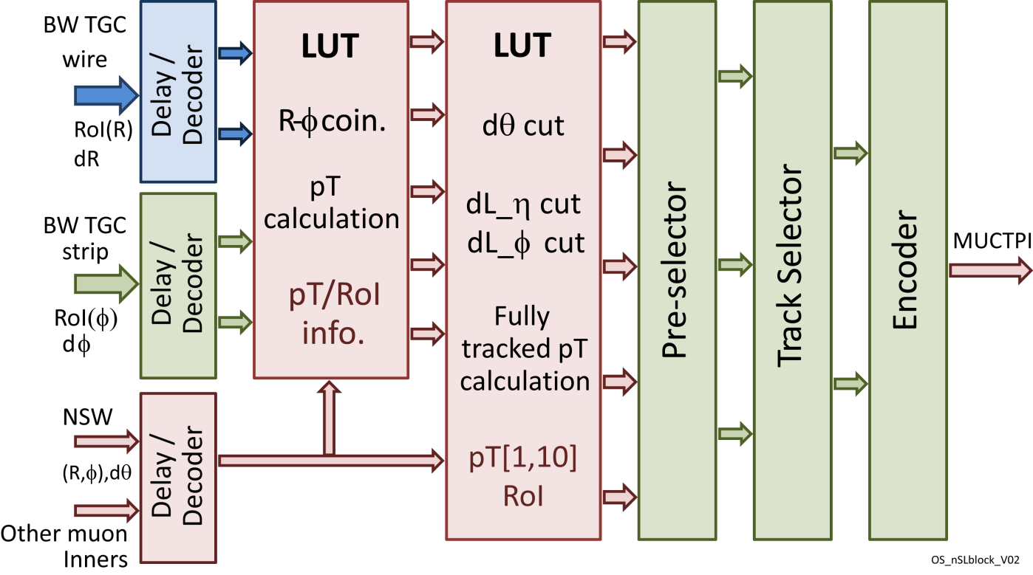
Sector Logic
Finds candidates in R-φ,
tagged by p_{T}
Mismatch of NSW and BW detector boundaries
⇒ fan-out to several modules
Big Wheel Regions-of-Interest
to be confirmed by NSW.
Red lines are NSW sector
boundaries.

Slide 25
Other Phase 1 Muon upgrades
Tile Muon trigger
The new Sector Logic to MUCTPI interface board

Slide 26
Thank you

Slide 27
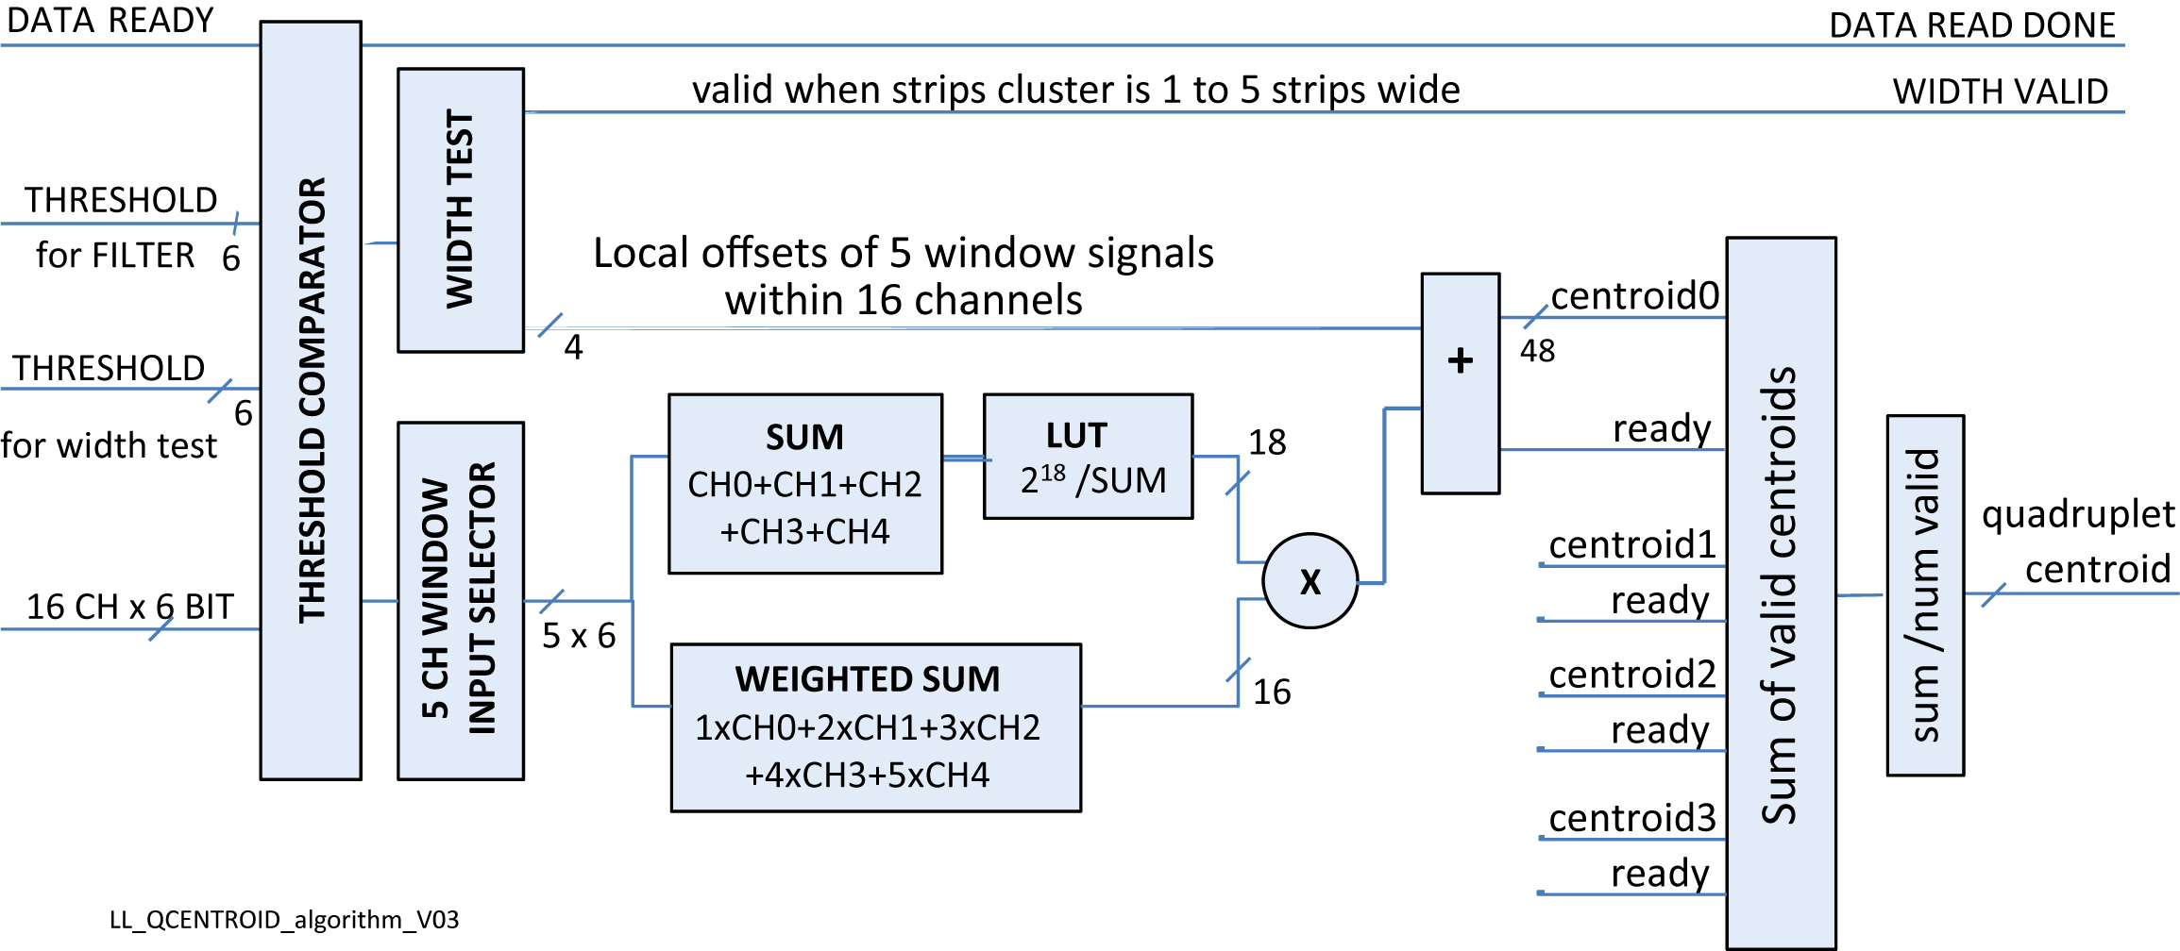
sTGC centroid calculation & averaging

Slide 28
LAr ATCA carrier and mezz board

