Slide 1
Diamonds are the best CALIFES friends
W. Farabolini
09 December 2013

Slide 2
Some unusual specifications
Very low beam charge: down to 10⁵ electrons = 0.016 pC
  Califes specification 0.6 nC per bunch -> 3.75 10⁹ electrons
  charge to be reduced by a factor up to 37500
How to achieve this ?
Problem of measurement
Problem of dark current
Problem of secondary electrons

Slide 3
Reduce the bunch charge in a controllable way
Laser can be attenuate thanks to the optical filter and a single bunch can be isolated using the pulse picker.
Beam charge measures with the BCM has been proven down to 150 pC (no attend was made to go lower).
200 ns pulse achievable (300 bunches) than switch to 1 bunch -> 0.5 pC (still 30 time too high)

Slide 4
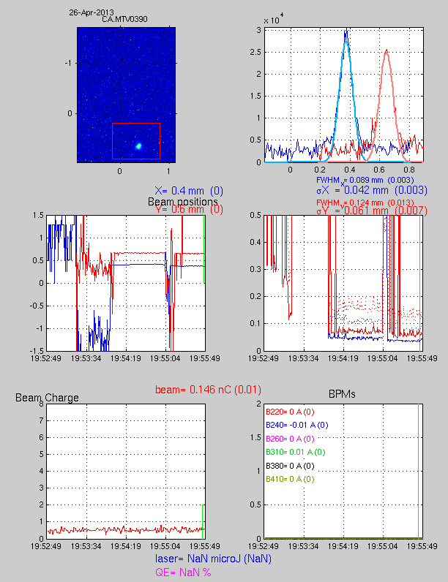
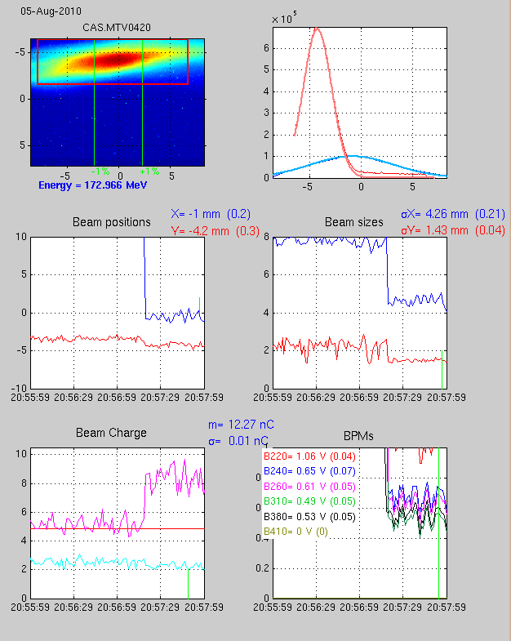
Low charge measurement and small beam size
This spectrum line is no often used since it requires the degaussing of magnet BHB400 afterwards

Slide 5
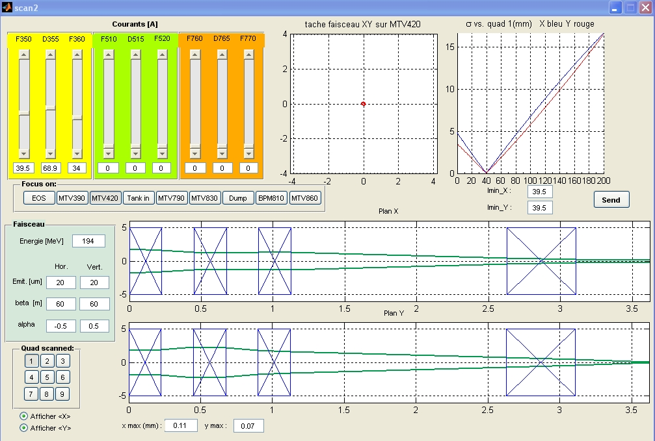
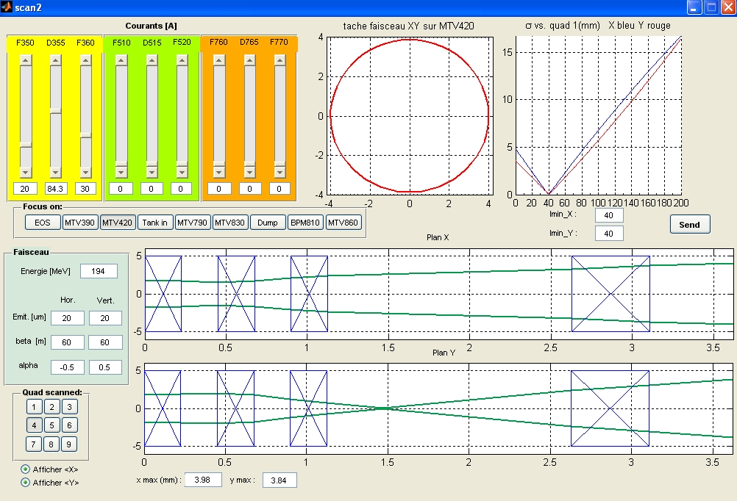
Beam envelope simulation
Focus the beam on the detector surface
Then dilute the beam in a controlled manner.

Slide 6
Possible problems and their mitigation
Dark current becomes predominant
  -> reduce the RF power (klystron, gun attenuator)
  -> only proper beam energy will be sent to the detector (spectrum line)
Secondary electrons due to beam dilution
  -> use a collimator before the detector
Back scattered electrons from dump
  -> use a magnetic deflector after the detector
Present diagnostics not sensitive enough
  -> install a Faraday cup after the detector
Risk to send high charge beam to the detector
  -> Interlock the BHB400 magnet

