Slide 1
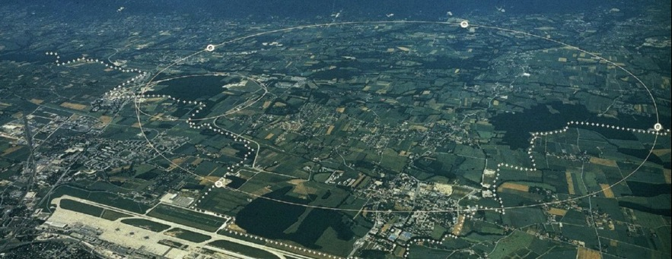
Diamond Detector Test Stand
@ CALIFES
F. Burkart, O. Stein
TE-MPE-PE, LHC machine protection

Slide 2
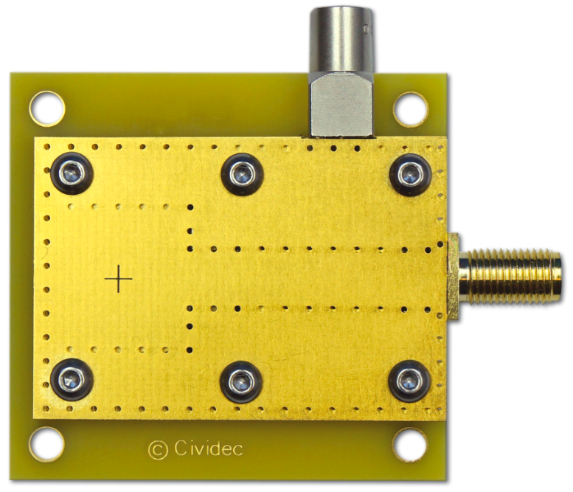
Diamond Detectors
Bias voltage, LEMO
Nanosecond time resolution.
Radiation hard.
Wide dynamic range (1e – 5E9e).
Signal, SMA
4cm
E
5cm

Slide 3
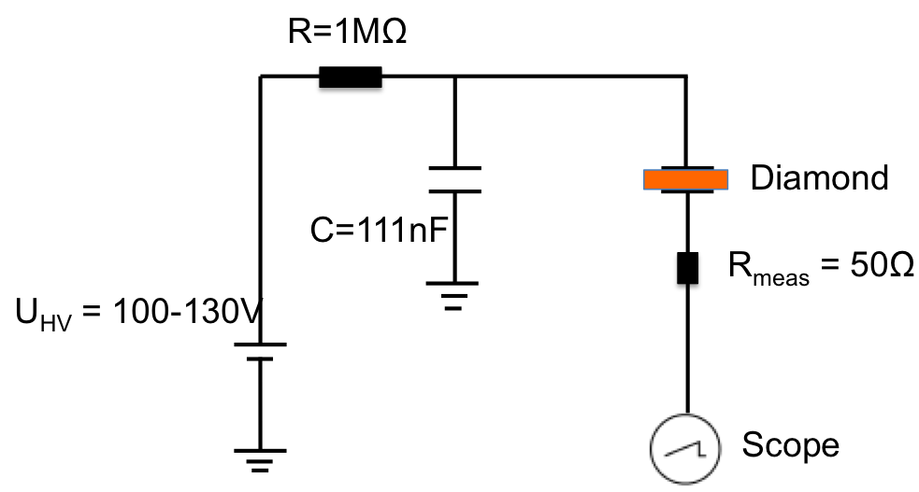
Diamond Detectors
Bias voltage, LEMO
Nanosecond time resolution.
Radiation hard.
Wide dynamic range (1e – 5E9e).
Signal, SMA
4cm
5cm

Slide 4
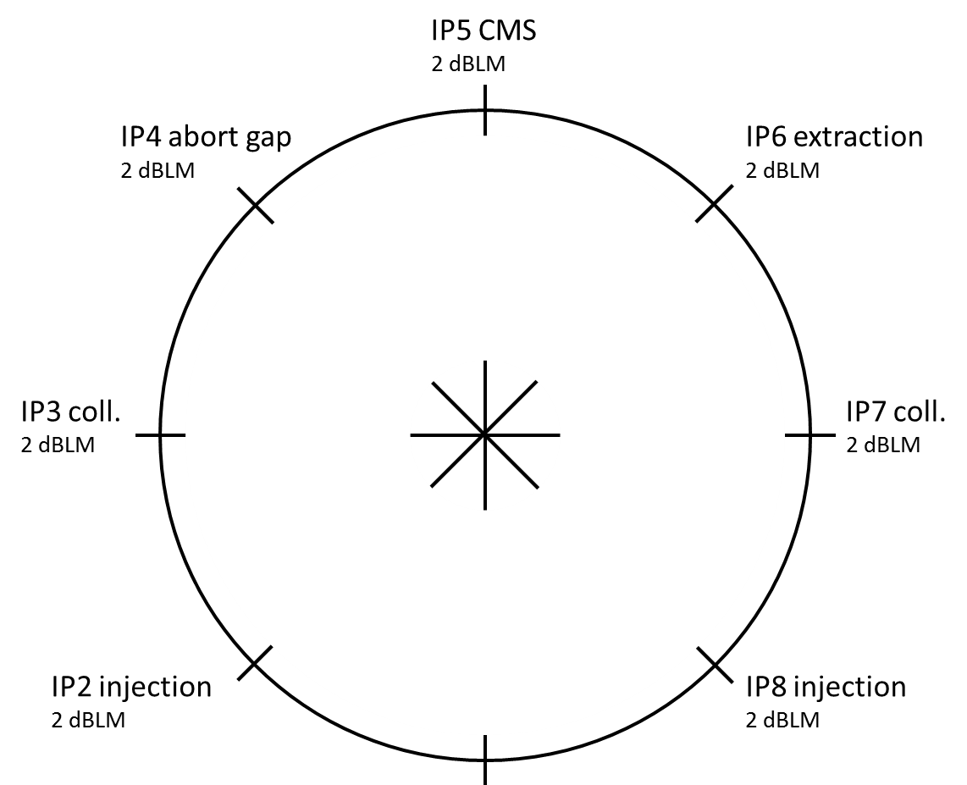
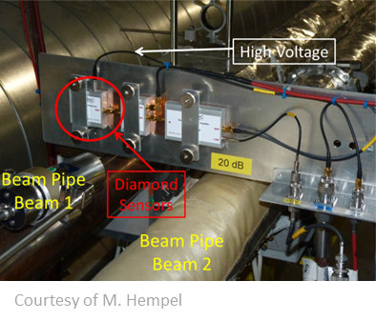
Diamond Detectors installed at LHC
14 dBLMs installed along the LHC.
Diamond type: pCVD (cividec) 10 mm x 10 mm, wire bonded (8@LHC).
Analysis of dBLM data lead to e.g. a better understanding of UFO-events.
BQM

Slide 5
Application of Diamond Detectors
Installed in the LHC to resolve bunch-by-bunch losses
  IR 2, 3, 4, 6, 7, 8
  Abort gap monitoring.
  Detection of ultra-fast losses (< 3 LHC turns).
Used as beam instrumentation for accelerator equipment damage tests in the HiRadMat-facility.
  High radiation / high fluence environment.
  Used for alignment of equipment to the beam.
  Online monitoring of beam impacting on material.

Slide 6
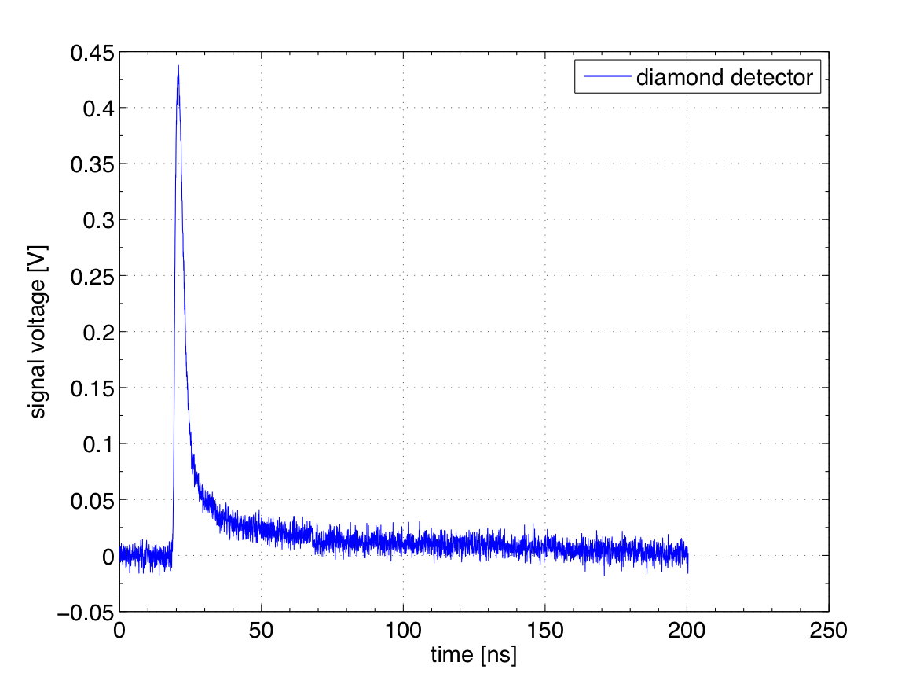
HiRadMat – damage experiment single bunch
Carbon target
1.5E11 protons
Bunch length: 0.5ns

Slide 7
HiRadMat – damage experiment multi-bunch
50 ns
Copper target
1.5E11 protons
Bunch length: 0.5ns
Bunch spacing: 50ns

Slide 8
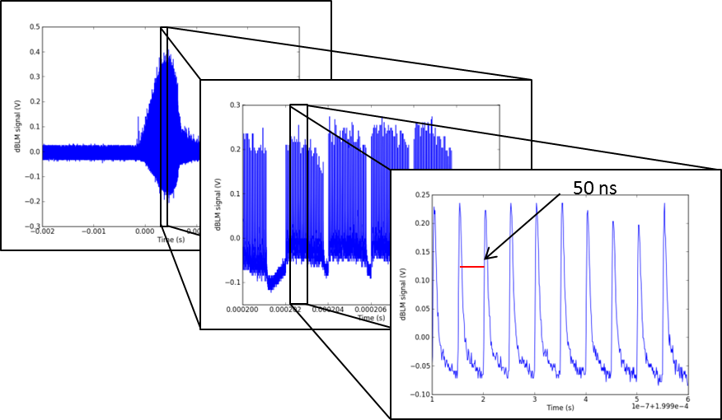
LHC – UFO event
Event, ~1ms
Bunch train, ~10us
Single bunches

Slide 9
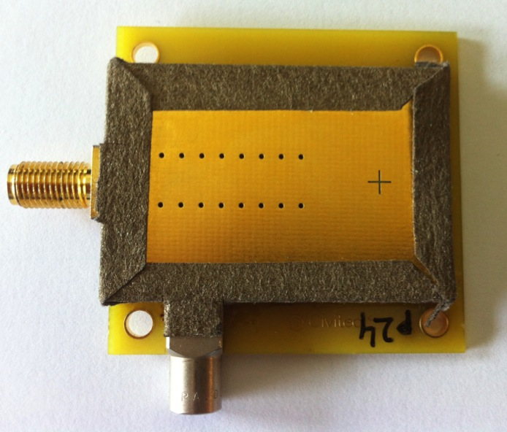
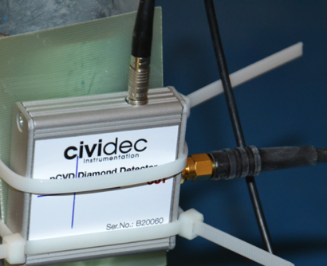
Diamond Detectors of MPE
3x100 μm thick diamond detectors (used in HiRadMat damage experiments)
  (Prototyp; designed with CIVIDEC for high-fluence experiments).
2x500 μm thick diamond detectors
  Standard LHC-type detector

Slide 10
What we want to do …
  Improve understanding of measurement data taken in HiRadMat.
  Detector characterization:
  Measure charge collection distance (CCD).
  Evaluate efficiency of detector.
  Linearity of diamond detectors.
  Sensitivity and saturation limits.
Diamond detector studies on polarization effects.
Influence of supply capacitance on signal decay.
Minimum time resolution for detection.

Slide 11
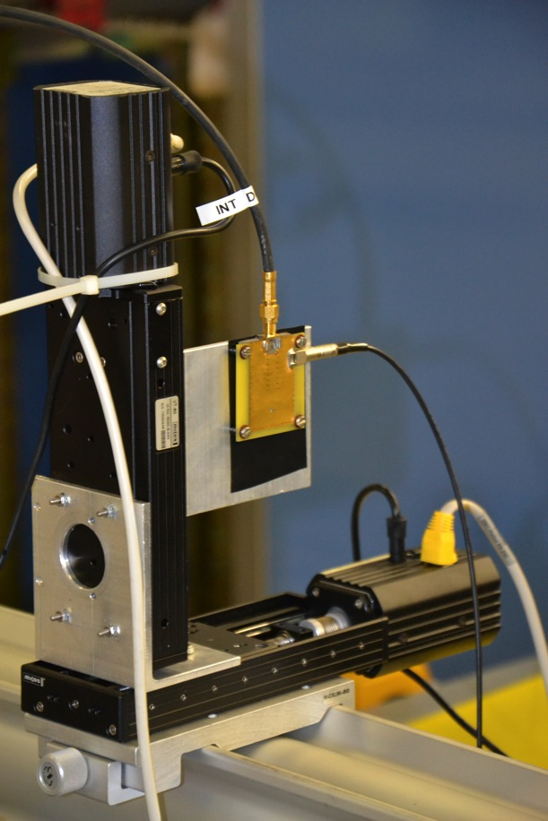
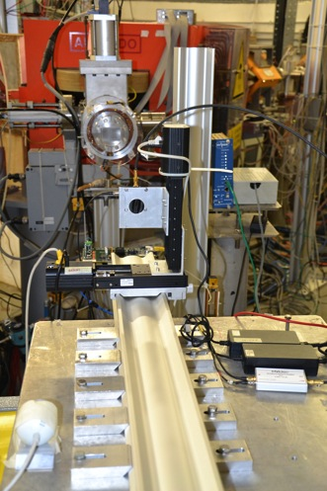
Experimental equipment
Detectors,
Detector holders,
Stage system for alignment,
Beam screen with camera between
Detector and Dump,
Scope.
Signal, SMA
Detector, PCB
HV, LEMO

Slide 12
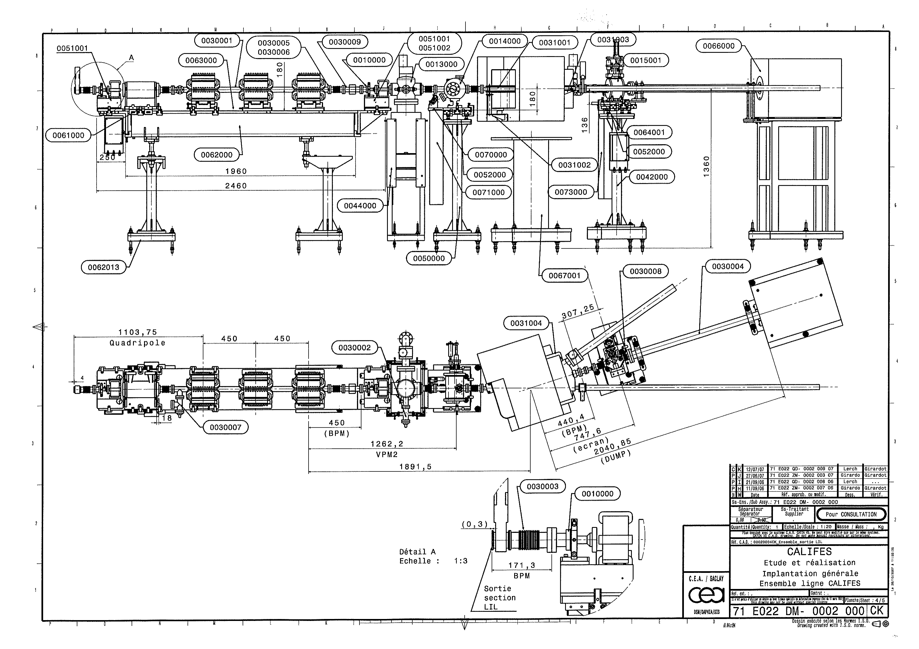
Technical drawings
detectors
BPM
Beam dump
Beam screen

Slide 13
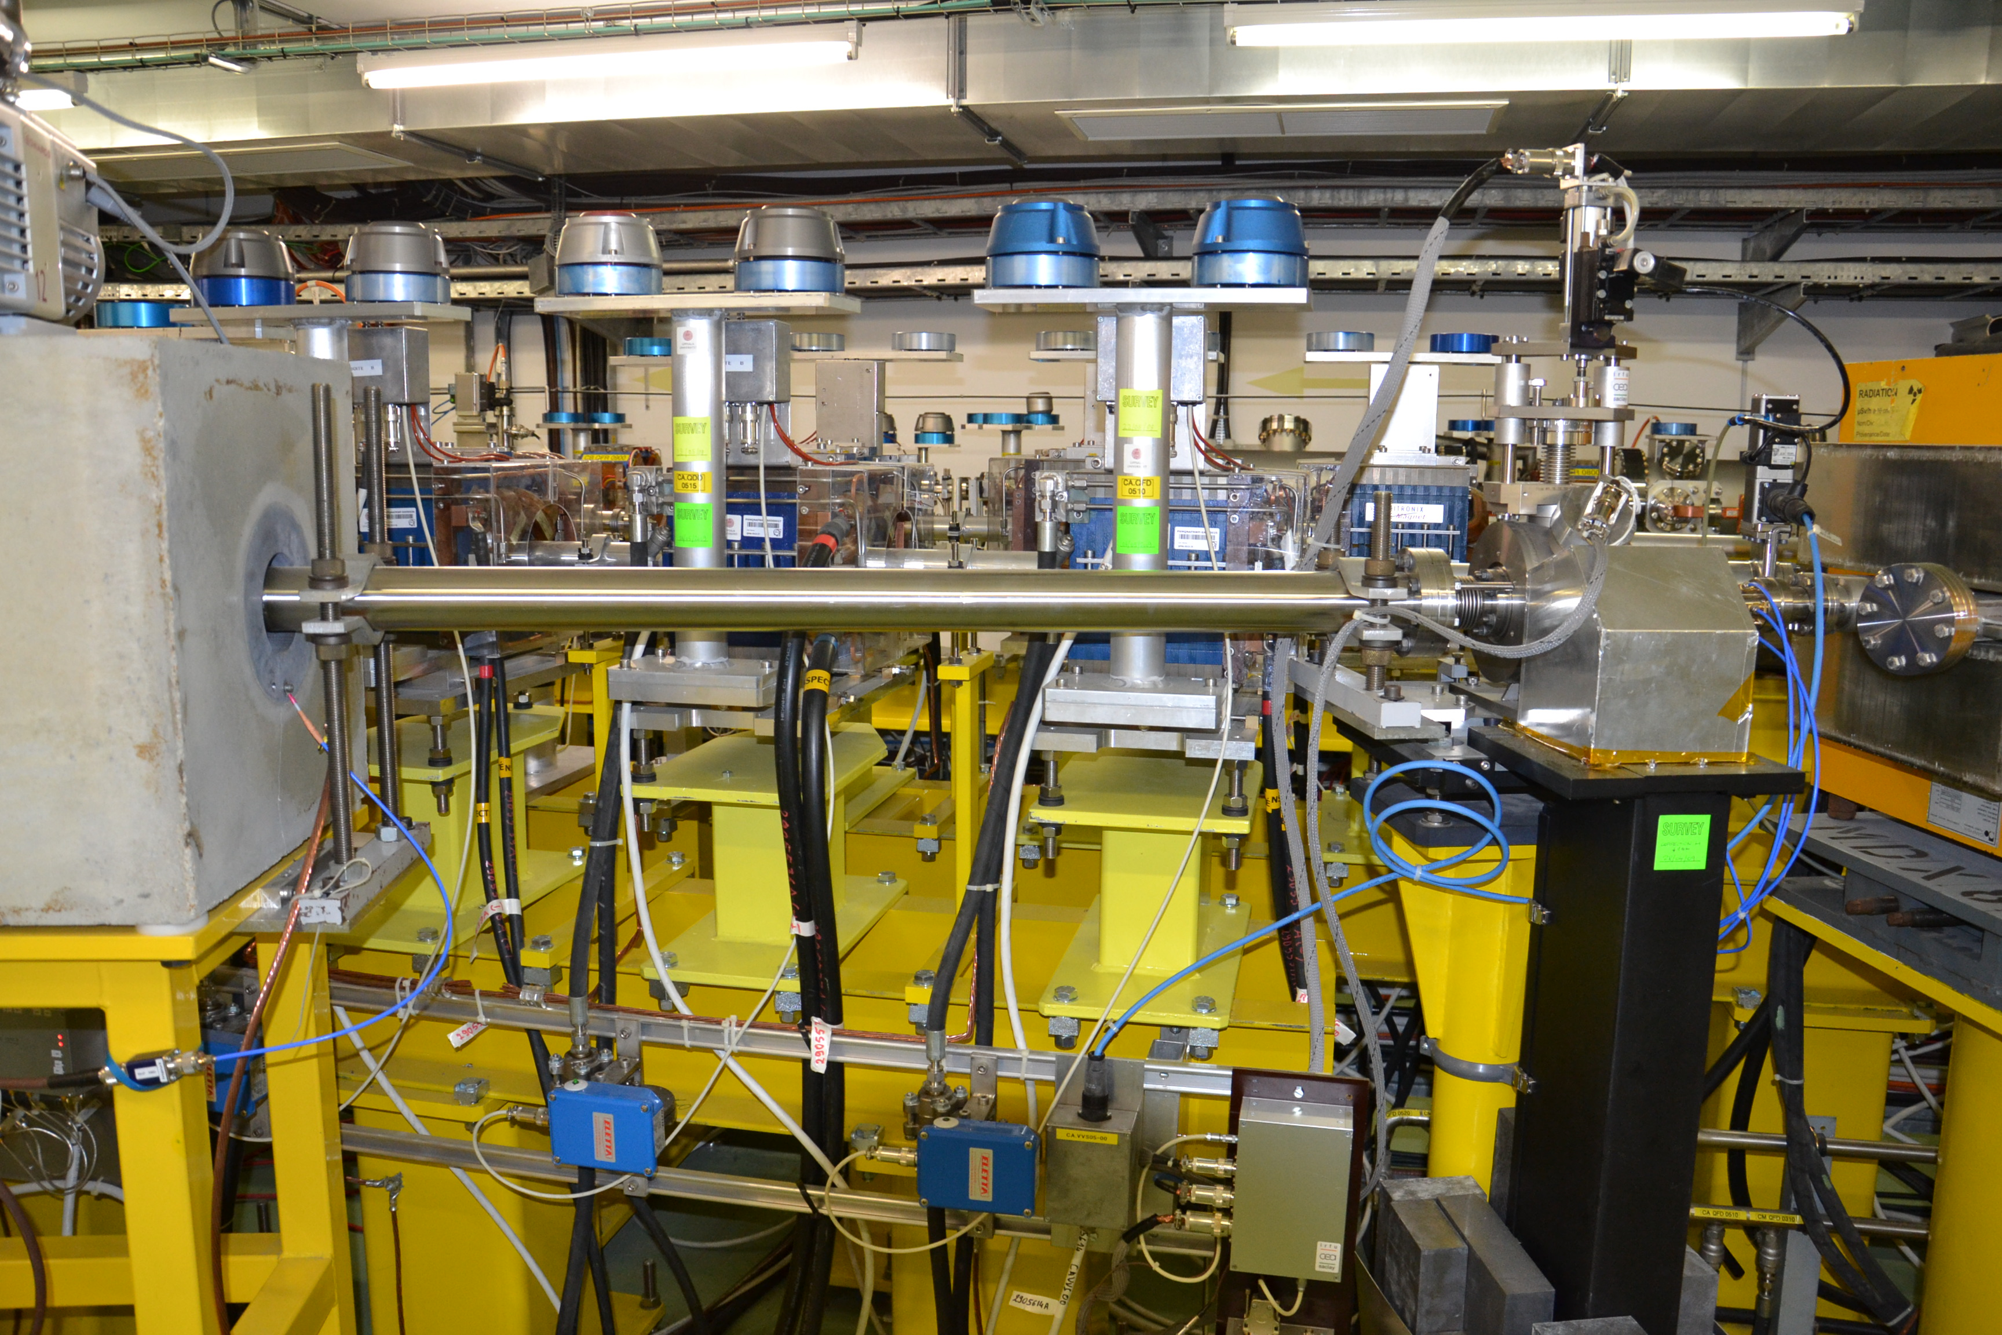
Dipole
magnet
Beam dump
Beam screen
BPM

Slide 14
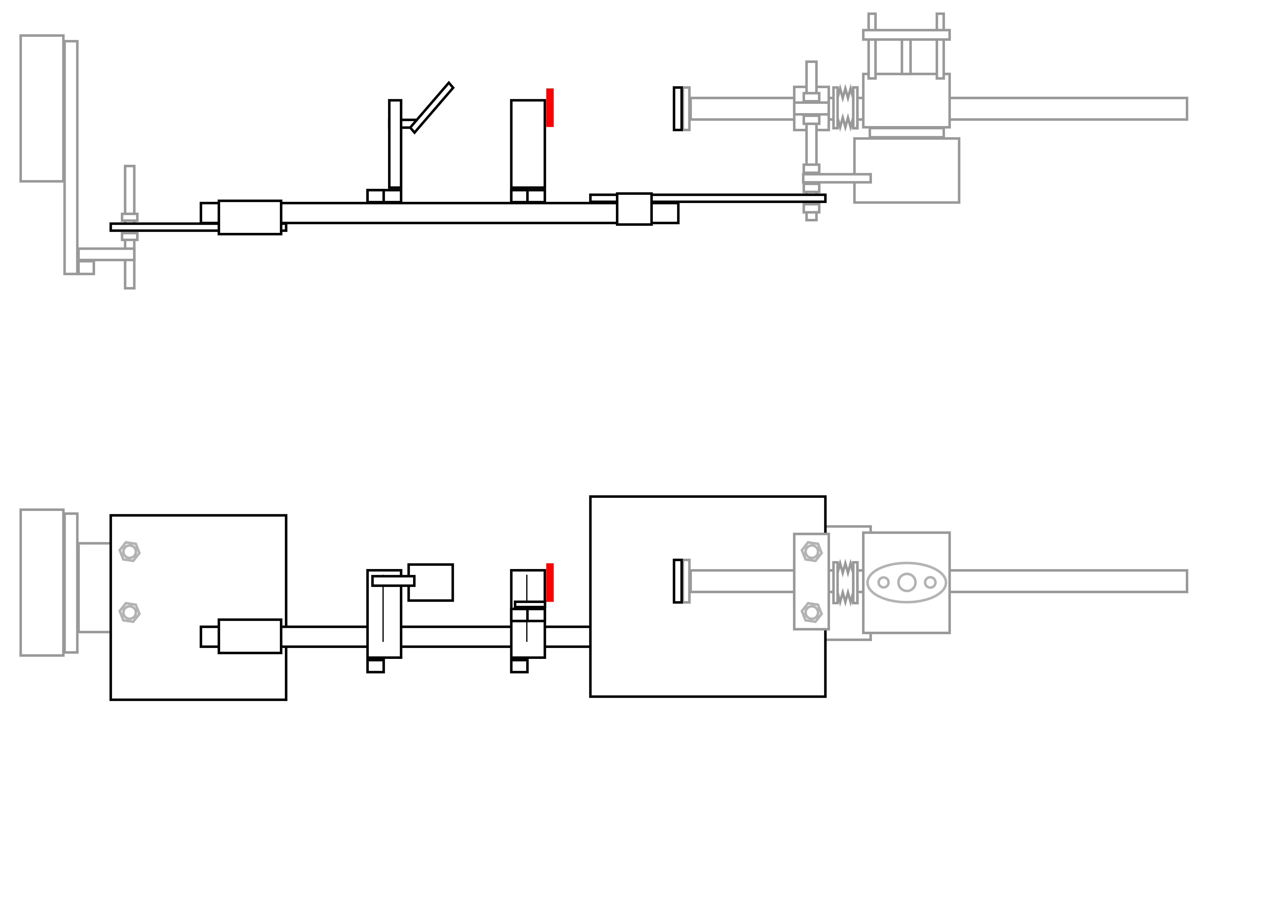
Installation scheme (1/2)
Side
Beam
Dump
Screen
dBLM
Window
Screen station
Top
Beam
X- stage
XY- stage system
Optical rail

Slide 15
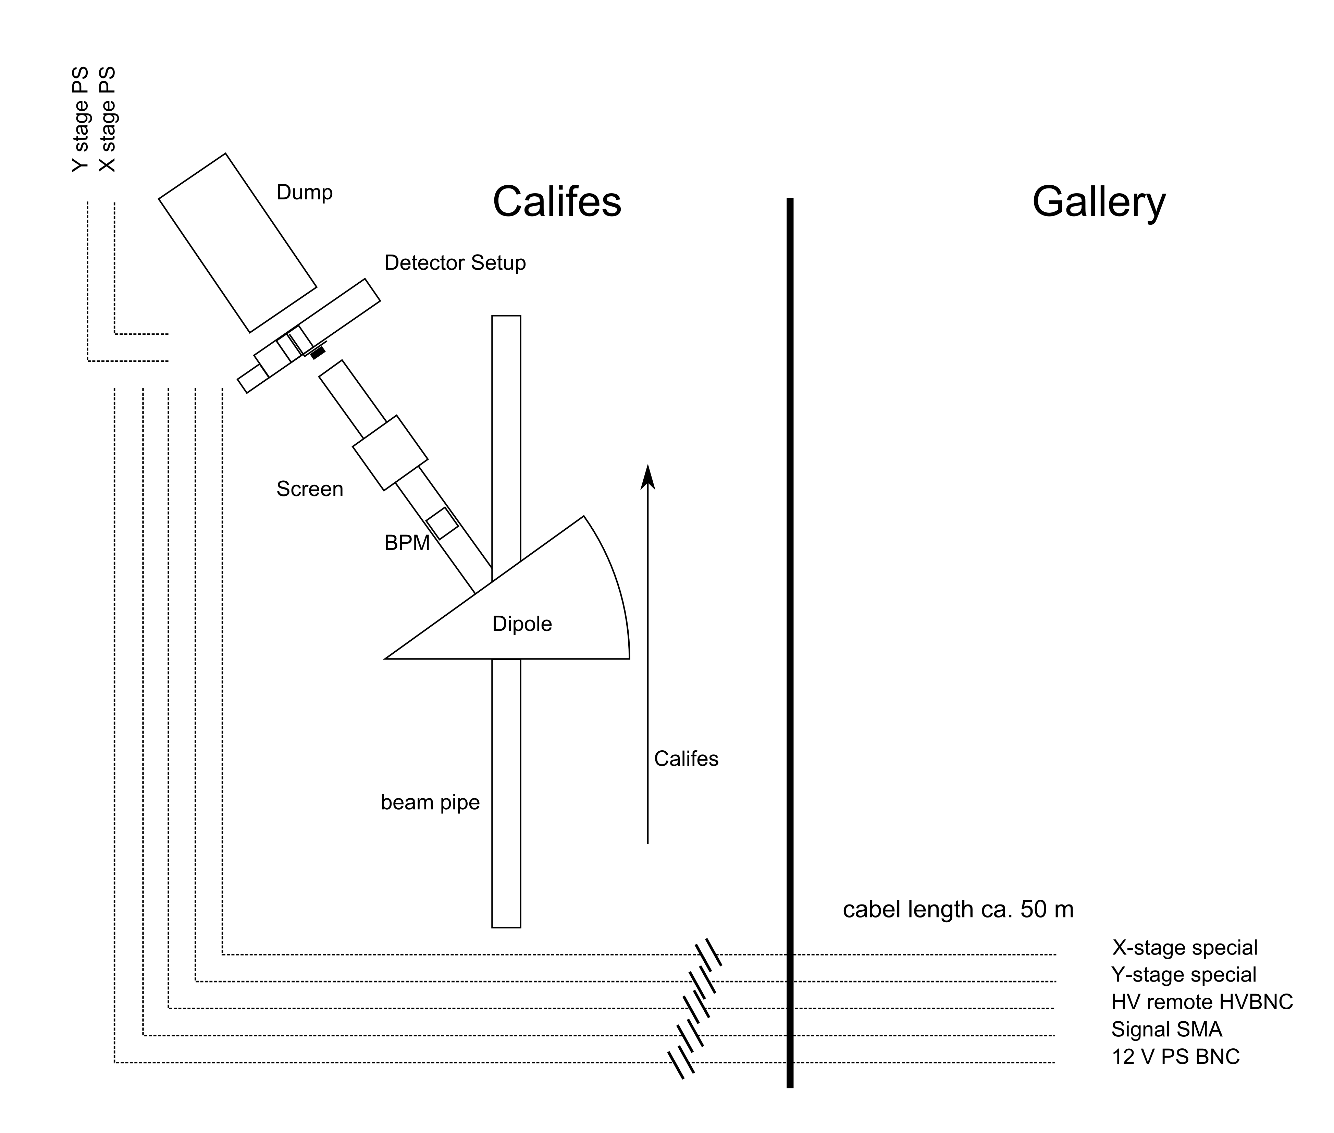
Installation scheme (2/2)

Slide 16
Fluence [charged particles/cm²/pp]
Assumptions:
200 MeV electrons
2 mm x 2 mm spot size
0.1 mm aluminum foil as beam window
Fluence [charged particles / cm2 / pp]
PRELIMINARY

Slide 17
Energy deposition in aluminum foil
Assumptions:
200 MeV electrons
2 mm x 2 mm spot size
0.1 mm aluminum foil as beam window
Energy deposition [GeV / cm3 / pp]
PRELIMINARY
Estimated damage limit 1000bunches à 1E10e.

Slide 18
Collaboration with BE-BI
First step to medium - / long-term test stand.
Possibilities at CALIFES:
  dBLM tests.
  Test of electronics, DAQ.
  Test of high-intensity beam loss monitors.
  Radiation-hardness tests.
Collaboration: Bernd Dehning, Eduardo Nebot (BE-BI).

Slide 19
To be specified:
Setup layout:
  Support construction, installation of rail.
  Cabling→ Patrick Lelong.
Beam pipe modification:
  Installation of beam window. → Esa Puja.
Schedule for installations.
Beam parameters at Detector (Intensity, Monitoring, Beam size)
Beam dump as Faraday cup.
Radiation issues / shielding.
Other protection issues?
  Interlocking for dipole magnet.

Slide 20
Thank You for your attention!
Any Questions?

Slide 21
Beam Parameters CALIFES
Electrons @ ~200MeV.
Intensities from (10⁷ ?)- 10¹⁰ electrons per shot.
1-300bunches
Bunch length: 4ps
Adjustable beam sizes < 100μm sigma.
Beam profile measurements (beam screen, 50cm upstream of detector installation).
Beam current measurements (Faraday-Cup (beam dump block) / WCM / BCT).
BPMs.

Slide 22
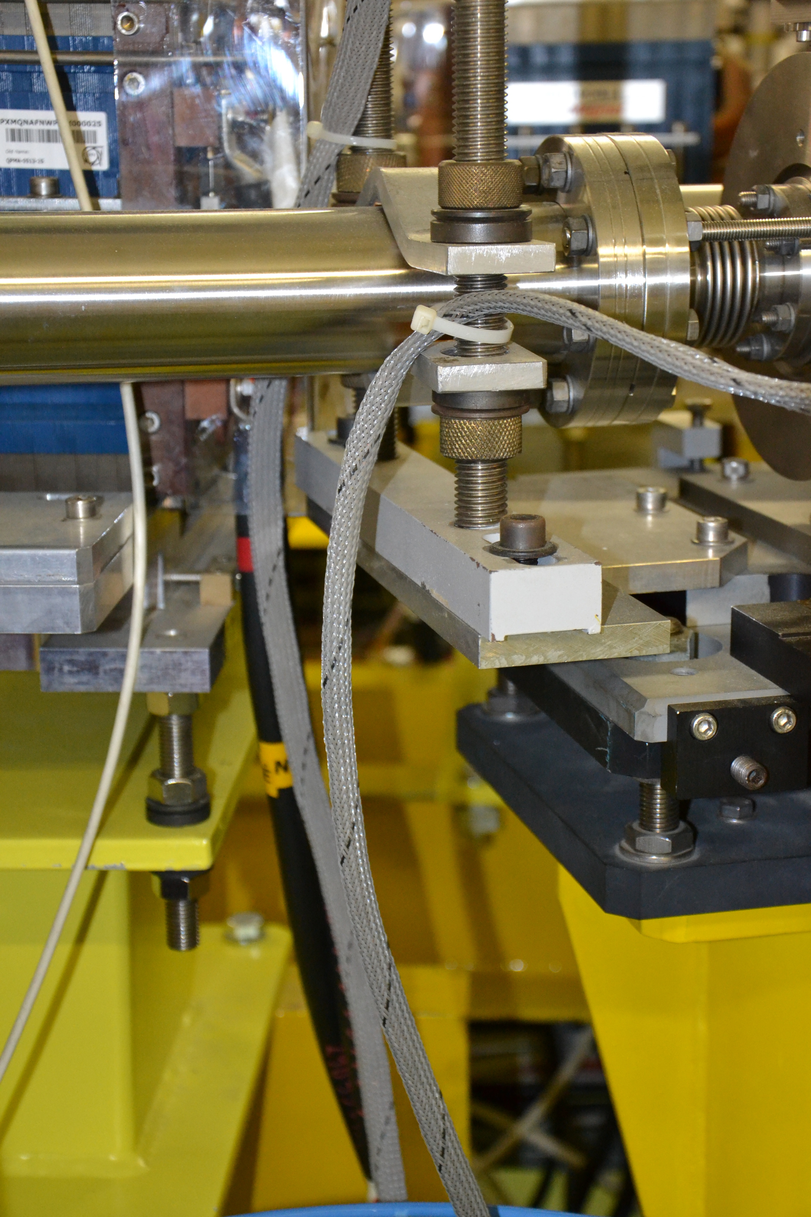

Slide 23
Beam profile in distance of beam window

Slide 24
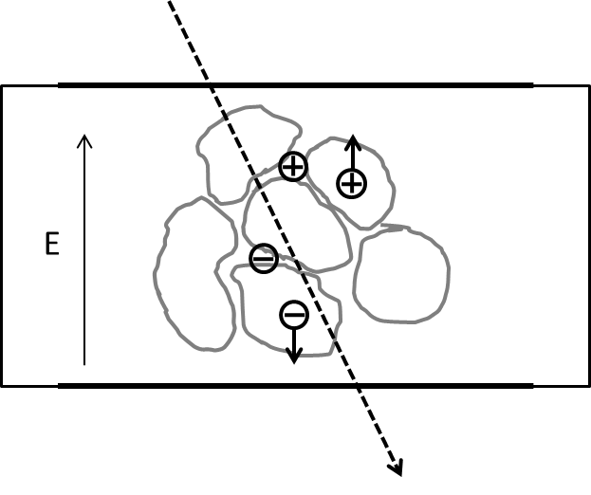
Charge collection distance

Slide 25
Time schedule
Installation in January?

