Slide 1
MBHSM01 Test Status
December 17, 2013

Slide 2
Introduction
MBHSM01 - the first 11T dipole coil in a mirror structure w/o warm bore
  1-m long coil (#8) made of 0.7 mm diameter Nb₃Sn RRP 108/127 and RRP 114/127 strands
  0.025 mm thick and 11 mm wide stainless steel core in the conductor
Main test goals are coil performance study in a different mechanical structure and under different pre-load conditions, as well as further study of the quench protection
Two previous tests of the 11 T coils at FNAL demonstrated significant quench current degradation. One of the main tasks of MBHSM01 test is to understand the cause of the limited coil performance demonstrated in MBHSP01/02

Slide 3
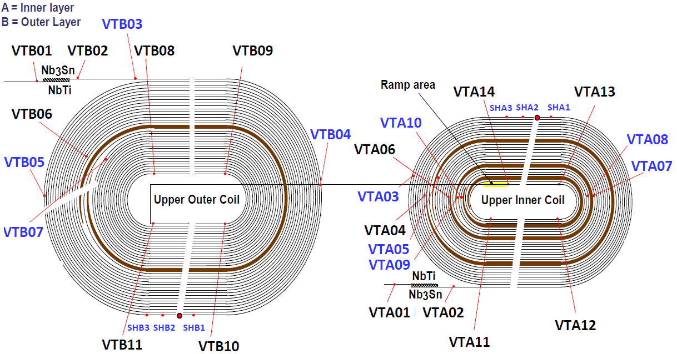
Voltage Taps in MBHSM01
Additional VT installed in the multi-layer blocks, mid-plane and around the spot heaters (shown in blue color) will help to find quench locations both in the low and high field areas

Slide 4
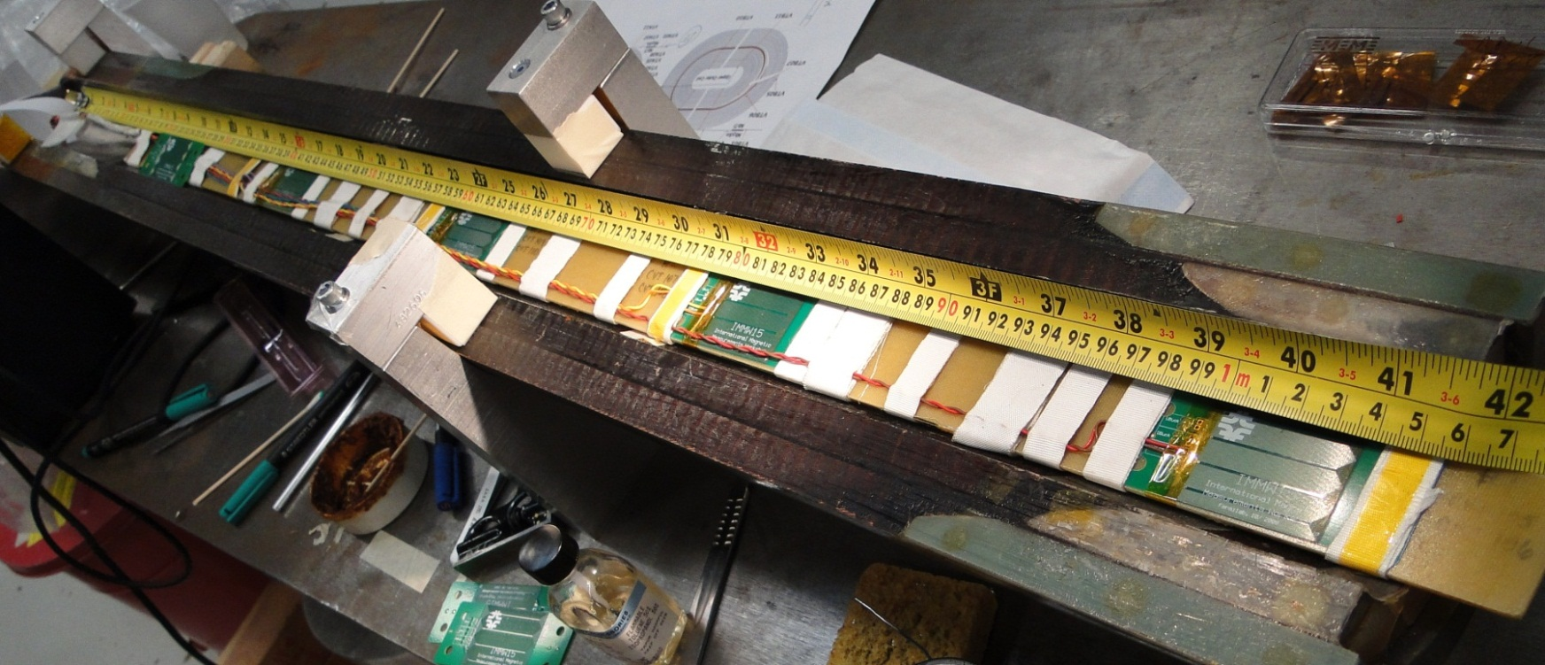
Quench Antenna
Quench antenna (QA) with 5 independent PCB-based segments installed on the inner coil surface
  3-piece QA in MBHSP02 demonstrated reliable and efficient operation for the IL quenches

Slide 5
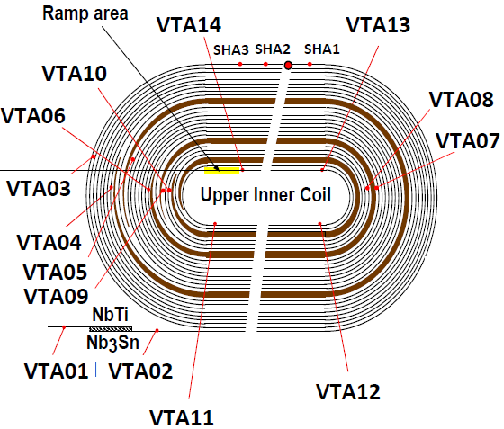
Quench Antenna (cont’d)
LE
RE

Slide 6
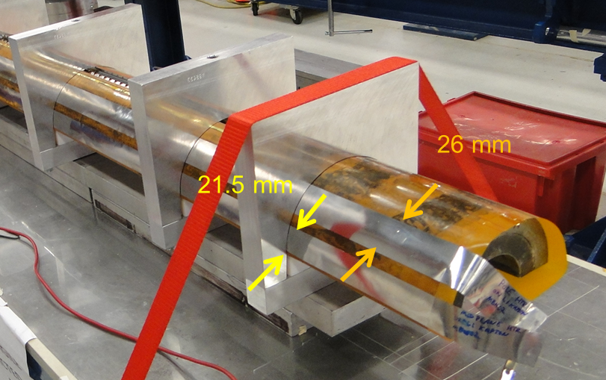
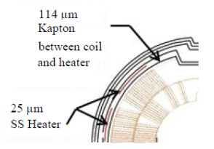
MBHSM01 Strip Heaters
Coil is equipped with 2 protection heaters placed between the first and second ground insulation Kapton layers on the outer coil surface
Heaters are composed of 1000 mm long, 0.025 mm thick and 21.5 mm wide (in mid-plane) or 26 mm wide (in pole area) stainless steel strips

Slide 7
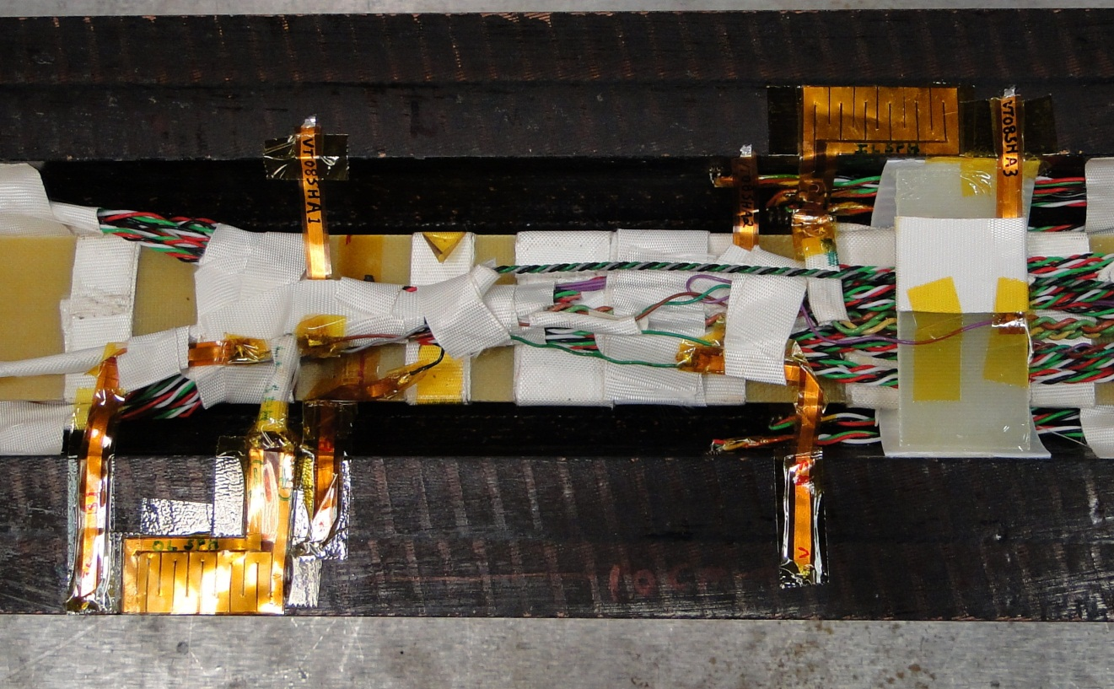
Spot Heaters
Spot heaters (SH) installed for the quench propagation study, as well as for the quench temperature studies
  VT installed around the spot heaters
5 cm
10 cm

Slide 8
Witness sample data
Large spread of witness sample results. Two extremes – the lowest and the highest SSL estimates are presented below
Currently not clear what is the fraction of strands of each type in the conductor
E. Barzi & D.Turrioni

Slide 9
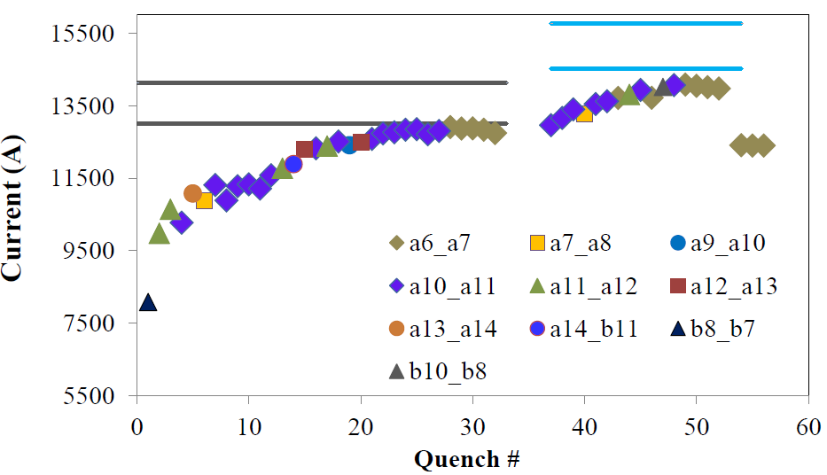
MBHSM01 Quench Training
Highest quench current at 4.5 K: 12.9 kA (92-100) % of SSL
at 1.9 K: 14.1 kA (89-97) % of SSL
SSL at 1.9 K
SSL at 4.5 K
4.5 K
1.9 K
4.5 K

Slide 10
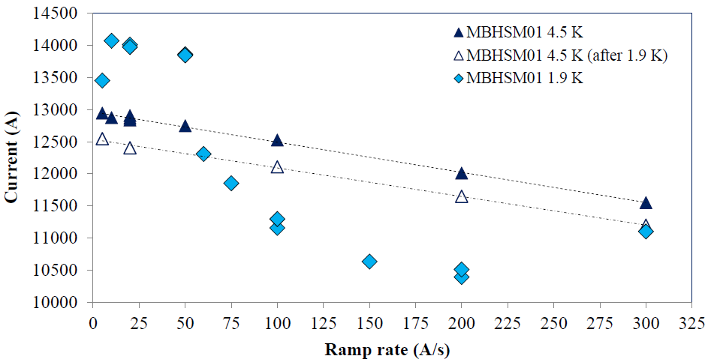
Ramp Rate Study
Quench locations: A6-A7 (low ramp rates at 4.5 K and 1.9 K), A7-A8 (above 50 A/s at 4.5 K) and A11-A12 (above 50 A/s at 1.9 K)
No quench observed at 1.9 K when ramping down from 13 kA at 200 A/s

Slide 11
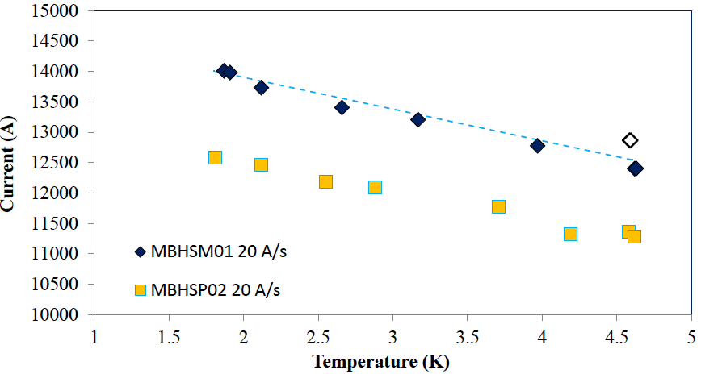
Temperature Dependence
All MBHSM01 quenches initiated in A6-A7 segment

Slide 12
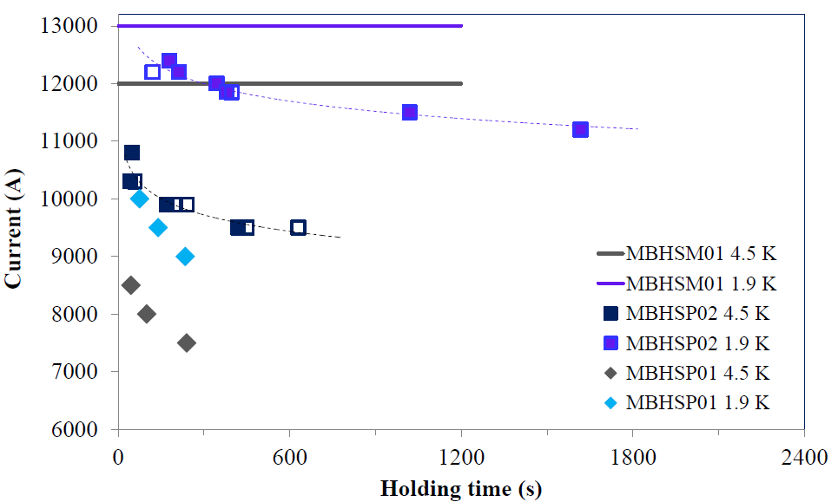
“Holding quenches”
MBHSP01/02 showed so called “holding quenches”, when magnet is quenching at fixed current after holding it for a certain time
No quench for “holding” time of ~ 21 min

Slide 13
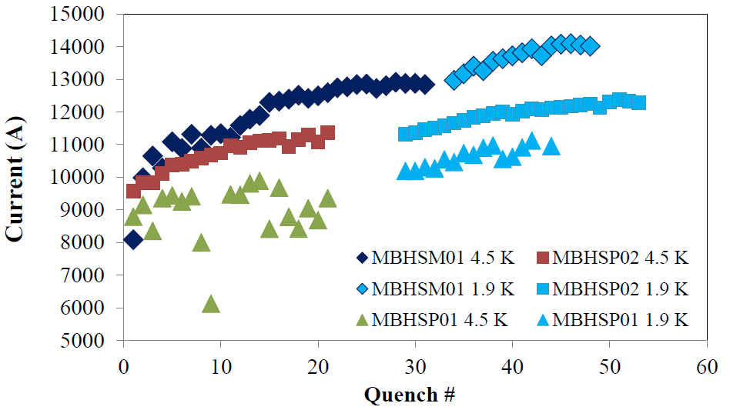
MBHSM01 Test Results

Slide 14
Summary/Test Status
Currently MBHSM01 test in progress. Quench training and ramp rate studies completed both at 4.5 K and 1.9 K
The magnet reached ~ 13 kA or (92-100)% of SSL at 4.5 K and 14.1 kA or (89-97)% of SSL at 1.9 K
No spontaneous quench observed when “holding” 12 kA at 4.5 K or 13 kA at 1.9 K for ~ 21 minutes
Temperature dependence of the quench current shows similar minor degradation at all temperatures
Next step is quench protection study and comprehensive analysis of data

