Slide 1
Integration of collimators in the dispersion suppressors
Status of 11 T cryo-assembly integration
Dec 17, 2013
Delio.Ramos@cern.ch

Slide 2
Outline
(Today’s) “Rules of the game” (Some say design constrains, functional specifications, interfaces, etc...)
11 T + Collimator cryostat concept
What’s next

Slide 3
Full interchangeability with a standard dipole
(no changes to neighbouring cryomagnets)
X
No changes to cryo, electrical or mechanical interfaces (different jack’s position is inevitable)
15660 mm long, interc. included
Inside the 11 T cryostat:
  X-line remains straight
  He II free cross section: 60 cm²
  Pressure drop of He II circuit: 4.3 kPa/m (50 mm smooth pipe)
  Pressures and temperatures acording to LHC-Q-ES-0001 (edms 90032)
Y
M1
M2
V1
V2
K2
K1
M3
N
E
C’
W
QRL side

Slide 4
Operation and maintenance
Mechanical decoupling from cryostat and collimator for removal and alignment of collimator without warming up the arc ⇨ bellows between collimator tank and cryostat, independent supports to the floor, compatible integration
One collimator design fits beam 1 and beam 2
Minimise exposure to residual radiation ⇨ simplify removal/installation of collimator, ex. quick CF flanges, pre-aligned collimator support system, “rapid” electrical and hydraulic connections (but not remote handling), permanent bakeout insulation
Ports for “RF-ball” test of new sectors
Transport constraints: Stay in the “shadow” of the existing arc cryostat

Slide 5
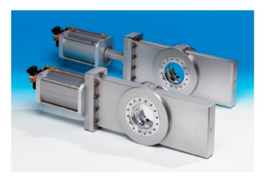
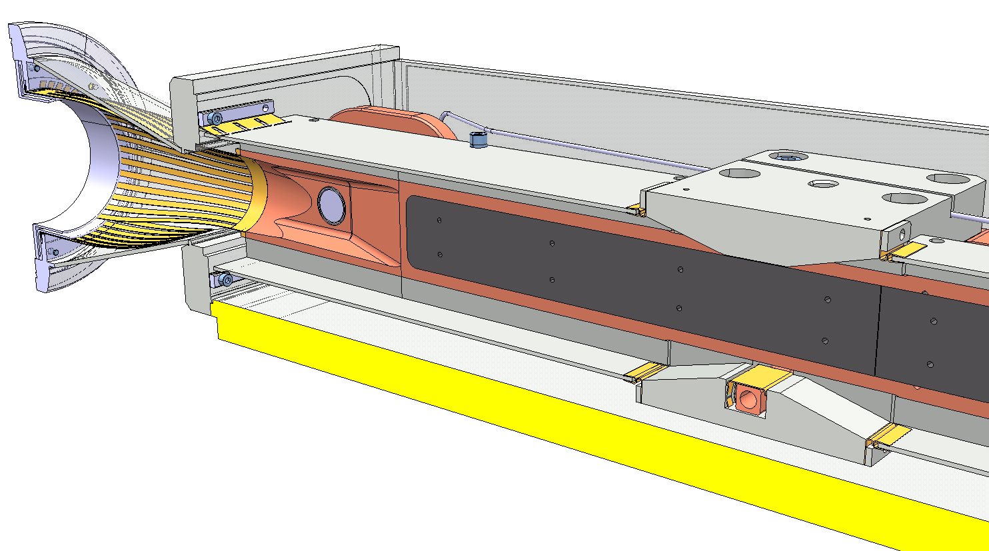
Vacuum
Room temperature (bakeable) collimator vacuum operated and maintainded independently from cold beam vacuum ⇨ sector valves on both lines
Beam screens (K-line cooling) with same reliability and performance as rest or the arcs (no helium to beam vacuum welds, testing, etc.)
No demountable vacuum tight joints in cryogenic system
Ensure pressure safety of each new beam vacuum “subsectors” ⇨ rupture disks on SSS ports
Ensure pressure safety of insulation vacuum (DN 200’s)
Respect current RF-impedance requirements: ex. shielded sector valves, shielded bellows, max 15º taper angle

Slide 6
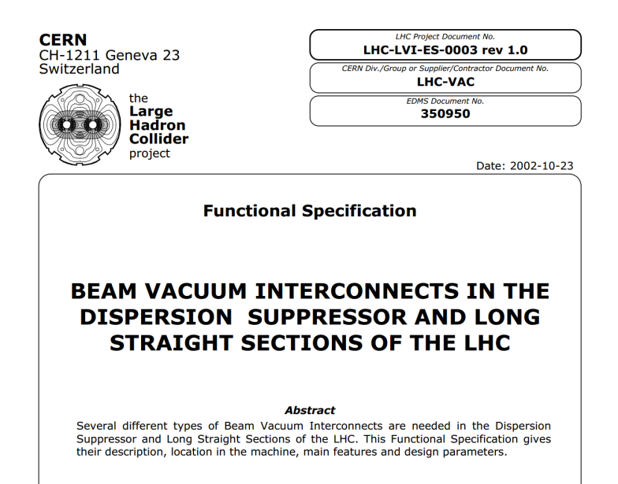
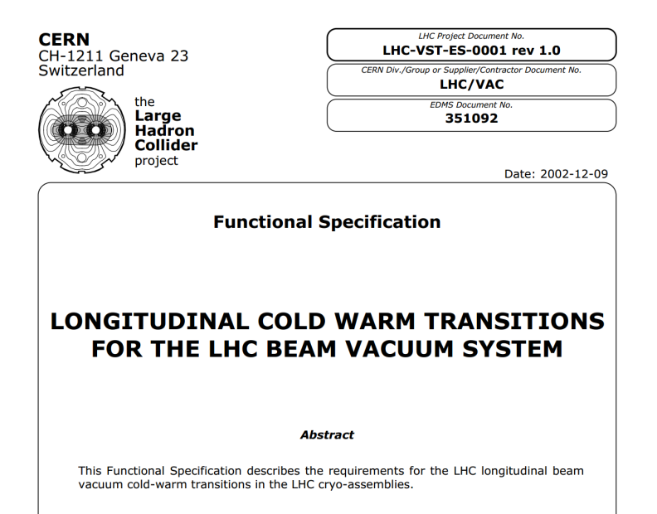
Thermo-mechanical
Busbar flexibility must take into account adjacent magnets
Temperature offset between cold mass and beam screen during transient
Temperature variation between two cold masses during transient
Cold to warm transitions on the beam lines

Slide 7
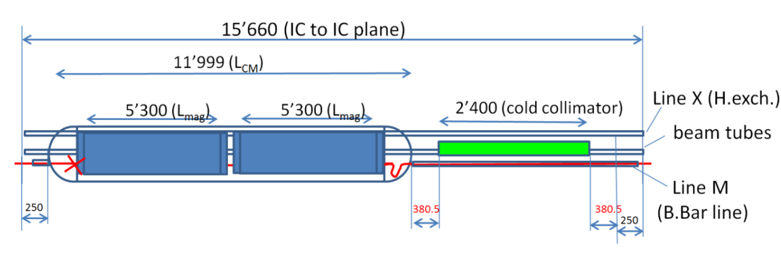
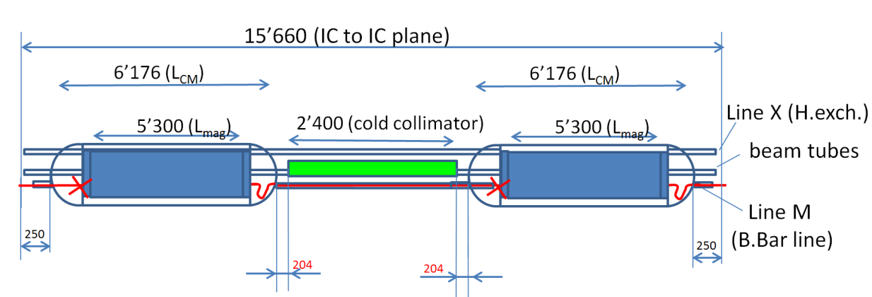
Standard interfaces + fixed length → why the collimator must be in the middle
Not possible to fit netiher the collimator nor sector valves between standard bus bar lines. New routing needed to make vertical space for the collimator
Additional module needed to create a standard interconnect interface and thermal compensation.
Interference with W sleeve (ok if collimator on the other side).
Standard interfaces
New end covers may be made to route the bus bars in a way to provide enough space for the collimator (no interchangeability between cold masses).

Slide 8
Basic concept
Independently cryostated and handled cold masses, linked through two short transfer lines
Transfer lines with expansion joints mechanically decouple cryostats A and B
Splice and piping interfonnect in the tunnel, all other work prior to installation
Can use the existing TCLD collimator design with modified the supports
Independently supported collimator
Line X
Cold mass A
Cold mass B
Collimator
Lines M, E, N, K, C’
Busbar lyra
Reinforced jacks to widstand vacuum forces
Flexible S-shaped busbar stabiliser
Busbar splice and interconnect done in the tunnel

Slide 9
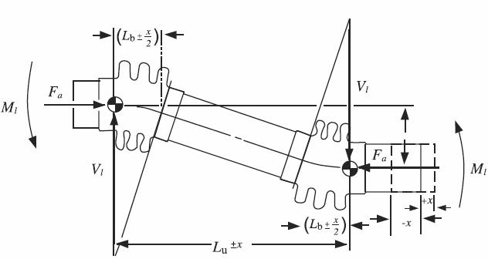
Mechanical alignment decoupled with expansion joints
No cold support adjustment
Conventional alignment procedure with adjustment on cryostat jacks and displaced fiducials
Universal expansion joint

Slide 10
Access for in-situ repair
Cold mass A
Cold mass B
Collimator
Once the collimator removed, the vacuum vessel cover can slide open
In-situ access for repair of «fragile» components:
  Expansion joints
  Flexible hoses
  Diode
  Instrumentation feedthrough (IFS)
  Current leads (?)

Slide 11
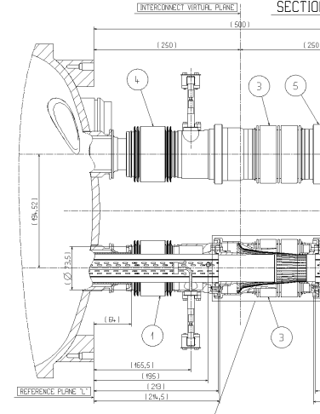
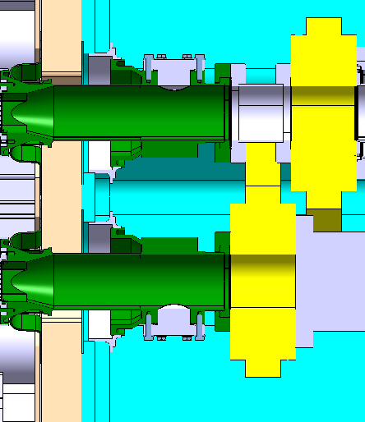

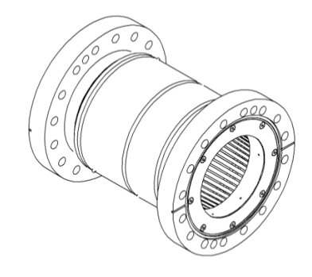
Will it fit in 15660 mm? (Layout of beam line equipped with collimator)
800

Slide 12
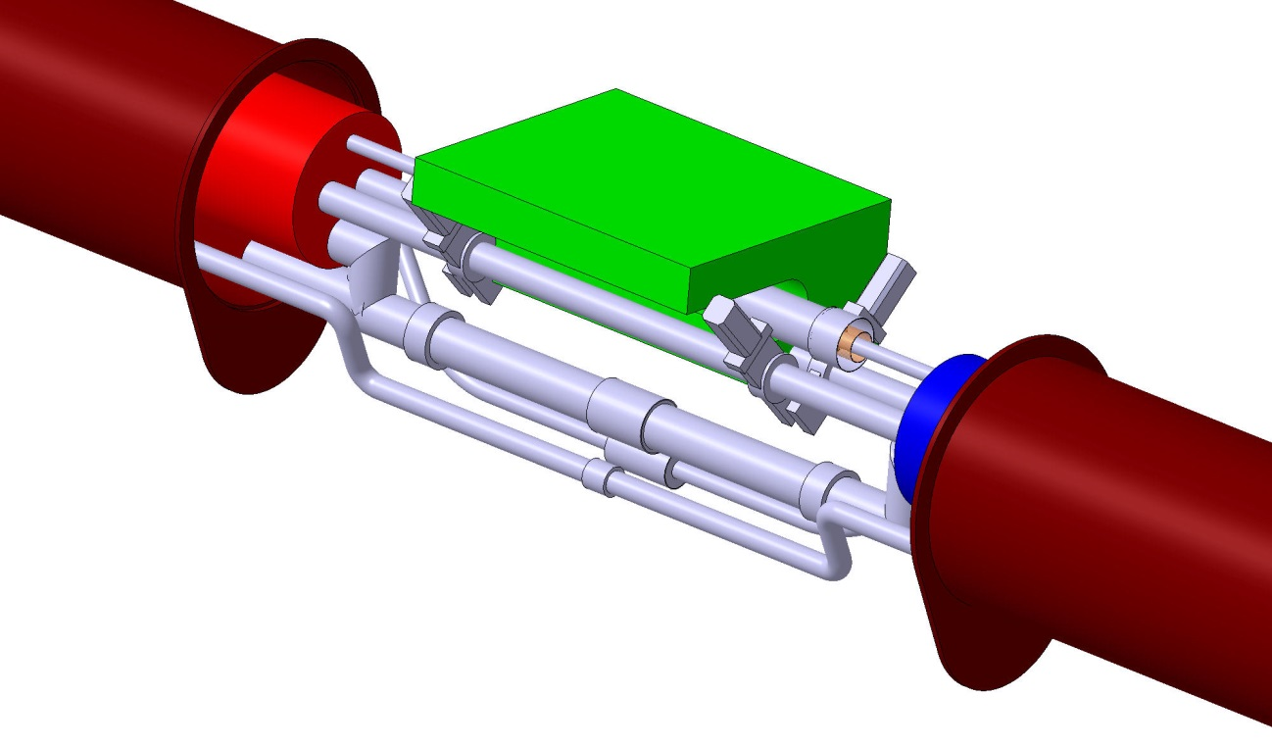
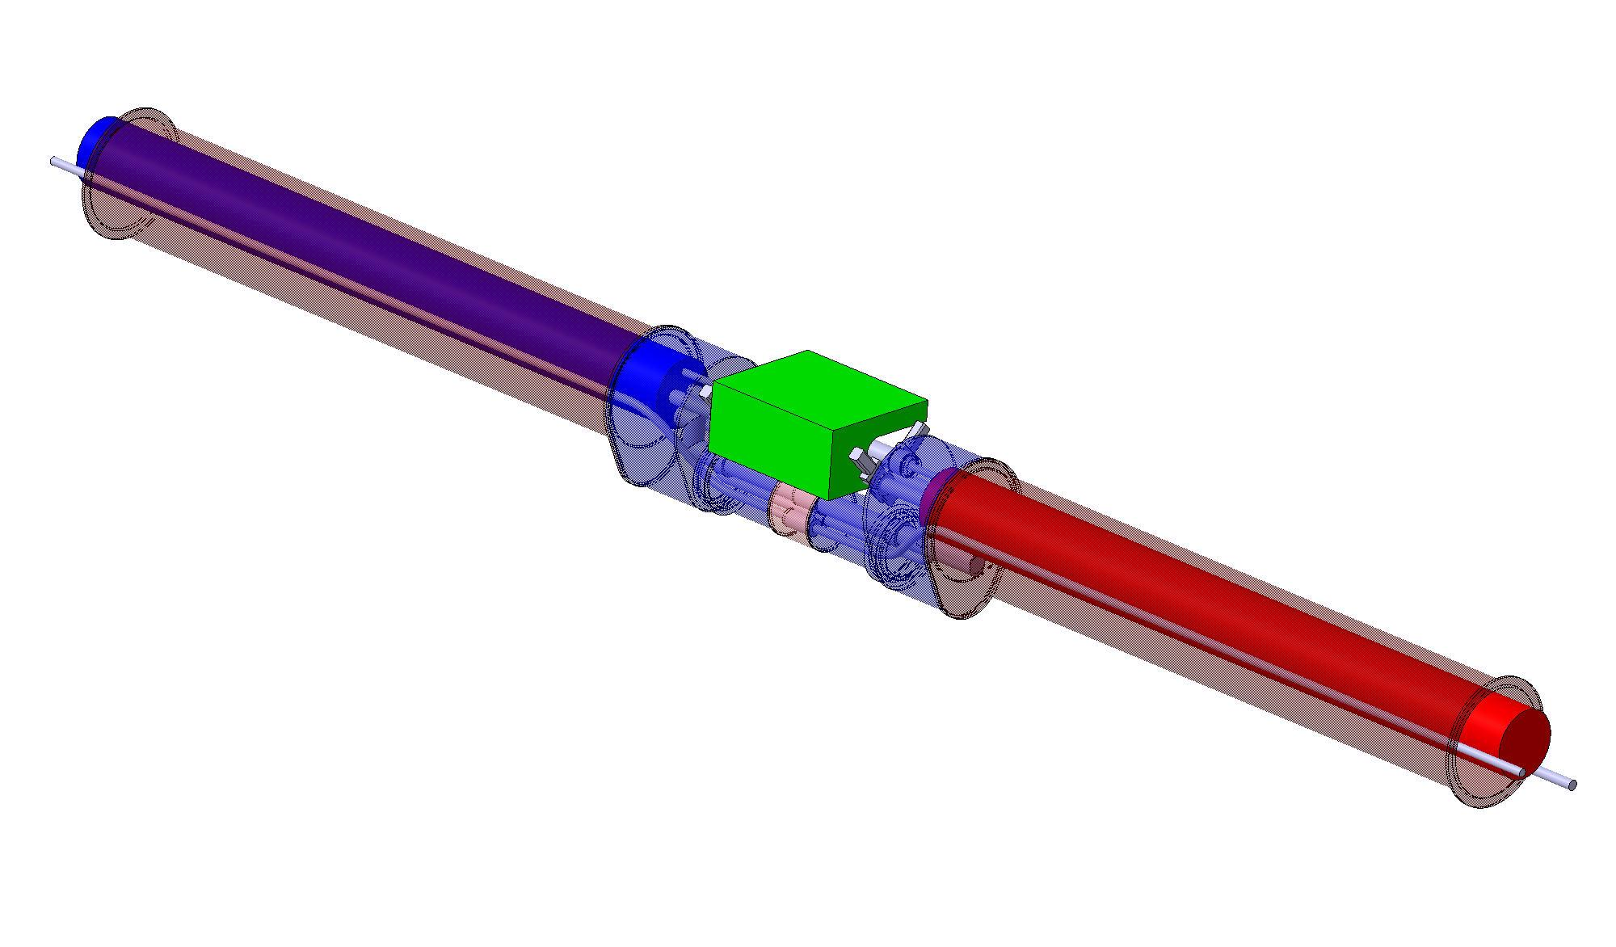
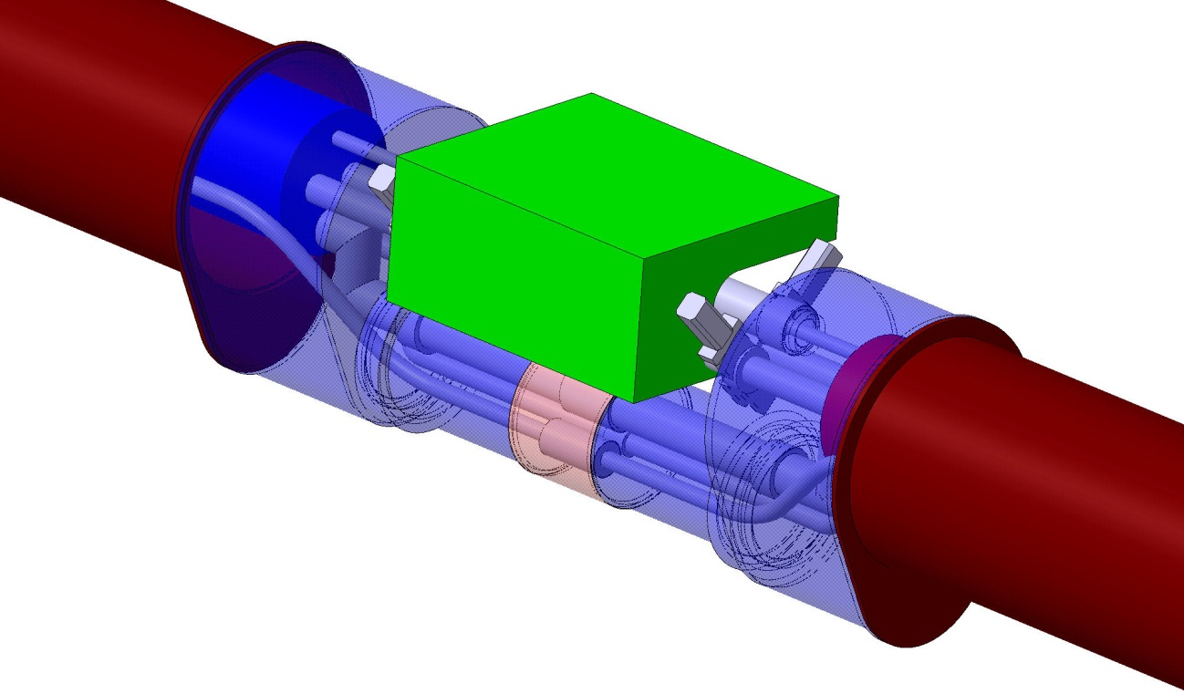
Concept of 11 T cryo-assembly

Slide 13
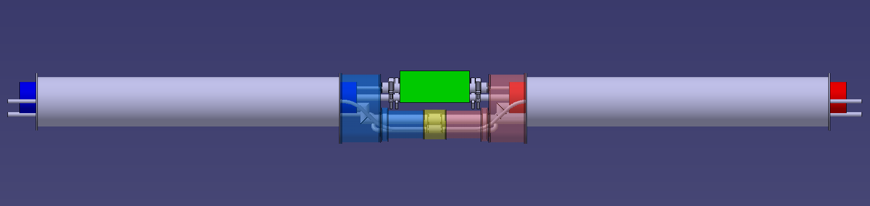
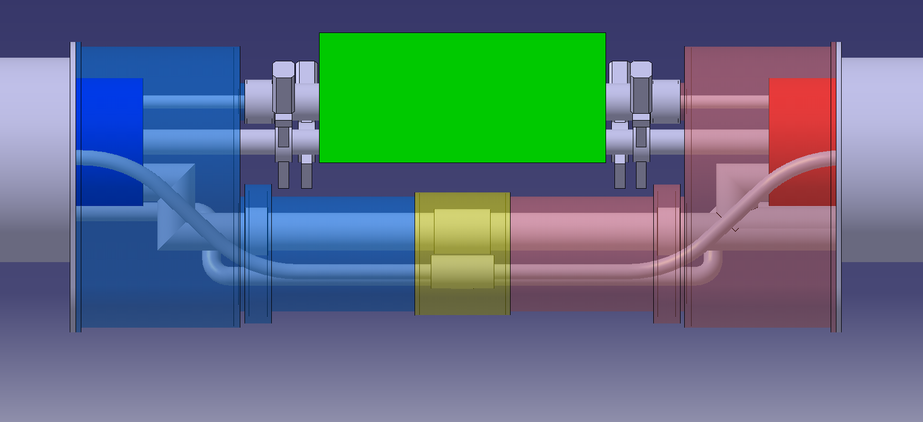
Expansion joints
RF-shielded bellows
Interconnect sleeve (rigid)
Expansion joints or flexible hoses
on all lines

Slide 14
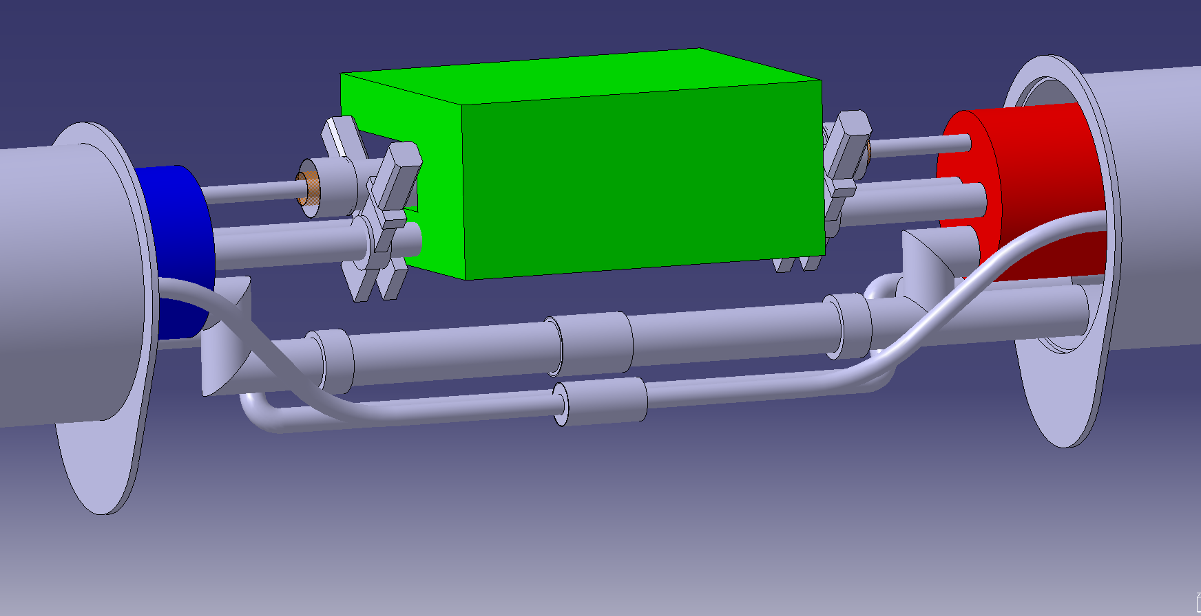
Collimator
Line X
Diode ?
Line M (6 busbars + splools)
Line E
Line N
Lines C’ and K (not shown)
Splices
C’ and K lines not shown

Slide 15
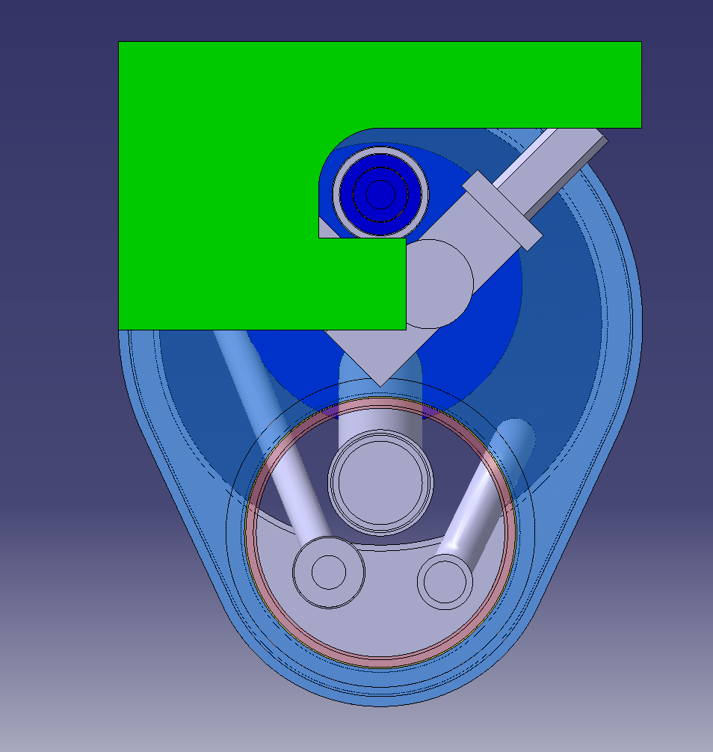
Elements defining the design in the transverse plane
X
Line X insulation
RF-shield module of gate valve
M
N
E
Transport side
QRL side

Slide 16
Main features
Seen by neighbouting magnets as standard dipole: Staightforward replacement in case of major problem
Can be cold tested as a single unit in a dipole test bench and split in two for handling and transport
Standard alignment procedures
Completely independent operation of collimator and cryogenic systems
Access for some in-situ repairs
Simplified construction
Non-compromised functionality wrt existing arcs
Passed a first iteration with simplified CAD model
Minimised impact on the collimator design (assuming 800 mm long TCLD)

Slide 17
The short term “to do list”
50 mm, as the other magnets, standard beamscreens
Cold bore diameter?
Are M1 and M2 busbars needed?
Do we need spools?
Routing the busbars inside the cold mass end covers is the next challenge
Re-design components that can be optimised in length
Detail pipe dimensions and routing
Can we pull the line N cable? Can the line N splice be avoided?
Do we need diodes? One unit enough for both cold masses?
Trim powering? (Use line N? Compatibility with DFBA?)
Cold tests done prior to beam screen installation?
Determine position of supports for compatibility with special SSS cryostating tool and dipole anchors
Do we need to shield the collimator from busbar magnetic field as in the QTC? (stainless or carbon steel covers?)
Do we need more DN200’s on adjacent magnets?
Draft and approve interface specification
yes
Start busbar routing as if we do
Just started
June 2014?

Slide 18

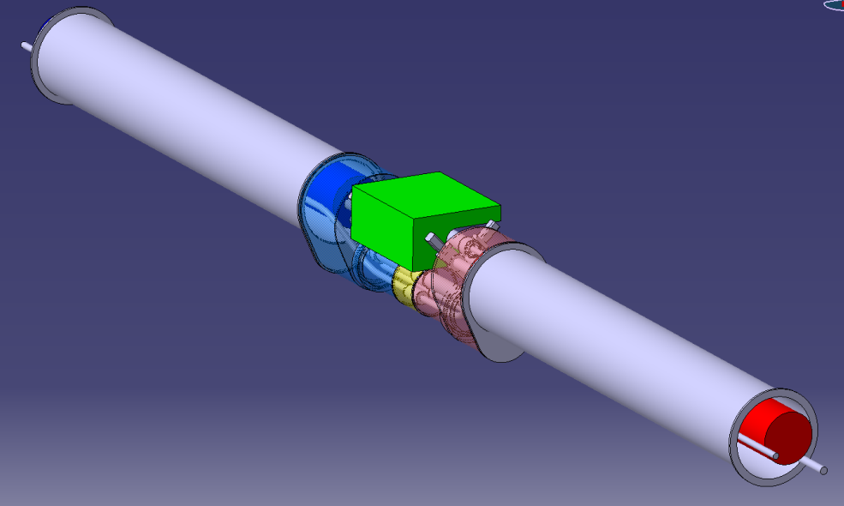
Steps towards “valid for installation” cryostats
2014-15
Mockup of the bypass subassembly (asap!)
  Validate integration of all components
  Measure fabrication tolerances
  Test alignement flexibility
  Train personnel on assembly procedures
  Exercise installation, alignment and removal of collimator
  Simulate repair interventions
  Develop tooling
  Feedback for design improvements
Iterate on drawings, specifications, tooling design
Fabricate and cold test full scale prototype (i.e. 2 cold masses)
Fabricate series
2016?
2017-18?

Slide 19
Final remarks
Making it all fit in 15660 mm is not yet guaranteed -> let’s optimise all we can
One should aim for a design at least as robust as existing arc cryostats, demonstrated by testing
Let’s stick to common practices as much as we can
We need only 2 units for IR2 but more may follow: industrialisation and standardisation of the design are justified from the beginning
Good designs require time for testing and re-iteration, let’s give ourselves the chance to do it by answering open questions as soon as possible!

