Slide 1
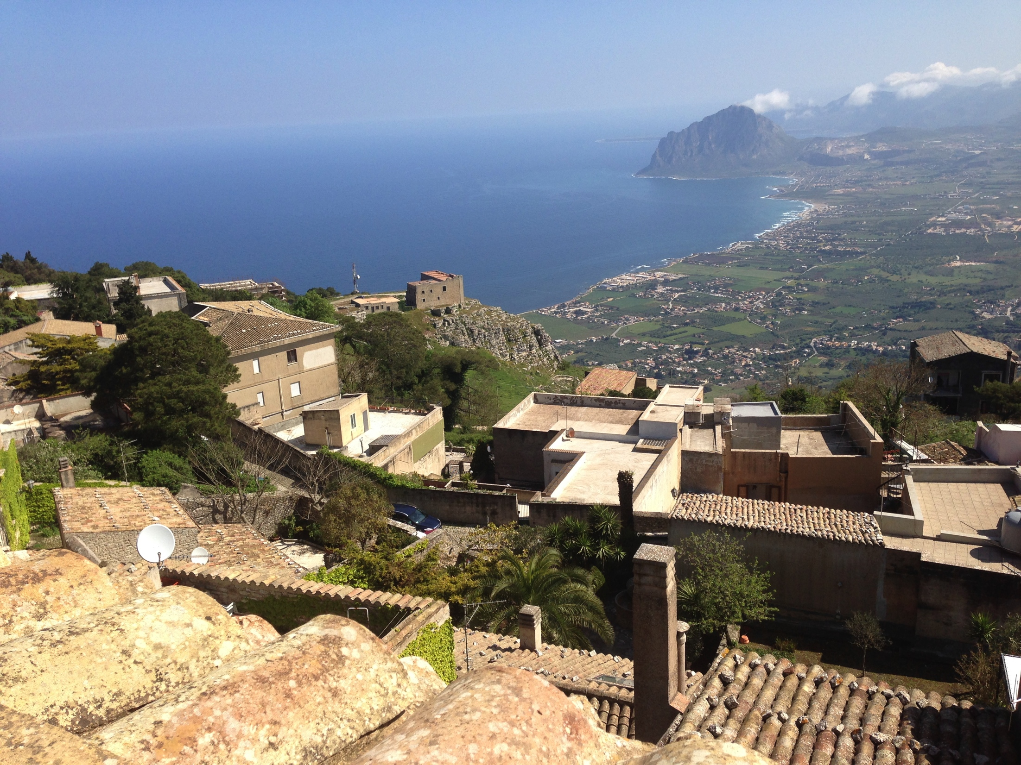
The LHC Synchrotron Light Monitor (BSRT)
Fritz Caspers
Aurelie Goldblatt
Andriy Nosych (CERN / ALBA)
Federico Roncarolo
Georges Trad
Christine Völlinger
Manfred Wendt
CERN

Slide 2
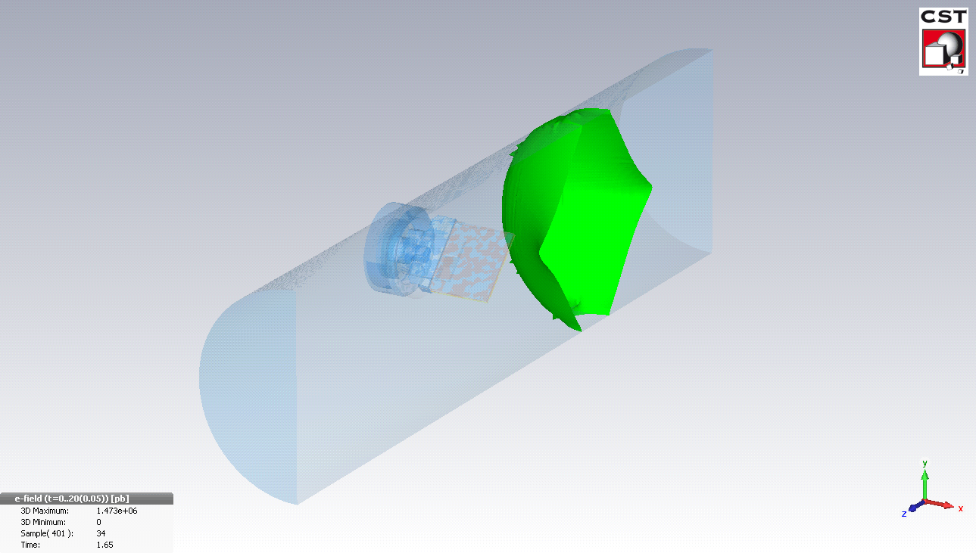

Outline
Introduction
The LHC Synchrotron Light Monitor (BSRT)
The BSRT Extraction Mirror System
Wakefield Simulations
Stretched Wire Measurements
Mirror Losses
Summary

Slide 3
Introduction
The measurement of the LHC transverse emittance / beam profile is challenging
  High beam intensity (beam current: 0.58 mA) and
  high beam power (~4e12 W at 7 TeV)
  at a typical transverse beam size of a few 1/10 mm.
  Too high energy deposition and residual losses in minimum invasive diagnostics, e.g. wire scanner
  Several quasi non-invasive methods still not fully operational, e.g. residual gas ionization, bunched beam Schottky signals.
Synchrotron light presently is the best option for the transverse profile monitoring of the LHC beams:
  The LHC Beam Synchrotron Radiation Telescope (BSRT)
    is based on synchrotron light radiation from an SC undulator (at low energies) and a dipole magnet (at higher energies)
    monitors simultaneously the transverse beam profile, the longitudinal bunch profile (LDM) and sensed the abort gap (AGM).

Slide 4
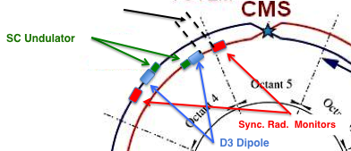
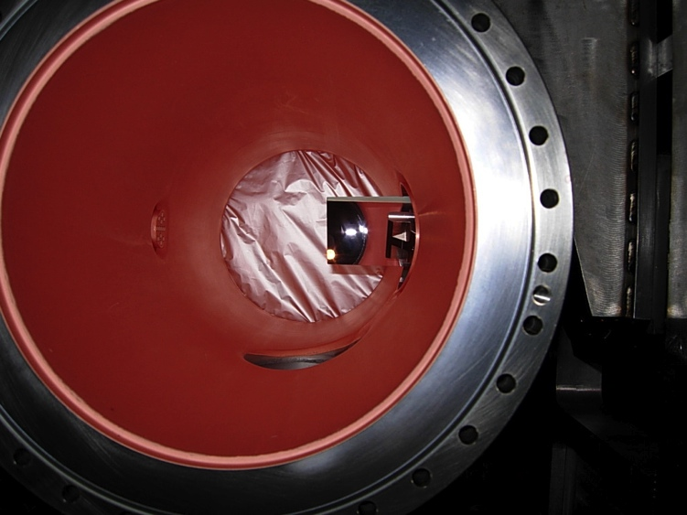
The LHC BSRT
Extraction mirror
View port
Synchrotron radiation is generated
  by the SC undulator,
  used for proton beam energies up to ~1.5 TeV
  by the D3 dipole for higher beam energies

Slide 5
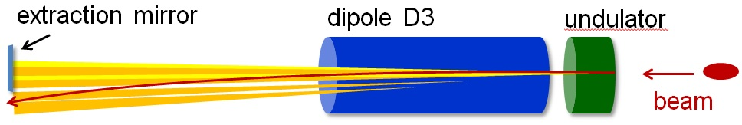
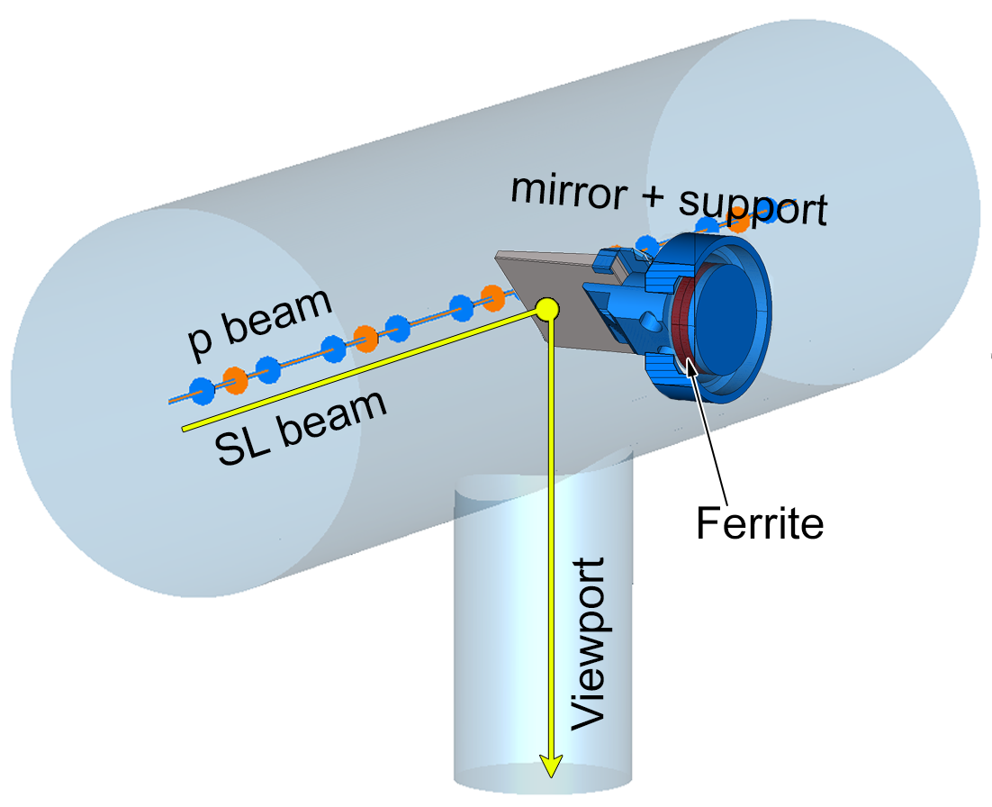
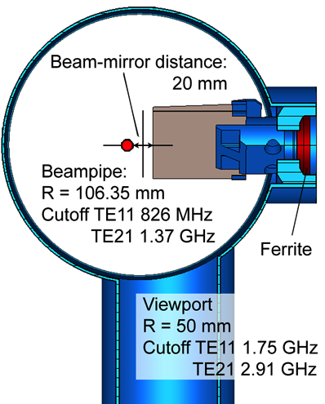
BSRT Hardware Schema
Gated camera
(BSRTS)
Proton/Ion
beam
Optical delay line
DC Camera
60 %
Abort Gap Monitor
(AGM)
40 %
10 %
Neutral filters
90 %
Color filters
Long. Density Monitor
(LDM)
60 %
40 %

Slide 6
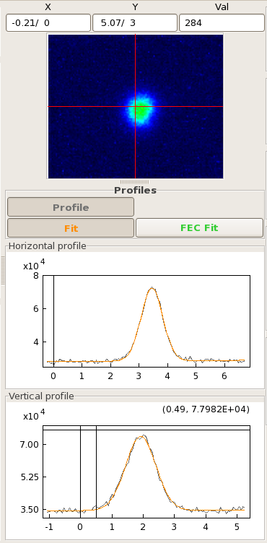
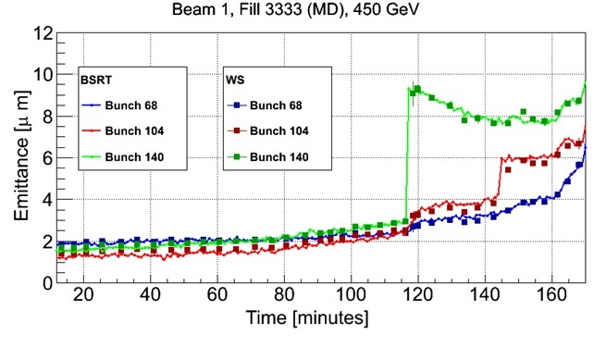
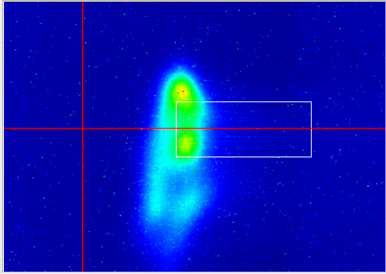
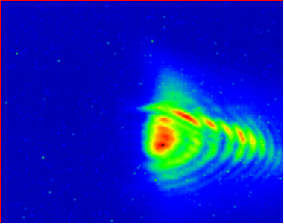
BSRT Operation
…however, the BSRT (particular system B2) showed “unphysical” beam profiles!
450 GeV
4 TeV

Slide 7
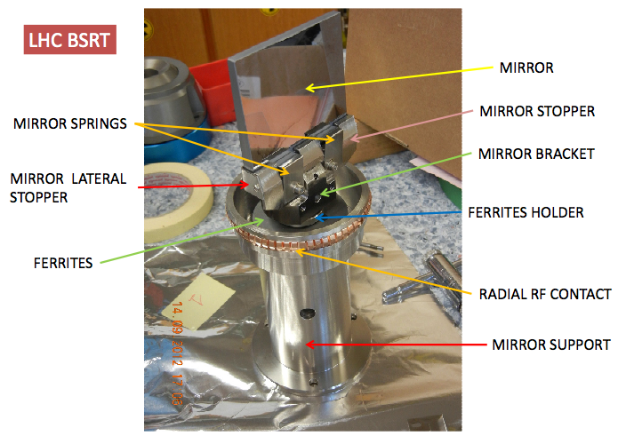
BSRT Extraction Mirror
The extraction mirror was designed being retractable by remote operation
  However, this feature was almost never used!

Slide 8
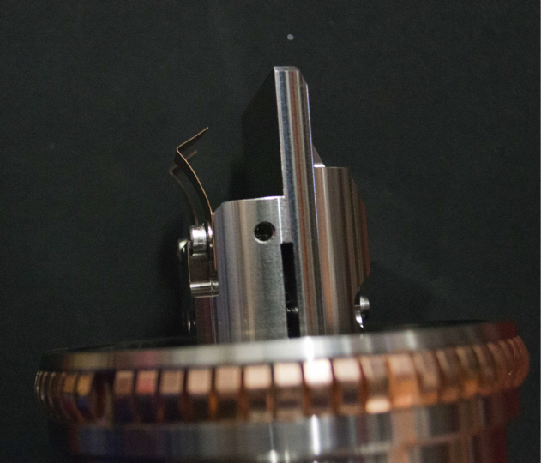
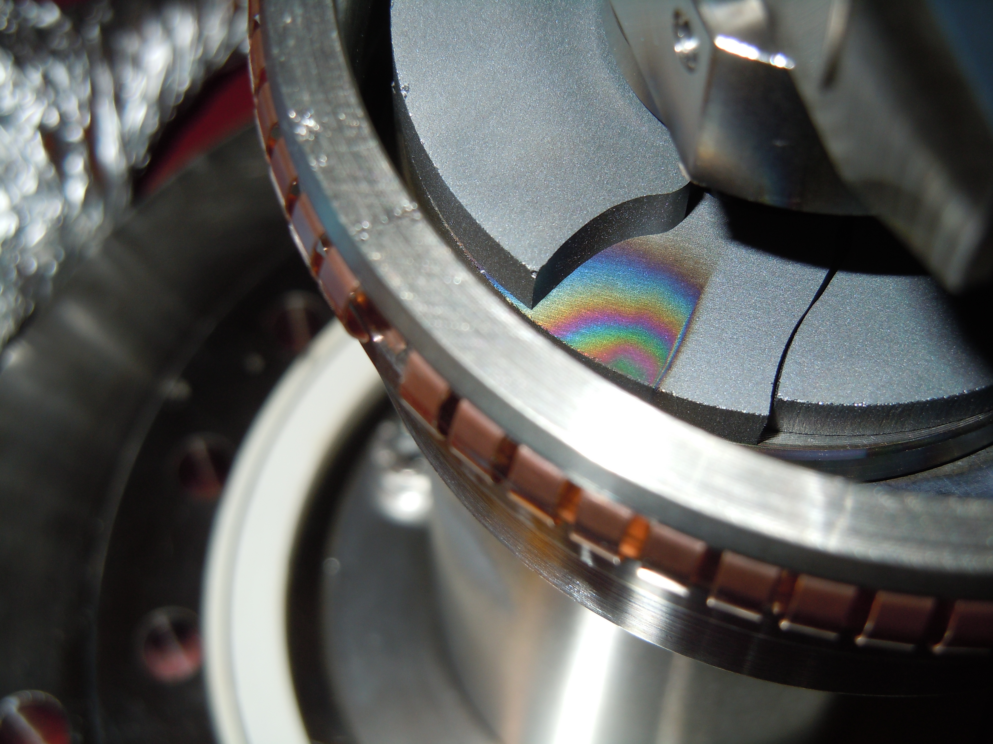
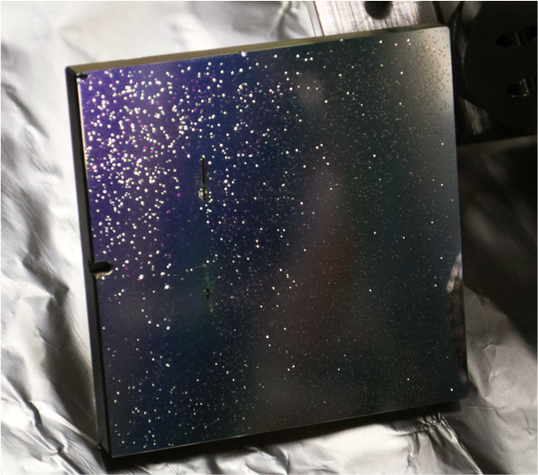
Extraction Mirror Issues
Experimented with various mirror material options
  Si & glass bulk, different coatings, etc.
deformed mirror clamps
overheated and
broken ferrite rings
blistered mirror coating

Slide 9
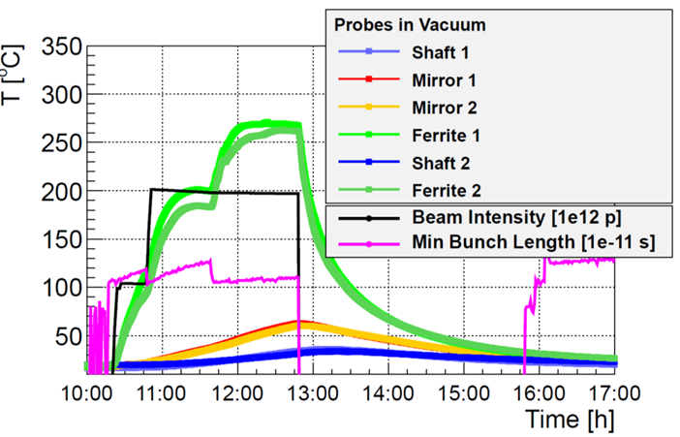
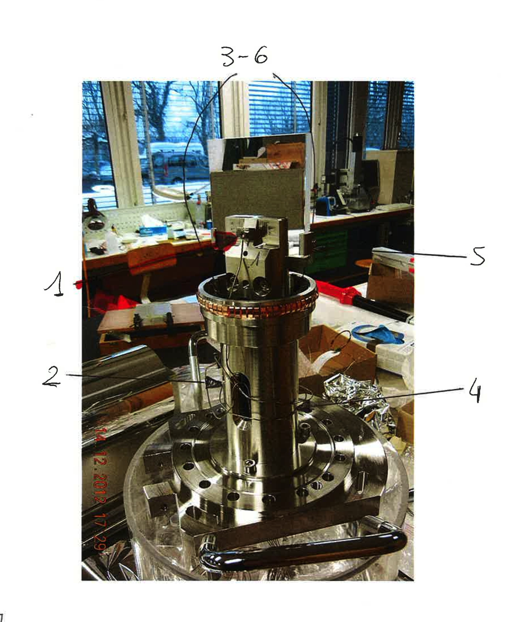
Extraction Mirror Issues (cont.)
Mirror 1
Mirror 2
Ferrite 1
Ferrite 2
Installed temperature probes during LHC technical stop
  Correlation to beam intensity and bunch length
  Ferrite heating likely > Curie temperature of the ferrite HOM damping material
Shaft 1
Shaft 2

Slide 10
Wakefield Simulations: Objectives
Verify HOM resonance(s) of the present configuration
Support a decision an improved BSRT mirror holder system
  Minimize heating due to beam induced RF (HOM) power losses!
  Feasible choice in terms of geometric structure
    Keep the existing vacuum tank construction!
    Don’t alter mirror position and area
    Avoid the need of HOM damping material, e.g. ferrites!
    Avoid exotic, non LS1 manageable ideas (time limit!)!!
      Experimented with spoiler and other solutions…
Detailed wakefield analysis for two geometries:
  Existing mirror holder geometry, replacing some metal parts by ceramic (Shapal) material: Plan A.
  New mirror holder design, with a longer mirror. This version still allows to retract the mirror, but is optimized for a fixed position: Plan B.

Slide 11
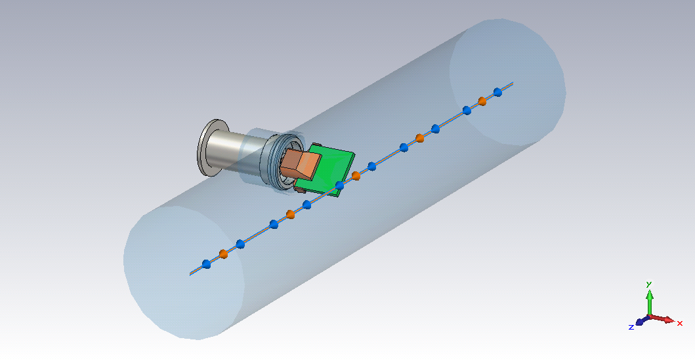
BSRT Mirror Holder Structure A
retractable mirror holder mechanics
mirror, fused silica,
45⁰ orientation
75x75x7.5 mm
beam &
wake integration
path
212.7 mm
diameter
1000 mm length
+10 mm
beam offset
Background material: PEC
  Vacuum displayed almost transparent

Slide 12
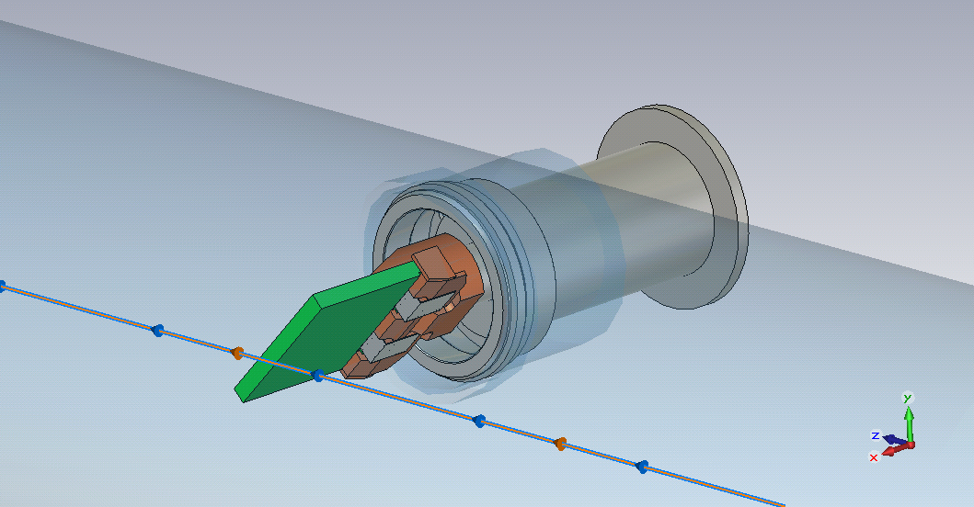
Mirror Holder A (cont.)
Discretization: 35e6 mesh cells
  Hexahedral mesher
  Equidistant cells, 1.3 mm
  Omitted screws, pins, etc.
  Parametric model
  (based on STEP file)
  Tried to follow
  CST guidelines…
contact spring
(simplified)
holder parts:
Shapal or metal
Retractable stem
and disk system
metal clips
mirror material:
fused silica (er=3.83, tand=1.39e-3)
or vacuum

Slide 13
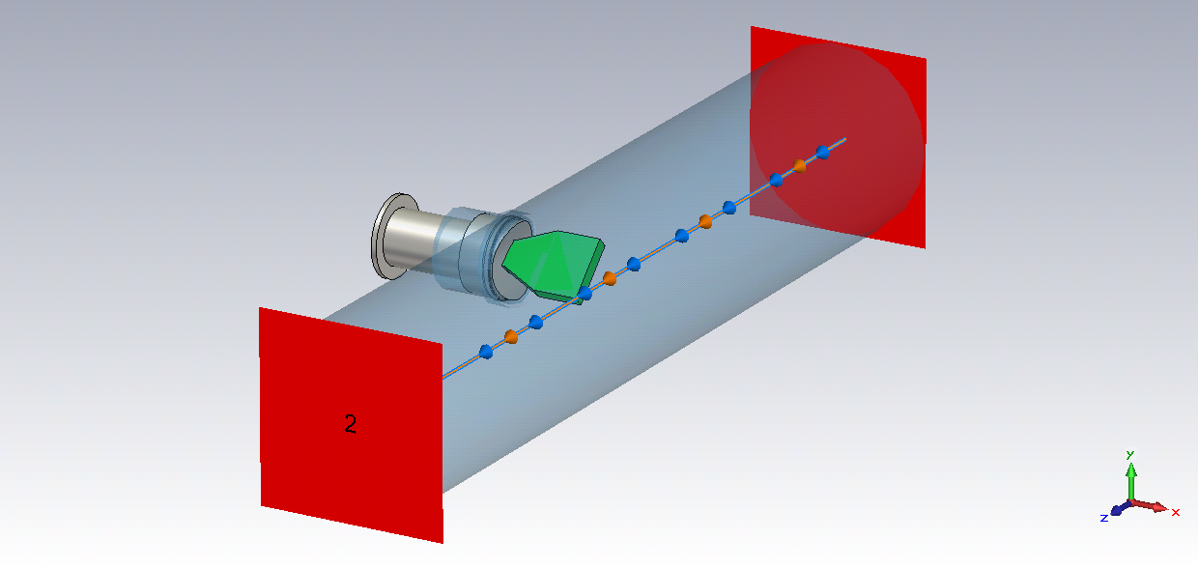
BSRT Mirror Holder Structure B
Boundaries:
  x & y: electric, z: open
  in addition WG ports
    100 modes
elongated mirror,
fused silica,
45⁰ orientation
75x75 mm active area
15 mm thick
non-retractable
mirror holder with
30x15x15 mm slot
Beam:
  Gaussian, β=1
  σ=50 mm
  charge: 1.7e-9 C
  max. freq.: 2.05 GHz (-20 dB)

Slide 14
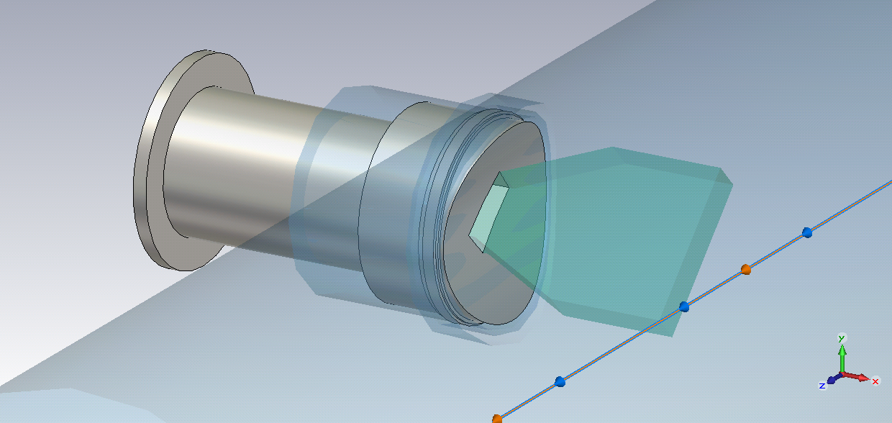
Mirror Holder B (cont.)
contact springs
(simplified)
45⁰ rotated mirror,
preferable fixed position,
15 mm thick fused silica
spherically shaped
mirror holder with slot,
30 mm long,
15 mm height (thickness of the mirror)
15 mm deep

Slide 15
Wakefield Analysis
CST Wakefield solver settings
  Increased wakelength from 20 m to 50 m
    However, stored energy does not reach the -60 dB goal a priory
  Added WG ports to the open boundaries for better energy absorption
    Increased the modes from 20 to 100
  Added DFT/FFT post-processing
  Tried to follow CST guidelines, e.g. equidistant mesh, etc.
  ~30…36 hour simulation time using 24 cores, sufficient memory
    No error messages, except a few wrong filled PEC staircase cells
Configurations
  Structure A
    Present design: mirror holder in metal, mirror out of fused silica
    Modified design: mirror holder & shaft in Shapal, fused silica mirror
    Modified design without mirror: mirror material set to vacuum
  Structure B
    Default design: 15 mm thick mirror made out of fused silica
    Design without mirror: mirror material set to vacuum

Slide 16
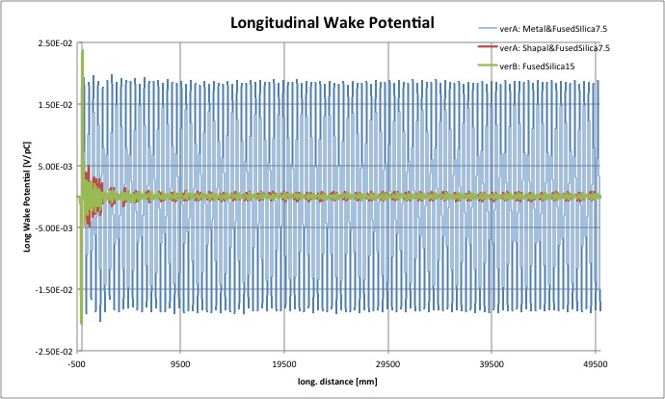
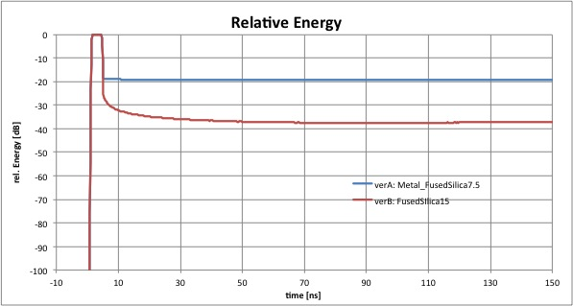
Results – Time Domain

Slide 17
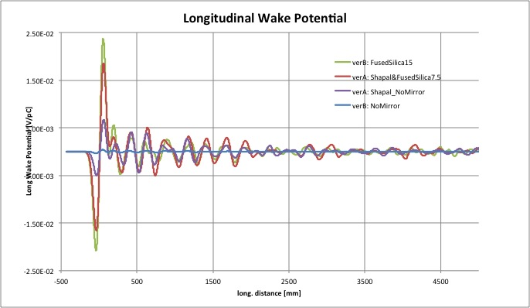
Time Domain (cont.)

Slide 18
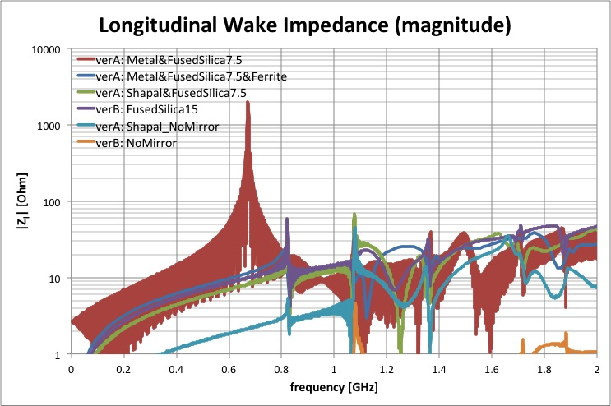
Results – Frequency Domain
the actual peak value is much higher!
f_{res} is shifted, lower value
higher order resonances

Slide 19
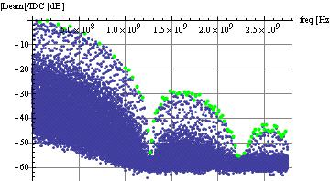
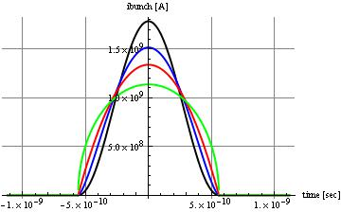
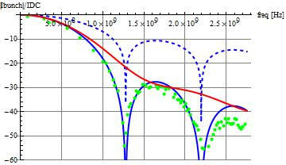
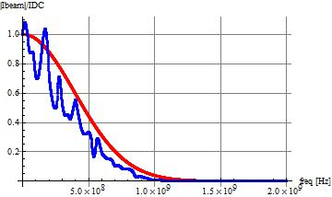
Estimation of the Absorbed Power
t_{bunch}=1.12 ns
bad interpolation because
of bad sampling
tweaked FD response
t_{bunch}=1.12 ns
t_{bunch}=1.12 ns

Slide 20
Power Estimation (cont.)
Assumptions
  i_{bunch} = n_{proton} e f_{rev} with n_{proton}=1.6e11, f_{rev}=11.545kHz
  P_{WB}=n_{bunch} i_{bunch}² Z_{loss} with n_{bunch}=1380, Z_{loss}=2 n_{bunch} Σ[Re(Z_{l} ) PS]
  P_{NB}=i_{beam}² Z_{shunt} with i_{beam}=n_{bunch} i_{bunch}
    Z_{shunt} is based on the estimated or measured bunch current spectrum and Z_{l}
Estimated power losses in Watt:
Config.: | A metal | A Shapal | B | A no mirror | B no mirror
P_{NB}* (calc) | >>76 | 0.9 | 1.0 | 0.05 | ~0
P_{NB}* (meas) | >>48 | 0.6 | 0.7 | 0.04 | ~0
P_{WB} (calc) | >>103 | 1.3 | 1.1 | 0.34 | ~0
P_{WB} (meas) | >>66 | 0.3 | 0.3 | 0.09 | ~0
* taking just the first resonance around ~800 MHz

Slide 21
Stretched Wire Measurements
cylindrical tank,
212.7 mm ID
sync light mirror
on a retractable
shaft system
microwave foam
absorbers,
50 mm thick
310 Ω matching
resistor
10 dB
attenuator
~360 Ω characteristic
impedance
dist
stretched wire,
0.25 mm dia.
10 mm off center
600 mm
50 Ω coaxial cables
VNA
(S21)

Slide 22
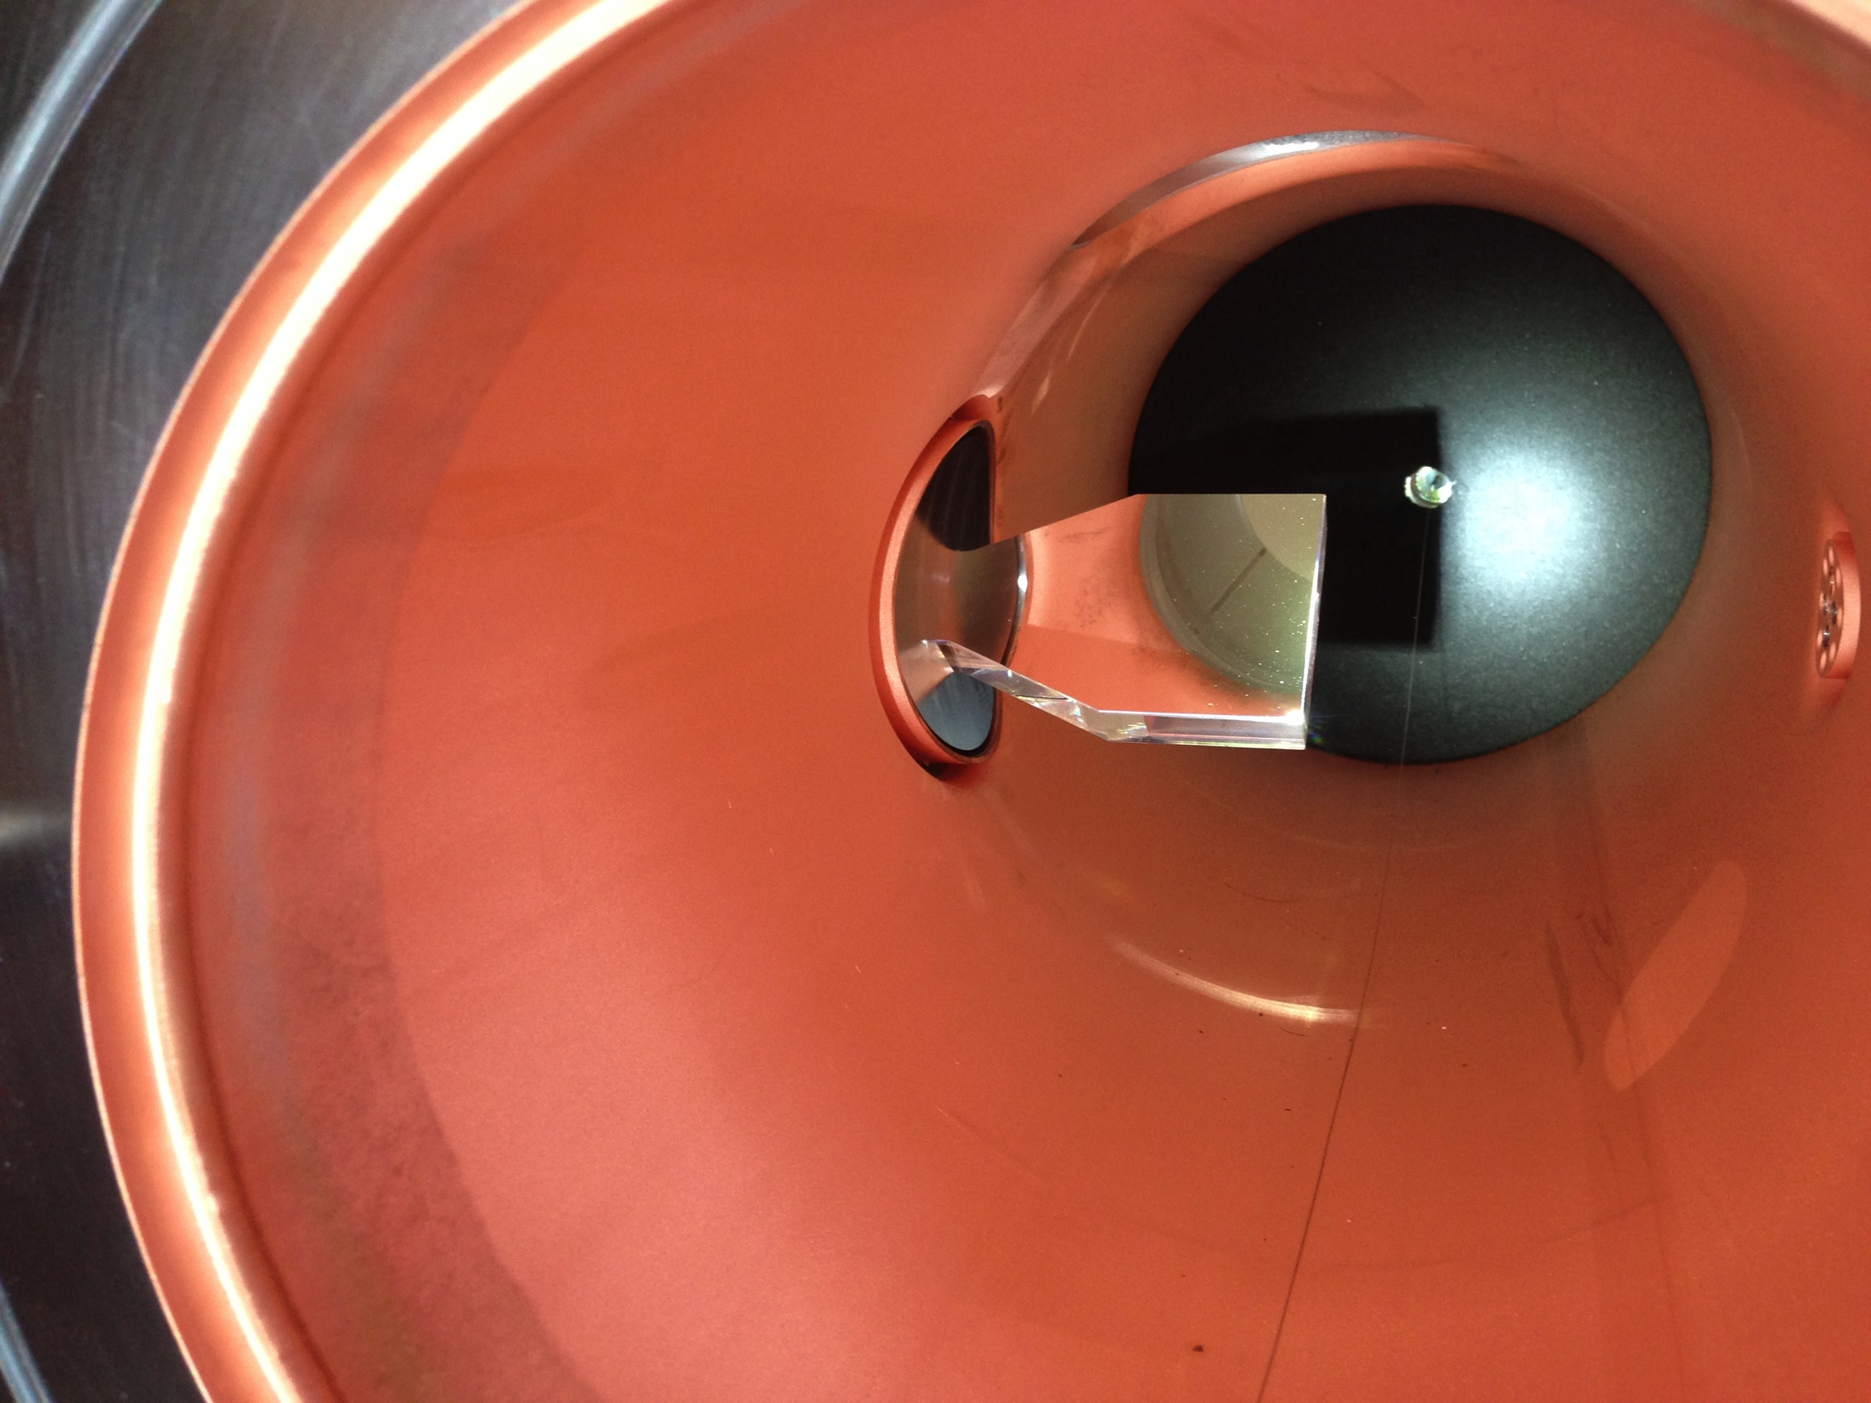
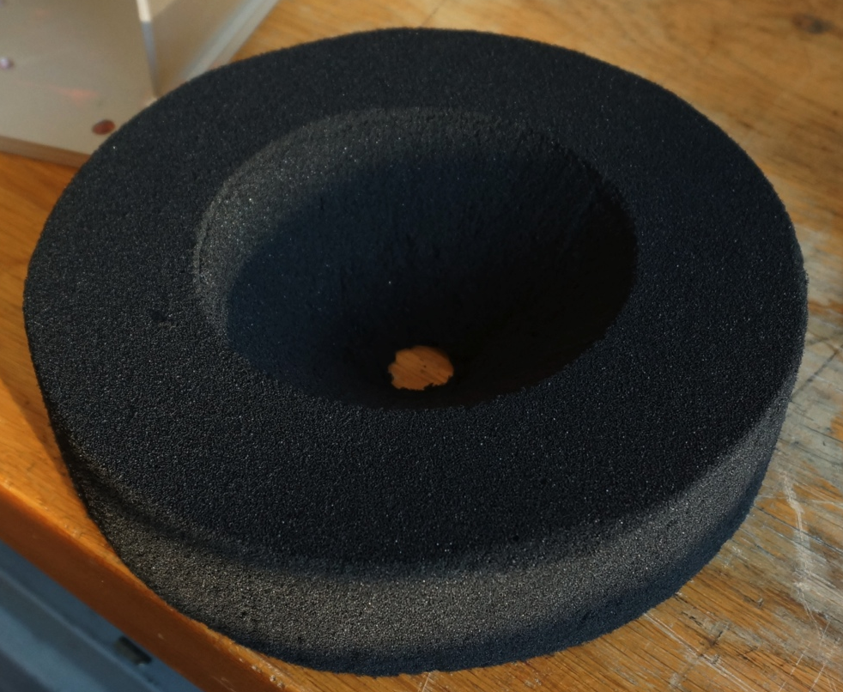
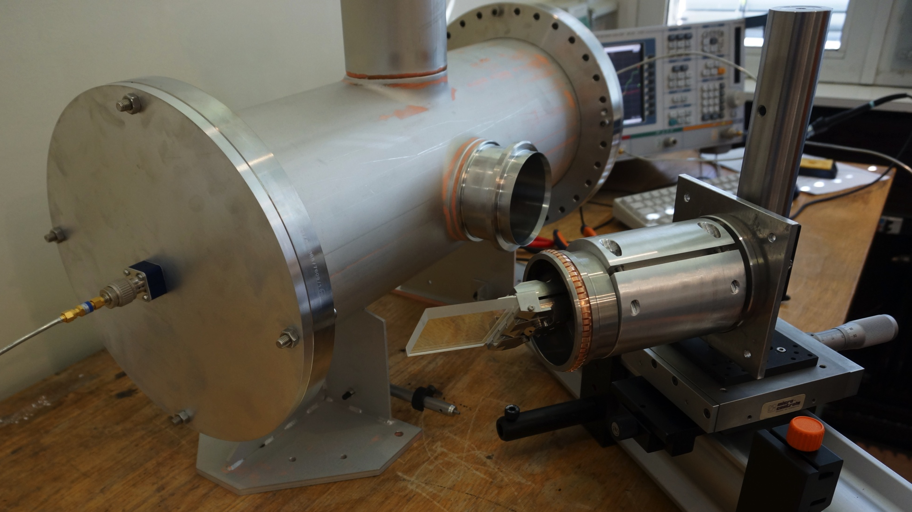
Stretched Wire Setup
The “magic” foam!
View inside wire setup
with new extraction mirror
Stretched wire setup
with original extraction mirror

Slide 23
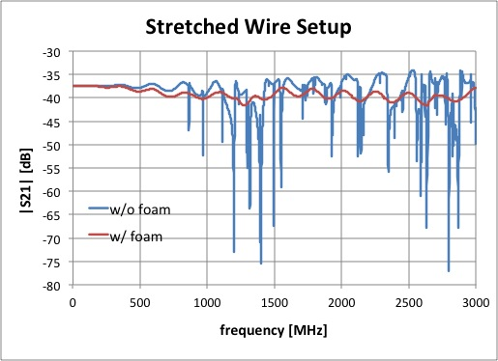
Tame Reflections and Resonances!
Impedance matching towards the ports by a series resistor
  No wound / low inductance carbon resistor, for the matching <1 GHz
  Suppress reflections between VNA and setup by 10 dB attenuators
Absorb reflections at the discontinuities using microwave absorbing foam!

Slide 24
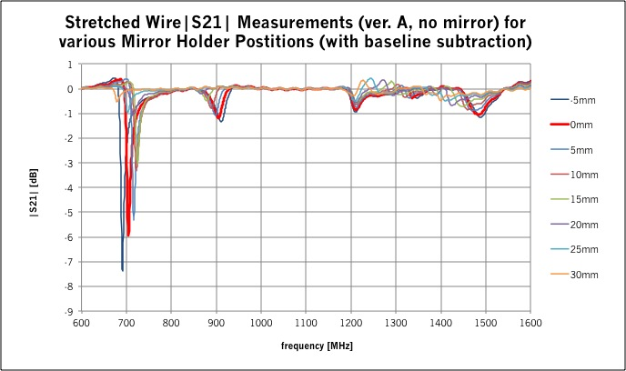
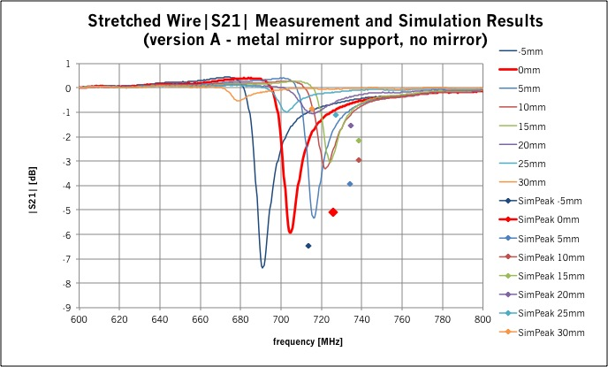
Stretched Wire Results

Slide 25
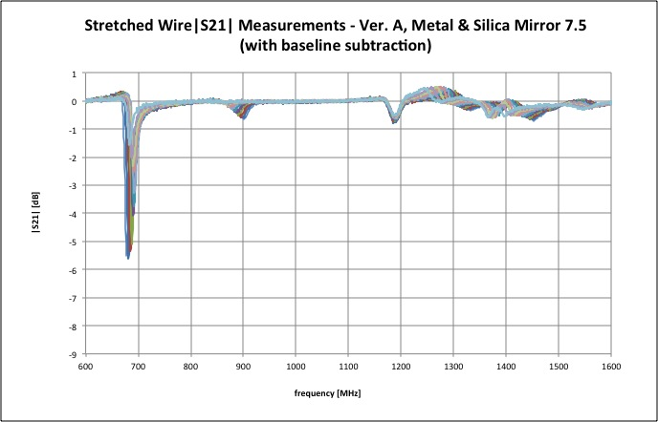
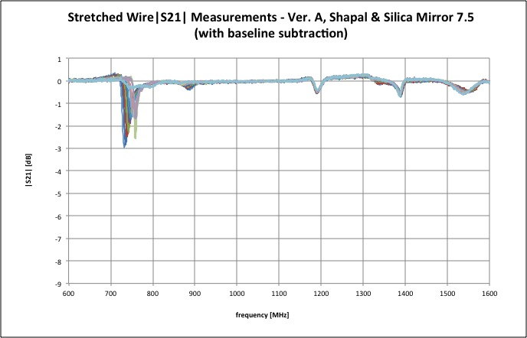
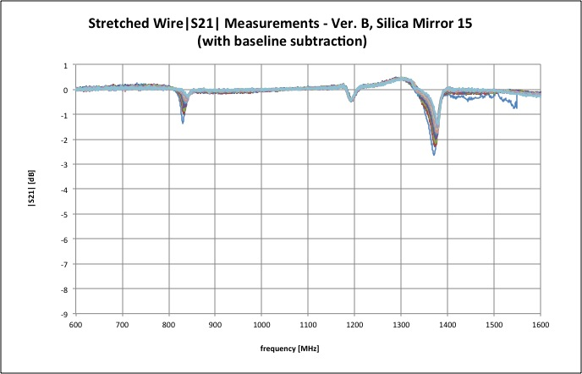
Stretched Wire Results (cont.)
…there is no free lunch!

Slide 26
Measurement of Mirror Losses
DUT: mirror
S-Band WG (WR284),
f_{c} = 2GHz
Measure |S21| and |S11|
Compute |S21|²+|S11|²
  Losses are proportional to
  1-[|S21|²+|S11|²]
VNA
(S11 & S21)
The mirror material (silicon) has higher losses than expected
  “bad” quality material
A 2nd probe measured had a damaged coating
  …but showed lower losses.

Slide 27
Summary…
The extraction mirror system of LHC synchrotron light monitor (BSRT) has been analyzed for HOM resonances
  Resonance effects of the past system could not be tamed with ferrite absorbers due to insufficient cooling.
  Two alternate solutions have been studied with wakefield simulations and stretched wire measurements
    Both solutions promise to have substantial lower impedances!
There is a qualitative agreement between simulations and measurements
  Simulations can be very time consuming!
  HOM / wakefield problems need to be analyzed by different methods to get a better view of the full picture.

Slide 28
…To Do List, and open Questions
Additional analysis need to be performed
  Analysis of the wire measurements!
  Eigenmode analysis
    Did some brief eigenmode simulations, but still need to verify the numbers…
    Need to perform probe-based measurements to complete the picture
  Investigation of the transverse beam impedance
    Simulations, dual-wire measurements?
How does the wire alters the DUT?
  Does it just give qualitative results?
    Useful only below f_{c}?
  Other measurement methods?
    RF-probes? Bead-pull?
What is the “best” method to simulate our problem?
  Computing time and resources!
  How to include the effects of thin coatings?

Slide 29
THANKS
to Benoit Salvant and Elias Metral,
and the CERN impedance police!
to Uwe Niedermayer for his help and discussions on absorptive boundaries in CST.
to the entire CERN BRST team,
and to the CERN BI mechanical support team
  special thanks to Morad Hamani!
THANK YOU!

