Slide 1
A New Indirect Probe of the Higgs Self-Coupling
TLEP Vidyo Meeting
Jan 6th 2014
Matthew McCullough
Simons Postdoctoral Fellow, MIT

Slide 2
Measuring the Self-Coupling
Why is it important?
  It is there, so we should try to constrain it
  Known Higgs mass means it is predicted in SM. Important test!
  Probe of SM scalar potential, with implications for lifetime of Universe!
    (See e.g. Elias-Miro et al.)

Slide 3
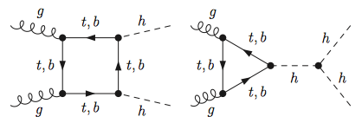
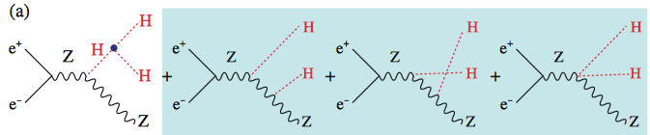
Measuring the Self-Coupling
At LHC (Requires E_{CM} > 2 m_{h}):
At ILC (Requires E_{CM} > 2 m_{h} + m_{Z}):
Dolan, Englert,
Spannowsky
J. Tian, K. Fujii

Slide 4
What if E_{CM} < 2 m_{h} + m_{Z}?
At 240 GeV:
But what if we have:
We would never know?
e
Z
e
h

Slide 5
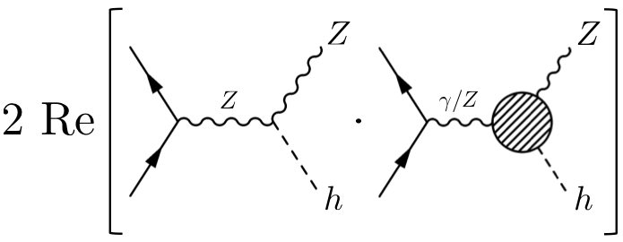
What if E_{CM} < 2 m_{h} + m_{Z}?
Lepton colliders are precision machines. Actually measure LO tree-level and NLO, NNLO, etc:
Can probe new physics in loops as well!
  New physics = new state, modified coupling

Slide 6
Self-Coupling at NLO
For now take simplifying (unrealistic) assumption that only self-coupling is modified:
Which would arise in EFT from

Slide 7
Self-Coupling at NLO
At LO (tree-level) no difference:
e
Z
e
h

Slide 8
Self-Coupling at NLO
At NLO modified coupling enters in the following loops:
And also:

Slide 9
Self-Coupling at NLO
Can use modified self-coupling and calculate:
Does this make sense in QFT?
  Yes, modified self-coupling only at LO.
  If extending to NNLO need counter-term to higher-dimension operator.
  Same as modified htt coupling in gluon fusion

Slide 10
Self-Coupling at NLO
Result:
Feynarts/Formcalc/LoopTools
At TLEP sensitive to
Thus a modified self-coupling of
… would generate a deviation in the cross section measurement!

Slide 11
Self-Coupling at NLO
Result:
At TLEP sensitive to
Thus a modified self-coupling of
Or, if there is a deviation it may be due to modified self-coupling!

Slide 12
Self-Coupling at NLO
Sounds great, but there is a but…
In any realistic BSM scenario not just self-coupling modified.
Really measure:
Can’t “fingerprint” self-coupling from a single cross section deviation.

Slide 13
Self-Coupling at NLO
Could make arguments about whether or not cancellations are occurring.
Or use theoretical arguments ( ) to create a one-sided bound
But there is a better way to proceed… (Mentioned in paper, but emphasized recently by Jesse Thaler)

Slide 14
Self-Coupling at NLO
Corrections are energy-dependent
Corrections from not energy-dependent.
Combine measurements to constrain different linear combinations.
  Get an ellipse-plot constraint

Slide 15
Self-Coupling at NLO
Combining different measurements:
TLEP240 +TLEP350?
(Need input on cross-section precision at 350 GeV. Assuming 1% here)
TLEP240 + ILC500?

Slide 16
Self-Coupling at NLO
Combining different measurements:
Can see usual 28% on plot, but much more information from multiple energies.
Calculation only valid to first order in so take large deviations with pinch of salt.
Note axis scale

Slide 17
Conclusions
Previously assumed that below di-Higgs threshold, nothing could be said about Higgs self-coupling. I.e. the following scenarios are equivalent:
or
This is not true.

Slide 18
Conclusions
In fact, the following two scenarios
or
are distinguishable due to NLO effects.
Indirect constraint has ambiguity
Measurements at multiple energies can lead to ellipse-plot constraints.

Slide 19
Conclusions
In future, could be looking at plots like:

