Slide 1

Services for Long-Term DP in HEP
Services, Common Projects, Business Model(s)
Jamie.Shiers@cern.ch
CMS Week, December 2013
International Collaboration for Data Preservation and
Long Term Analysis in High Energy Physics

Slide 2
Introduction
After several years of study and analysis, the DPHEP Study Group delivered a Blueprint
A summary was input to the ESPP update and Data Preservation is now part of the European Strategy for Particle Physics
A small set of services / projects have been identified / agreed upon
These, together with the associated resources, should now be considered – and handled – as FULL PRODUCTION SERVICES

Slide 3
and

Slide 4
The Approach (DPHEP@RDA-2)
Whilst retaining a holistic view, the problem is broken down into a number of key areas. Each is addressed using state-of-the-art techniques, that include:
  Digital library tools (Invenio²) & services (CDS³, INSPIRE⁴, ZENODO⁵)
  Sustainable software, coupled with advanced virtualization techniques⁶ and validation frameworks⁷
  Proven bit preservation at the 100PB scale, together with a sustainable funding model with an outlook to 2040/50

Slide 5
The Approach (DPHEP@RDA-2)
Whilst retaining a holistic view, the problem is broken down into a number of key areas. Each is addressed using state-of-the-art techniques, that include:
  Digital library tools (Invenio²) & services (CDS³, INSPIRE⁴, ZENODO⁵) + related tools (HepData, RIVET, …)
  Sustainable software, coupled with advanced virtualization techniques⁶ and validation frameworks⁷
  Proven bit preservation at the 100PB scale, together with a sustainable funding model with an outlook to 2040/50

Slide 6
bridges

Slide 7
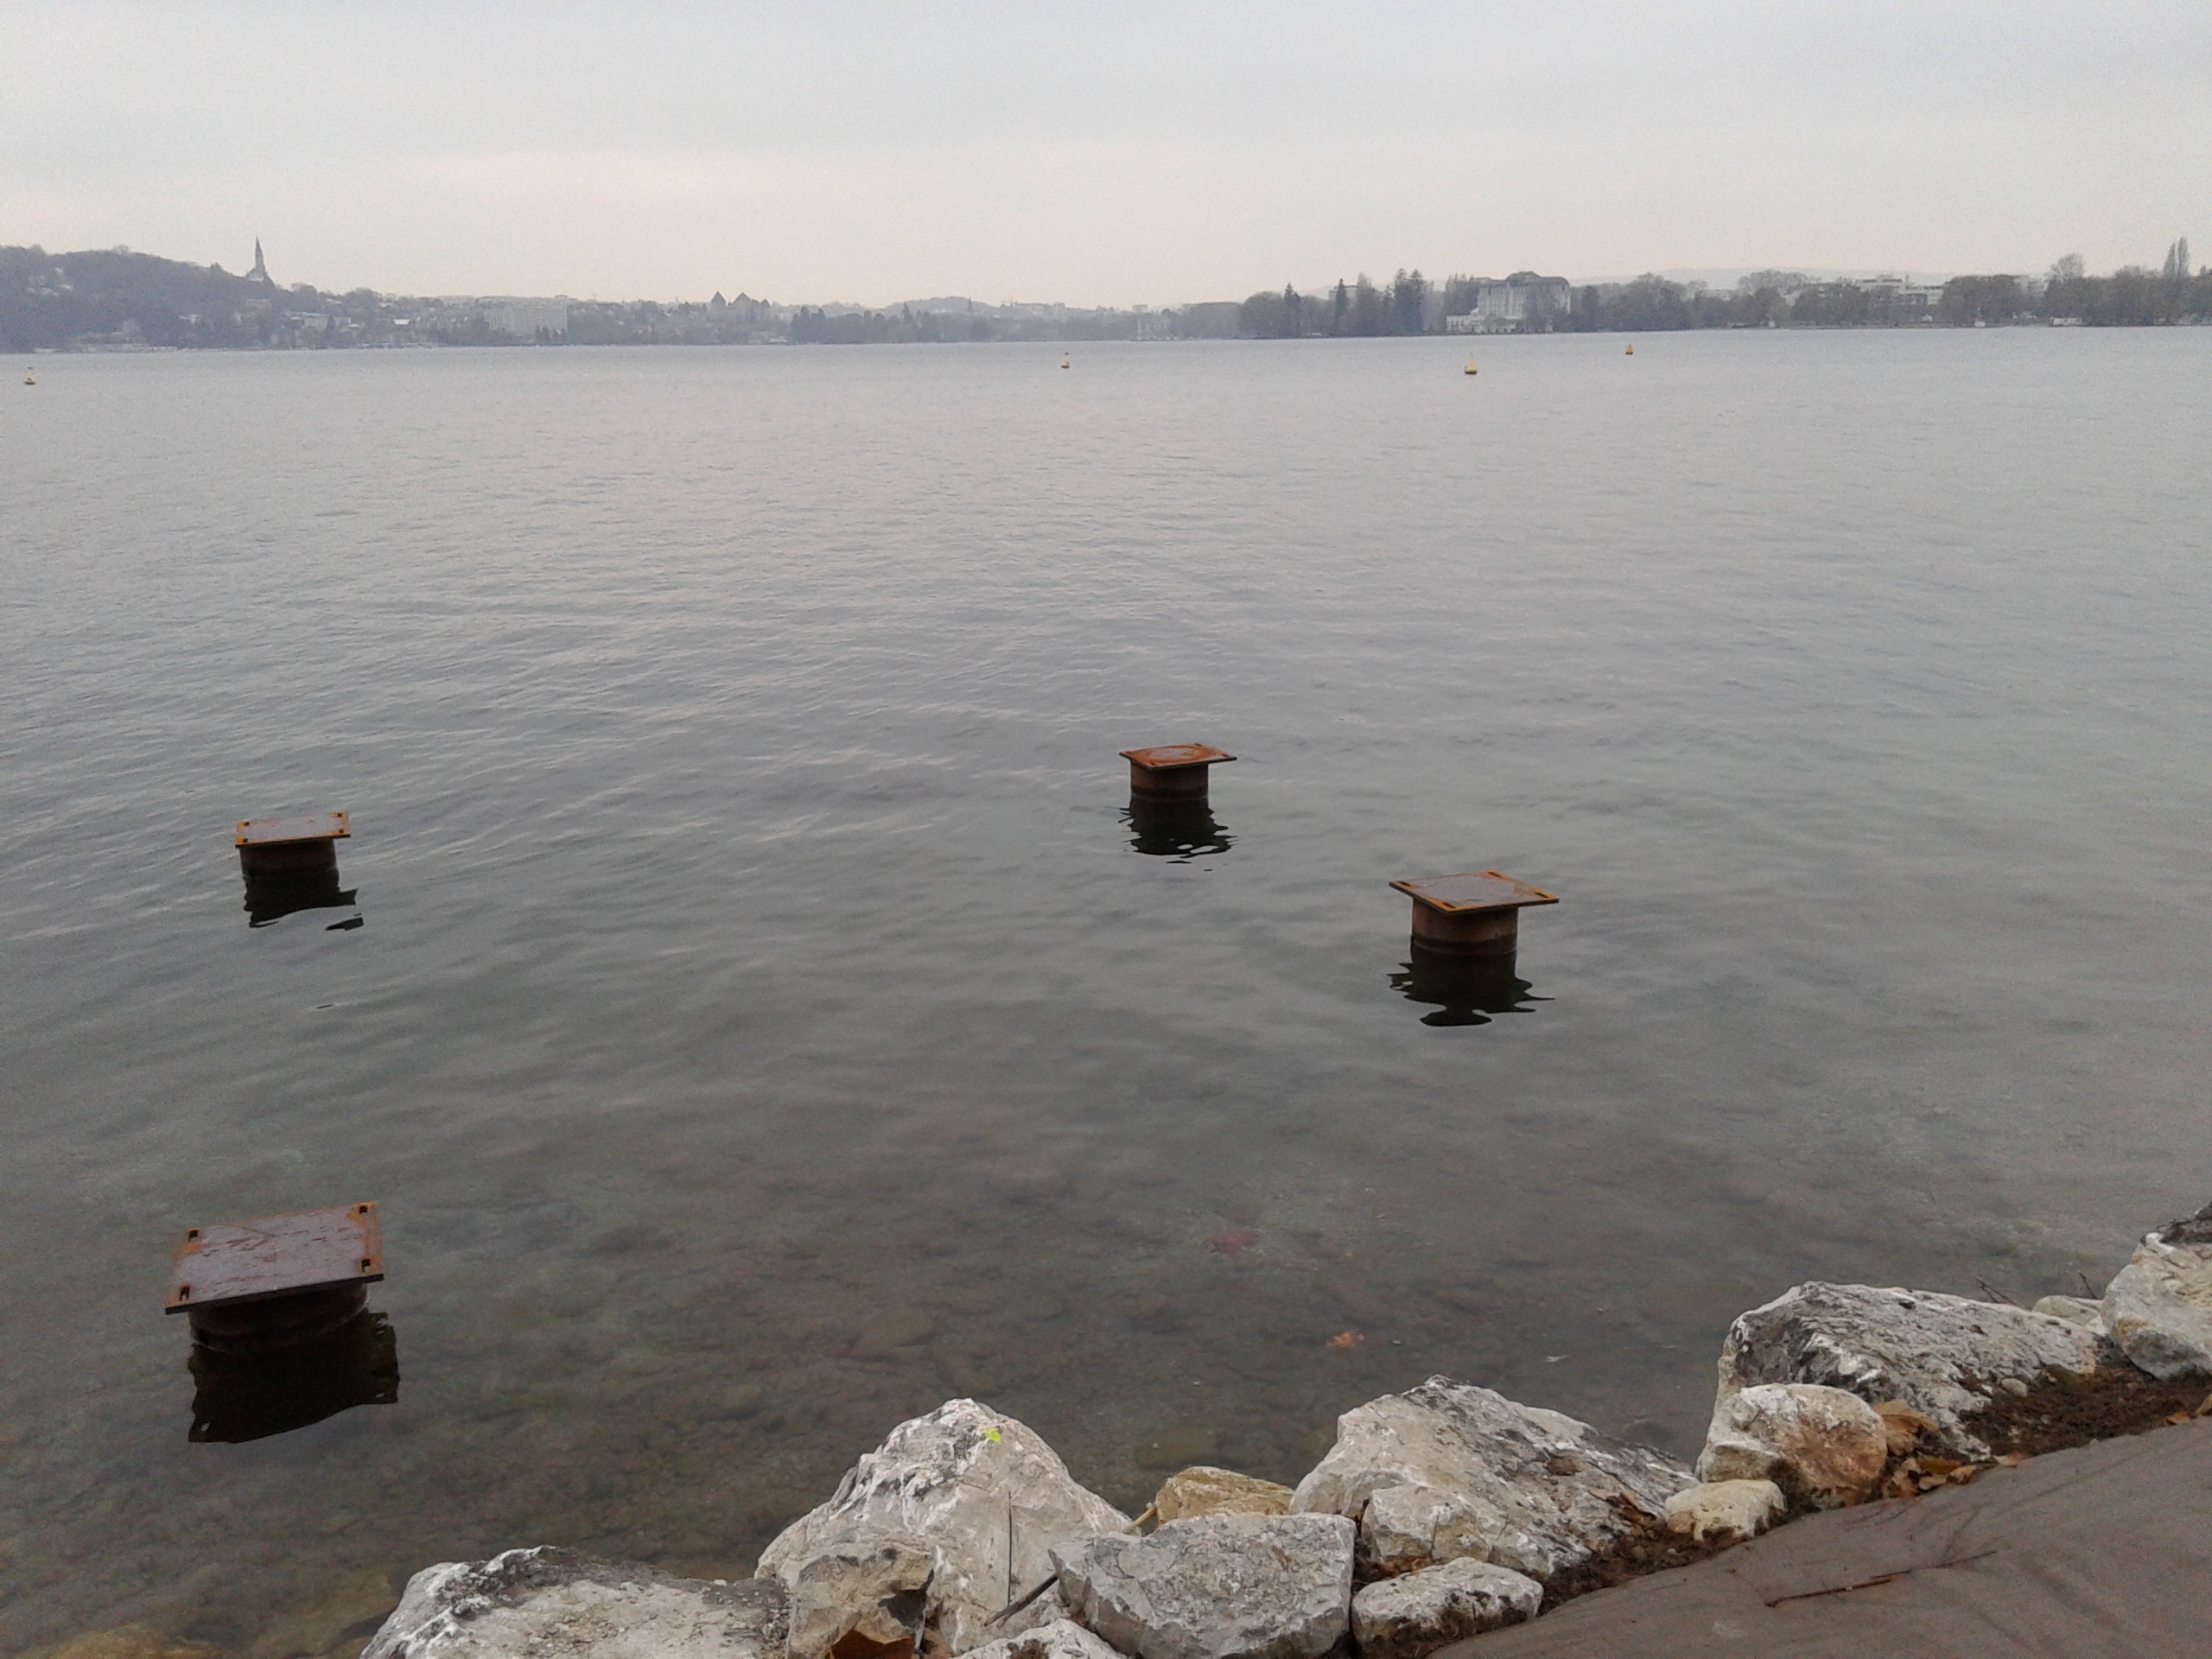

Slide 8
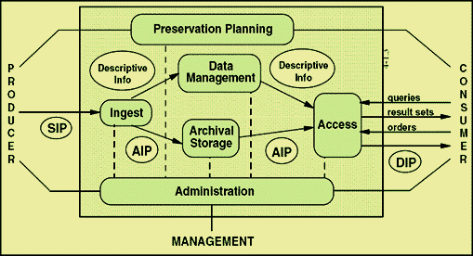
Digital Preservation Solution
the ISO OAIS Reference Model for an OAIS. This reference model is defined by recommendation CCSDS 650.0-B-1 of the Consultative Committee for Space Data Systems;^{[1]} this text is identical to ISO 14721:2003.
Source: Long-Term Preservation of Digital Documents. 2006. doi:10.1007/978-3-540-33640-2. ISBN 978-3-540-33639-6.
Public Domain.

Slide 9
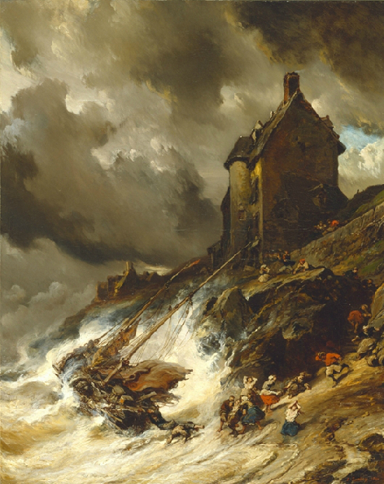
Digital processes break easily
Short-period funding
Software lifecycle: code, interfaces, formats…
Dependent on expert knowledge
Thin documentation and metadata
Source: : wikipedia PD Image resources

Slide 10
Bridging Components
We need to design and build “bridges” between the individual components
Respecting an overall architecture (OAIS)
Ensuring the implementation is not tied to “CERN services” – e.g. fully applicable to other HEP experiments / services at other sites
As “future-proof” as possible
We need to do this together – and profiting from extensive existing experience “elsewhere”
A “hurried implementation” now could cost a huge amount in the long term

Slide 11
Practically
Get the experts from the service providing groups / teams, plus the users, together asap
Involve external expertise early on!
Having something implemented well ahead of (CMS) deadlines
Accept that the first iteration may (will?) require modification / re-design
This could start in the 1st working week in 2014…
Continue to use DPHEP IB for coordination / information + detailed technical (multi-party) meetings to prepare for these

Slide 12
resources

Slide 13
Resource Requests / Reporting
Data Preservation resources (M+P) will feature in updates of CERN Medium Term Plan
  Important / necessary for resourcing and continuity
  “Zero sum game” is IMHO a “worst case scenario”
Also expect to use Resource Review Board: some significant elements, e.g. “bit preservation” already funded!
Continue to report to senior CERN management – their buy-in and support essential!
The January “Full Costs of Curation” workshop will be fundamental in preparing “Business Plan”

Slide 14
Summary
The hardware resources required “immediately” have been agreed as part of a pilot
Longer term resource requests need to be formulated as part of overall needs
Key CERN services: strong support and commitment from the departments / groups
Need to bridge these – and understand (DPHEP) how equivalent services can be offered at other host labs and beyond

