Slide 1



AD-4 Status Report 2013
Biological Effects of Antiprotons
Are Antiprotons a Candidate for Cancer Therapy?
Michael H. Holzscheiter
The ACE Collaboration
Additional ontributions to phase two:
University of Athens, Queen’s University Belfast
German Cancer Research Center Heidelberg
Universita d’Insubria Como, University of Umeå

Slide 2
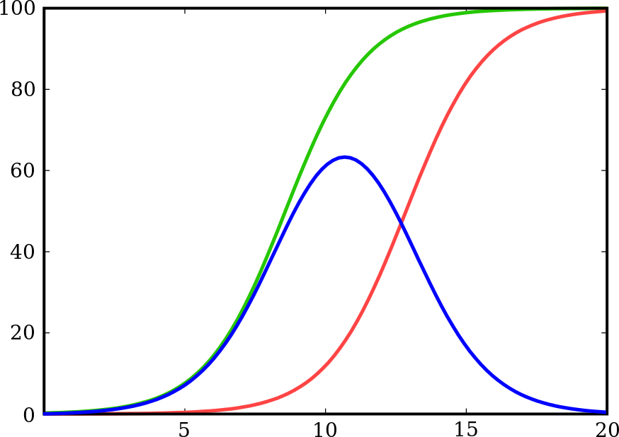
Rationale for Conformal Radiotherapy
Dose and tumor control are limited due to organs at risk.
Tumor control
Complications
Probability (%)
Therapeutic
window
Dose (arb. Gy)

Slide 3
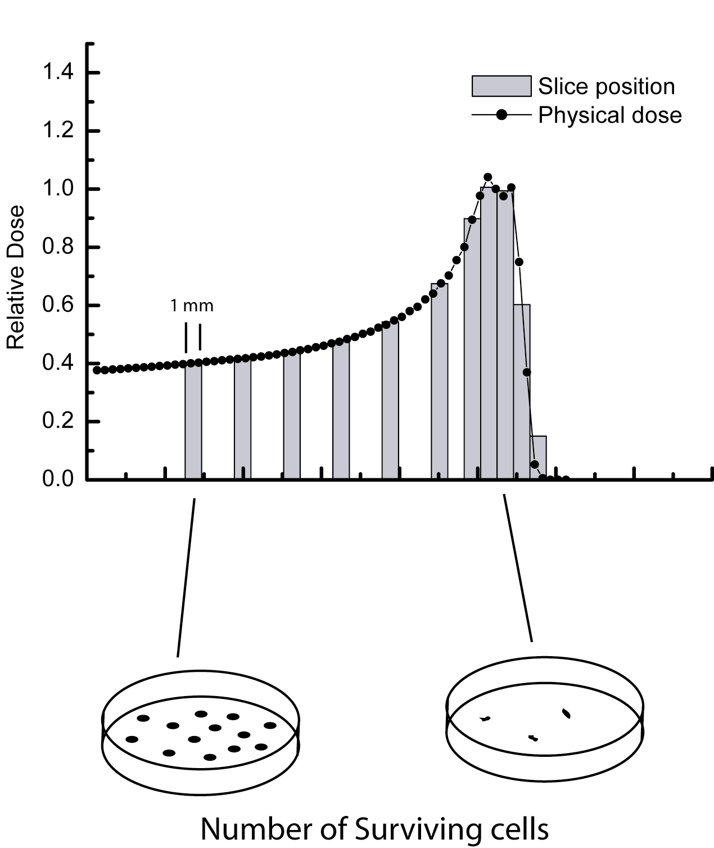
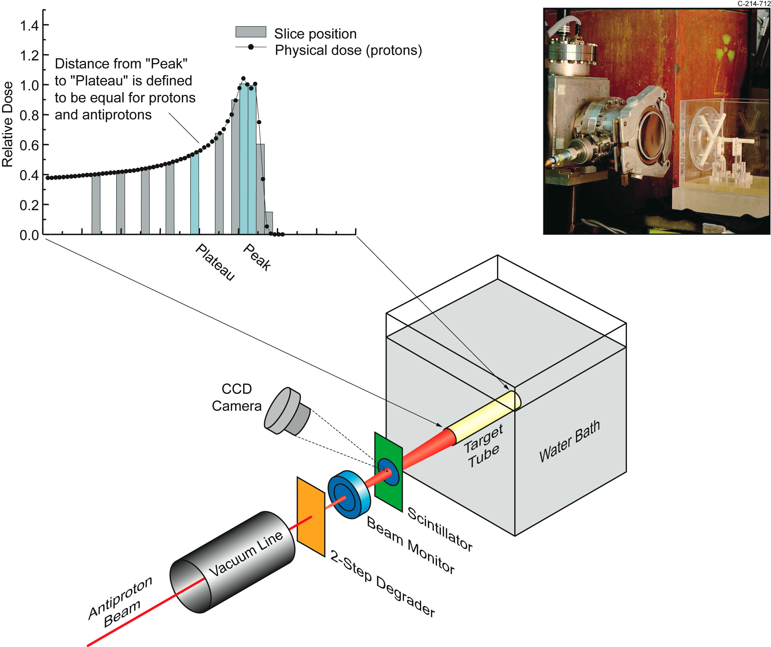
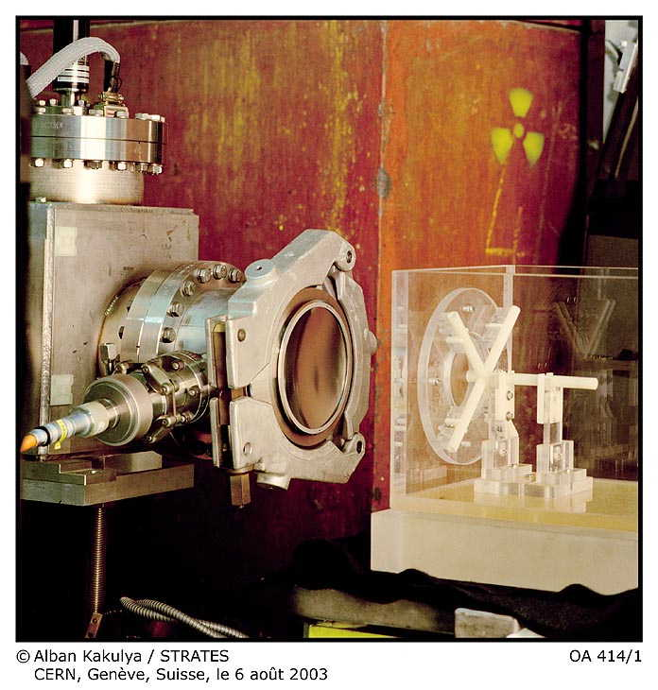
The AD-4 Experiment at CERN
INGREDIENTS:
V-79 Chinese Hamster cells
embedded in gelatin
Antiproton beam from AD (126 MeV)
METHOD:
Irradiate cells with dose levels to
give survival in the peak is between
0 and 90 %
Slice samples, dissolve gel, incubate
cells, and look for number of colonies
V79
Developed by Ford and Yerganian in 1958 from lung tissue of a young male Chinese Hamster (Cricetulus griseus)
ANALYSIS:
Study cell survival in peak (tumor),
plateau (skin), and along the entire
beam path. Compare the results to
protons (and carbon ions)

Slide 4
Final Analysis of Data
Biology
Physics
Cell Count:
cells plated
cells counted
PE from control
PE from fit
Potential Errors:
Fitting Algorithm
Stability of fit
Redo dose calculations
Refine geometries
New input files
Run all relevant years
using same FLUKA release
Fluka issues
Benchmark Experiment
no longer in agreement?
Combine data set
Extract RBE vs. Depth

Slide 5
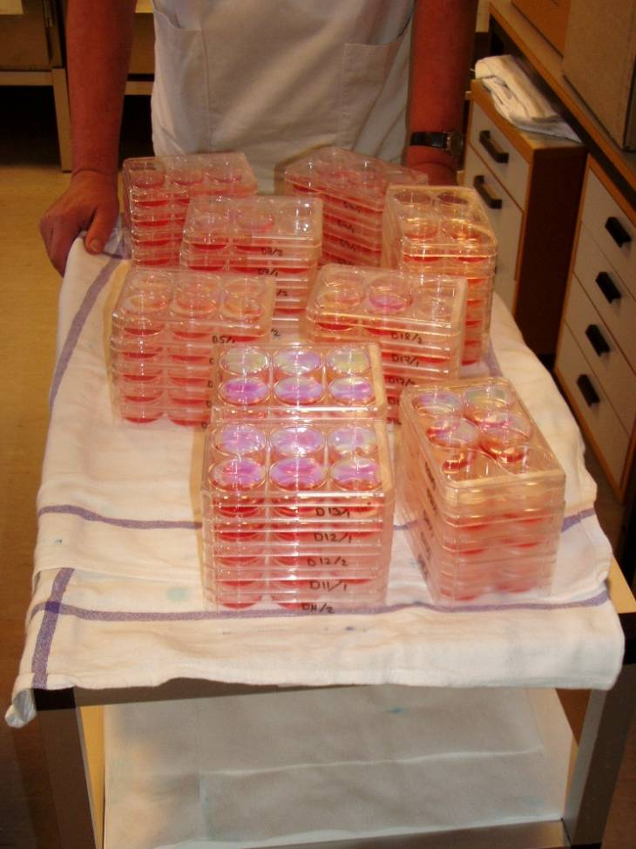
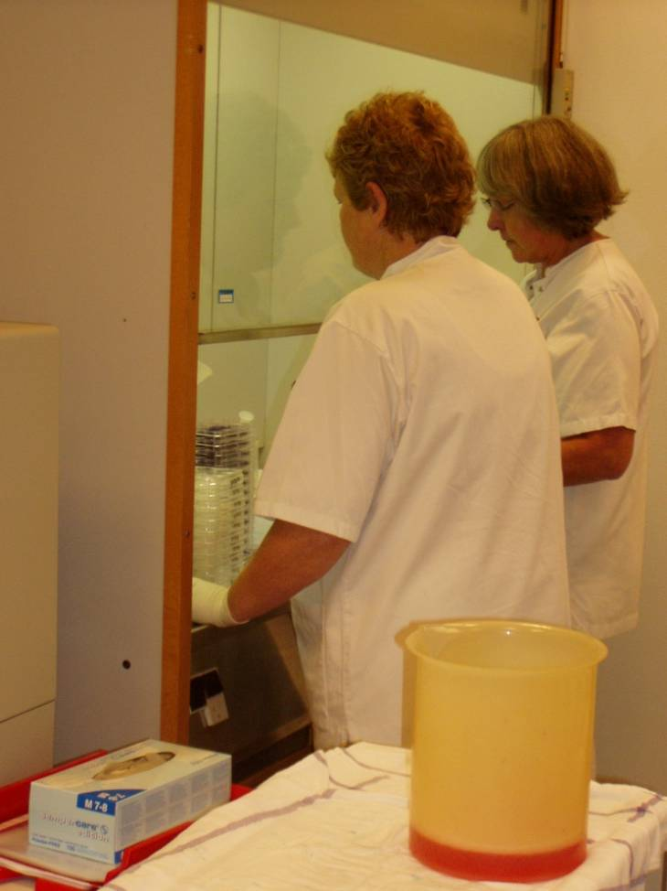
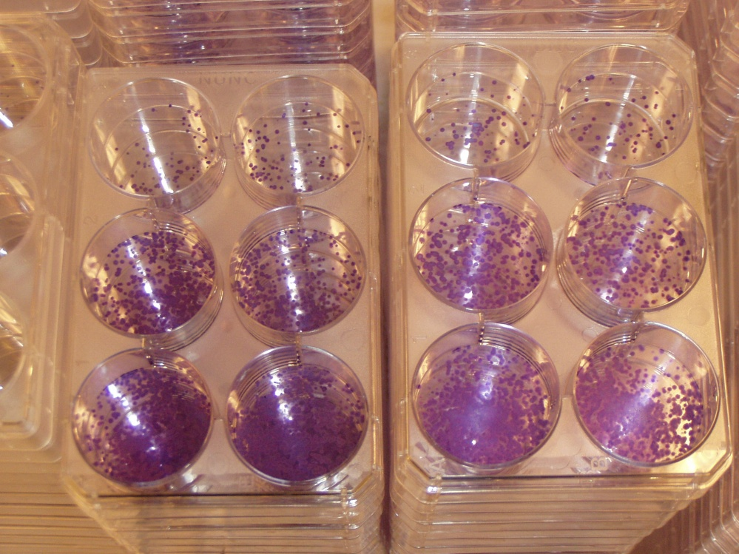
The Gel-Tube Method

Slide 6
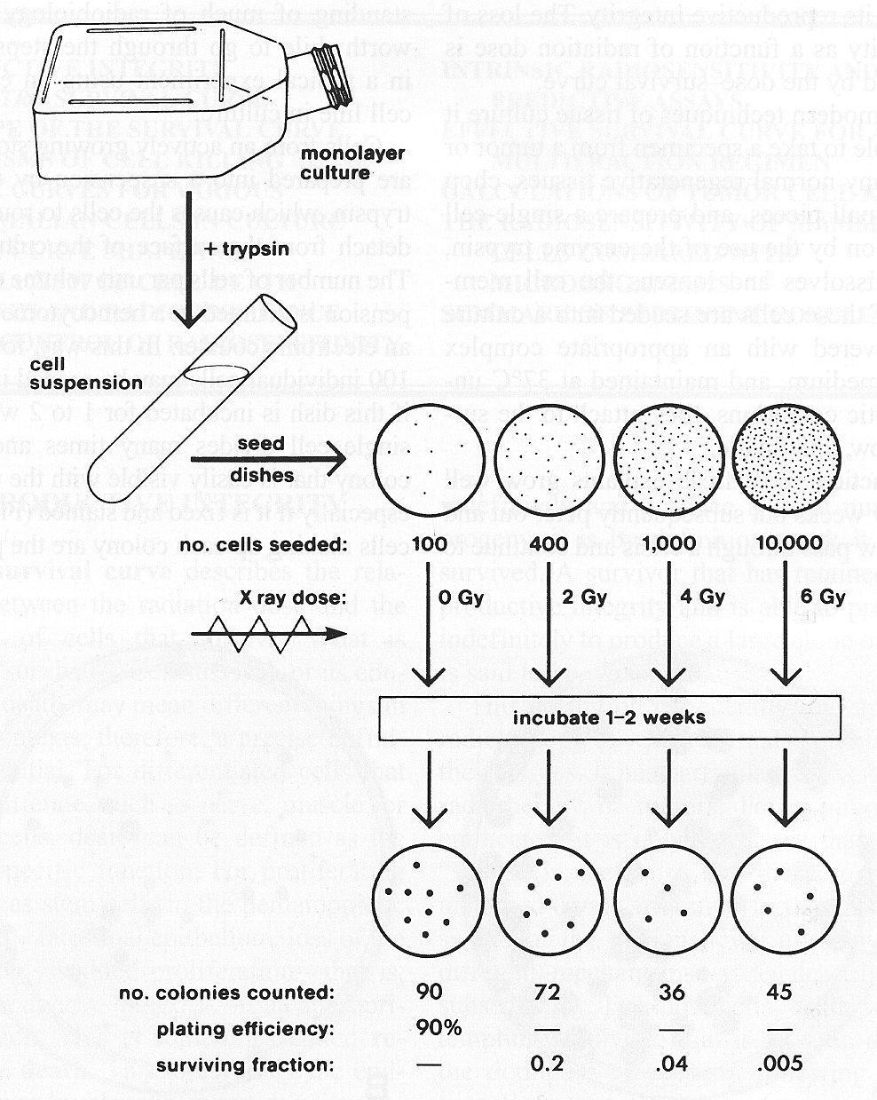
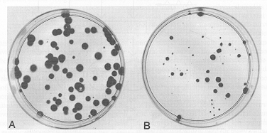
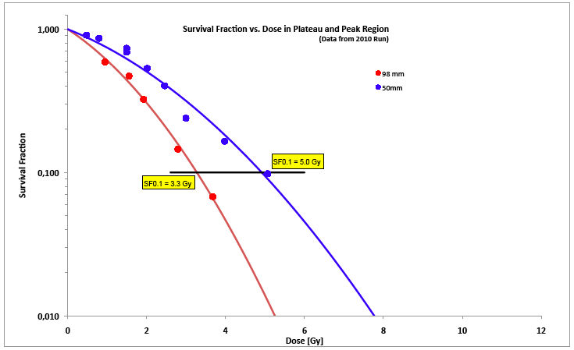
Biological Analysis Method
RBE_{peak/plateau} = 1.52

Slide 7
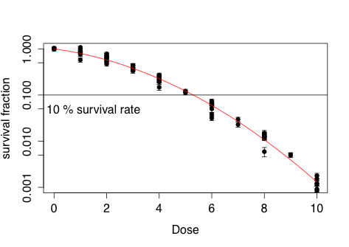
Final Analysis of Data
Biology
Response to Reference Radiation
Combined data from 2008, 2010, and 2012
Cell Count:
cells plated ✓
cells counted ✓
PE from control ✓
Response to X-rays ✓
D_{SF=10%} = 5.3 Gy
PE from fit
Potential Errors:
Fitting Algorithm
Stability of fit

Slide 8
Final Analysis of Data
Biology
Physics
Cell Count:
cells plated ✓
cells counted ✓
PE from control ✓
Response to X-rays ✓
PE from fit
Potential Errors:
Fitting Algorithm
Stability of fit
Redo dose calculations
Refine geometries ✓
New input files ✓
Re-Run all relevant years
Fluka issues
Benchmark Experiment
no longer in agreement?
Which version to use???
Sensitivity towards diff.
versions
Combine data set
Extract RBE vs. Depth

Slide 9
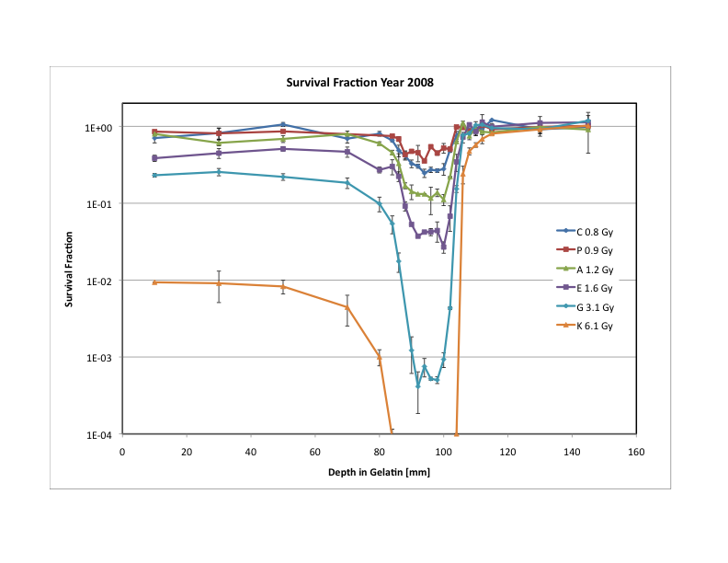
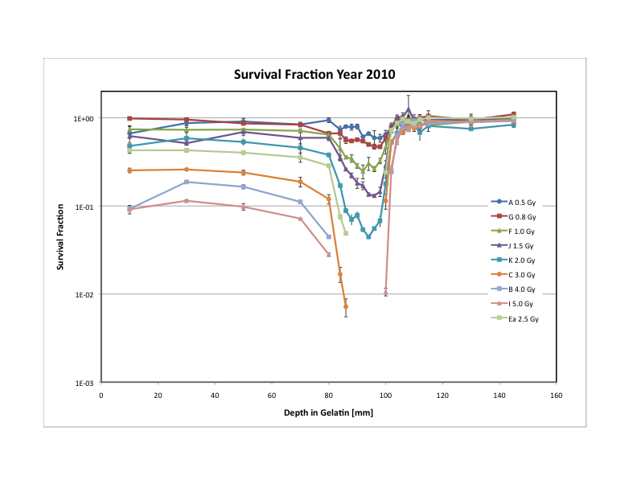
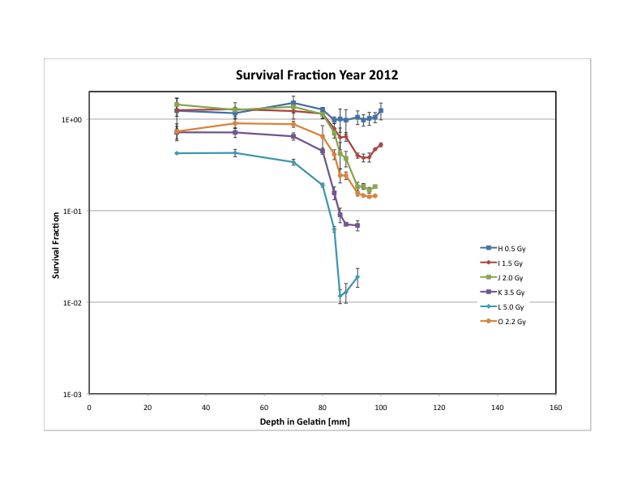
Available Data Sets

Slide 10
RBE Analysis for Antiprotons
Physical dose calculations requires exact
knowledge of beam parameters and geometrical settings as input to FLUKA
To compare different years all dose calculations have to be repeated using identical release of FLUKA package.
Different years had (slightly) different set-ups and geometric effects need to be corrected for.
Do changes in FLUKA necessitate new benchmark measurements to decide which version is best suited for the experiment?

Slide 11
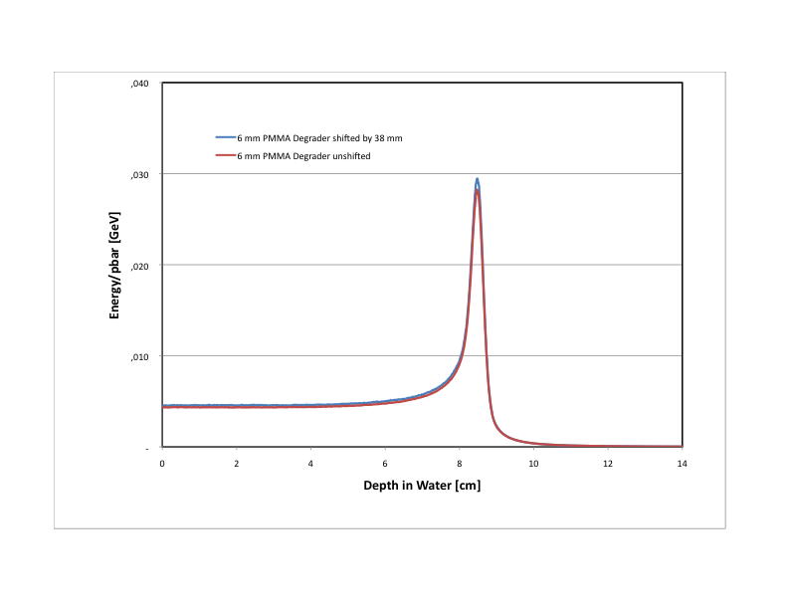
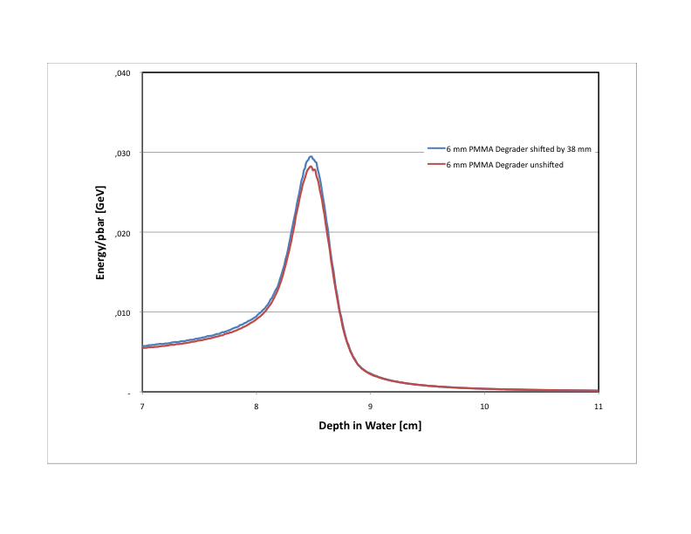
Influence from Geometry
Uncertainties in placement of degraders:
2%

Slide 12
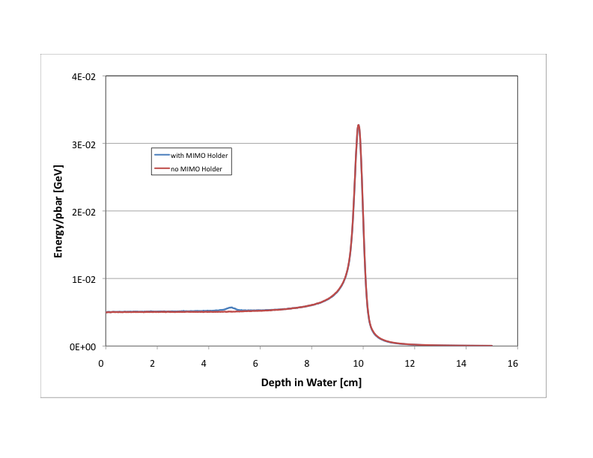
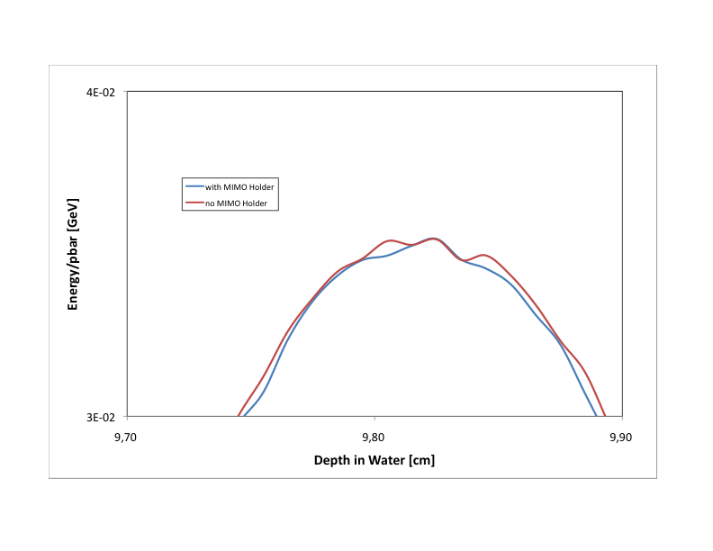
Influence from Geometry
Simplification in material arrangement outside of direct beam
(Approximate beam monitor by simple plane)

Slide 13
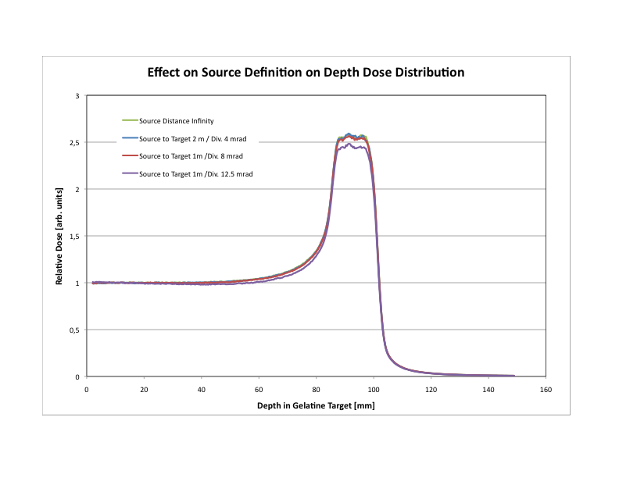
Influence from Geometry
Beam definition using EBT-2 GafChromic Film:
For lack of better knowledge we assume virtual source position, beam spot size, and beam divergence to produce spot on EBT film
Estimated beam divergence from mechanical beam line design is maximal 4 mrad
< 4%
FLUKA simulations show that the effect is small
unless extreme (unrealistic) cases are used

Slide 14
Influence from FLUKA Version
Effect of FLUKA Version on Depth Dose Profile (2)
21%

Slide 15
Influence from FLUKA Version
Effect of FLUKA Version on Depth Dose Profile
10%

Slide 16
Influence from FLUKA Version
Effect of FLUKA Version on Spread-out Bragg Peak
Change
of shape

Slide 17
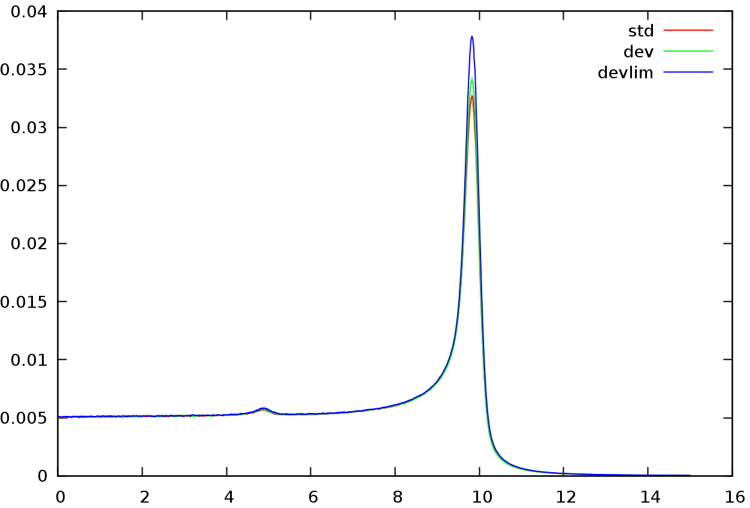
Influence from FLUKA Version
Current Status
FLUKA versions available to us are
(STD) current official release (FLUKA 2011.2b.2 6/2013)
(DEV) beta release provided to us by FLUKA team 7/2013
(DEV LIM) beta release with modified physics cards to better
describe low energy processes and specifically
antiproton annihilation at rest

Slide 18
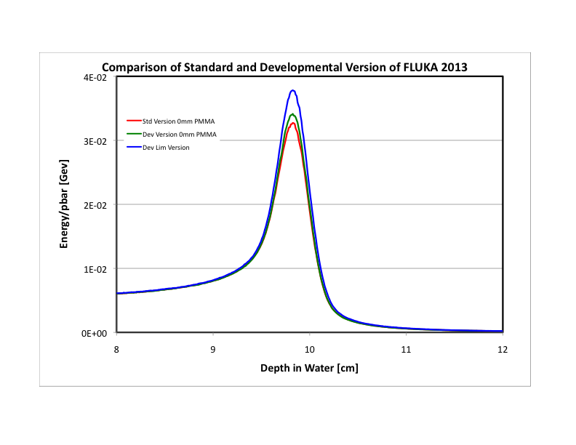
Dev Lim version 16% higher
Dev version 4% higher

Slide 19
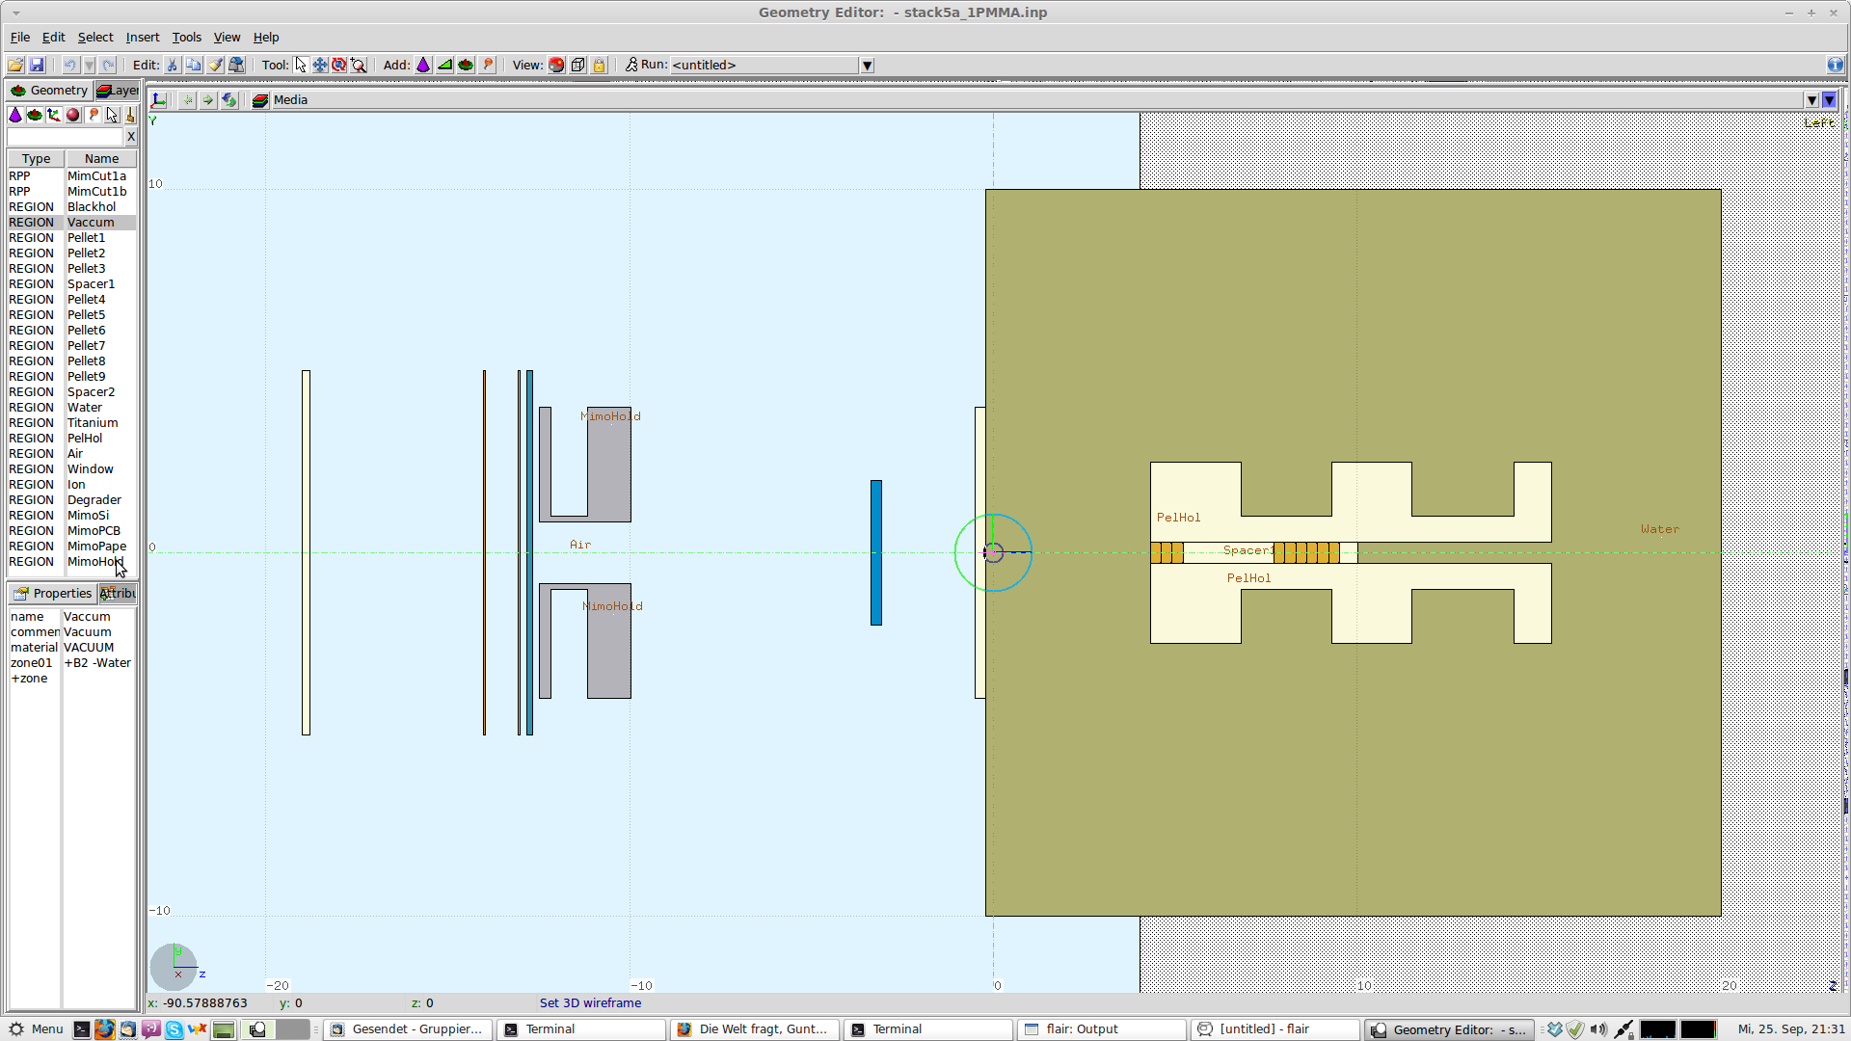
Can Benchmark help?
Construct 9-tablet Alanine stack and insert into water phantom. Include this set-up and all other experimental details in FLUKA input file.

Slide 20
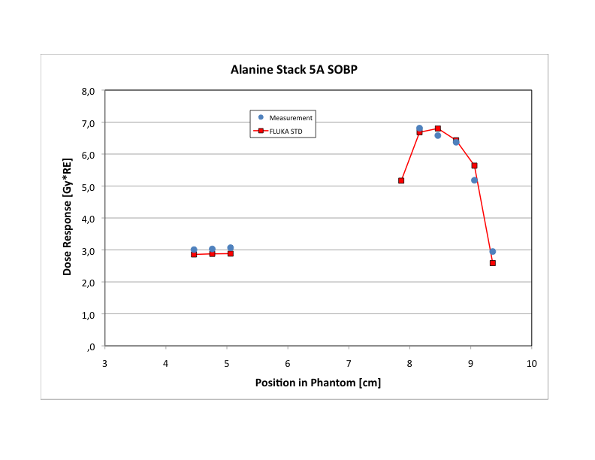
Can Benchmark help?
  Use different FLUKA versions to calculate dose deposited in Alanine pellets
  Use Hansen and Olsen track structure model to translate calculated dose into expected response of Alanine
?
?
?

Slide 21
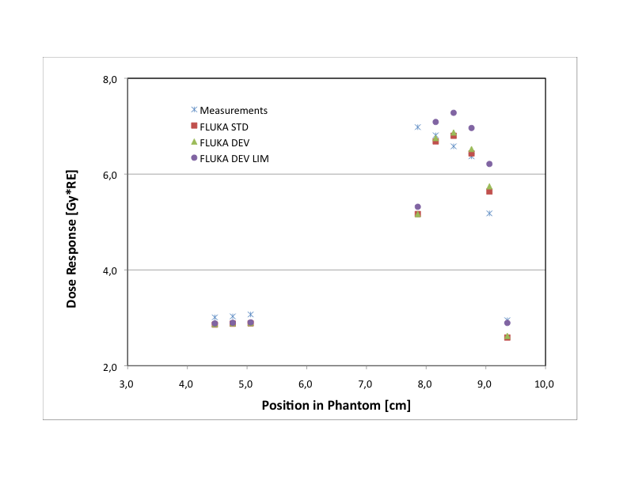

Slide 22
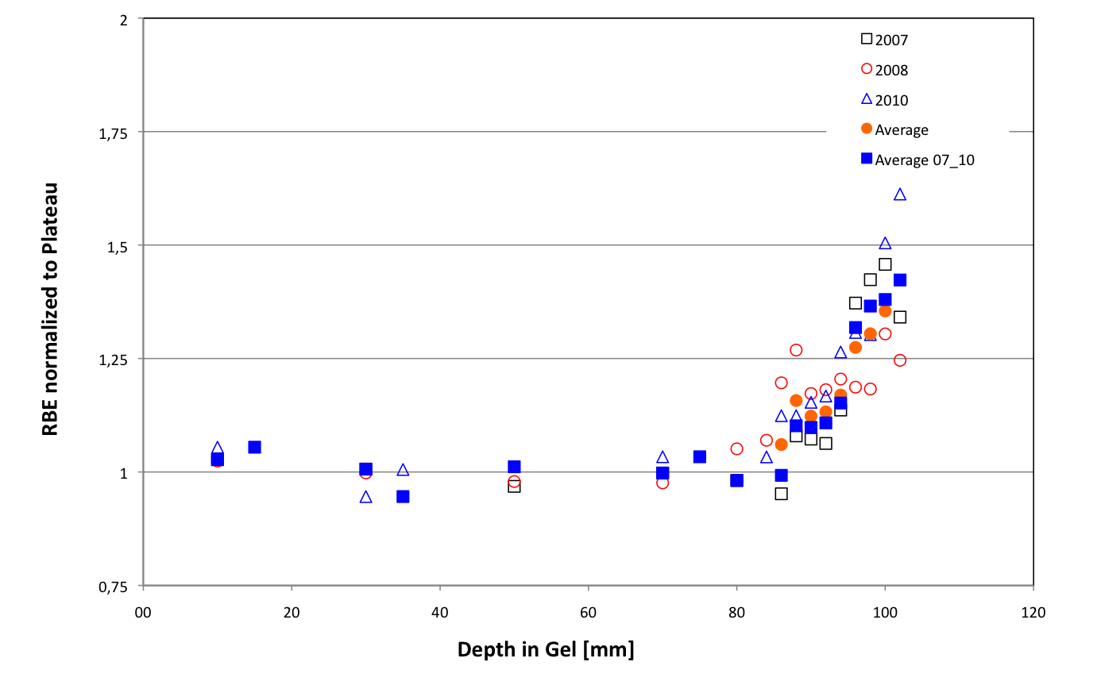
The Final Steps
Recalculate dose values for all years
Combine data from different years
before fitting (higher quality fits)
Analyze for RBE using reference data
Estimate realistic error bars
Compare functionality of RBE of
antiprotons and carbon ions
Use RBE vs. depth function for virtual
treatment planning

Slide 23
Closing Remarks
After 7 years of running with 500 MeV/c antiprotons we have
collected a statistical significant pool of data.
Some problems in combining and interpreting these data continue,
but the collaboration has decided on a clear path towards the final
analysis
All tools for this analysis are in place and after a final decision
concerning the FLUKA version of choice is reached can be applied
immediately
This will result in a final publication on the RBE Depth Profile of
antiprotons which then can be used for dose planning exercises
and will be made available to the community at large.
The AD-4 Collaboration has decided to terminate the
active phase of AD-4/ACE and requests no further
beam time from CERN………

Slide 24
BUT………
…….we strongly feel a dedicated and well executed benchmark experiment would benefit the quality of the data and the final ACE result, the FLUKA team, and the community interested in absolute dosimetry using alanine for general particle beam therapy.
Irradiate 2 or 3 full stacks of alanine pellets covering the entire depth dose curve
Needed:
36 hours of beam time, including beam set-up and tuning at 500 MeV/c and return to normal operation.

Slide 25
THANK YOU
CERN for your continued interest and support
The AD Users community for your patience and the many incidences of generous help from all experiments during our runs
The AD Operations team for your relentless efforts to provide us with the best beam possible

Slide 26
Can Benchmark help?
Measure SOBP Dose Profile with Alanine
Alanine response is directly related to the absolute dose via Hansen and Olson track structure model using detailed information on particle energy spectrum of all fragments
Successfully used in 2006 benchmark experiment.
Bassler et al., Nucl. Instr. and Meth. in Phys. Res. B 266 (2008) 929–936

