Slide 1
3 MeV instrumentation commissioning
U. Raich, Federico Roncarolo, F. Zocca
Linac-4 Beam Coordination Committee 10.1.2013

Slide 2
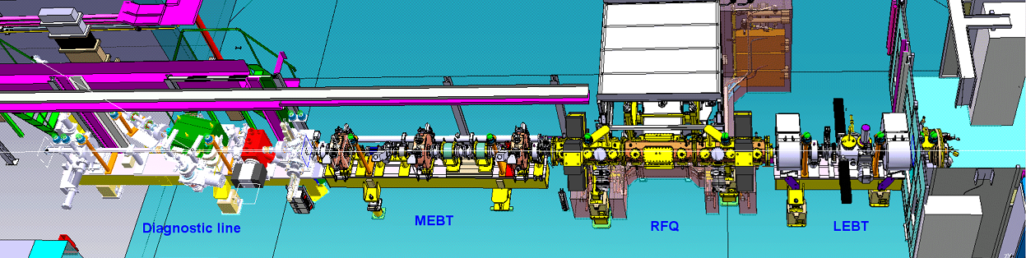
Current Setup

Slide 3
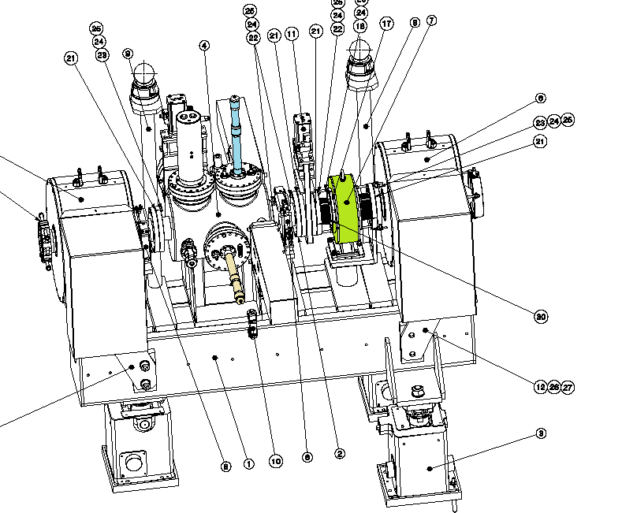
LEBT
Faraday Cup
BCT
Wire Grids

Slide 4
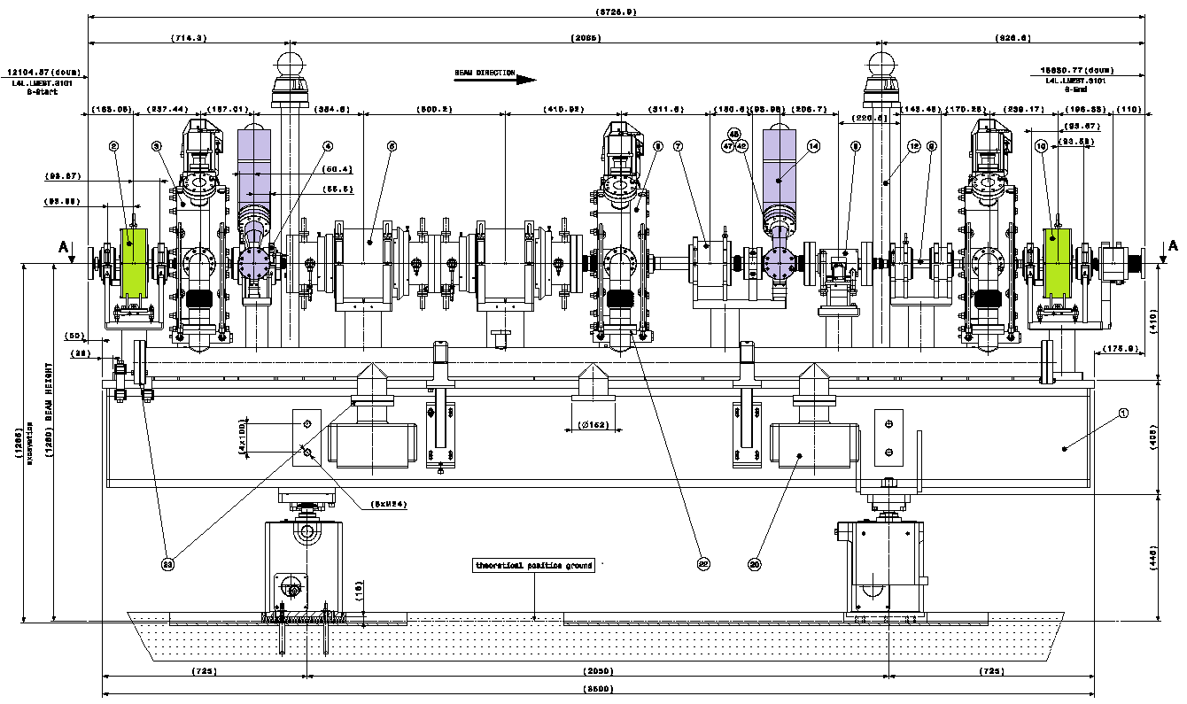
MEBT (chopper line)
BWS
BWS
BCT
BCT

Slide 5
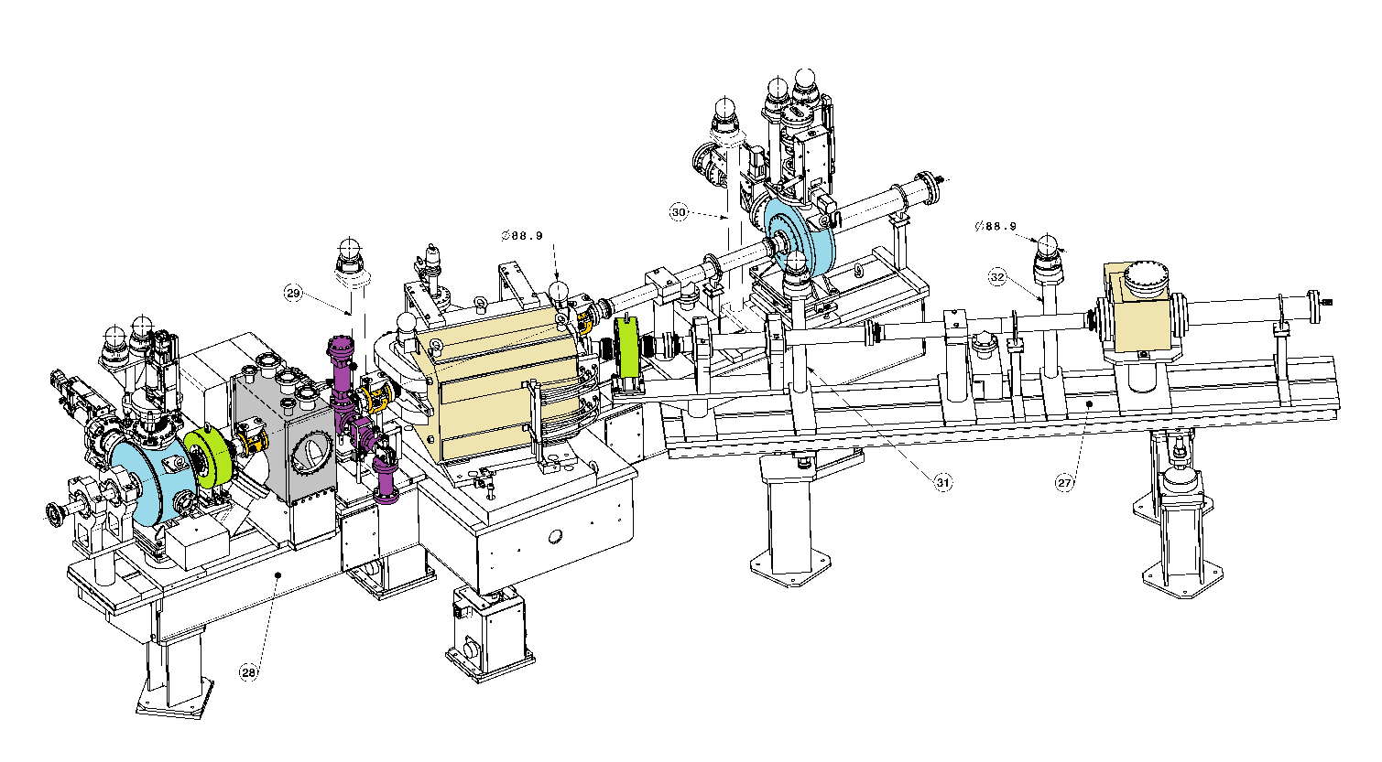
Measurement Bench
Emittance
Meter Grid
BPM
Spectrometer
Magnet
Spectrometer
Grid
Halo
Monitor
Emittance
Meter Slit
BCT
BCT
BSM

Slide 6
Instruments installed
LEBT:
  Faraday Cup
  Wire Grid
MEBT (chopper line)
  2 wire scanners
  2 Beam Current Transformers (BCTs)
Measurement Line
  Slit/Grid Emittance meter
  2 BCTs
  2 (3) Beam Position Monitors (BPMs)
  Bunch Shape Monitor
  Spectrometer
  Halo Monitor

Slide 7
Measurement campaigns
~ 3 months at the 3 MeV test stand
May – October move and re-installation into the L4 tunnel
Since November ~ 3 weeks of measurements

Slide 8
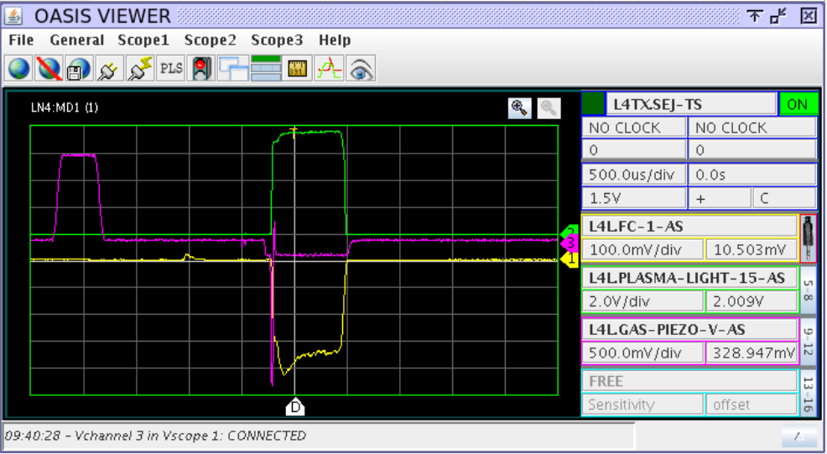
Faraday Cup
Connected to remotely accessible Oscilloscope
Guard ring polarization set to -1000V

Slide 9
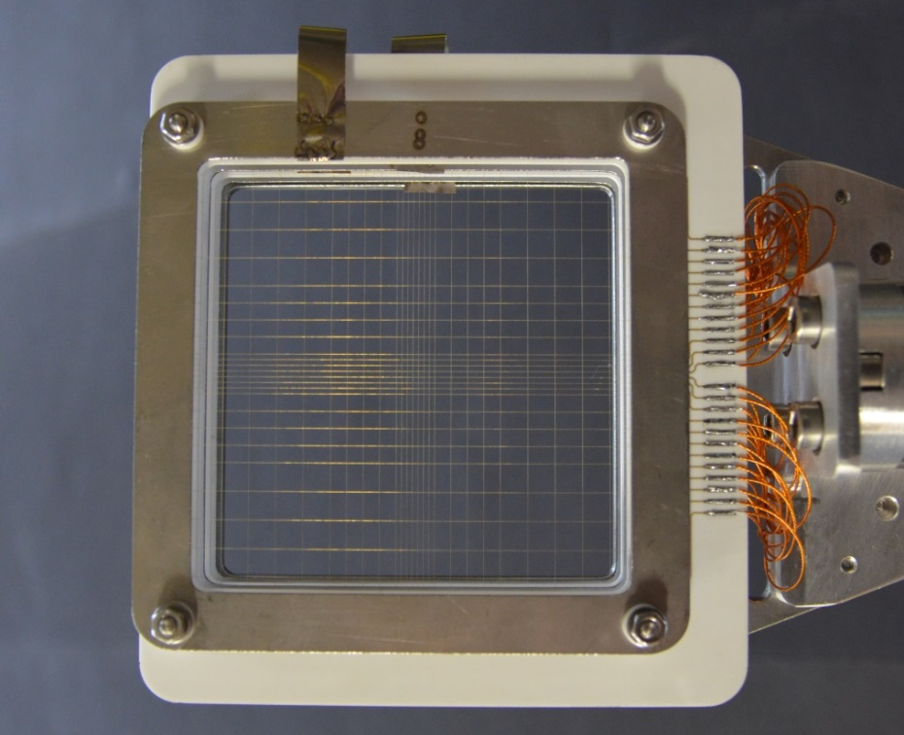
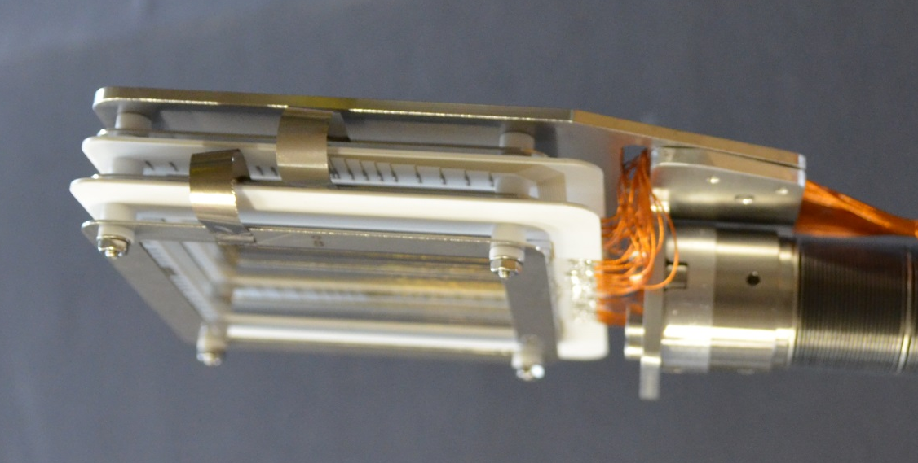
Wire Grids in LEBT
24 wires per plane with spacing 1mm, 3mm, 5mm
Wire signals sampled with 250 kHz

Slide 10
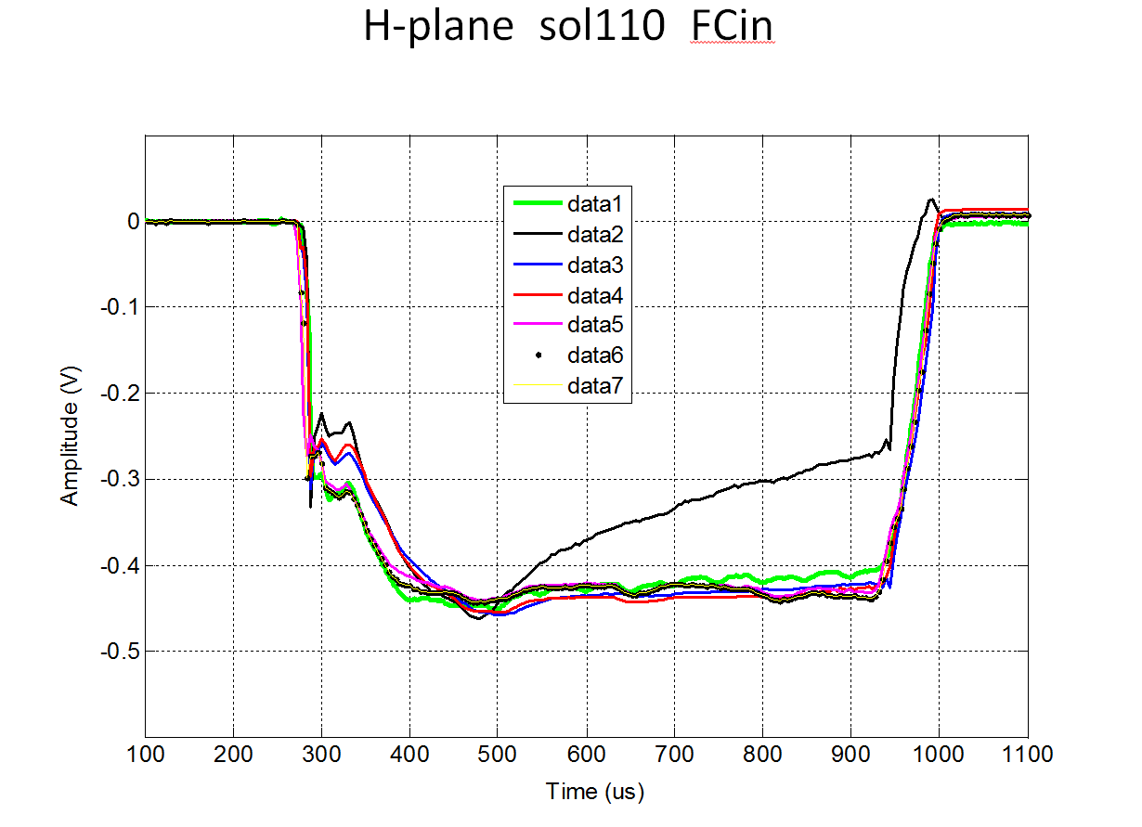
Wire Grid in LEBT
Can polarize frame
and wires
Measurements for different solenoid settings
Add wire signals and compare to FC
Frame needs to be polarized, wire polarization is less important

Slide 11
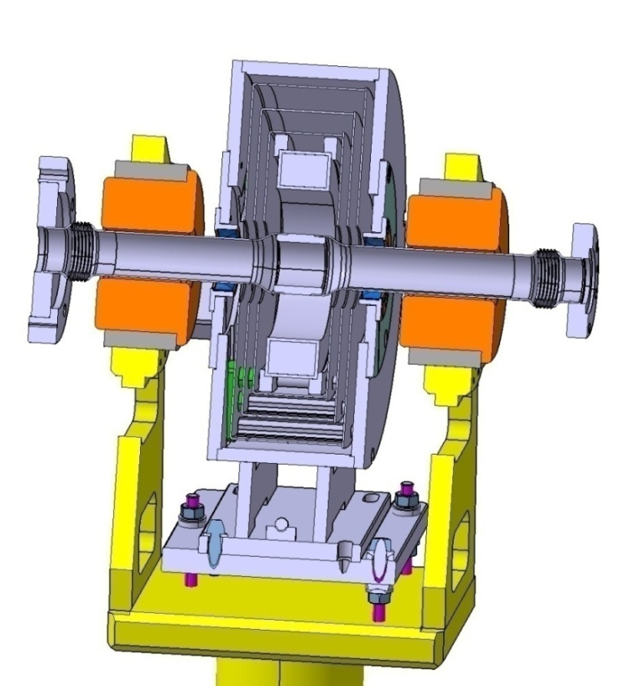
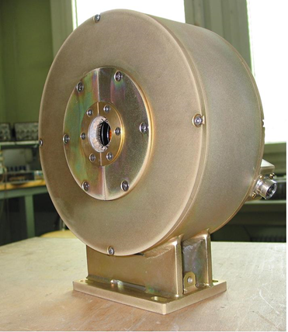
Beam Current Transformers
Instrument mostly used to see if beam arrives
Signal sampled at max. 200 MHz (2 samples added -> 100 MHz)
Multiple level shielding
Calibration after each beam pulse

Slide 12
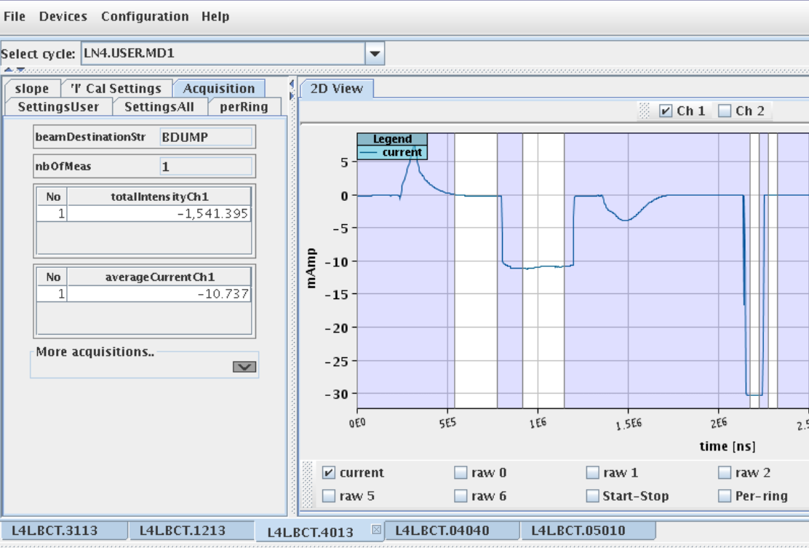
BCT signals
White areas show integration windows

Slide 13
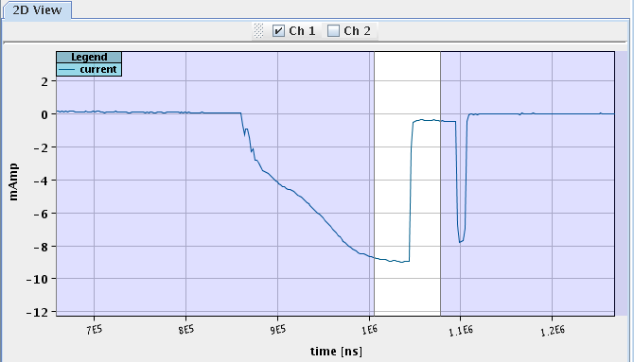
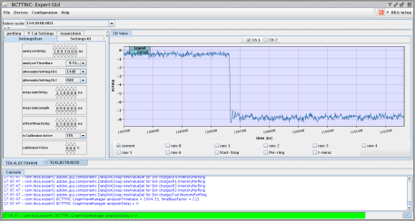
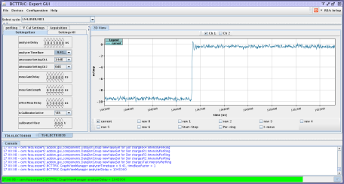
BCTs give an idea on chopper rise time

Slide 14
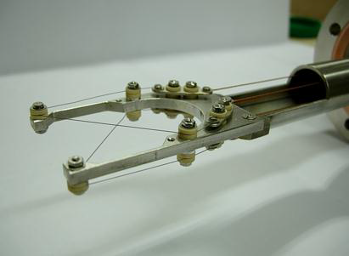
Wire scanners
40 um carbon wires
First X-shaped, now
L-shaped
Wires can be polarized
Readout at 205 kHz
Now configured in
L-shape

Slide 15
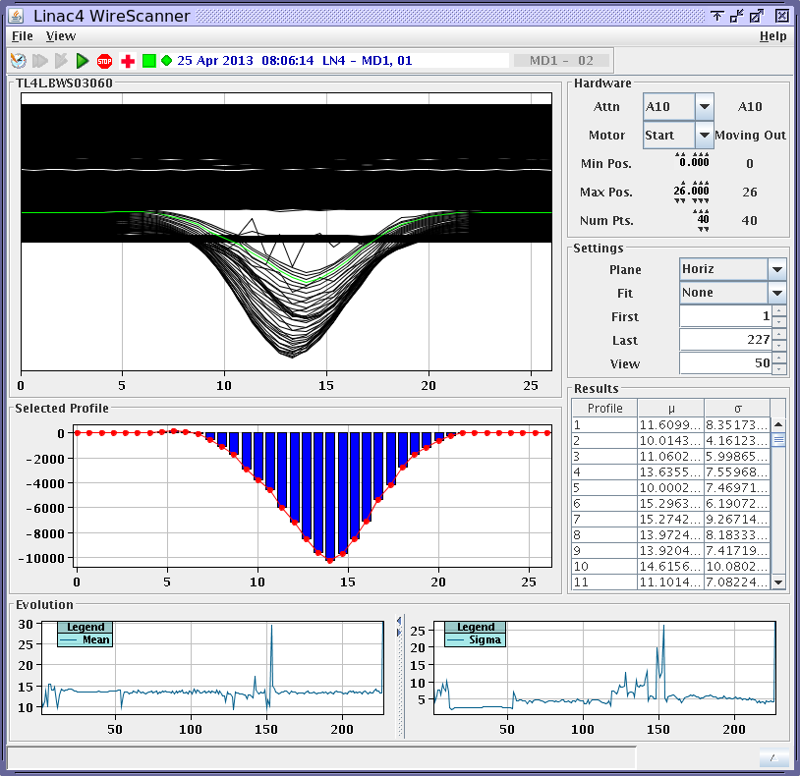
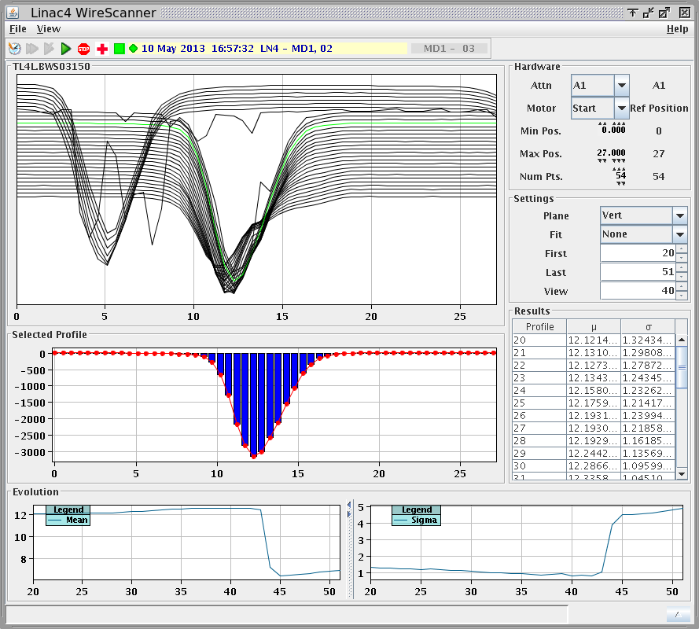
Wire Scanners and Chopper

Slide 16
Crosstalk between wires
On L-shaped wire scanners crosstalk from one wire to the next can be separated
Measured crosstalk when increasing positive wire polarization
Profile size shows ~ 2% dependence on wire polarization up to ~ 40V.

Slide 17
Crosstalk versus polarization
WS2 – 0V
WS2 – 5V
WS2 – 10V
WS2 – 15V
WS2 – 20V
WS2 – 40V
WS2 – 60V
WS2 – 80V
WS2 – 100V
WS2 – 120V

Slide 18
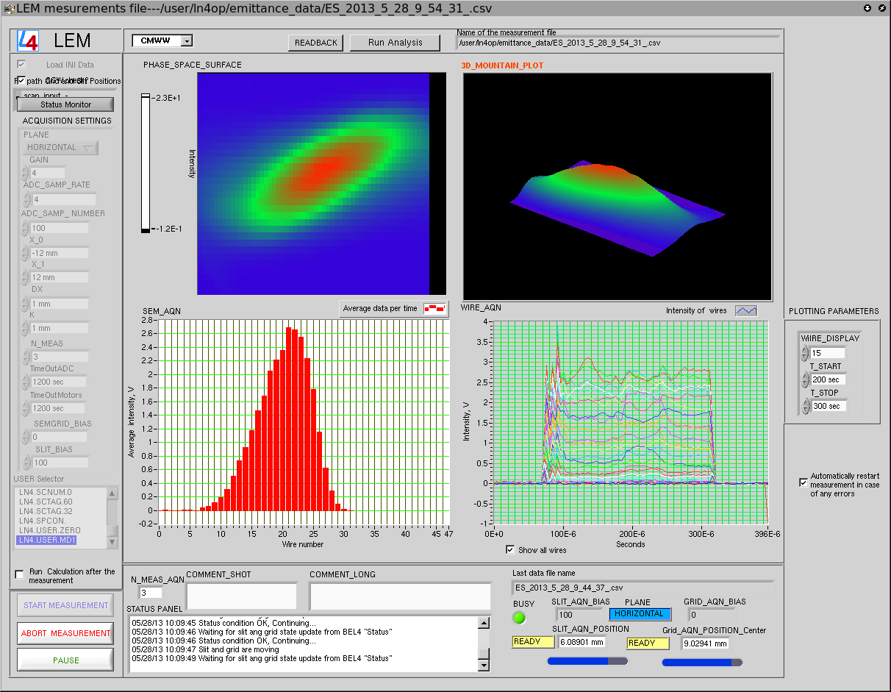
Emittance Meter
Labview program sets
Motor position of slit and grid
(controlled by PLC and FESA)
Accesses FESA class to control
Amplifier gain, plane ...
Reads ADCs and saves data in
.csv format for further evaluation
1 emittance plot every 4 µs

Slide 19
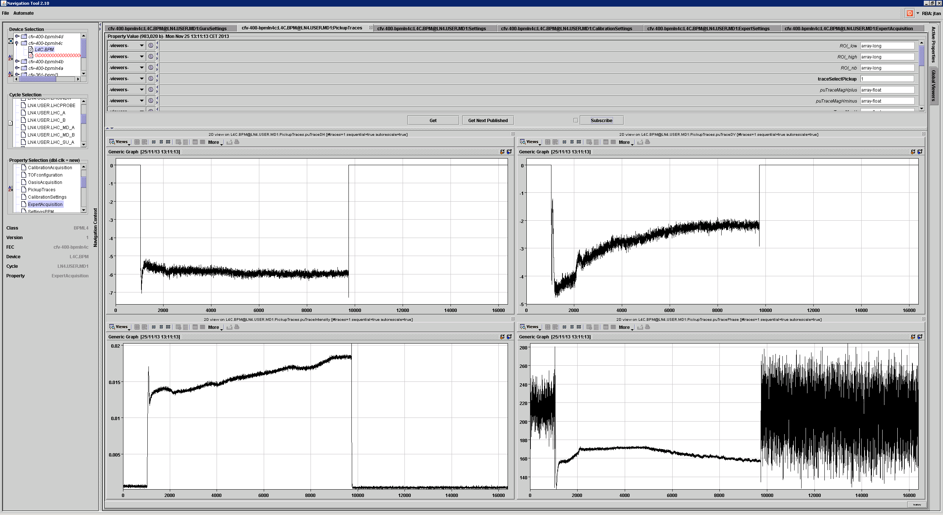
Beam position monitors
BPMs measure
Position
Intensity
Phase

Slide 20
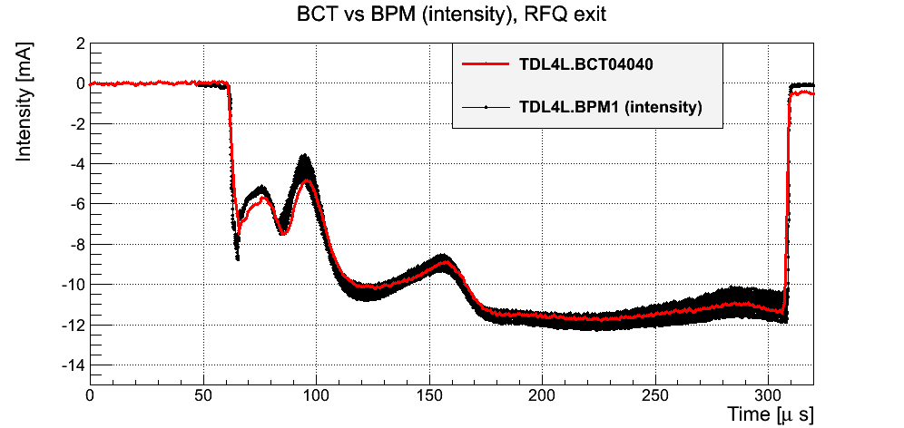
Intensity BCT-BPM

Slide 21
Bunch Shape Measurements
Has been used to adjust the bunchers in the test stand
Brought back into operation in the L4 tunnel
No bunch shape measurements yet because of missing buncher control

Slide 22
Concept of Laser Emittance Meter
Diamond
Detector
 | Pulsed fiber-laser
Wavelength | 1080 nm
Energy | 0.9 mJ
t_{pulse} | 110 ns
Beam quality – M² | 1.7
Repetition rate | 30kHz
Beam transport | Fiber
Particles_{stripped} / bunch | < 4e5
H⁰
 | Diamond Detector
Type | Polycrystalline
Size | 18 x 18 mm
Resolution | 5 channels
Thickness | 500 µm
Readout | 5 GS/s Scope
x-scan
H⁻
Bending Magnet
y-scan
H⁻ beam
Principle:
H⁻ beam
H⁰ beamlet
beamlet
after drift
Notes:
ICT: new LHC transformer to replace the FBCT in order to solve the beam position dependency issue

Slide 23
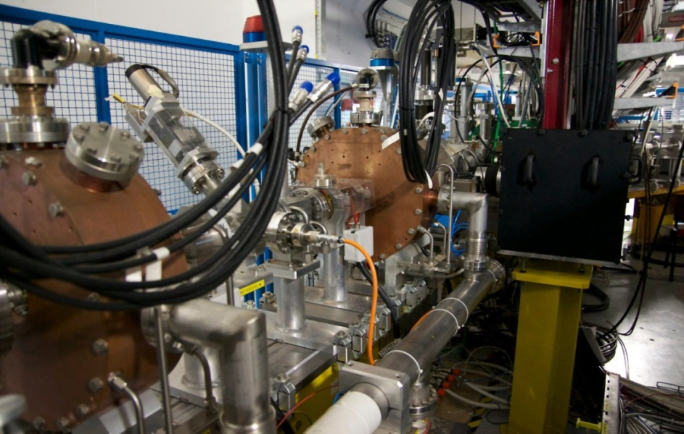
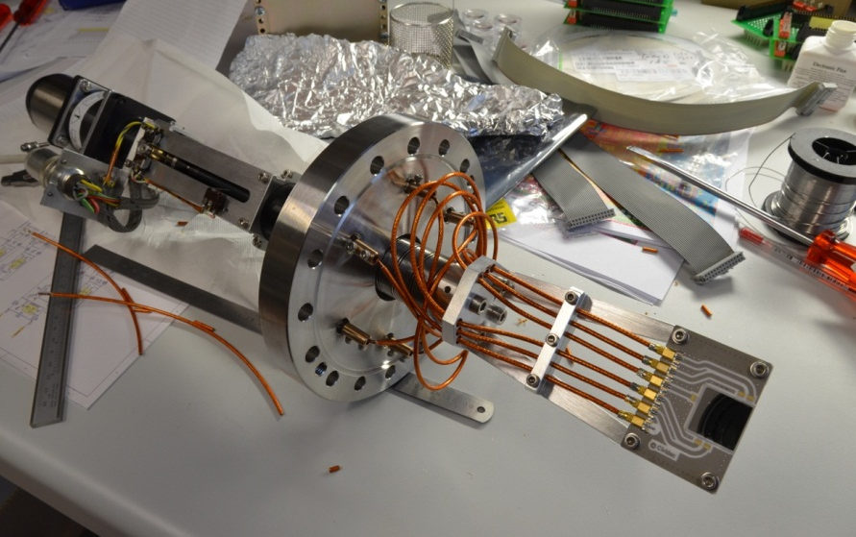
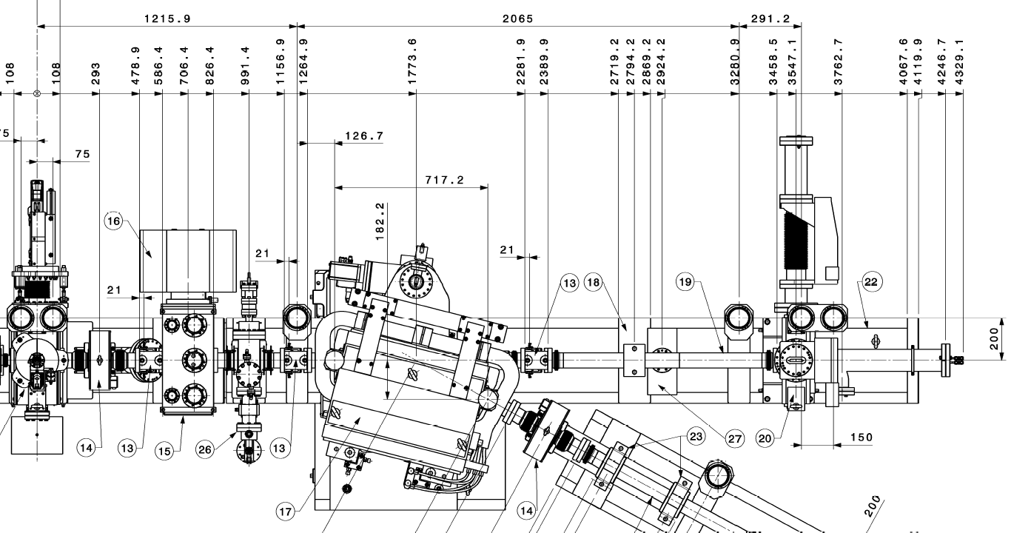
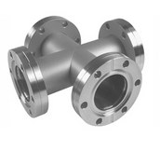
Setup at 3 MeV Diagnostics Testbench
Laser Delivery optics
Diamond Detector
H⁻ beam
H⁰
Laser
Focusing
Fiber delivery
Bending Magnet

