Slide 1
DE-KIT / GridKa LHC[OPN / ONE] Proposal
Bruno Hoeft
DE-KIT / GridKa -- Network Site Manager
LHCOPN OPS-WG Manager

Slide 2
LHCOPN operation
LHCOPN
  Is a well understood network setup
  Dedicated ownership
    for each T0 – T1 link (stated in MOU signed by each Tier-1 Site)
    As well as T1 – T1 backup link
  All responsibilities of each link are defined
  Tight controlling/observing of constant operation
  solid maintaining → LHCOPN operational model defined
  Collaborating partners are very responsive to faults/errors at LHCOPN
  A very restricted number of Sites
    manageable # of peers, relatively small BGP table →The lhcopn bgp routes are manageable
  The setup is very robust and can stand even severe interruptions

Slide 3
LHCOPN / LHCONE quality difference
High capacity throughput
raw data distributed from T0 to T1 for long time storage (tape archive) and first calculation (→ mDST)
Defined bandwidth requirement T0 → T1
  After LS1 ~600MB
Constant and continuous availability
→ as defined in MOU
High capacity throughput
mDST access of between T2 and T1 incl. T2 and T2 (mesh / no hierarchical structure anymore)
  Data volume smaller (no raw data / mDST only/manly)
  Data for batchjobs only
    No defined bandwidth requirements
Good availability
No objections of including T1-T1 traffic
  If backup capacity is secured

Slide 4
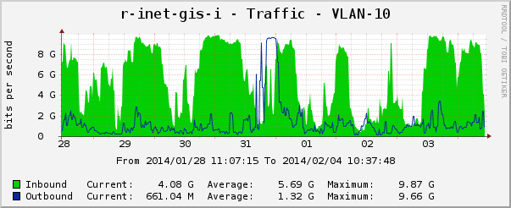
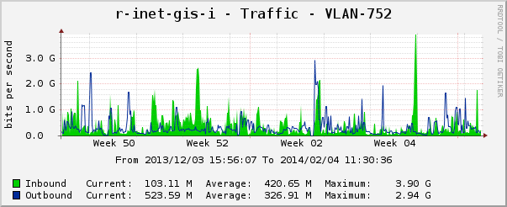
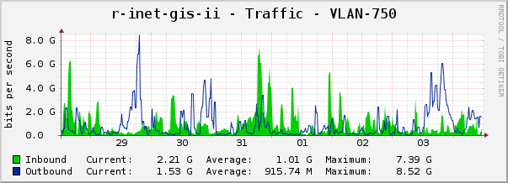
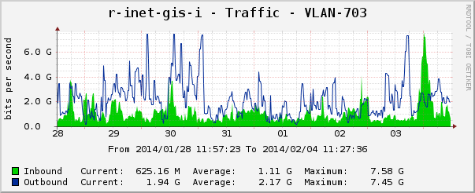
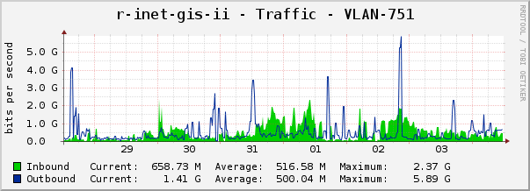
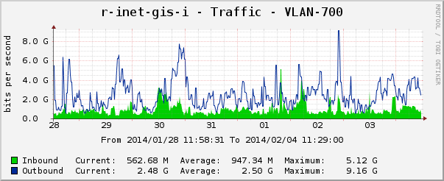
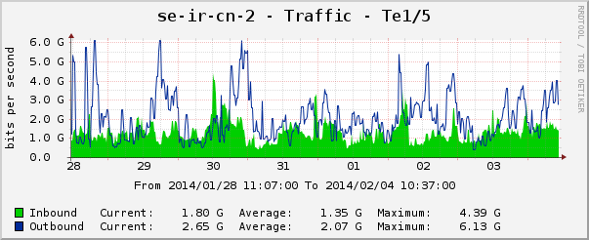
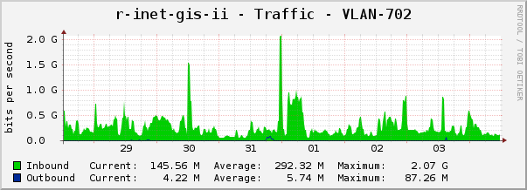
Historic link usage
LHCOPN CERN – GridKa/DE-KIT
Link filled
Upgrade will be inevitable
Even during LS1
FR-CCIN2P3 – GridKa/DE-KIT
IT-INFN-CNAF – GridKa/DE-KIT
Backup link
LHCONE GridKa/DE-KIT
Link filled not as much as LHCOPN
First thought about Upgrade requiered
NL-T1 – GridKa/DE-KIT
Backup link
LHCOPN
GPI GridKa – X-Win
This two interfaces needs to get combined
- GPI → connecting GridKa to the none LHCONE Tier-[23] centers
FR-In2P3
UNI Aachen
GPI GridKa – X-Win sum
DFN
Géant
…
10GE
GSI
DESY
CERN
10GE
GridKa /
DE-KIT
UNI Wupertal
GPI GridKa/DE-KIT
10GE
10GE
NL-T1
IT-INFN-CNAF
2GE
FNAL

Slide 5
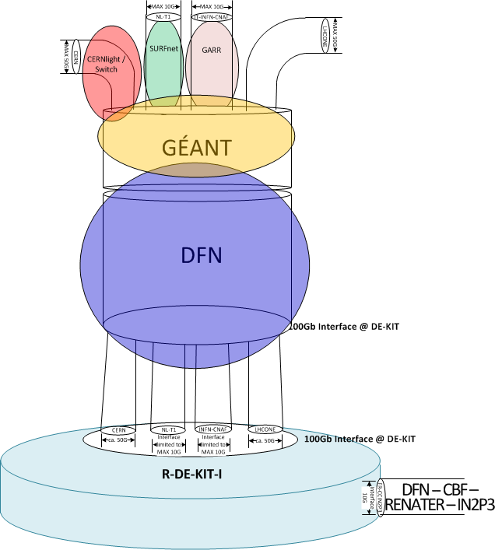
GridKa / DE-KIT planned network upgrade in 2014/2015
- 100G interface
- Multiple dynamical seperated subinterfaces (VLANs)
- Protocol
- tcp - udp - icmp -…
- replacment of CBFs :
- link via Géant
- one CBF to FR-CCIN2P3 remains
at least as long as the 100G deployed infrastructure does not includ redundancy
- Layer-2 P2P (VLAN separate)
  DE-KIT – CERN
  KIT – DFN - GÉANT – CERNlight/Switch – CERN
  BGP routing at DE-KIT (DFN Layer-2 VLAN only)
  NL-T1 --> KIT – DFN - GÉANT – SURFnet – SARA
  BGP routing at DE-KIT (DFN Layer-2 VLAN only)
  INFN-CNAF --> KIT – DFN - GÉANT – GARR – CNAF
  BGP routing at DE-KIT (DFN Layer-2 VLAN only)
  Layer-3 (HEPPI / LHCONE VRF)
  P2P – CBF – DE-KIT – FR-CCIN2P3 → last resort
  ? upgrade to 100G → Triangel DE-KIT – IN2P3 – CERN ?

Slide 6
Services to evolve
Information dashboard with several information layers
  From abstract information layer
  (red/green dashbord)
  Successive drill down to detailed “error” information
  e.g.: red/green dashboard → info about T1-T1: GridKa--IT-INFN-CNAF end2end link
    Splitting into DFN/Switch/GARR NREN Domains
    May be not as detailed as the e2emon of Géant showing red/green down to a single device
  Combine and consolidate information of different information systems
    Dashboard / waethermap / perfsonar / monalisa / … at one location/”web portal”

