Slide 1
ALICE – networking
LHCONE workshop
10/02/2014

Slide 2
Quick plans: Run 2 data taking
Both for Pb+Pb and p+p
  Reach 1 nb⁻¹ integrated luminosity for rare triggers
  Increase statistics for unbiased data sample
3 p+p periods
2 Pb+Pb, 1 p+Pb
Upgraded detector: calorimetry, readout electronics, DAQ, HLT
In general ALICE will take 2x the data volume compared to Run1

Slide 3
Quick plans: Run2 Grid ops
Continue to run RAW/MC/analysis exclusively on the Grid
Differentiation (payload) between Tiers should decrease further
  With the notable exception of RAW data storage at T0/T1
  More reliance on network
Clouds… wherever applicable
Storage federation – more later

Slide 4
Data treatment
Single file namespace – AliEn catalogue
Two replicas of all major data containers
  RAW, ESDs (10-20% of RAW), AODs (3-5% of RAW)
Data location (read/write)determined by auto-discovery mechanism
  Sorting the SEs by the network distance to the client making the request - network topology data with the geographical one
  Weighted with their recent reliability

Slide 5
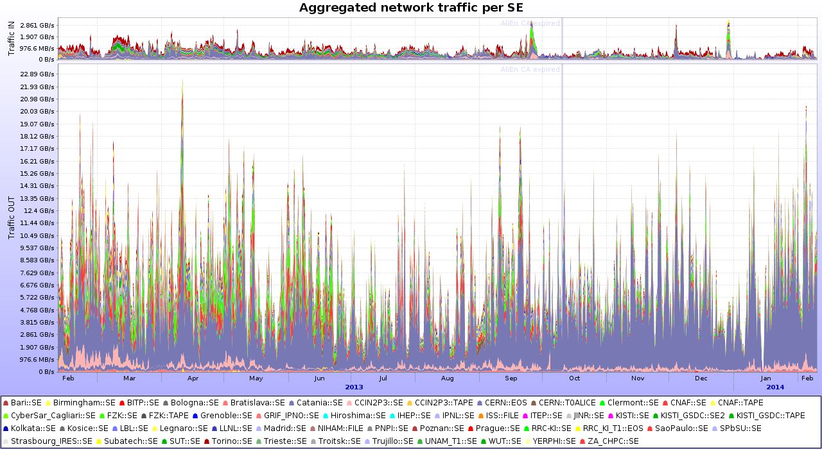
Storage discovery mechanism
The most critical part for high task efficiency and storage utilization
Its operation depends on detailed site to site network monitoring
24PB written
Last year
240 PB read

Slide 6
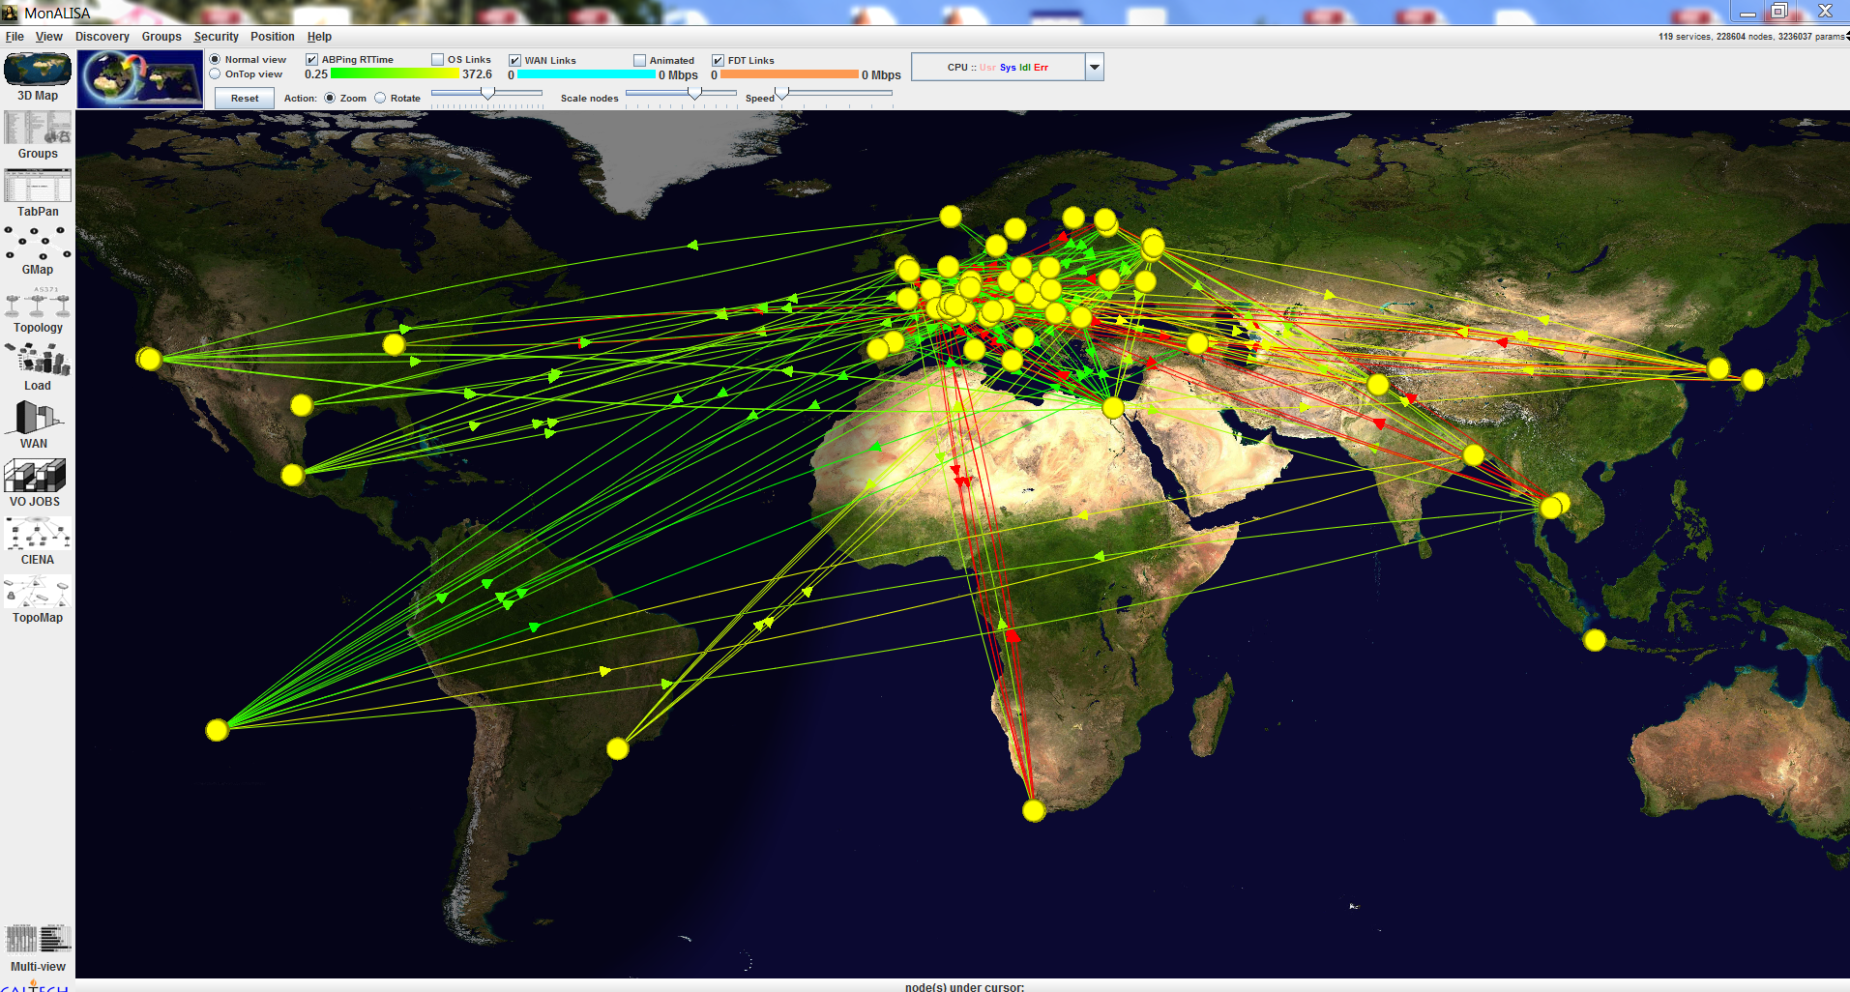
ALICE sites ping based measurements
Red lines - routing
issues between sites
Red lines indicate routing
problemss between the sites

Slide 7
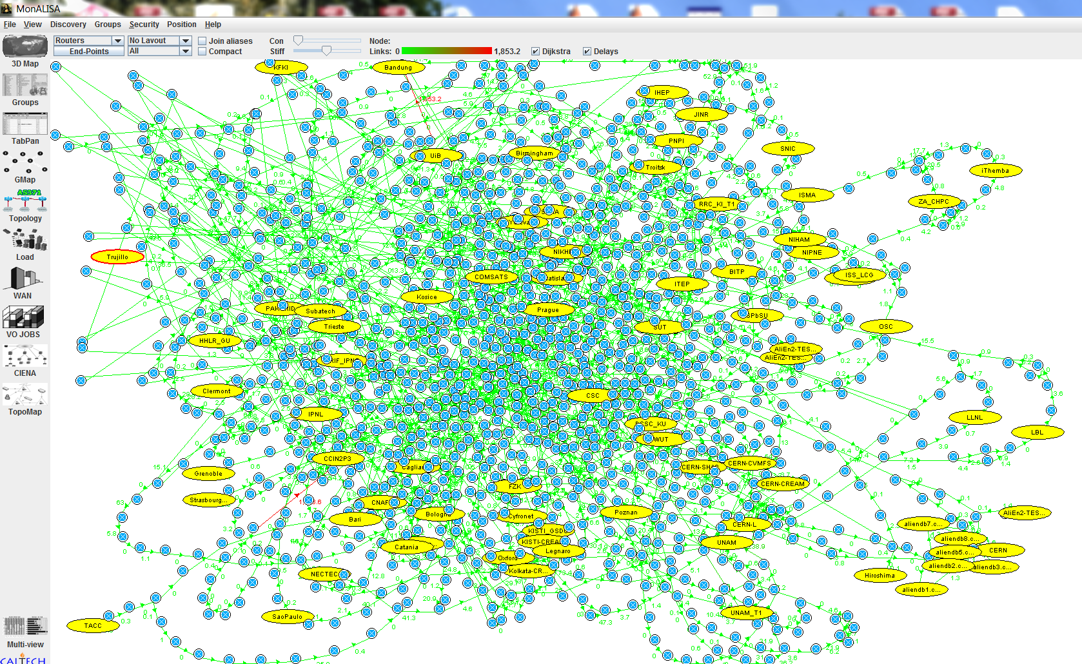
Monitoring network topology, latency and routers
Real Time Topology Discovery & Display

Slide 8
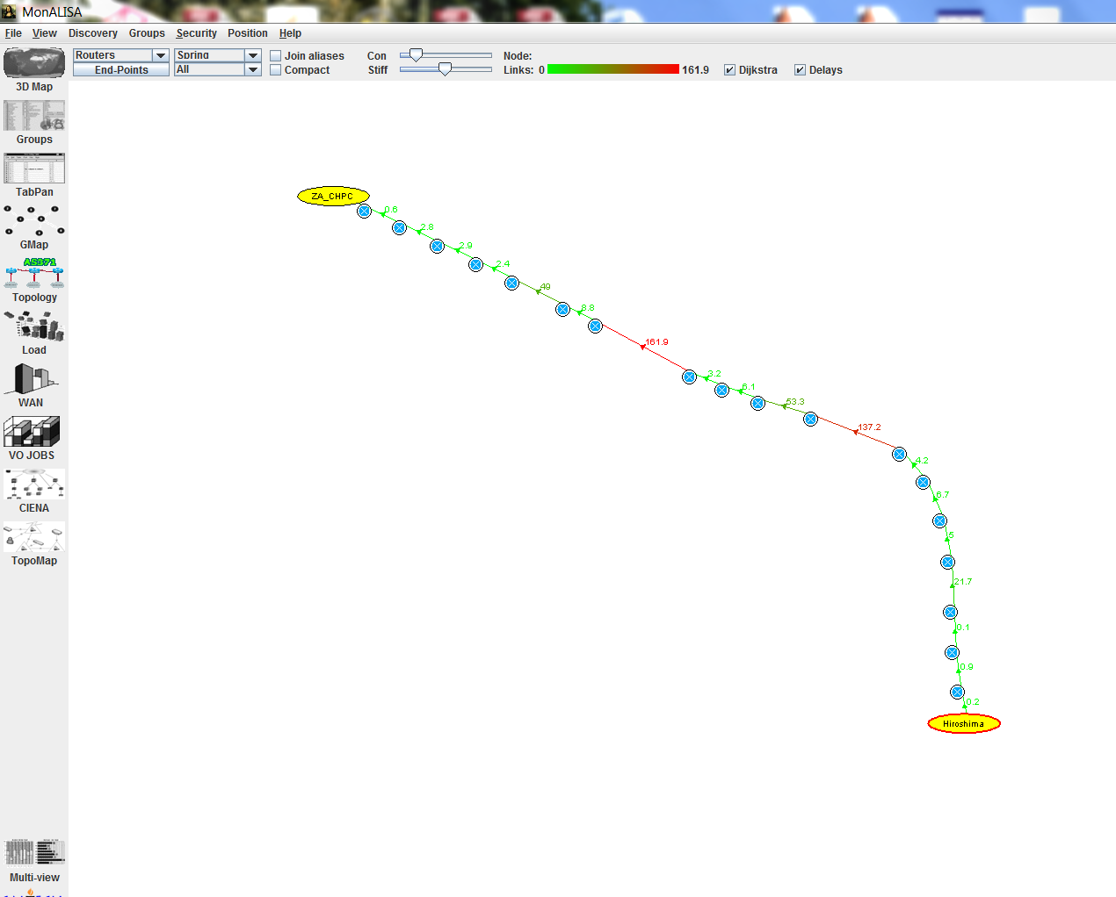
Path monitoring for each pair of sites
South Africa
Africa to Europe
Europe to Asia
Japan

Slide 9
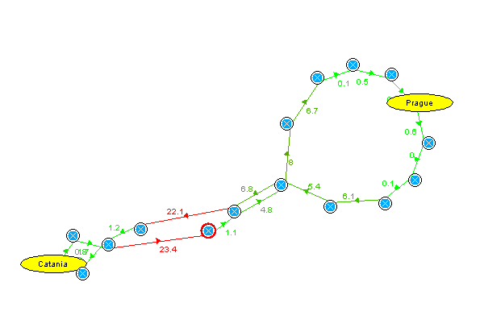
Asymmetric routing

Slide 10
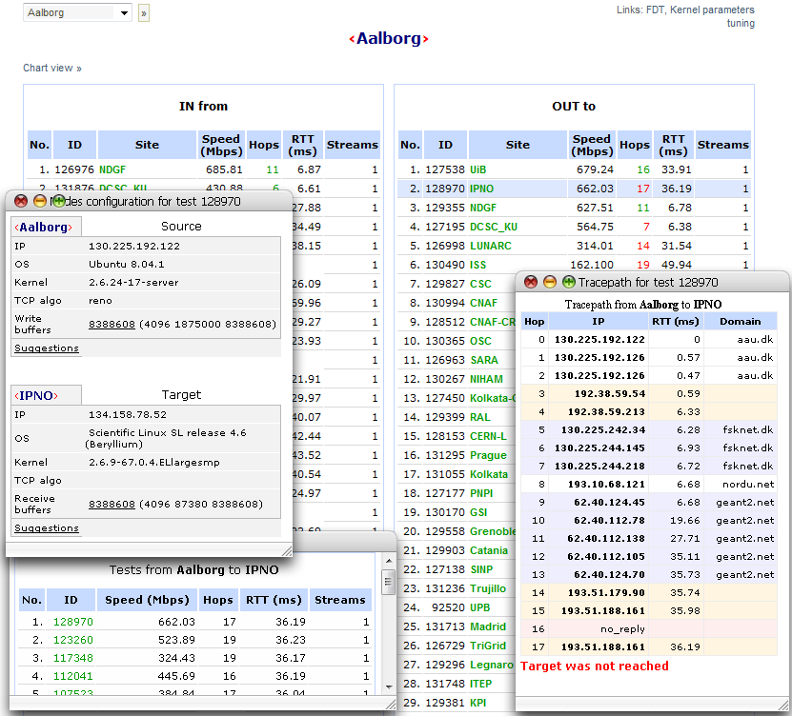
Available bandwidth measurements

Slide 11
Network mapping
Continuous WAN measurements for 85x85 site matrix
  MonALISA with FTD
Complex topology – automatic analysis of network conditions, coupled with SE tests
Resulting in
  Per site list of ‘best set’ of Storage elements
  Given to the client for data reading/writing

Slide 12
Network mapping (2)
The bandwidth tests, routing, kernel parameters are
  Available to the site administrators for tuning of local network and host parameters
  Negotiations with network providers
However…. the situation is not ideal
  Network tuning is a notoriously difficult task
  Even well-intended operators sometimes have difficulty responding to inquiries (terminology barrier?)
  New sites usually need ‘global’ help from network experts

Slide 13
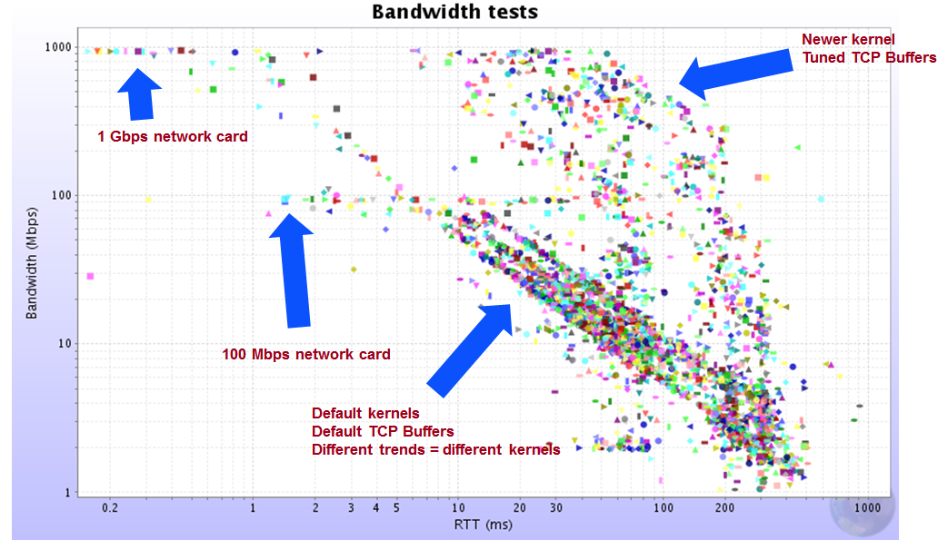
Active bandwidth tests between all sites

Slide 14
Grid expansion
Asia (Indonesia, Thailand, China, Pakistan,India), North and South America (Mexico, Brasil, Chile), Africa (South Africa)
  The above are new sites for ALICE
  All will need network tuning and expert help
Resources availability – two sources
  Established Grid sites planned ramp-up (predictable)
  New sites – additional resources – needed both for Run2 and beyond

Slide 15
Summary
The success of the ALICE computing model depends on accurate and continuously updated network map
File access is based on storage auto-discovery, which critically depends on the above
Sufficient bandwidth and good routing between sites is critical for efficient resources utilization, especially with ‘tight’ storage capacities, ever increasing data rates and storage federation concepts brought into practice
New Grid sites are emerging in places where the network is still underdeveloped – they will need help
LHCONE will help reaching the ‘ideal’ picture, where random data access will be sufficiently efficient to dilute even more the tiered Grid structure

